Slide 1
Trinity Lutheran Church Norman, Oklahoma – www.tlcnorman.org The Book of Galatians Theme: “The True Gospel You Have Received” Date: 7-17-22 Lesson: 18 - Chapter 3:17-22

Slide 4
(17) This is what I mean: the law, which came 430 years afterward, does not annul a covenant previously ratified by God, so as to make the promise void. (18) For if the inheritance comes by the law, it no longer comes by promise; but God gave it to Abraham by a promise.
(Gen 15:13; Ex 12:40,41; Ac 7:6;
Rom 8:17)

Slide 5
(19) Why then the law? It was added because of transgressions, until the offspring should come to whom the promise had been made, and it was put in place through angels by an intermediary. (20) Now an intermediary implies more than one, but God is one.
(Ex 19:3; 20:19-22;
Dt 4:39; 5:5,22-31; 6:4; 33:2; Ps 68:17;
Ac 7:38,53;
Rom 3:30; 4:15; 5:20; 1 Cor 8:6;
1 Tim 2:5; Heb 2:2; 6:17; 8:6; 9:15; 12:24)

Slide 6
(21) Is the law then contrary to the promises of God? Certainly not! For if a law had been given that could give life, then righteousness would indeed be by the law. (22) But the Scripture imprisoned everything under sin, so that the promise by faith in Jesus Christ might be given to those who believe.
(Ac 10:43;
Rom 3:9-21; 4:16; 7:12; 8:2-4; 11:32)

Slide 7
Luther’s Commentary - Vol. 26
Therefore Paul concludes as follows: The blessing is given on the basis of the promise; therefore it is not given on the basis of the Law. For the promise says: “In your Offspring they will be blessed.” Therefore he who has the Law does not have enough, for he does not yet have the blessing and so remains under the curse. Hence the Law cannot justify, because the blessing has not been added to it.
In addition, if the inheritance were by the Law, God would be found to be a liar, and the promise would become void. Likewise, if the Law could obtain the blessing, why would God promise it, saying, “In your Offspring, etc.”? Why would He not rather say: “Do this, and you will receive the blessing!” or “By keeping the Law you can merit eternal life”? This is an argument from contraries: The inheritance is given on the basis of the promise; therefore it is not on the basis of the Law.
But God gave it to Abraham by a promise.
This is undeniable, that before there was a Law, God by a promise granted Abraham the blessing or inheritance, that is, the forgiveness of sins, righteousness, salvation, and eternal life, which means that we are the sons and heirs of God and fellow heirs with Christ (Rom. 8:17). For Genesis clearly says (22:18): “In your Offspring shall all the nations be blessed.” There the blessing is granted without regard for the Law or works.
For before Moses was born or anyone had thought about the Law, God had already taken the initiative and granted the inheritance. “Then why do you boast that you attain righteousness through the Law, when righteousness, life, and salvation were given to Abraham your father without the Law and before the Law, in fact, before there was anyone who could have kept the Law?” Anyone who is not moved by all this is blind and stubborn. I have already set forth the argument about the promise carefully and at length, and so now I am only touching on it in passing.

Slide 8
That what was promised to faith in Jesus Christ might be given to those who believe.
Earlier Paul said that Scripture has consigned all things to sin. Is this to be forever? No, but only until what was promised has been given. Now the promise is the very inheritance or blessing promised to Abraham, that is, deliverance from the Law, sin, death, and the devil; and the gift of grace, righteousness, salvation, and eternal life. That promise, he says, is not obtained by any merit, Law, or work; but it is given. To whom? To believers. Believers in whom? In Jesus Christ, the Blessed Offspring who redeems believers from sin in order that they may receive the blessing.
These words are not obscure; they are very clear. Nevertheless, it takes effort to observe them diligently and to weigh their force and seriousness correctly. For if all things have been consigned to sin, it follows that all the Gentiles are accursed and lack the glory of God, that they are subject to the wrath of God and to the dominion of Satan, and that no one can be delivered from all these by anything except by faith in Christ Jesus. Therefore Paul battles mightily in these words against the fanatical opinions of the sophists and of all self-righteous people about the righteousness of the Law and of works, “that what was promised to faith in Jesus Christ might be given to those who believe.”

Slide 9
I have already shown at some length how one should respond to the passages that speak about works and about reward.﻿ The discussion does not require us to speak about works now; for the point under consideration here is not works but justification, namely, that it is not obtained through the Law and works but through faith in Christ, since all things are under sin and the curse. Apart from the issue of justification, no one can adequately praise true good works. Who can adequately proclaim the usefulness and the effect of even one work that a Christian does in faith and on the basis of faith? It is more precious than heaven and earth.
Therefore the whole world cannot grant a reward in this life equal to the value of one truly good work. Nor does the world have the grace to praise the good works of the pious, much less to reward them; for it does not notice them, or, if it does notice, it regards them, not as good works but as wicked crimes; and it hounds those who perform them from the face of the earth as a most dangerous menace to the human race. So it was that Christ, the Savior of the world, was subjected to the shameful death of the cross in exchange for His great and inestimable blessings.

Slide 10
LIFE APPLICATION
“The promise by faith in Jesus Christ might be given to those who believe.”
Why do you think some people believe the promises of God and others do not?

Slide 12
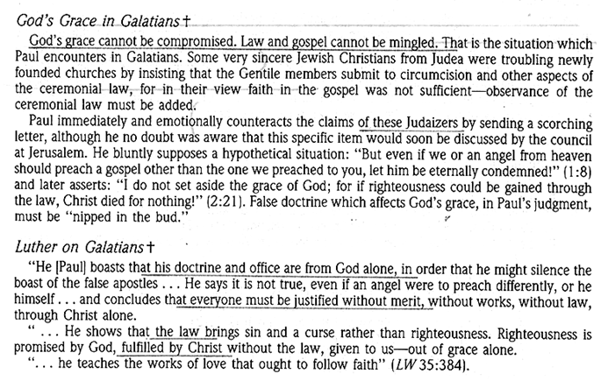

Slide 13
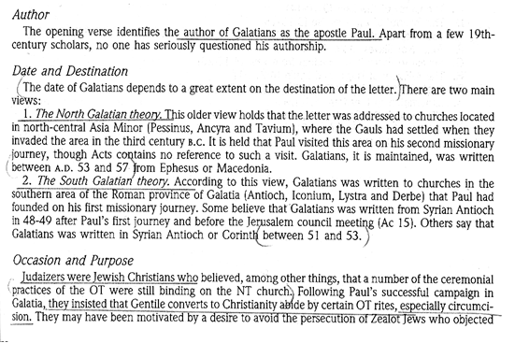

Slide 63
