Slide 1
Trinity Lutheran Church Norman, Oklahoma – www.tlcnorman.org The Book of Galatians Theme: “The True Gospel You Have Received” Date: 7-10-22 Lesson: 17 - Chapter 3:15,16

Slide 2
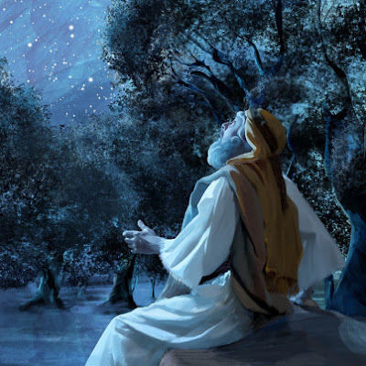

Slide 3
TEXT AND STUDY
(15) To give a human example, brothers: even with a man-made covenant, no one annuls it or adds to it once it has been ratified. (16) Now the promises were made to Abraham and to his offspring. It does not say, "And to offsprings," referring to many, but referring to one, "And to your offspring," who is Christ.
(Gen 3:15; 12:1-3; 22:1-8; 26:1-5;
28:10-15; 49:8-12;
Mt 26:28; Lk 1:72; Ac 3:25; 7:8;
Rom 4:13; 9:4; 2 Cor 3:14; Heb 8:9;

Slide 4
(17) This is what I mean: the law, which came 430 years afterward, does not annul a covenant previously ratified by God, so as to make the promise void. (18) For if the inheritance comes by the law, it no longer comes by promise; but God gave it to Abraham by a promise.
(Gen 15:13; Ex 12:40,41;
Ac 7:6 Rom 8:17)

Slide 5
Luther’s Commentary - Vol. 26
Thus far I have recounted nearly all the most powerful arguments that Paul treats in this epistle in support of the doctrine of justification; among these the most important and the most effective is the one he urges most both here and in Romans, the argument about the promise. For no one can deny that the promise is not the Law. Now he takes the words of the promise, “In your Offspring they shall be blessed, etc.,” and carefully considers them. Then he treats times and persons, and then the Offspring itself, explaining that this is Christ.
Finally he declares, by means of an antithesis, what the Law does, namely, that it consigns one under a curse. And thus he inverts the arguments that the false apostles were using in defense of the righteousness of the Law and turns them against the false apostles themselves. “You are stressing the Law,” he says, “as necessary for salvation. Have you not read that it says: ‘He who does them shall live by them’? But who does them? Therefore as many as rely on works of the Law are under a curse.”
Thus where the false apostles want to conclude that righteousness and life are from the Law, Paul turns their words around and concludes that the curse and death are from the Law. Thus he adequately protects and defends the doctrine of Christian righteousness by supporting it on the basis of the promise, in which he shows that the Offspring of Abraham himself is Christ, with His death, resurrection, blessing, and victory over all nations. He refutes the arguments of his opponents on the basis of the words of the Law, by which he says that the Law is so far from justifying that it has exactly the opposite effect, namely, that it consigns men under the curse. Now there follows the conclusion of these arguments

Slide 6
18. For if the inheritance is by the Law, it is no longer by promise.
So also in Rom. 4:14: “If it is the adherents of the Law who are to be the heirs, faith is null, and the promise is void.” Nor can it come out any other way; for the distinction is altogether clear, that the Law is not the promise. Natural reason, no matter how blind it is, is still forced to admit that it is one thing to promise and another thing to demand, one thing to grant and another to accept. If a horse could speak, it would be forced to say that it is one thing when a stableboy offers it oats to eat and another thing when the stableboy mounts it and rides it. Therefore the promise and the Law are as far apart from each other as heaven and earth. For the Law demands: “Do this!” The promise grants: “Accept this!”
Therefore Paul concludes as follows: The blessing is given on the basis of the promise; therefore it is not given on the basis of the Law. For the promise says: “In your Offspring they will be blessed.” Therefore he who has the Law does not have enough, for he does not yet have the blessing and so remains under the curse. Hence the Law cannot justify, because the blessing has not been added to it. In addition, if the inheritance were by the Law, God would be found to be a liar, and the promise would become void. Likewise, if the Law could obtain the blessing, why would God promise it, saying, “In your Offspring, etc.”? Why would He not rather say: “Do this, and you will receive the blessing!” or “By keeping the Law you can merit eternal life”? This is an argument from contraries: The inheritance is given on the basis of the promise; therefore it is not on the basis of the Law.

Slide 7
But God gave it to Abraham by a promise.
This is undeniable, that before there was a Law, God by a promise granted Abraham the blessing or inheritance, that is, the forgiveness of sins, righteousness, salvation, and eternal life, which means that we are the sons and heirs of God and fellow heirs with Christ (Rom. 8:17). For Genesis clearly says (22:18): “In your Offspring shall all the nations be blessed.” There the blessing is granted without regard for the Law or works. For before Moses was born or anyone had thought about the Law, God had already taken the initiative and granted the inheritance. “Then why do you boast that you attain righteousness through the Law, when righteousness, life, and salvation were given to Abraham your father without the Law and before the Law, in fact, before there was anyone who could have kept the Law?” Anyone who is not moved by all this is blind and stubborn. I have already set forth the argument about the promise carefully and at length, and so now I am only touching on it in passing.
Up to this point the most important part of this epistle has been set forth. Now there follow the analogies of the custodian and the young heir, the allegory about the two sons of Abraham, Isaac and Ishmael, and finally some commandments about morals. In this latter part of the epistle Paul is speaking rhetorically rather than teaching.

Slide 8
LIFE APPLICATION
“For if the inheritance comes by the law, it no longer comes by promise;
but God gave it to Abraham by a promise.”
How do we also live our lives believing the promises of God?

Slide 10
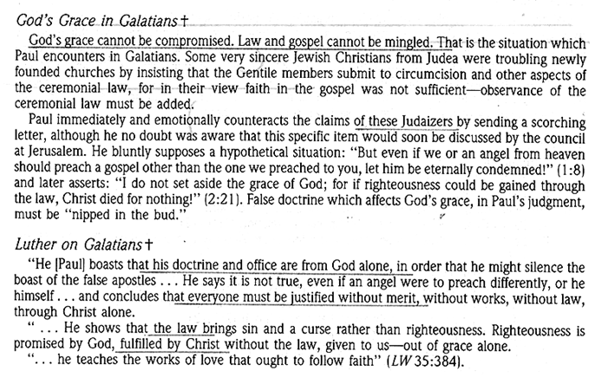

Slide 11
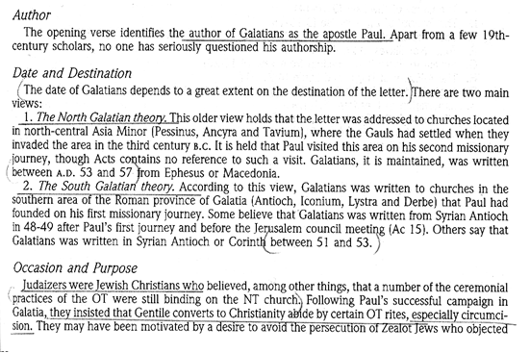

Slide 61
