Slide 1
Trinity Lutheran Church Norman, Oklahoma – www.tlcnorman.org The Book of Galatians Theme: “The True Gospel You Have Received” Date: 6-12-22 Lesson: 14 - Chapter 2:19-21

Slide 3
TEXT AND STUDY
(19) For through the law I died to the law, so that I might live to God. (20) I have been crucified with Christ. It is no longer I who live, but Christ who lives in me. And the life I now live in the flesh I live by faith in the Son of God, who loved me and gave himself for me. (21) I do not nullify the grace of God, for if justification were through the law, then Christ died for no purpose.
(Rom 6:2-14; 8:10-15, 35-39; 14:7,8;
2 Cor 5:14-17; 13:5-8; 1 Th 5:9-15; 1 Tim 2:3-7; Titus 2:11-14; Heb 7:11; 9:11-15; 1 Pet 4:1,2)

Slide 4
Luther’s Commentary. Vol. 26
That I might live to God.
That is, “that I might be alive in the sight of God.” You see, then, that there is no life unless you are without the Law, indeed, unless you are completely dead to the Law, namely, in your conscience. Meanwhile, as long as the body is alive, the flesh must be disciplined by laws and vexed by the requirements and punishments of laws, as I have often admonished. But the inner man, who owes nothing to the Law but is free of it, is a living, righteous, and holy person—not of himself or in his own substance but in Christ, because he believes in Him, as now follows:
20. I have been crucified with Christ.
Paul adds this because he wants to declare that the Law is the devourer of the Law. “Not only am I dead to the Law through the Law so that I might live to God,” he says, “but I am also crucified with Christ. But Christ is the Lord of the Law, because He has been crucified and has died to the Law. Therefore I, too, am lord of the Law. For I, too, have been crucified and have died to the Law, since I have been crucified and have died with Christ.” How? Through grace and faith.
When by this faith I am crucified and die to the Law, then the Law loses all its jurisdiction over me, as it lost it over Christ. Thus, just as Christ Himself was crucified to the Law, sin, death, and the devil, so that they have no further jurisdiction over Him, so through faith I, having been crucified with Christ in spirit, am crucified and die to the Law, sin, etc., so that they have no further jurisdiction over me but are now crucified and dead to me.
But here Paul is not speaking about being crucified with Christ by imitation or example—for imitating the example of Christ is also being crucified with Him—which is a crucifixion that pertains to the flesh. 1 Peter 2:21 deals with this: “Christ suffered for you, leaving you an example, that you should follow in His steps.” But he is speaking here about that sublime crucifixion by which sin, the devil, and death are crucified in Christ, not in me. Here Christ does everything alone. But I, as a believer, am crucified with Christ through faith, so that all these things are dead and crucified to me as well.

Slide 5
Nevertheless, I live.
Paul is speaking clearly and precisely. He says: “I am not speaking about my death and crucifixion as though I were not alive now. I am alive indeed, for I am made alive by the very death and crucifixion by which I die. That is, since I am liberated from the Law, sin, and death by grace and by faith, I am truly alive. Therefore the crucifixion and death by which I am crucified and die to the Law, sin, death, and all evils is resurrection and life to me. For Christ crucifies the devil, kills death, damns sin, and binds the Law. As one who believes this, I am liberated from the Law, etc. Therefore the Law is deaf, bound, dead, and crucified to me; and I, in turn, am deaf, bound, dead, and crucified to it.
Thus I live by this very death and crucifixion, that is, by this grace or liberty.” Here, as I have warned before, Paul’s phraseology must be observed. He says that we die and are crucified to the Law, even though it is rather the Law itself that dies and is crucified to us. But he deliberately uses this phraseology and says that we are crucified and dead to the Law; he does so to make his language more pleasant. For although the Law still remains, lives, and rules in the whole world and accuses and condemns all men, it is crucified and dies only to believers in Christ. Therefore only they have the glory of being crucified and dead to the Law, sin, etc.
Yet not I.
That is, “not in my own person or substance.” Here Paul clearly shows how he is alive; and he states what Christian righteousness is, namely, that righteousness by which Christ lives in us, not the righteousness that is in our own person. Therefore when it is necessary to discuss Christian righteousness, the person must be completely rejected. For if I pay attention to the person or speak of the person, then, whether intentionally or unintentionally on my part, the person becomes a doer of works who is subject to the Law.
But here Christ and my conscience must become one body, so that nothing remains in my sight but Christ, crucified and risen. But if Christ is put aside and I look only at myself, then I am done for. For then this thought immediately comes to my mind: “Christ is in heaven, and you are on earth. How are you now going to reach Him?” “I will live a holy life and do what the Law requires; and in this way I shall enter life.” By paying attention to myself and considering what my condition is or should be, and what I am supposed to be doing, I lose sight of Christ, who alone is my Righteousness and Life. Once He is lost, there is no aid or counsel; but certain despair and perdition must follow.

Slide 6
This is an extremely common evil; for such is human misery that in temptation or death we immediately put Christ aside and pay attention to our own life and our own deeds. Unless we are raised up here by faith, we must perish. In such conflicts of conscience, therefore, we must form the habit of leaving ourselves behind as well as the Law and all our works, which force us to pay attention to ourselves. We must turn our eyes completely to that bronze serpent, Christ nailed to the cross (John 3:14).
With our gaze fastened firmly to Him we must declare with assurance that He is our Righteousness and Life and care nothing about the threats and terrors of the Law, sin, death, wrath, and the judgment of God. For the Christ on whom our gaze is fixed, in whom we exist, and who also lives in us, is the Victor and the Lord over the Law, sin, death, and every evil. In Him a sure comfort has been set forth for us, and victory has been granted.

Slide 7
LIFE APPLICATION
In my baptism, I have been crucified with Christ. It is no longer I who live, but Christ who lives in me.
What effect does this have on my everyday life?

Slide 9
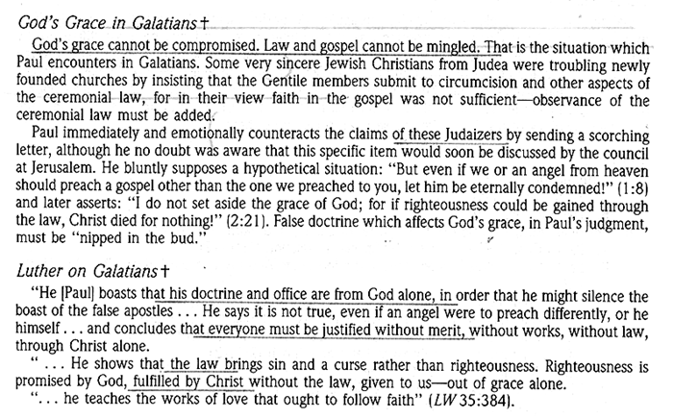

Slide 10
