Slide 1
THE BOOK OF EPHESIANS
“We Are His Workmanship”
Date: 6-30-24 Lesson: 8
Pastor David Nehrenz –
Trinity Lutheran Church – Norman, OK

Slide 2
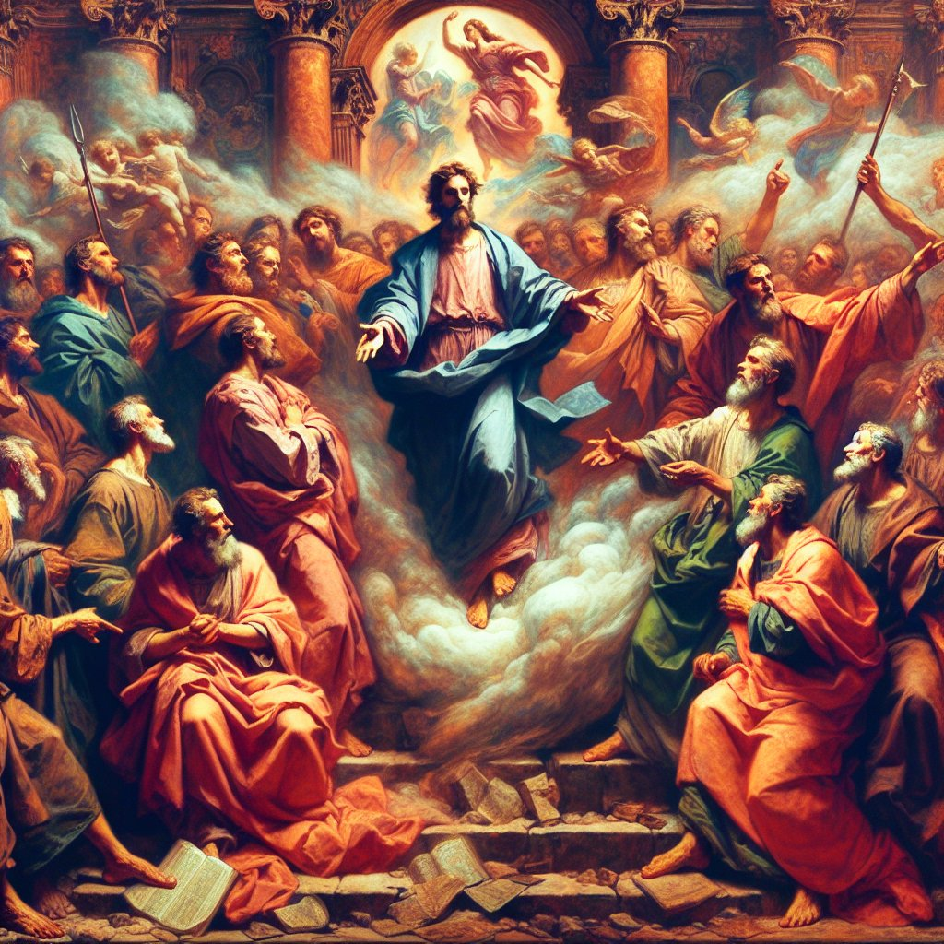

Slide 3
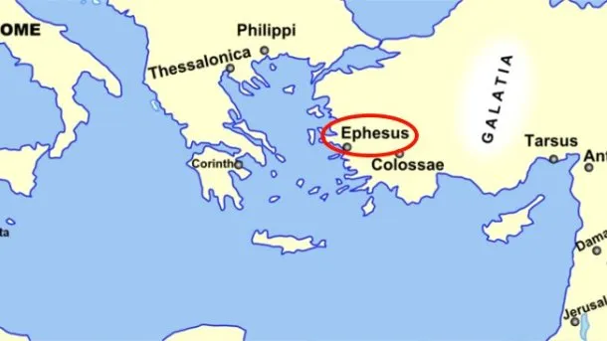
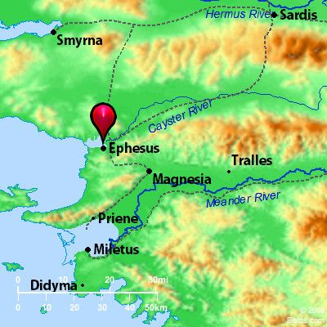
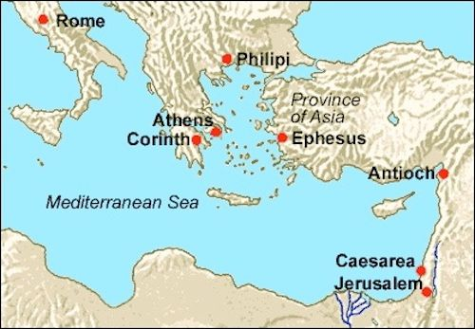

Slide 7
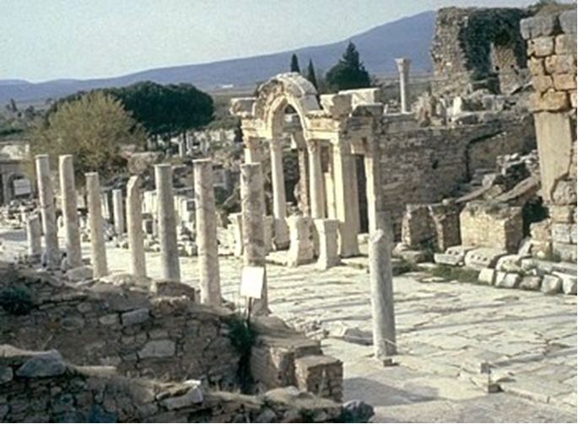

Slide 8
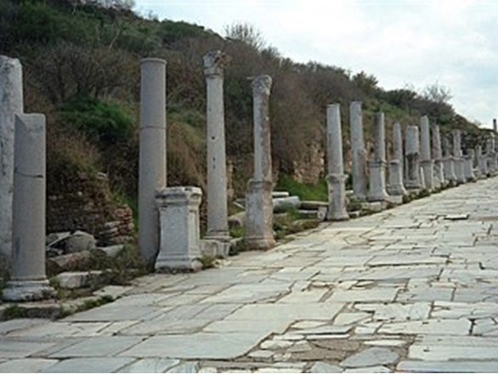

Slide 9
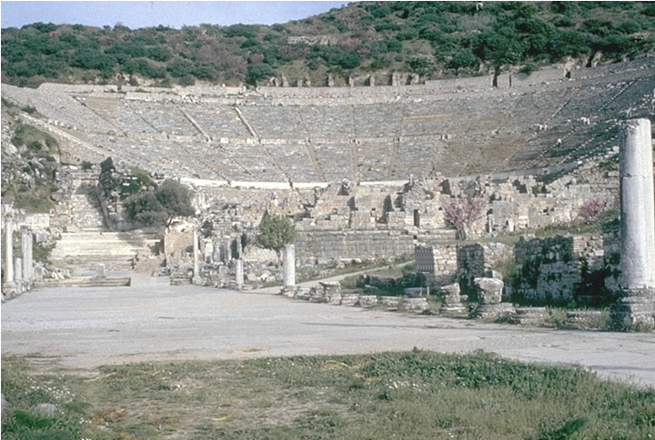

Slide 10
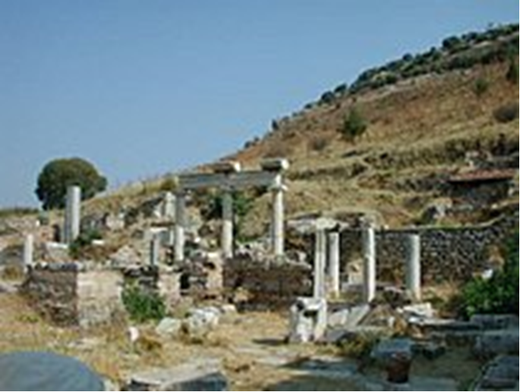

Slide 11
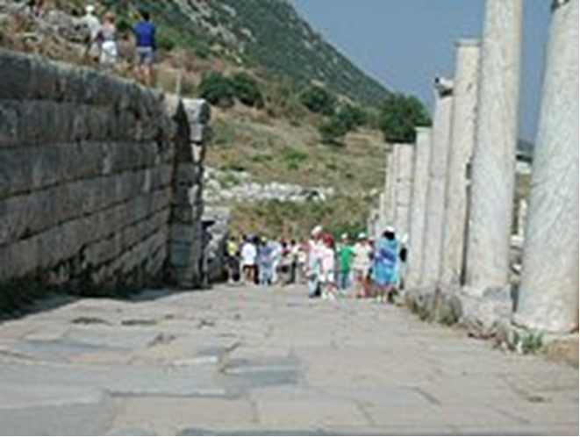
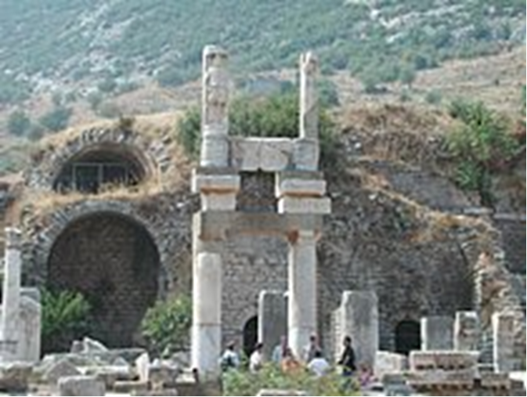

Slide 12
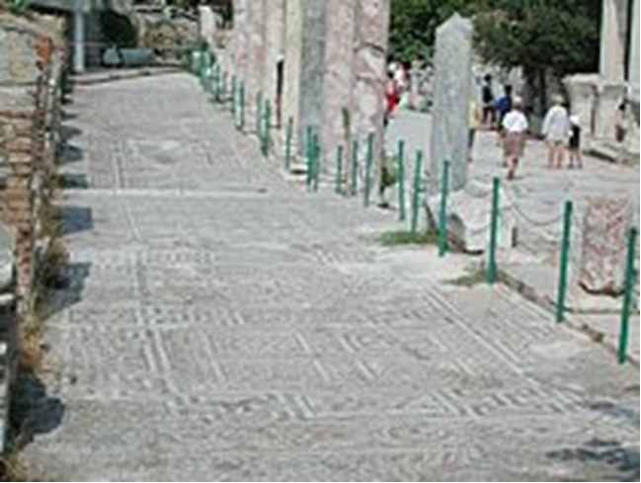
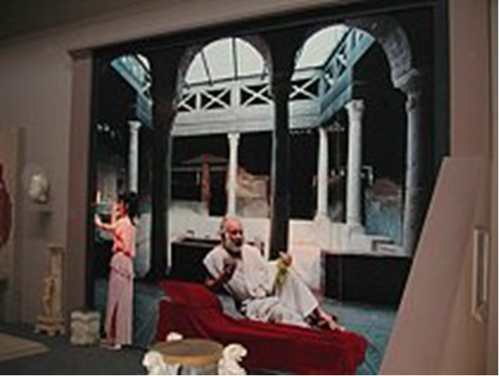

Slide 13
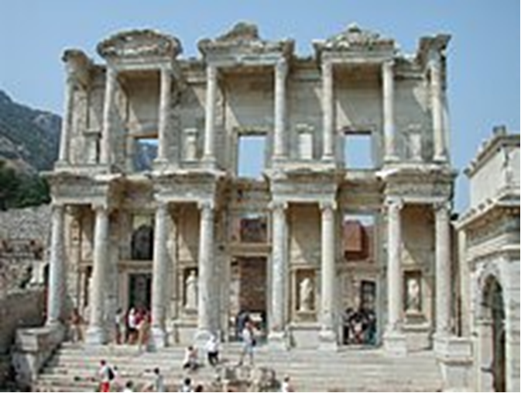

Slide 14
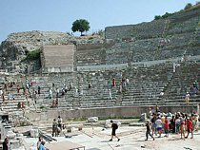
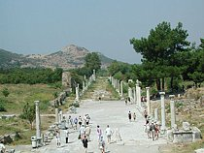

Slide 15
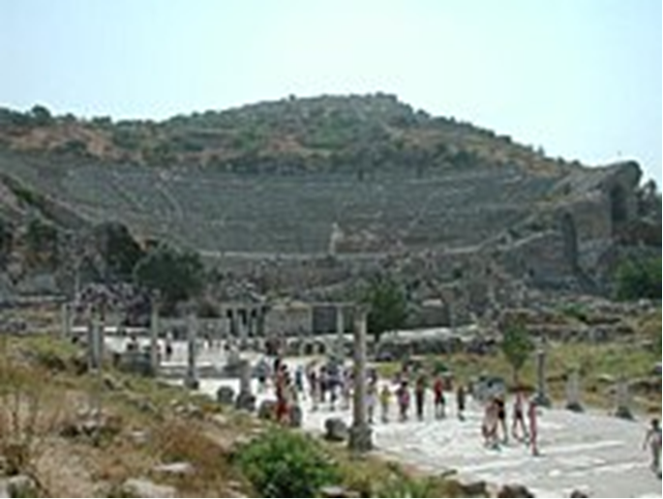
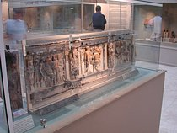

Slide 16
gave him as head over all things to the church, (23) which is his body, the fullness of him who fills all in all.
(Jer 23:24; Jn 1:16;
Rom 12:1-7; 1 Cor 12:12-27;
Eph 3:6-10; 4:12-16;
Col 1:24-29; 2:16-20; 3:14-17)

Slide 17
STUDY HELPS
FORMULA OF CONCORD – APOLOGY OF THE AUGSBERG CONFESSION
– ARTICLES 7/8 – The Church
Note: Defining “Church” was naturally one of the more controversial topics during the Reformation. The Medieval Church had developed a massive organizational structure for operating the Church. The foundation of this structure was the papacy. According to Rome, Jesus Christ established the office of the pope, who is Christ’s visible representative, or vicar, on earth. All churchly authority resides with the pope, who delegates it to others, primarily the bishops.
Obedience to the pope is to be absolute in all matters of faith and morals. Those who deny the pope’s authority and teachings as Christ’s representative cannot be saved. The Lutherans insisted that the Church cannot be defined by its outward organization. Rather, as the Augsburg Confession had defined earlier, the Church is primarily the gathering of God’s people around Christ’s Word and Sacraments. Rome accused the Lutherans of saying that even unbelievers were truly part of this Church.
The Lutherans were careful not to say this. In Articles VII and VIII of the Apology, Melanchthon speaks of the Church in a wide sense, including all who are seen to gather around Word and Sacraments, and in a narrow sense, that is, all who genuinely have faith in Christ, an aspect of Church that cannot be seen. Fellowship around, in, and through the Word and Sacraments defines unity in the faith. (See also AC VII/ VIII; SA III XII; LC II, The Third Article.)

Slide 18
ARTICLES 7/8
[1] They have condemned Article VII of our Confession, in which we said that the Church is the congregation of saints. The adversaries have added a long essay stating that the wicked are not to be separated from the Church, since John the Baptist has compared the Church to a threshing floor on which wheat and chaff are heaped together (Matthew 3: 12), and Christ has compared it to a net in which there are both good and bad fish (Matthew 13: 47).
[2] This is a true saying: “There is no remedy against the attacks of the slanderer.” Nothing can be spoken with such care that it can escape ridicule.
[3] For this reason we have added Article VIII. Let no one think that we separate the wicked and hypocrites from the outward fellowship of the Church, or that we deny power to Sacraments administered by hypocrites or wicked men. There is no need here of a long defense against this slander. Article VIII is enough to acquit us. For we grant that in this life hypocrites and wicked people have been mingled with the Church, and that they are members of the Church according to the outward fellowship of the signs of the Church, that is, of Word, profession, and Sacraments (especially if they have not been excommunicated). Neither are the Sacraments powerless because they are administered by wicked men. Yes, we can even be right in using the Sacraments administered by wicked men

Slide 19
[4] For Paul also predicts, “[ The antichrist] takes his seat in the temple of God” (2 Thessalonians 2: 4). In other words, he will rule and bear office in the Church.
[5] But the Church is not only the fellowship of outward objects and rites, as other governments, but at its core, it is a fellowship of faith and of the Holy Spirit in hearts. Yet this fellowship has outward marks so that it can be recognized. These marks are the pure doctrine of the Gospel and the administration of the Sacraments in accordance with the Gospel of Christ. This Church alone is called Christ’s body, which Christ renews, sanctifies, and governs by His Spirit. Paul testifies about this when he says, “And gave Him as head over all things to the Church, which is His body, the fullness of Him who fills all in all” (Ephesians 1: 22– 23).
[6] Those in whom Christ does not act are not the members of Christ. The adversaries admit this too. The wicked are “dead” members of the Church. We wonder why the adversaries have found fault with our description that speaks of living members.
[7] Neither have we said anything new. Paul has defined the Church precisely in the same way, that it should be cleansed in order to be holy. He adds the outward marks, the Word and Sacraments.

Slide 20
THE LIFE APPLICATION
“He gave him as head over all things to the church,
which is his body, the fullness of him who fills all in all.”
If Jesus is the head of the church, then he is the head over our families too.
What effect does that have on our lives together in the church and in the home?

Slide 23
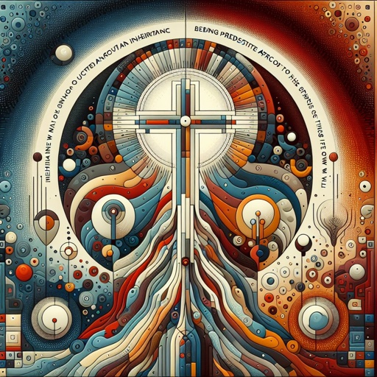

Slide 24
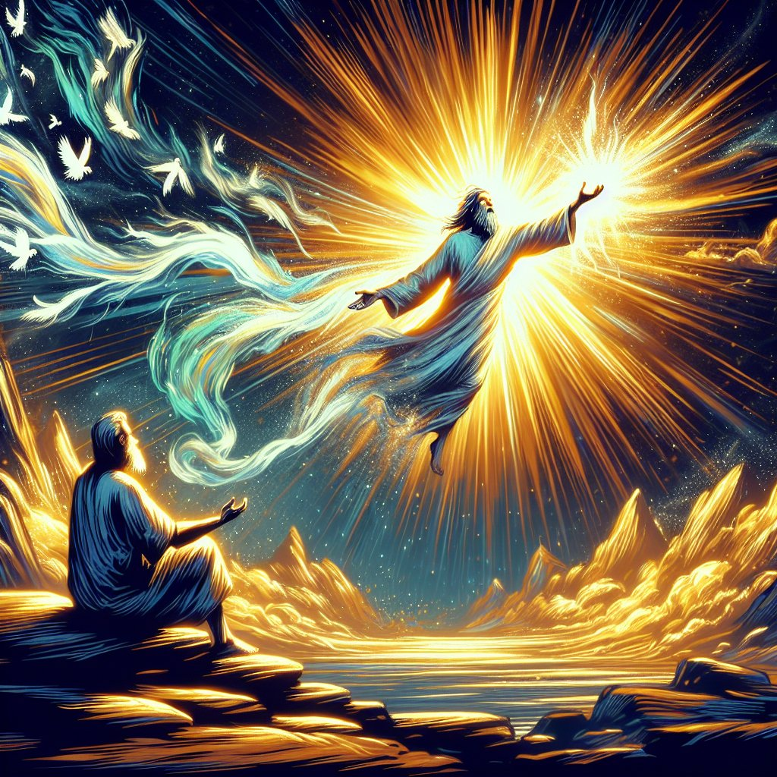

Slide 29
