Slide 1
THE BOOK OF EPHESIANS
“We Are His Workmanship”
Date: 6-2-24 Lesson: 6
Pastor David Nehrenz –
Trinity Lutheran Church – Norman, OK

Slide 2
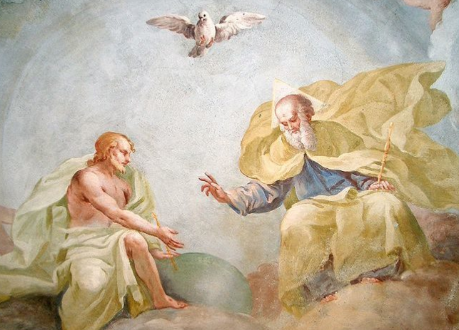

Slide 3
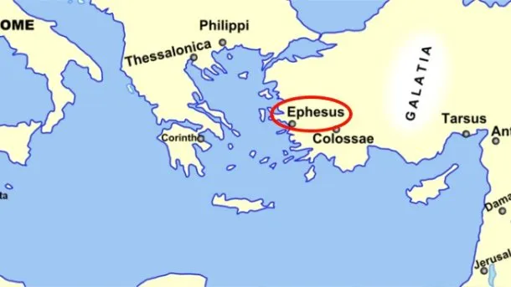
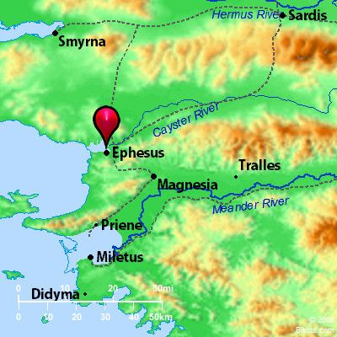
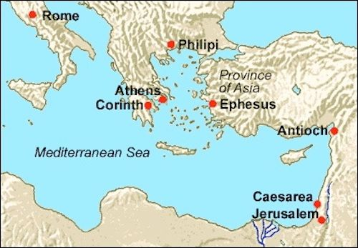

Slide 7
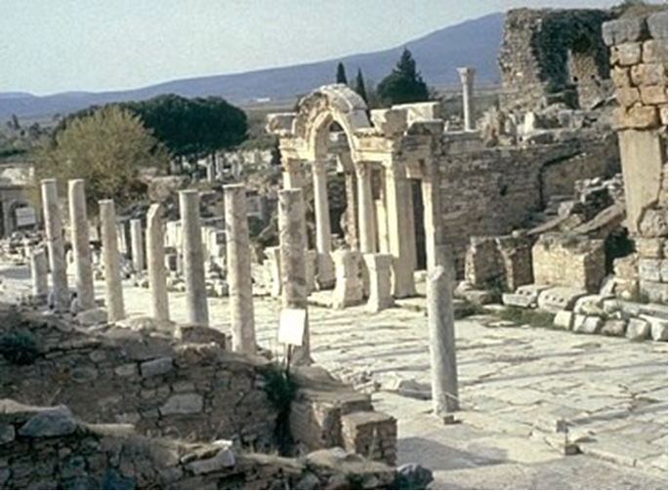

Slide 8
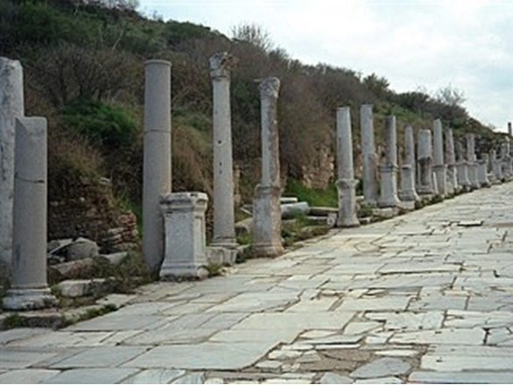

Slide 9
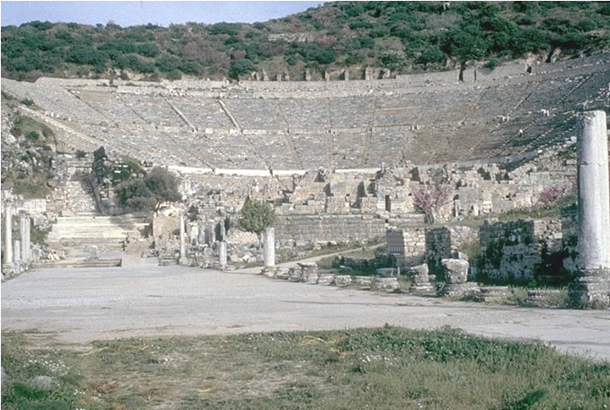

Slide 10
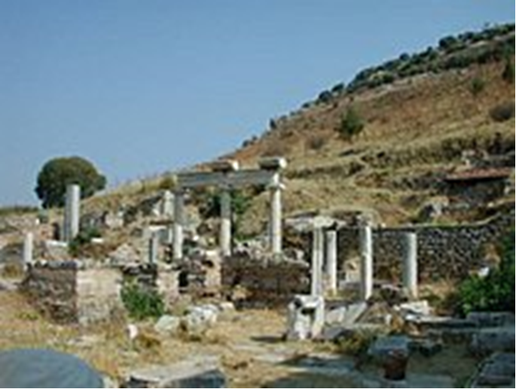

Slide 11
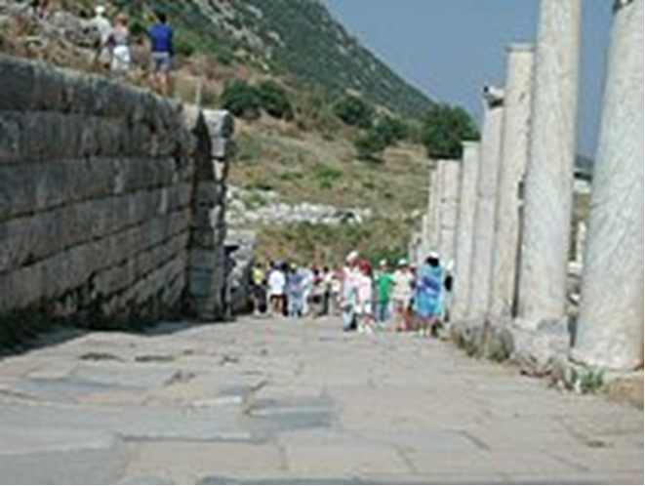
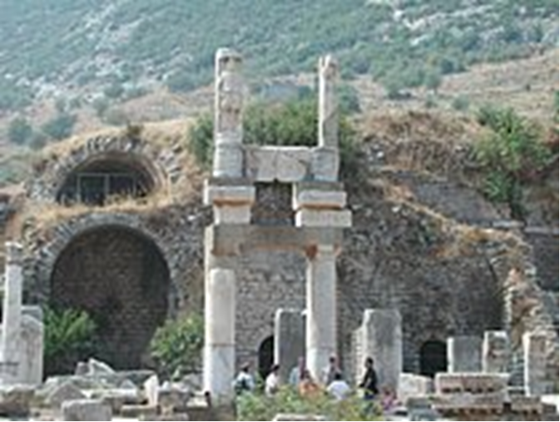

Slide 12
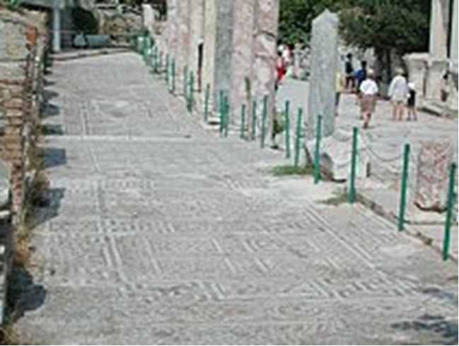
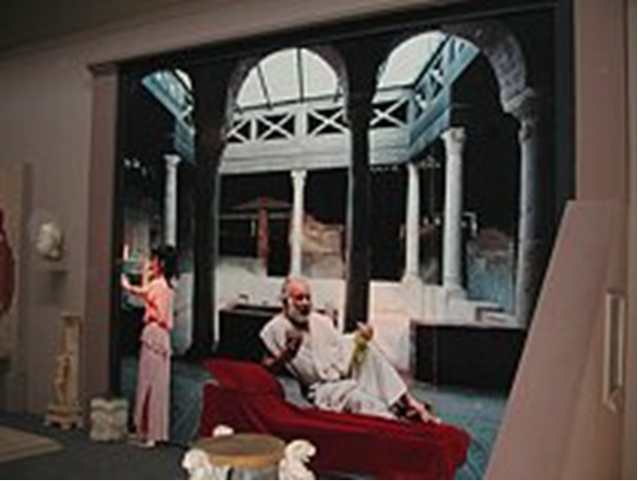

Slide 13
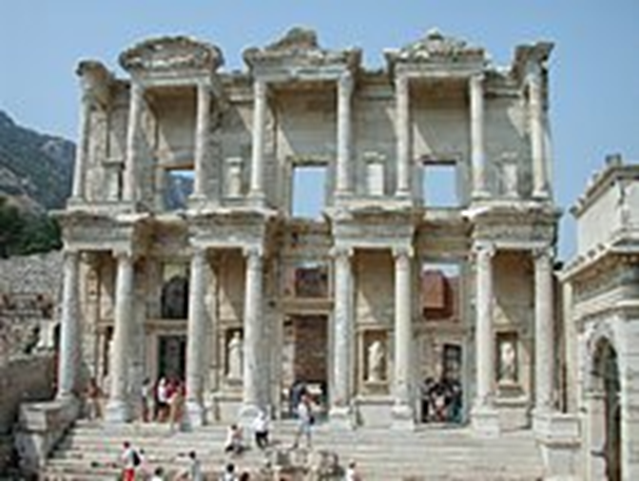

Slide 14
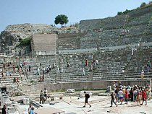
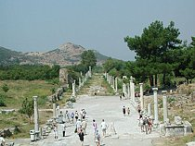

Slide 15
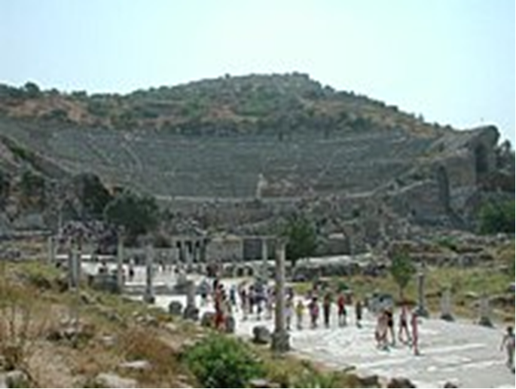
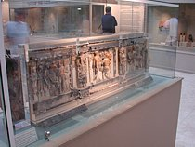

Slide 16
TEXT
(19) and what is the immeasurable greatness of his power toward us who believe, according to the working of his great might
(Is 40:26; Php 3:21; Col 1:27-29)

Slide 17
(20) that he worked in Christ when he raised him from the dead and seated him at his right hand in the heavenly places, (21) far above all rule and authority and power and dominion, and above every name that is named, not only in this age but also in the one to come. (22) And he put all things under his feet and
(Ex 15:6; Ps 8:5,6; 48:10; Is 41:10; Mt 12:32; 22:44; 28:18; Mk 16:19; Jn 3:31;
Ac 2:24; 3:15; 1 Cor 6;14; 11:3; 15:24,27; 2 Cor 13:4; Php 2:9-10; Col 1:16-18; 2:12,19;
Heb 1:4; 2:6-9; 10:13; 1 Pet 3:22)

Slide 18
gave him as head over all things to the church, (23) which is his body, the fullness of him who fills all in all.
(Jer 23:24; Jn 1:16; Rom 12:5;
1 Cor 10:16,17; 12:13, 27; Col 1:24; 2:9,10; 3:11)

Slide 19
STUDY HELPS
FORMULA OF CONCORD – SOLID DECLARATION
– ARTICLE 8 – The Person of Christ
[8] We believe, teach, and confess also that both natures mentioned remain unmingled and undestroyed in their nature and essence. Each keeps its natural, essential properties to all eternity and does not lay them aside. Neither do the essential properties of the one nature ever become the essential properties of the other nature.
[9] We believe, teach, and confess that it is the property of the divine nature to be almighty, eternal, infinite, everywhere present at the same time, and all-knowing. In other words, it agrees with the properties of [the divine] nature and its natural essence. These are essential attributes of the divine nature. Never in eternity do they become essential properties of the human nature. [10] On the other hand, these are properties of the human nature: being a bodily creation or creature, flesh and blood, finite and located in one place; it suffers, dies, ascends, and descends; it moves from one place to another, suffers hunger, thirst, cold, heat, and the like. These properties never become properties of the divine nature.

Slide 20
[11] We believe, teach, and confess that now, since the incarnation, each nature in Christ does not exist by itself so that each is, or makes up, a separate person. These two natures are so united that they make up one single person, in which the divine and the received human nature are and exist at the same time. So now, since the incarnation, there belongs to the entire person of Christ personally not only His divine nature, but also His received human nature. So without His divinity, and also without His humanity, the person of Christ or the incarnate Son of God is not complete. We mean the Son of God who has received flesh and become man [John 1: 14]. Therefore, Christ is not two distinct persons, but one single person, even though two distinct natures are found in Him, unconfused in their natural essence and properties.
[12] We also believe, teach, and confess that the received human nature in Christ has and retains its natural, essential properties. But over and above these, through the personal union with the Deity, and afterward through glorification, Christ’s human nature has been exalted to the right hand of majesty, power, and might, over everything that can be named, not only in this world, but also in that which is to come [Ephesians 1: 21]. [13] Consider this majesty, to which Christ has been exalted according to His humanity. He did not first receive it when He rose from the dead and ascended into heaven. He received it when He was conceived in His mother’s womb and became man, and the divine and human natures were personally united with each other.

Slide 21
THE LIFE APPLICATION
“Christ, when he raised him from the dead and seated him at his right hand in the heavenly places, far above all rule and authority and power and dominion, and above every name that is named, not only in this age but also in the one to come.”
When we get discouraged about the state of the world here on earth,
how do these words encourage us to not give up hope, but cling to Christ at all times?

Slide 24
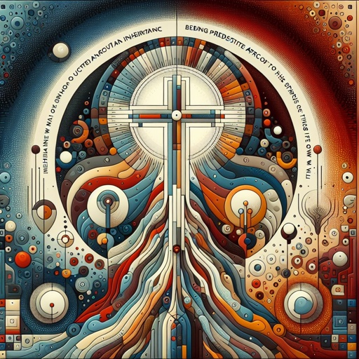

Slide 25
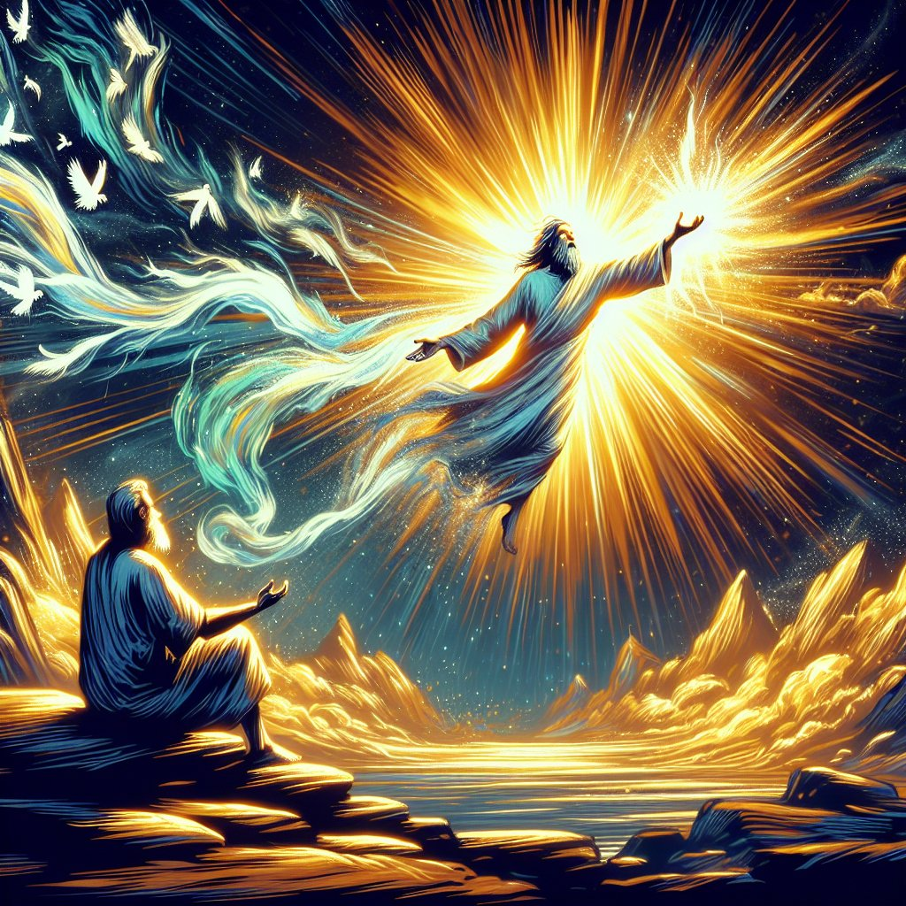

Slide 26
