Slide 1
THE BOOK OF EPHESIANS
“We Are His Workmanship”
Date: 5-19-24 Lesson: 5
Pastor David Nehrenz –
Trinity Lutheran Church – Norman, OK

Slide 3
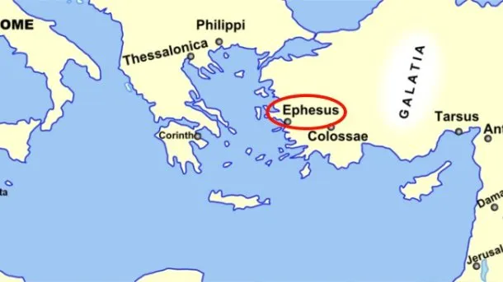
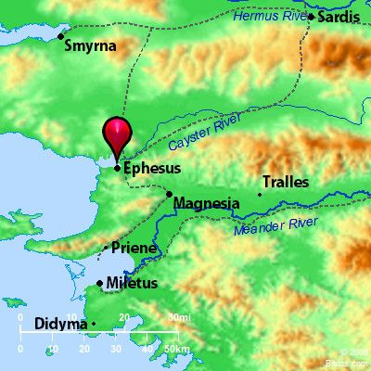
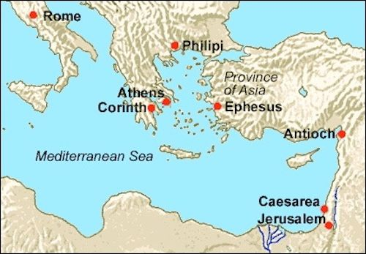

Slide 7
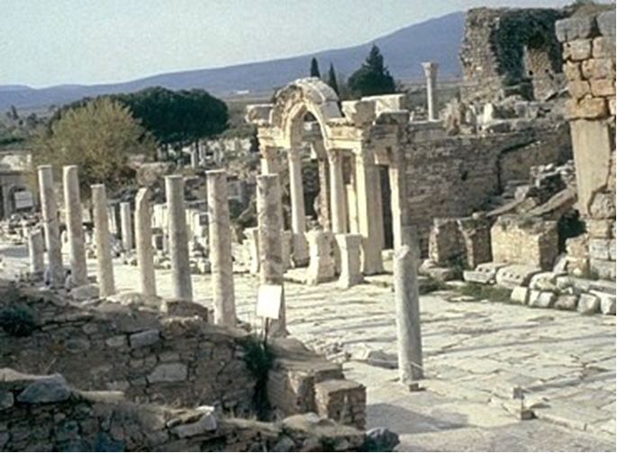

Slide 8
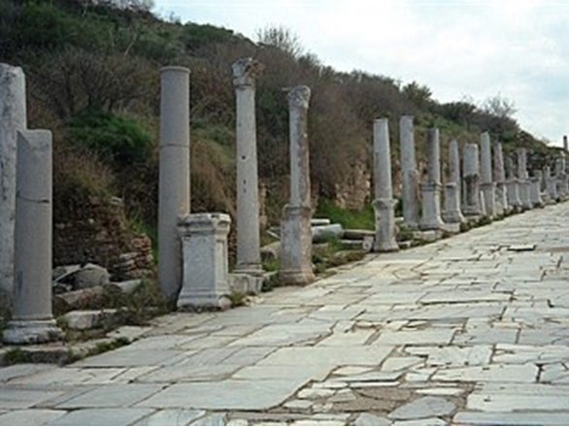

Slide 9
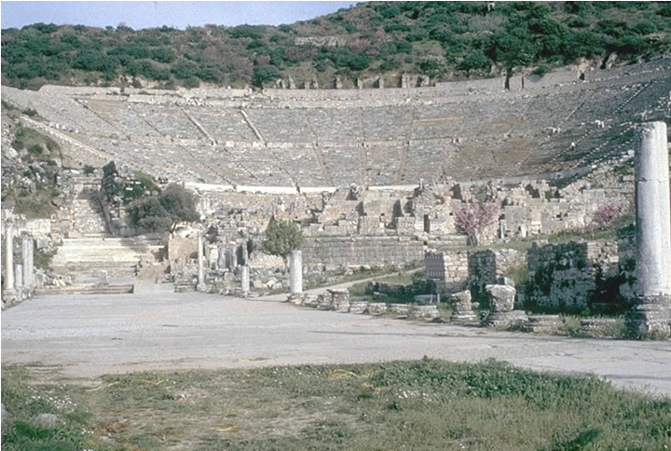

Slide 10
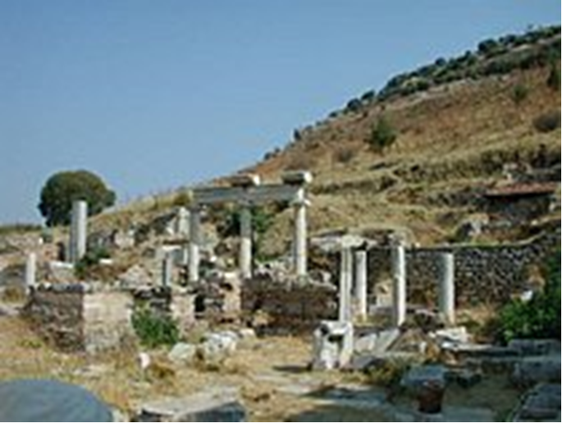

Slide 11
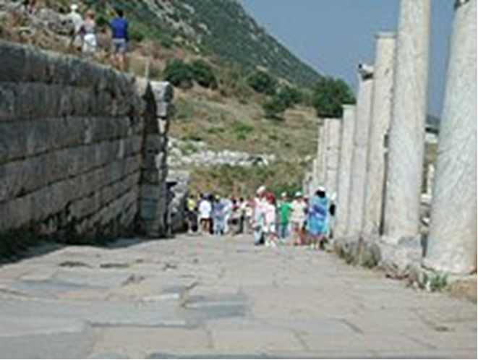
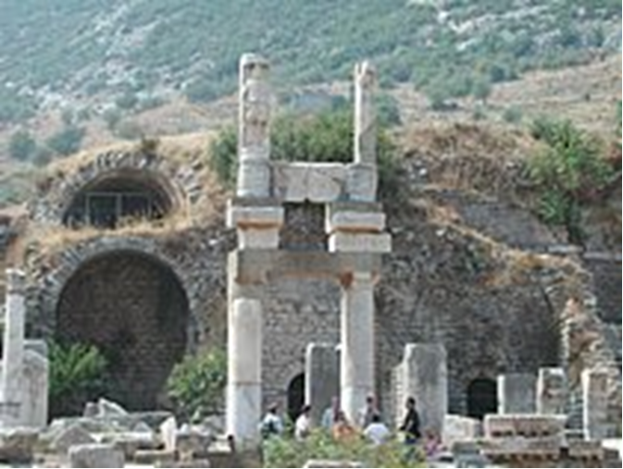

Slide 12
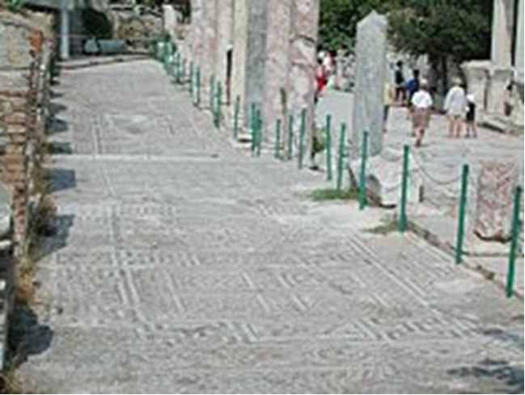
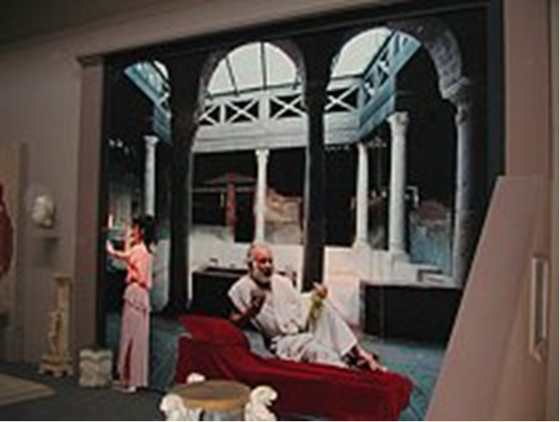

Slide 13
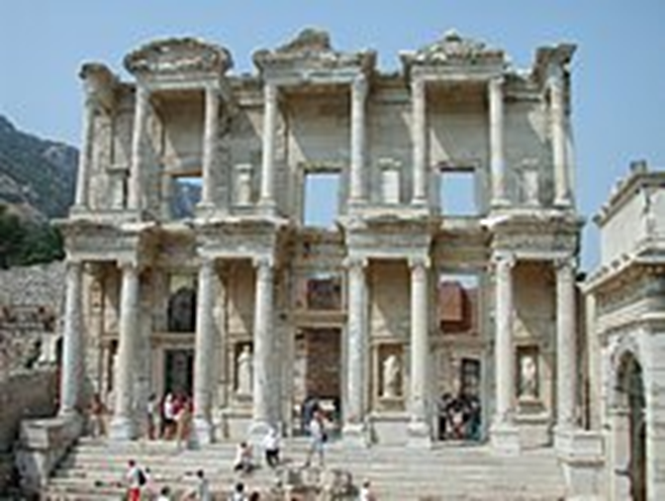

Slide 14
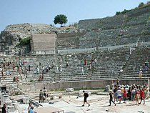
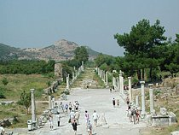

Slide 15
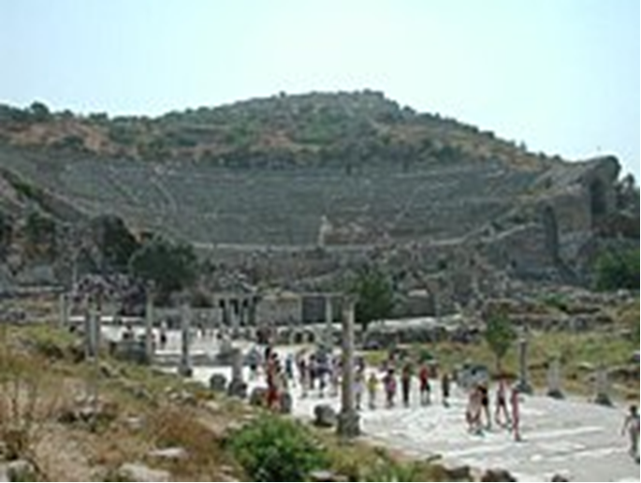
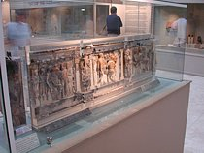

Slide 16
(17) that the God of our Lord Jesus Christ, the Father of glory, may give you a spirit of wisdom and of revelation in the knowledge of him, (18) having the eyes of your hearts enlightened, that you may know what is the hope to which he has called you, what are the riches of his glorious inheritance in the saints,
(Rom 2:4; 6:4; 8:25-28; 15:6; 1 Cor 2:10-13; 12:8; 2 Cor 4:4-6; Php 1:9; 3:14; Col 1:9-13,27; 2 Tim 1:9;
Heb 3:1; 6:4; 10:32;
1 Jn 1:5-7;
Rev 1:6; 3:17,18)

Slide 17
(19) and what is the immeasurable greatness of his power toward us who believe, according to the working of his great might
(Is 40:26; Php 3:21; Col 1:27-29)

Slide 18
(20) that he worked in Christ when he raised him from the dead and seated him at his right hand in the heavenly places, (21) far above all rule and authority and power and dominion, and above every name that is named, not only in this age but also in the one to come. (22) And he put all things under his feet and
(Ex 15:6; Ps 8:5,6; 48:10; Is 41:10; Mt 12:32; 22:44; 28:18; Mk 16:19; Jn 3:31;
Ac 2:24; 3:15; 1 Cor 6;14; 11:3; 15:24,27; 2 Cor 13:4; Php 2:9-10; Col 1:16-18; 2:12,19;
Heb 1:4; 2:6-9; 10:13; 1 Pet 3:22)

Slide 19
gave him as head over all things to the church, (23) which is his body, the fullness of him who fills all in all.
(Jer 23:24; Jn 1:16; Rom 12:5; 1 Cor 10:16,17; 12:13, 27; Col 1:24; 2:9,10; 3:11)

Slide 20
STUDY HELP
FORMULA OF CONCORD – SOLID DECLARATION – ARTICLE 2 – Free Will
“[13] If we want to think or speak correctly and usefully about eternal election, or the predestination or preordination of God’s children to eternal life, we should make it our custom to avoid speculating about God’s bare, secret, concealed, mysterious foreknowledge. Instead, we should think or speak about how God’s counsel, purpose, and ordination in Christ Jesus— who is the true Book of Life— is revealed to us through the Word.
[14] In a word, what God’s Son says remains eternally true, “For apart from Me you can do nothing” [John 15: 5]. Paul says, “For it is God who works in you, both to will and to work for His good pleasure” [Philippians 2: 13]. To all godly Christians who feel and experience in their hearts a small spark or longing for divine grace and eternal salvation this precious passage is very comforting. For they know that God has kindled in their hearts this beginning of true godliness. He will further strengthen and help them in their great weakness to persevere in true faith unto the end [1 Peter 5: 10].
[16] After God (through the Holy Spirit in Baptism) has kindled and caused a beginning of the true knowledge of God and faith, we should pray to Him without ceasing [1 Thessalonians 5: 17]. We should ask that through the same Spirit and His grace, by means of the daily exercise of reading and doing God’s Word, He would preserve in us faith and His heavenly gifts, strengthen us from day to day, and keep us to the end. For unless God Himself is our schoolmaster, we can study and learn nothing that is acceptable to Him and helpful to ourselves and others.”

Slide 21
THE LIFE APPLICATION
“The immeasurable greatness of his power toward us who believe,
according to the working of his great might”
If God has great power and might,
how does this inform and empower our prayer lives?

Slide 24
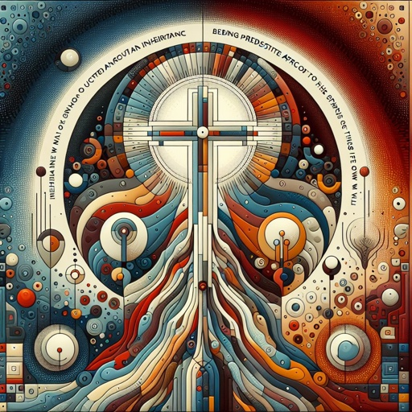

Slide 25
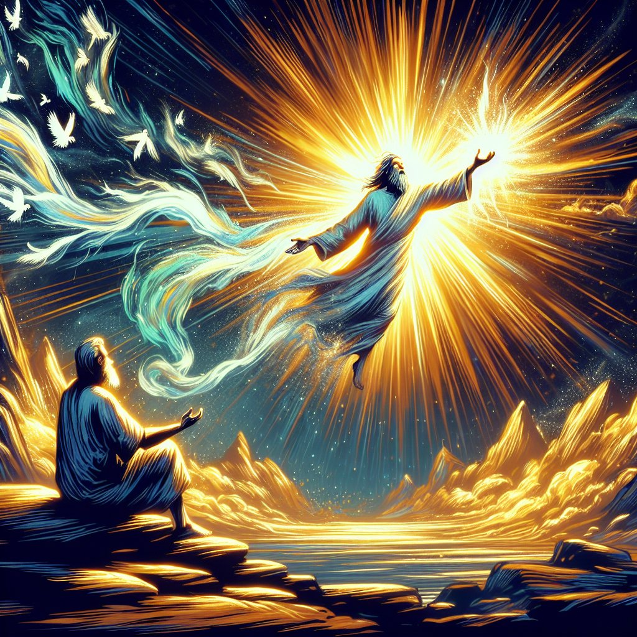

Slide 26
