Slide 1

THE BOOK OF EPHESIANS
“We Are His Workmanship”
Date: 3-9-25 Lesson: 41
Pastor David Nehrenz –
Trinity Lutheran Church – Norman, OK

Slide 2
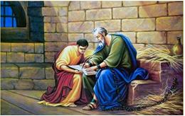

Slide 3
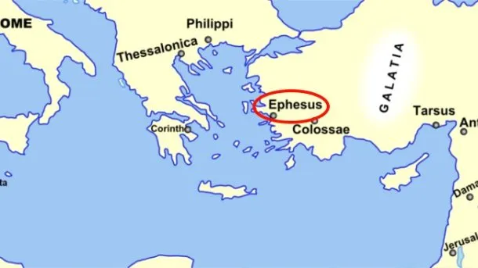
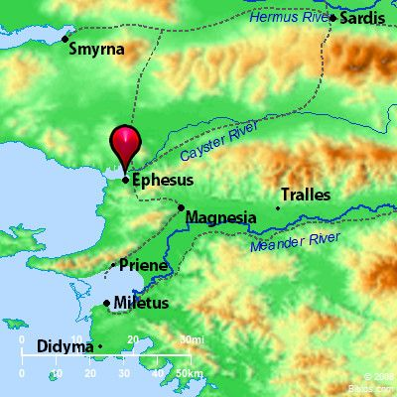
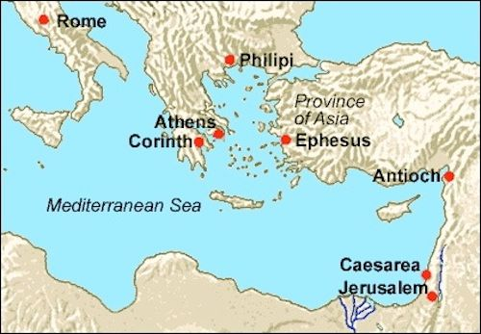

Slide 4
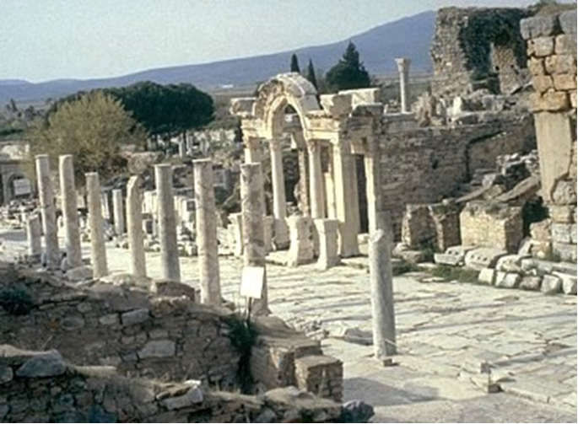

Slide 5
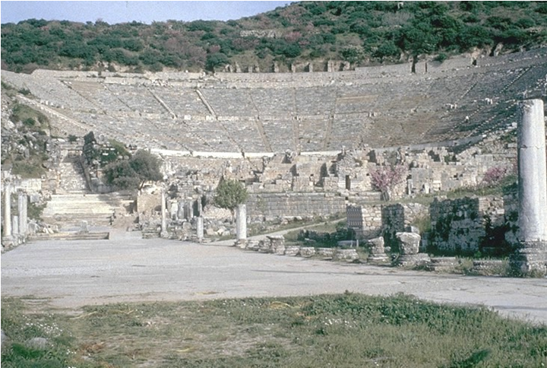

Slide 6
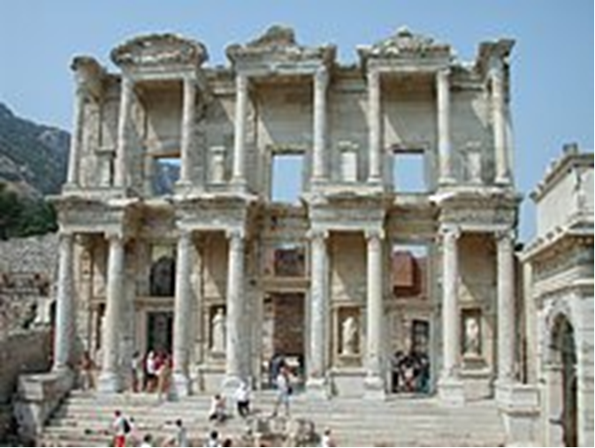

Slide 7
THE TEXT (Ephesians 6:21-24)
(21) So that you also may know how I am and what I am doing, Tychicus the beloved brother and faithful minister in the Lord will tell you everything. (22) I have sent him to you for this very purpose, that you may know how we are, and that he may encourage your hearts.
(Ac 20:4; Col 1:1; 2:2; 4:7-14; 2 Tim 4:12; Titus 3:12)

Slide 8
(23) Peace be to the brothers, and love with faith, from God the Father and the Lord Jesus Christ. (24) Grace be with all who love our Lord Jesus Christ with love incorruptible.
(Ex 20:6; 1 Cor 8:3; 15:42-53; 16:22; 2 Cor 13:13; Gal 5:6; 6:16; 1 Th 5:8; 2 Th 3:16; 1 Pet 1:4; 5:14)

Slide 9
STUDY HELPS
Tychicus is one of those Bible characters who probably doesn’t receive the recognition due them. True, Tychicus is only mentioned five times in the New Testament, but the ministry he provided was noteworthy.
We first meet Tychicus in Acts 20:4, during Paul’s third missionary journey. He is mentioned as one of Paul’s companions on the way from Corinth to Jerusalem to deliver a gift to the church there (see Romans 15:25–26). We learn that Tychicus was a native of Asia, or what we would call Asia Minor today.
Tychicus is called a “dear brother” of Paul’s and a “faithful servant” of the Lord’s (Ephesians 6:21). In Colossians 4:7, Tychicus is a “faithful minister and fellow servant” who was with Paul during his first Roman imprisonment. He was entrusted to deliver Paul’s epistles to the Ephesians and Colossians and to bring news of the apostle to those congregations: “Tychicus will tell you all the news about me. . . . I am sending him to you for the express purpose that you may know about our circumstances and that he may encourage your hearts” (Colossians 4:7–8). Encouragement is also mentioned as part of Tychicus’s ministry in Ephesians 6:22.

Slide 10
In traveling to Colossae, Tychicus accompanied Onesimus, the former slave who was returning to Philemon. No doubt, Tychicus, as a good friend of Paul’s, emphasized the need for grace in receiving Onesimus back home (see Philemon 1:17).
Paul intended to send either Tychicus or another man to Crete in order to give Titus a chance to visit Paul (Titus 3:12). Later, Tychicus was with Paul in Rome during the apostle’s second Roman imprisonment, and Paul sent him to Ephesus in order to free up Timothy for a visit (2 Timothy 4:12). In both Crete and Ephesus, then, Tychicus was an “interim pastor” of sorts, filling in for Titus and Timothy.

Slide 11
There is an unnamed believer alluded to in 2 Corinthians 8:22, described as a “brother who has often proved to us in many ways that he is zealous, and now even more so because of his great confidence in you.” Many commentators surmise that this is a reference to Tychicus. The description seems to fit.
We may not know much about Tychicus, but what we do know is impressive and praiseworthy. Tychicus was a trusted messenger, faithful preacher, and loyal friend. Paul placed great confidence in him, sending him to accomplish important works. Tychicus obviously had the ability to minister in a variety of situations, bringing encouragement to those he served. Tychicus surely modeled the quality that all church elders are to possess: “He must hold firmly to the trustworthy message as it has been taught, so that he can encourage others by sound doctrine and refute those who oppose it” (Titus 1:9).
Tychicus (/ˈtɪkɪkəs/: Greek: Τυχικός) was an Asiatic Christian who, with Trophimus, accompanied the Apostle Paul on a part of his journey from Macedonia to Jerusalem. He is also alluded to have been with Paul in Rome, where the apostle sent him to Ephesus, probably for the purpose of building up and encouraging the church there. In the New Testament, he is mentioned five times (Acts 20:4; Ephesians 6:21–22; Colossians 4:7; Titus 3:12; 2 Timothy 4:12)

Slide 12
Appearance in the Bible:
1.Acts 20:4 states that Tychicus was from the Roman province of Asia. The Western text indicates that he was an Ephesian. Paul ends the letter to the Ephesians, and hands it over to Tychicus.
(2) In Ephesians 6:21, the author (Paul) calls Tychicus a "dear brother and faithful servant in the Lord" (NIV)
(3) while in Colossians 4:7 he says he is "a dear brother, a faithful minister and fellow servant in the Lord." In both Ephesians and Colossians, the author indicates that he is sending Tychicus to the Christians to whom he is writing, in order to encourage them.
(4) The passages in the Epistle to Titus (Titus 3:12) and to Timothy show that Tychicus was again with Paul after the appeal to the emperor had resulted in the apostle regaining his freedom. The passage in Titus evidently refers to the interval between Paul's first and second Roman imprisonments, and while he was again engaged in missionary journeys. The apostle writes to Titus, who was in Crete in charge of the churches there, that he intended to send either Artemas or Tychicus to him, so as to take the oversight of the work of the gospel in that island so that Titus might be free to come to be with the apostle at Nicopolis.
(5) The last passage where Tychicus is mentioned occurs in 2 Timothy, which was written in Rome not long before Paul's execution. To the very end Paul was busy as ever in the work of the gospel; and though it would have been a comfort to him to have his friends beside him, yet the interests of the kingdom of Christ are uppermost in his thoughts, and he sends these friends to help the progress of the work. To the last, Tychicus was serviceable as ever: "Tychicus I sent to Ephesus" (2 Timothy 4:12). As Timothy was in charge of the church in Ephesus (1 Timothy 1:3), the coming of Tychicus would set him free, so as to enable him to set off at once to rejoin Paul at Rome, as the apostle desired. (2 Tim 4:9,21)

Slide 13
LIFE APPLICATION
Peace, faith, love and grace. Explain what each of these are in our daily lives.
NEW BIBLE STUDY
to begin on March 16:
“The Apostles, Nicene and Athanasian Creeds – The Truth about the Trinity”
-The Ecumenical Creeds as Summaries About Who God Is, Versus False Religions and Cults-

Slide 14
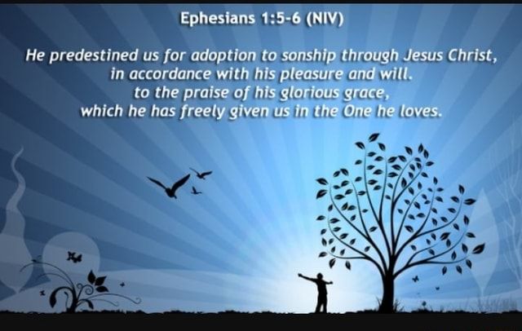

Slide 15
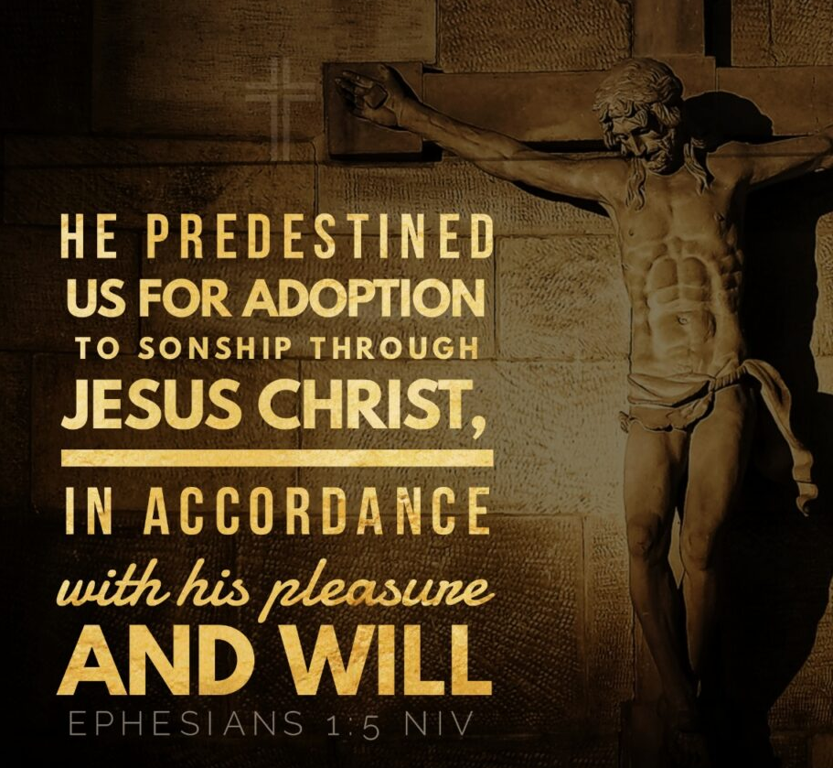

Slide 16
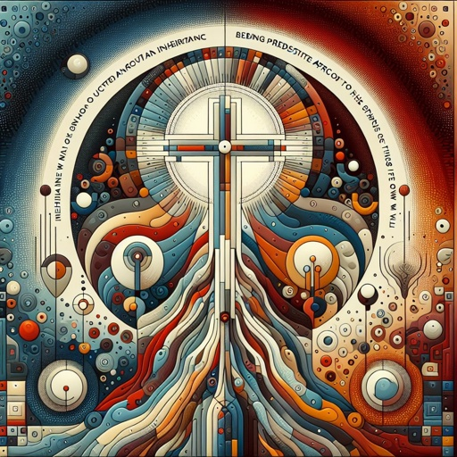

Slide 17
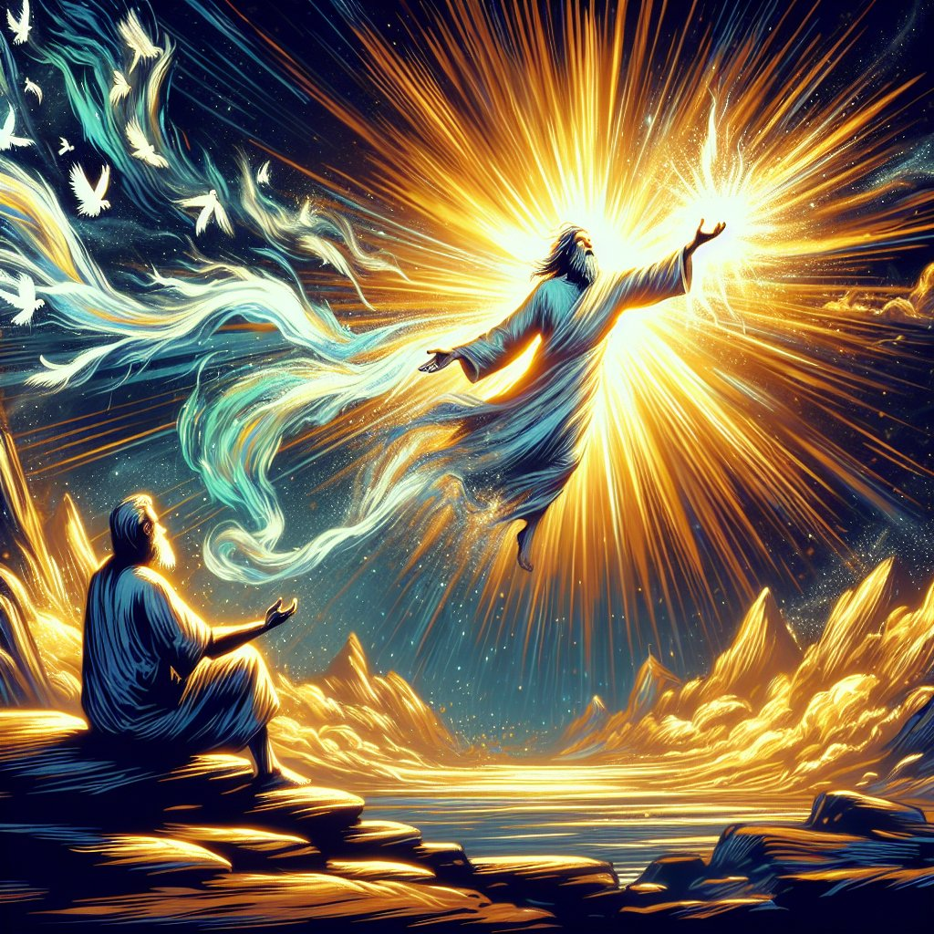

Slide 18


Slide 19


Slide 20
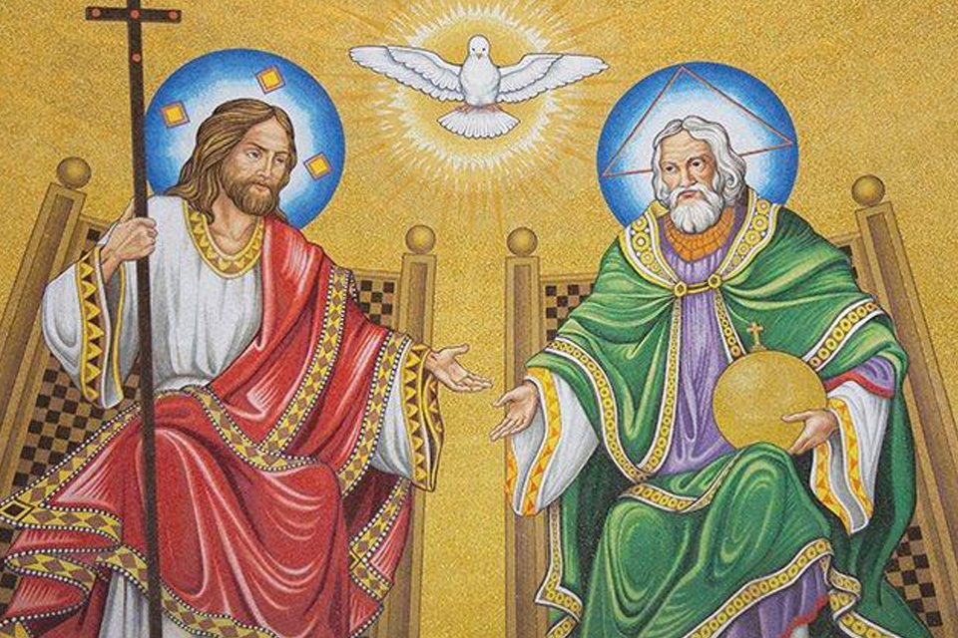

Slide 21
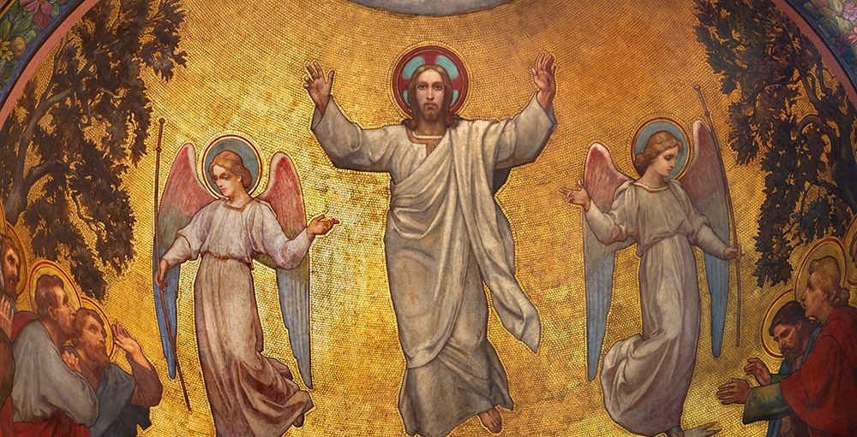

Slide 22
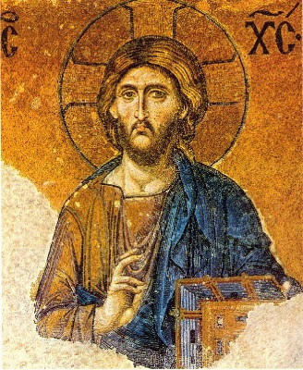

Slide 23
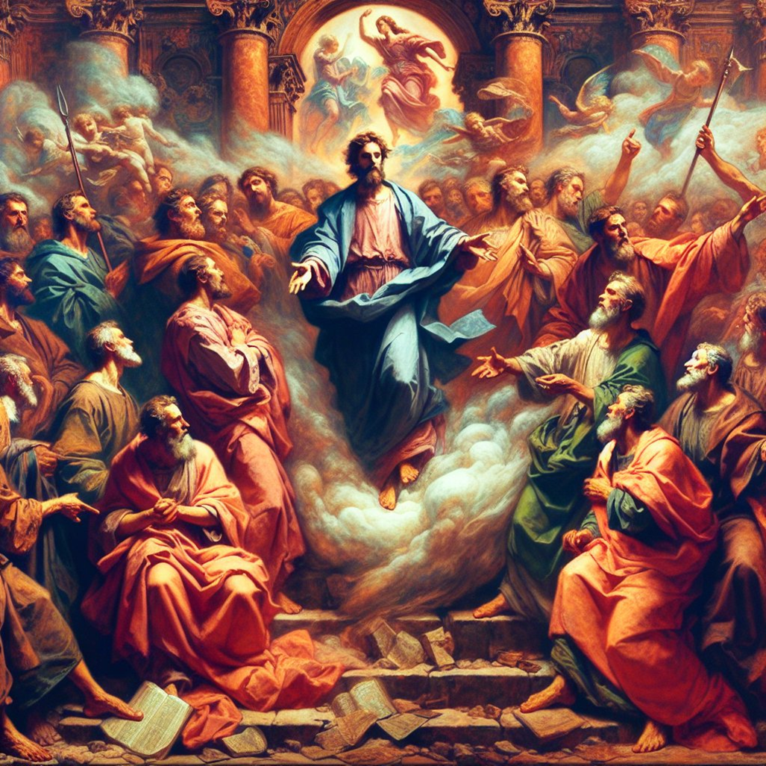

Slide 24
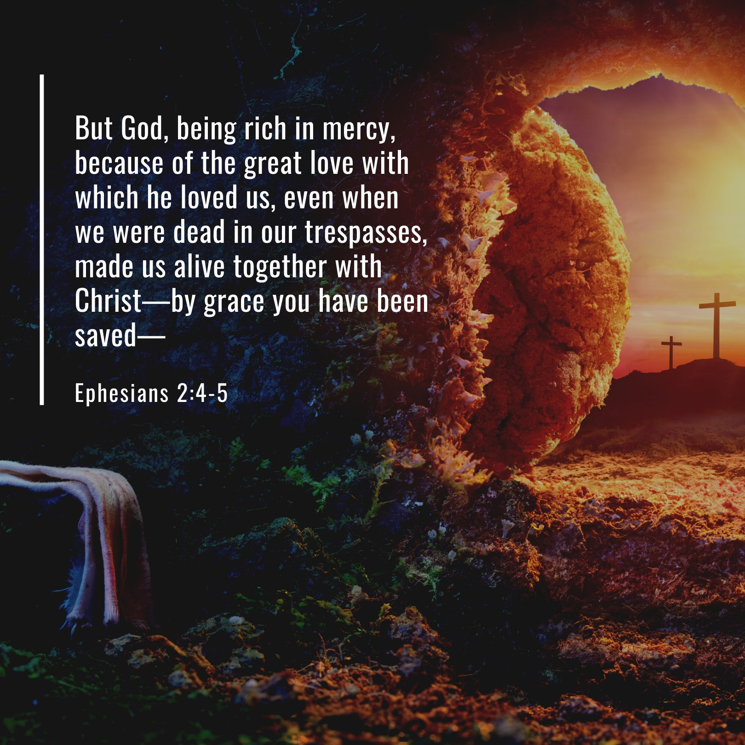

Slide 25
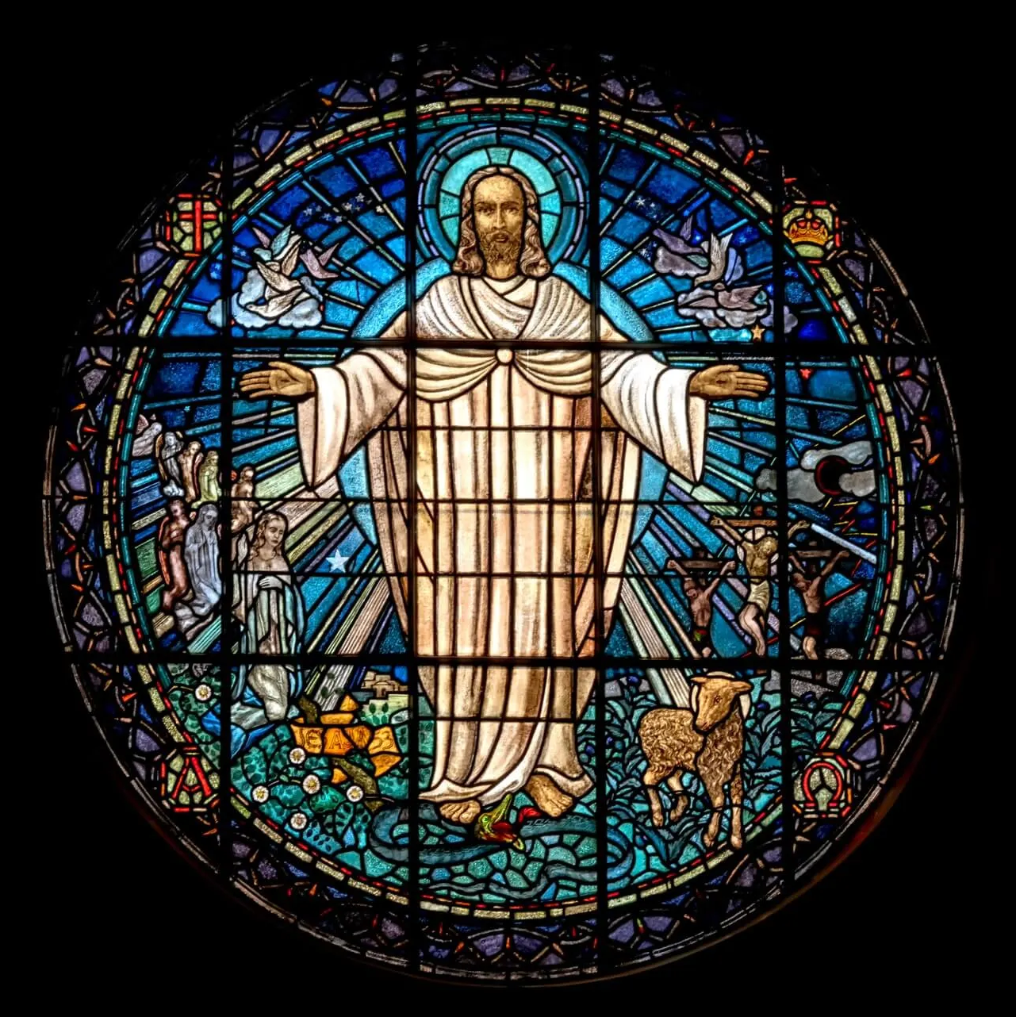

Slide 26
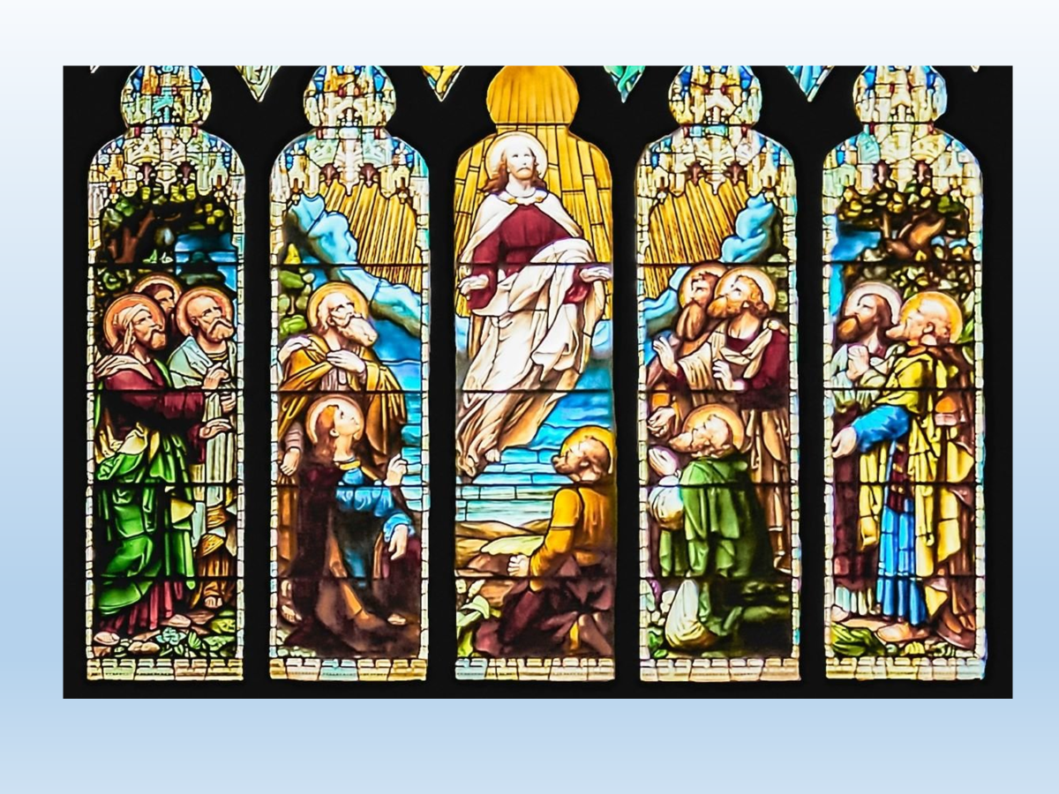

Slide 27


Slide 28
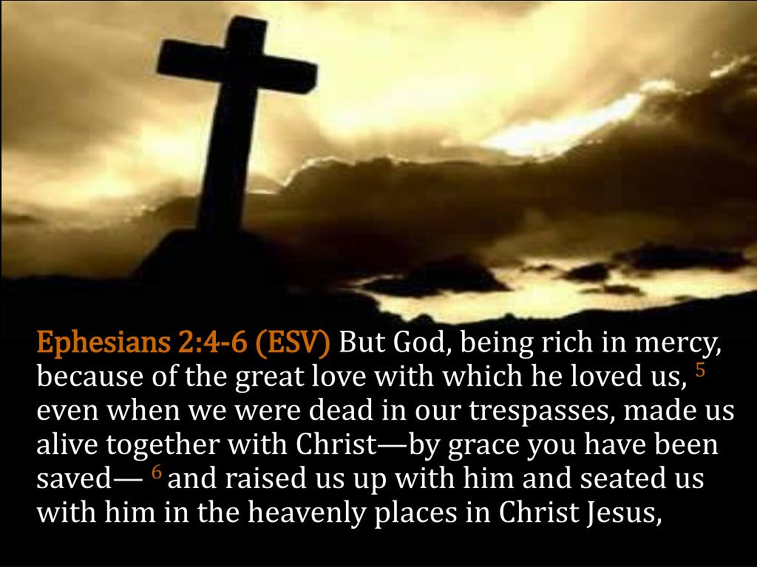

Slide 29


Slide 30
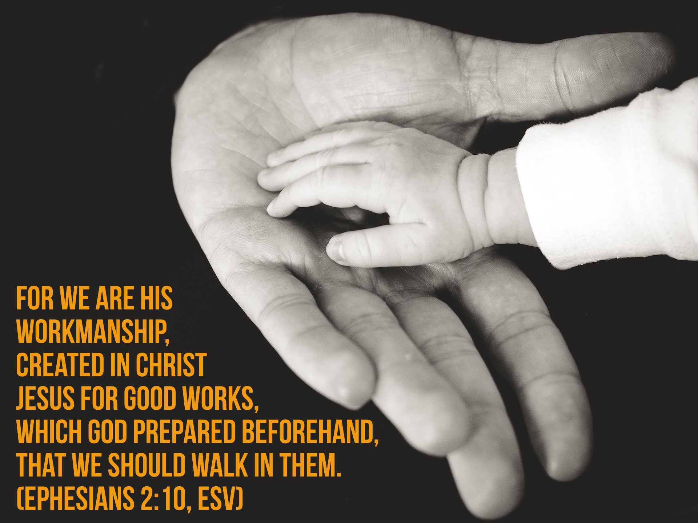

Slide 31
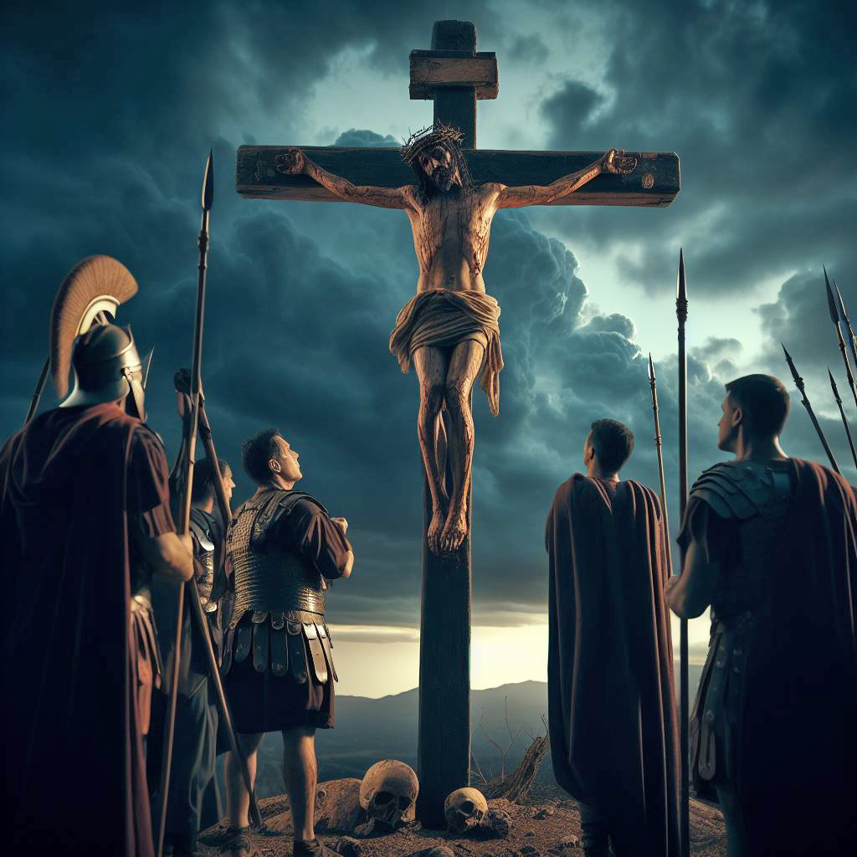

Slide 32


Slide 33
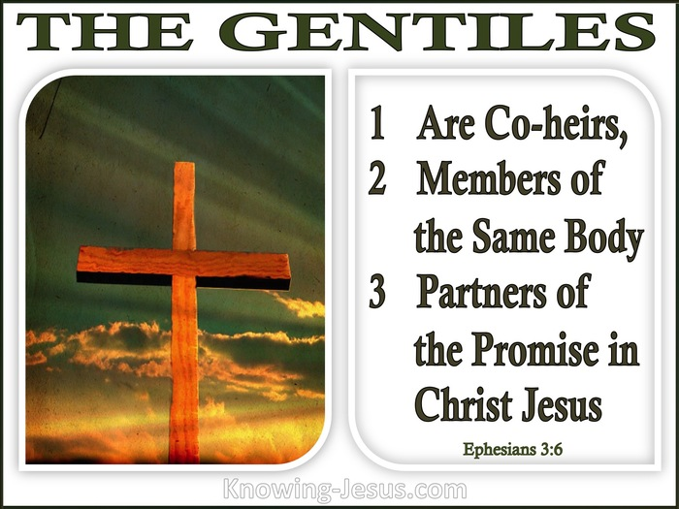

Slide 34
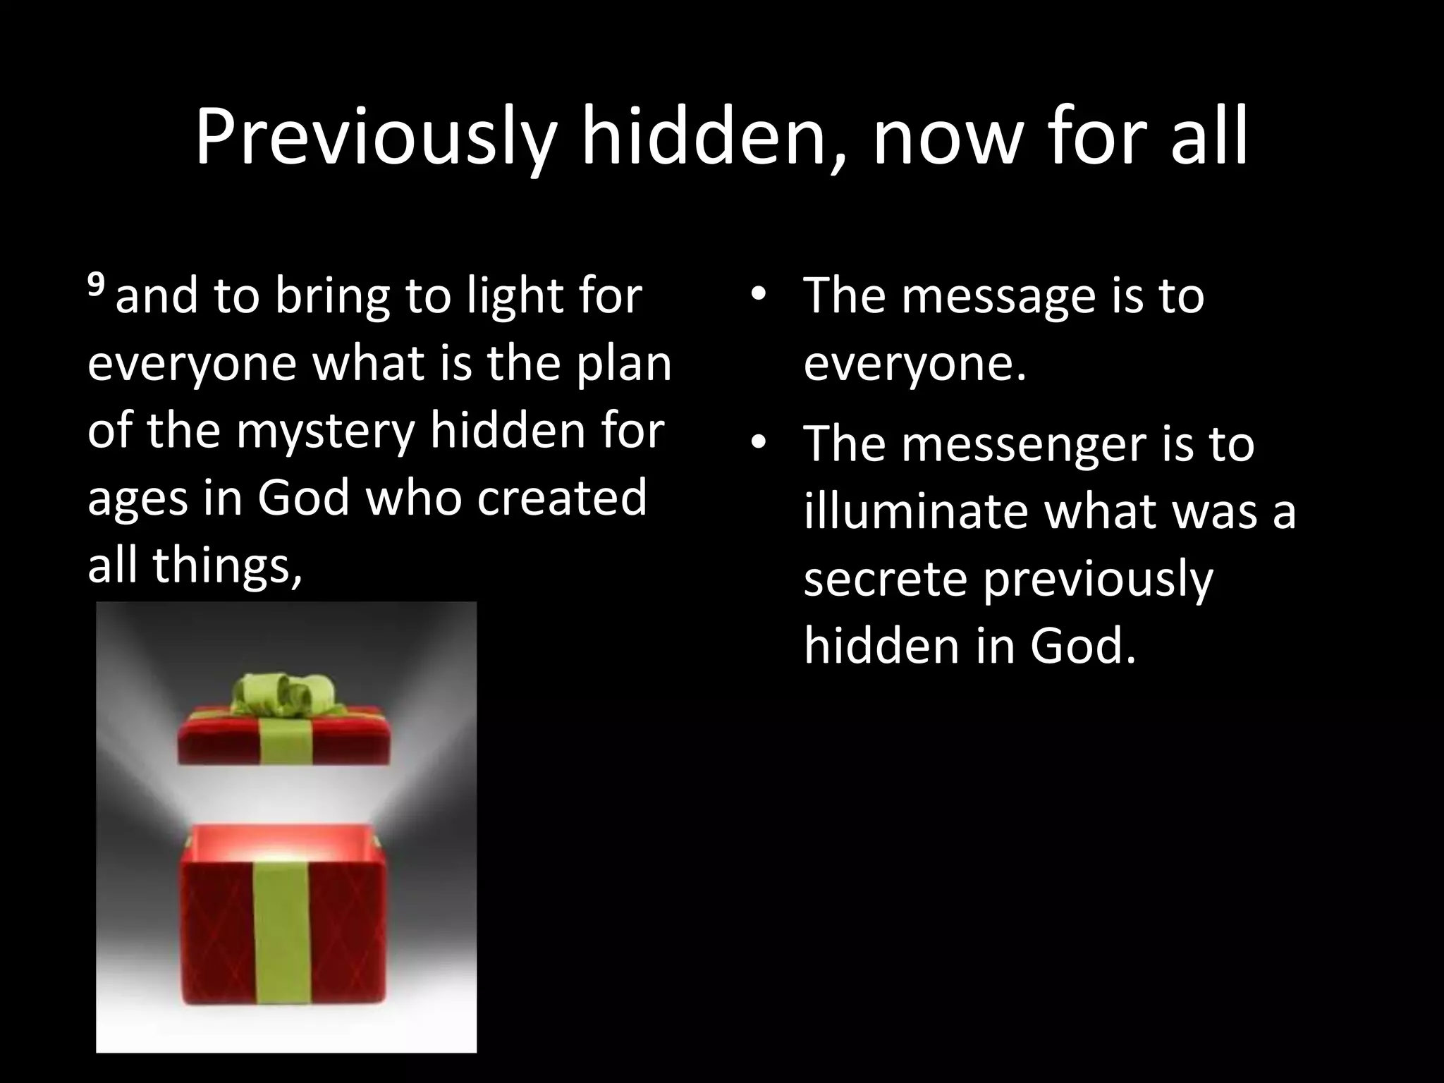

Slide 35


Slide 36
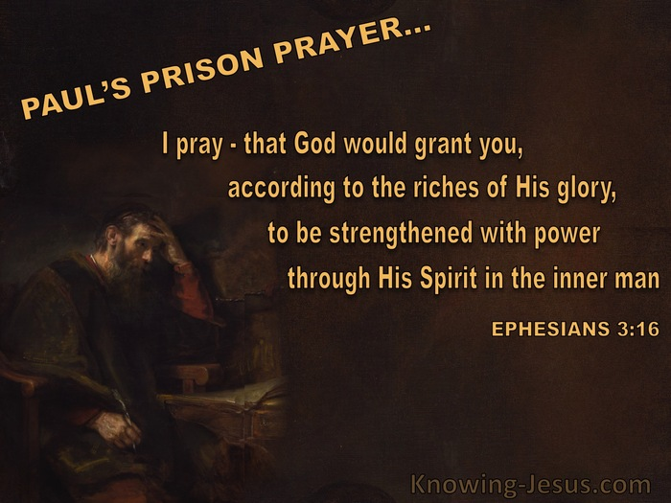

Slide 37


Slide 38
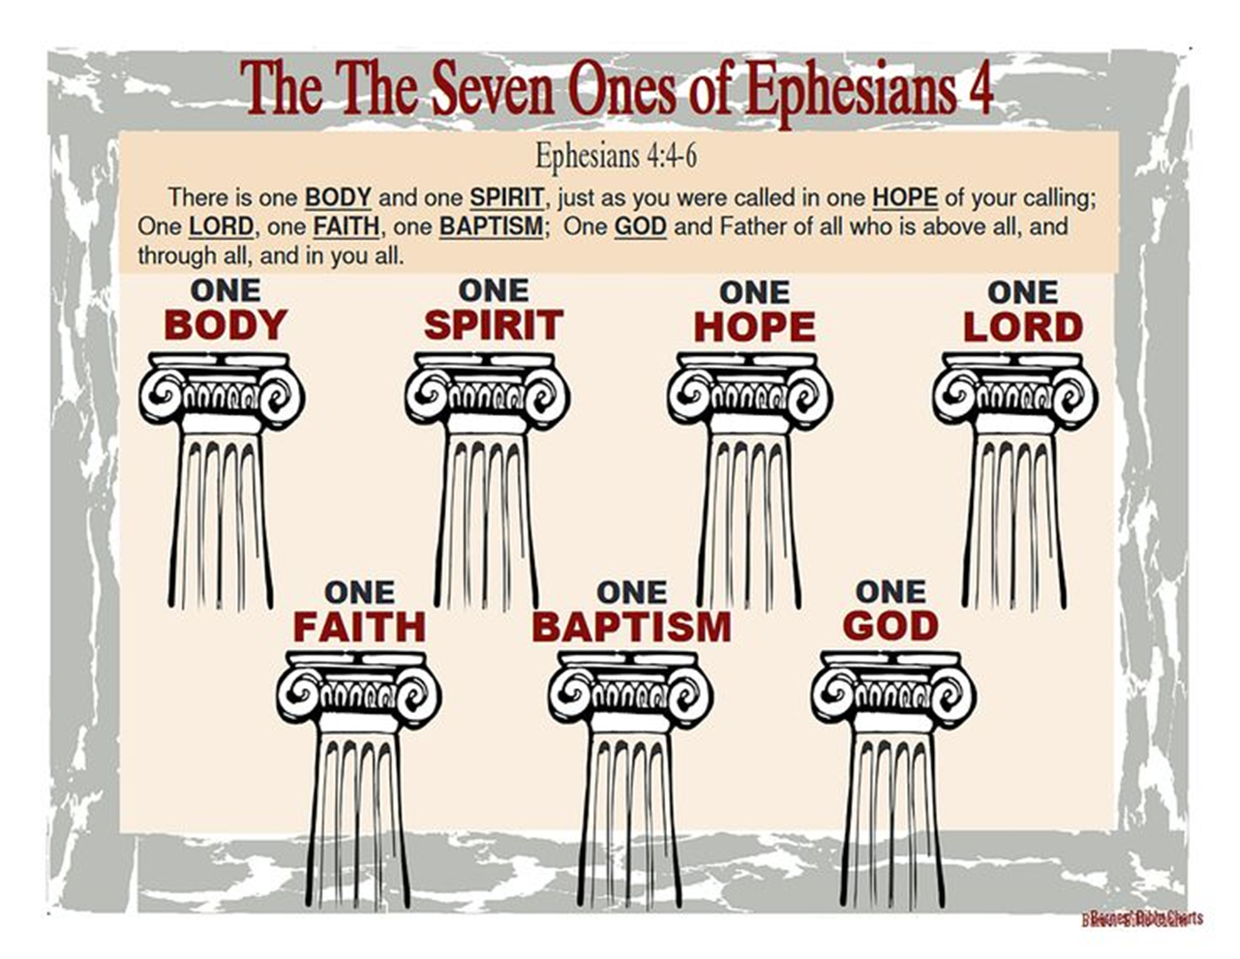

Slide 39
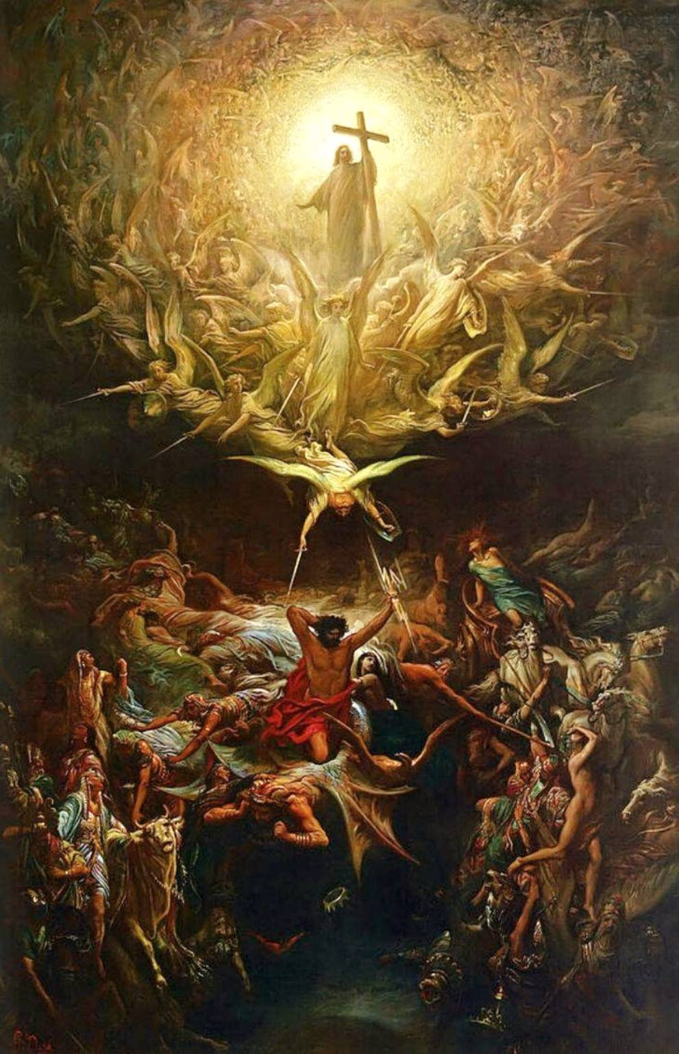

Slide 40
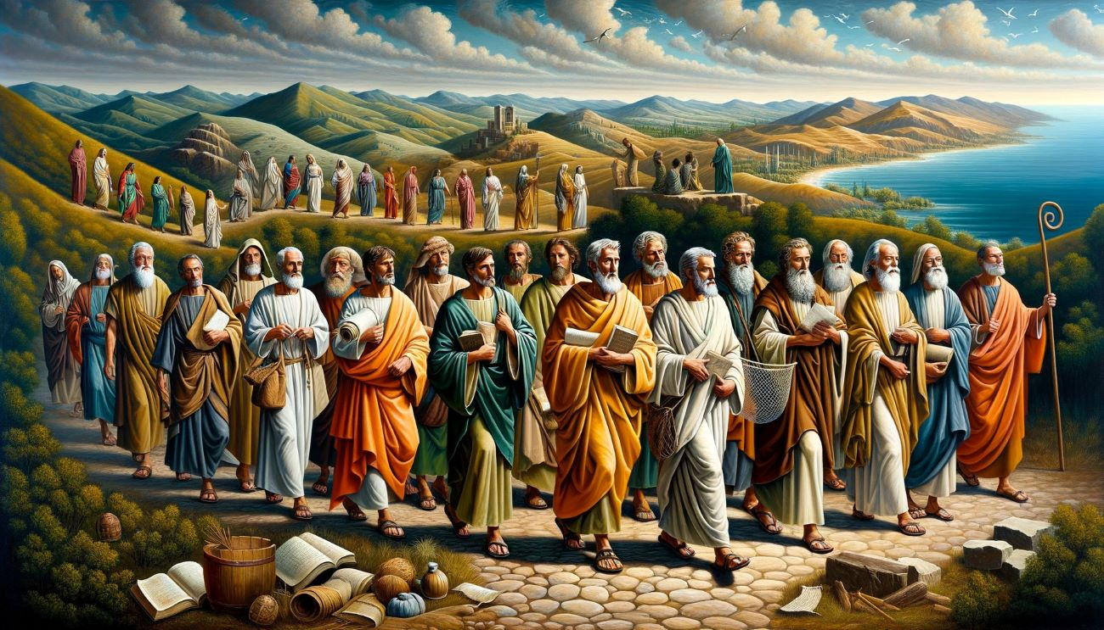

Slide 41
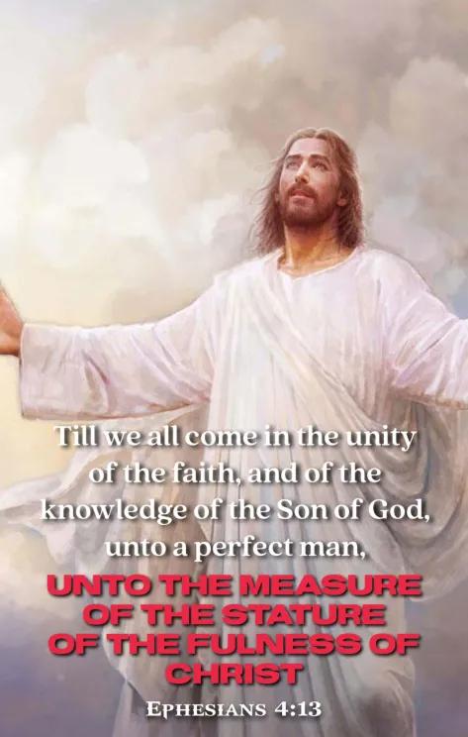

Slide 42


Slide 43


Slide 44
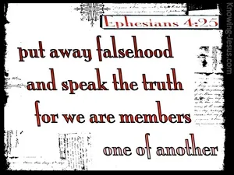

Slide 45


Slide 46


Slide 47
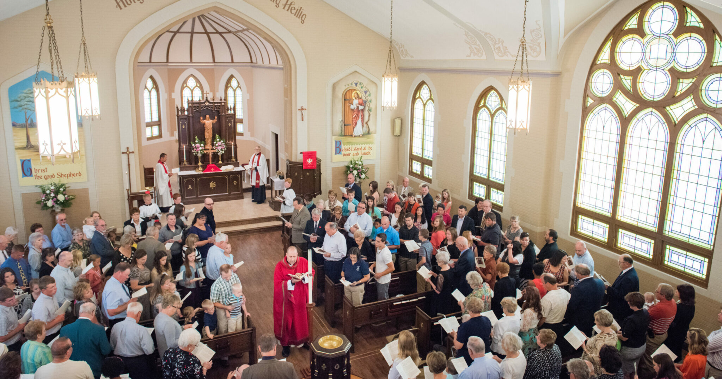

Slide 48


Slide 49


Slide 50
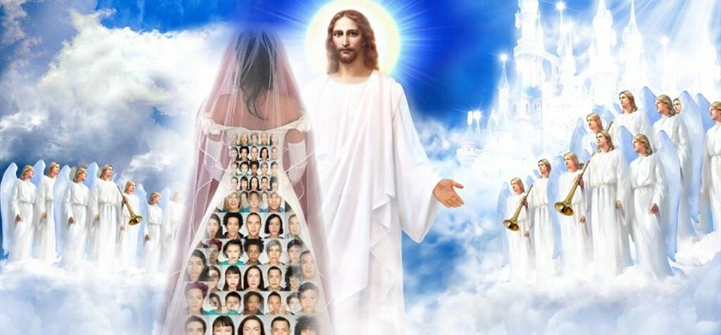

Slide 51
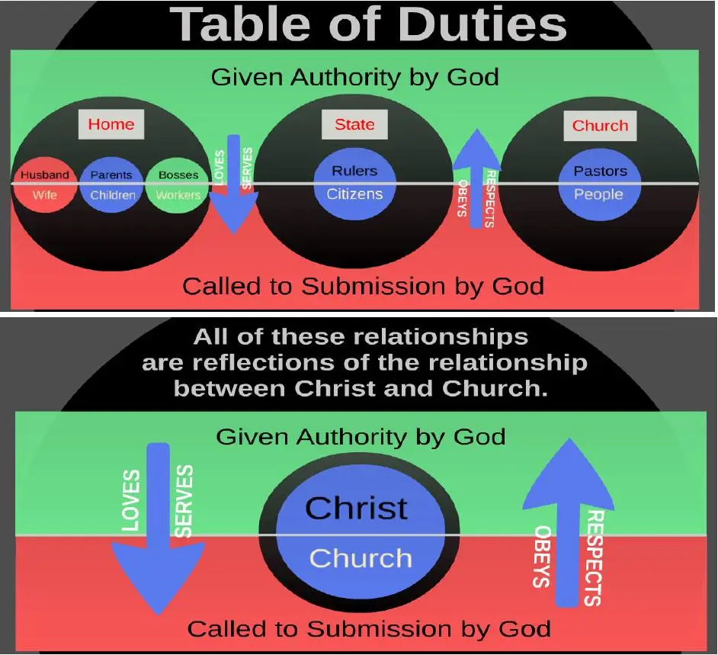

Slide 52
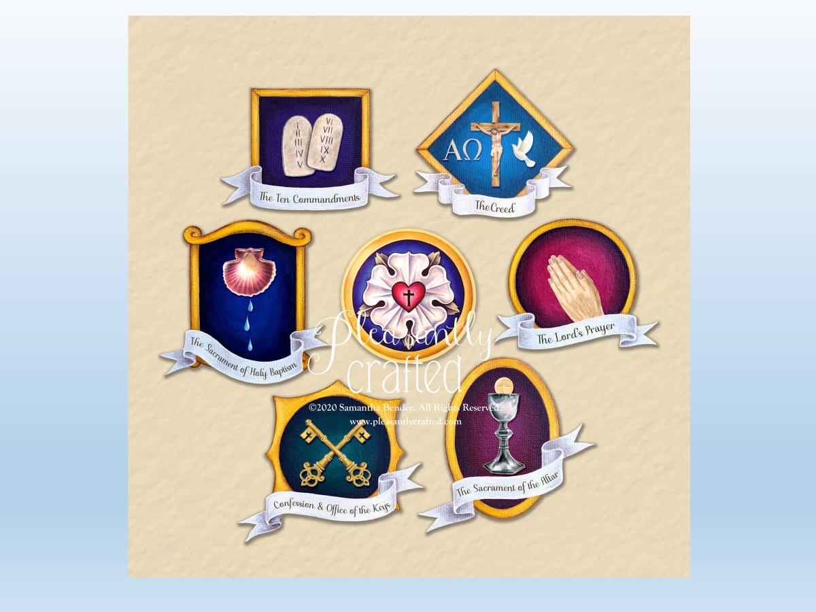

Slide 53
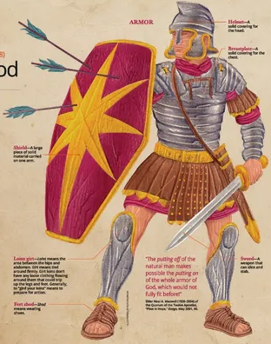

Slide 54
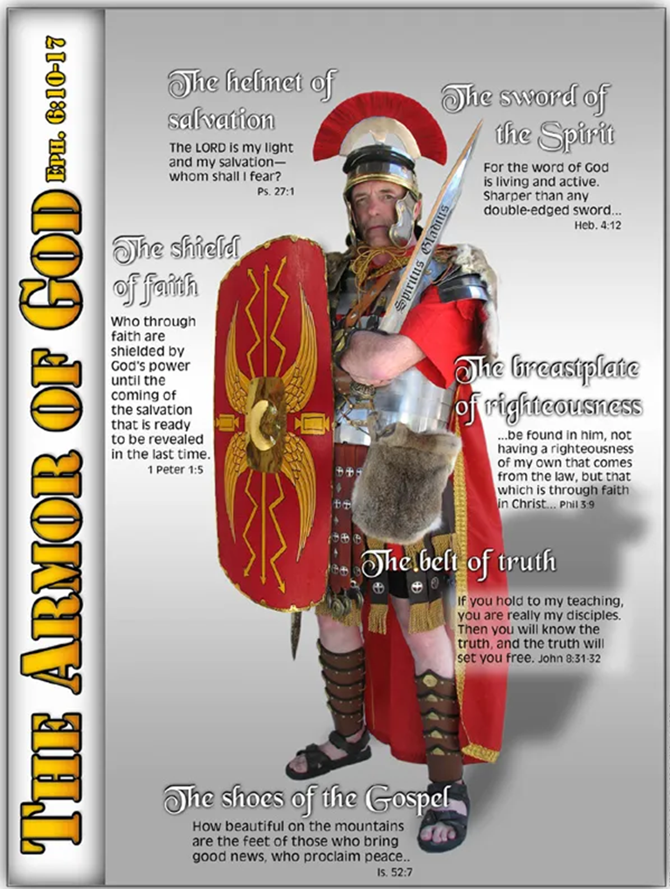

Slide 55
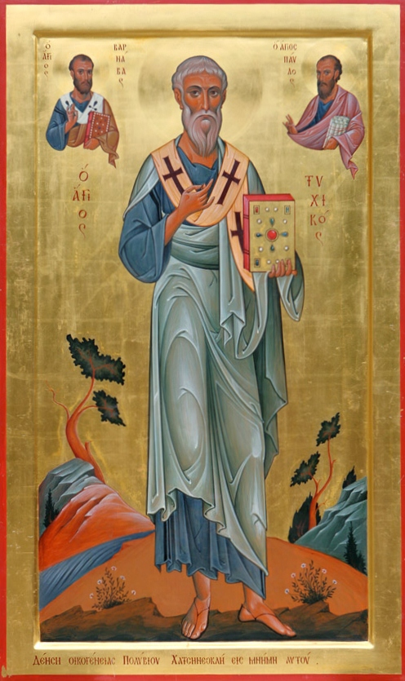

Slide 56
