Slide 1

THE BOOK OF EPHESIANS
“We Are His Workmanship”
Date: 3-2-25 Lesson: 40
Pastor David Nehrenz –
Trinity Lutheran Church – Norman, OK

Slide 2
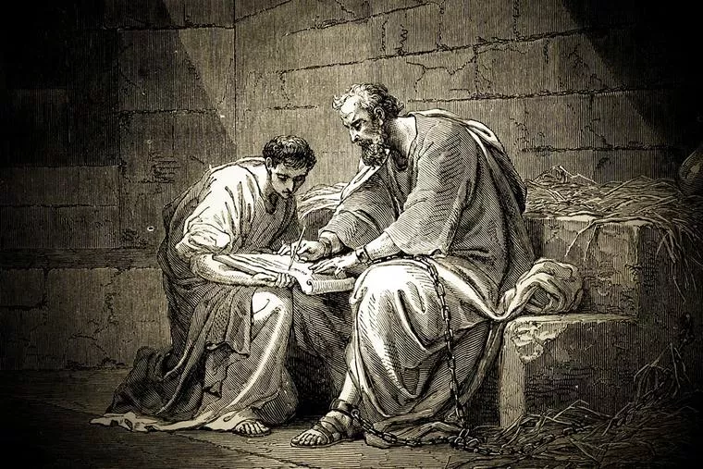

Slide 3
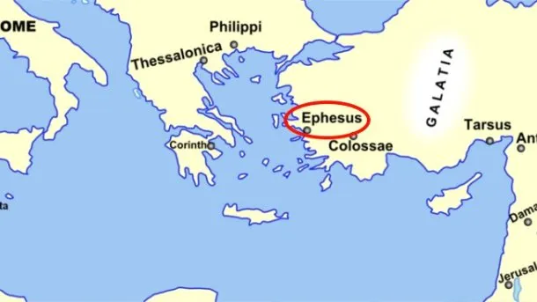
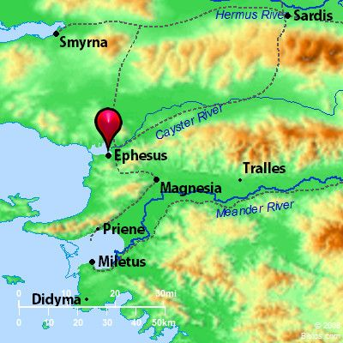
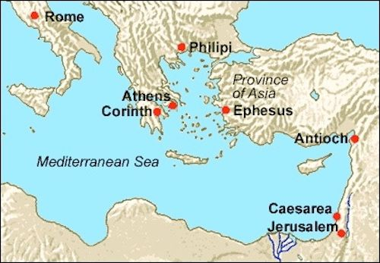

Slide 4
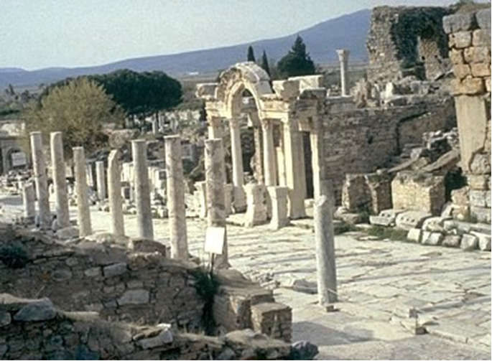

Slide 5
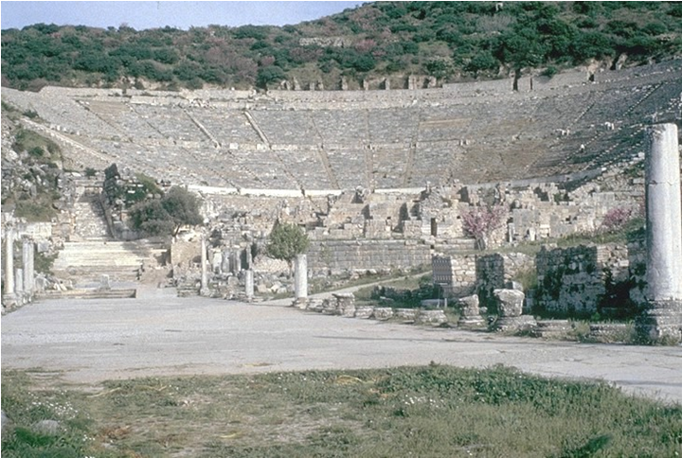

Slide 6
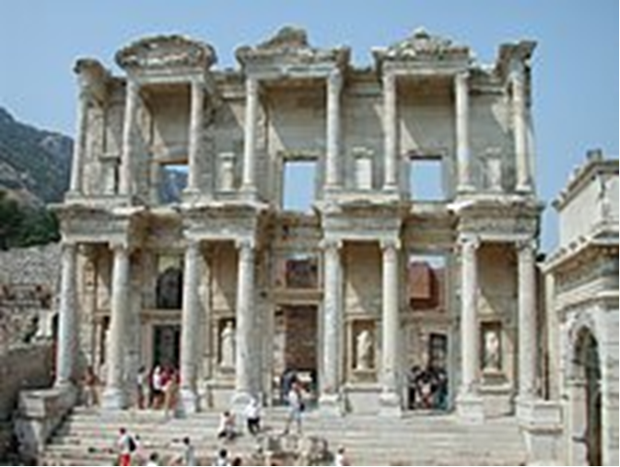

Slide 7
THE TEXT (Ephesians 6:18-24)
(18) praying at all times in the Spirit, with all prayer and supplication.
(Mt 26:41; Mk 14:33; Lk 18:1; Rom 8:15,16, 26,27; Php 1:4; 4:6; Col 4:2-4; Jude 20)
To that end keep alert with all perseverance, making supplication for all the saints,
(Acts 1:14; Col 1:3; 1 Tim 2:1)

Slide 8
(19) and also for me, that words may be given to me in opening my mouth boldly to proclaim the mystery of the gospel, (20) for which I am an ambassador in chains,
that I may declare it boldly, as I ought to speak.
(Is 50:4; Mt 10:17-20; Ac 4:29; 9:15; 21:33; 28:20; Rom 16:25; 2 Cor 5:20; Col 4:3; 1 Th 5:25; 2 Th 3:1)

Slide 9
(21) So that you also may know how I am and what I am doing, Tychicus the beloved brother and faithful minister in the Lord will tell you everything. (22) I have sent him to you for this very purpose, that you may know how we are, and that he may encourage your hearts.
(Ac 20:4; Col 1:1; 2:2; 4:7-14; 2 Tim 4:12; Titus 3:12)

Slide 10
(23) Peace be to the brothers, and love with faith, from God the Father and the Lord Jesus Christ. (24) Grace be with all who love our Lord Jesus Christ with love incorruptible.
(Ex 20:6; 1 Cor 8:3; 15:42-53; 16:22; 2 Cor 13:13; Gal 5:6; 6:16; 1 Th 5:8; 2 Th 3:16; 1 Pet 1:4; 5:14)

Slide 11
STUDY HELPS
Tychicus is one of those Bible characters who probably doesn’t receive the recognition due them. True, Tychicus is only mentioned five times in the New Testament, but the ministry he provided was noteworthy.
We first meet Tychicus in Acts 20:4, during Paul’s third missionary journey. He is mentioned as one of Paul’s companions on the way from Corinth to Jerusalem to deliver a gift to the church there (see Romans 15:25–26). We learn that Tychicus was a native of Asia, or what we would call Asia Minor today.
Tychicus is called a “dear brother” of Paul’s and a “faithful servant” of the Lord’s (Ephesians 6:21). In Colossians 4:7, Tychicus is a “faithful minister and fellow servant” who was with Paul during his first Roman imprisonment. He was entrusted to deliver Paul’s epistles to the Ephesians and Colossians and to bring news of the apostle to those congregations: “Tychicus will tell you all the news about me. . . . I am sending him to you for the express purpose that you may know about our circumstances and that he may encourage your hearts” (Colossians 4:7–8). Encouragement is also mentioned as part of Tychicus’s ministry in Ephesians 6:22.

Slide 12
In traveling to Colossae, Tychicus accompanied Onesimus, the former slave who was returning to Philemon. No doubt, Tychicus, as a good friend of Paul’s, emphasized the need for grace in receiving Onesimus back home (see Philemon 1:17).
Paul intended to send either Tychicus or another man to Crete in order to give Titus a chance to visit Paul (Titus 3:12). Later, Tychicus was with Paul in Rome during the apostle’s second Roman imprisonment, and Paul sent him to Ephesus in order to free up Timothy for a visit (2 Timothy 4:12). In both Crete and Ephesus, then, Tychicus was an “interim pastor” of sorts, filling in for Titus and Timothy.
There is an unnamed believer alluded to in 2 Corinthians 8:22, described as a “brother who has often proved to us in many ways that he is zealous, and now even more so because of his great confidence in you.” Many commentators surmise that this is a reference to Tychicus. The description seems to fit.
We may not know much about Tychicus, but what we do know is impressive and praiseworthy. Tychicus was a trusted messenger, faithful preacher, and loyal friend. Paul placed great confidence in him, sending him to accomplish important works. Tychicus obviously had the ability to minister in a variety of situations, bringing encouragement to those he served. Tychicus surely modeled the quality that all church elders are to possess: “He must hold firmly to the trustworthy message as it has been taught, so that he can encourage others by sound doctrine and refute those who oppose it” (Titus 1:9).

Slide 13
LIFE APPLICATION
“Praying at all times in the Spirit, with all prayer and supplication.
To that end keep alert with all perseverance, making supplication for all the saints.”
Explain the importance of daily prayers and perseverance.

Slide 14
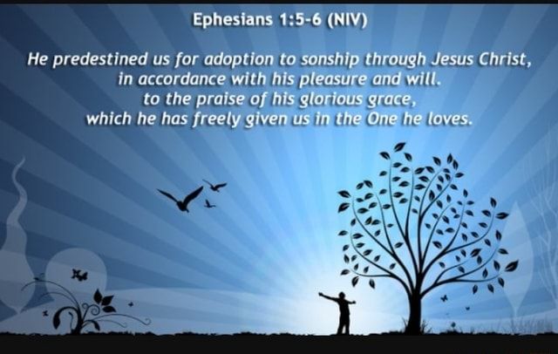

Slide 15
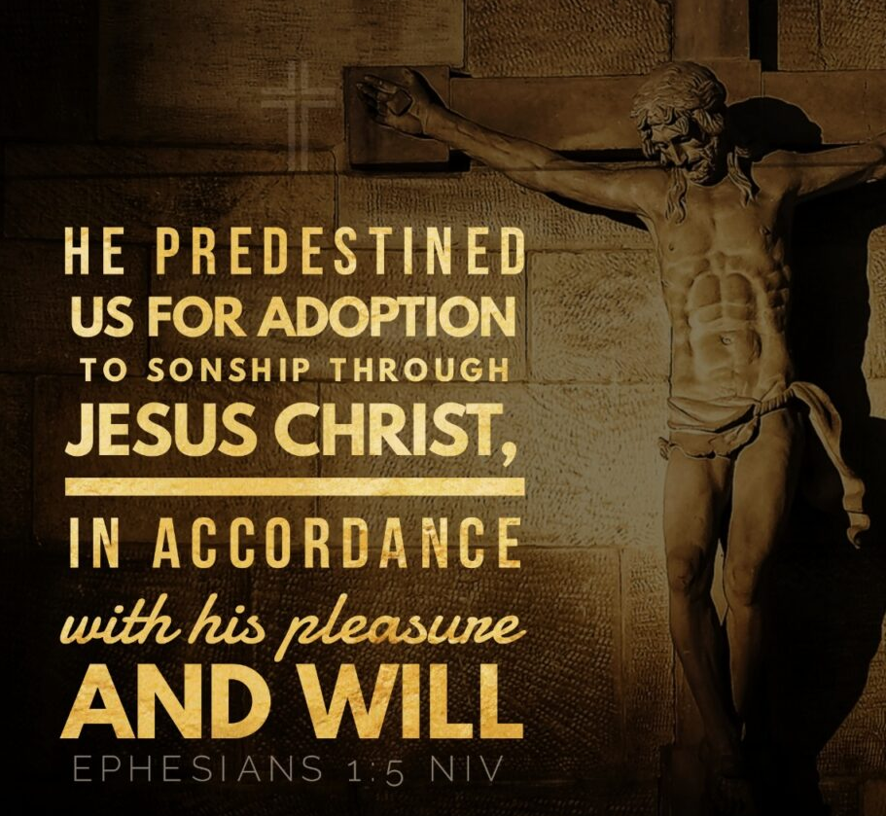

Slide 16
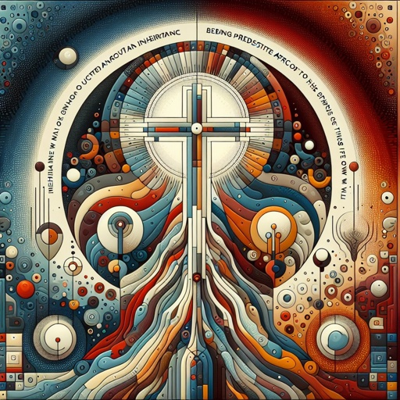

Slide 17
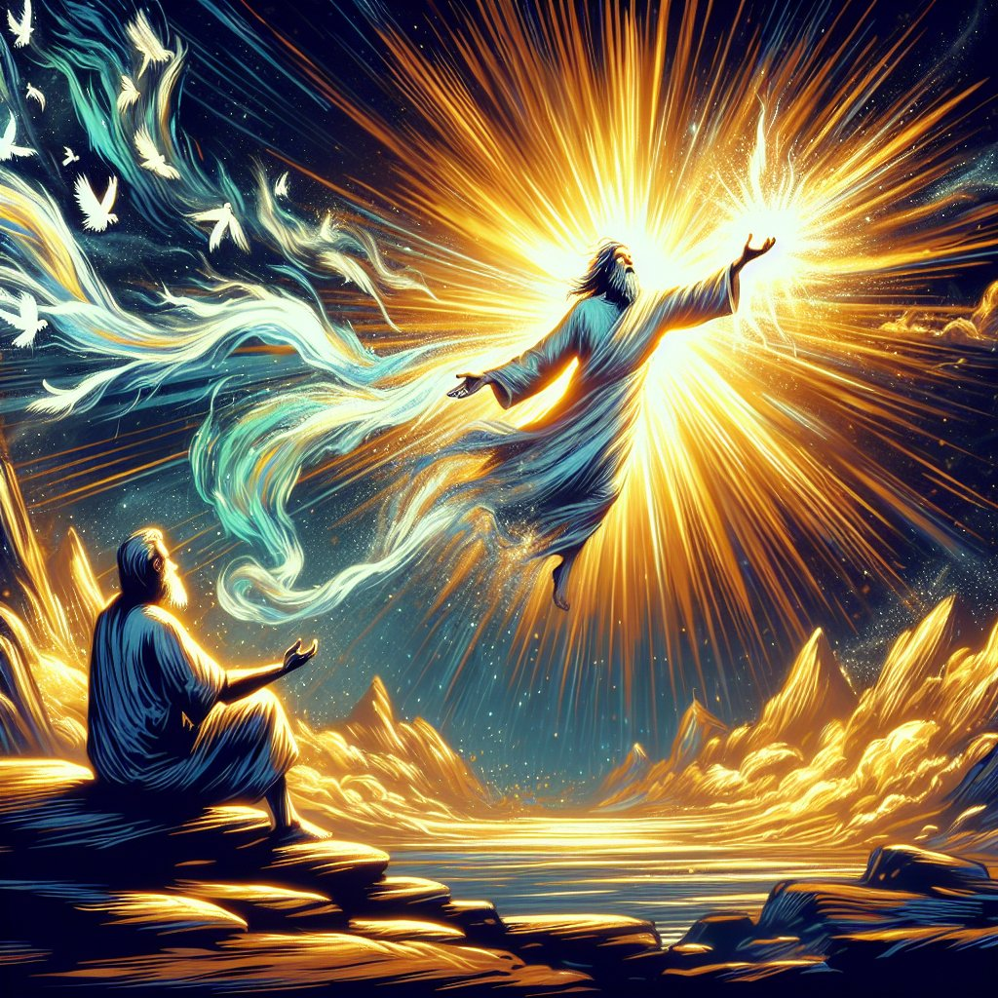

Slide 18


Slide 19


Slide 20
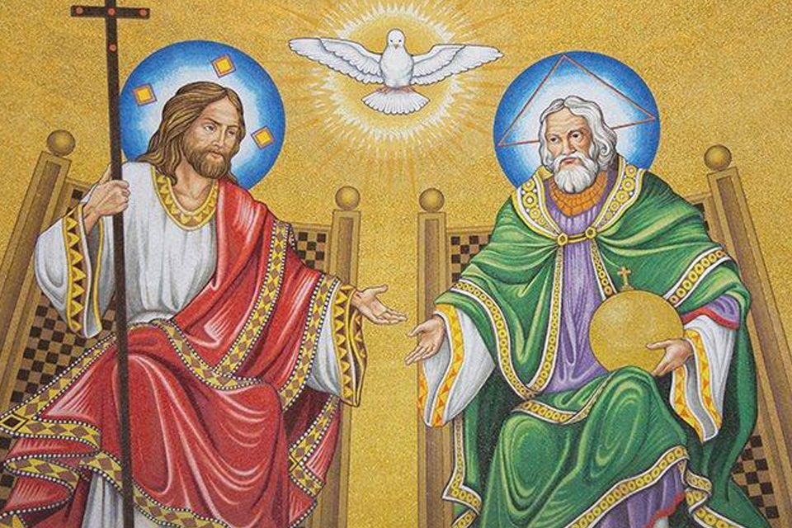

Slide 21
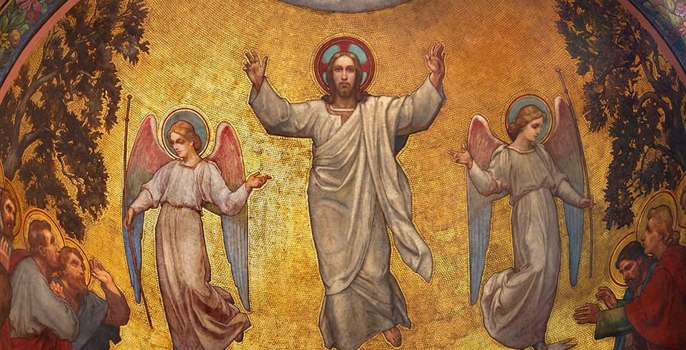

Slide 22
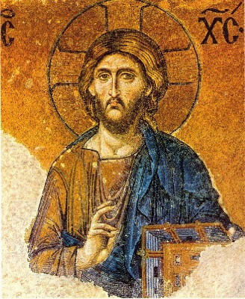

Slide 23
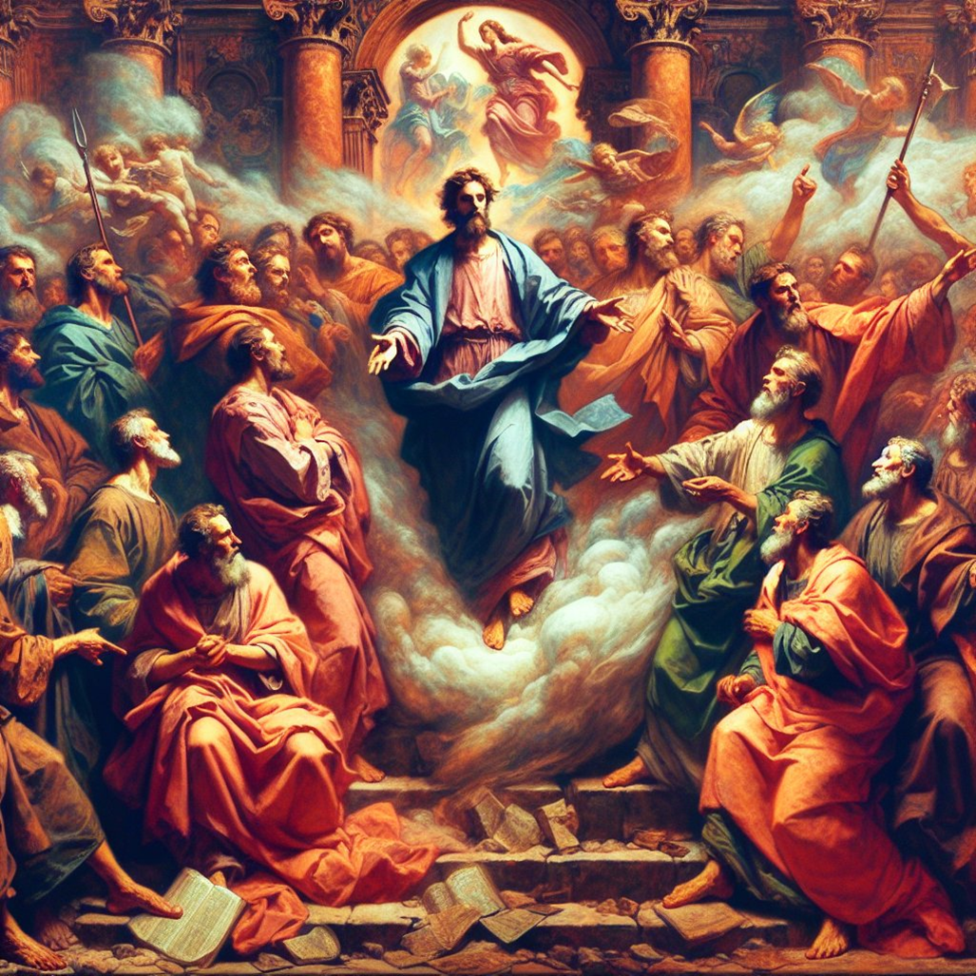

Slide 24
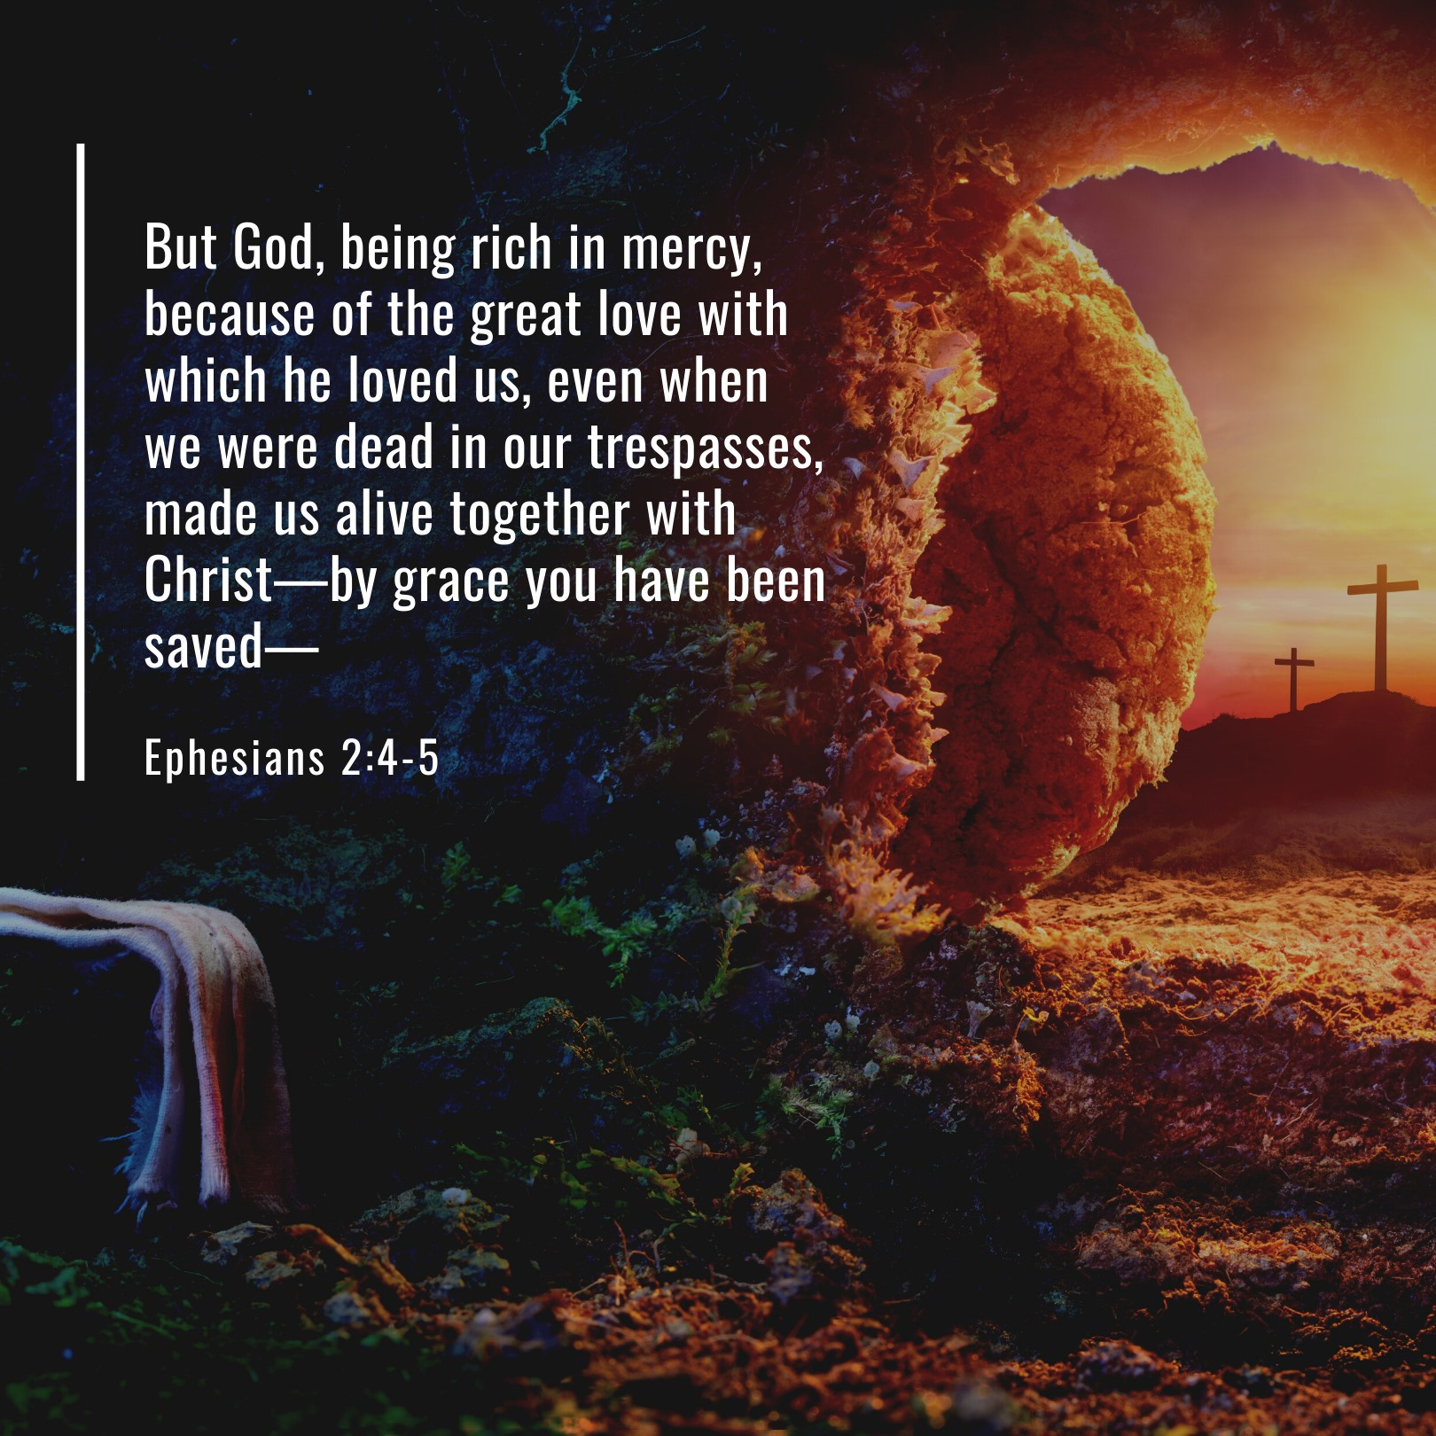

Slide 25
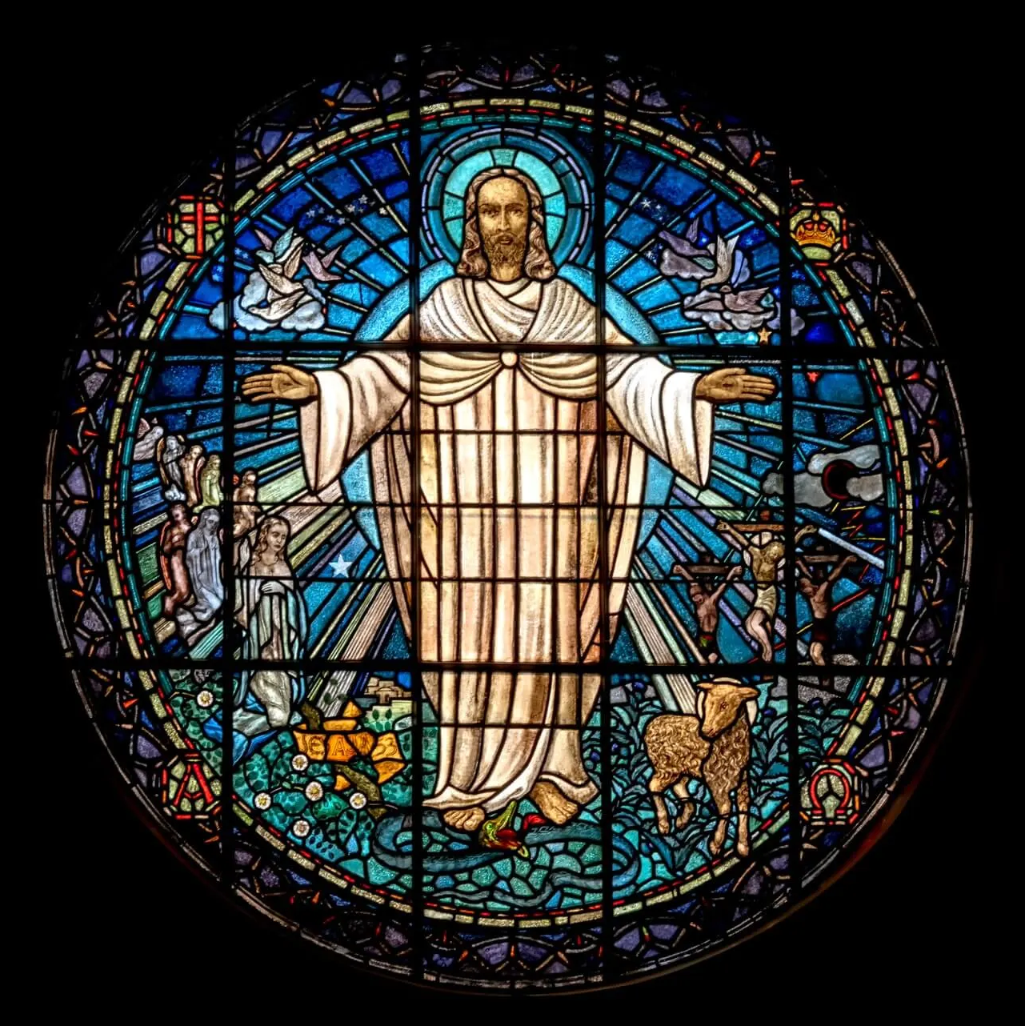

Slide 26
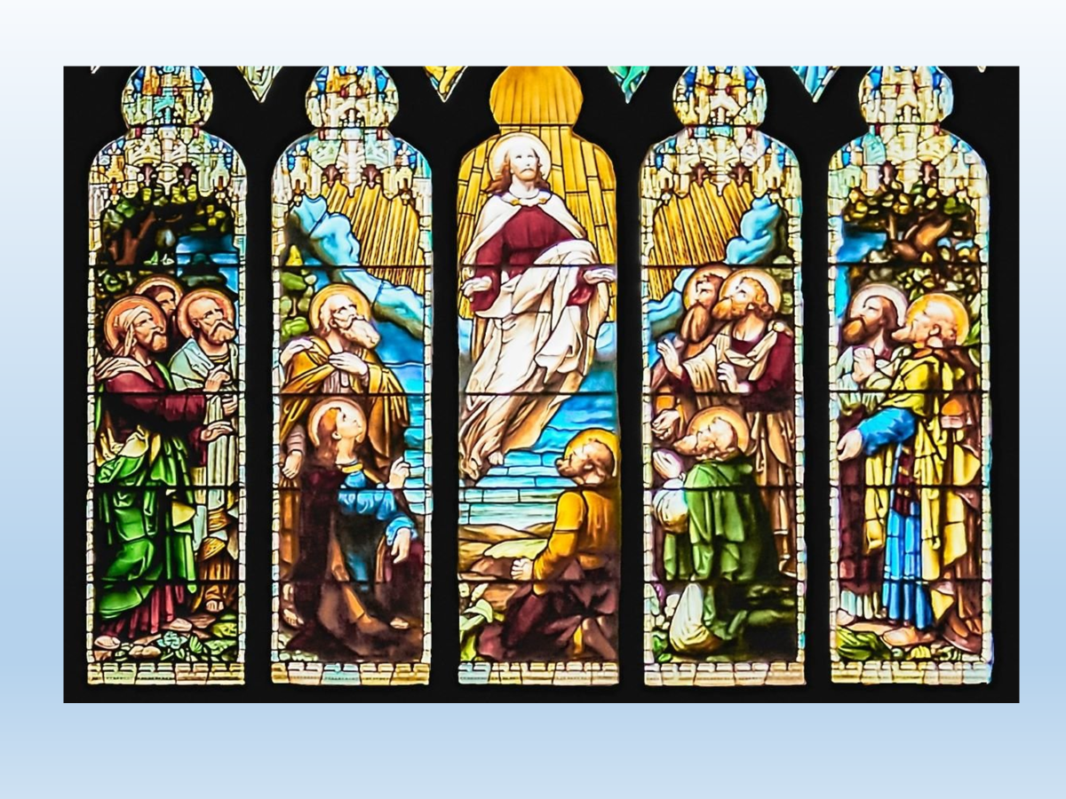

Slide 27


Slide 28
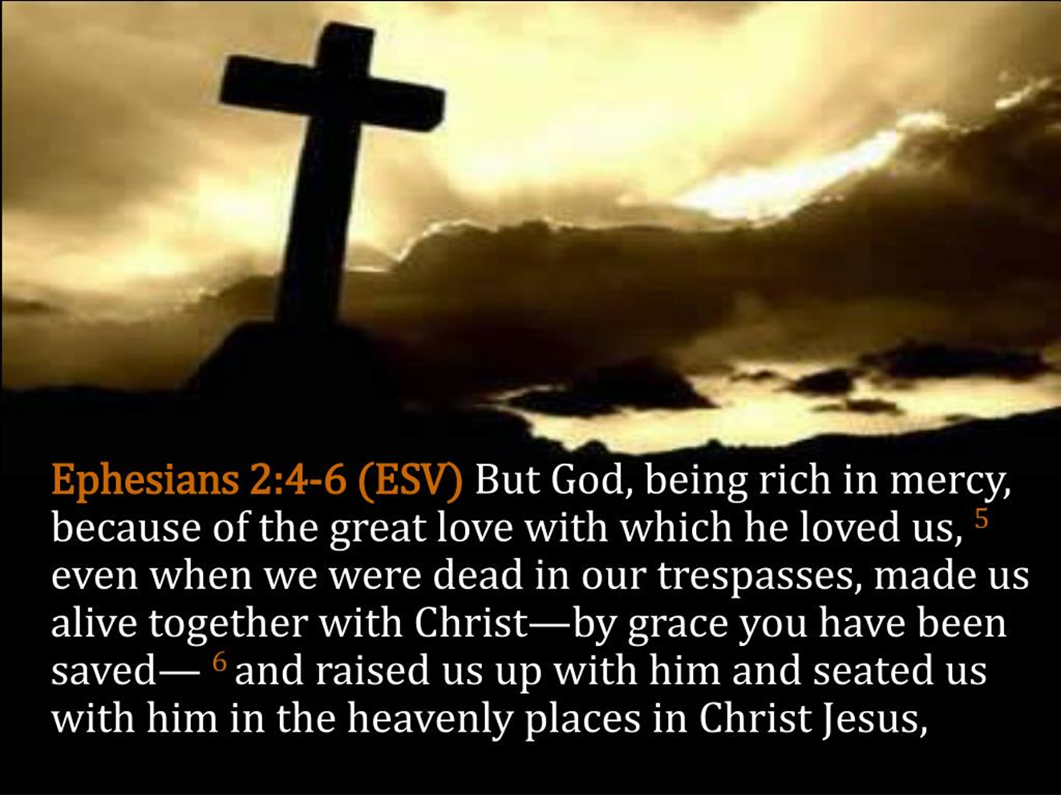

Slide 29
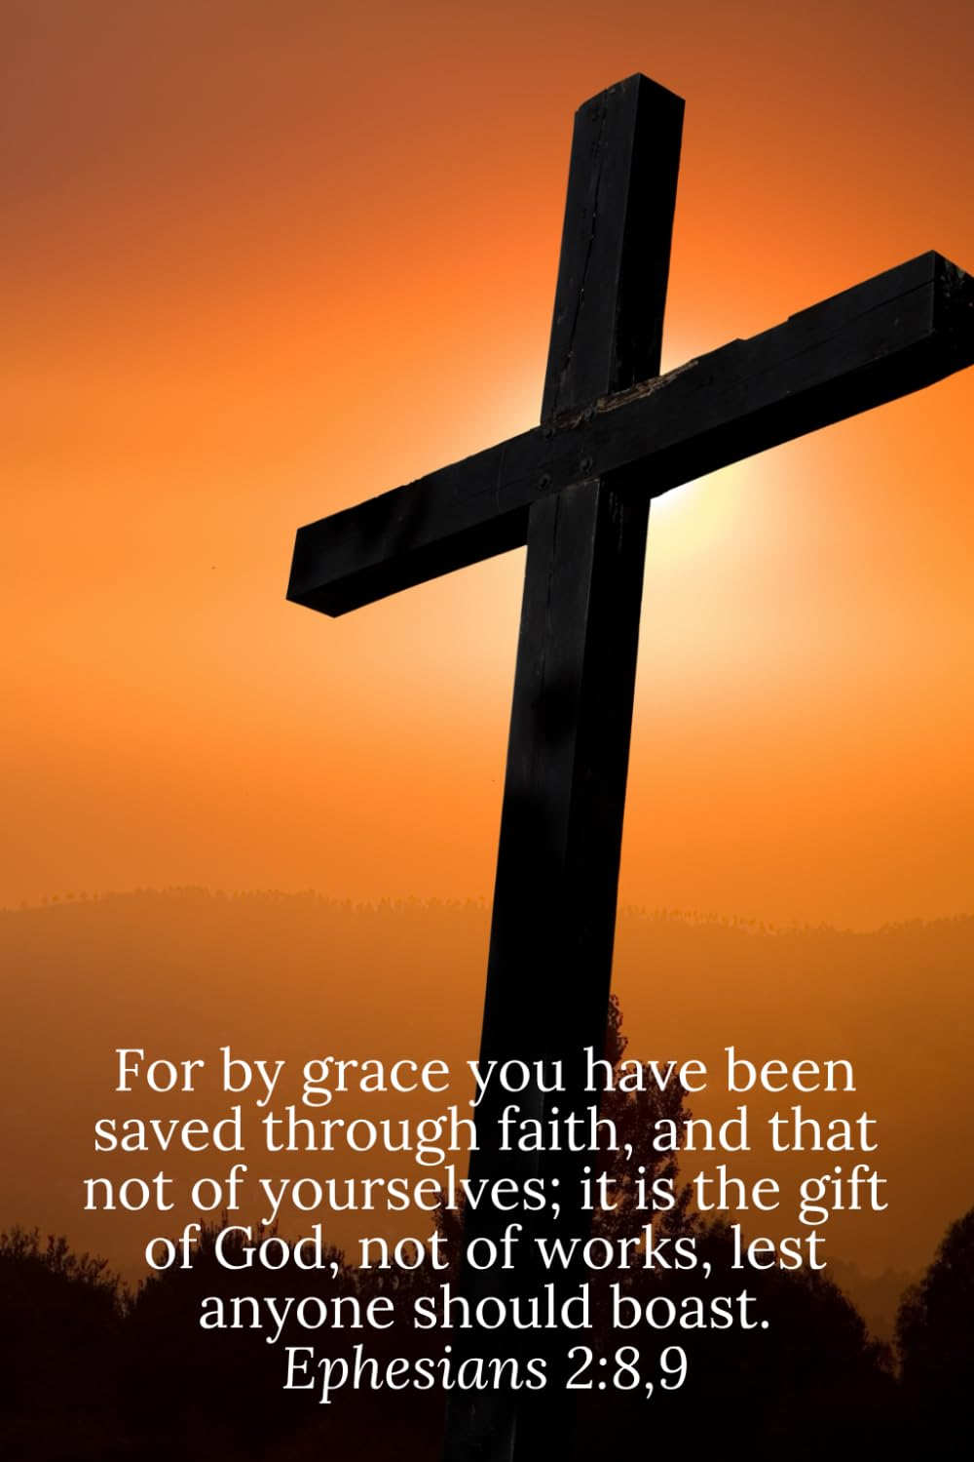

Slide 30
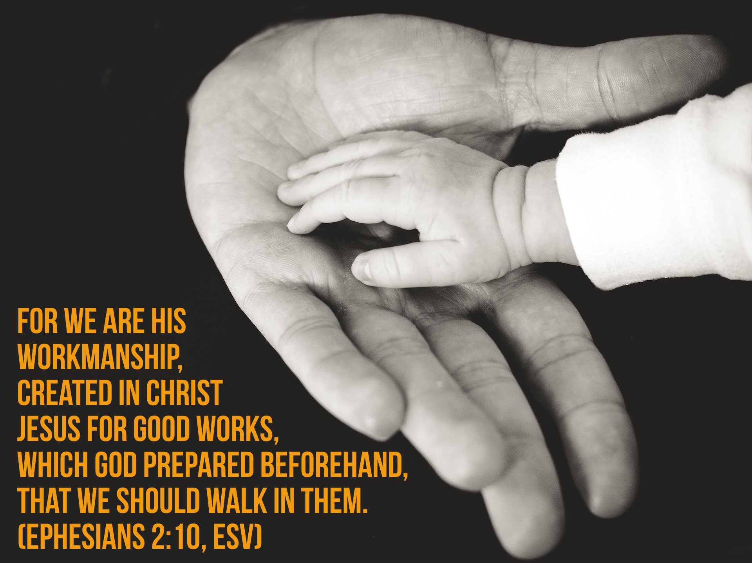

Slide 31
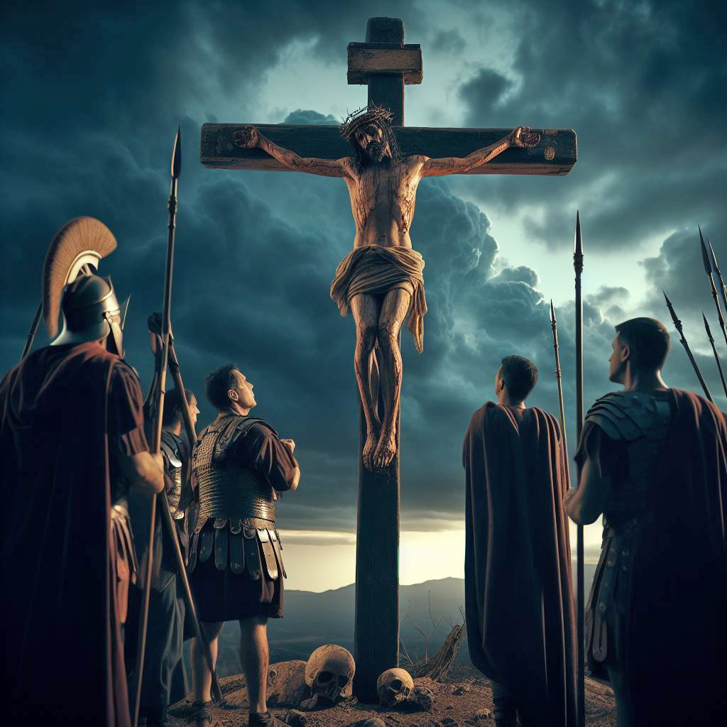

Slide 32


Slide 33
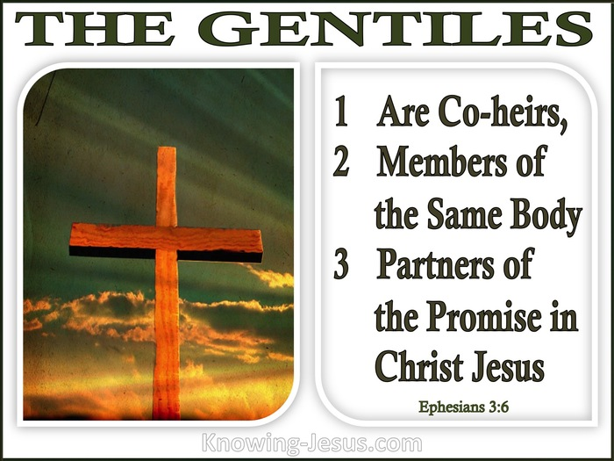

Slide 34
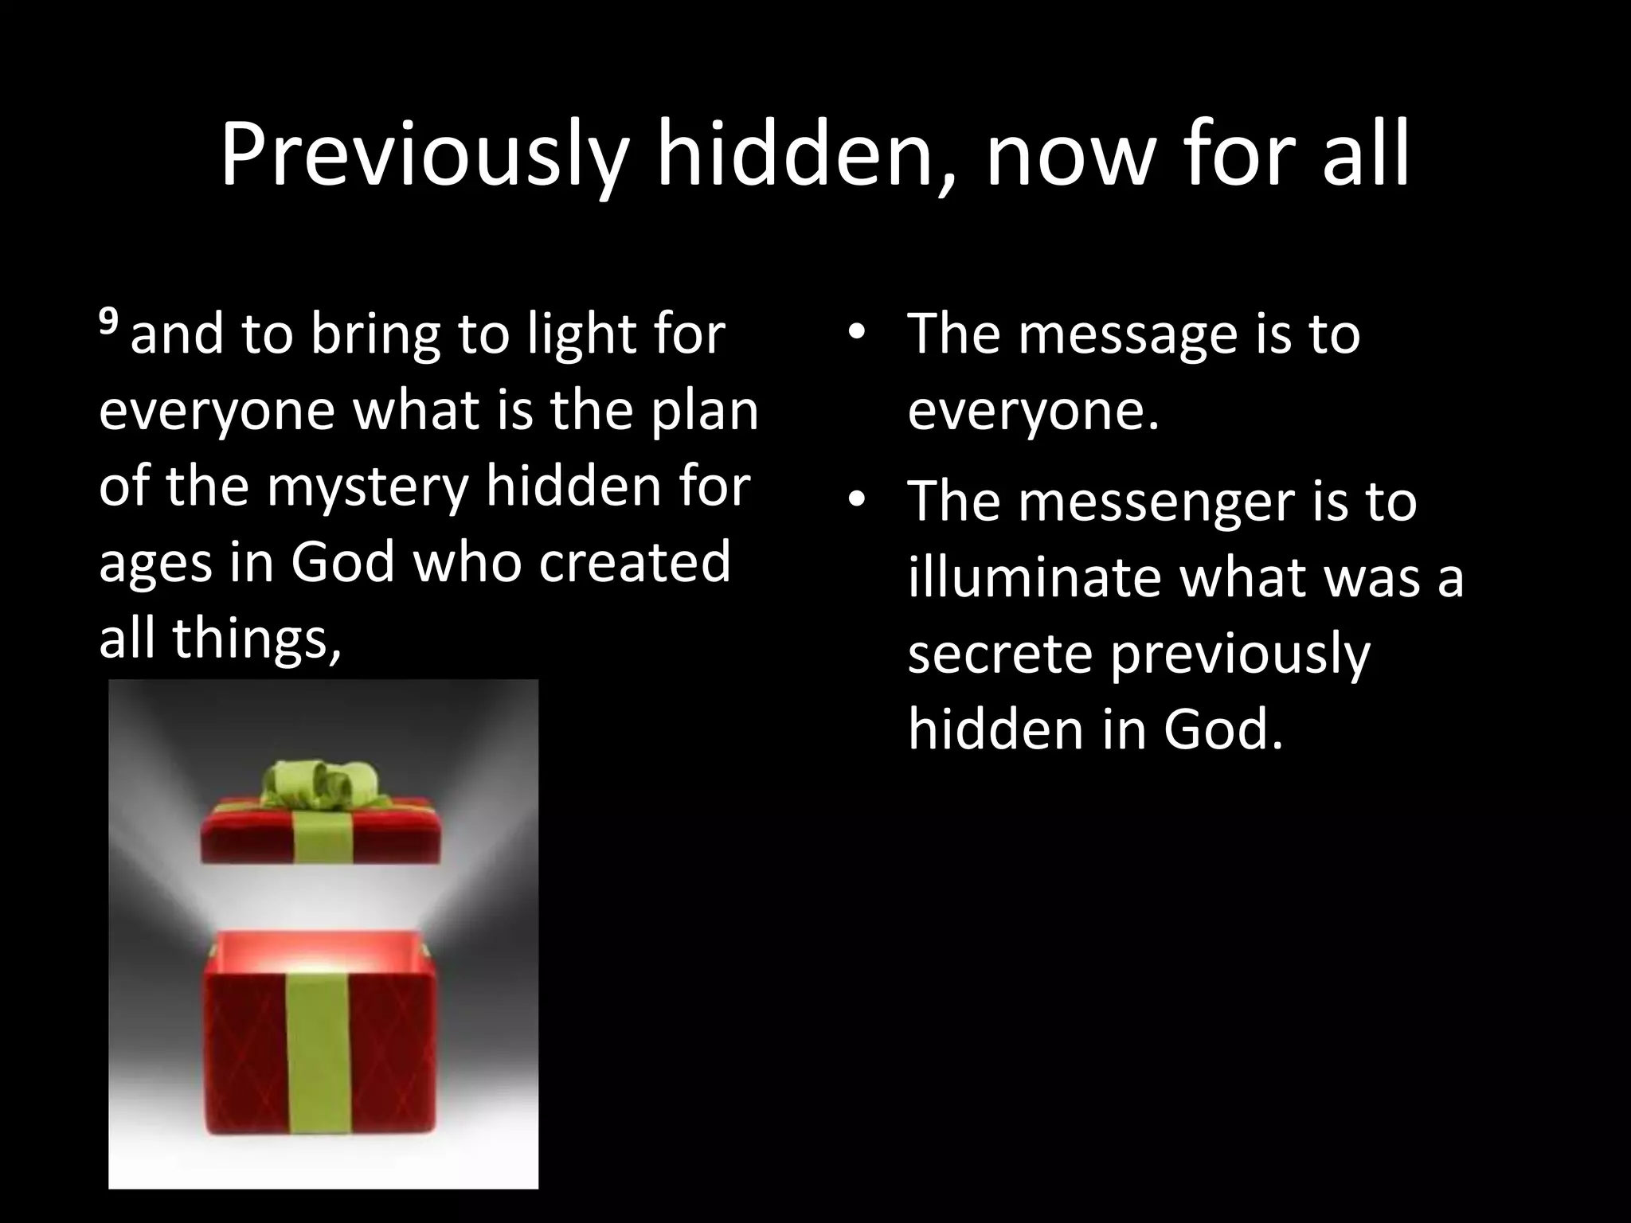

Slide 35


Slide 36
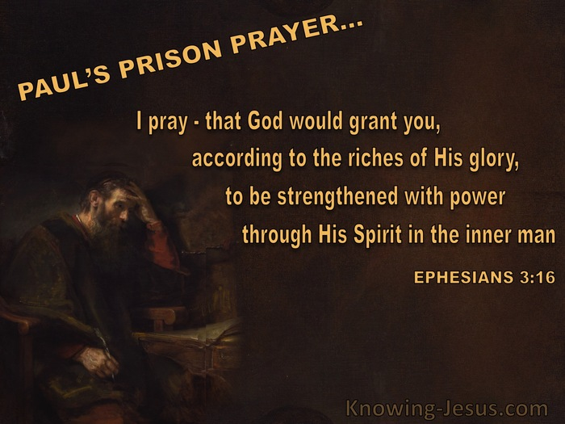

Slide 37


Slide 38
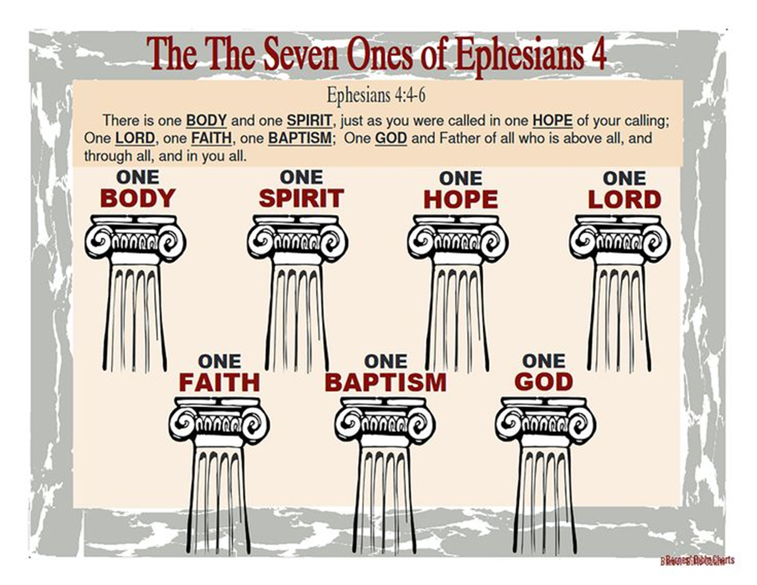

Slide 39
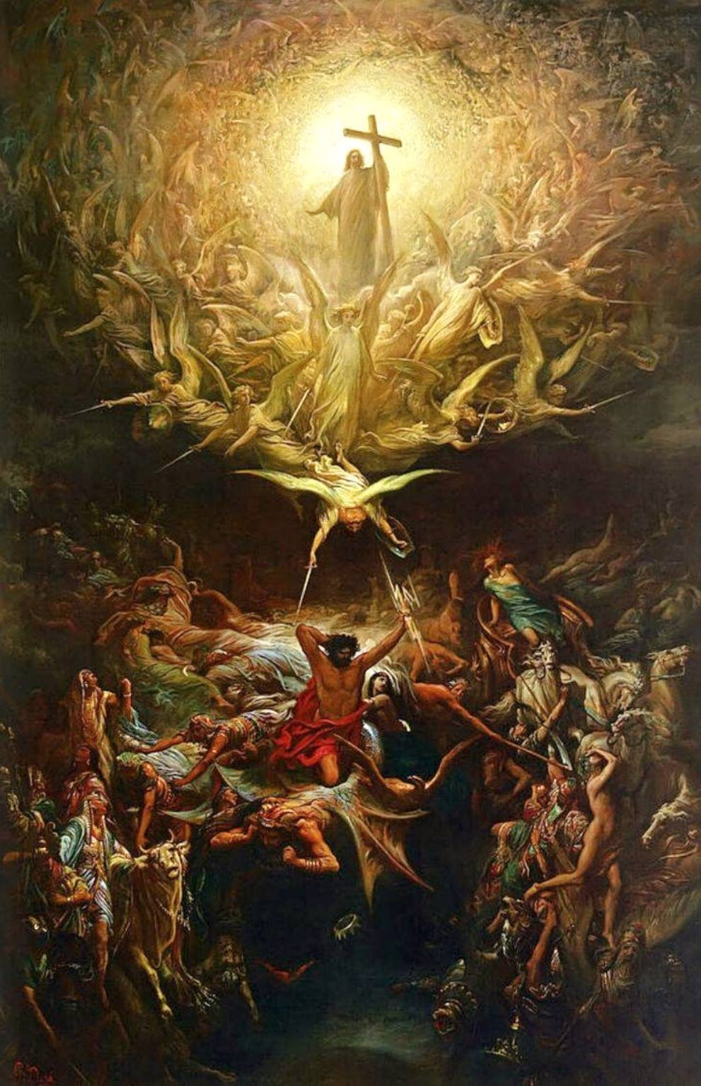

Slide 40
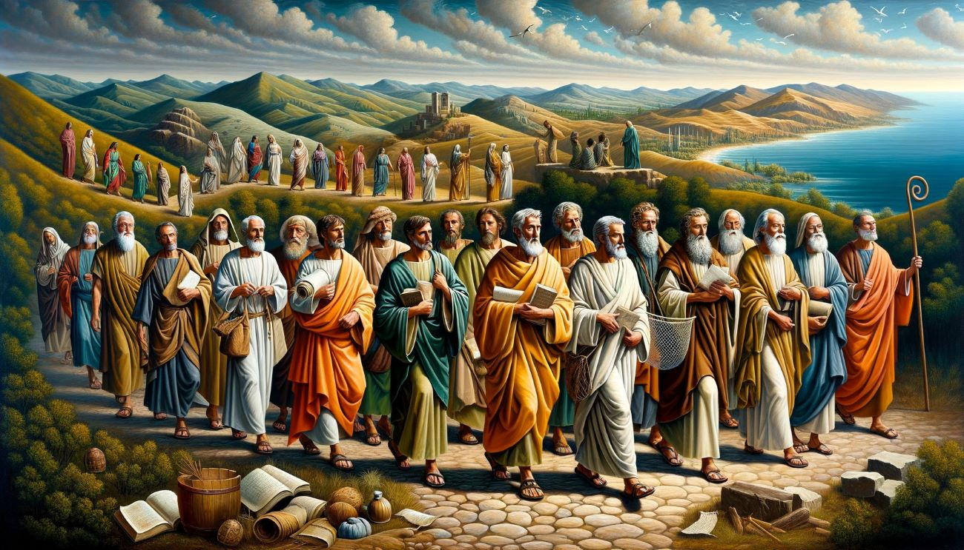

Slide 41
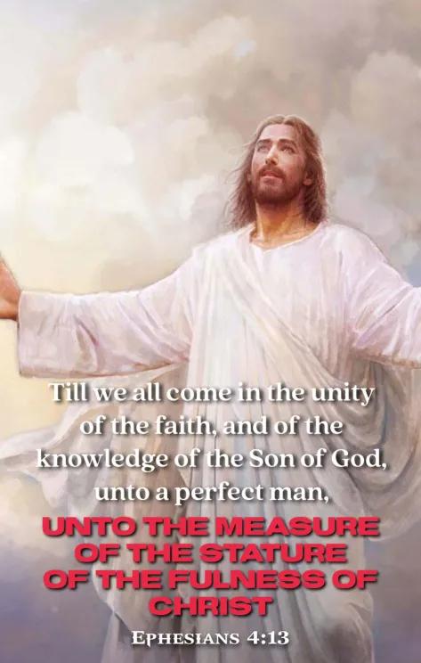

Slide 42
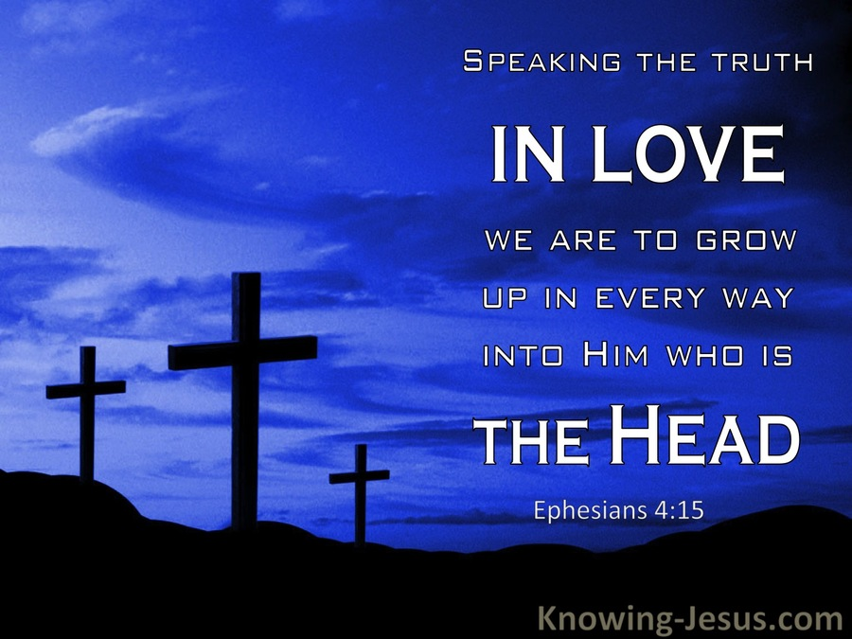

Slide 43


Slide 44
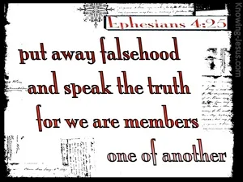

Slide 45


Slide 46


Slide 47
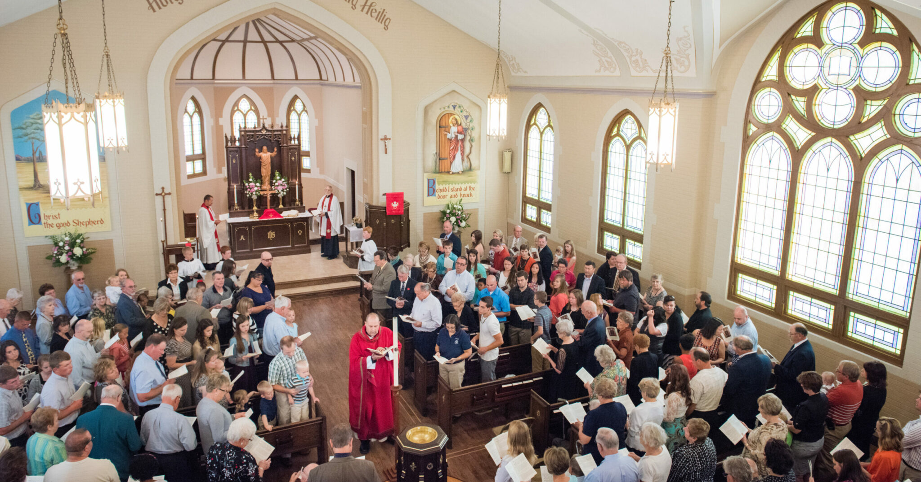

Slide 48
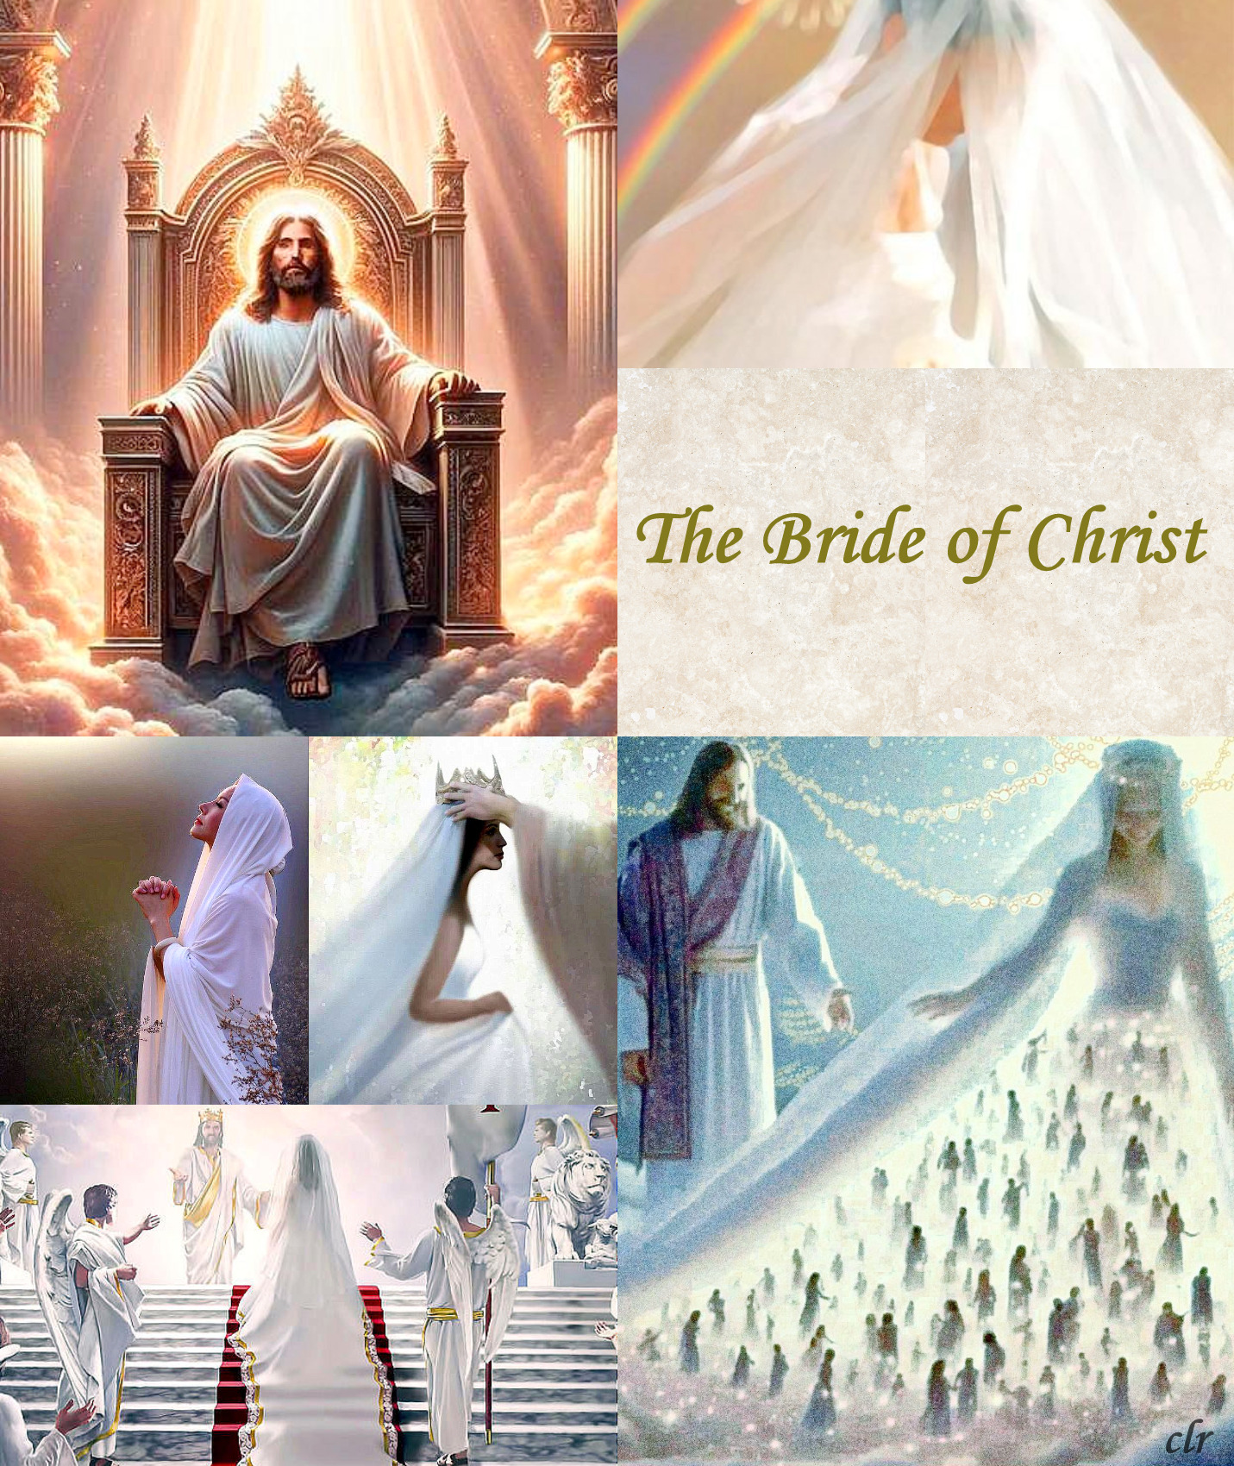

Slide 49


Slide 50
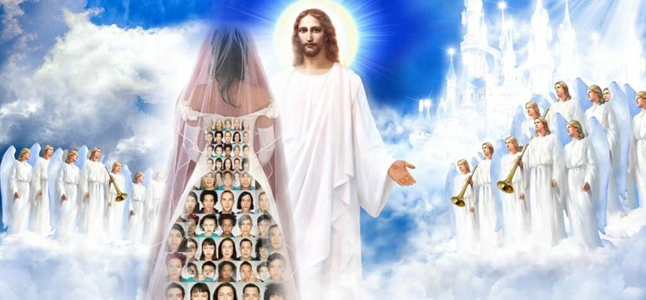

Slide 51
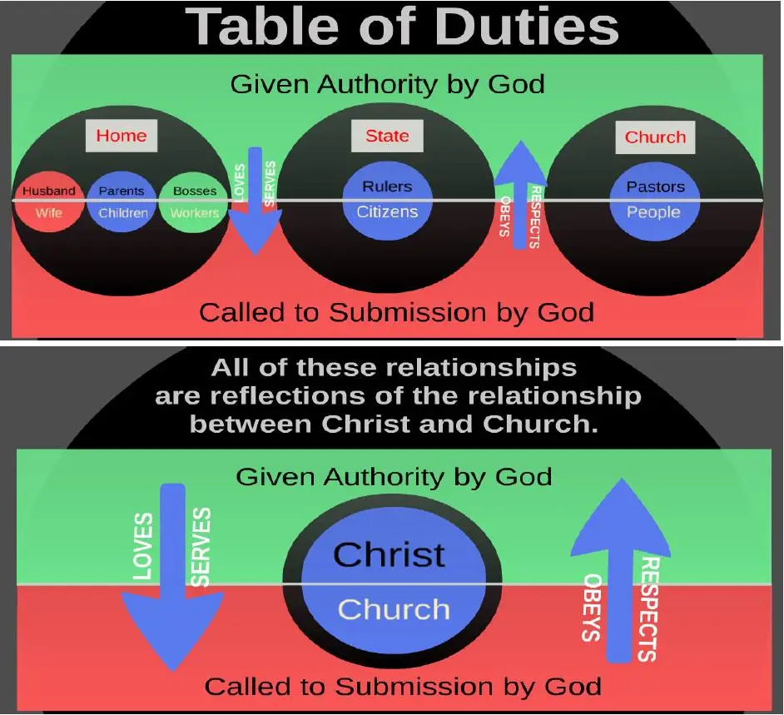

Slide 52
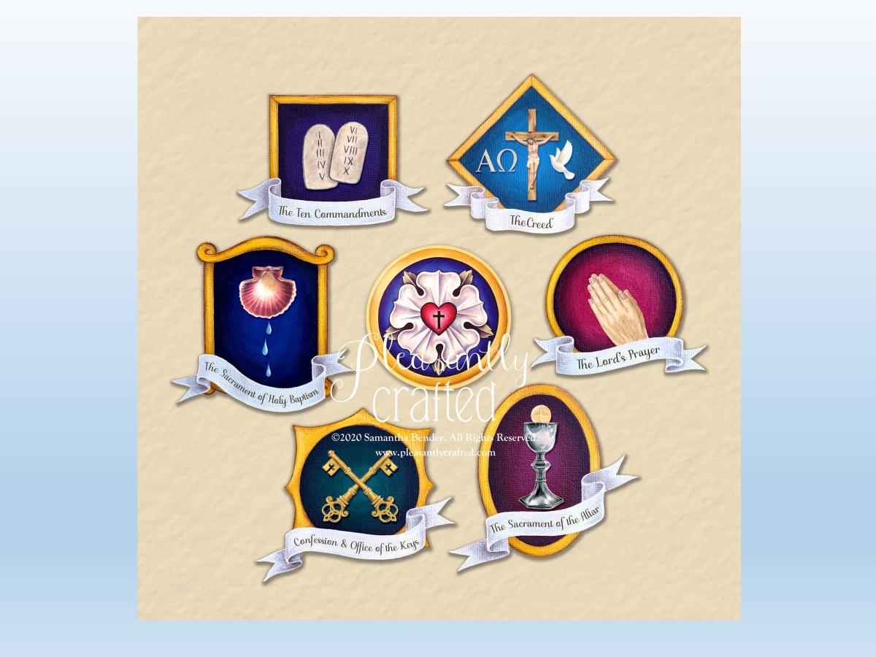

Slide 53
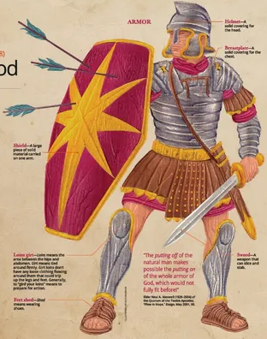

Slide 54
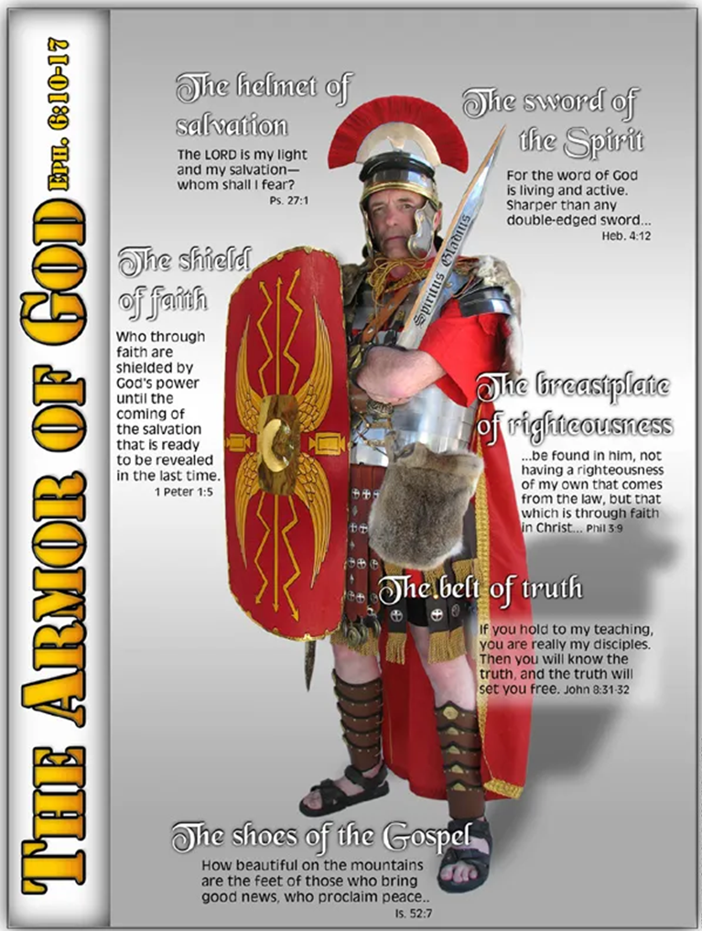

Slide 55
