Slide 1

THE BOOK OF EPHESIANS
“We Are His Workmanship”
Date: 2-23-25 Lesson: 39
Pastor David Nehrenz –
Trinity Lutheran Church – Norman, OK

Slide 2
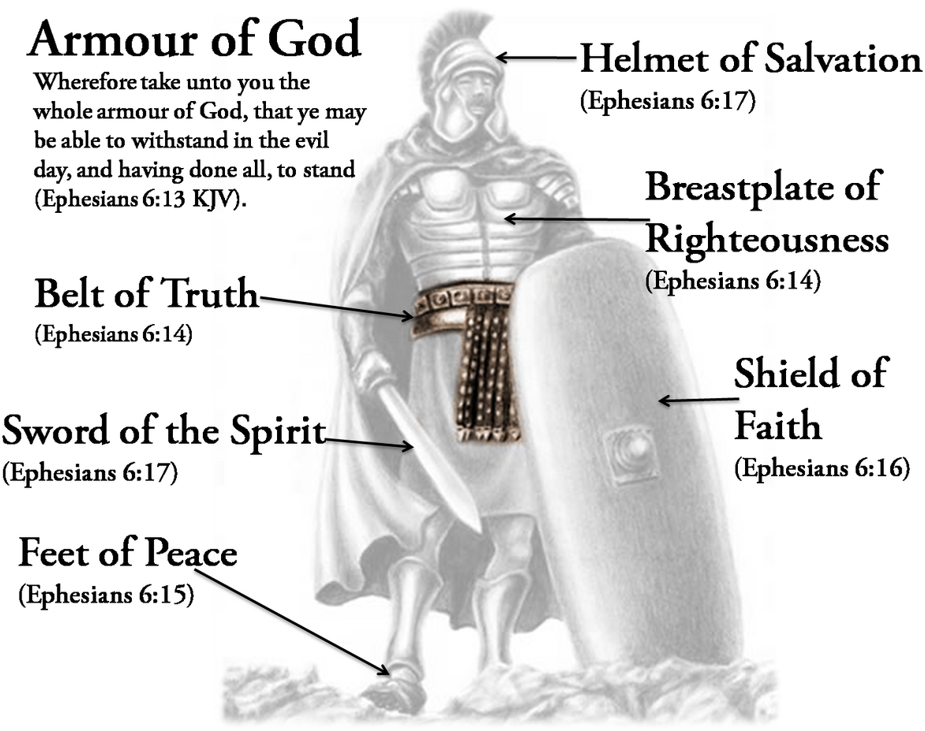

Slide 3
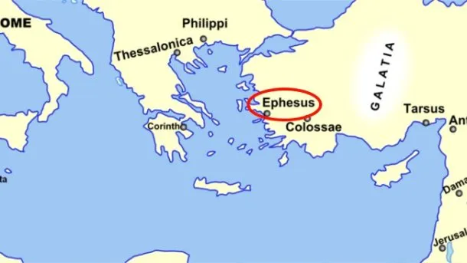
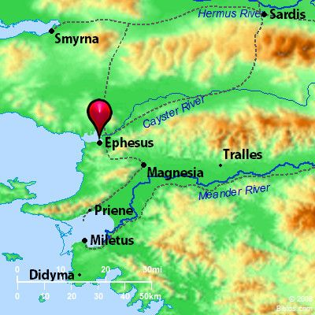
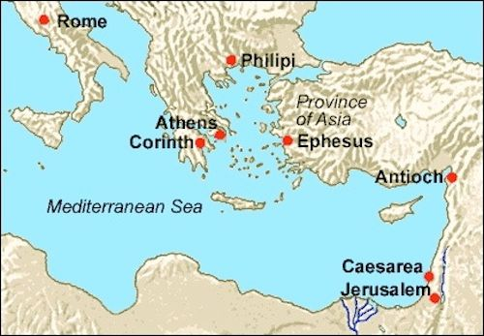

Slide 4
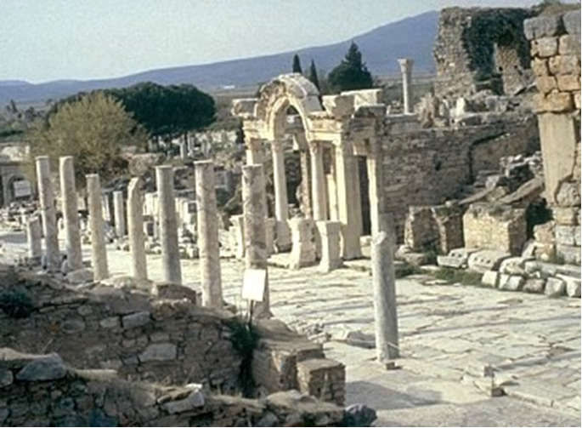

Slide 5
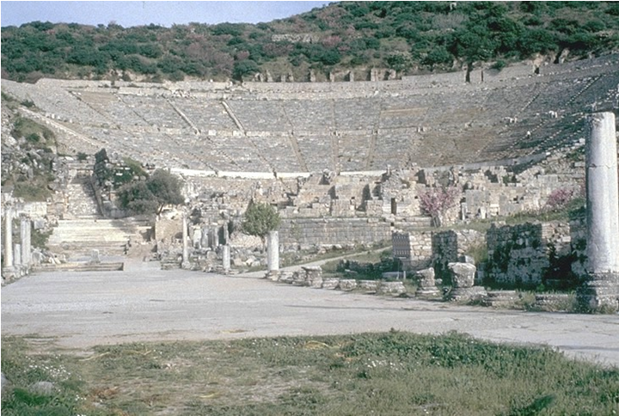

Slide 6
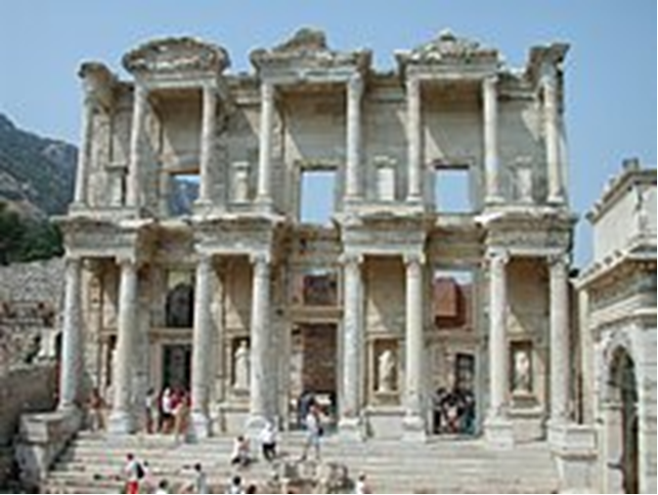

Slide 7
THE TEXT (Ephesians 6:14-18a)
(14) Stand therefore, having fastened on the belt of truth,
(Ex 12:11; Is 11:5; Lk 12:35; Eph 4:14,15; Heb 12:1; 1 Pet 1:13)

Slide 8
and having put on the breastplate of righteousness,
(Ps 132:9; Is 59:17; 61:10; 2 Cor 6:7; 1 Th 5:8)

Slide 9
(15) and, as shoes for your feet, having put on the readiness given by the gospel of peace.
(Ex 12:11; Is 52:7; Rom 10:15)

Slide 10
(16) In all circumstances take up the shield of faith,
with which you can extinguish all the flaming darts of the evil one;
(Ps 120:4; Mt 5:37; 13:19; 1 Pet 5:9; 1 Jn 5:4)

Slide 11
(17) and take the helmet of salvation,
(Is 59:17; 1 Thess 5:8)

Slide 12
and the sword of the Spirit, which is the word of God,
(Is 49:2; Hos 6:5; 2 Cor 6:7; Heb 4:12)

Slide 13
(18a) praying at all times in the Spirit, with all prayer and supplication.
(Mt 26:41; Lk 18:1; Rom 8:15,16, 26,27; Php 1:4; 4:6; Col 4:2-4; Jude 20)

Slide 14
STUDY HELPS – Various quotes from the Book of Concord
Preface to the Large Catechism: [12] And what need is there for more words? If I were to list all the profit and fruit God’s Word produces, where would I get enough paper and time? The devil is called the master of a thousand arts. But what shall we call God’s Word, which drives away and brings to nothing this master of a thousand arts with all his arts and power? The Word must indeed be the master of more than a hundred thousand arts.
[14] If these reasons were not enough to move us to read the catechism daily, we should feel bound well enough by God’s command alone. He solemnly commands in Deuteronomy 6: 6– 8 that we should always meditate on His precepts, sitting, walking, standing, lying down, and rising. We should have them before our eyes and in our hands as a constant mark and sign.
Clearly He did not solemnly require and command this without a purpose. For He knows our danger and need, as well as the constant and furious assaults and temptations of devils. He wants to warn, equip, and preserve us against them, as with a good armor against their fiery darts [Ephesians 6: 10– 17] and with good medicine against their evil infection and temptation.

Slide 15
The Sixth Petition of the Lord’s Prayer: [109] Therefore, we Christians must be armed [Ephesians 6: 10– 18] and daily expect to be constantly attacked. No one may go on in security and carelessly, as though the devil were far from us. At all times we must expect and block his blows. Though I am now chaste, patient, kind, and in firm faith, the devil will this very hour send such an arrow into my heart that I can scarcely stand. For he is an enemy that never stops or becomes tired. So when one temptation stops, there always arise others and fresh ones.

Slide 16
The Sacrament of the Altar: [80] Besides this, you will also have the devil about you. You will not entirely tread him under foot [Luke 10: 19], because our Lord Christ Himself could not entirely avoid him. [81] Now, what is the devil? Nothing other than what the Scriptures call him, a liar and a murderer [John 8: 44]. He is a liar, to lead the heart astray from God’s Word and to blind it, so that you cannot feel your distress or come to Christ. He is a murderer, who cannot bear to see you live one single hour. [82] If you could see how many knives, darts, and arrows are every moment aimed at you [Ephesians 6: 16], you would be glad to come to the Sacrament as often as possible.
In other words, we know ‹assuredly› that out of pure grace, without any merit of our own, we have been elected in Christ to eternal life. No one can pluck us out of His hand [John 10: 29]. He has not only promised this gracious election with mere words, but has also certified it with an oath and sealed it with the holy Sacraments. We can ‹ought to› call these to mind in our most severe temptations and take comfort in them, and with them we can quench the fiery darts of the devil [Ephesians 6: 16].

Slide 17
LIFE APPLICATION
Note that all the parts of the armor of God are defensive protection,
except for one that is an offensive weapon:
The Word of God.
Explain the importance of every piece of armor
in our daily battle against the devil, the world and our own sinful flesh.

Slide 18
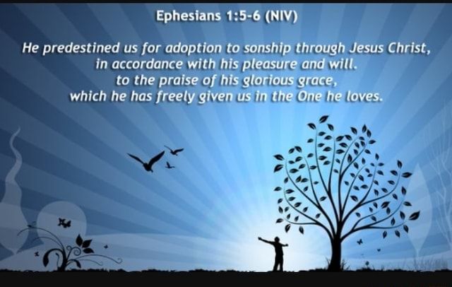

Slide 19
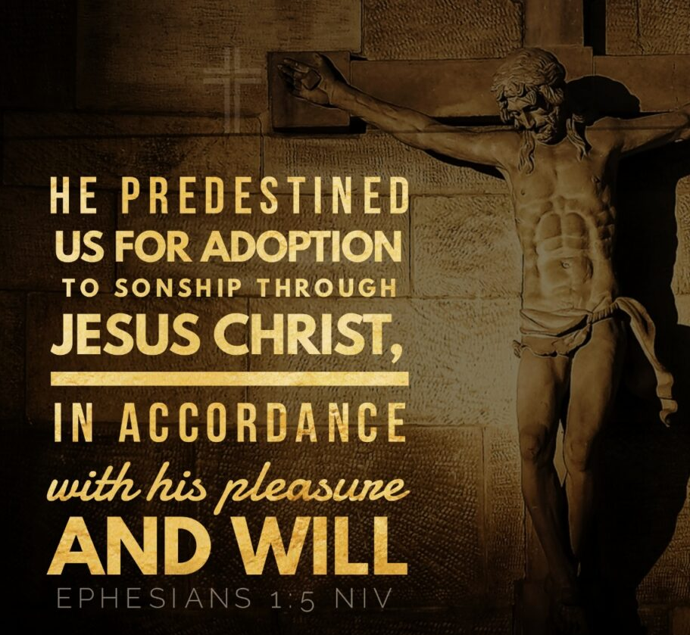

Slide 20
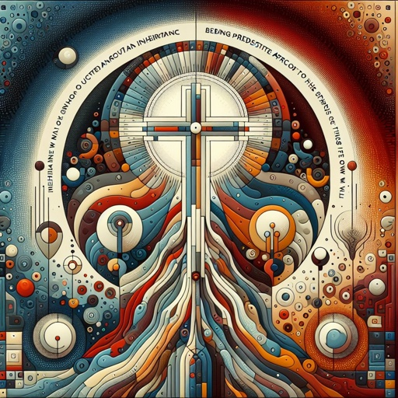

Slide 21
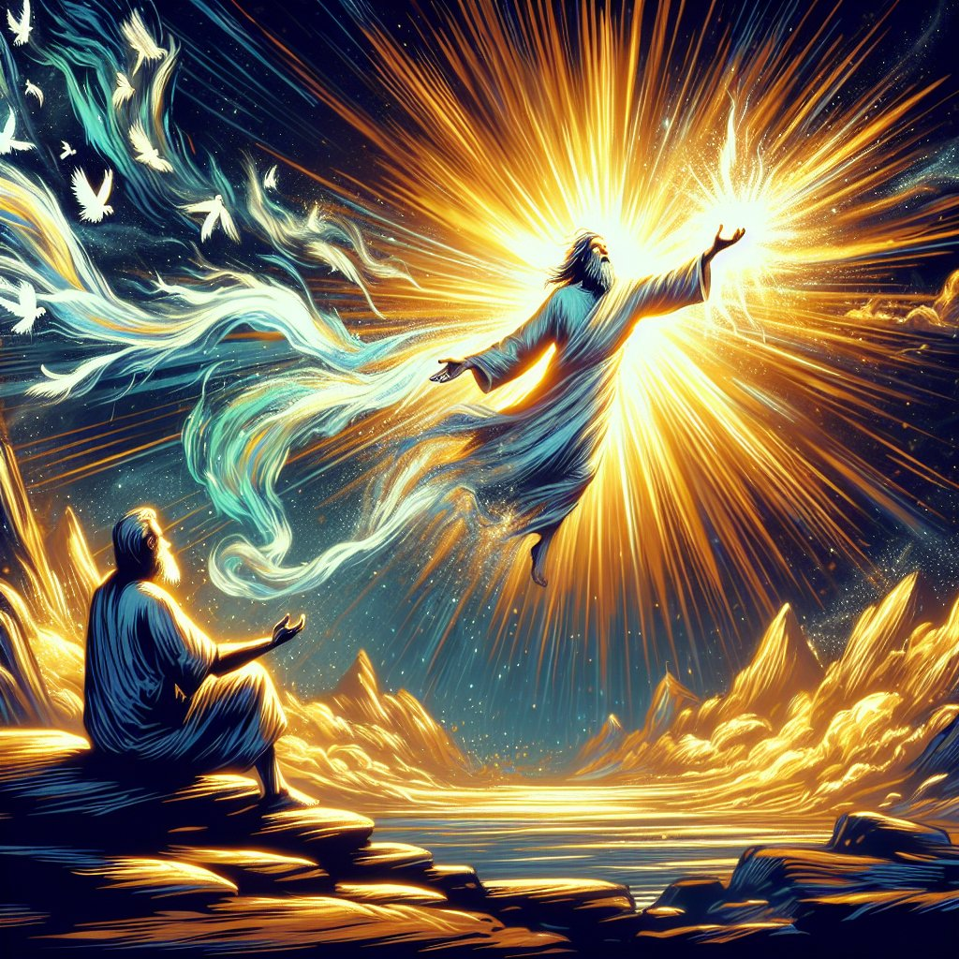

Slide 22


Slide 23


Slide 24
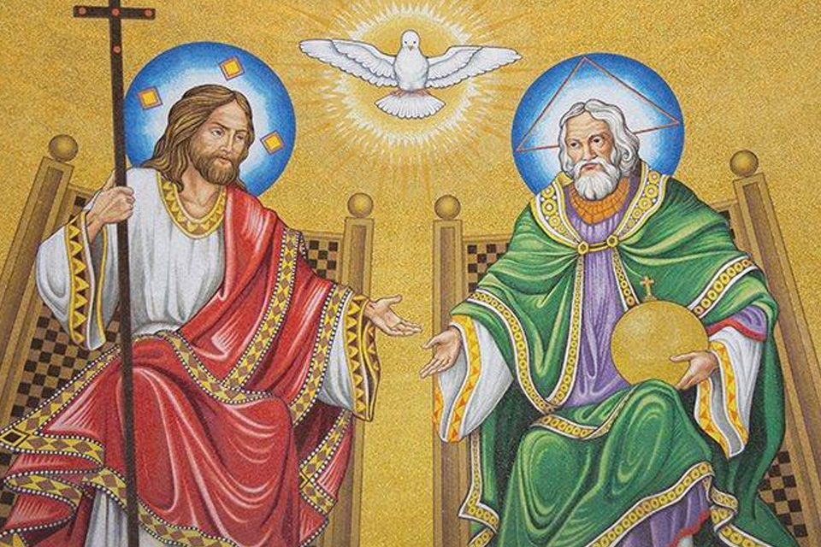

Slide 25
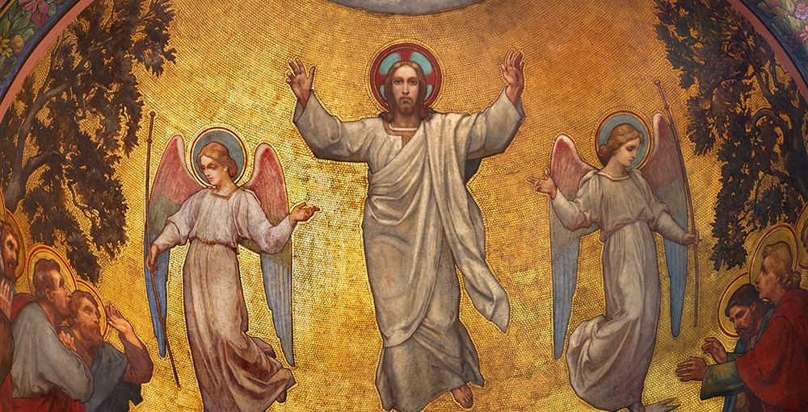

Slide 26
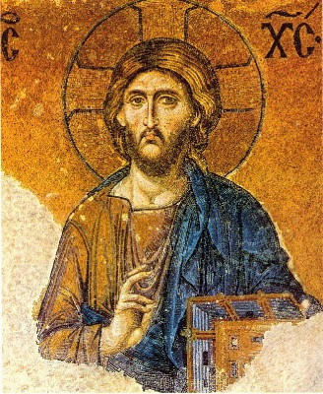

Slide 27
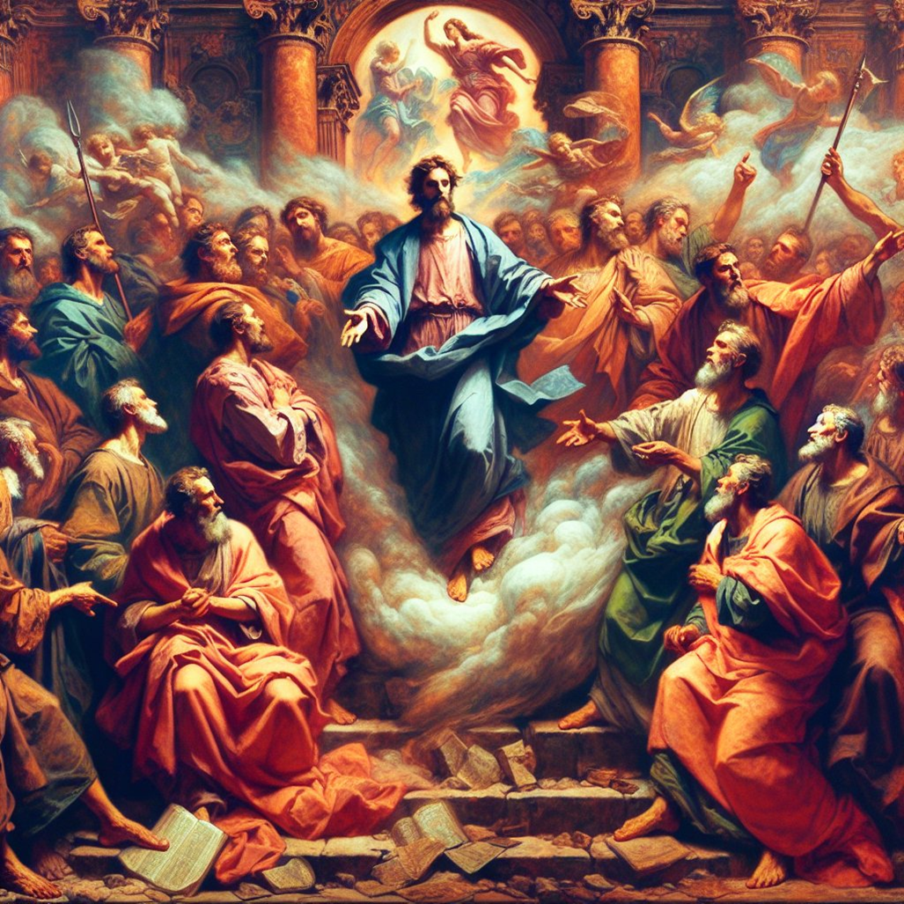

Slide 28


Slide 29
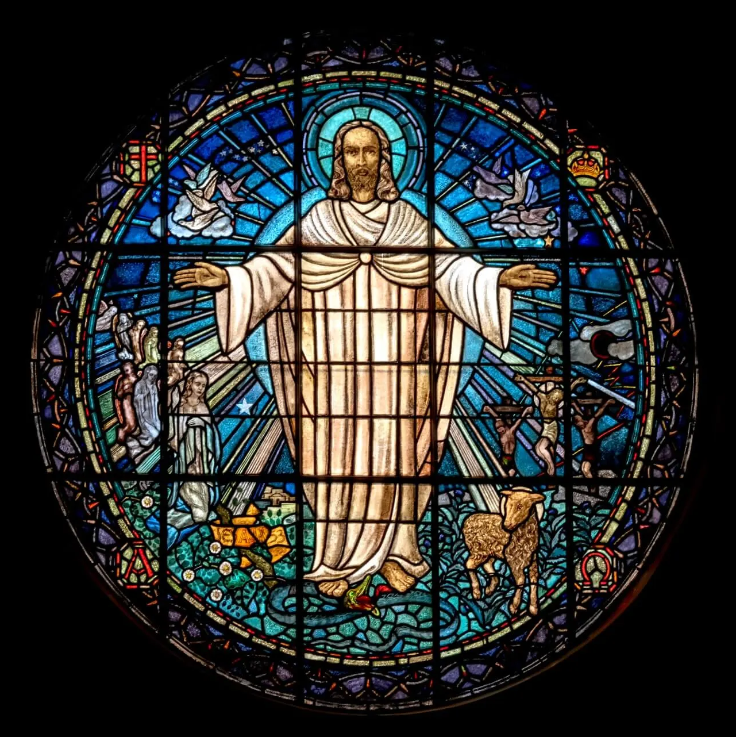

Slide 30
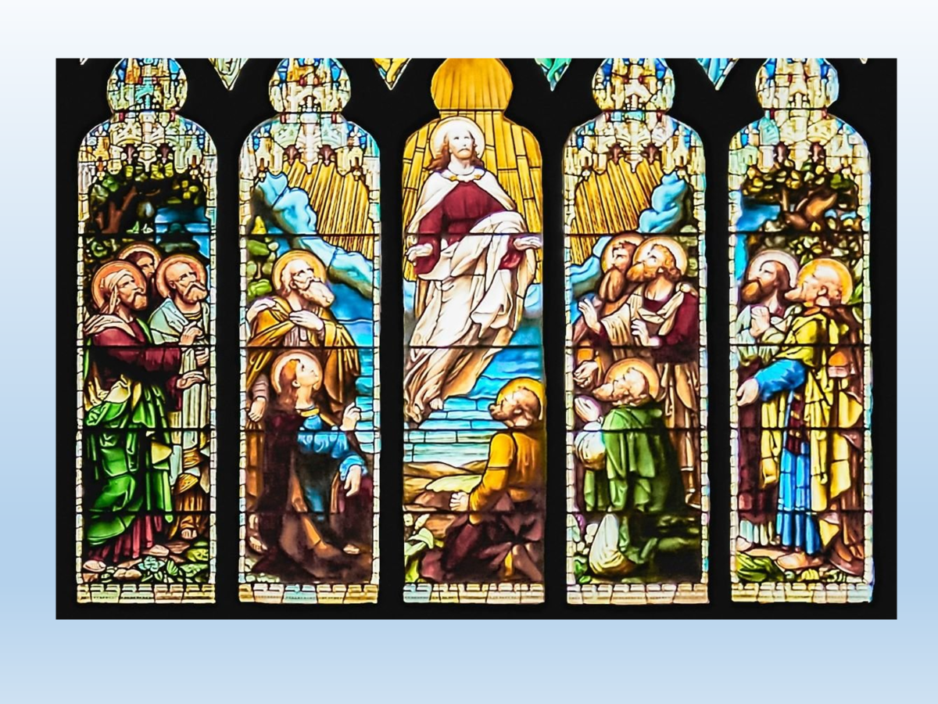

Slide 31


Slide 32
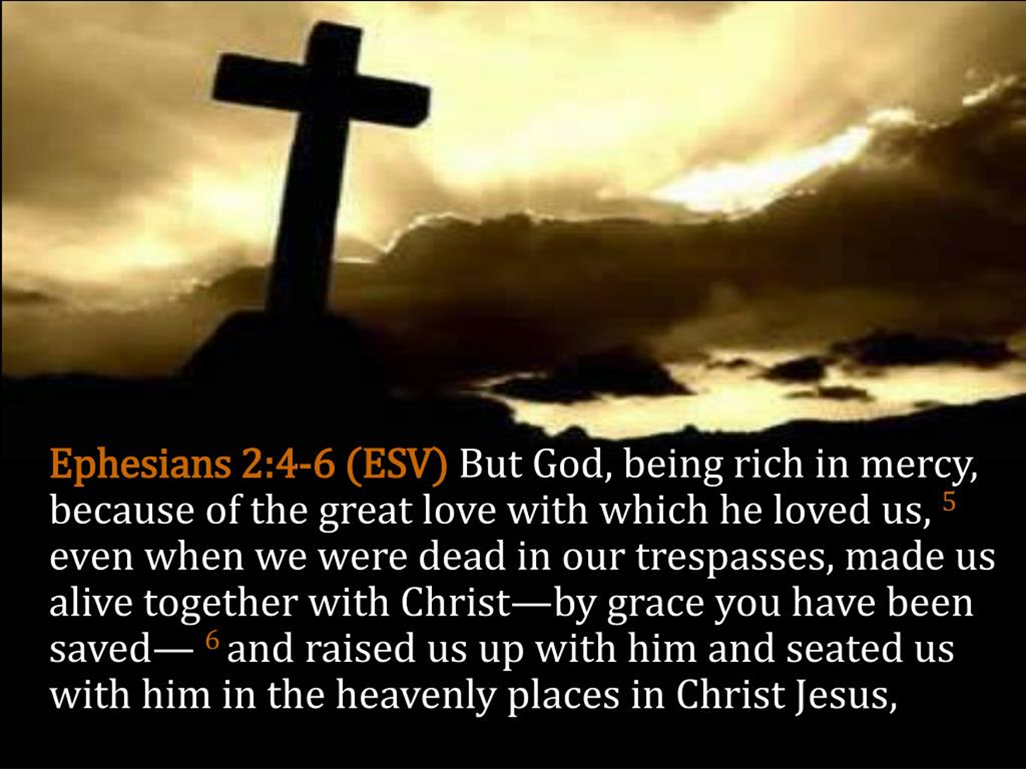

Slide 33
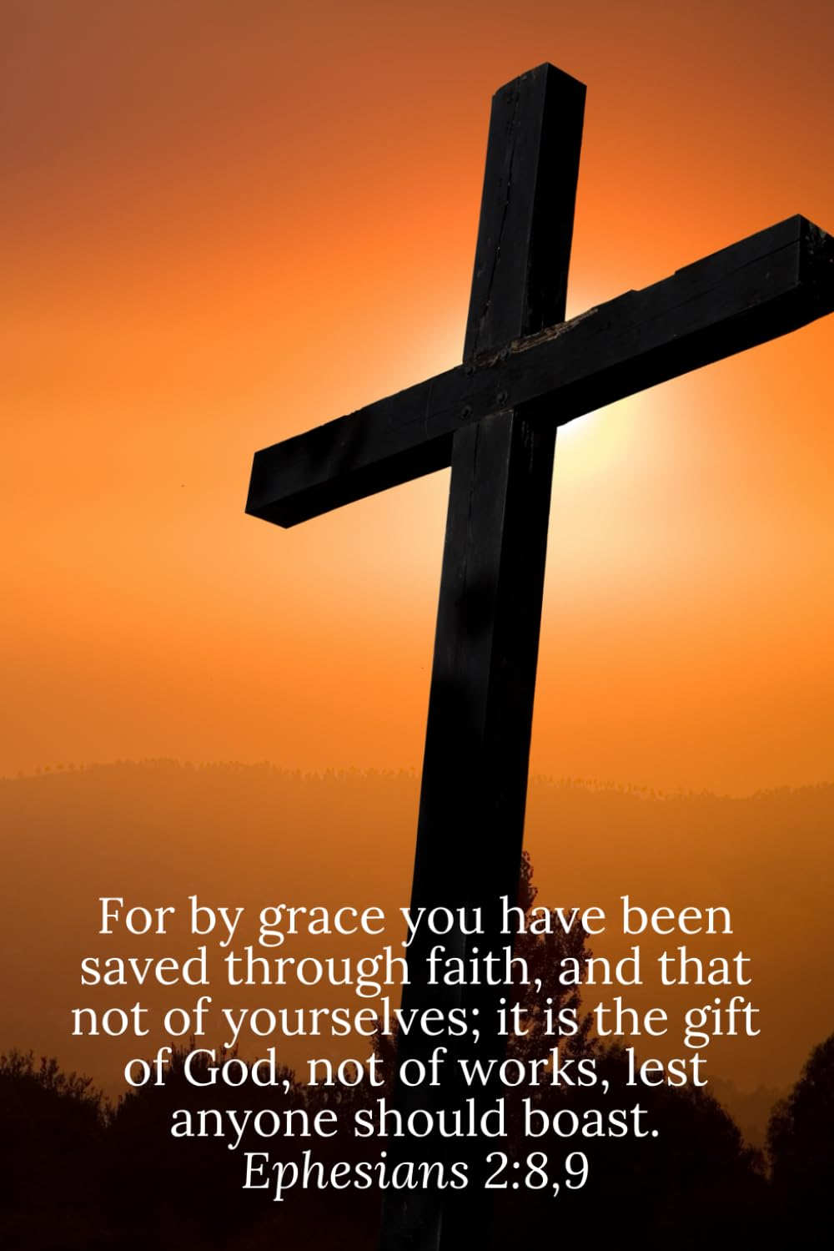

Slide 34
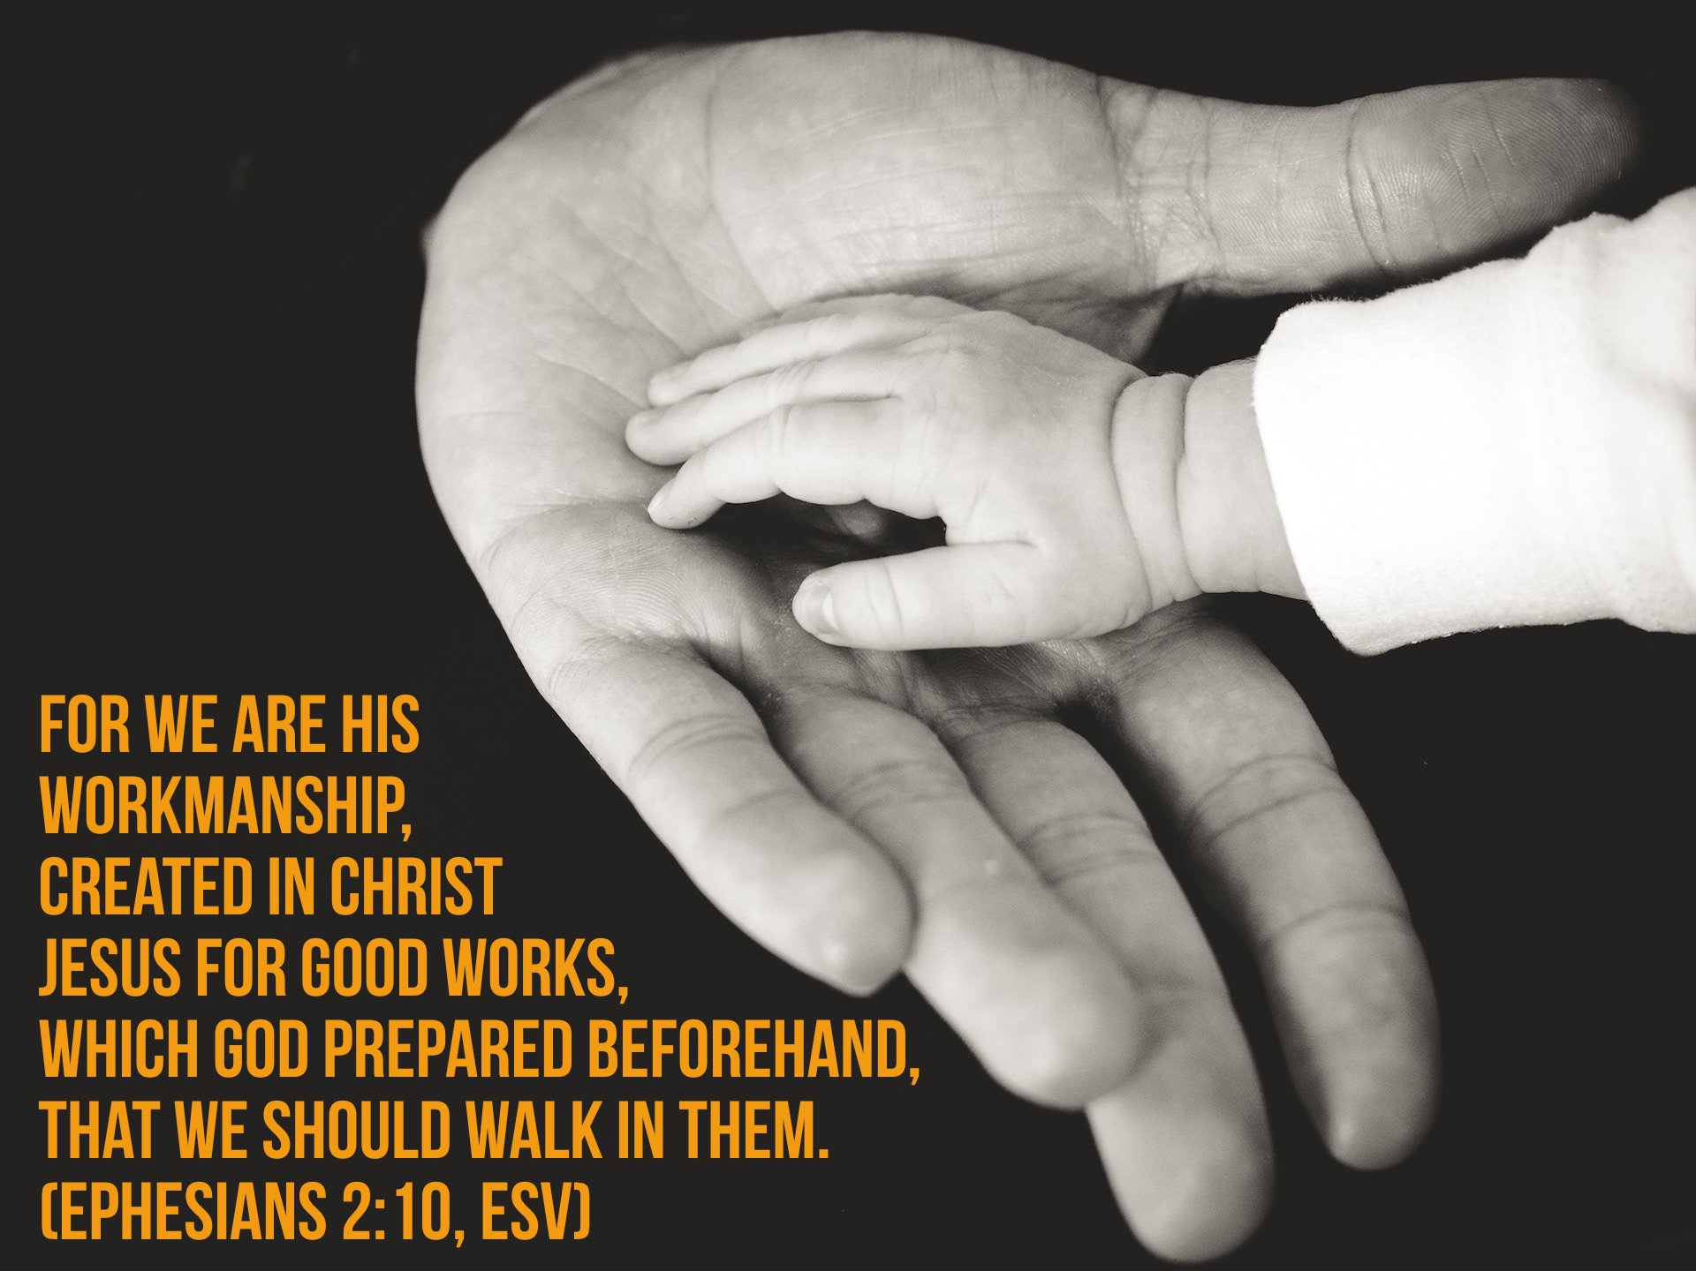

Slide 35
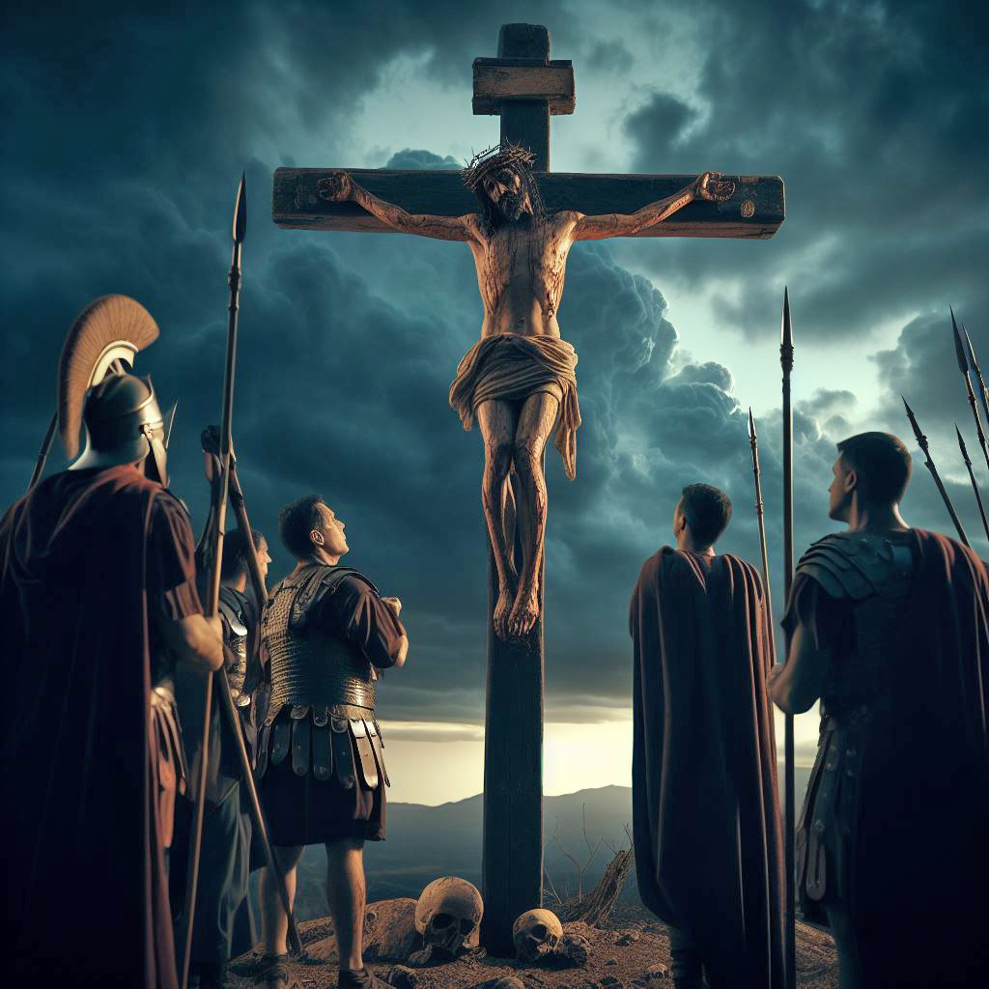

Slide 36


Slide 37


Slide 38
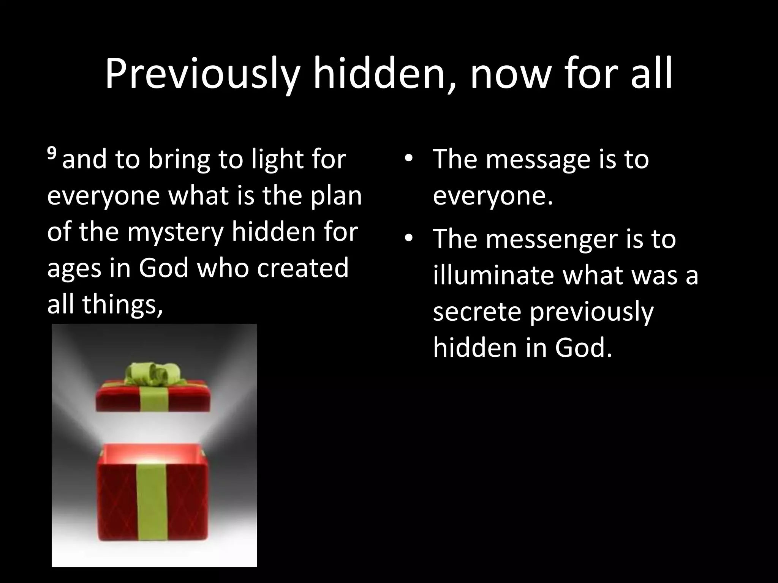

Slide 39


Slide 40
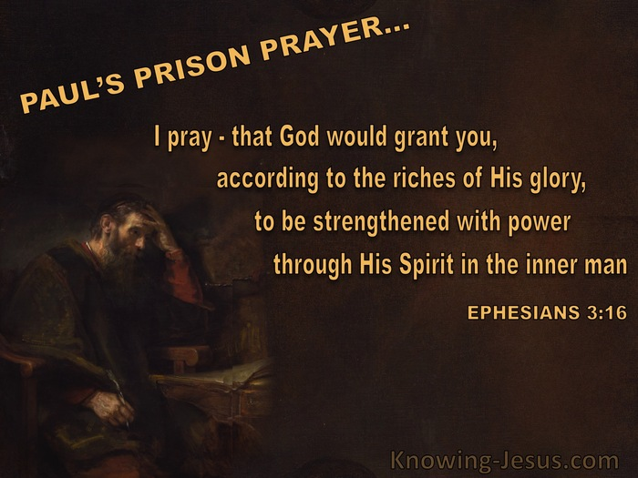

Slide 41


Slide 42
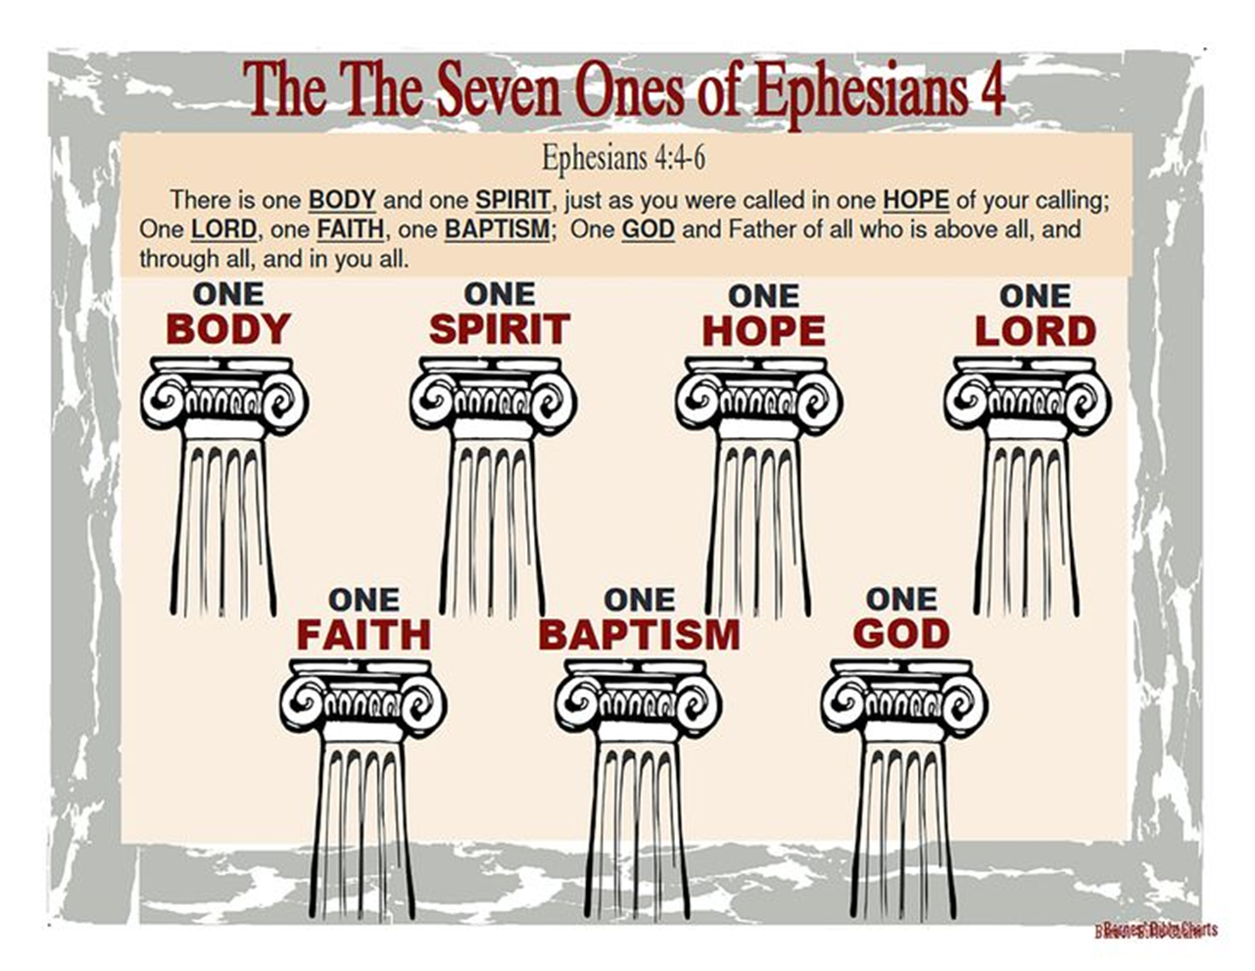

Slide 43
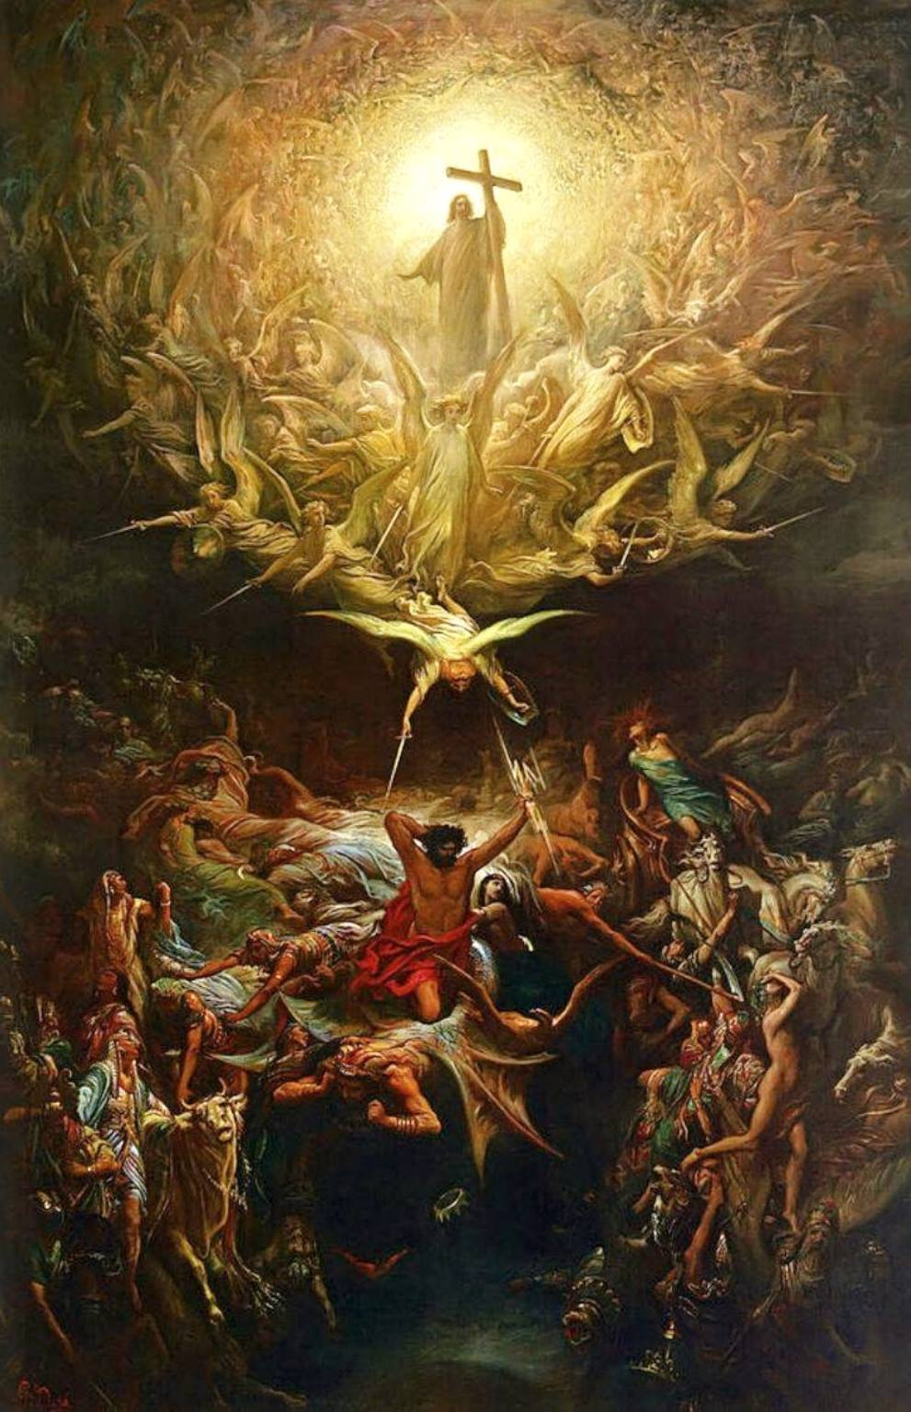

Slide 44
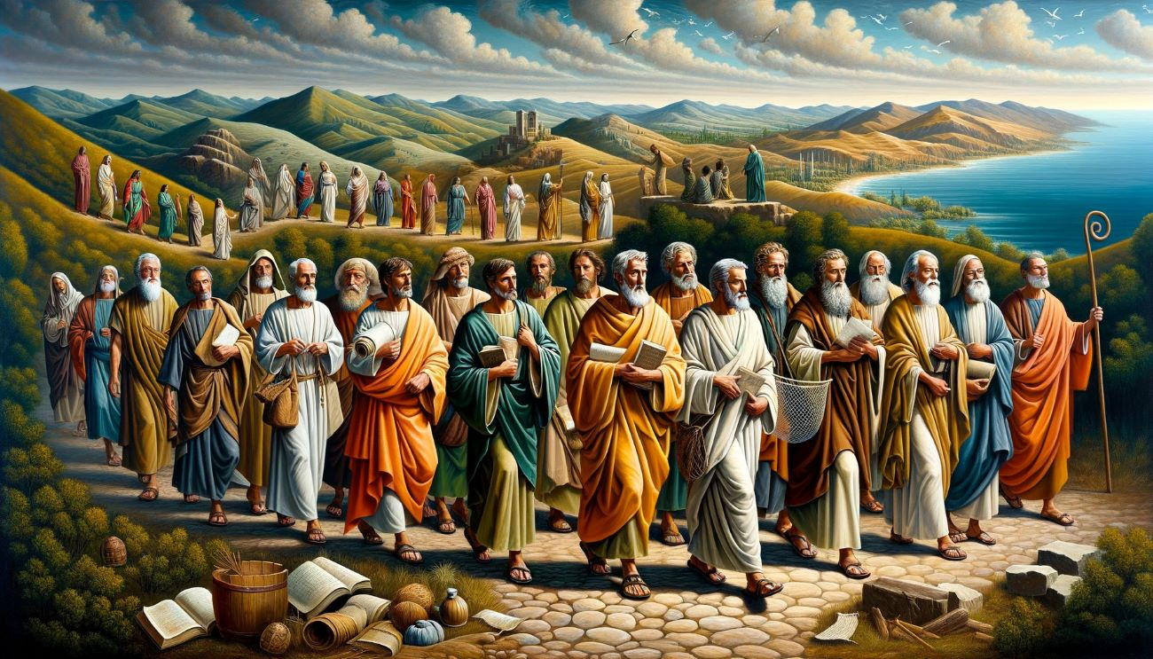

Slide 45
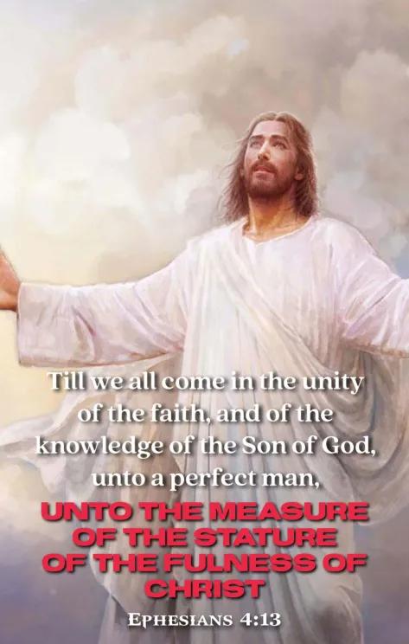

Slide 46


Slide 47


Slide 48
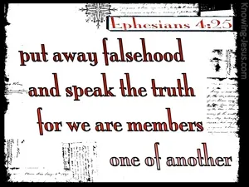

Slide 49


Slide 50


Slide 51
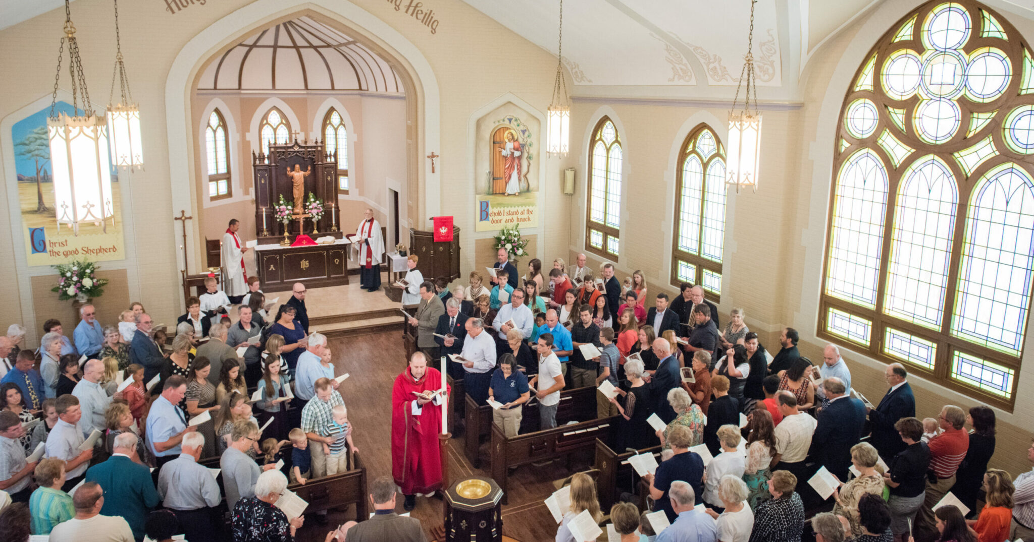

Slide 52
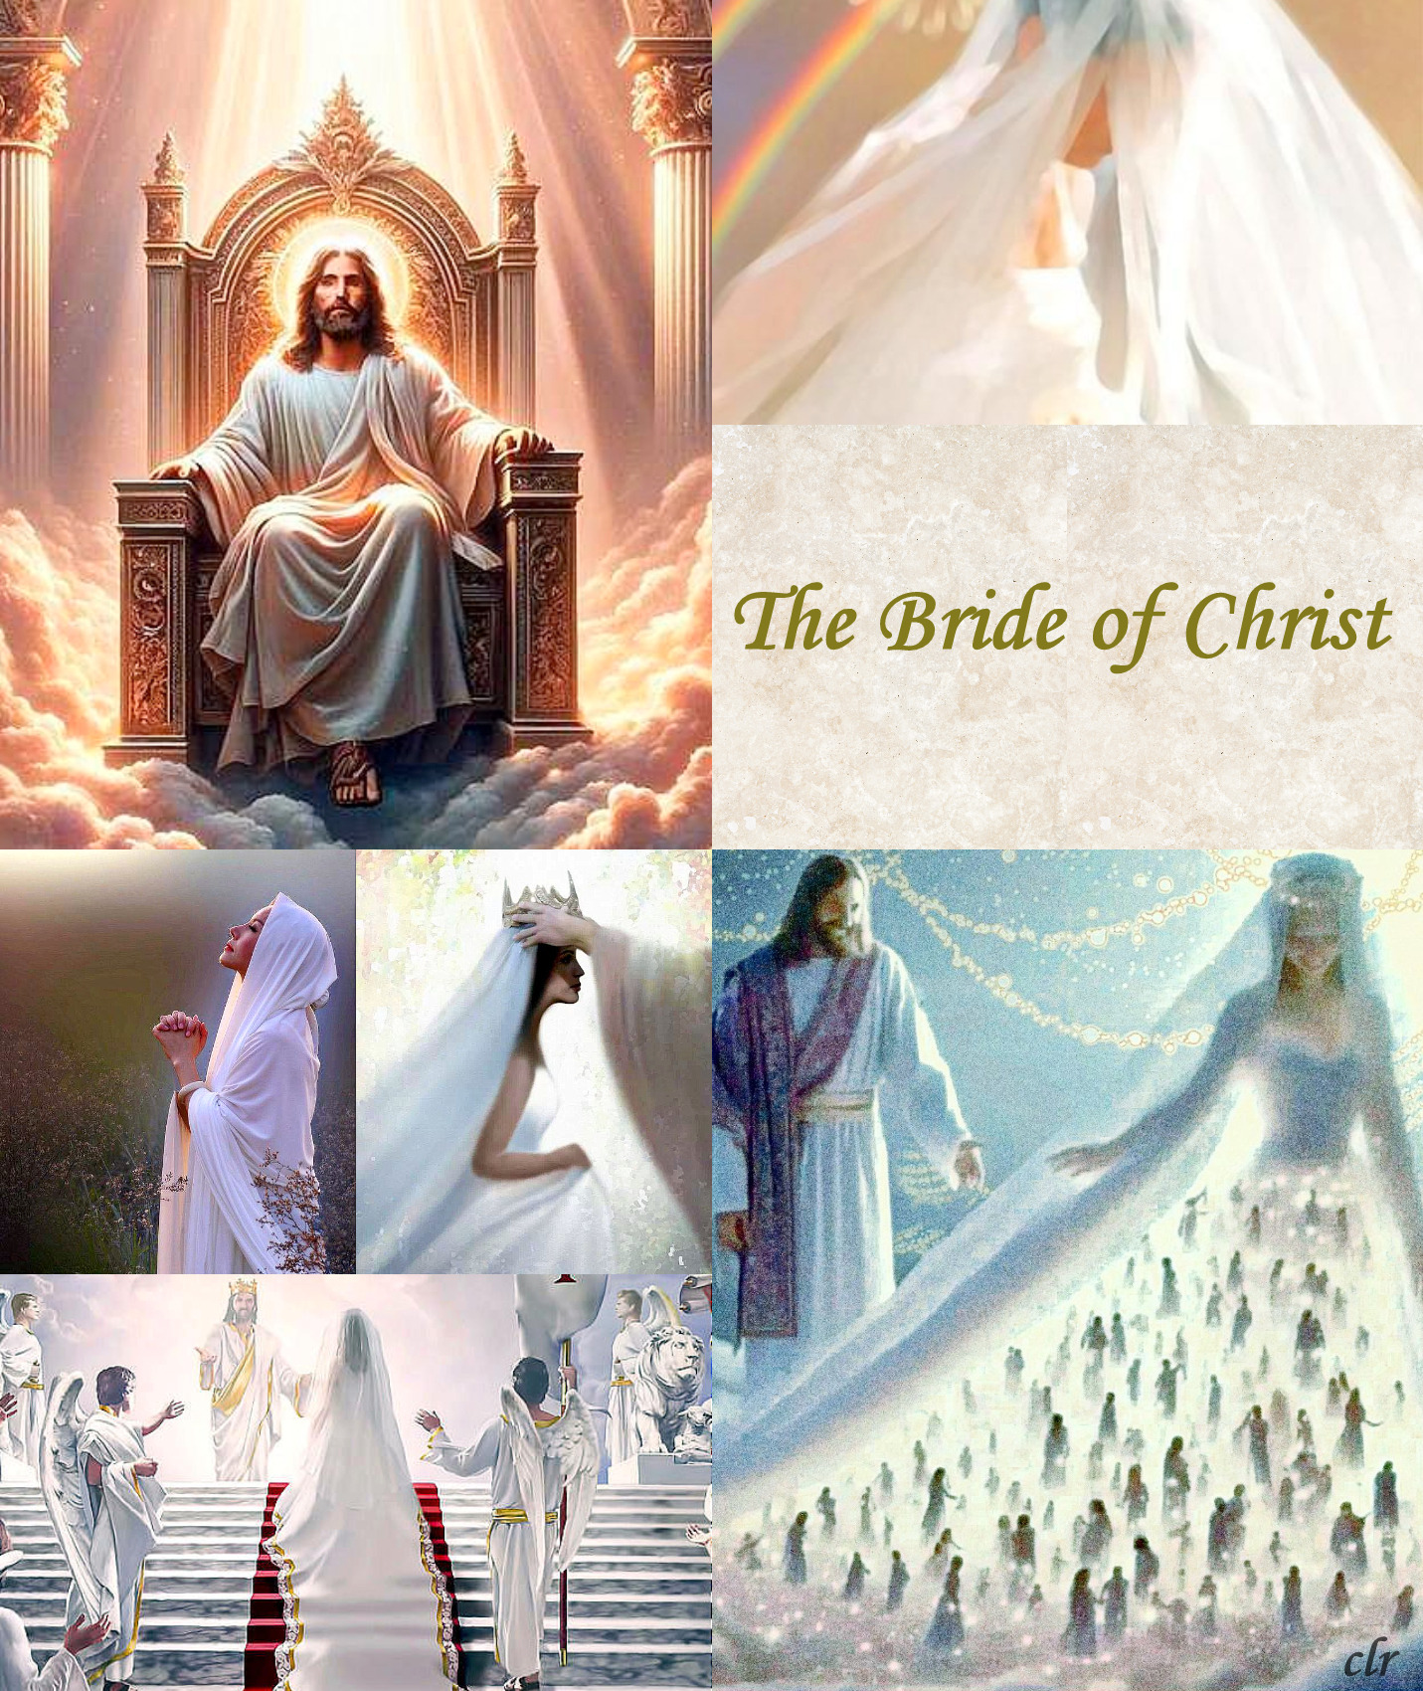

Slide 53


Slide 54
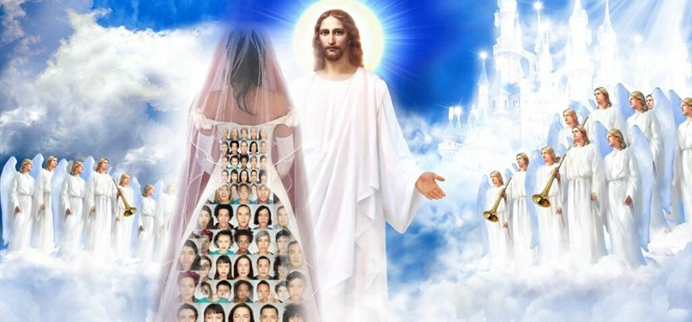

Slide 55
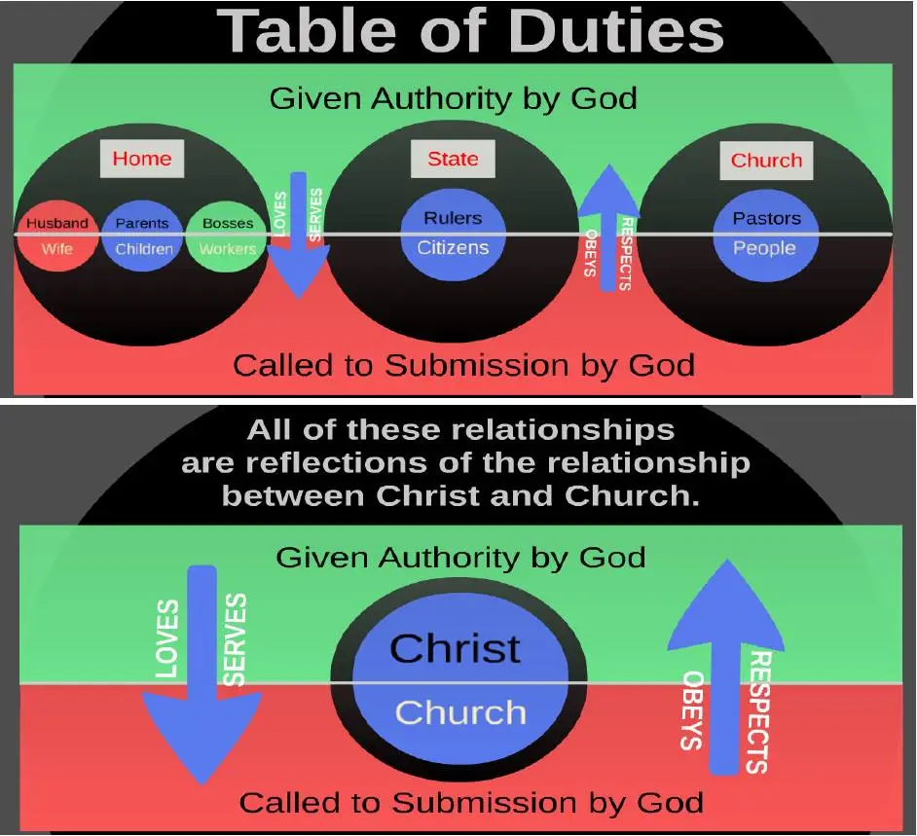

Slide 56
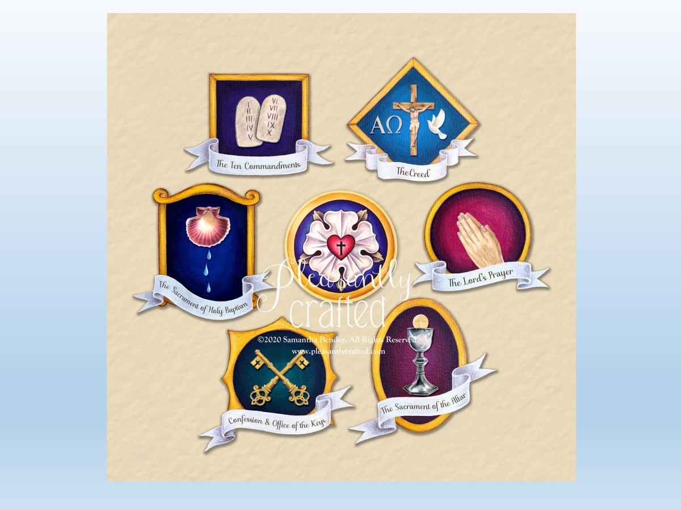

Slide 57
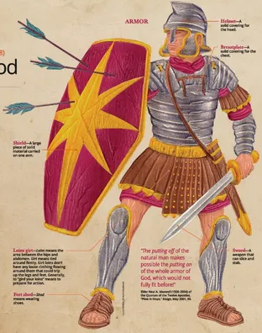

Slide 58
