Slide 1

THE BOOK OF EPHESIANS
“We Are His Workmanship”
Date: 2-9-25 Lesson: 37
Pastor David Nehrenz –
Trinity Lutheran Church – Norman, OK

Slide 2
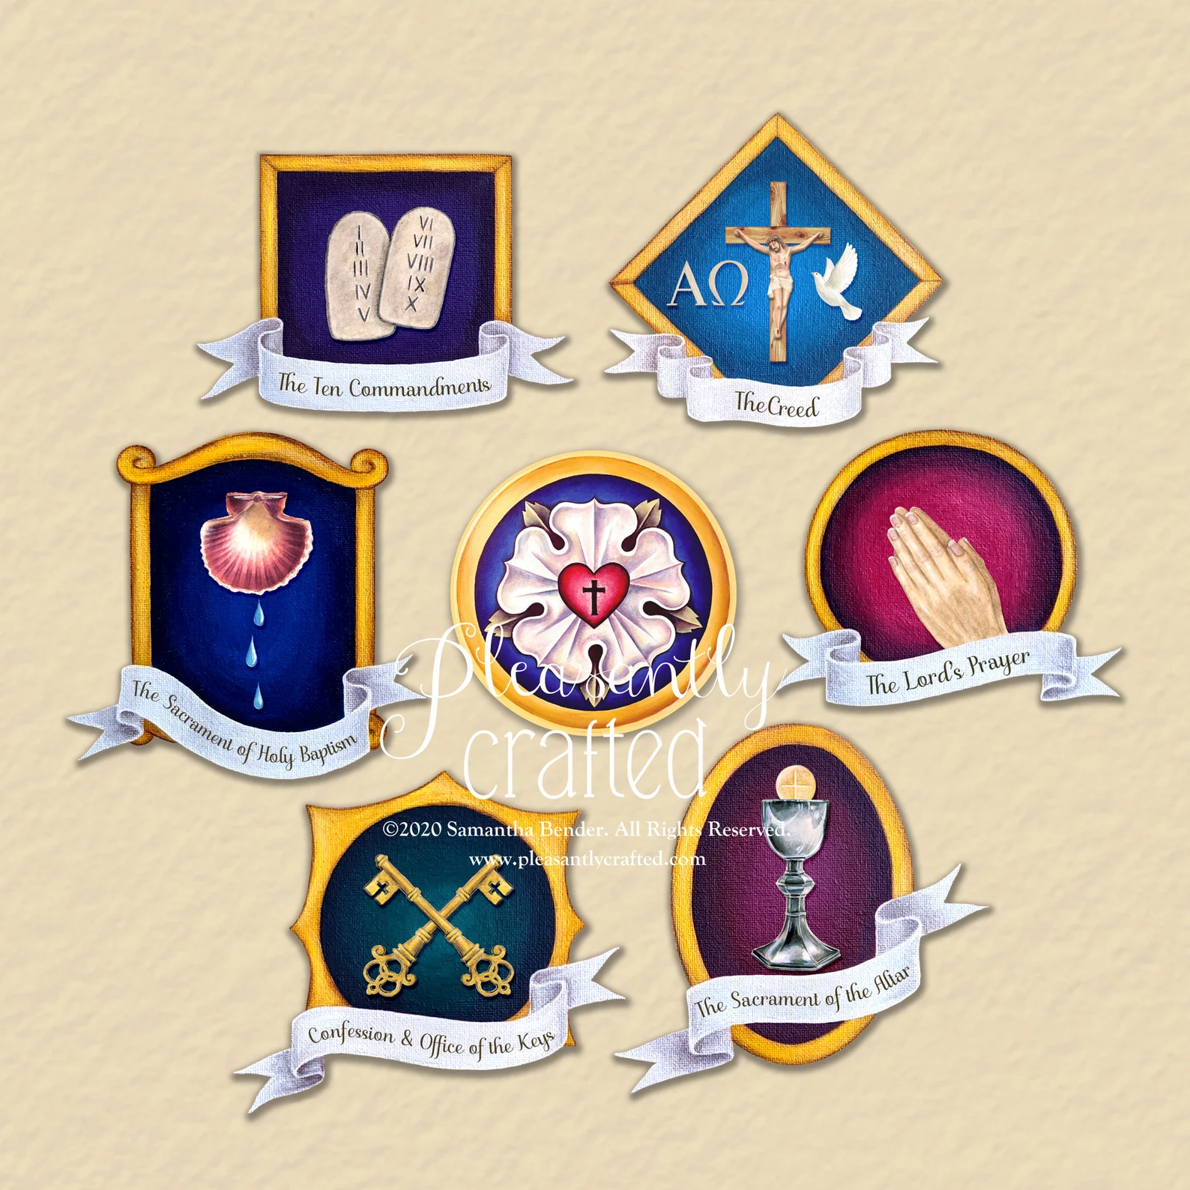

Slide 3
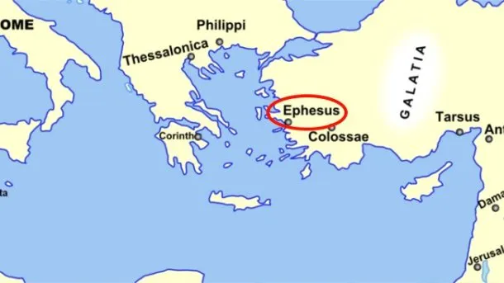
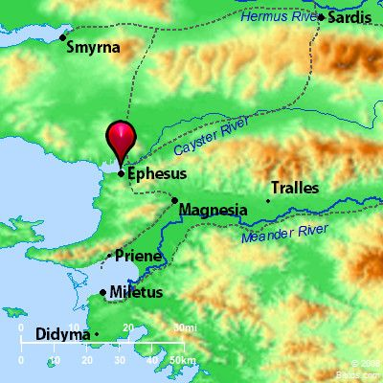
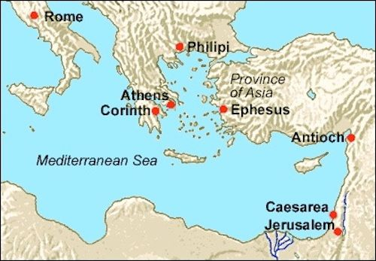

Slide 4
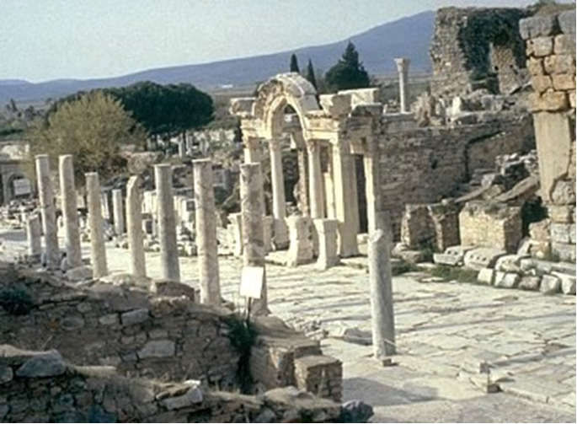

Slide 5
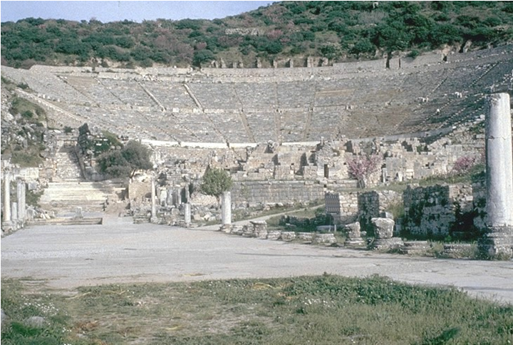

Slide 6
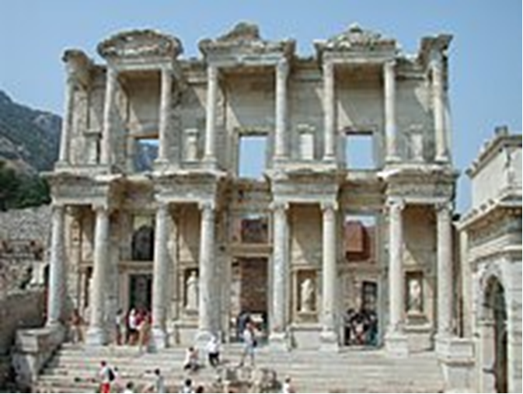

Slide 7
THE TEXT (Ephesians 6:5-9)
(5) Slaves, obey your earthly masters with fear and trembling, with a sincere heart, as you would Christ, (6) not by the way of eye-service, as people-pleasers,
but as servants of Christ doing the will of God from the heart,
(7) rendering service with a good will
as to the Lord and not to man,
(8) knowing that whatever good anyone does,
this he will receive back from the Lord, whether he is a slave or free.
(1 Cor 3:8; 7:22; 12:13; 2 Cor 5:10; 11:3;
Gal 1:10; 3:28; Php 2:12; Col 3:11,22-24;
1 Tim 6:1; Titus 2:9,10; 1 Pet 2:18)

Slide 8
(9) Masters, do the same to them,
and stop your threatening,
knowing that he who is both their Master and yours is in heaven,
and that there is no partiality with him.
(Lev 25:43; Dt 10:17; Job 31:13-15;
Jn 13:13; Ac 10:34,35 ;
Rom 2:9-13; Col 4:11; 1 Pet 1:17)

Slide 9
STUDY HELPS
Luther’s Large Catechism - THE SEVENTH COMMANDMENT
[222] You shall not steal.
[223] …the commandment about temporal property. God also wants property protected. He has commanded that no one shall take away from, or diminish, his neighbor’s possessions.
[233] Therefore, let everyone know his duty, at the risk of God’s displeasure: he must do no harm to his neighbor nor deprive him of profit nor commit any act of unfaithfulness or hatred in any bargain or trade. But he must also faithfully preserve his property for him, secure and promote his advantage. This is especially true when one accepts money, wages, and one’s livelihood for such service.
[249] It is necessary for us to do no more than to teach and to warn with God’s Word. But to check such open greediness there is need for the princes and government. They themselves should take note and have the courage to establish and maintain order in all kinds of trade and commerce. They must do this, lest the poor be burdened and oppressed and the leaders themselves be burdened with other people’s sins.

Slide 10
[250] Briefly, in summary (as in the former commandments) this is what is forbidden: (a) To do our neighbor any injury or wrong (in any conceivable manner, by impeding, hindering, and withholding his possessions and property), or even to consent or allow such injury. Instead, we should interfere and prevent it.
[251] (b) It is commanded that we advance and improve his possessions. When they suffer lack, we should help, share, and lend both to friends and foes.
[252] Whoever now seeks and desires good works will find here more than enough to do that are heartily acceptable and pleasing to God. In addition, they are favored and crowned with excellent blessings. So we are to be richly compensated for all that we do for our neighbor’s good and from friendship. King Solomon also teaches this in Proverbs 19 [: 17], “Whoever is generous to the poor lends to the LORD, and He will repay him for his deed.”
[253] Here, then, you have a rich Lord. He is certainly enough for you. He will not allow you to come up short in anything or to lack. So you can with a joyful conscience enjoy a hundred times more than you could scrape together with unfaithfulness and wrong.

Slide 11
Luther’s Large Catechism - THE SEVENTH COMMANDMENT - HONESTY AND WORK
By Ricardo Willy Rieth
Work, property, money, and material goods occupy a central place in the lives of individuals, families, and communities. According to the Gospel, is all this directly related to the Christian faith and the practice of love…
The Seventh Commandment, more than anything, is a guideline for how Christians can actively help others to protect and promote what they possess. Luther’s readiness to help others materially is described by the term “liberality,” which is synonymous with “generosity.” The practice of liberality is a clear expression of love, which is born of faith. The real meaning of this commandment relates to a poverty of spirit (Matthew 5: 3), which is only fulfilled by the grace of God. This is proclaimed by the example of Christ, who became poor in consequence of His love for humanity (cf. Philippians 2: 6– 7).

Slide 12
Beginning with the Seventh Commandment, work and honesty are presented as a fundamental part of Christian life in the domestic economy…work and honesty in economic relations cannot be dissociated from the Christian life…The commandment requires active fulfillment and positive behavior. In other words, the love generated by faith leads Christians to dedicate themselves to do everything possible so that their neighbors preserve their property and are able to use it for their benefit. The content of the Seventh Commandment forbids harming others, doing injustice against them in any way in labor, commercial, and financial relations.
Professions, or vocations, correspond to the spheres in which God places His creatures, giving them intelligence, energy, skills, abilities, and attitudes to serve others in love, to do good, and to be the salt of the earth and light of the world (Matthew 5: 13– 14). It is remarkable how Luther’s explanation of the Seventh Commandment is closely related to his interpretation of the First Commandment, for him the most important commandment of all because it is fulfilled through the work of faith, given by the Holy Spirit.
Luther’s Large Catechism with Annotations and Contemporary Applications (pp. 378-383).
Concordia Publishing House. Kindle Edition.

Slide 13
Every Christian has a vocation = calling (vocatio)
We walk in faith toward God and love for our neighbor.
1st Table of the Law – Commandments 1-3
2nd Table of the Law – Commandments 4-10
How do you balance the living out of these Six Daily Callings?:
Disciple of Christ Jesus our Lord
If married – Spouse; If single - Son / Daughter
If married – Parent; If single - Brother / Sister Uncle / Aunt
Occupation and Employment
Congregation Member
Citizen of your Community

Slide 14
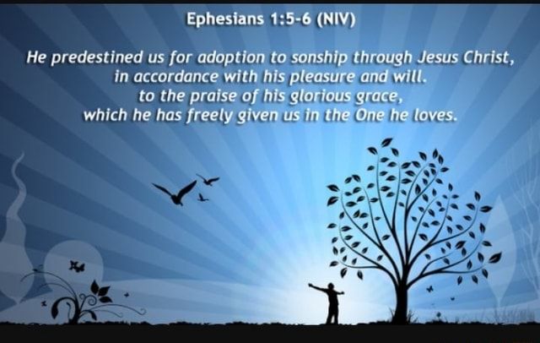

Slide 15
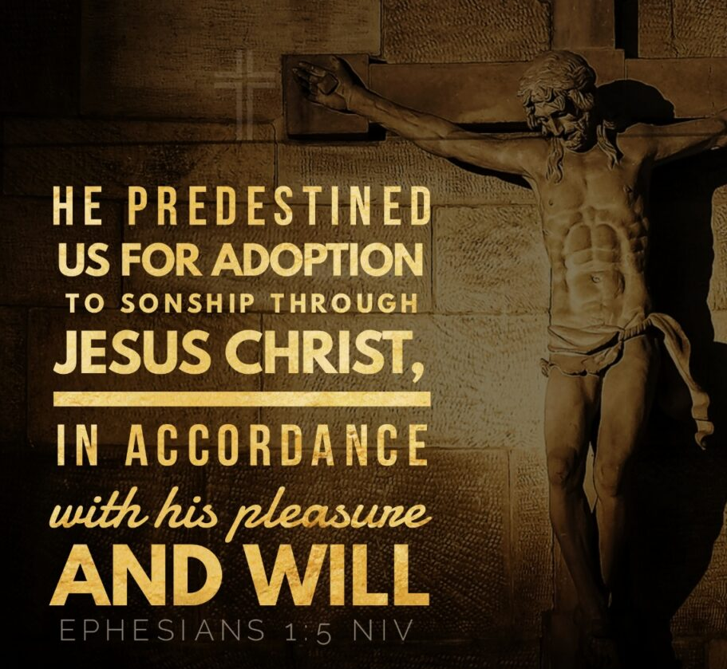

Slide 16
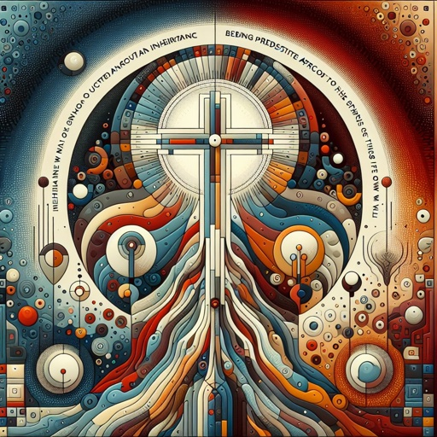

Slide 17
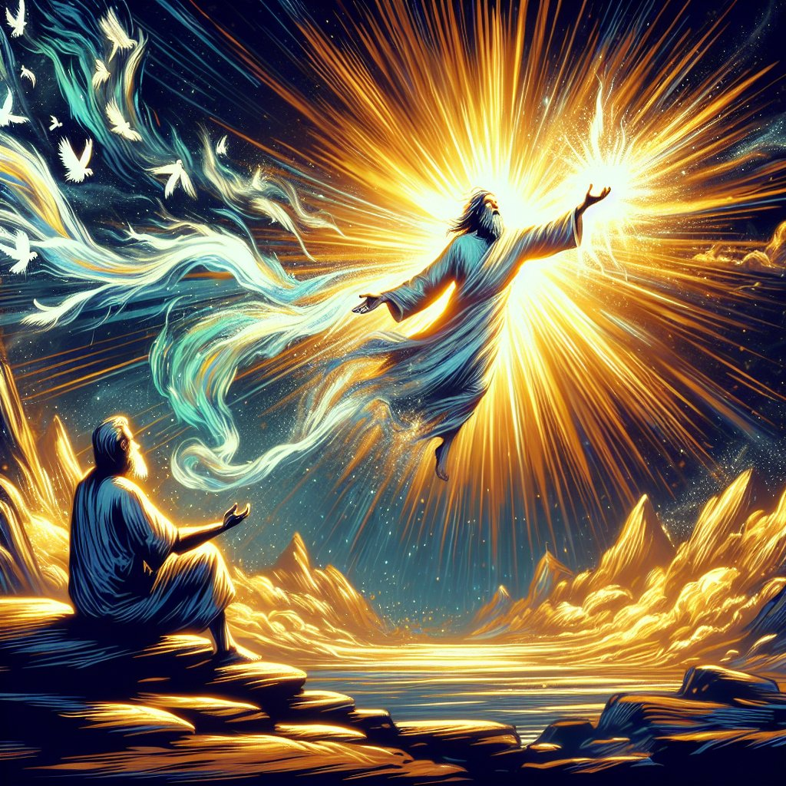

Slide 18


Slide 19


Slide 20
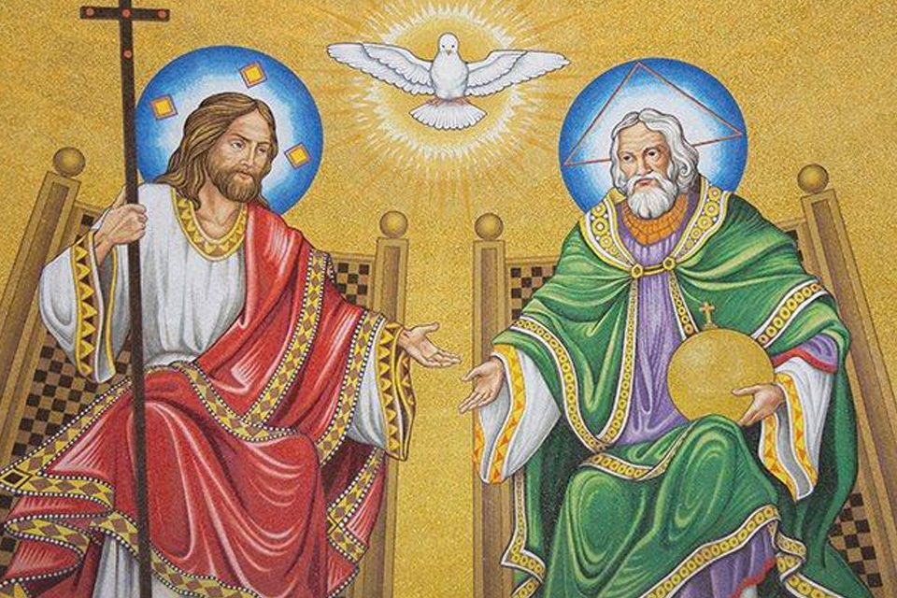

Slide 21
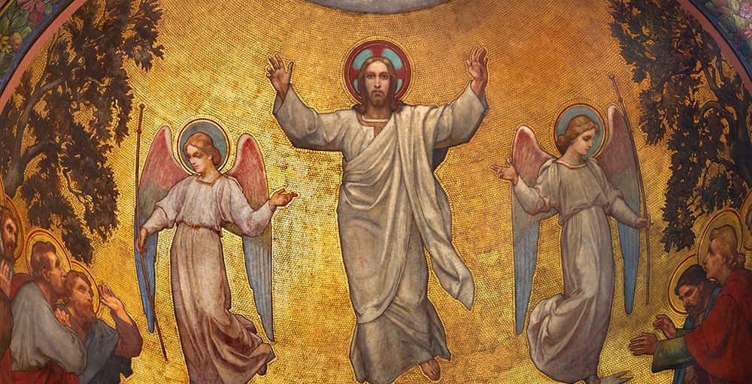

Slide 22
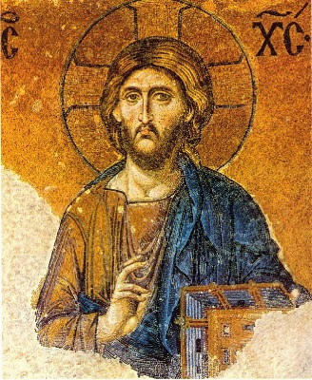

Slide 23
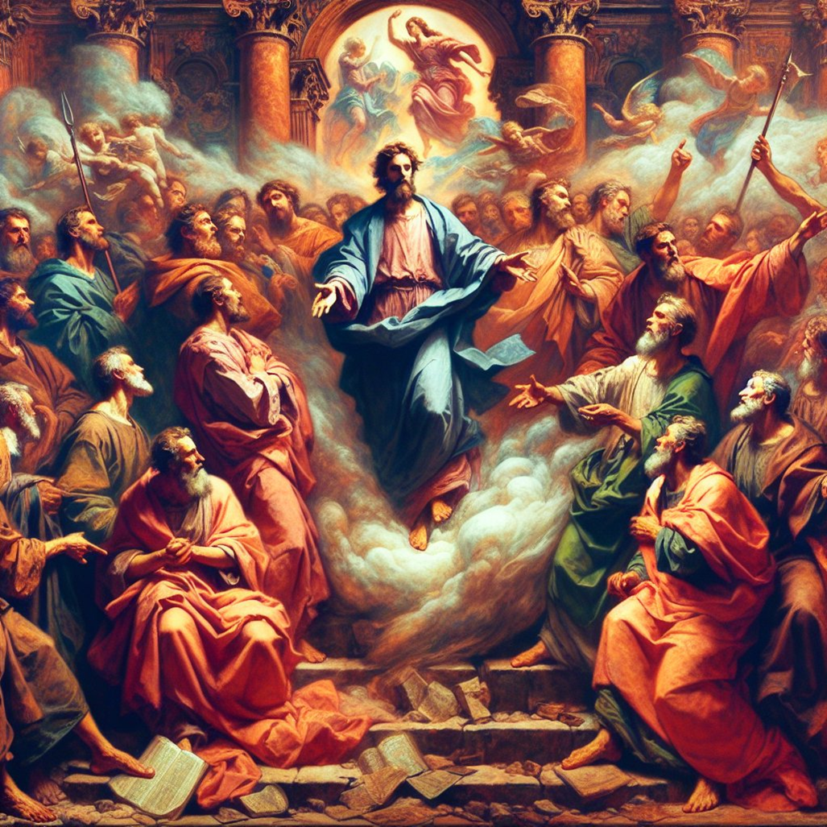

Slide 24


Slide 25
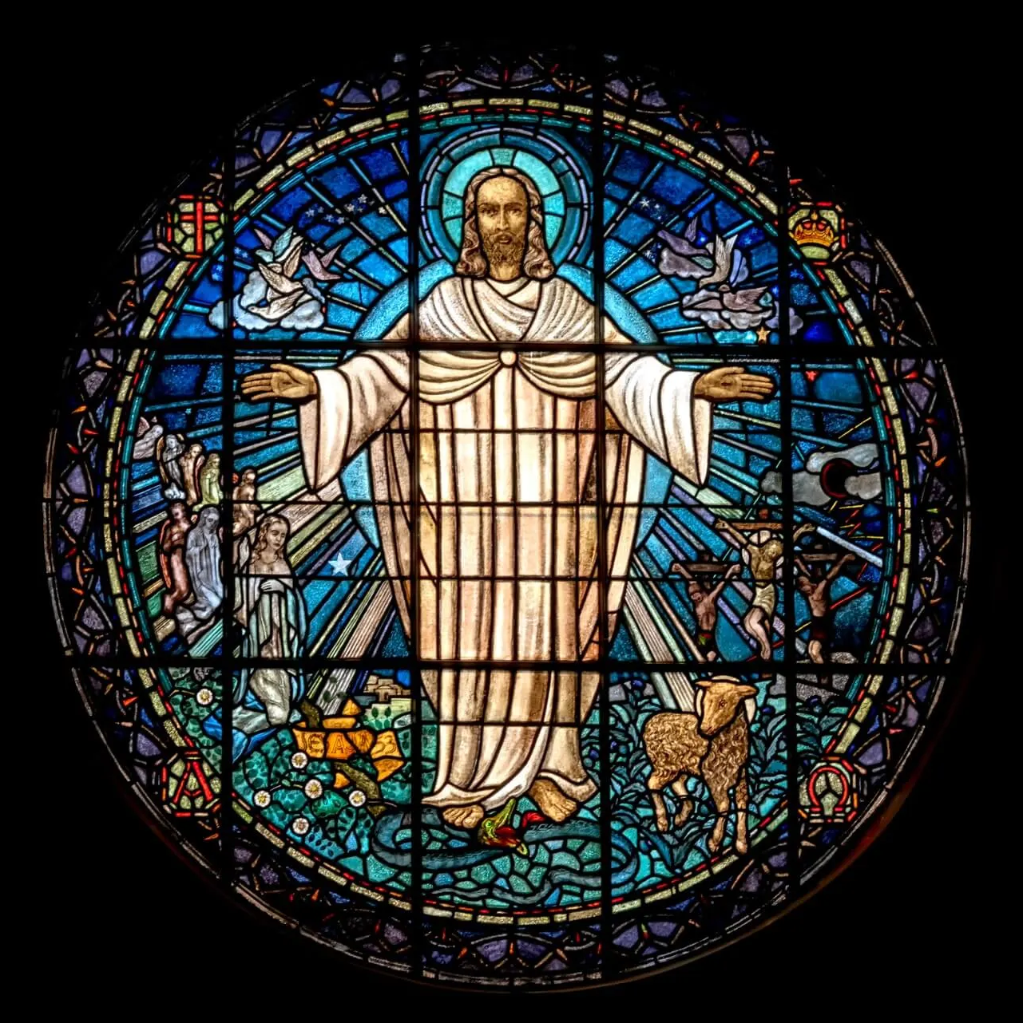

Slide 26
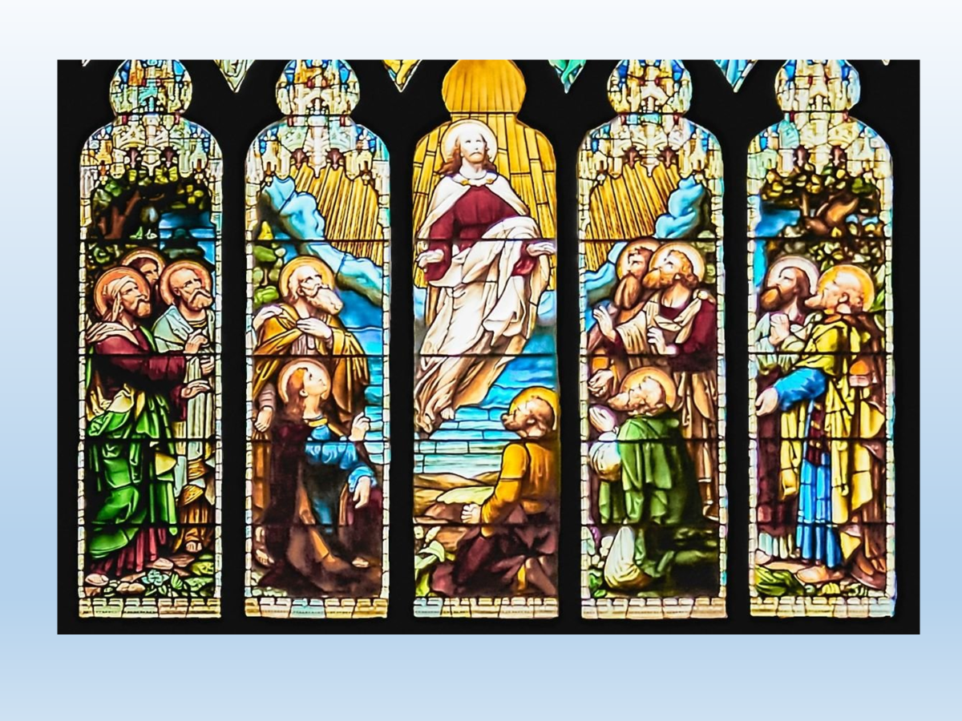

Slide 27


Slide 28
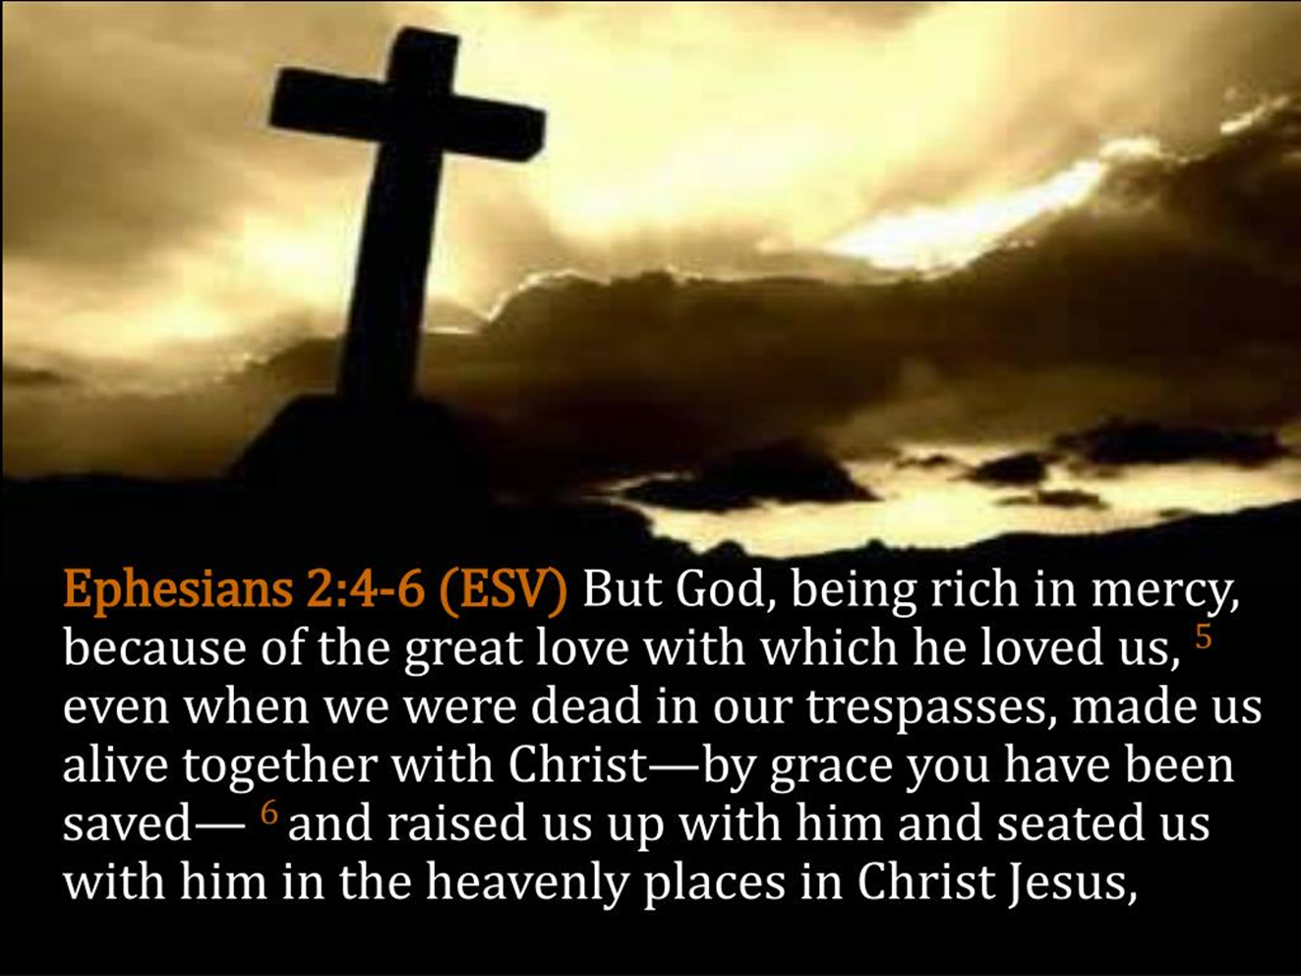

Slide 29
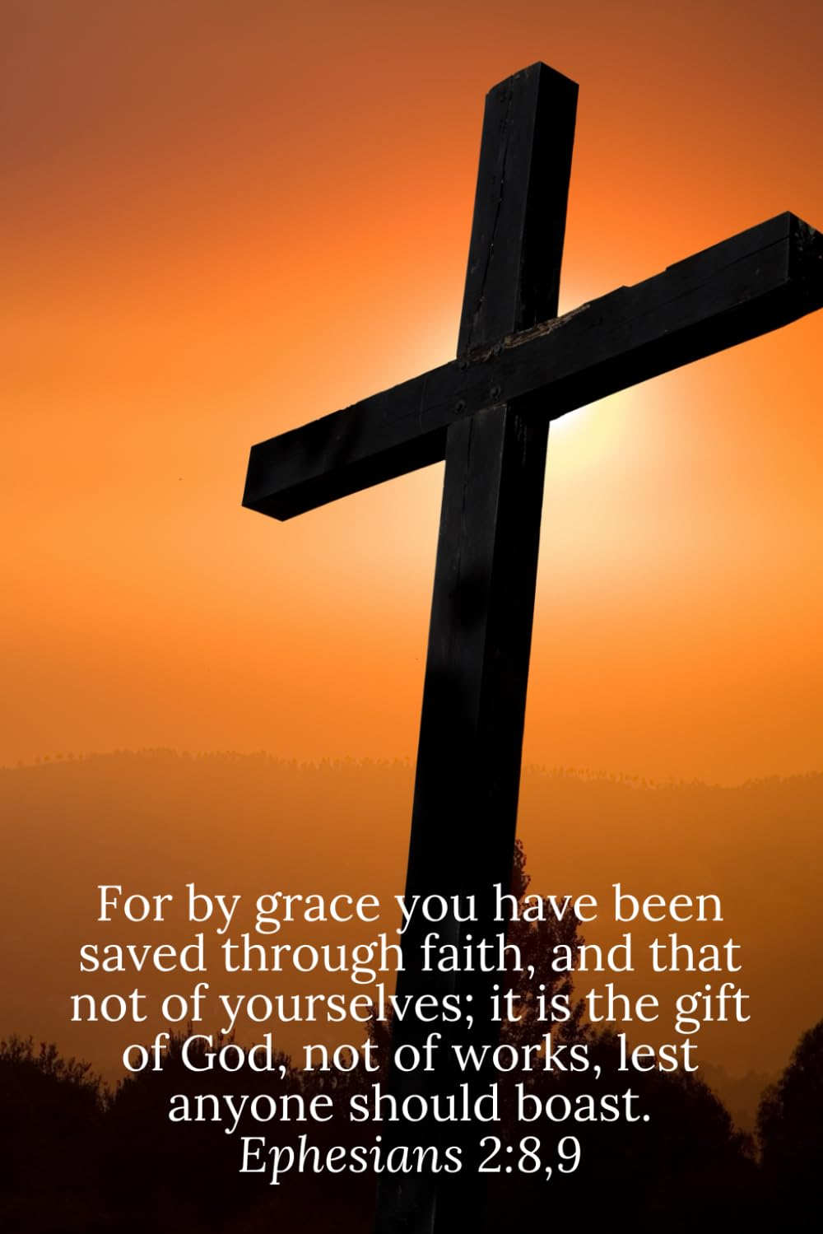

Slide 30
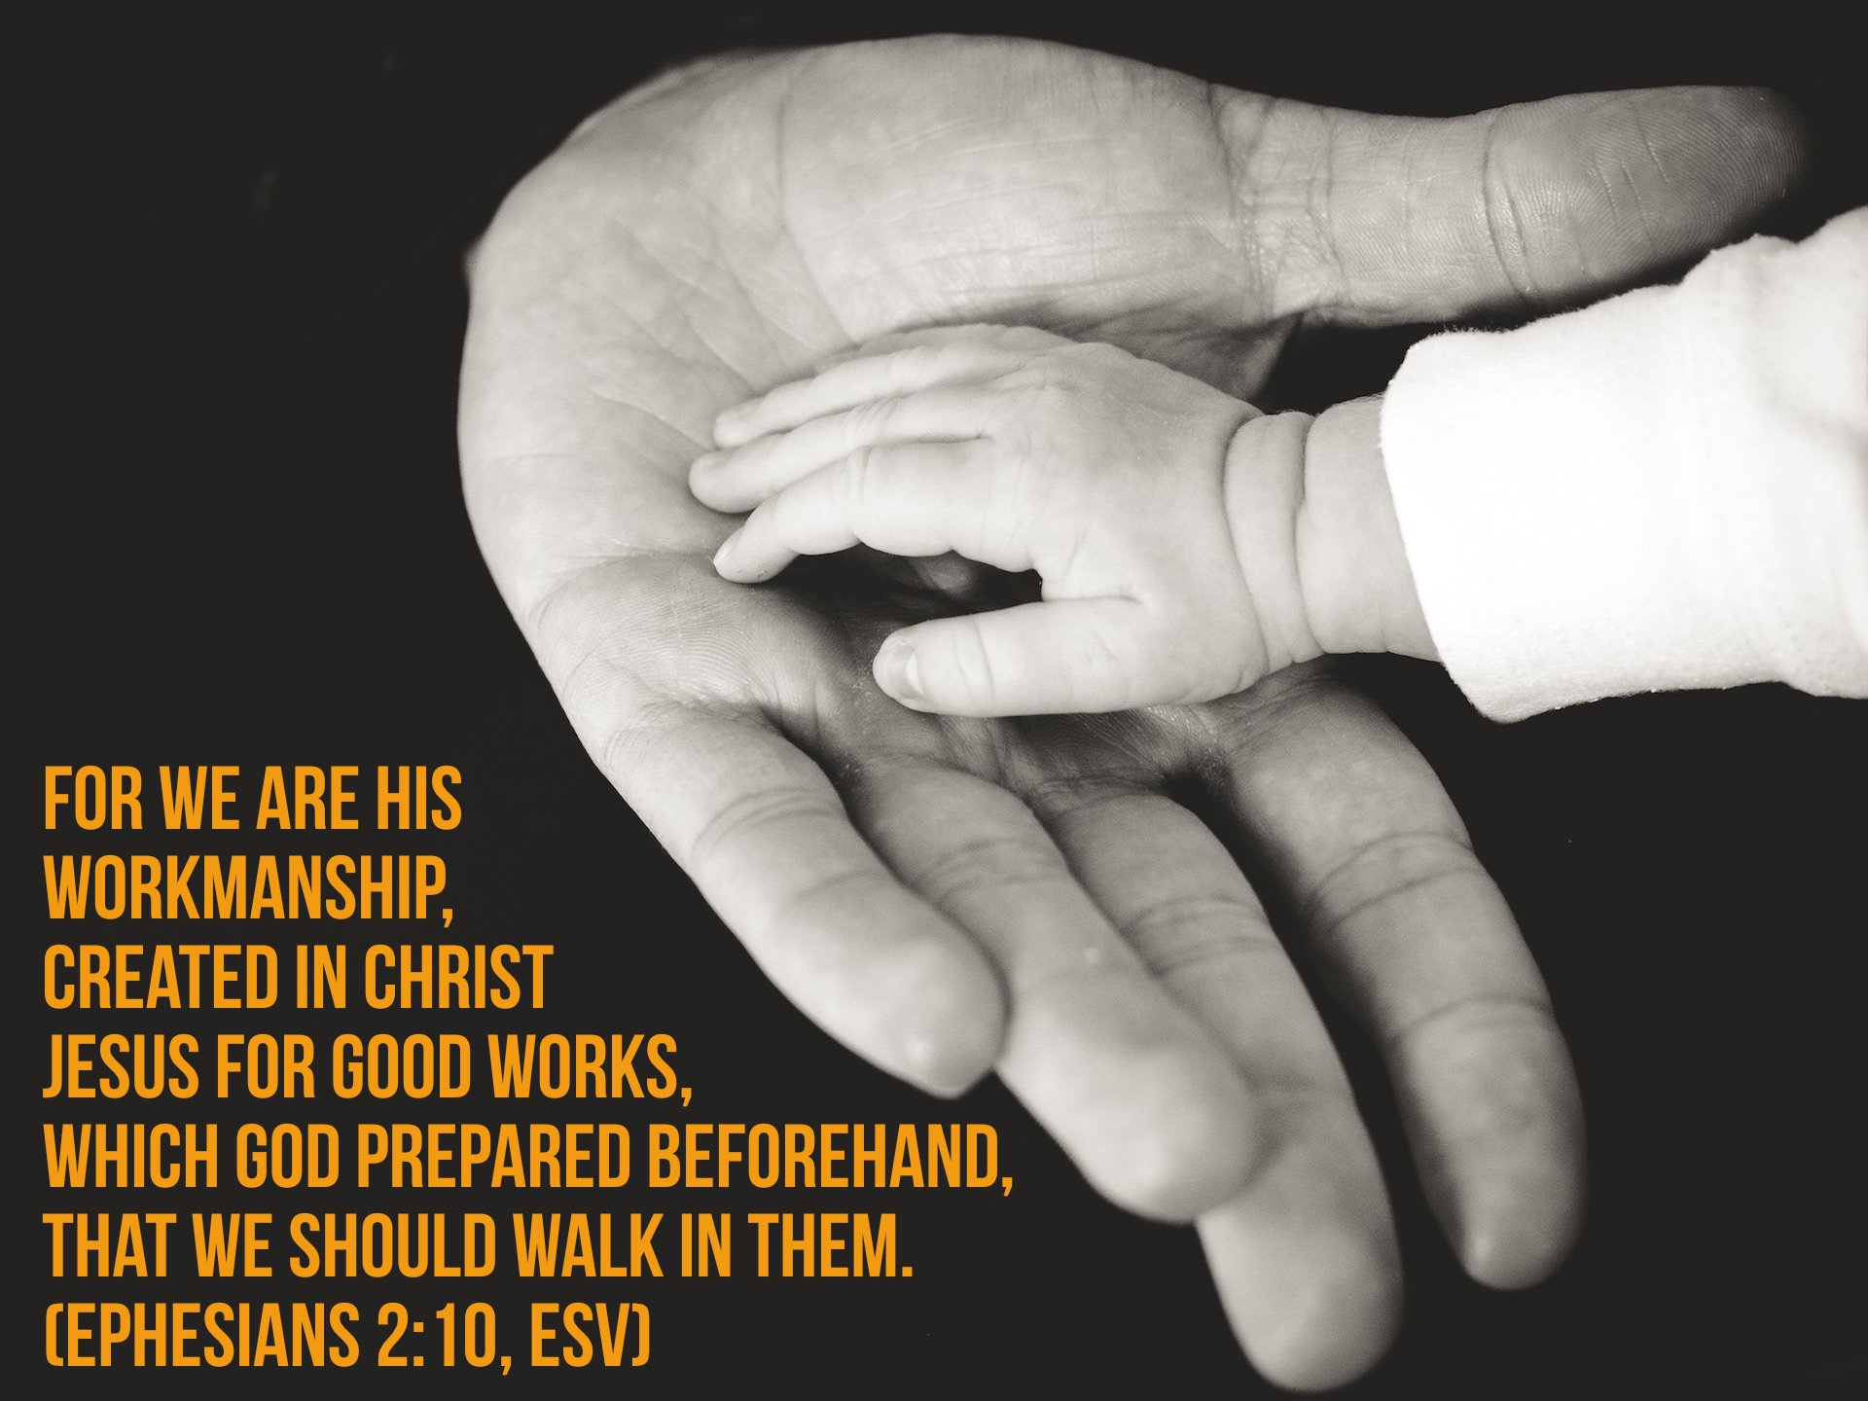

Slide 31
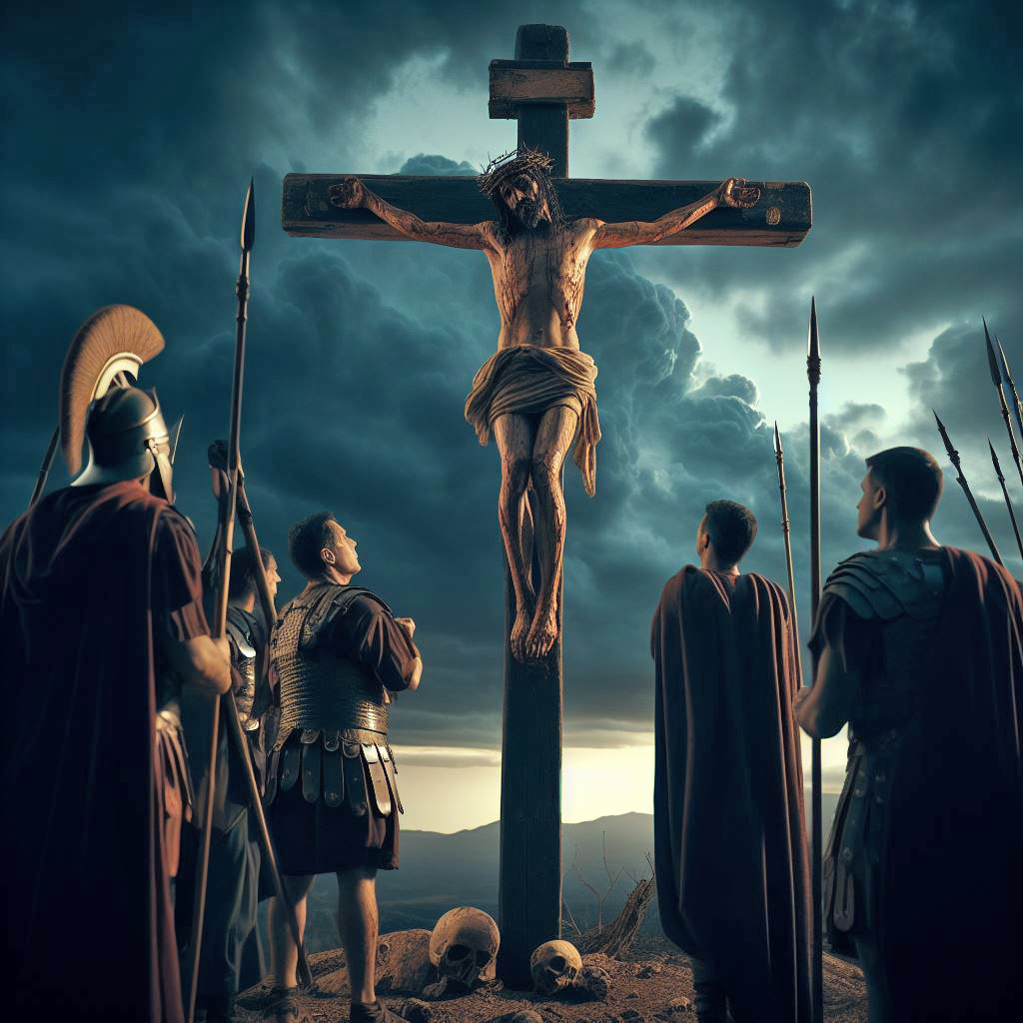

Slide 32


Slide 33
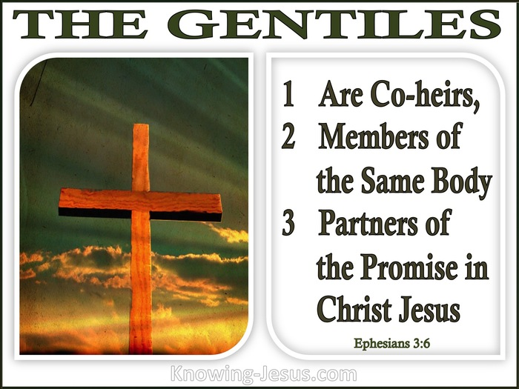

Slide 34
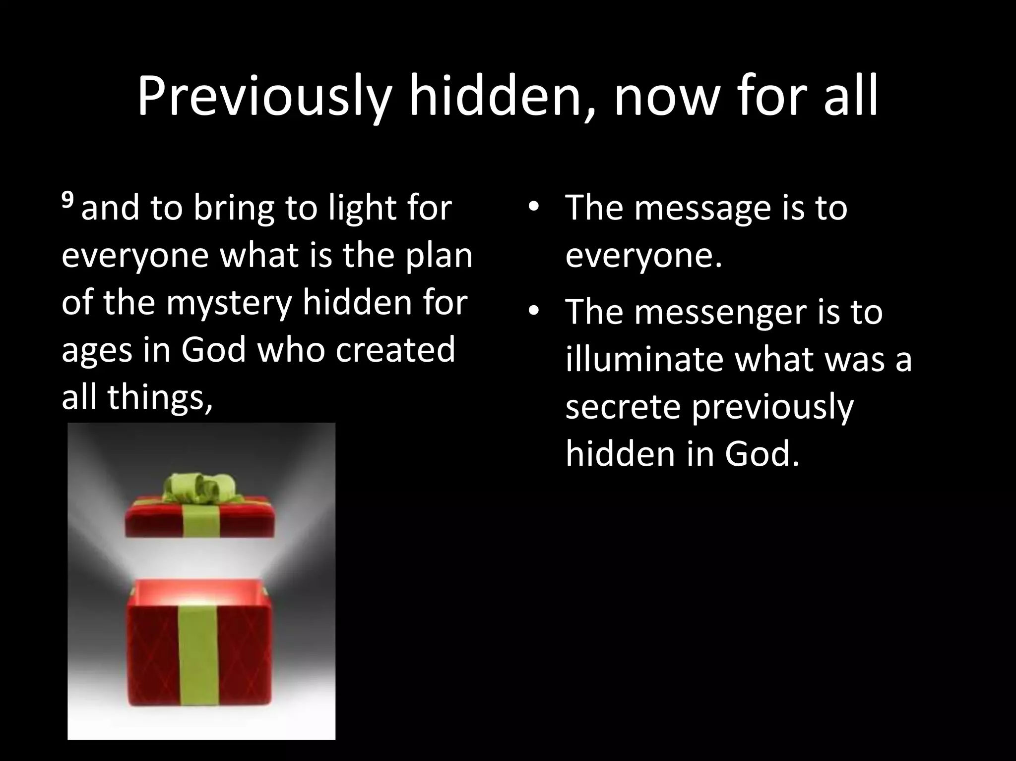

Slide 35


Slide 36
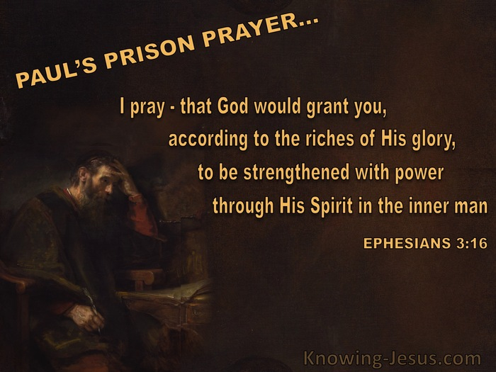

Slide 37


Slide 38
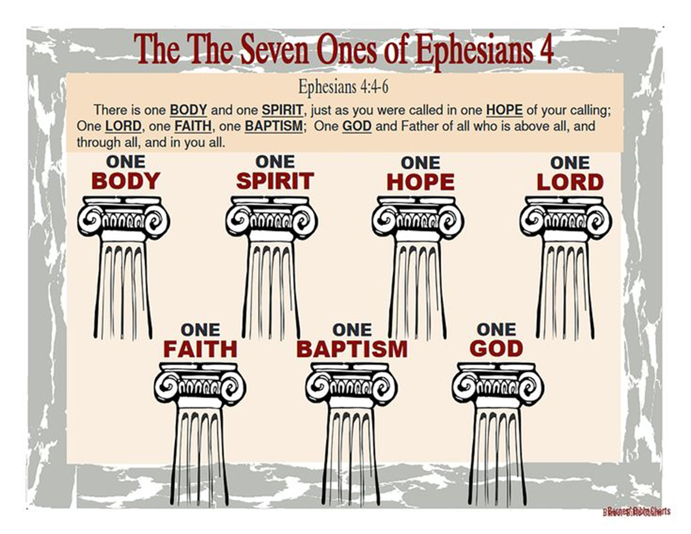

Slide 39
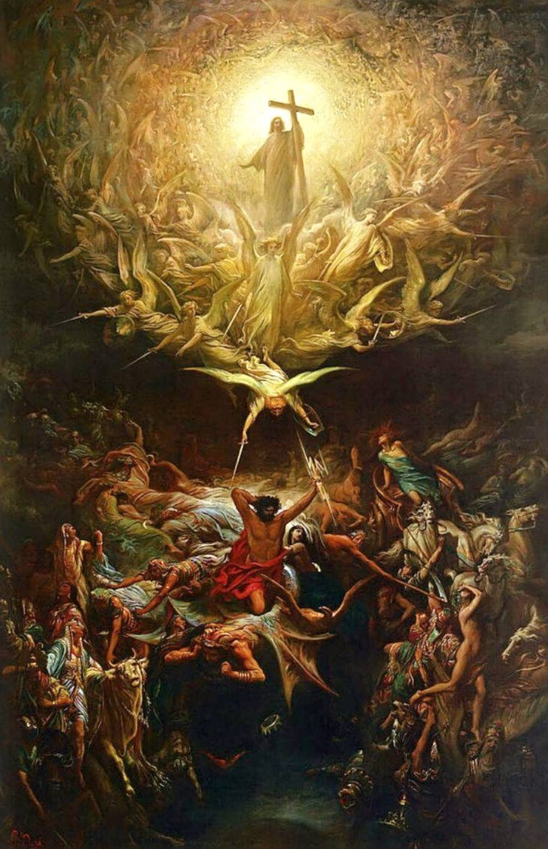

Slide 40
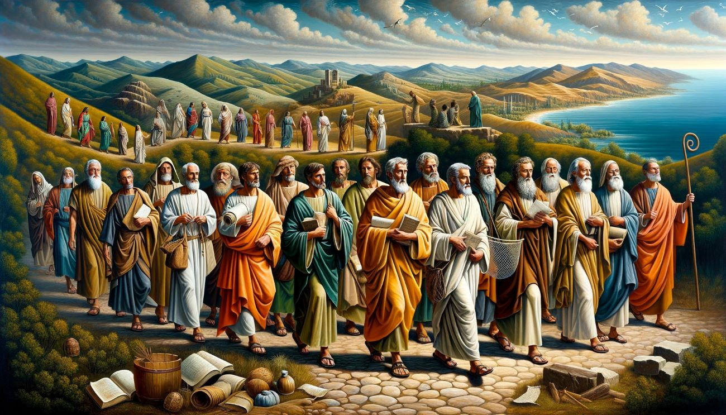

Slide 41
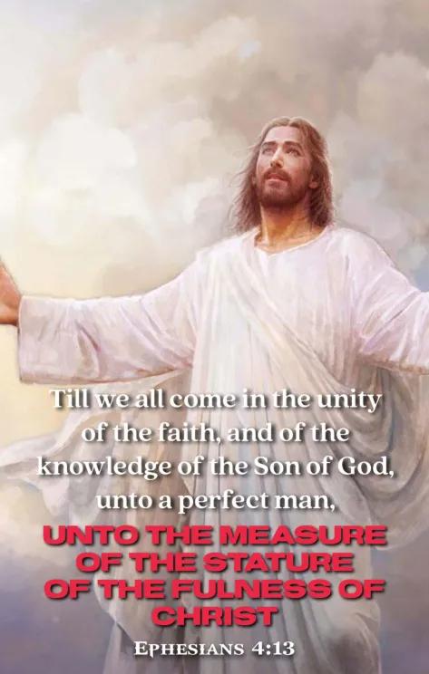

Slide 42


Slide 43


Slide 44
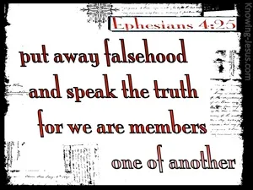

Slide 45


Slide 46


Slide 47
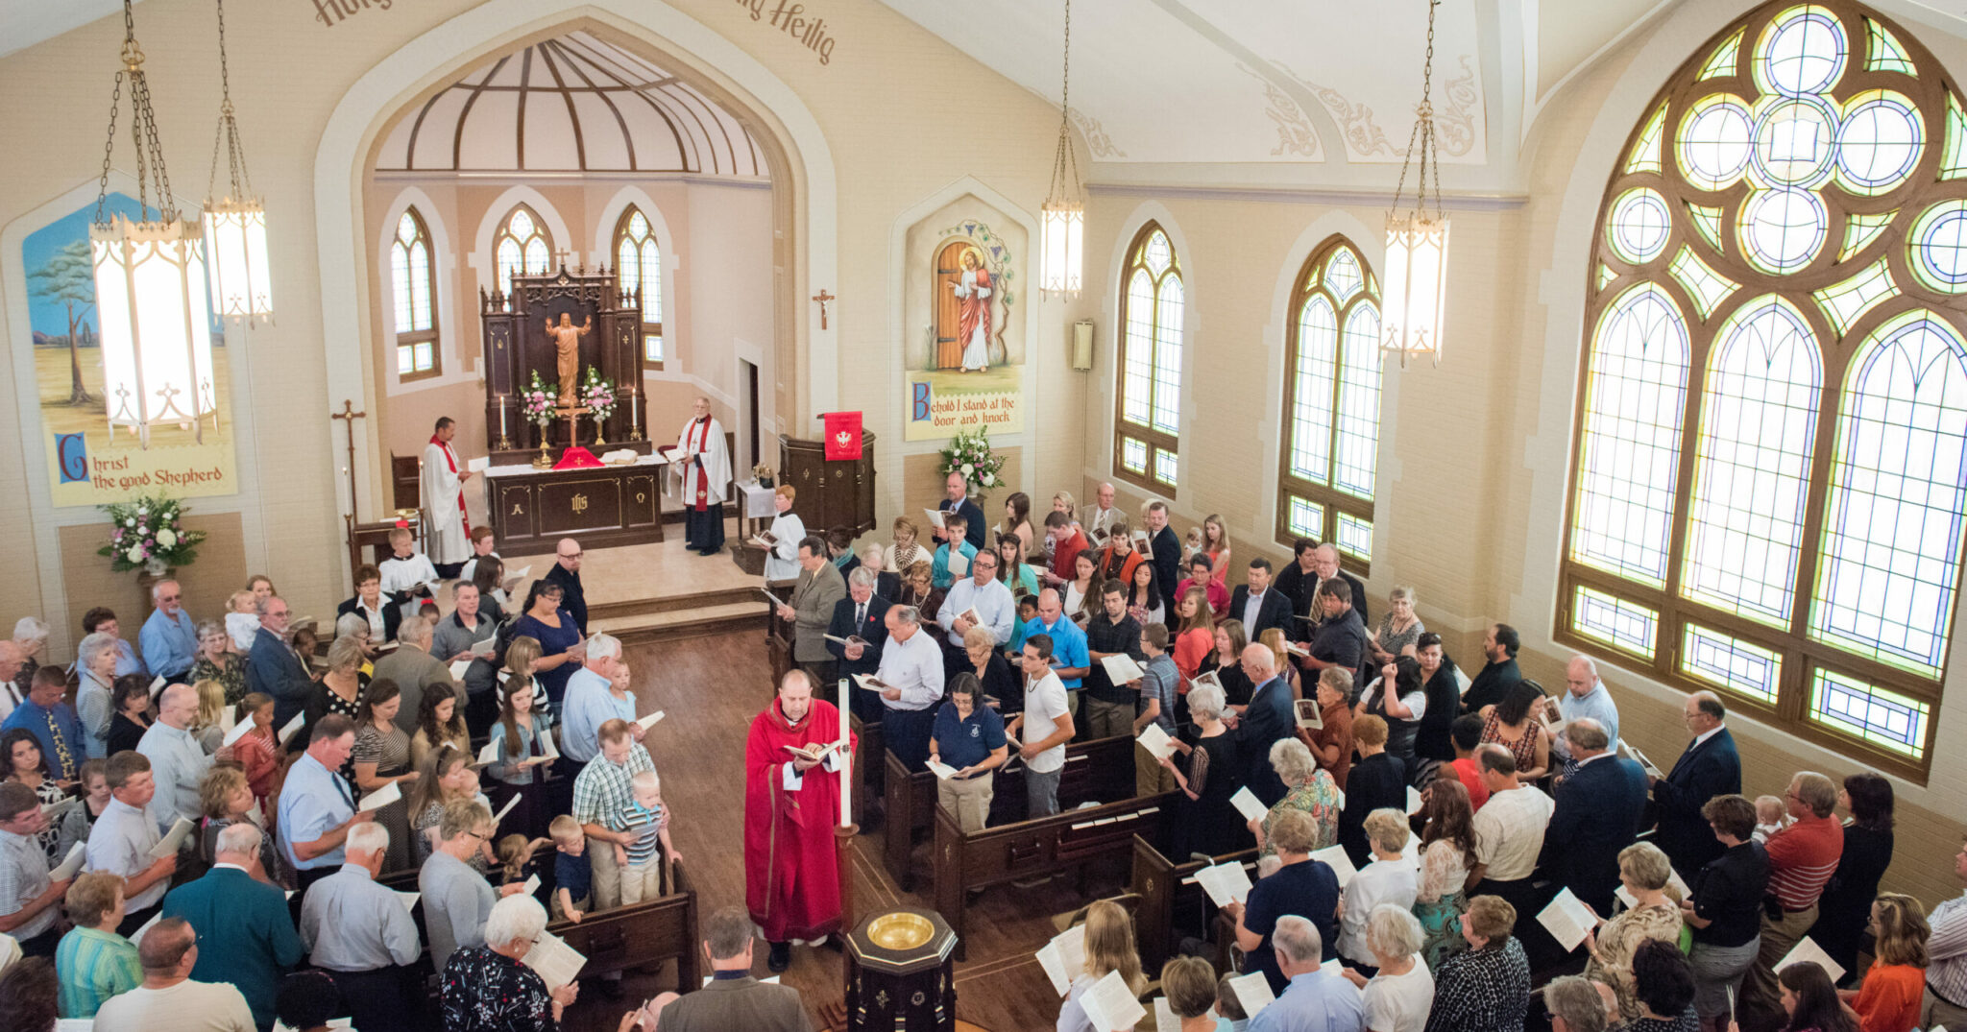

Slide 48
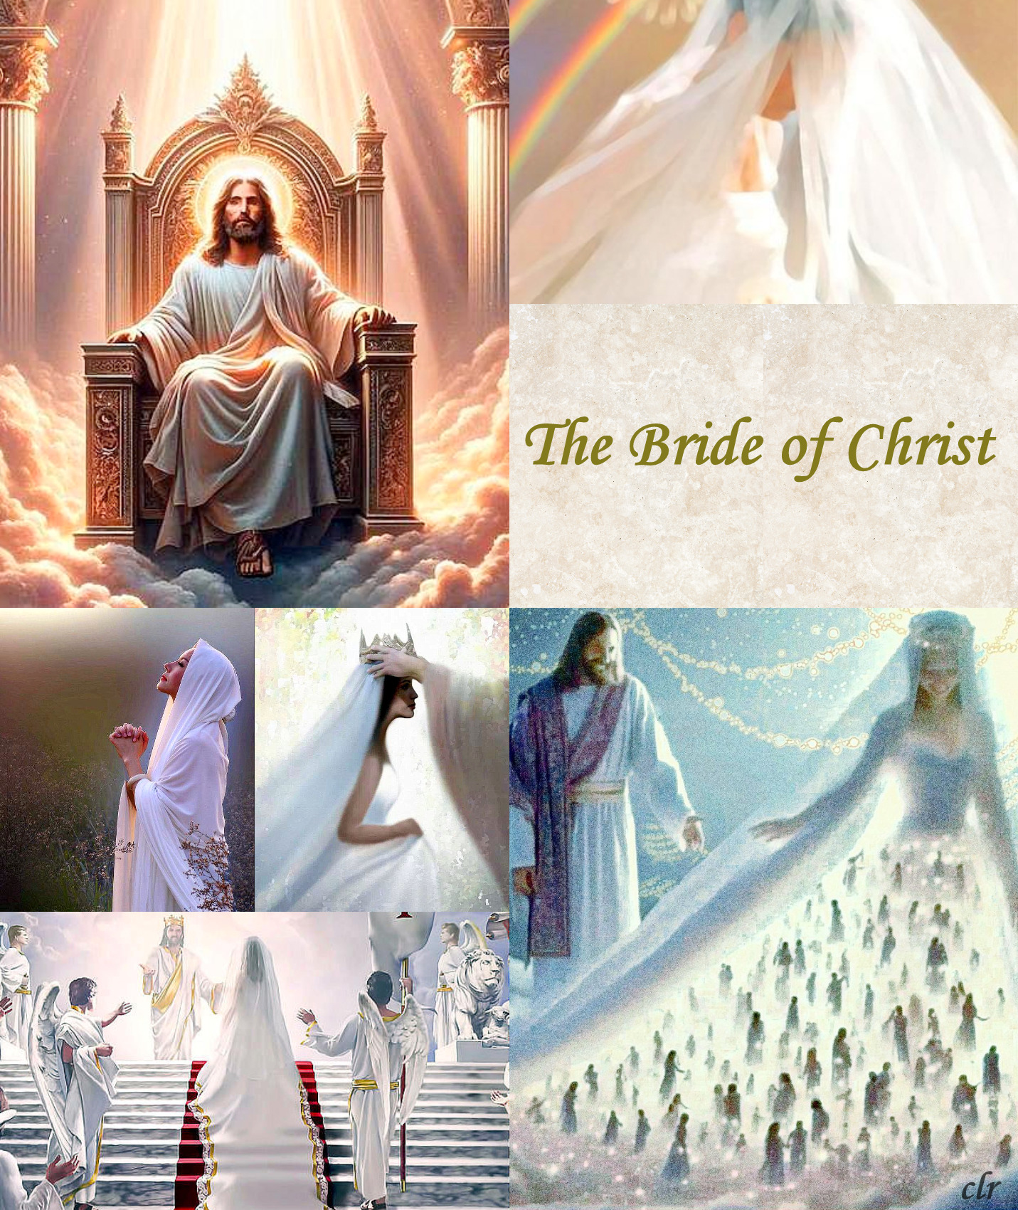

Slide 49
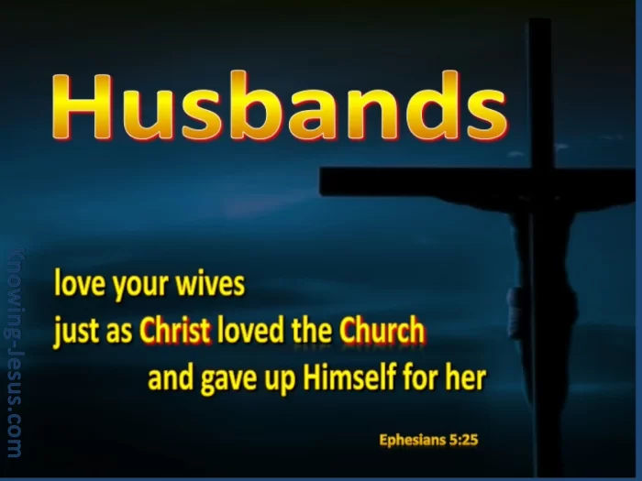

Slide 50
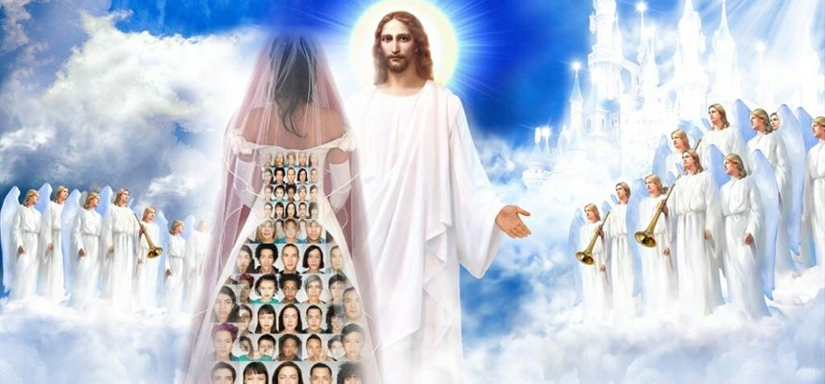

Slide 51
