Slide 1

THE BOOK OF EPHESIANS
“We Are His Workmanship”
Date: 2-2-25 Lesson: 36
Pastor David Nehrenz –
Trinity Lutheran Church – Norman, OK

Slide 2
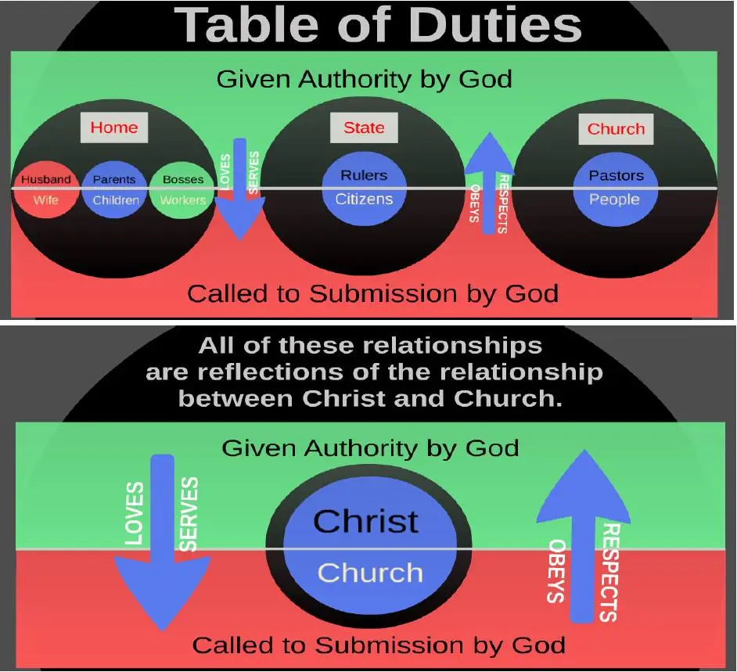

Slide 3
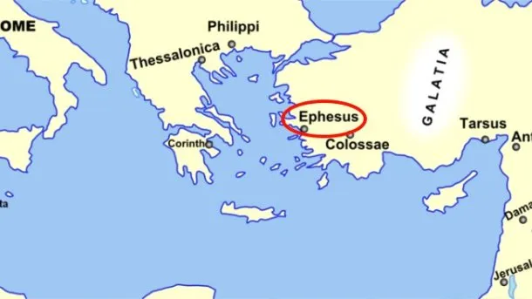
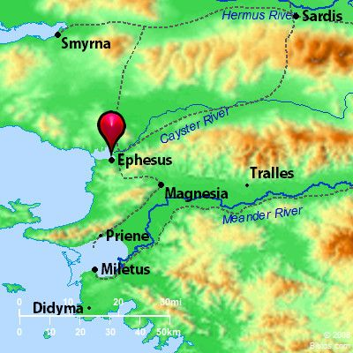
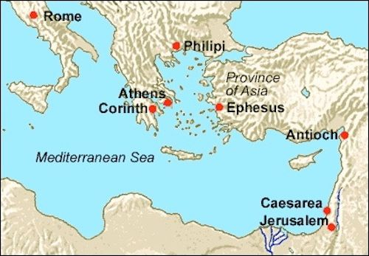

Slide 4
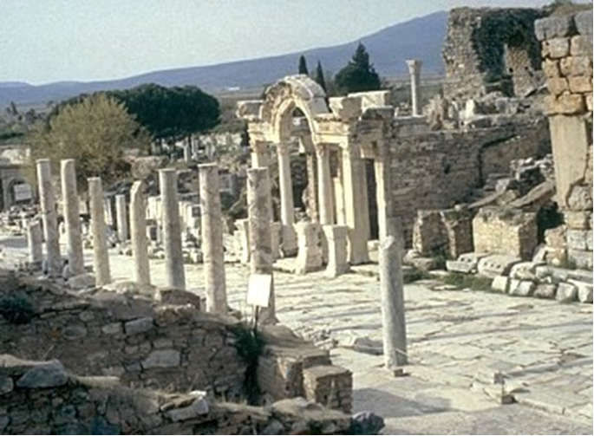

Slide 5
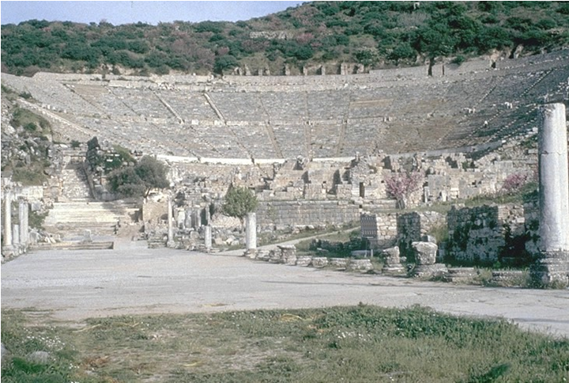

Slide 6
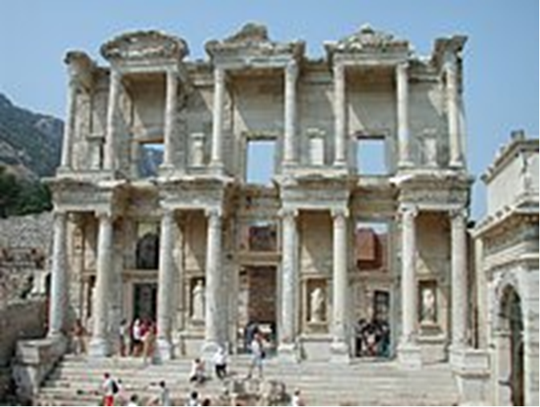

Slide 7
THE TEXT (Ephesians 6:1-9)
(1) Children, obey your parents in the Lord, for this is right.
(2) "Honor your father and mother" (this is the first commandment with a promise),
(3) "that it may go well with you and that you may live long in the land."
(Ex 20:6-12; Dt 5:16; Prov 1:8; 6:20; 23:22; Col 3:20; 1 Tim 4:8)

Slide 8
(4) Fathers, do not provoke your children to anger,
but bring them up in the discipline and instruction of the Lord.
(Gen 18:19; Dt 4:9; 6:7,20; 11:19; Ps 78:4; Prov 13:24; 19:18; 22:6; 29:17;
2 Tim 3:15; Col 3:21)

Slide 9
(5) Slaves, obey your earthly masters with fear and trembling, with a sincere heart, as you would Christ, (6) not by the way of eye-service, as people-pleasers,
but as servants of Christ doing the will of God from the heart,
(7) rendering service with a good will
as to the Lord and not to man,
(8) knowing that whatever good anyone does,
this he will receive back from the Lord, whether he is a slave or free.
(Ps 62:12; Mt 16: 27; Rom 2:6; 6:22;
1 Cor 3:8; 7:22; 12:13; 2 Cor 5:10; 11:3;
Gal 1:10; 3:28; Php 2:12; Col 3:11,22-24;
1 Tim 6:1; Titus 2:9,10; 1 Pet 2:18)

Slide 10
(9) Masters, do the same to them,
and stop your threatening,
knowing that he who is both their Master and yours is in heaven,
and that there is no partiality with him.
(Lev 25:43; Dt 10:17; Job 31:13-15;
Jn 13:13; Ac 10:34,35 ;
Rom 2:9-13; Col 4:11; 1 Pet 1:17)

Slide 11
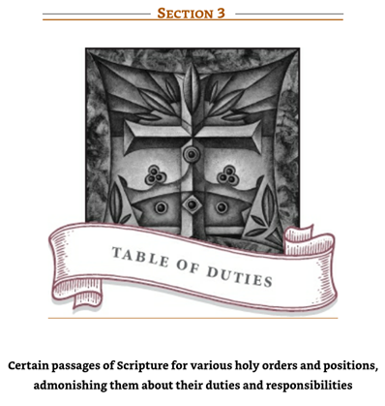

Slide 12
To Parents
Fathers, do not exasperate your children; instead, bring them up in the training and instruction of the Lord. Eph. 6:4
To Children
Children, obey your parents in the Lord, for this is right. “Honor your father and your mother”—which is the first commandment with a promise—“that it may go well with you and that you may enjoy long life on the earth.” Eph. 6:1–3

Slide 13
To Workers of All Kinds
Slaves, obey your earthly masters with respect and fear, and with sincerity of heart, just as you would obey Christ. Obey them not only to win their favor when their eye is on you, but like slaves of Christ, doing the will of God from your heart. Serve wholeheartedly, as if you were serving the Lord, not men, because you know that the Lord will reward everyone for whatever good he does, whether he is slave or free. Eph. 6:5–8
To Employers and Supervisors
Masters, treat your slaves in the same way. Do not threaten them, since you know that He who is both their Master and yours is in heaven, and there is no favoritism with Him. Eph. 6:9
To Youth
Young men, in the same way be submissive to those who are older. All of you, clothe yourselves with humility toward one another, because, “God opposes the proud but gives grace to the humble.” Humble yourselves, therefore, under God’s mighty hand, that He may lift you up in due time. 1 Peter 5:5–6

Slide 14
LIFE APPLICATION
Every Christian has a vocation = calling (vocatio)
We walk in faith toward God and love for our neighbor.
(1st and 2nd Tables of the Law)
How do you balance the living out of these six daily callings?:
Disciple of Christ – Spouse – Parent –
Occupation – Church Member - Citizen

Slide 15
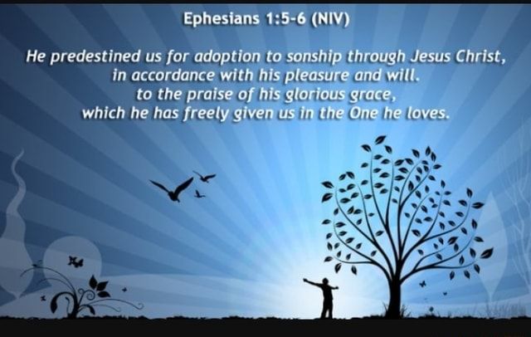

Slide 16
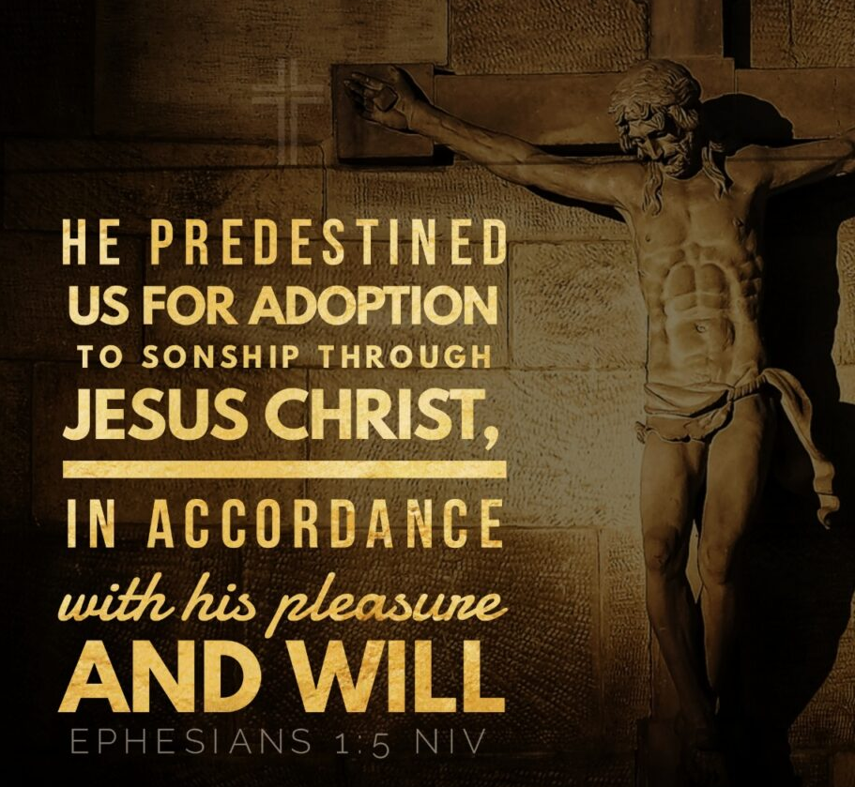

Slide 17
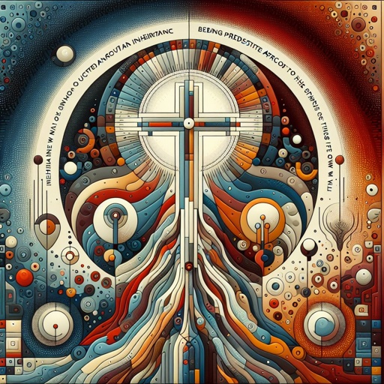

Slide 18
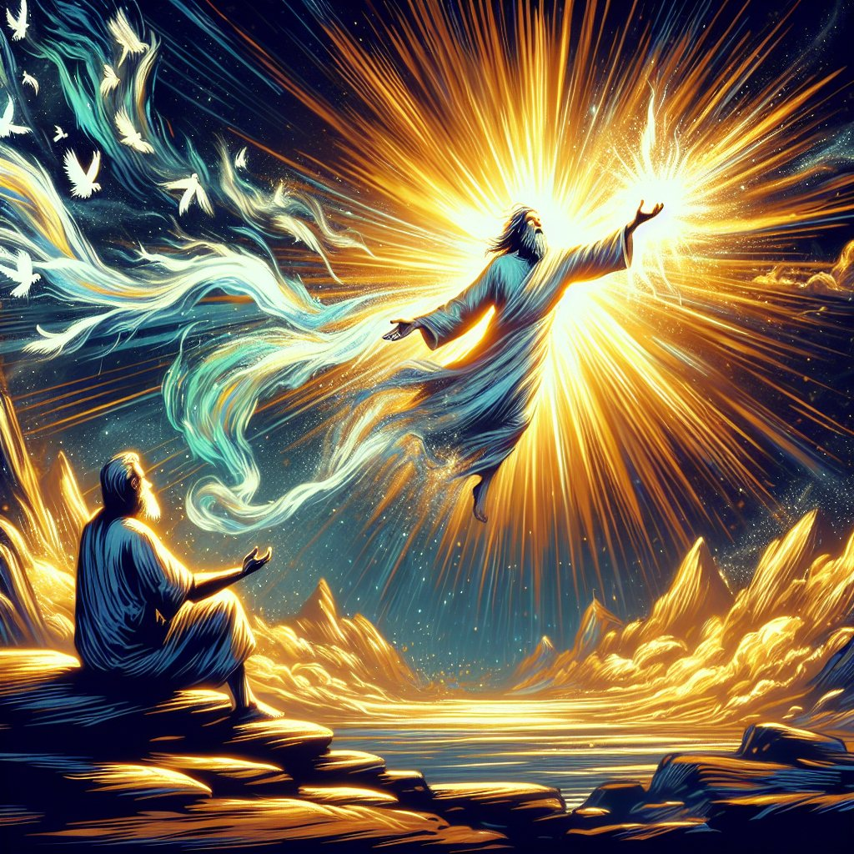

Slide 19
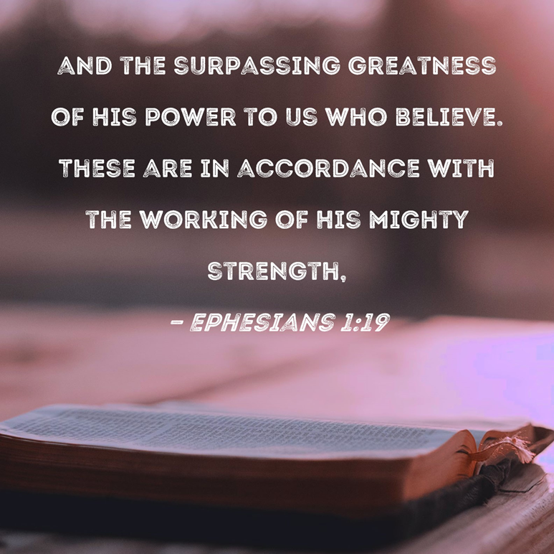

Slide 20


Slide 21
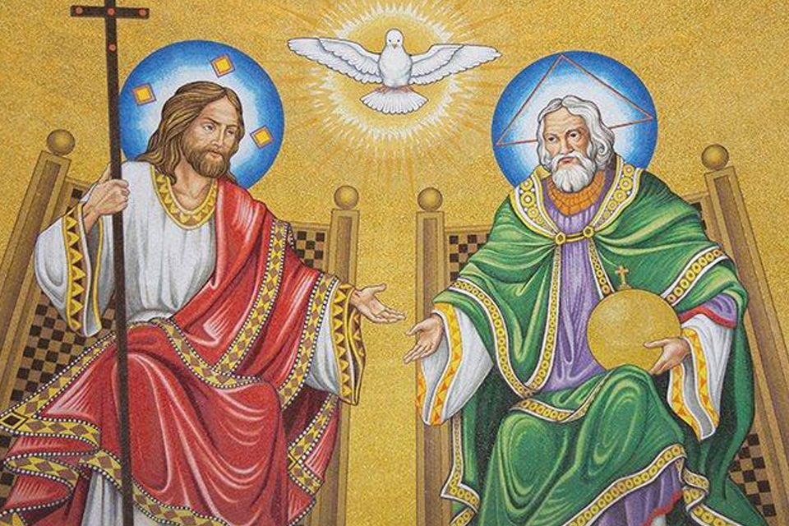

Slide 22
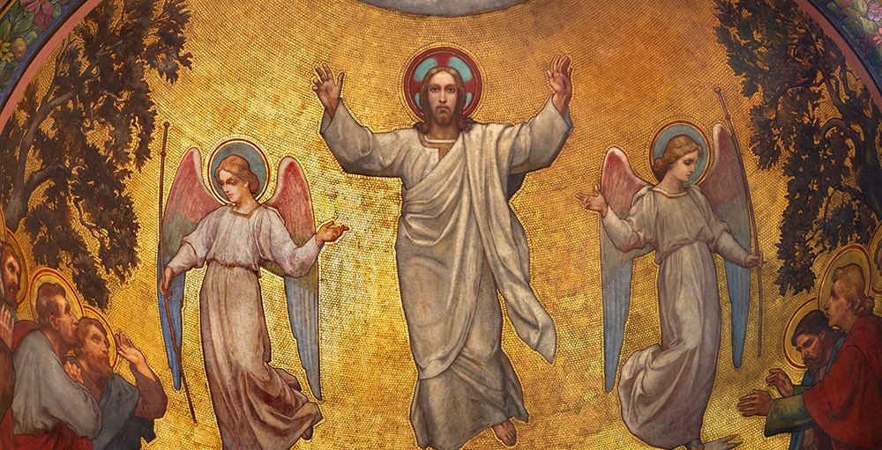

Slide 23
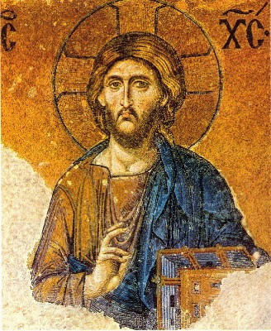

Slide 24
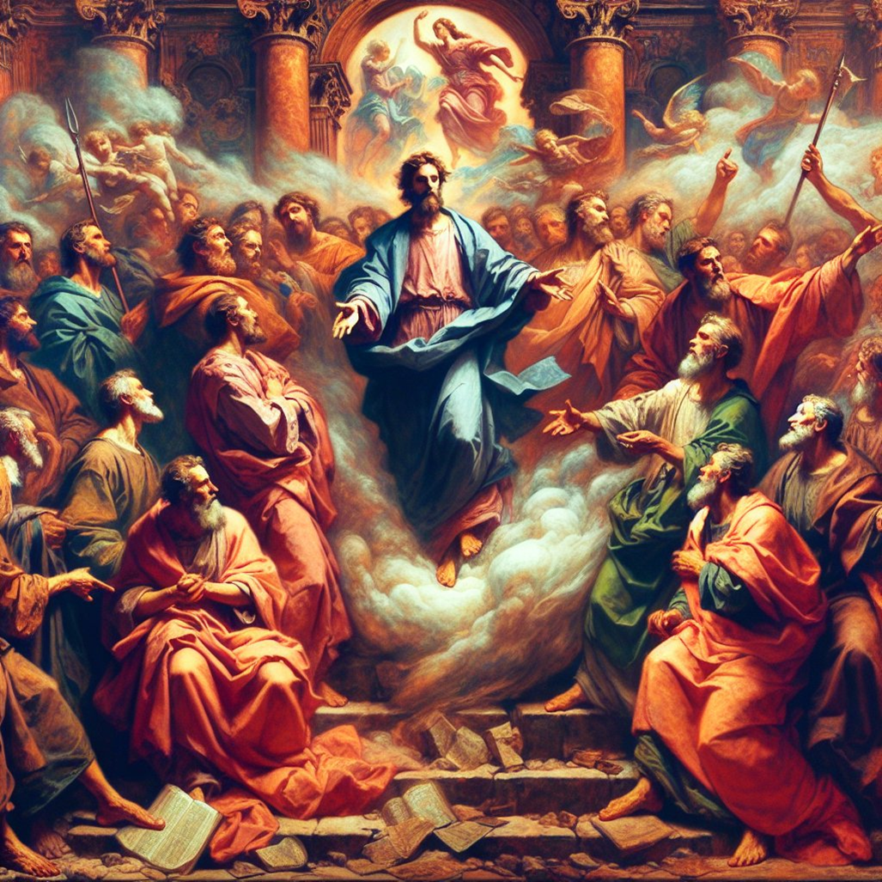

Slide 25


Slide 26
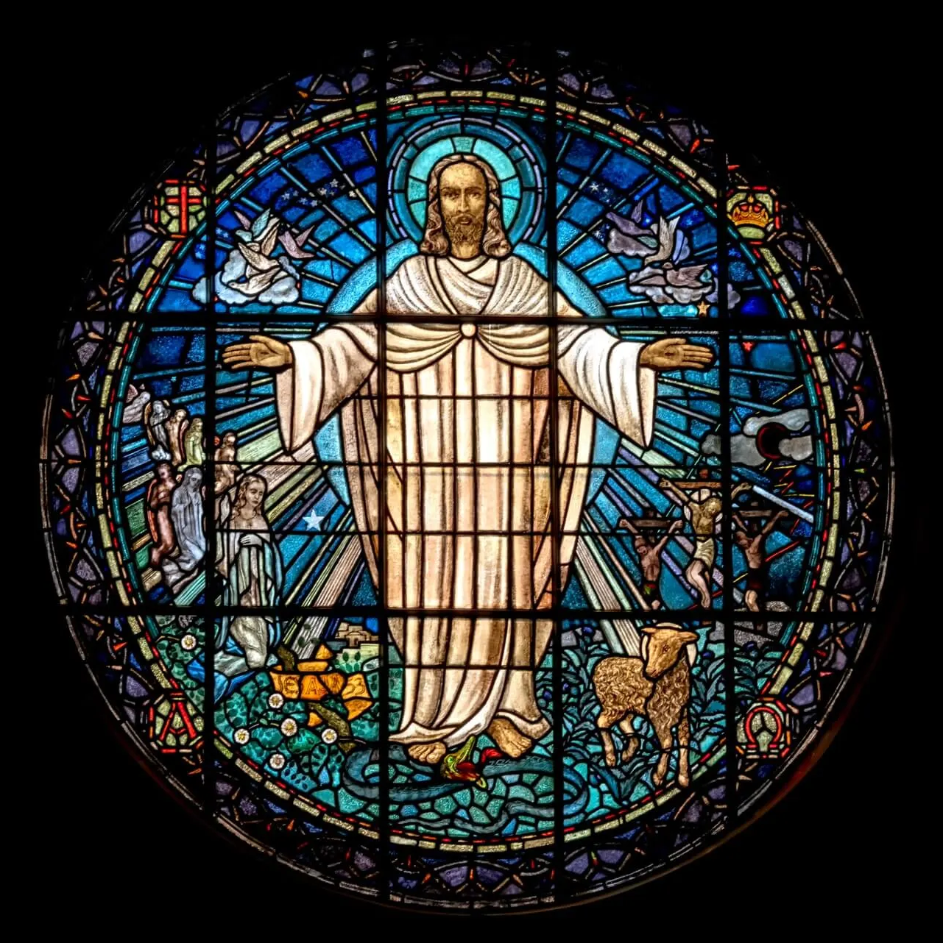

Slide 27
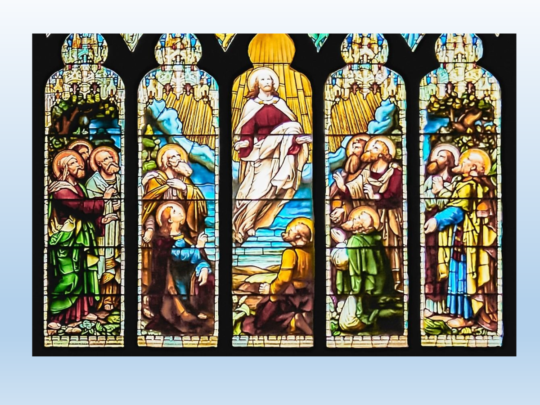

Slide 28


Slide 29
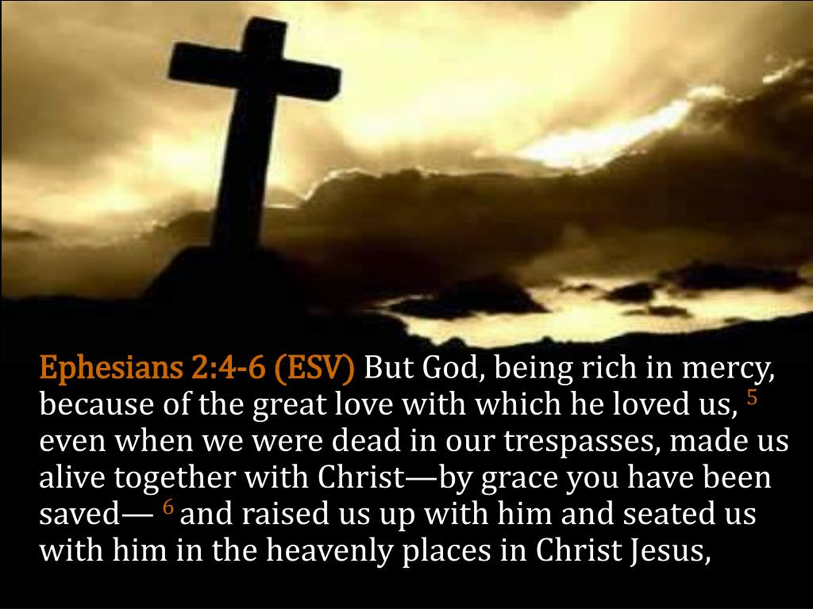

Slide 30


Slide 31
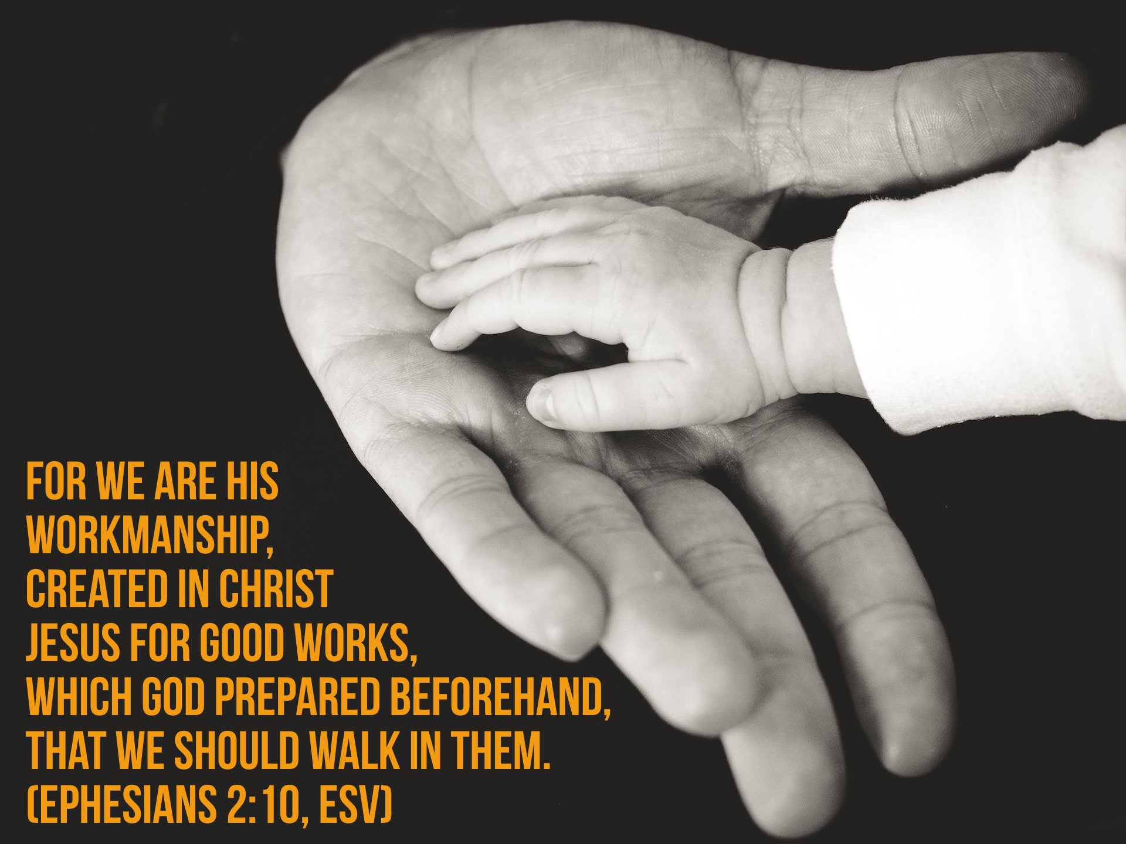

Slide 32
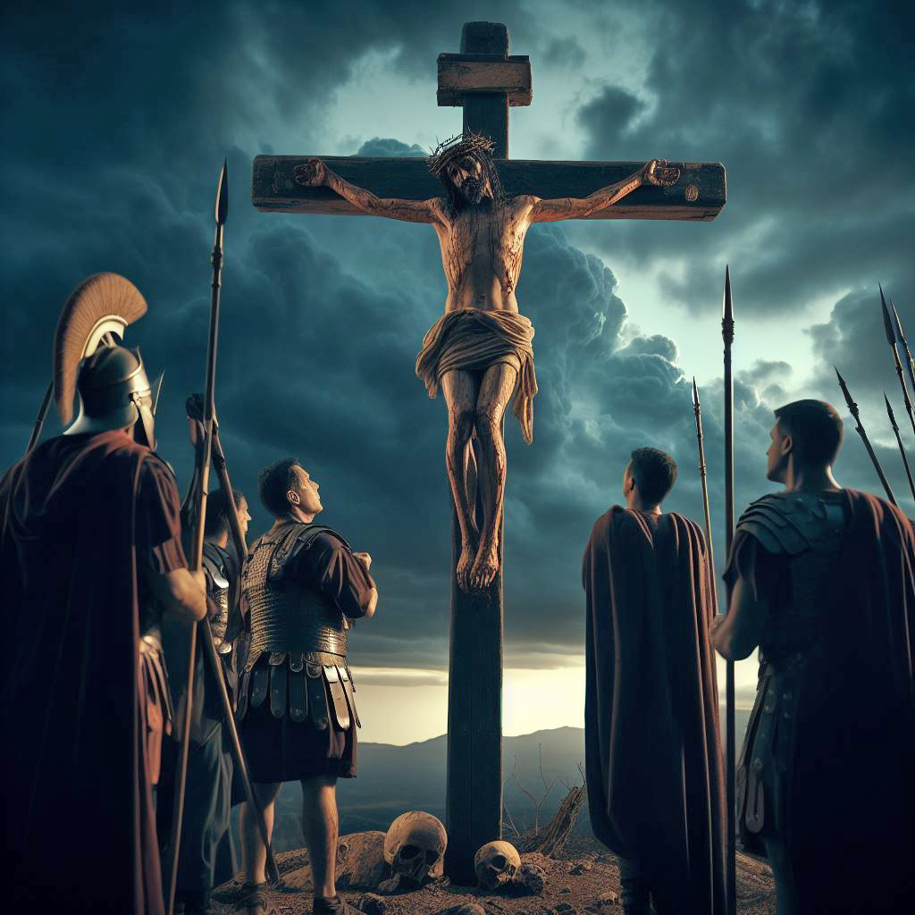

Slide 33


Slide 34
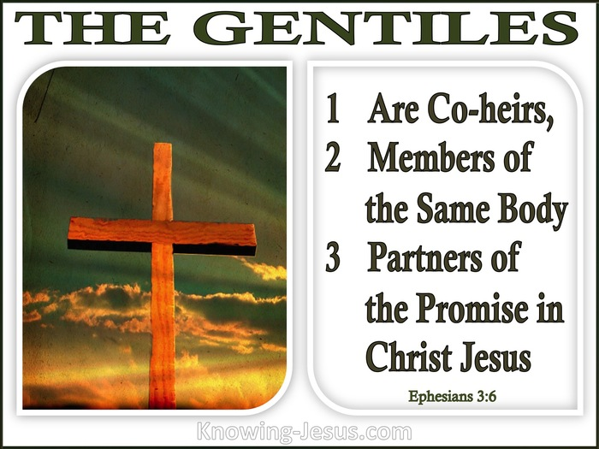

Slide 35
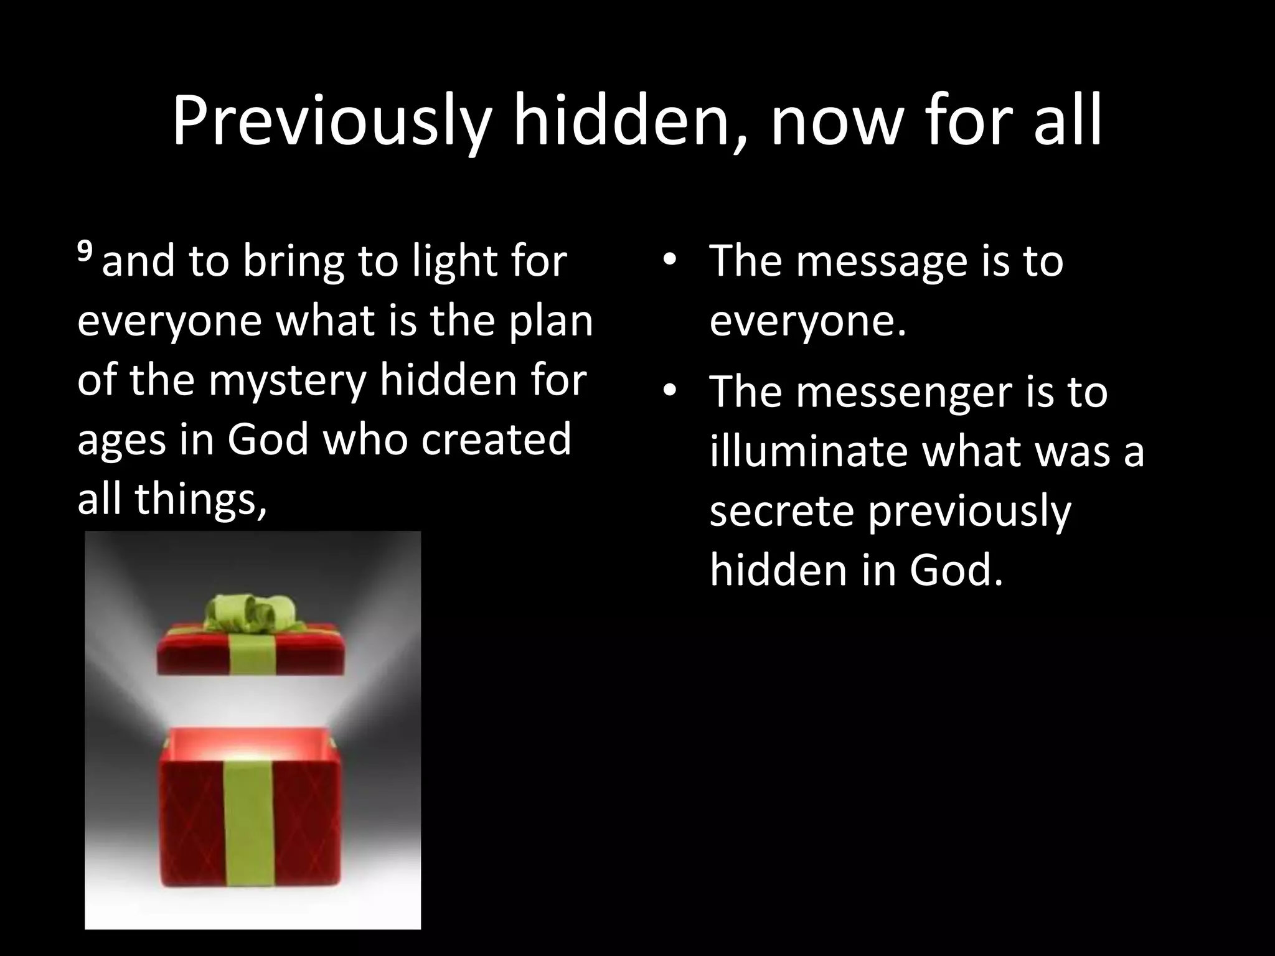

Slide 36


Slide 37
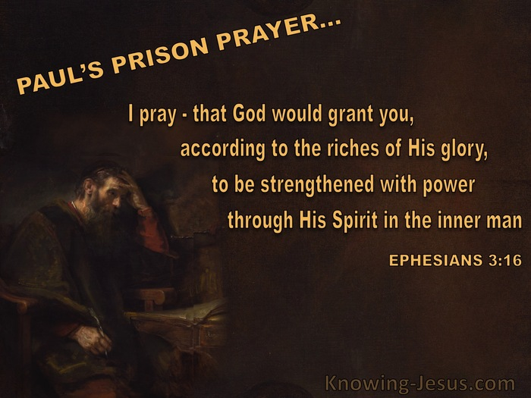

Slide 38


Slide 39
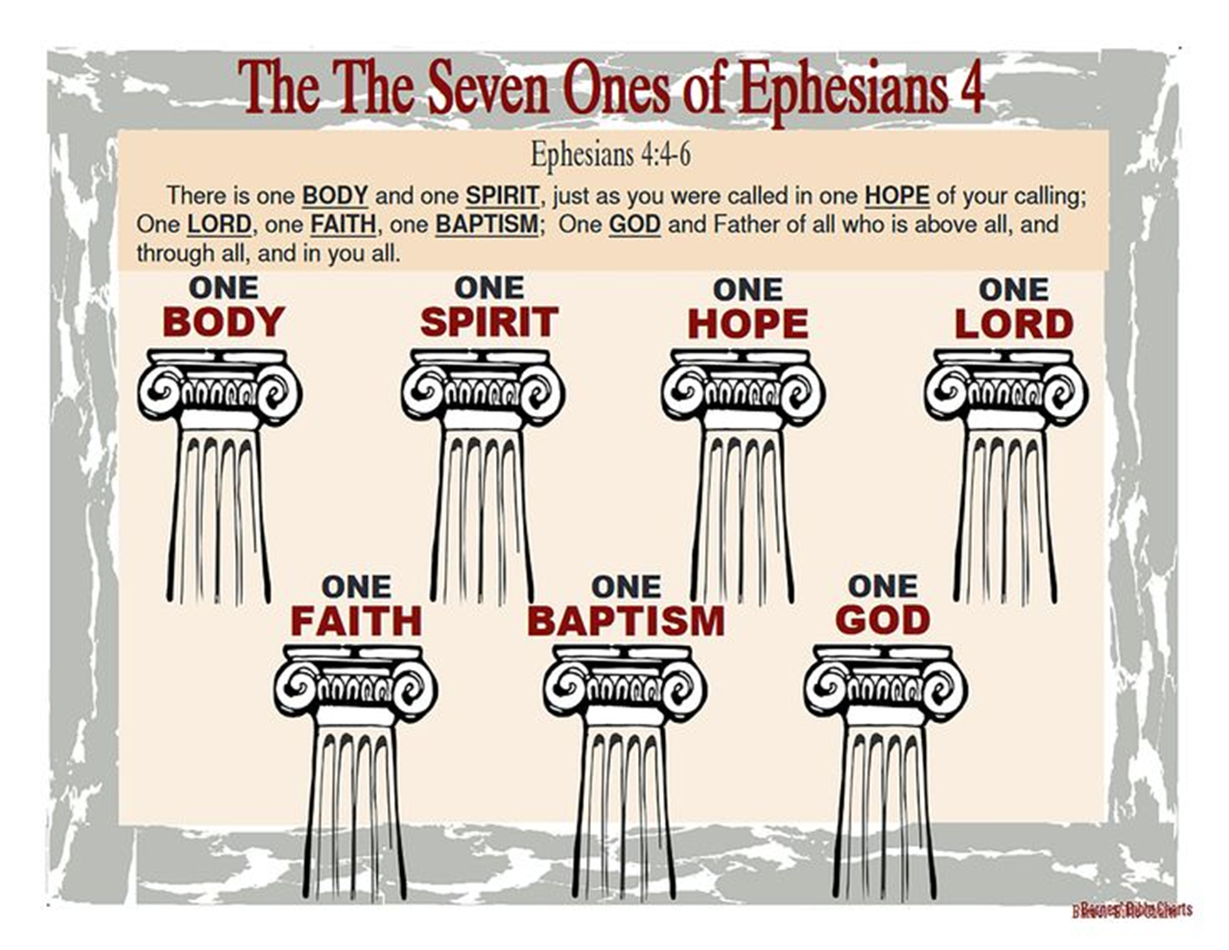

Slide 40
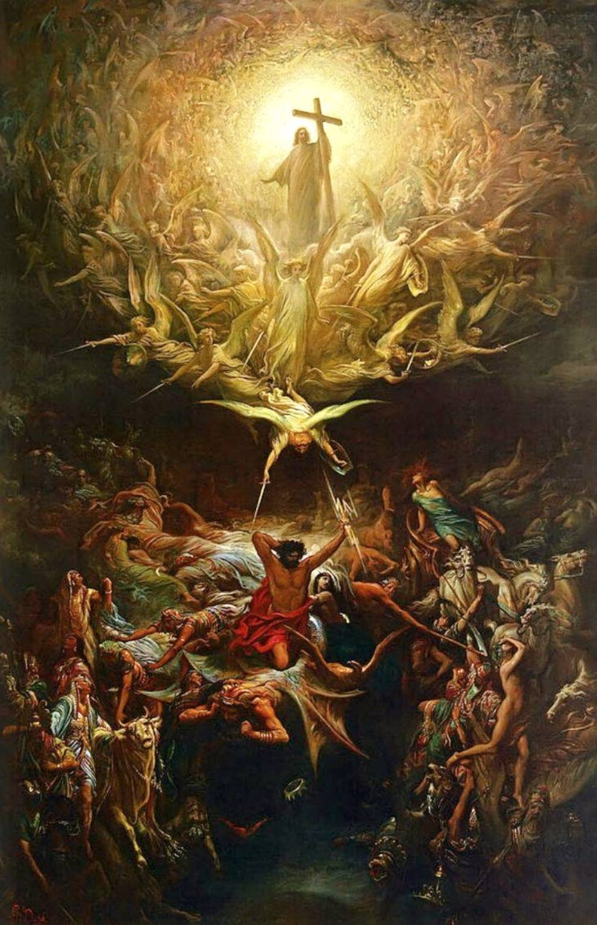

Slide 41
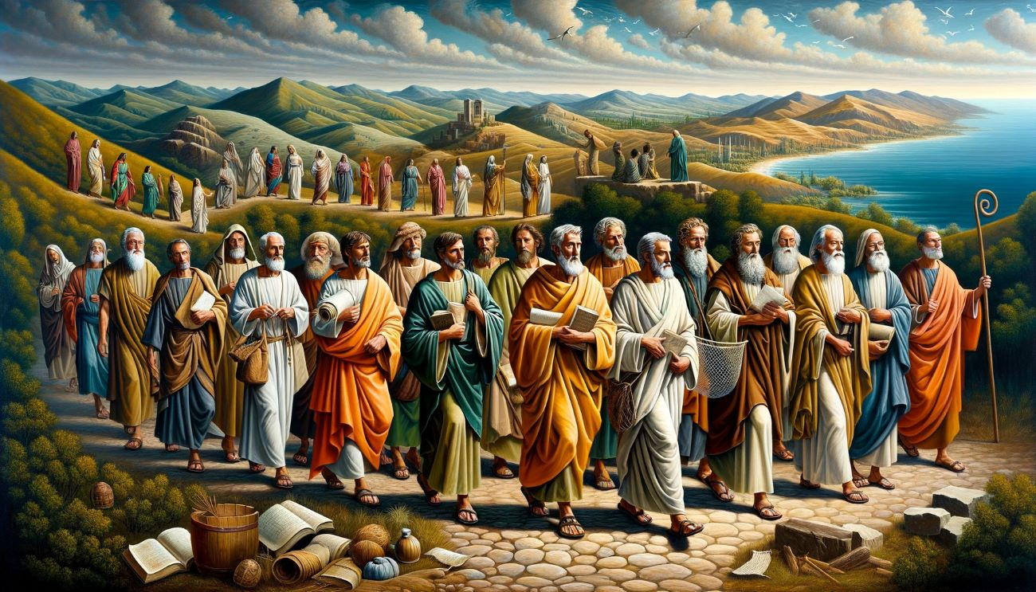

Slide 42
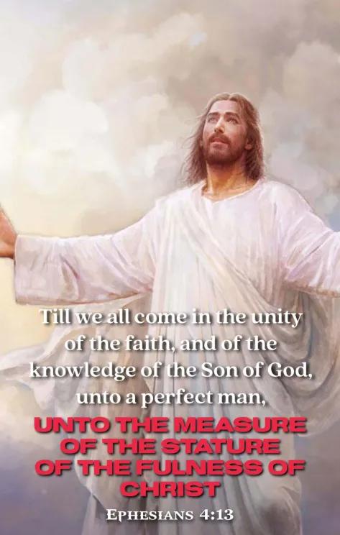

Slide 43


Slide 44


Slide 45
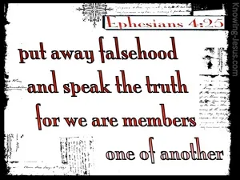

Slide 46


Slide 47


Slide 48
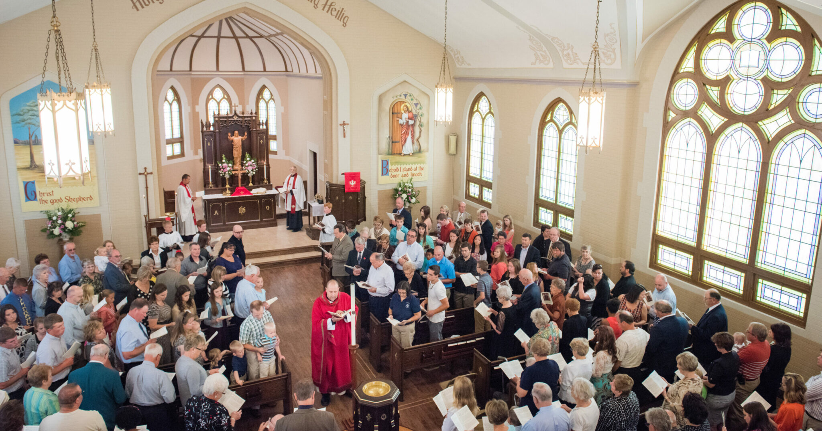

Slide 49
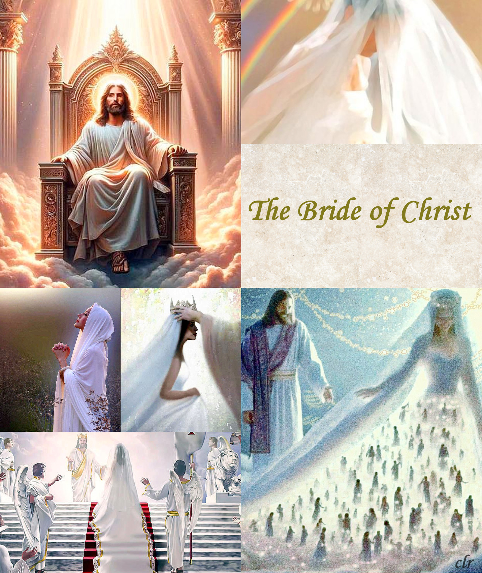

Slide 50
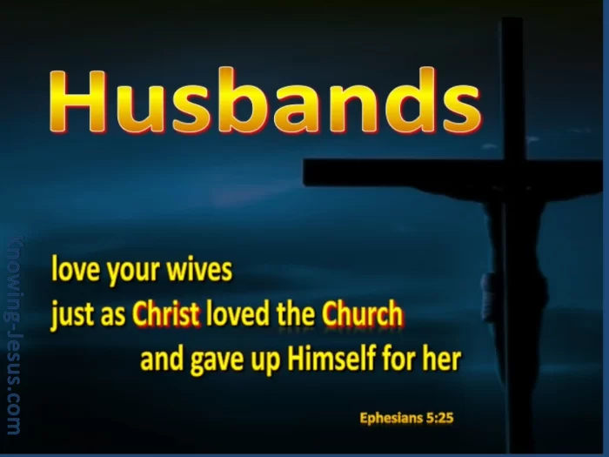

Slide 51
