Slide 1
THE BOOK OF EPHESIANS
“We Are His Workmanship”
Date: 1-19-25 Lesson: 35
Pastor David Nehrenz –
Trinity Lutheran Church – Norman, OK

Slide 2
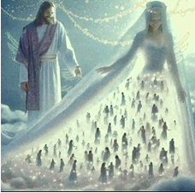

Slide 3
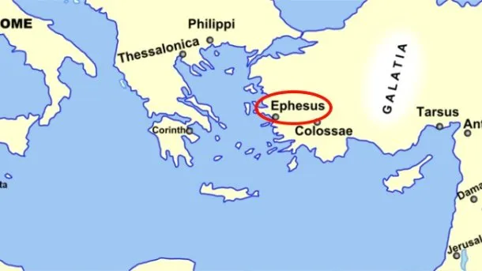
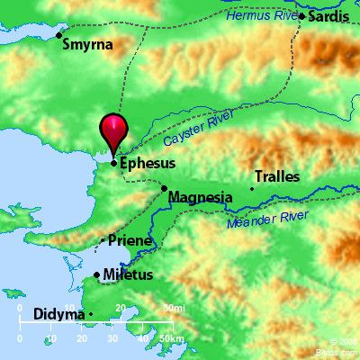
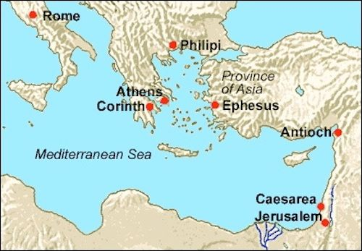

Slide 4
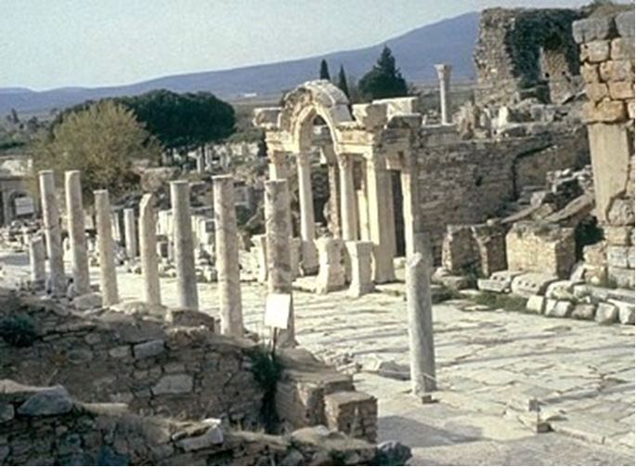

Slide 5
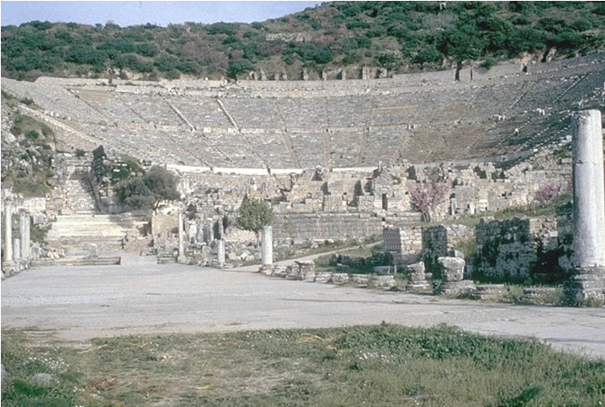

Slide 6
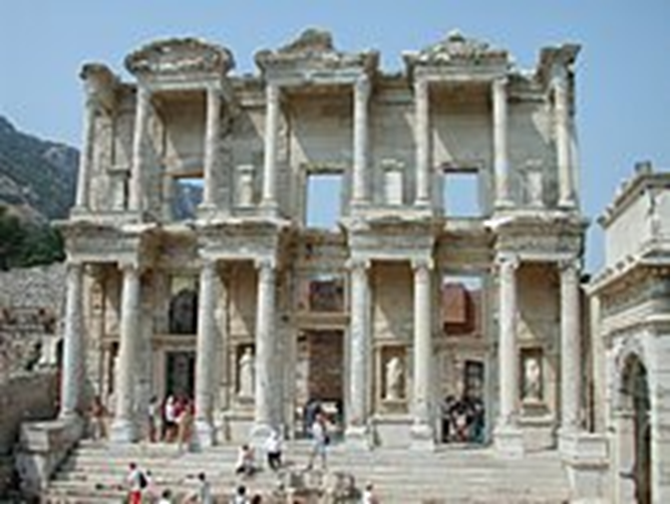

Slide 7
THE TEXT (Ephesians 5:31-33)
(31) "Therefore a man shall leave his father and mother and hold fast to his wife,
and the two shall become one flesh."
(32) This mystery is profound,
and I am saying that it refers to Christ and the church.
(33) However, let each one of you love his wife as himself,
and let the wife see that she respects her husband.
(Gen 2:18-25; Mt 19:4-6; 22:1-14, 22-32; 25:1-13;
Mk 2:19,20; 10:6-9; Lk 12:35-37; 20:34-38; Jn 2:1-12; Rom 7:2,3; 1 Cor 6:15-20;
Heb 13:4; 1 Pet 3:1-8; Rev 19:7-9; 21:1-9; 22:16,17)

Slide 8
STUDY HELPS
The Large Catechism – The Sixth Commandment
[217] Now, I speak of this in order that the young may be guided so that they desire the married estate and know that it is a blessed estate and pleases God. For in this way, over time we might cause married life to be restored to honor. There might be less of the filthy, loose, disorderly behavior that now run riot the world over in open prostitution and other shameful vices arising from disregard for married life.
[218] Therefore, it is the duty of parents and the government to see to it that our youth are brought up with discipline and respectability. When they have become mature, parents and government should provide for them to marry in the fear of God and honorably. God would not fail to add His blessing and grace, so that people would have joy and happiness from marriage.
[219] Let me now say in conclusion what this commandment demands: Everyone should live chaste in thought, word, and deed in his condition— that is, especially in the estate of marriage. But also everyone should love and value the spouse God gave to him [Ephesians 5: 33]. For where marital chastity is to be maintained, man and wife must by all means live together in love and harmony. Then one may cherish the other from the heart and with complete faithfulness. For harmony is one of the principal points that enkindles love and desire for chastity, so that, where this is found, chastity will follow without any command.
[220] Therefore, St. Paul diligently encourages husband and wife to love and honor one another.
[221] Here you have again precious, indeed, many and great good works. You can joyfully boast about them, against all churchly estates chosen

Slide 9
LIFE APPLICATION
The vital distinction between:
1. THE ORDER OF SALVATION
Husband, wife, children all on the same level – saved by grace through faith,
as sons of God connected to THE SON OF GOD – JESUS CHRIST – heirs of the inheritance to eternal life – the priesthood of all believers who are baptized into the Body of Christ – the Church
(Rom 8:14-17; Gal 3:25-29; 1 Pet 2:9,10)
2. THE ORDER OF CREATION
God the Father sent his
Son, Jesus our Lord – submitted to his Father
Husband – submits to Christ
Wife – submits to her husband
Children – submit to their father and mother
(Eph 5:22-33; Col 3:18-21; 1 Pet 3:1-8)
These operate at one and the same time, and are great blessings!

Slide 10
3. Marriage was the first institution created by God in the Garden of Eden.
At a marriage was the first miracle done by Jesus at the wedding in Cana.
The marriage banquet and feast in heaven is the wedding that will have no end.
4. “This, the first of his signs, Jesus did at Cana in Galilee,
and manifested his glory.
And his disciples believed in him.”
At a wedding we see three things with the eyes of Holy Scripture:
1. The original married couple – Adam and Eve.
2. The present couple who are getting married at a church.
3. Jesus the Bridegroom and the Church the Bride.
The Glory of Jesus prepares us for the
Lamb’s Wedding Banquet and Marriage Feast in heaven, which knows no end.
We have a foretaste of this in the Lord’s Supper, around the altar here on earth.

Slide 13
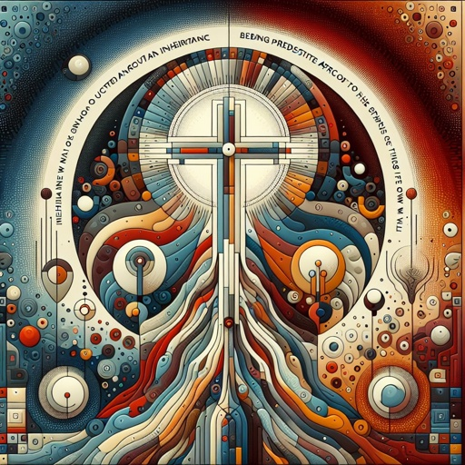

Slide 14
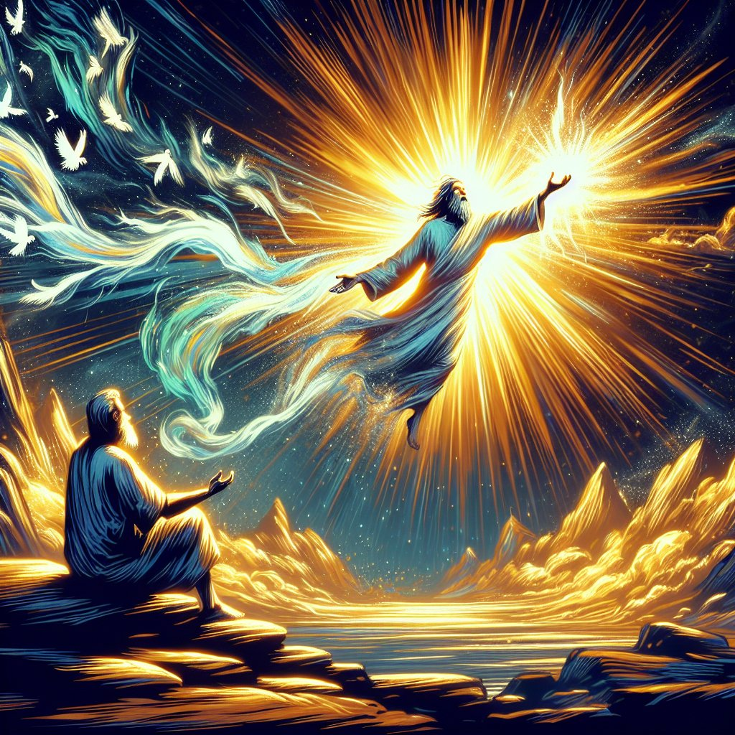

Slide 19
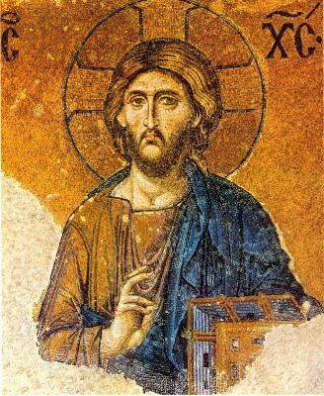

Slide 20
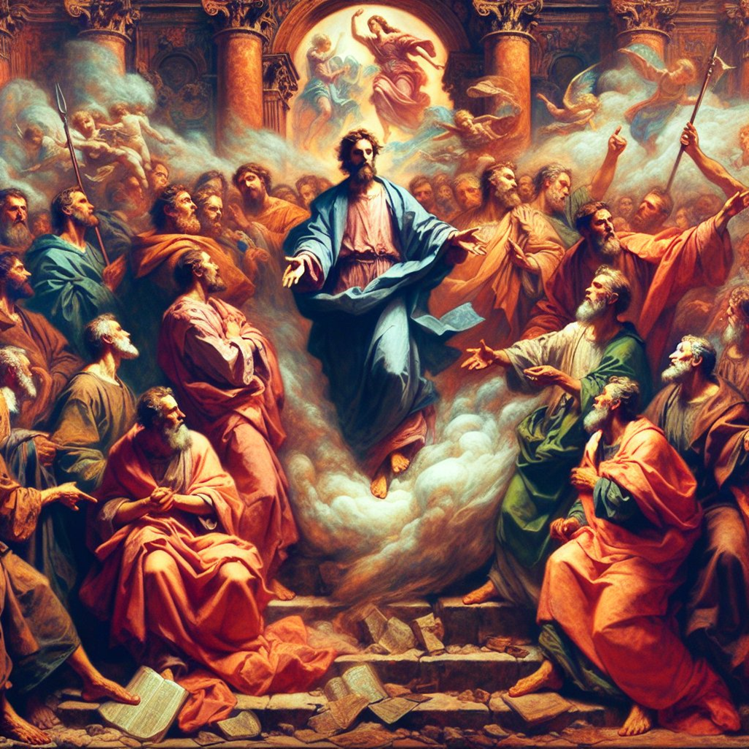

Slide 36
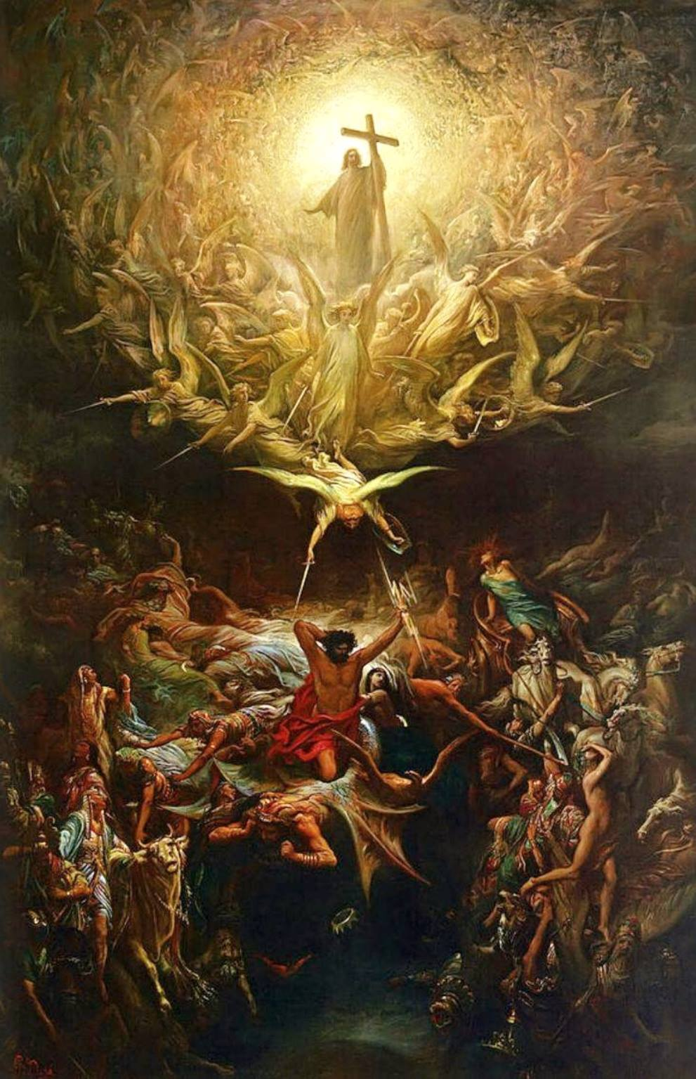

Slide 37
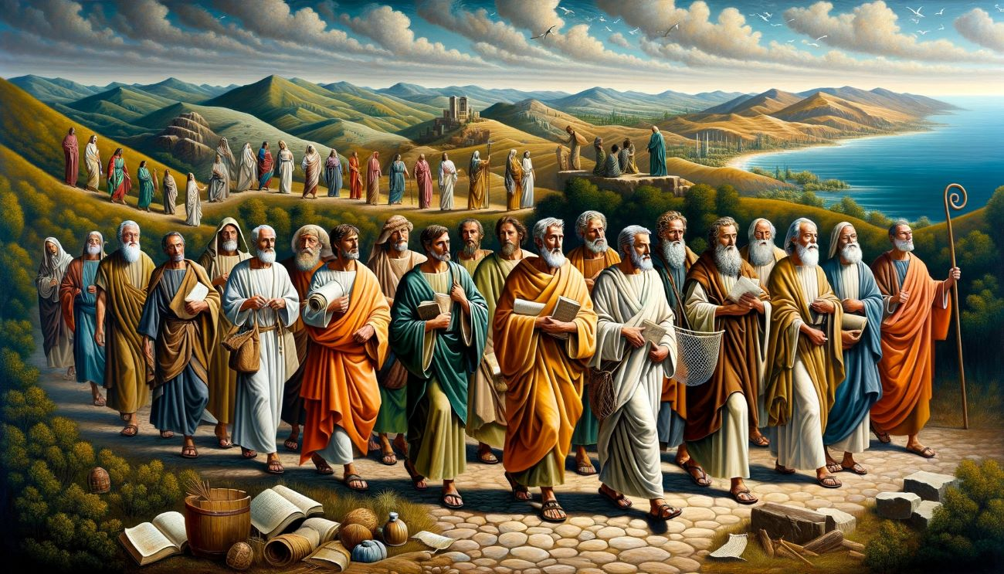

Slide 38
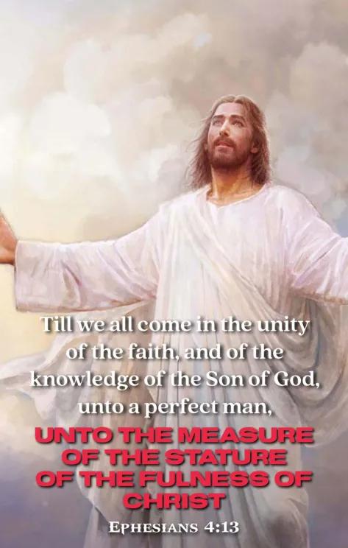

Slide 44
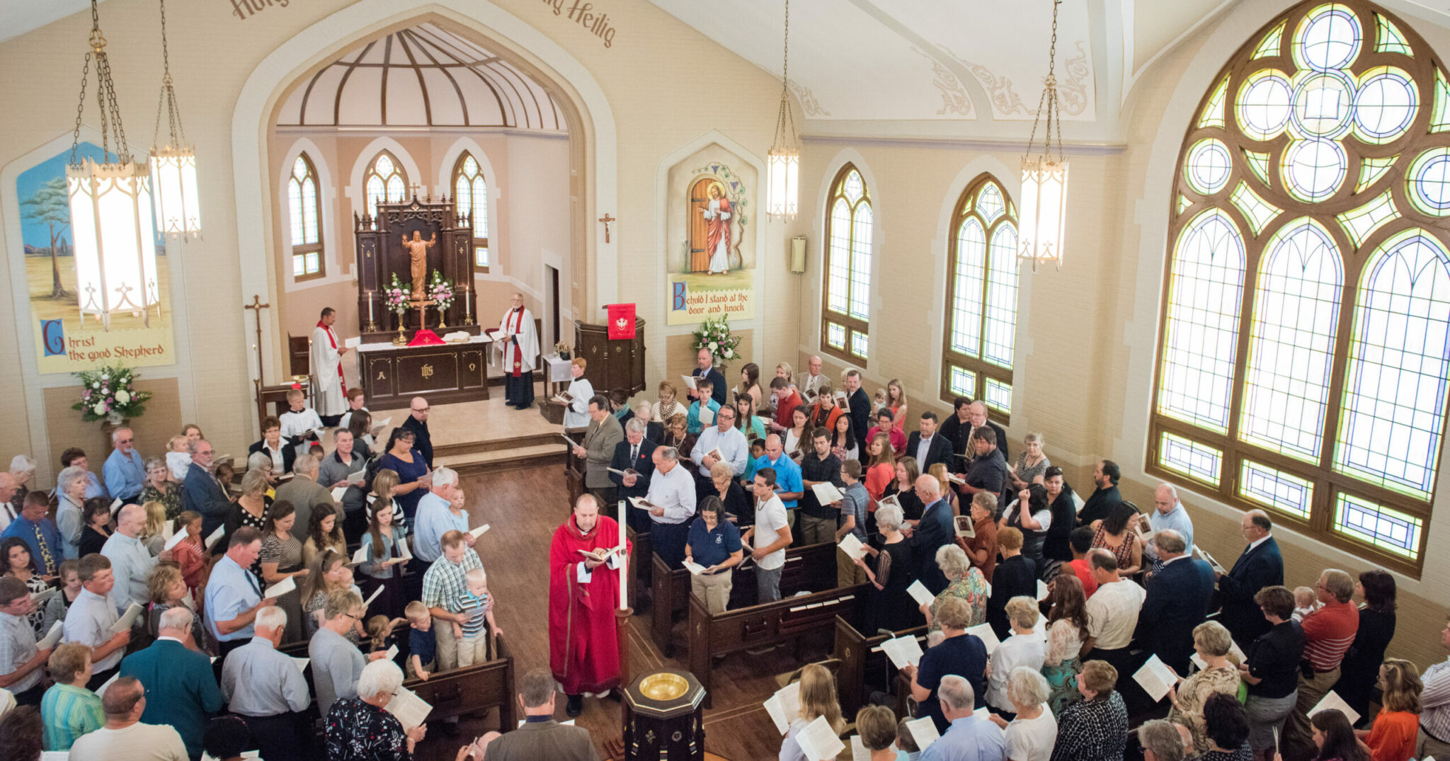

Slide 45
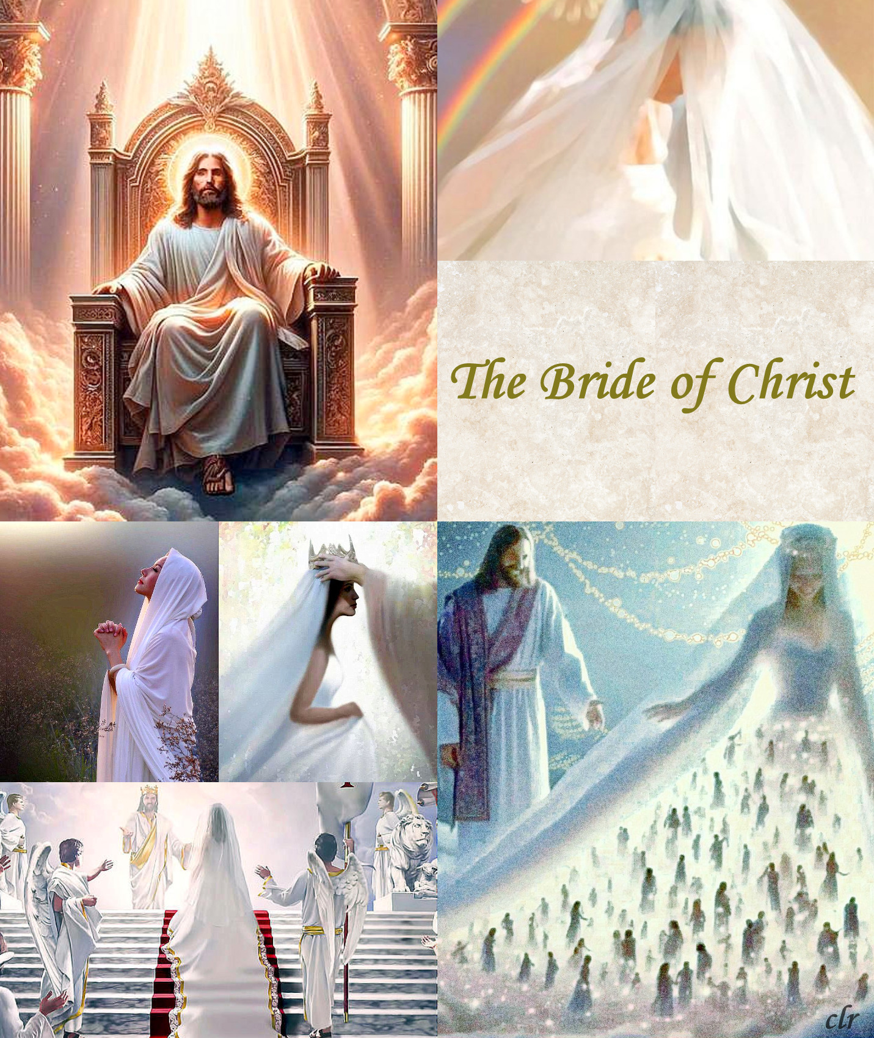

Slide 47
