Slide 1
THE BOOK OF EPHESIANS
“We Are His Workmanship”
Date: 1-12-25 Lesson: 34
Pastor David Nehrenz –
Trinity Lutheran Church – Norman, OK

Slide 2
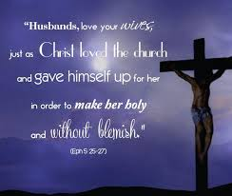

Slide 3
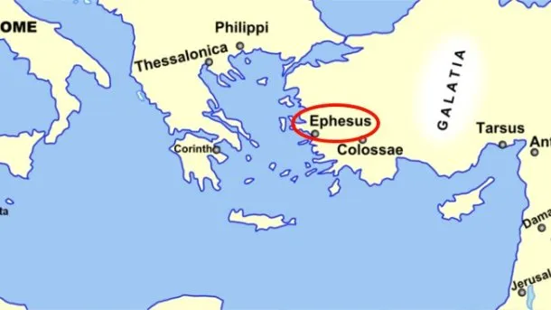
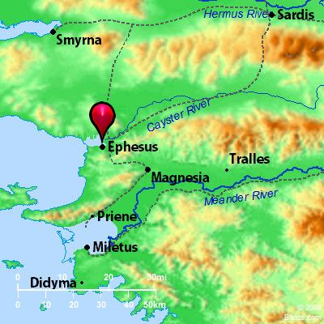
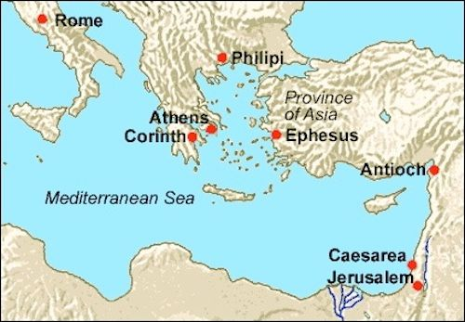

Slide 4
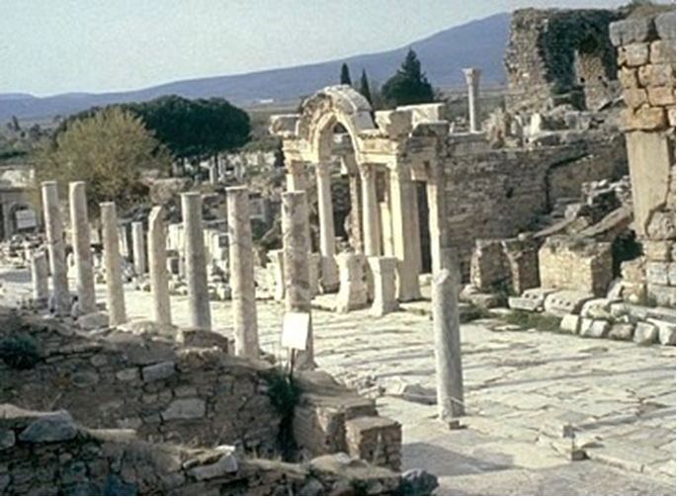

Slide 5
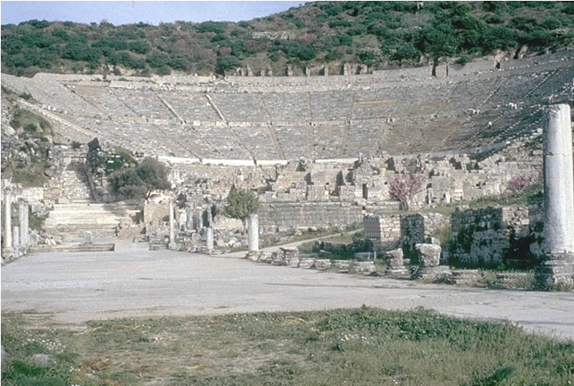

Slide 6
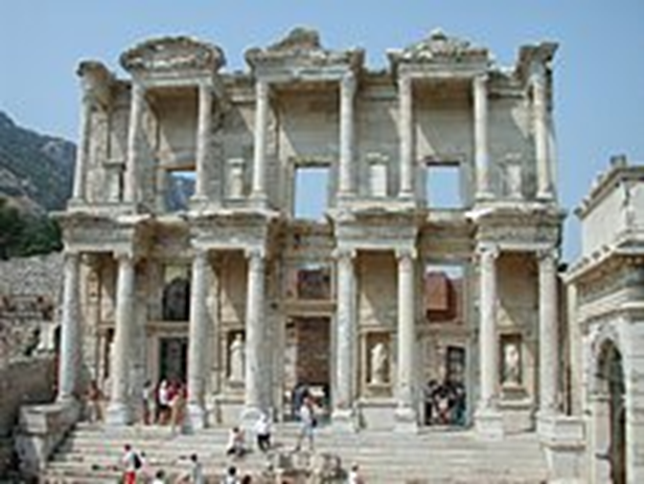

Slide 7
THE TEXT (Ephesians 5:25-33)
(25) Husbands, love your wives, as Christ loved the church and gave himself up for her,
(26) that he might sanctify her, having cleansed her by the washing of water with the word,
(27) so that he might present the church to himself in splendor,
without spot or wrinkle or any such thing, that she might be holy and without blemish.
(28) In the same way husbands should love their wives as their own bodies. He who loves his wife loves himself.
(29) For no one ever hated his own flesh, but nourishes and cherishes it, just as Christ does the church,
(30) because we are members of his body.
(Gen 2:23; Ps 45:13; Ezek 16:8-14; Mt 9:15; 25:1-13; Jn 3:3-6; 15:3; 17:17-19; Ac 22:16; Rom 12:5; 1 Cor 6:11,15; 12:27; 2 Cor 4:14; 11:2; Gal 2:20; Col 3:19,20; Titus 2:14; 3:5;
Heb 2:11; 6:5; 10:10-14; 13:12; 1 Pet 3:7,21; 1 Jn 3:16;
Rev 7:14; 21:2,9-11)

Slide 8
(31) "Therefore a man shall leave his father and mother and hold fast to his wife,
and the two shall become one flesh."
(32) This mystery is profound, and I am saying that it refers to Christ and the church.
(33) However, let each one of you love his wife as himself,
and let the wife see that she respects her husband.
(Gen 2:24; Mt 19:5; Mk 10:7,8; Jn 3:5-8, 23-29; Rom 11:25; 1 Cor 6:16;
1 Pet 3:2-6; Rev 19:7-9; 21:1-7,9; 22:16,17)

Slide 9
STUDY HELPS
Apology of the Augsburg Confession
ARTICLE XXIII (XI) The Marriage of Priests
Note: In this article, Melanchthon rebuts the Confutation’s argument that priests should not marry. He anchors his argument in the institution of marriage at creation. Marriage is a divine ordinance that the Church cannot contradict. Melanchthon is not saying that a minister who chooses to remain celibate should be married; rather, he insists that the Church cannot command men to be celibate who want to be ministers in the Church, when clearly the gift of celibacy is reserved only for a very few. Nowhere in the Bible is forced celibacy, or forced marriage, tied to ministry. The apostles were both married and single. Priestly celibacy is yet another example of anti-scriptural traditions in the Roman Church. (See also AC XXIII; SA III XI.)
[Arguments for the Marriage of Priests]
[7] First, Genesis 1: 28 teaches that people were created to be fruitful, and that one sex should desire the other in a proper way. We are not speaking about lustful desire, which is sin, but about that appetite that was in nature in its perfection. They call this physical love. This love of one sex for the other is truly a divine ordinance. But since this ordinance of God cannot be removed without an extraordinary work of God, it makes sense that statutes or vows cannot remove the right to contract marriage.

Slide 10
[9] Second, because this creation, or divine ordinance, in humanity is a natural right, jurists have said wisely and correctly that the union of male and female belongs to natural right. Natural right is unchangeable. Therefore, the right to contract marriage must always remain. Where nature does not change, that ordinance which God gave nature does not change. It cannot be removed by human laws.
[11] Therefore, let this point remain, that both Scripture teaches and the jurist says wisely: the union of male and female belongs to natural right.
[12] Furthermore, a natural right is truly a divine right because it is an ordinance divinely imprinted on nature. Because this right cannot be changed without an extraordinary work of God, the right to contract marriage remains, the natural desire of one sex for the other sex is an ordinance of God in nature, and for this reason is a right. Otherwise, why would both sexes have been created?
[28] We will reply to these daydreams in an orderly way. In the first place, the adversaries should acknowledge that in believers, marriage is pure because it has been sanctified by God’s Word. That is to say, it is a matter that is permitted and approved by God’s Word, as Scripture testifies abundantly.
[29] Christ calls marriage a divine union when He says, “What therefore God has joined together” (Matthew 19: 6). [30] And Paul says of marriage, of meats and similar things, “It is made holy by the word of God and prayer” (1 Timothy 4: 5), that is, “by the Word,” by which consciences become certain that God approves, and “by prayer,” that is, by faith, which uses it with thanksgiving as God’s gift.

Slide 11
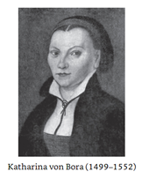
Before her marriage to Martin Luther, Katharina von Bora, the daughter of German nobility, was a nun of the Marienthron convent. Far from being the “unseen partner” in the Lutherhaus, she was a talented and knowledgeable wife, mother, and advocate for evangelical reforms. Katharina exhibited a deep spirituality in her private and family life as she encouraged her husband in times of desperation and doubt and provided for the numerous students and guests to Wittenberg and the parsonage.

Slide 12
LIFE APPLICATION
The vital distinction between:
1. THE ORDER OF SALVATION
Husband, wife, children all on the same level – saved by grace through faith,
as sons of God connected to THE SON OF GOD – JESUS CHRIST – heirs of the inheritance to eternal life – the priesthood of all believers who are baptized into the Body of Christ – the Church
(Rom 8:14-17; Gal 3:25-29; 1 Pet 2:9,10)
2. THE ORDER OF CREATION
God the Father sent his
Son, Jesus our Lord – submitted to his Father
Husband – submits to Christ
Wife – submits to her husband
Children – submit to their father and mother
(Eph 5:22-33; Col 3:18-21; 1 Pet 3:1-8)
These operate at one and the same time, and are great blessings!
How does the Word of God explain the purposes of marriage for mankind, as a good gift?

Slide 15
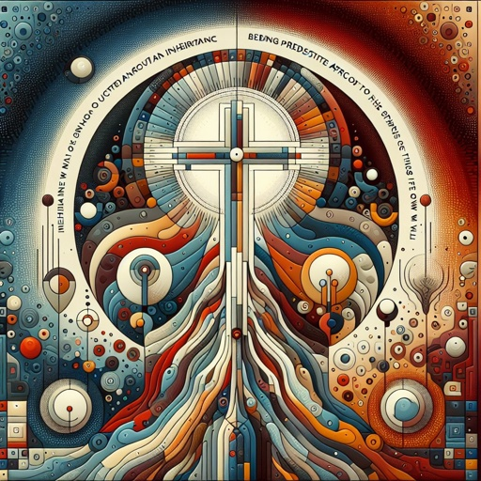

Slide 16
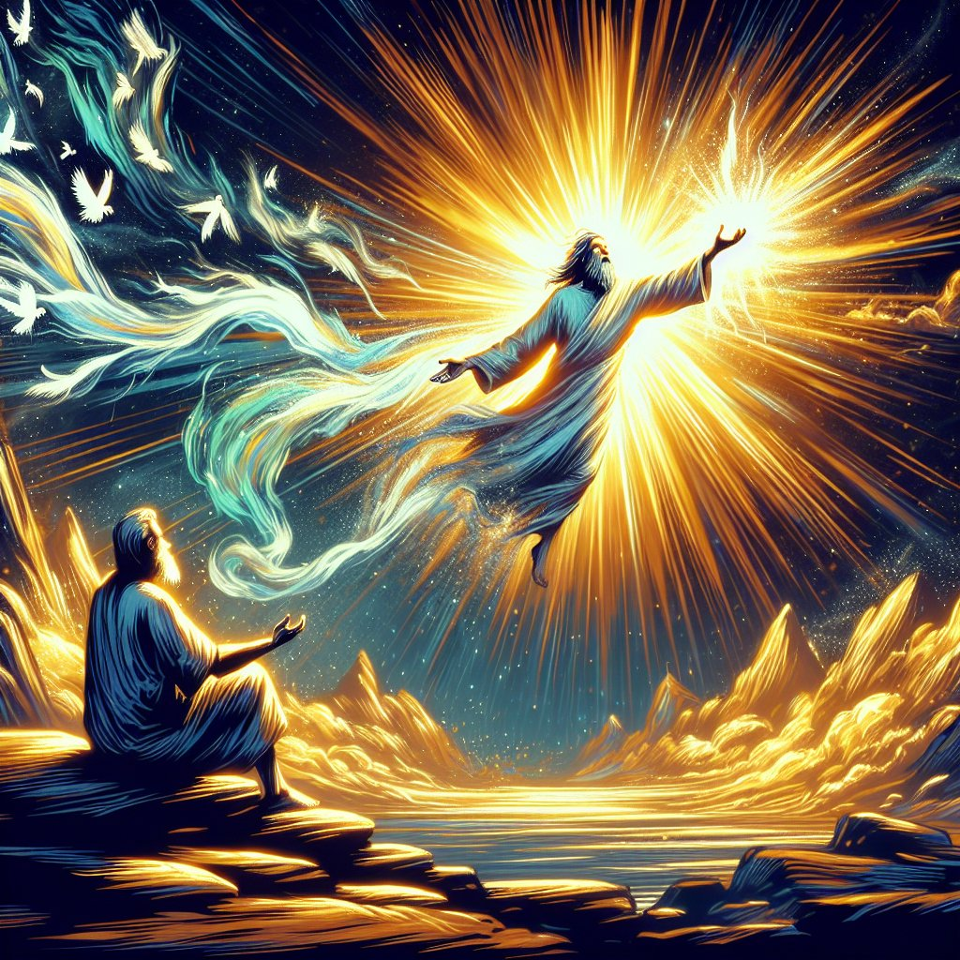

Slide 17
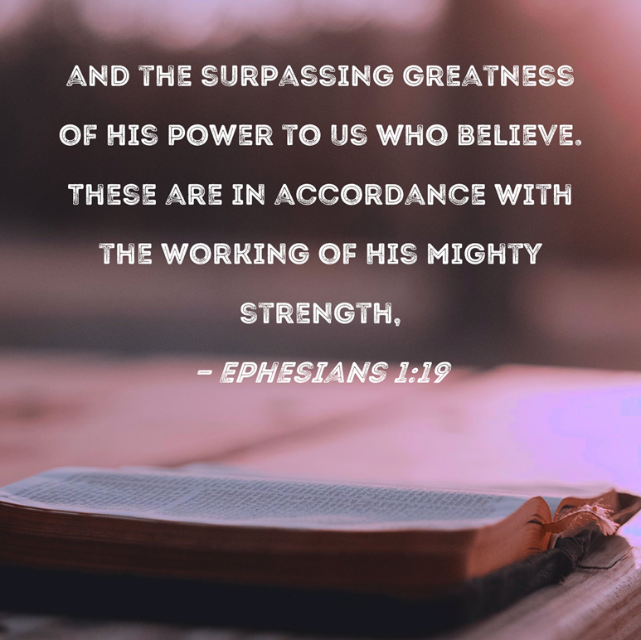

Slide 21
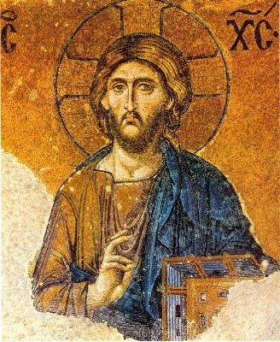

Slide 22
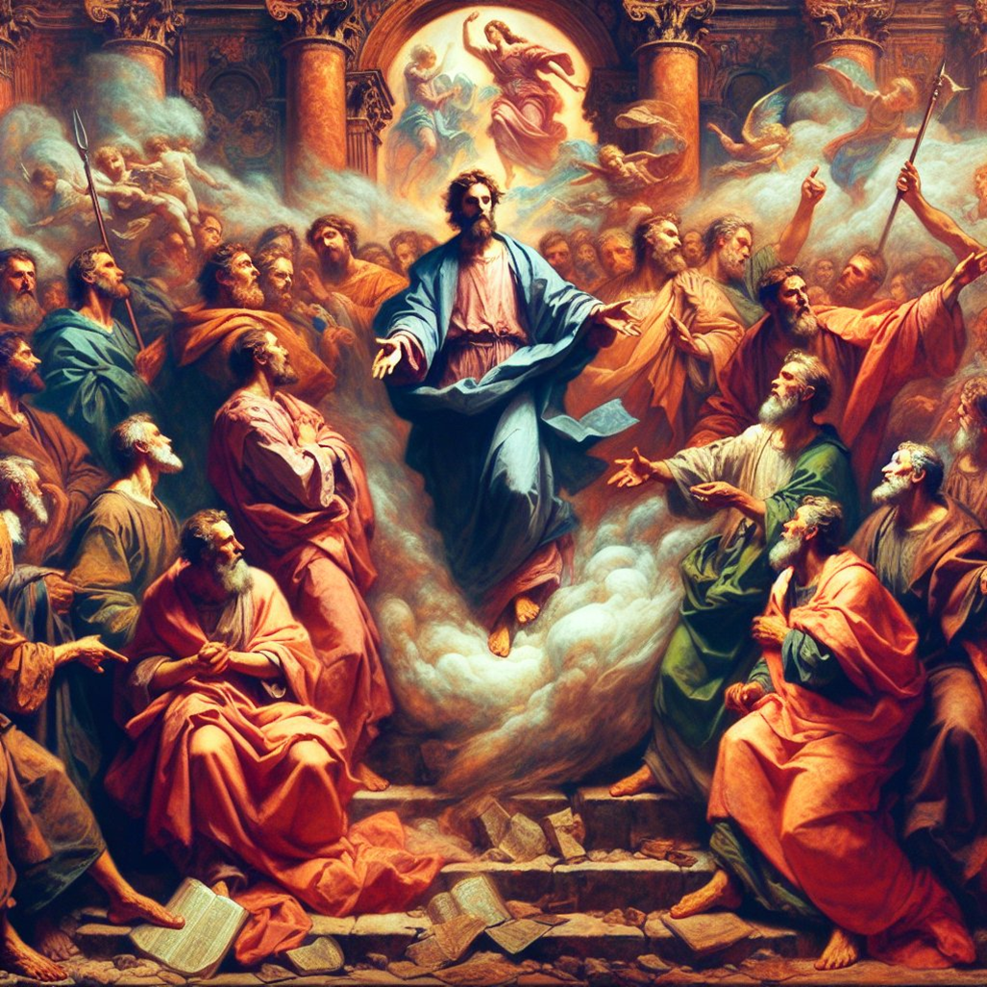

Slide 38
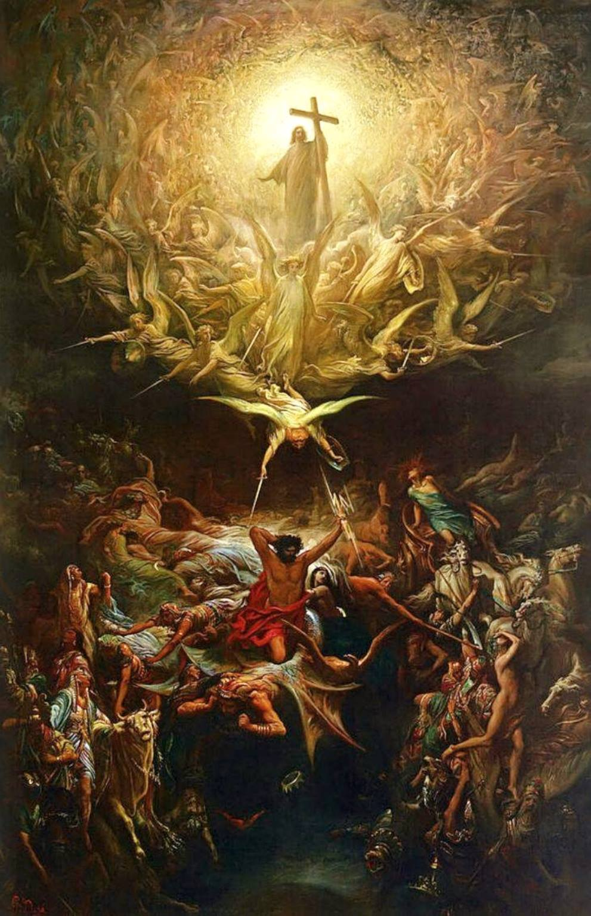

Slide 39
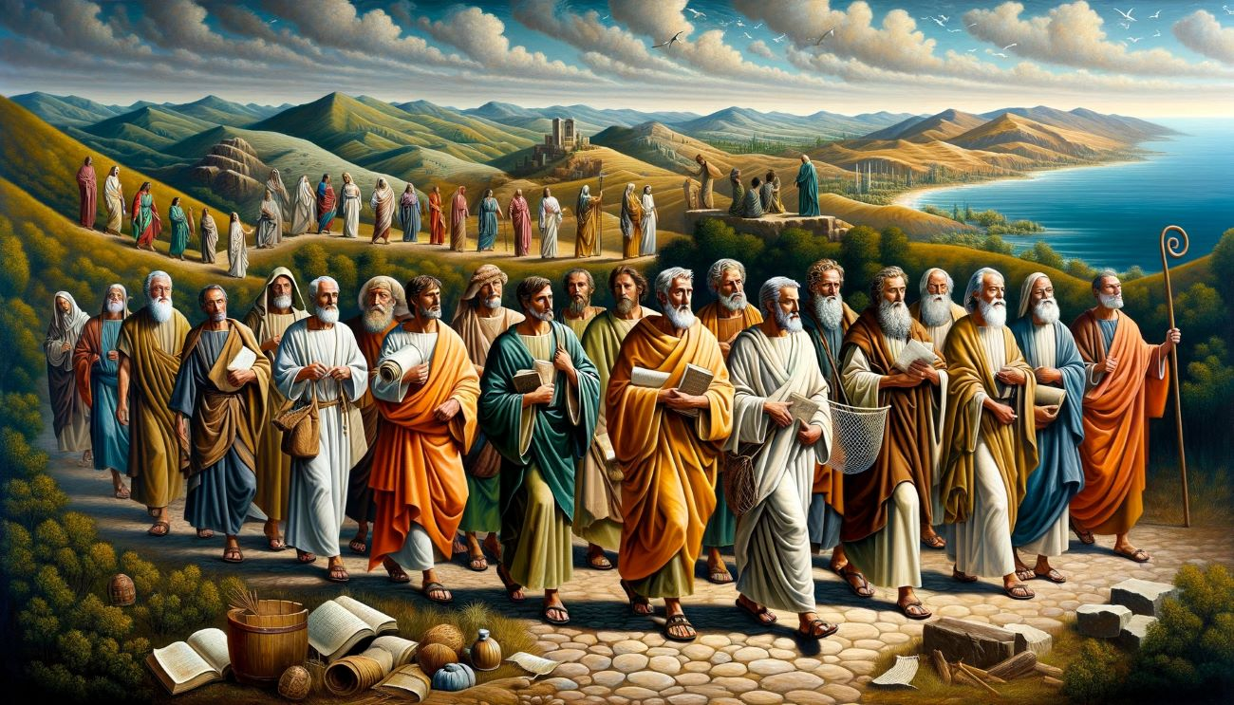

Slide 40
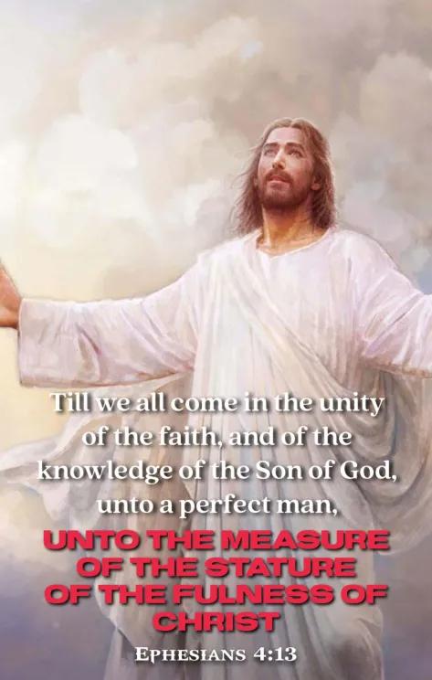

Slide 42
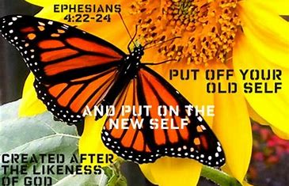

Slide 46
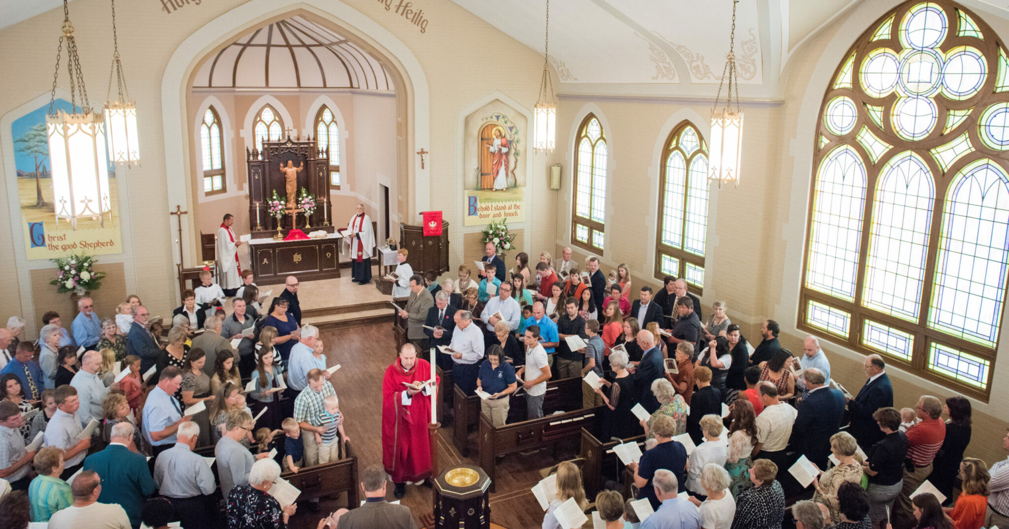

Slide 47
