Slide 1
THE BOOK OF EPHESIANS
“We Are His Workmanship”
Date: 12-1-24 Lesson: 30
Pastor David Nehrenz –
Trinity Lutheran Church – Norman, OK

Slide 3
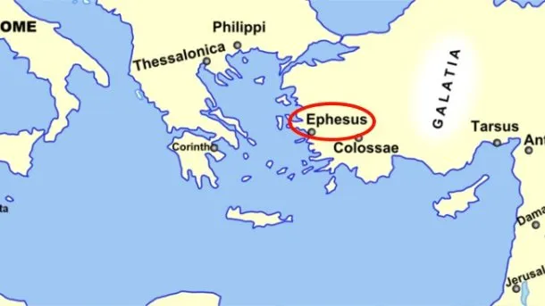
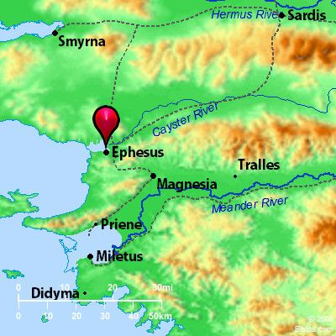
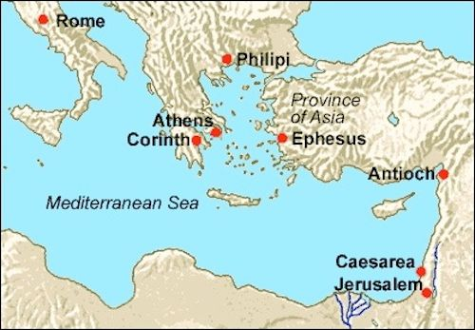

Slide 4
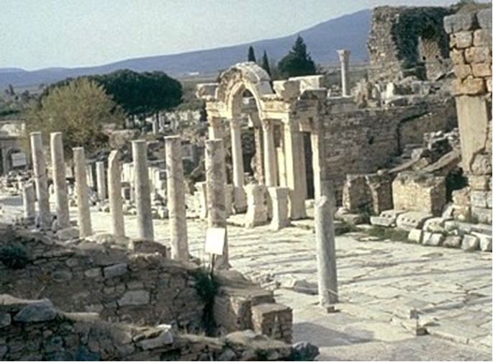

Slide 5
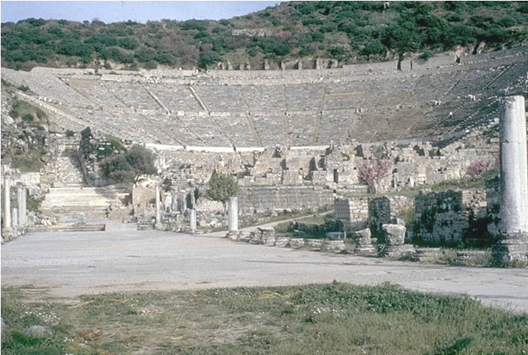

Slide 6
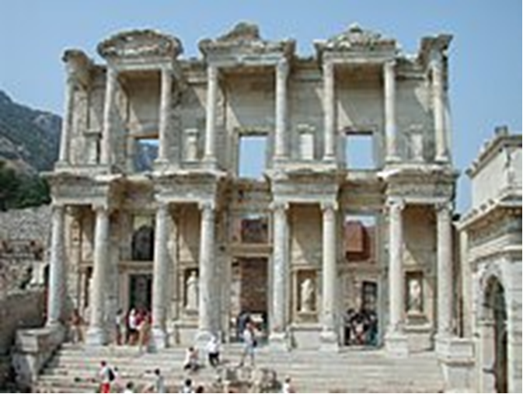

Slide 7
THE TEXT - (Ephesians 5:1-21)
Therefore be imitators of God, as beloved children. (2) And walk in love, as Christ loved us and gave himself up for us, a fragrant offering and sacrifice to God.
(Gen 8:21; Ex 29:18,25,41; Lev 1:9,13,17; Mt 5:48; Lk 6:36; Jn 1:12; 13:34; Gal 1:4; 2:20; Heb 7:27)

Slide 8
(3) But sexual immorality and all impurity or covetousness must not even be named among you, as is proper among saints. (4) Let there be no filthiness nor foolish talk nor crude joking, which are out of place, but instead let there be thanksgiving. (5) For you may be sure of this, that everyone who is sexually immoral or impure, or who is covetous (that is, an idolater), has no inheritance in the kingdom of Christ and God. (6) Let no one deceive you with empty words, for because of these things the wrath of God comes upon the sons of disobedience. (7) Therefore do not associate with them;
(Mt 25:34; Mk 13:5; Ac 20:32; Rom 1:18; 1 Cor 6:9,11,18; 2 Cor 6:16; Col 3:5; 1 Pet 2:9)
.

Slide 9
(8) for at one time you were darkness, but now you are light in the Lord. Walk as children of light (9) (for the fruit of light is found in all that is good and right and true),
(10) and try to discern what is pleasing to the Lord.
(Mt 5:14; 7:16-20; Lk 16:8; Jn 8:12; Ac 26:18; Rom 15:14; Gal 5:22,23; 1 Tim 5:4; 1 Jn 1:5)

Slide 10
(11) Take no part in the unfruitful works of darkness, but instead expose them.
(12) For it is shameful even to speak of the things that they do in secret.
(Rom 13:12; 2 Cor 6:14)

Slide 11
(13) But when anything is exposed by the light, it becomes visible, (14) for anything that becomes visible is light. Therefore it says, "Awake, O sleeper, and arise from the dead, and Christ will shine on you." (15) Look carefully then how you walk, not as unwise but as wise, (16) making the best use of the time, because the days are evil.
(Is 26:19; 60:1; Mal 4:2; Jn 3:20,21; 5:25 Rom 13:11; Eph 6:13; Col 4:5)

Slide 12
(17) Therefore do not be foolish, but understand what the will of the Lord is. (18) And do not get drunk with wine, for that is debauchery, but be filled with the Spirit, (19) addressing one another in psalms and hymns and spiritual songs, singing and making melody to the Lord with all your heart, (20) giving thanks always and for everything to God the Father in the name of our Lord Jesus Christ, (21) submitting to one another out of reverence for Christ.
(Lev 10:9; Ps 27:6; 34:1; 95:2; Prov 20:1; Is 28:7; Lk 1:15; Ac 16:25; Rom 12:2; 13:13; 1 Cor 14:15,26; Col 1:9; 3:15 – 4:1; 1 Thess 4:3; Heb 13:15; 1 Pet 5:5)

Slide 13
STUDY HELPS
FORMULA OF CONCORD - Article IV. – GOOD WORKS - [PRESERVATION IN THE FAITH]
[30] Third, whether good works preserve salvation, or whether they are necessary for preserving faith, righteousness, and salvation is another issue in dispute. This again is of high and great importance, for “the one who endures to the end will be saved” (Matthew 24: 13). Also, “For we share in Christ, if indeed we hold our original confidence firm to the end” (Hebrews 3: 14). We must also explain well and precisely how righteousness and salvation are preserved in us, lest salvation be lost again.
[31] Above all, this false Epicurean delusion is to be seriously rebuked and rejected: some imagine that faith, and the righteousness and salvation that they have received, cannot be lost through sins or wicked deeds, not even through willful and intentional ones. They imagine that a Christian retains faith, God’s grace, righteousness, and salvation even though he indulges his wicked lusts without fear and shame, resists the Holy Spirit, and purposely engages in sins against conscience.
[32] Against this deadly delusion the following true, unchangeable, divine threats and severe punishments and warnings should be repeated often and impressed upon Christians who are justified through faith: Do not be deceived: neither the sexually immoral, nor idolaters, nor adulterers. . . will inherit the kingdom of God. (1 Corinthians 6: 9– 10) Those who do such things will not inherit the kingdom of God. (Galatians 5: 21; see also Ephesians 5: 5) If you live according to the flesh you will die. (Romans 8: 13) On account of these the wrath of God is coming [upon the children of disobedience]. (Colossians 3: 6)

Slide 14
[33] The Apology provides an excellent model that shows how and when exhortations to good works can be made without darkening the doctrine of faith and of the article of justification. In Article XX (90), on the passage 2 Peter 1: 10,“ Be all the more diligent to make your calling and election sure,” it says: Peter speaks of works following the forgiveness of sins and teaches why they should be done.
They should be done so that the calling may be sure, that is, should they fall from their calling if they sin again. Do good works in order that you may persevere in your calling, in order that you do not lose the gifts of your calling. They were given to you before, and not because of works that follow, and which now are kept through faith. Faith does not remain in those who lose the Holy Spirit and reject repentance.
[34] On the other hand, this does not mean that faith lays hold of righteousness and salvation only in the beginning and then resigns its office to works as though they had to sustain faith, the righteousness received, and salvation. It means that the promise, not only of receiving, but also of retaining righteousness and salvation, is firm and sure to us. St. Paul (Romans 5: 2) ascribes to faith not only the entrance to grace, but says that we stand in grace and boast of the future glory. In other words, he credits the beginning, middle, and end to faith alone. They were broken off because of their unbelief, but you stand fast through faith. (Romans 11: 20) [He will] present you holy and blameless and above reproach before Him, if indeed you continue in the faith. (Colossians 1: 22– 23) By God’s power [you] are being guarded through faith for a salvation. (1 Peter 1: 5) Obtaining the outcome of your faith, the salvation of your souls. [1 Peter 1: 9]

Slide 15
[35] It is clear from God’s Word that faith is the proper and only means through which righteousness and salvation are not only received, but also preserved by God. Therefore, it is right to reject the Council of Trent’s decree, and whatever elsewhere is set forth with the same meaning. For they say our good works preserve salvation, or the righteousness of faith that has been received, or even faith itself. They say it is either entirely or in part kept and preserved by our works.
[36] Before this controversy quite a few pure teachers used similar expressions to explain the Holy Scriptures. However, they in no way intended to confirm the above-mentioned errors of the papists. Still, a controversy arose over such expressions, from which all sorts of offensive distractions followed. Therefore, according to St Paul’s admonition (2 Timothy 1: 13) it is safe to hold fast both to “the pattern of the sound words” and to the pure doctrine itself. In this way, much unnecessary wrangling may be cut off and the Church preserved from many scandals.
Concordia Publishing House. Concordia: The Lutheran Confessions-A Readers Edition of the Book of Concord - 2nd edition (pp. 550-551). Concordia Publishing. Kindle Edition.

Slide 16
LIFE APPLICATION
“Walk as children of light
(for the fruit of light is found in all that is good and right and true)”
What are the ways we turn away from the darkness and turn toward the Light?

Slide 19
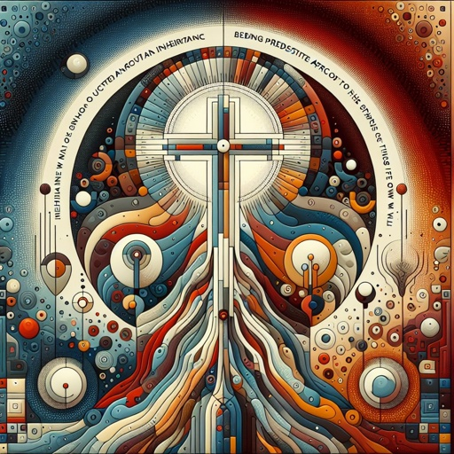

Slide 20
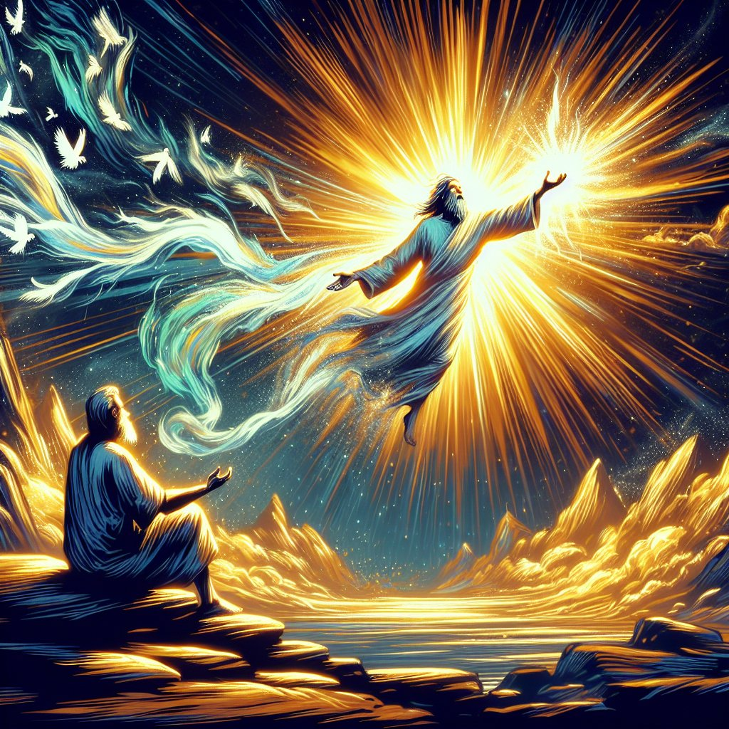

Slide 21
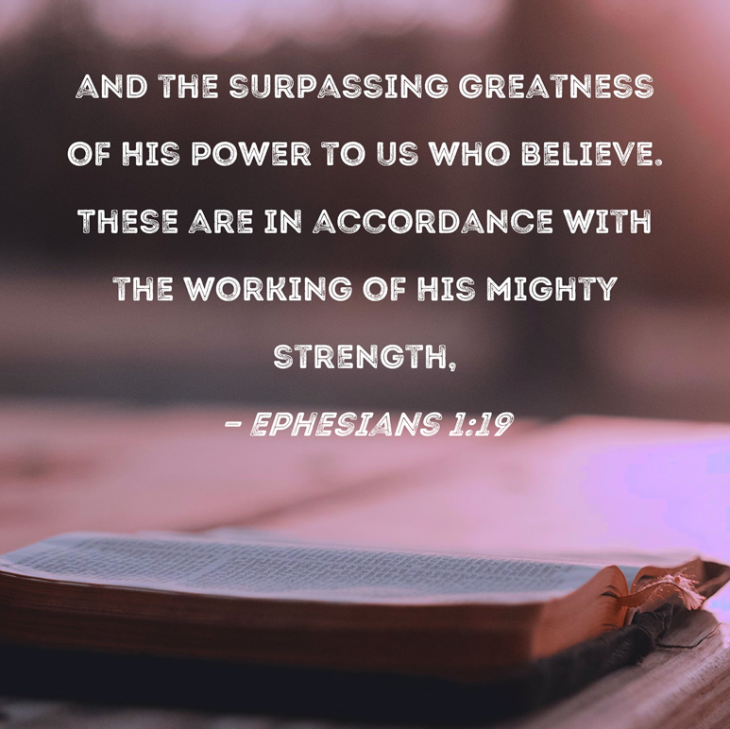

Slide 25
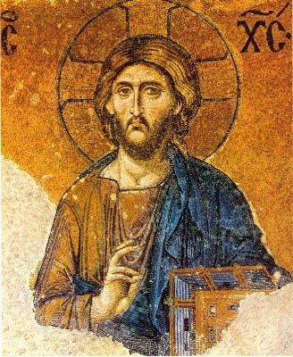

Slide 26
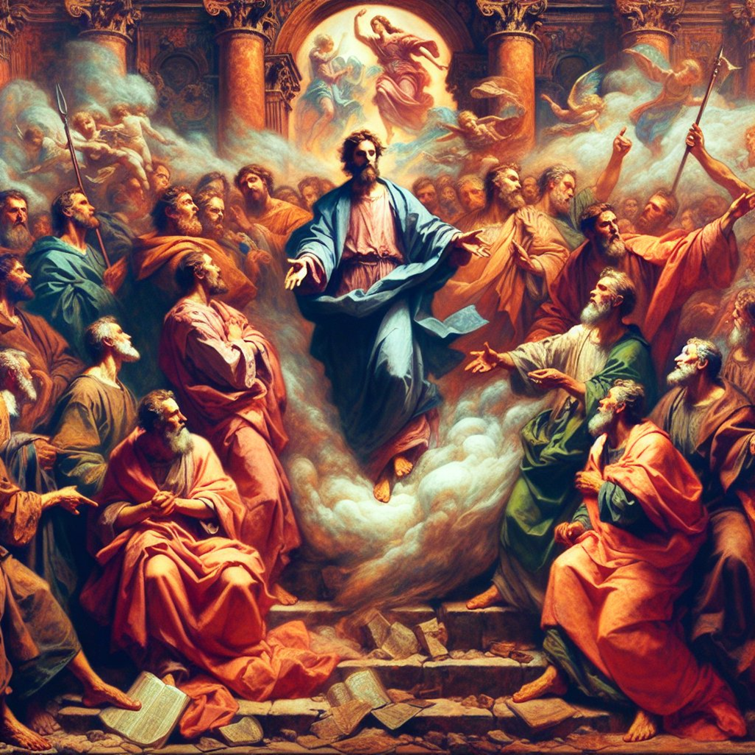

Slide 42
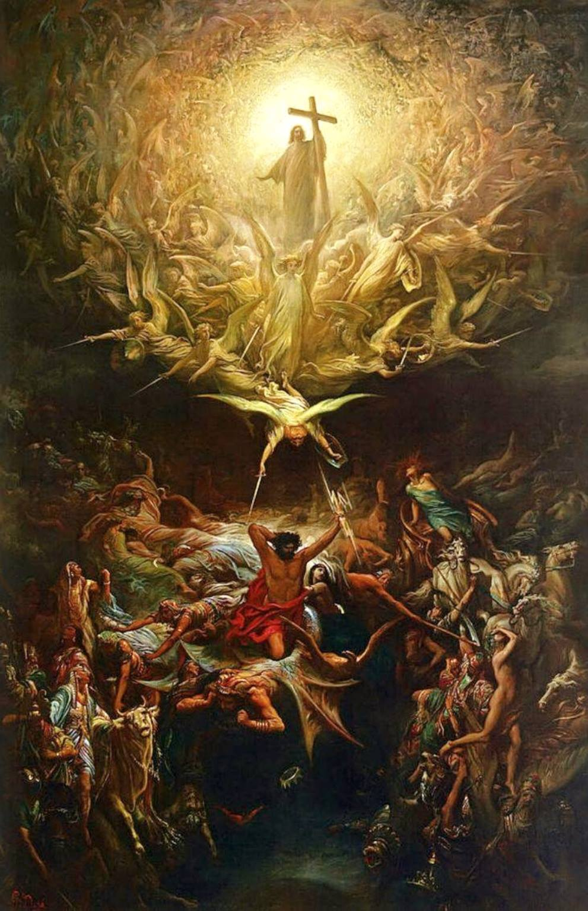

Slide 43
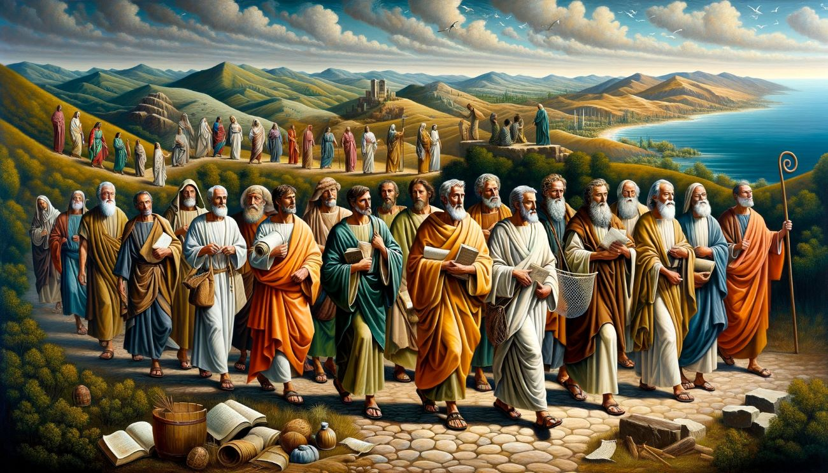

Slide 44
