Slide 1
THE BOOK OF EPHESIANS
“We Are His Workmanship”
Date: 4-28-24 Lesson: 3
Pastor David Nehrenz –
Trinity Lutheran Church – Norman, OK

Slide 2
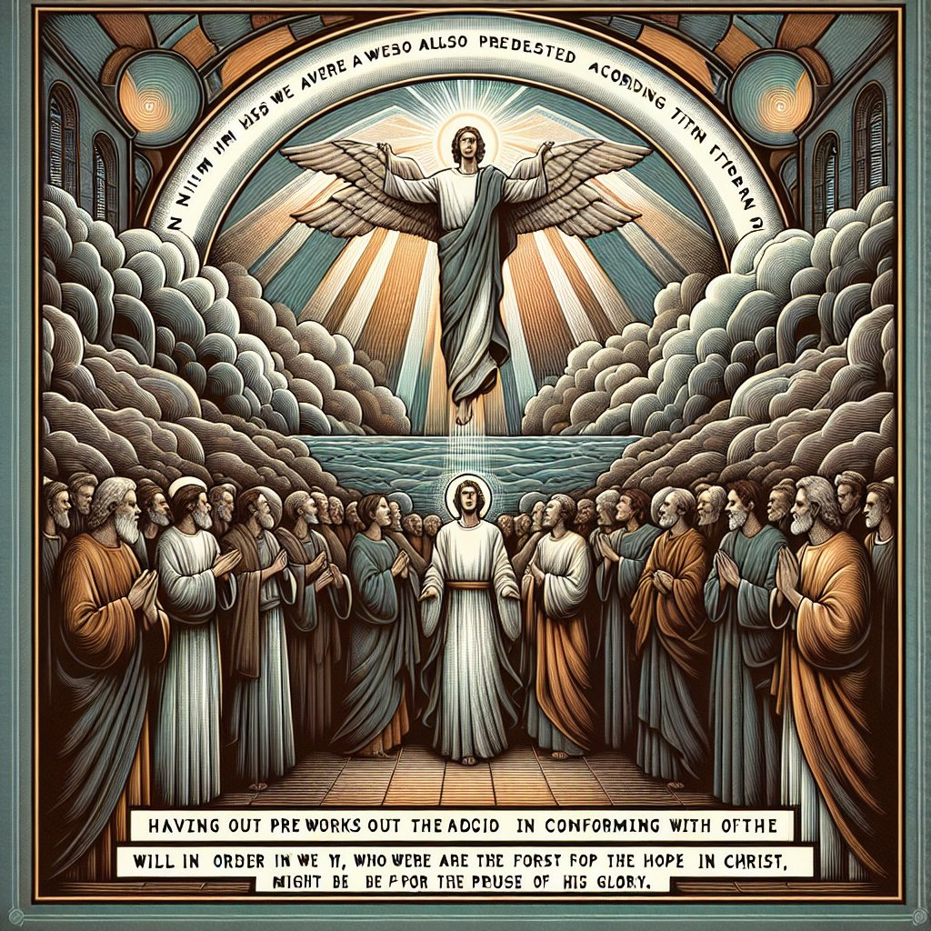

Slide 3
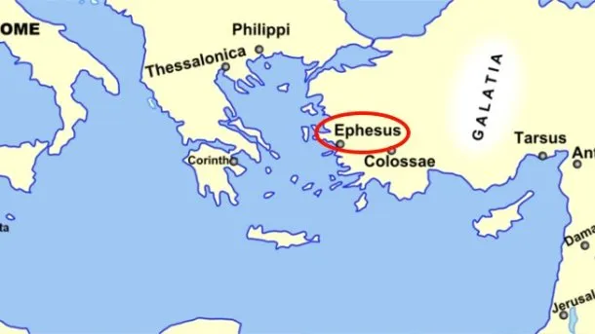
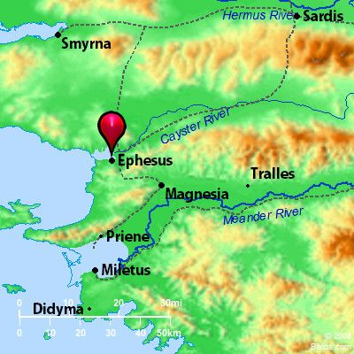
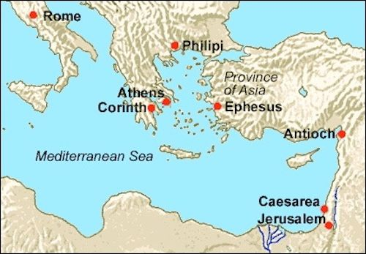

Slide 7
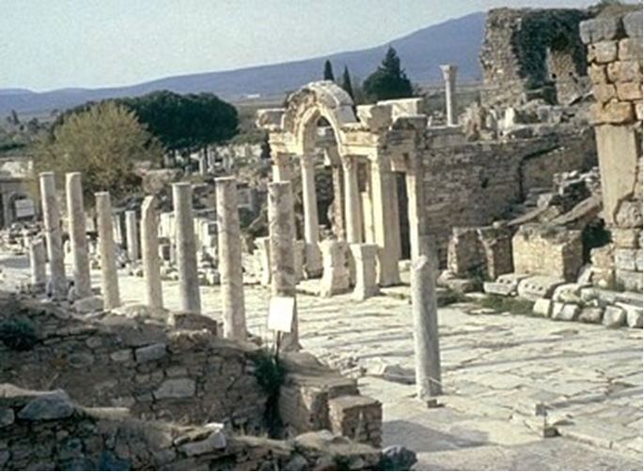

Slide 8
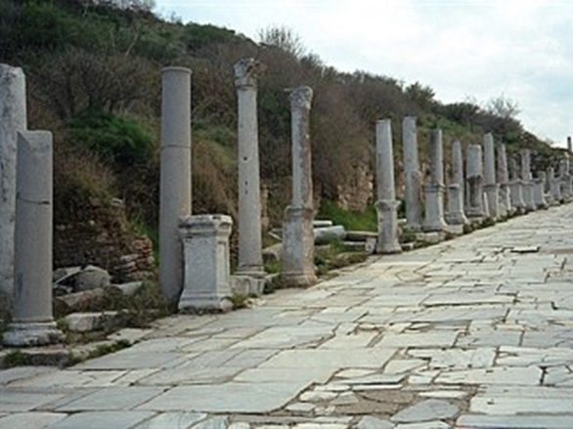

Slide 9
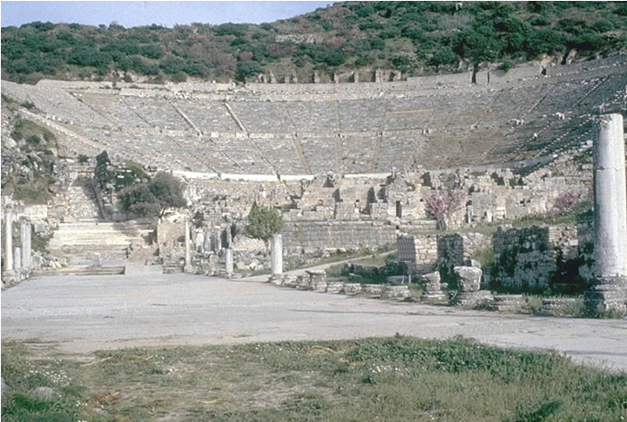

Slide 10
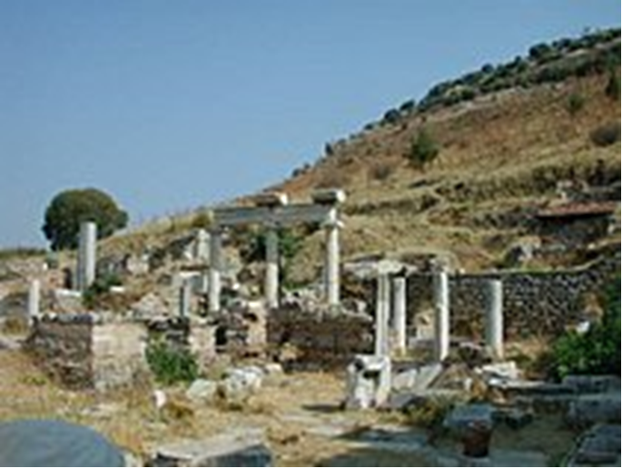

Slide 11
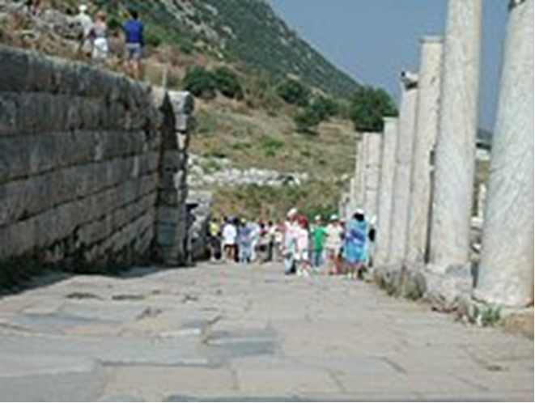
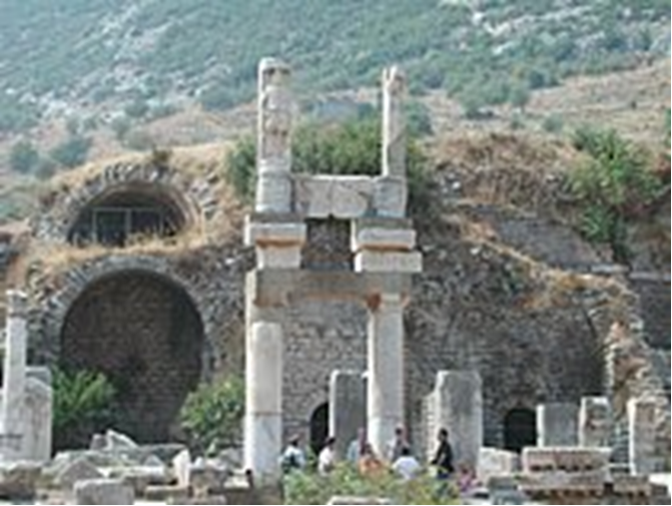

Slide 12
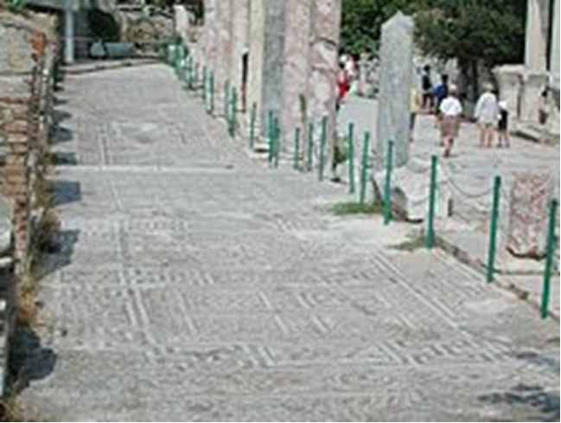
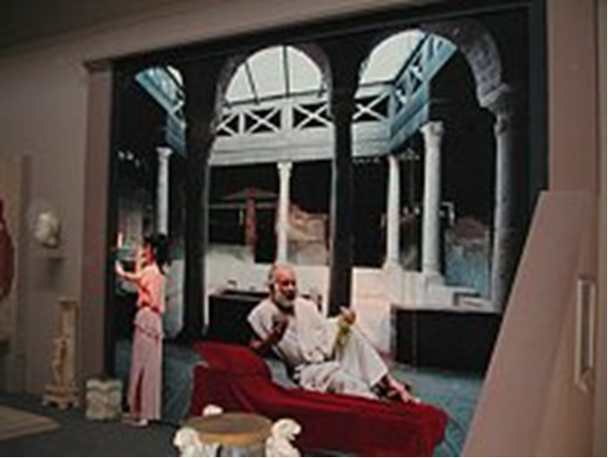

Slide 13
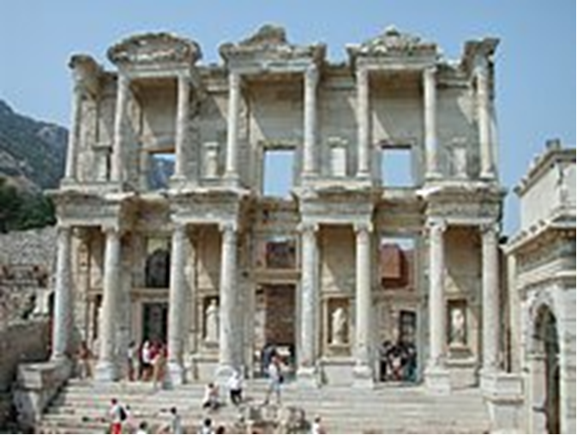

Slide 14
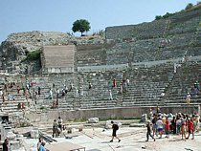
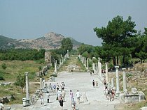

Slide 15
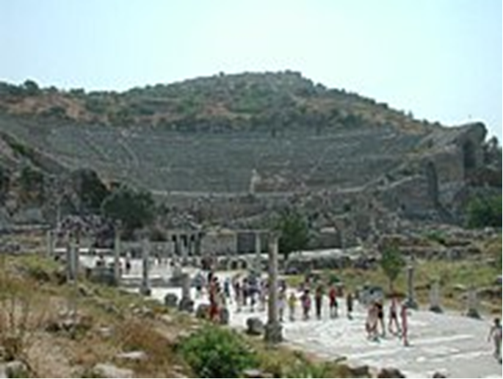
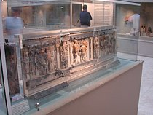

Slide 16
(7) In him we have redemption through his blood, the forgiveness of our trespasses, according to the riches of his grace, (8) which he lavished upon us, in all wisdom and insight (9) making known to us the mystery of his will, according to his purpose, which he set forth in Christ (10) as a plan for the fullness of time, to unite all things in him, things in heaven and things on earth.
(11) In him we have obtained an inheritance, having been predestined according to the purpose of him who works all things according to the counsel of his will, (12) so that we who were the first to hope in Christ might be to the praise of his glory.
(13) In him you also, when you heard the word of truth, the gospel of your salvation, and believed in him, were sealed with the promised Holy Spirit, (14) who is the guarantee of our inheritance until we acquire possession of it, to the praise of his glory.
(vv. 7,8) (Rom 2:4; 3:24; Titus 2:14; Gal 3:13; 1 Pet 1:18,19)
(vv. 9,10) (Mk 1:15; Rom 5:6; 11:25; 16:25; Gal 4:4; Col 1:6,20)
(vv. 11,12) (Heb 6:17)
(vv. 13,14) (Jn 14:16,17; Ac 20:32; Rom 3:24; 16:3; 2 Cor 5:5; Col 1:5)

Slide 17
In him we have obtained an inheritance… the word of truth, the gospel of your salvation, and believed in him, were sealed with the promised Holy Spirit, (14) who is the guarantee of our inheritance.
Why is this best inheritance anyone can ever receive?

Slide 20
