Slide 1
THE BOOK OF EPHESIANS
“We Are His Workmanship”
Date: 9-29-24 Lesson: 21 –
LCMS ARMED FORCES
- Mission Video
Pastor David Nehrenz –
Trinity Lutheran Church – Norman, OK

Slide 3
Vicar Ryan Mills was at Trinity Lutheran from 2003-2004
https://www.lcms.org/ministry-to-the-armed-forces

Slide 4
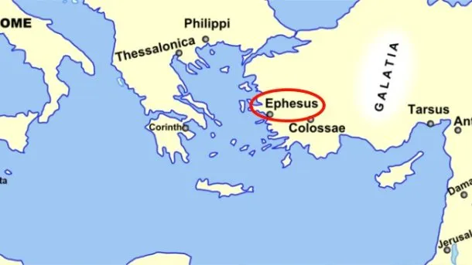
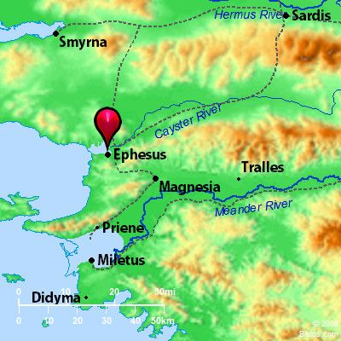
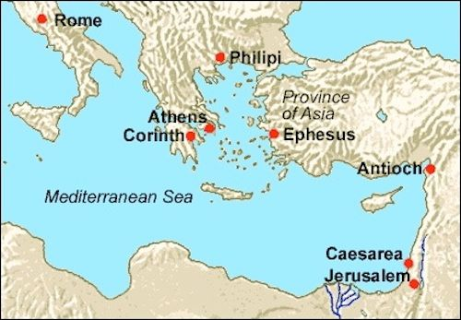

Slide 5
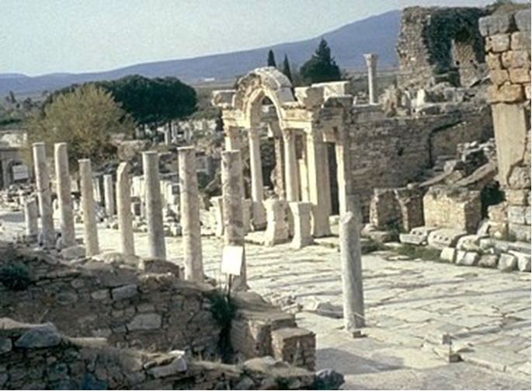

Slide 6
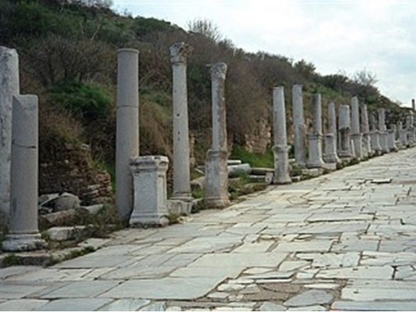

Slide 7
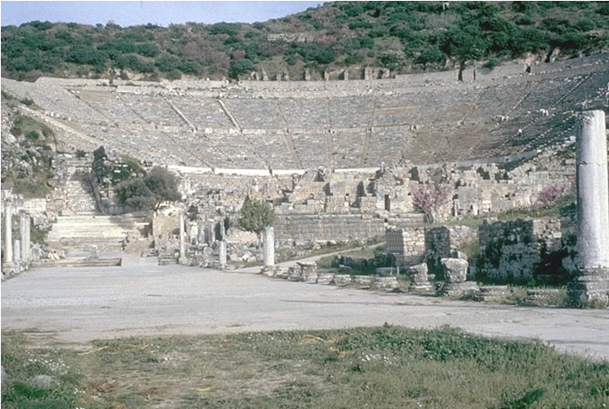

Slide 8
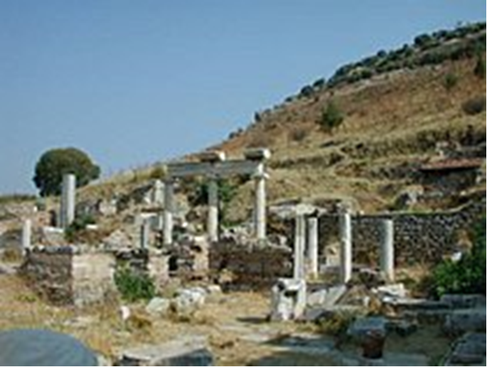

Slide 9
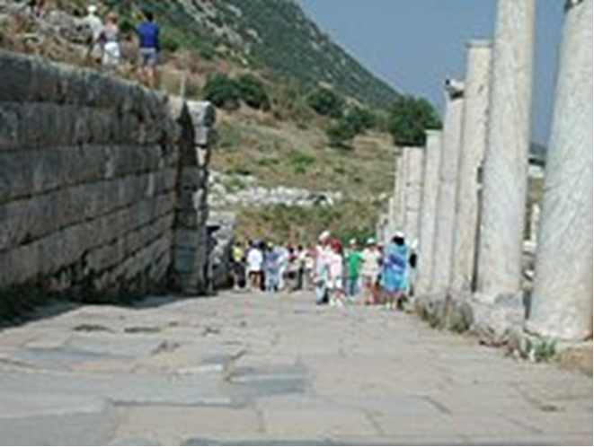
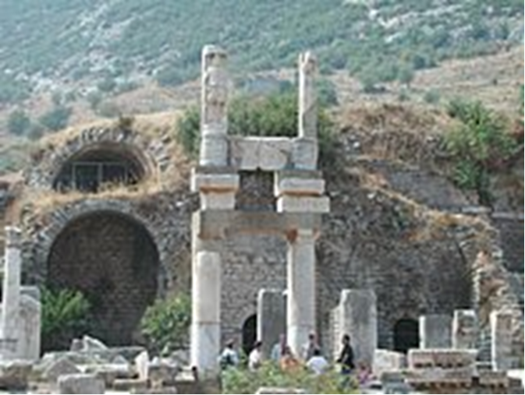

Slide 10
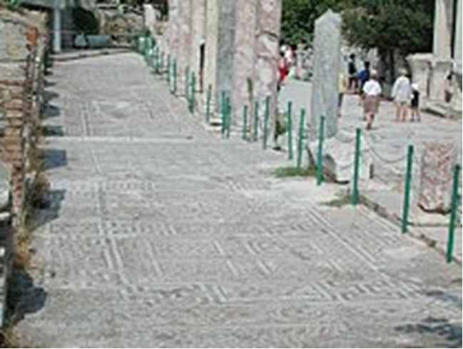
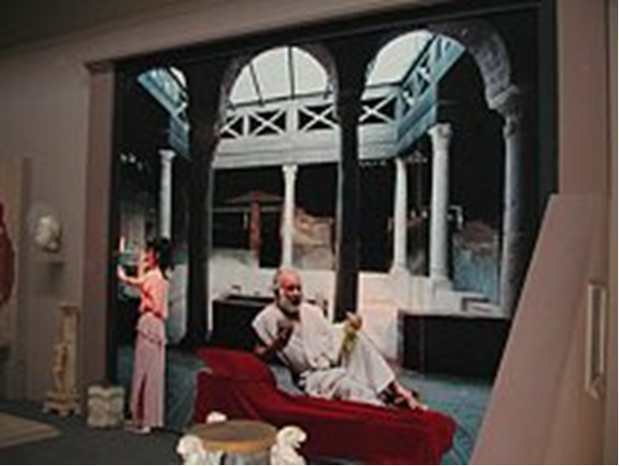

Slide 11
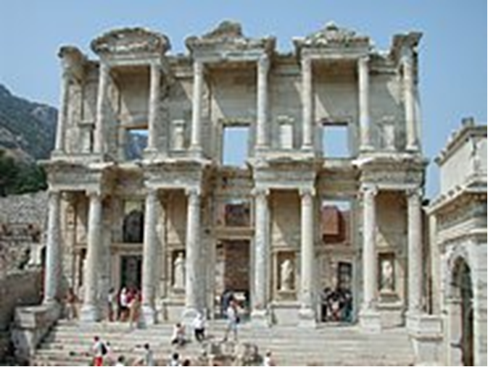

Slide 12
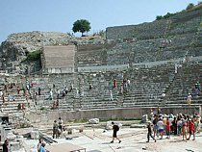
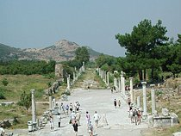

Slide 13
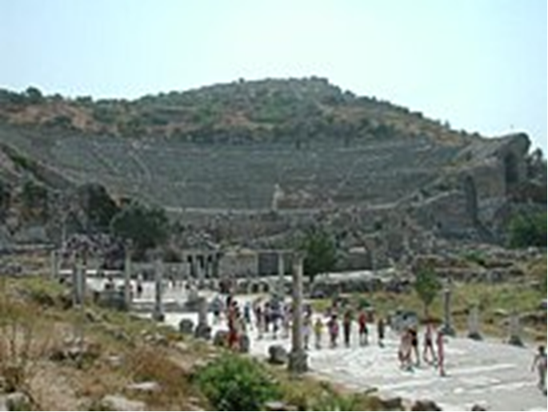
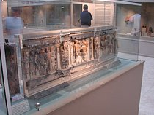

Slide 14
THE TEXT - (Ephesians 3:17-21)
(17) so that Christ may dwell in your hearts through faith
--that you,
being rooted and grounded in love,
(18) may have strength to comprehend with all the saints what is the breadth and length and height and depth,
(19) and to know the love of Christ that surpasses knowledge, that you may be filled with
all the fullness of God.
(Job 11:5-9; Jn 1:5; 14:23; Ps 103:11;
Rom 8:9,10,39; 11:33;
Gal 3:20,27; 4:9; Php 4:7; Col 1:23; 2:7-10)

Slide 15
(20) Now to him who is able to do far more abundantly than all that we ask or think, according to the power at work within us,
(21) to him be glory in the church and in Christ Jesus throughout all generations, forever and ever. Amen.
(1 Ki 3:13; Rom 11:36; 16:25-27; 1 Cor 9:8; 1 Tim 1:17; Jude 24-25)

Slide 16
STUDY HELPS
PART 2 THE APOSTLES’ CREED – Large Catechism
Note: The Ten Commandments show us what we are and are not to do, but the Creed shows us the One who creates, redeems, and sanctifies us. Luther broke with long-standing Church tradition by dividing the Creed into three main portions. Prior to Luther’s time the Creed had been divided into twelve parts. This division was based on the legend that each apostle had contributed one part of the Creed. Luther does away with such foolish speculation and focuses properly on each person of the Holy Trinity: Father, Son, and Holy Spirit. (See the Nicene and Athanasian Creeds; AC I and III; SA I; SA II I; SC II; FC Ep VIII and FC SD VIII.)

Slide 17
[1] So far we have heard the first part of Christian doctrine. We have seen all that God wants us to do or not to do. Now there properly follows the Creed, which sets forth to us everything that we must expect and receive from God. To state it quite briefly, the Creed teaches us to know Him fully [Ephesians 3: 19].
[2] This is intended to help us do what we ought to do according to the Ten Commandments. For (as said above) the Ten Commandments are set so high that all human ability is far too feeble and weak to keep them. Therefore, it is just as necessary to learn this part of Christian doctrine as to learn the former. Then we may know how to attain what they command, both where and how to receive such power.
[3] For if we could by our own powers keep the Ten Commandments as they should be kept, we would need nothing further, neither the Creed nor the Lord’s Prayer.
[4] But before we explain this advantage and necessity of the Creed, it is enough at first for the simpleminded to learn to comprehend and understand the Creed itself.
[5] In the first place, the Creed has until now been divided into twelve articles. Yet, if all the doctrinal points that are written in the Scriptures and that belong to the Creed were to be distinctly set forth, there would be far more articles. They could not all be clearly expressed in so few words.
[6] But to make the Creed most easily and clearly understood as it is to be taught to children, we shall briefly sum up the entire Creed in three chief articles, according to the three persons in the Godhead [Colossians 2: 9]. Everything that we believe is related to these three persons. So the First Article, about God the Father, explains creation. The Second Article, about the Son, explains redemption. And the Third, about the Holy Spirit, explains sanctification.
[7] We present them as though the Creed were briefly summarized in so many words: I believe in God the Father, who has created me; I believe in God the Son, who has redeemed me; I believe in the Holy Spirit, who sanctifies me. One God and one faith, but three persons.
[8] Therefore, three articles or confessions. Let us go over the words briefly.
Concordia Publishing House. Concordia: The Lutheran Confessions-A Readers Edition of the Book of Concord - 2nd edition (pp. 398-399). Concordia Publishing. Kindle Edition.

Slide 18
LIFE APPLICATION:
Now to him who is able to do far more abundantly than all that we ask or think,
according to the power at work within us,
to him be glory in the church and in Christ Jesus
throughout all generations, forever!
In view of this, what does this say about being more bold in our prayer lives?

Slide 21
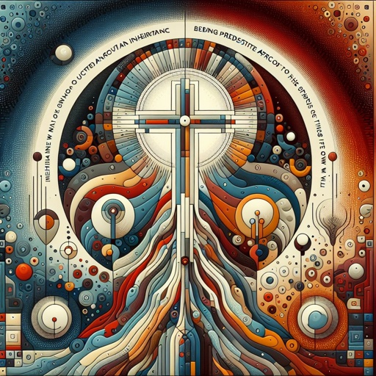

Slide 22
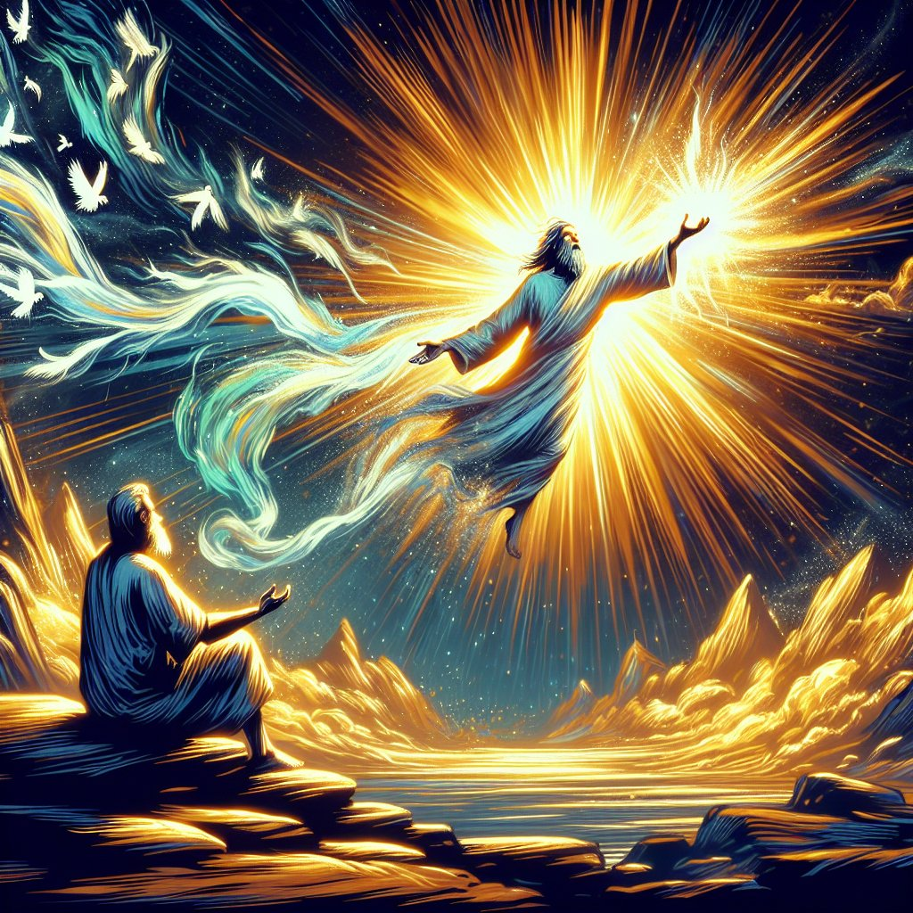

Slide 23
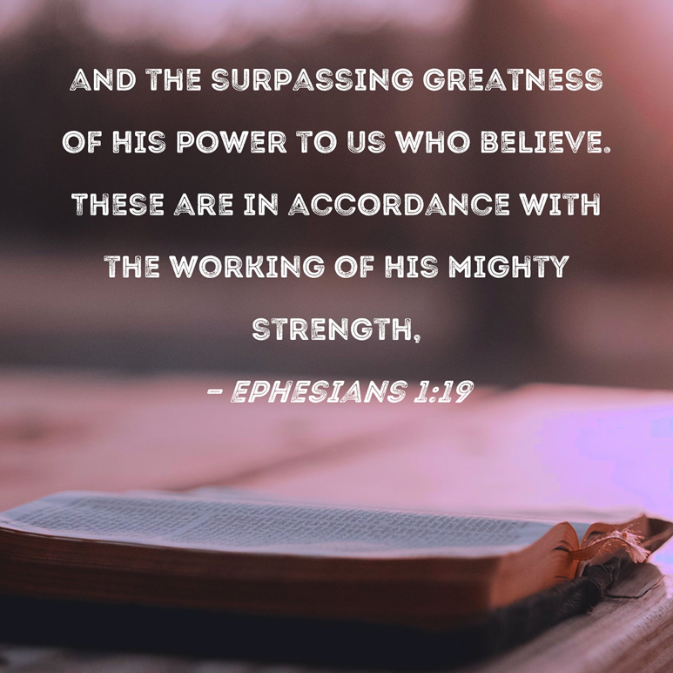

Slide 27
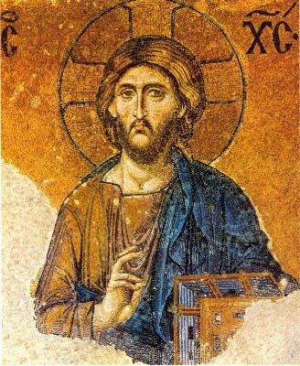

Slide 28
