Slide 1
THE BOOK OF EPHESIANS
“We Are His Workmanship”
Date: 7-21-24 Lesson: 11
Pastor David Nehrenz –
Trinity Lutheran Church – Norman, OK

Slide 3
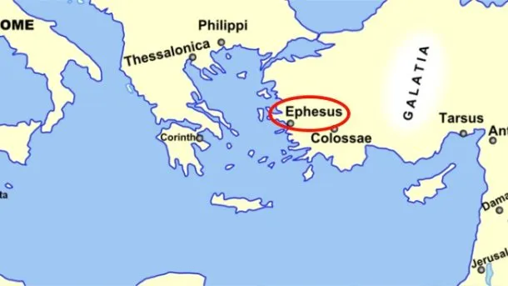
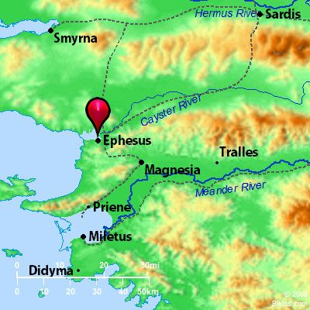
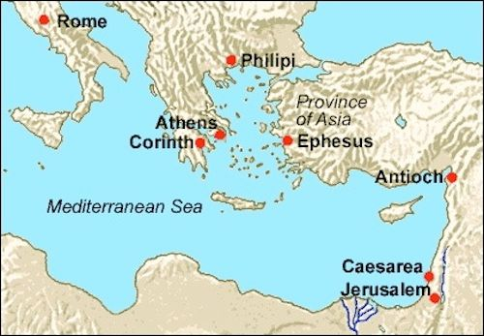

Slide 7
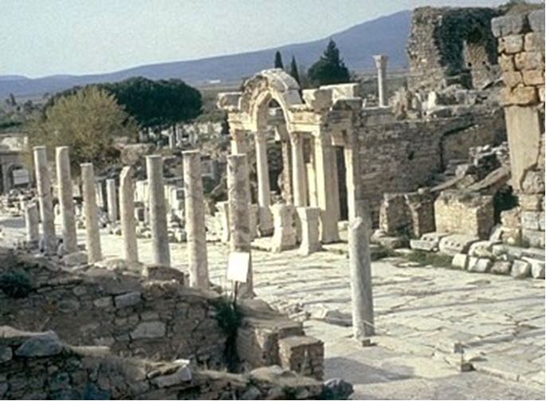

Slide 8
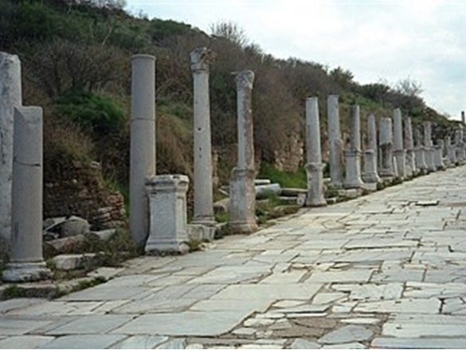

Slide 9
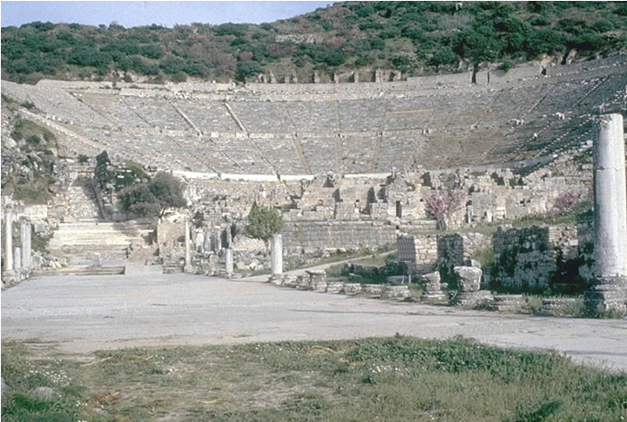

Slide 10
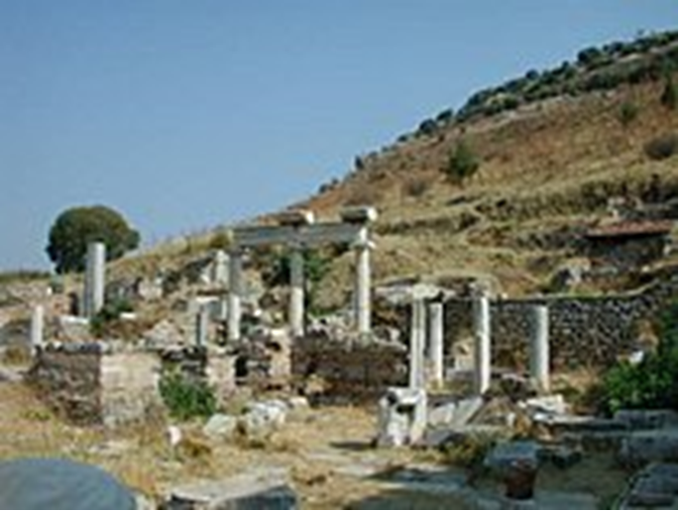

Slide 11
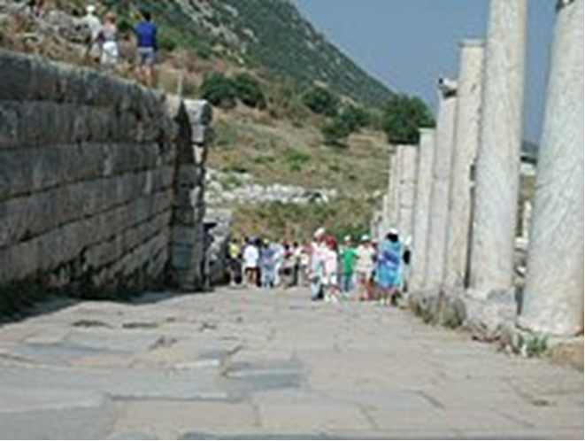
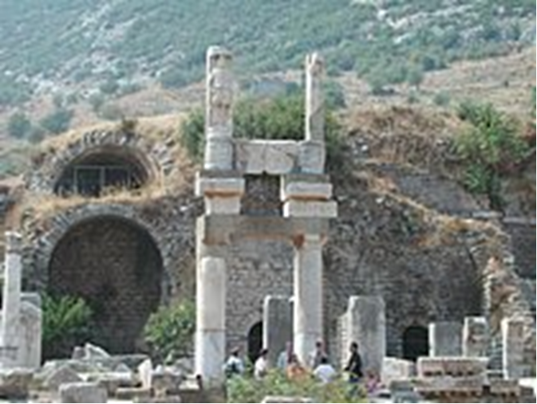

Slide 12
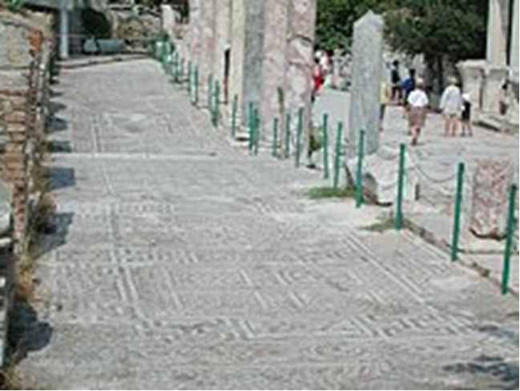
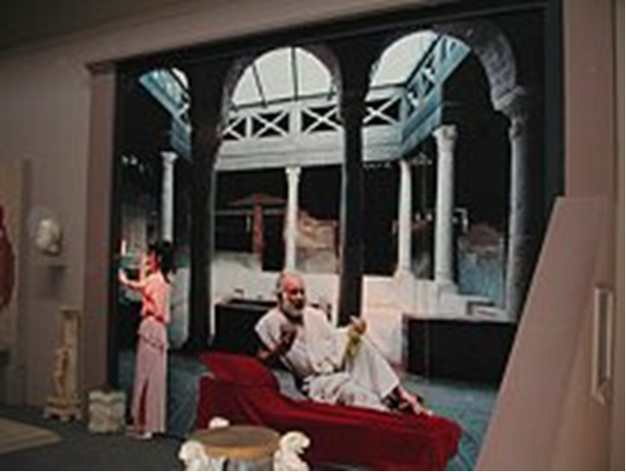

Slide 13
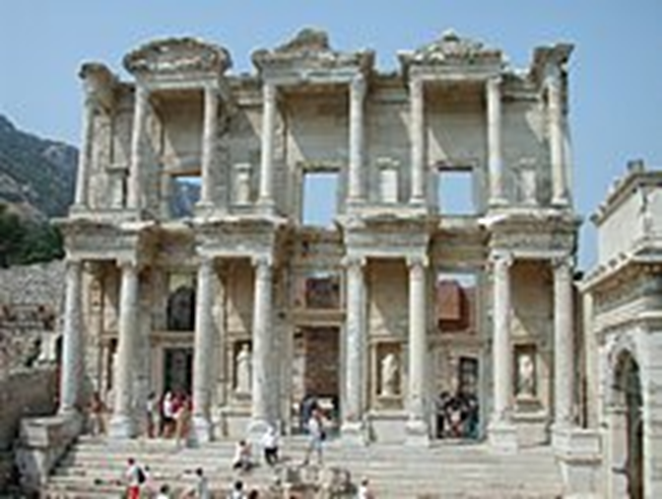

Slide 14
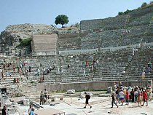
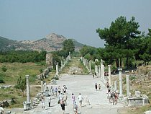

Slide 15
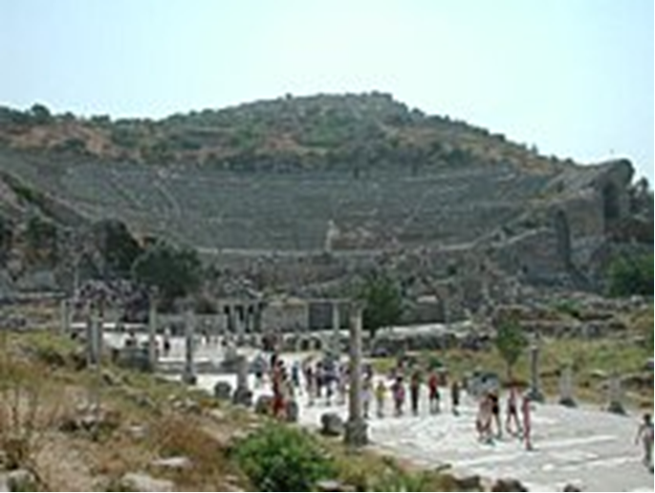
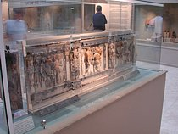

Slide 16
GOSPEL
(4) But God, being rich in mercy, because of the great love with which he loved us,
(5) even when we were dead in our trespasses, made us alive together with Christ
--by grace you have been saved—
(6) and raised us up with him and seated us with him in the heavenly places in Christ Jesus,
(7) so that in the coming ages he might show the immeasurable riches of his grace in kindness toward us in Christ Jesus.
NOTES:
This is an apt description of our true friends:
God the Father, Christ Jesus His Son, the Holy Spirit our Counselor
(Ps 103:12; Mk 10:30; Jn 5:24; 14:19; Ac 15:11;
Rom 2:4; 5:6-10; 6:1-11; 10:12;
2 Cor 4:14; Php 3:20; Col 2:12,13; 3:1; Titus 3:4,5; Rev 3:21; 20:4)

Slide 17
STUDY HELPS
– Formula of Concord – Summary, Rule and Content
Article 2 – Free Will -
Notes:
II. FREE WILL Since the fall into sin, the will of mankind is so blind and corrupt that we can chose only to do evil. We are spiritually dead by nature, enemies of God and naturally hostile toward Him. While we are free to choose in earthly matters, we have no power, ability, or free will in spiritual matters. Before conversion we are entirely incapable— in any way— of responding to or cooperating with God’s grace. After conversion and because of Christ, the new man in us does in fact respond to and cooperate with God the Holy Spirit. (See also AC XVIII; Ap XVIII; FC SD II.)

Slide 18
STATUS OF THE CONTROVERSY THE CHIEF QUESTIONS IN THIS CONTROVERSY
[1] The will of mankind is found in four different states: (1) before the fall; (2) since the fall; (3) after regeneration; and (4) after the resurrection of the body. The chief question in this article is only about the will and ability of mankind in the second state. That is, what powers in spiritual matters does a person have after the fall of our first parents and before regeneration? Can a person by his own powers— prior to and before his regeneration by God’s Spirit— get ready and prepare himself for God’s grace? Can a person accept ‹and apprehend› or reject the grace offered through the Holy Spirit in the Word and holy ‹divinely instituted› Sacraments?

Slide 19
AFFIRMATIVE STATEMENTS
The Pure Teaching about This Article, according to God’s Word
[2] 1. This is our teaching, faith, and confession on this subject: in spiritual matters the understanding and reason of mankind are ‹completely› blind and by their own powers understand nothing, as it is written in 1 Corinthians 2: 14, “The natural person does not accept the things of the Spirit of God, for they are folly to him, and he is not able to understand them because they are spiritually discerned.”
[3] 2. Likewise, we believe, teach, and confess that the unregenerate will of mankind is not only turned away from God, but also has become God’s enemy. So it only has an inclination and desire for that which is evil and contrary to God, as it is written in Genesis 8: 21, “the intention of man’s heart is evil from his youth.” Romans 8: 7 says, “The mind that isset on the flesh is hostile to God, for it does not submit to God’s law; indeed, it cannot.” Just as a dead body cannot raise itself to bodily, earthly life, so a person who by sin is spiritually dead cannot raise himself to spiritual life. For it is written in Ephesians 2: 5, “even when we were dead in our trespasses, [He] made us alive together with Christ.” And 2 Corinthians 3: 5 says, “Not that we are sufficient in ourselves to claim anything as coming from us, but our sufficiency is from God.”

Slide 20
[4] 3. God the Holy Spirit, however, does not bring about conversion without means. For this purpose He uses the preaching and hearing of God’s Word, as it is written in Romans 1: 16, the Gospel “is the power of God for salvation to everyone who believes.”
[5] Also Romans 10: 17 says, “Faith comes from hearing, and hearing through the word of Christ.” It is God’s will that His Word should be heard and that a person’s ears should not be closed (Psalm 95: 8). With this Word the Holy Spirit is present and opens hearts, so that people (like Lydia in Acts 16: 14) pay attention to it and are converted only through the Holy Spirit’s grace and power, who alone does the work of converting a person.
[6] For without His grace, and if He does not grant the increase, our willing and running, our planting, sowing, and watering (1 Corinthians 3: 5– 7)— are all nothing. As Christ says ‹in John 15: 5›, “apart from Me you can do nothing.” With these brief words the Spirit denies free will its powers and ascribes everything to God’s grace, in order that no one may boast before God (1 Corinthians 1: 29; [2 Corinthians 12: 5; Jeremiah 9: 23]).
Concordia Publishing House. Concordia: The Lutheran Confessions-A Readers Edition of the Book of Concord – Formula of Concord2nd edition (pp. 477-478). Concordia Publishing. Kindle Edition.

Slide 23
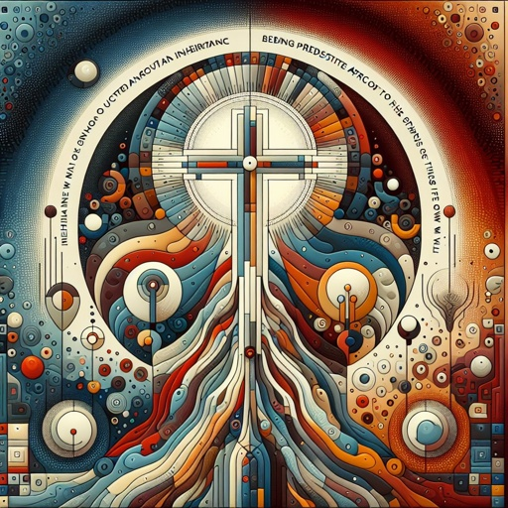

Slide 24
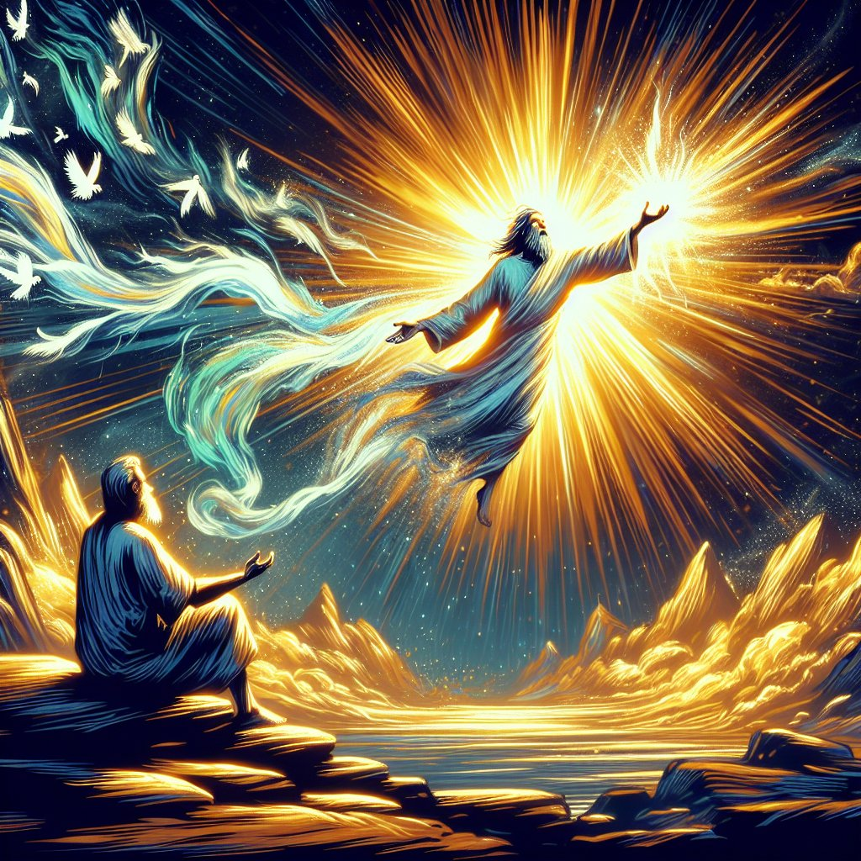

Slide 25
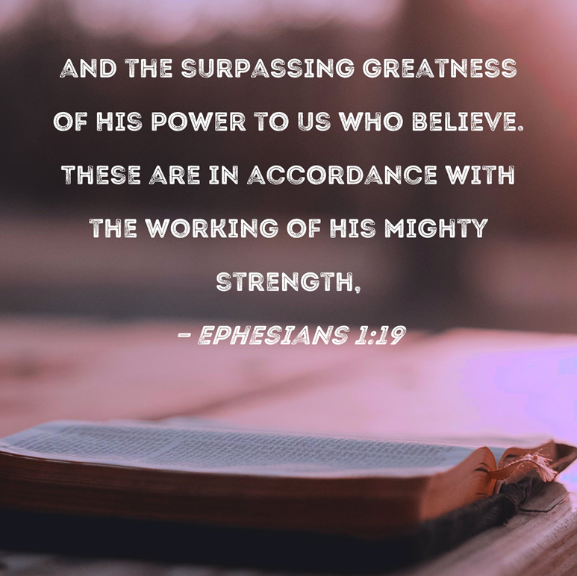

Slide 29
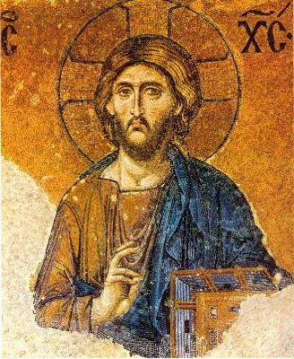

Slide 30
