Slide 1
THE BOOK OF EPHESIANS
“We Are His Workmanship”
Date: 4-7-24 Lesson: 1
Pastor David Nehrenz – Trinity Lutheran Church – Norman, OK

Slide 2
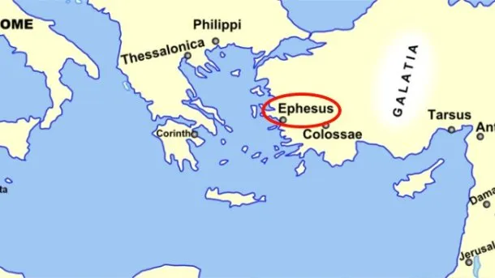
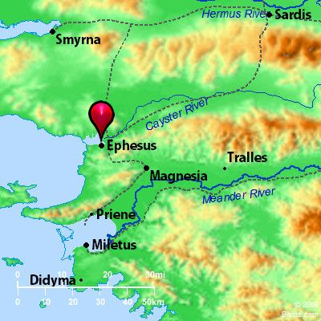
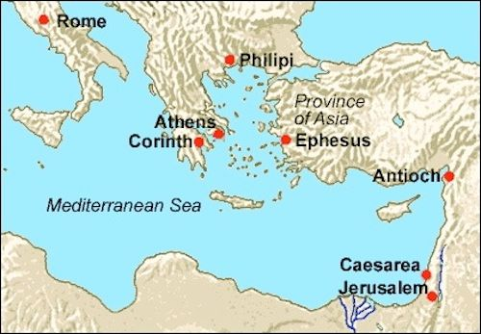

Slide 4
THE TEXT
(Ephesians 1:1-14) Paul, an apostle of Christ Jesus by the will of God,
To the saints who are in Ephesus, and are faithful in Christ Jesus:
(2) Grace to you and peace from God our Father and the Lord Jesus Christ.
(3) Blessed be the God and Father of our Lord Jesus Christ, who has blessed us in Christ with every spiritual blessing in the heavenly places, (4) even as he chose us in him before the foundation of the world, that we should be holy and blameless before him. In love (5) he predestined us for adoption through Jesus Christ, according to the purpose of his will, (6) to the praise of his glorious grace, with which he has blessed us in the Beloved.
(7) In him we have redemption through his blood, the forgiveness of our trespasses, according to the riches of his grace, (8) which he lavished upon us, in all wisdom and insight (9) making known to us the mystery of his will, according to his purpose, which he set forth in Christ (10) as a plan for the fullness of time, to unite all things in him, things in heaven and things on earth.
(11) In him we have obtained an inheritance, having been predestined according to the purpose of him who works all things according to the counsel of his will, (12) so that we who were the first to hope in Christ might be to the praise of his glory.
(13) In him you also, when you heard the word of truth, the gospel of your salvation, and believed in him, were sealed with the promised Holy Spirit, (14) who is the guarantee of our inheritance until we acquire possession of it, to the praise of his glory.

Slide 7
STUDY NOTES:
(v. 1) (Acts 9:13; 18:19-24; 19:1-35; 20:16,17; 1 Cor 15:32; 16:8; 1 Tim 1:3; 2 Tim 1:18; 4:12; Rev 1:11; 2:1)
(v. 2) (Rom 1:17)
(v. 3) (Jn 20:17; 2 Cor 1:3; 1 Pet 1:3)
(v. 4) (Mt 25:34; Jn 17:24; Col 3:12; Rom 8:29-33; 9:6-26; 11:5,7,28; 16:13;)
(v. 5) (Lk 12:32; Rom 8:13-15; Col 1:19)
(v. 6) (Mt 3:17; 17:5; Mk 1:11; 9:7; 12:6; Lk 3:22; 20:13; Col 1:13; 2 Pet 1:17)

Slide 8
THE LIFE APPLICATION “He chose us in him before the foundation of the world, that we should be holy and blameless before him.” What effect does this truth have on you?

Slide 9
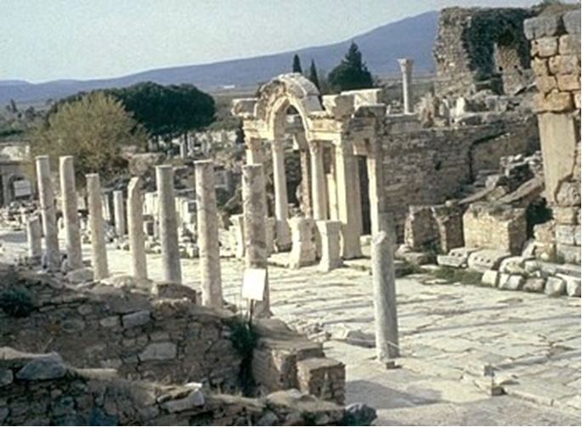

Slide 10
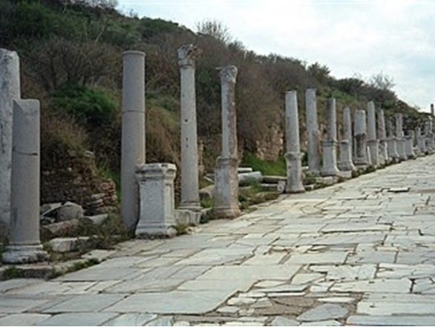

Slide 11
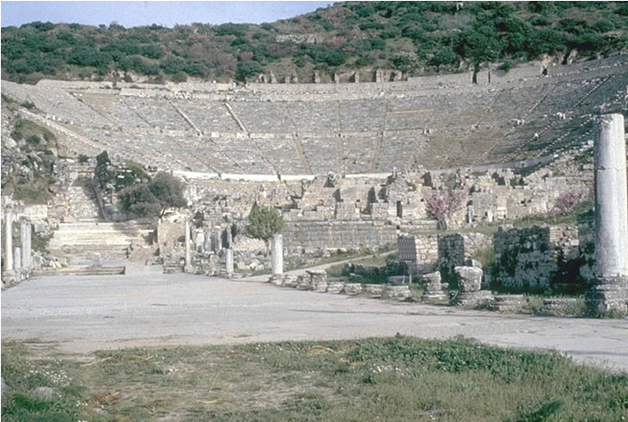

Slide 12
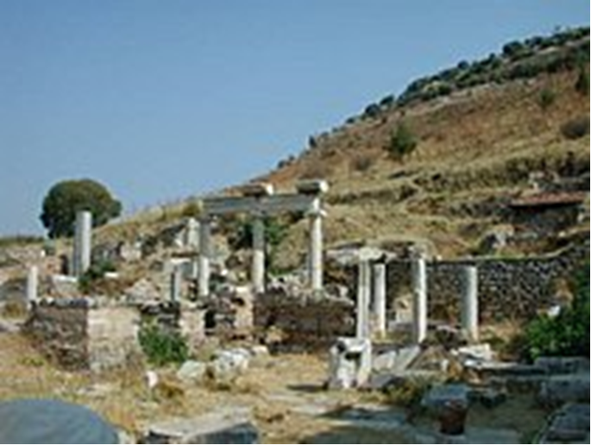

Slide 13
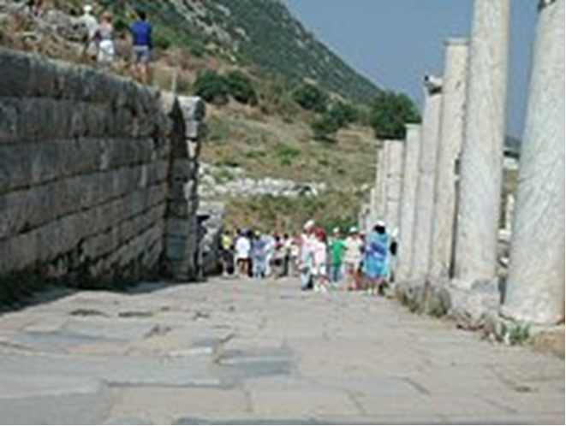
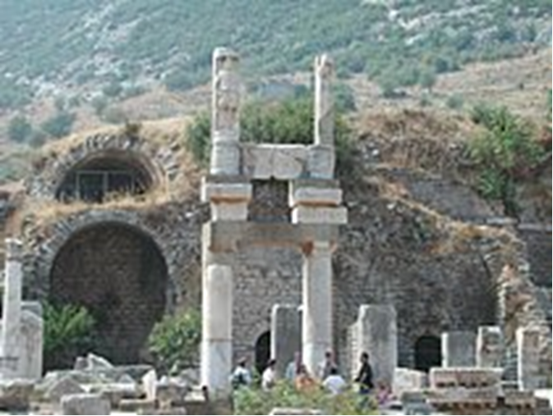

Slide 14
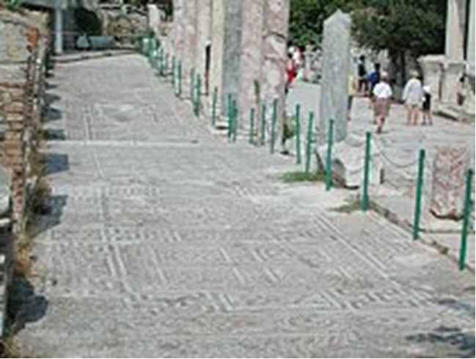
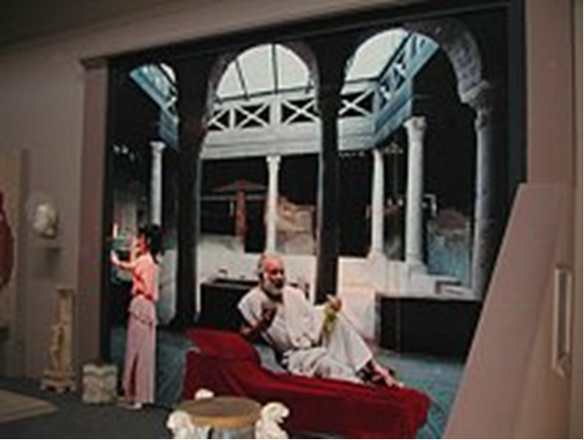

Slide 15
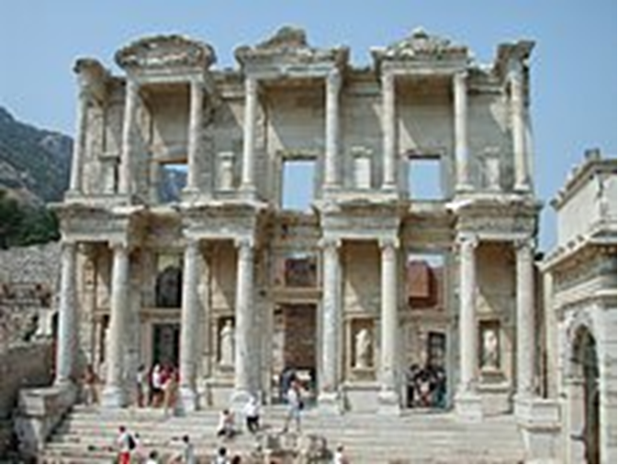

Slide 16
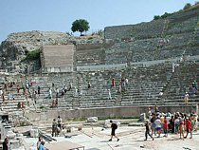
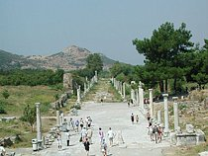

Slide 17
