Slide 1
“God’s Treasured Possession!”
-The Book of Deuteronomy-
Old Israel and New Israel =
The Church
Lesson 21 for us:
Date: 3-26-17
“For a hanged man on a tree is cursed by God”
Jesus became a curse for us on the tree of the cross so that we can be blessed and eat from the tree of life in heaven
Text: Chapter 21

Slide 2
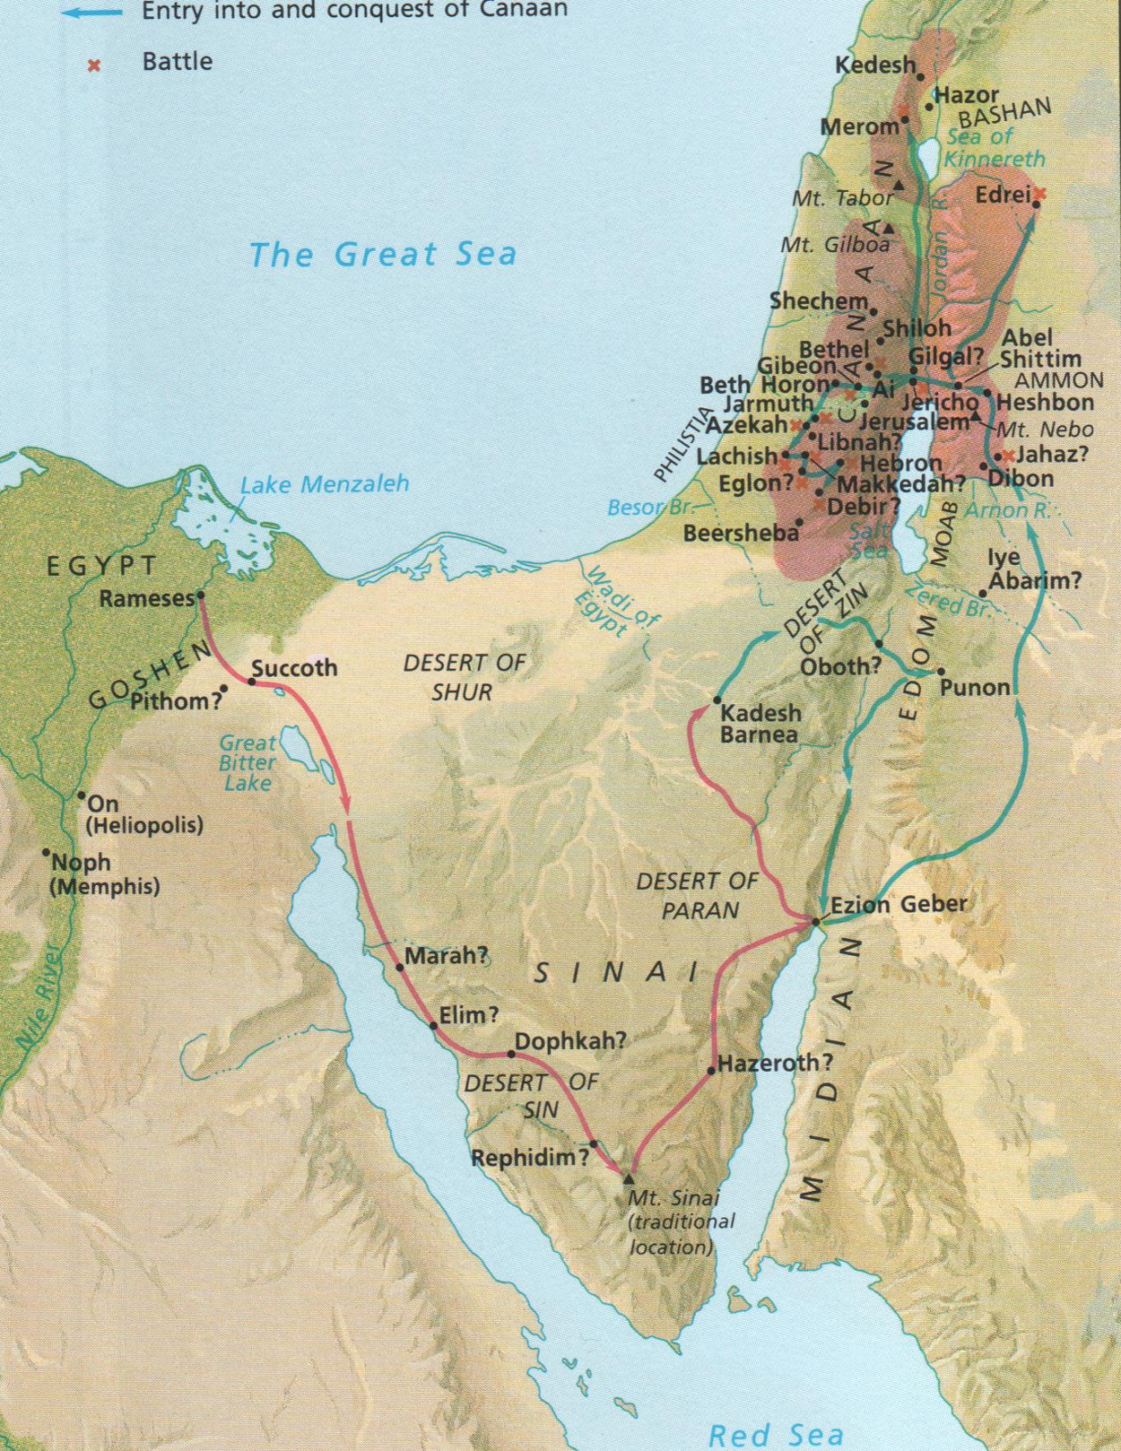

Slide 6
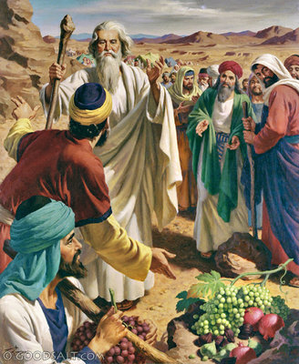

Slide 7
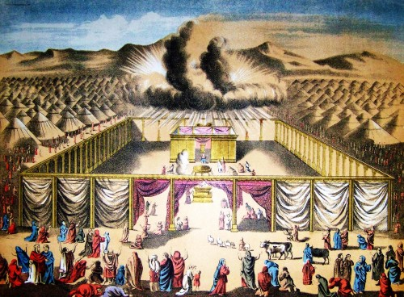

Slide 8
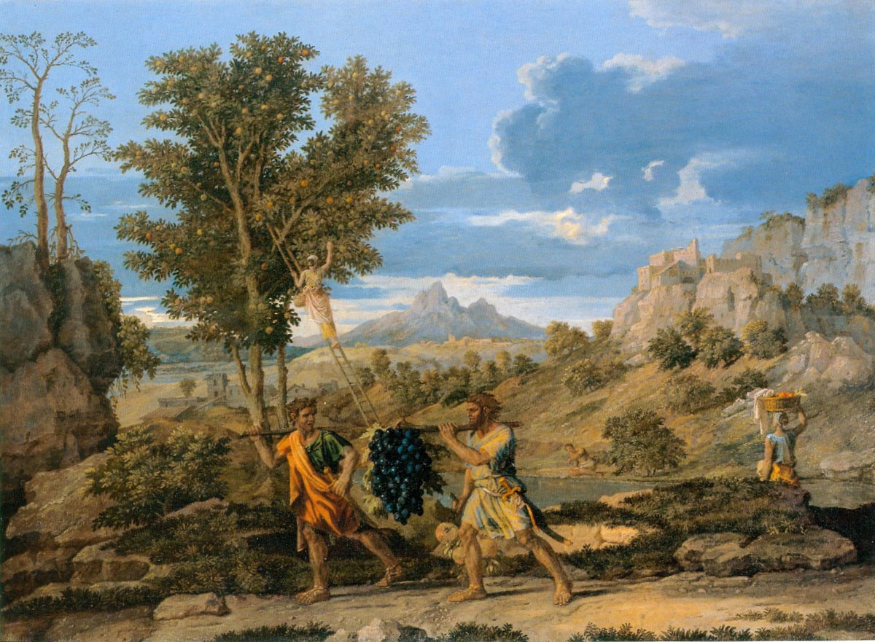

Slide 9
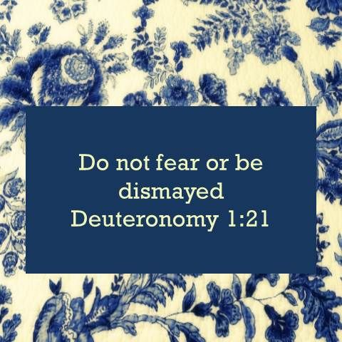

Slide 21
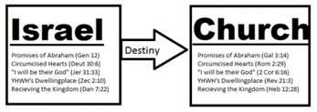

Slide 32
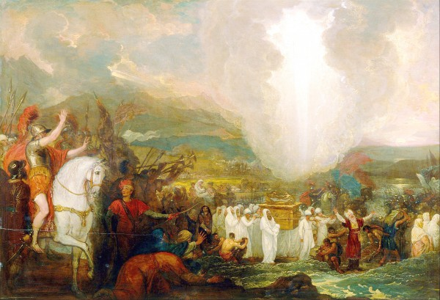

Slide 34
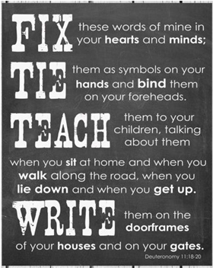
?

Slide 39
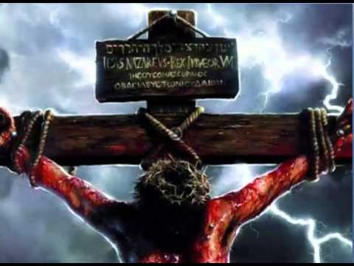

Slide 50
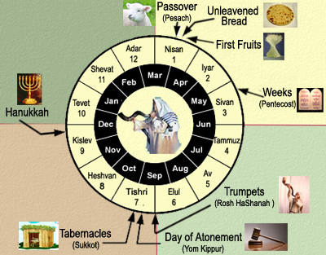

Slide 54
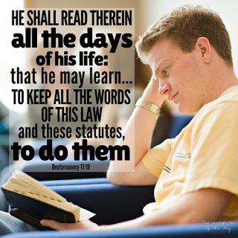

Slide 55
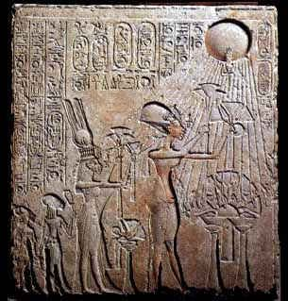

Slide 56
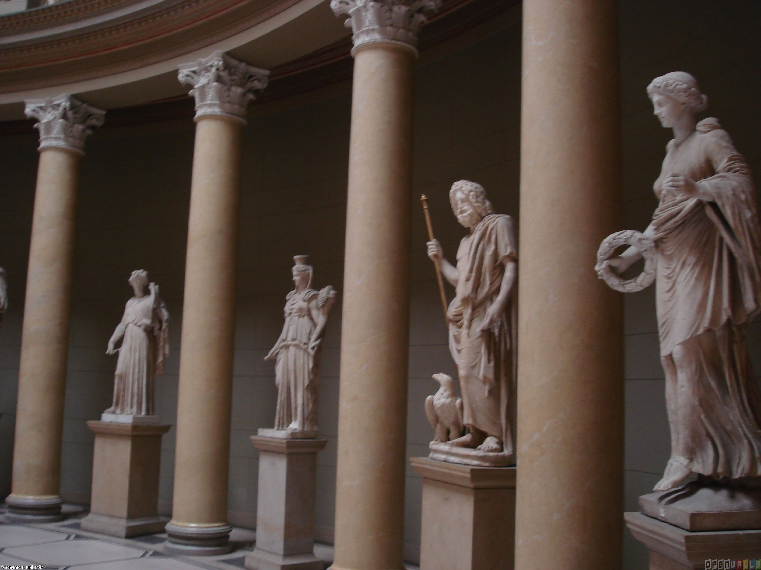

Slide 57
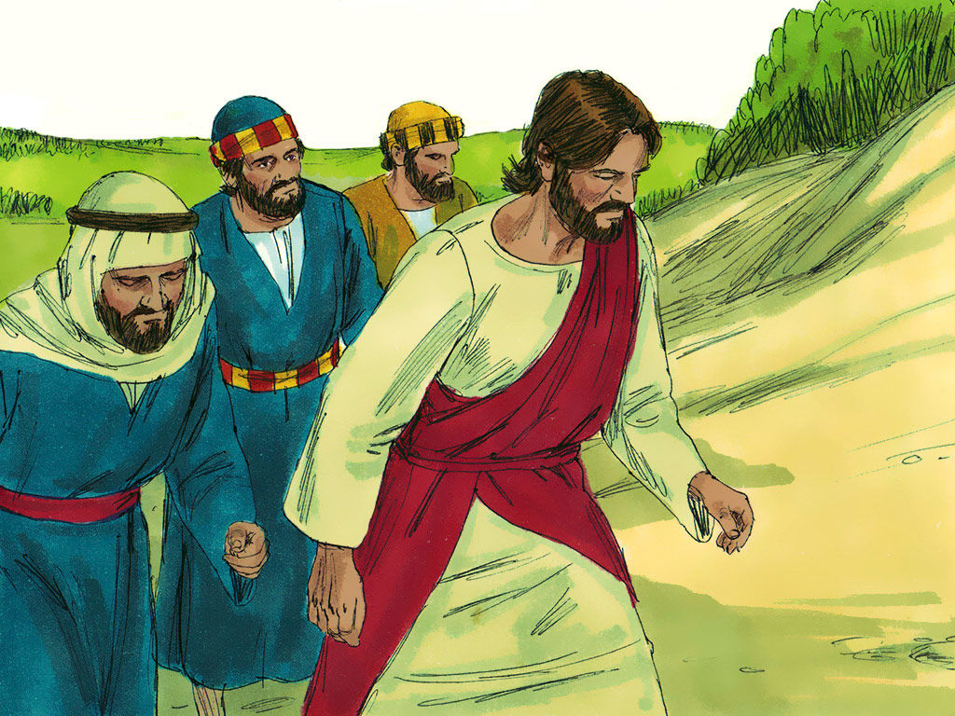

Slide 58
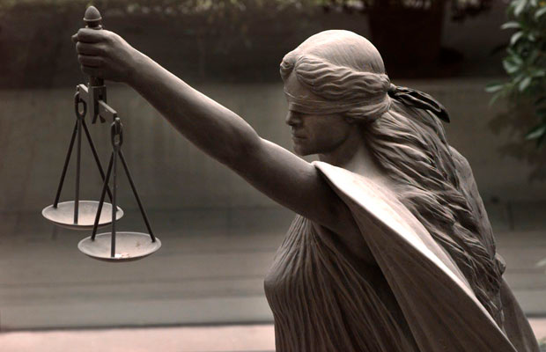

Slide 64
http://www.lcms.org/lutheran-center-for-religious-liberty
Lutheran Center for Religious Liberty
The mission of the Lutheran Center for Religious Liberty is to ignite and fuel a uniquely Lutheran response to increasing intrusions, limitations and challenges by the government in the life of the Church, while educating, encouraging and equipping LCMS members and organizations to take informed action in support of marriage, life and religious freedom.

Slide 65
http://www.lcms.org/social-issues/free-to-be-faithful
A religious liberty education and awareness campaign from The Lutheran Church—Missouri Synod
In response to increasing intrusions by government in the realm of the church, the LCMS launched this “Free to be Faithful” campaign in September 2012 to educate and move people to take informed action to protect religious freedom and all the cultural issues that pertain to it: confessing the faith in the public square, marriage, defending the sanctity of human life, etc.

Slide 69
A
A. THE TEXT
(1) "If in the land that the Lord your God is giving you to possess someone is found slain, lying in the open country, and it is not known who killed him, (2) then your elders and your judges shall come out, and they shall measure the distance to the surrounding cities. (3) And the elders of the city that is nearest to the slain man shall take a heifer that has never been worked and that has not pulled in a yoke. (4) And the elders of that city shall bring the heifer down to a valley with running water, which is neither plowed nor sown, and shall break the heifer's neck there in the valley.
(5) Then the priests, the sons of Levi, shall come forward, for the Lord your God has chosen them to minister to him and to bless in the name of the Lord, and by their word every dispute and every assault shall be settled. (6) And all the elders of that city nearest to the slain man shall wash their hands over the heifer whose neck was broken in the valley, (7) and they shall testify, 'Our hands did not shed this blood, nor did our eyes see it shed. (8) Accept atonement, O Lord, for your people Israel, whom you have redeemed, and do not set the guilt of innocent blood in the midst of your people Israel, so that their blood guilt be atoned for.' (9) So you shall purge the guilt of innocent blood from your midst, when you do what is right in the sight of the Lord.
.

Slide 70
(10) "When you go out to war against your enemies, and the Lord your God gives them into your hand and you take them captive, (11) and you see among the captives a beautiful woman, and you desire to take her to be your wife, (12) and you bring her home to your house, she shall shave her head and pare her nails. (13) And she shall take off the clothes in which she was captured and shall remain in your house and lament her father and her mother a full month. After that you may go in to her and be her husband, and she shall be your wife. (14) But if you no longer delight in her, you shall let her go where she wants. But you shall not sell her for money, nor shall you treat her as a slave, since you have humiliated her.
(15) "If a man has two wives, the one loved and the other unloved, and both the loved and the unloved have borne him children, and if the firstborn son belongs to the unloved, (16) then on the day when he assigns his possessions as an inheritance to his sons, he may not treat the son of the loved as the firstborn in preference to the son of the unloved, who is the firstborn, (17) but he shall acknowledge the firstborn, the son of the unloved, by giving him a double portion of all that he has, for he is the firstfruits of his strength. The right of the firstborn is his.

Slide 71
(18) "If a man has a stubborn and rebellious son who will not obey the voice of his father or the voice of his mother, and, though they discipline him, will not listen to them, (19) then his father and his mother shall take hold of him and bring him out to the elders of his city at the gate of the place where he lives, (20) and they shall say to the elders of his city, 'This our son is stubborn and rebellious; he will not obey our voice; he is a glutton and a drunkard.' (21) Then all the men of the city shall stone him to death with stones. So you shall purge the evil from your midst, and all Israel shall hear, and fear.
(22) "And if a man has committed a crime punishable by death and he is put to death, and you hang him on a tree, (23) his body shall not remain all night on the tree, but you shall bury him the same day, for a hanged man is cursed by God. You shall not defile your land that the Lord your God is giving you for an inheritance.

Slide 72
B. Study Notes:
1. The priest bring curses and blessings upon the people (Num 6:22-27; 35:33)
2. Washing hands as a symbol of innocence (Mt 27:24); Breaking the neck of the heifer as a symbol of ritual atonement and judicial execution and a symbolic substitutionary death.

Slide 73
3. The taking of a captive woman and the shaving of her head etc… is a symbol of leaving behind and mourning her former life and being cleansed
(Lev 14:8; Num 8:7). Even though this whole practice seems strange to modern ears, this is how the ancient world operated when they defeated another nation. But the mercy of Israel was that she was now a wife of an Israelite and could not be treated as a slave, after she was dishonored, if the man put her away. In other words, she had rights and privileges that could not be denied her.

Slide 74
4. The having of two wives or more was not God’s original plan in creation, but he allowed it for a time. (Gen 2:20-25; 4:19; 25:6; 35:23-26) If you look at the stories of the Old Testament patriarchs, this created no end of difficulties for all the people in their families. However, the favored wife could not be allowed to take away the first-born son rights from the unfavored wife. The double share for the first-born meant more responsibility to carry on the inheritance of the father after he died. It was a form of succession, like royal lines, when the eldest son becomes the next king. (Gen 27; 48:14)

Slide 75
5. The stoning to death of a rebellious son who dishonors and curses his own mother and father was the way to purge this evil from Israel. It created the fear of God among the people and was a warning to all the children to not disobey the 4th Commandment. We see how seriously God considers this commandment!
(Ex 20:12; 21:15-17; Prov 30:17;
Mk 7:10; 10:19; Eph 6:1-3)
6. Capital punishment for murderers showed that a person who took another man’s life gave up his own right to live, since he broke the 5th Commandment.
(John 8:44; Ac 23:29; Rom 13:1-4;
1 Pet 4:15; I John 3:15)

Slide 76
7. To be hung on a tree was to be cursed. To take the body down and bury it took undue attention from the person. Murder was punished with strict judgment. In the New Testament, Jesus is the One who was cursed on the tree of the cross to take our punishment upon himself.
(Mt 27:46; John 19:31; Gal. 3:13;
2 Cor 5:21; 1 Pet 2:24)

Slide 77
C. LIFE APPLICATION:
The whole Lenten season is about Jesus becoming a curse for us on the tree of the cross.
How does his death on our behalf, which removes the curse,
affect our lives each day?

Slide 78
C. LIFE APPLICATION:
What are the things or people or situations of which
we are afraid?
2. How is the Lord our God with us despite our fears?

Slide 83
