Slide 1
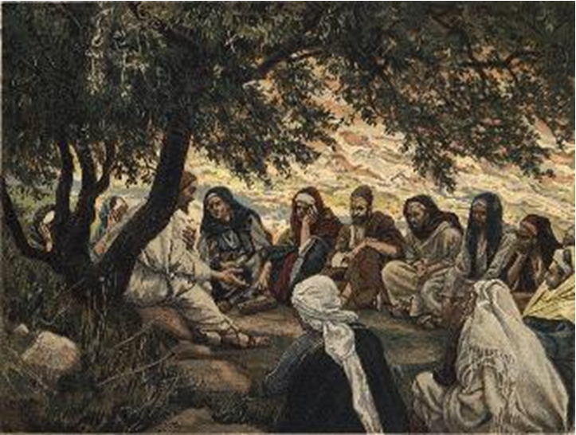
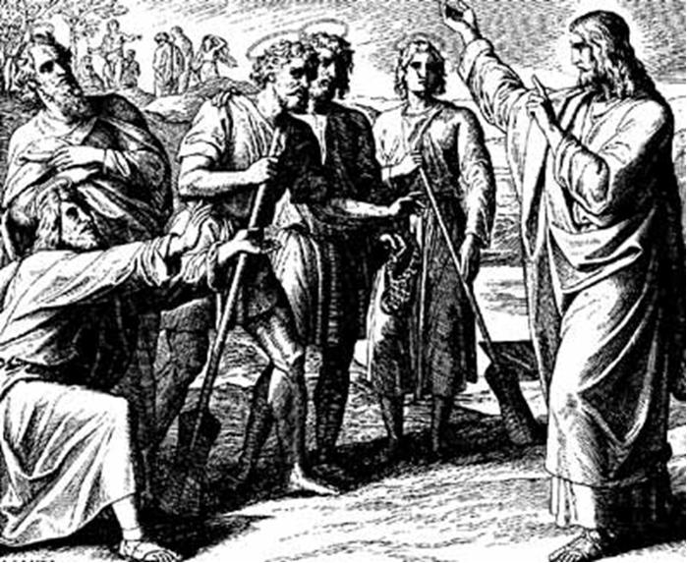
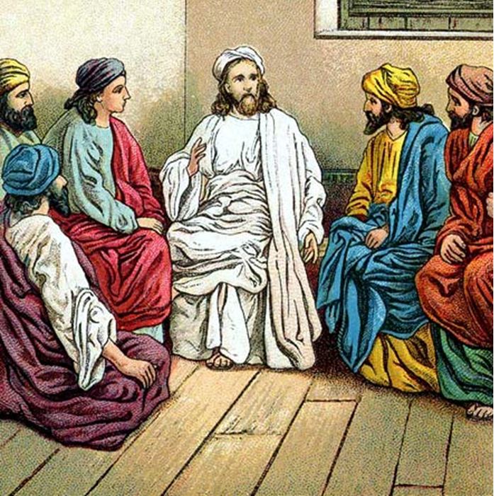
“The Apostles, Nicene and Athanasian Creeds
The Truth about the Trinity”
-The Ecumenical Creeds as Summaries
About Who God Is,
Versus False Religions and Cults-
Part 1 - A Bible Study of the Apostles’ Creed
Trinity Lutheran Church LCMS Norman, OK. Pastor David Nehrenz
Lesson 9 – June 1, 2025

Slide 2
  The Three Ecumenical Creeds
  Lutheran Church - Missouri Synod adheres to the three Ecumenical Creeds. These creeds are succinct yet accurate statements of the true Christian faith.
  Among the major doctrines confessed in the creeds are:
  • the eternal and triune natures of God,
  • the dual nature of Christ Jesus (being both fully God and fully man),
  • the working of faith in believers by the Holy Spirit,
  • the resurrection of the dead on the last day,
  • the return of Christ Jesus in judgement, and
  • everlasting life in heaven for those redeemed by the Grace of God through the working of the Holy Spirit and the innocent suffering and death & true resurrection of our Lord Jesus Christ on the third day.
  1. The Apostle's Creed
  The Nicene Creed
  The Athanasian Creed

Slide 3
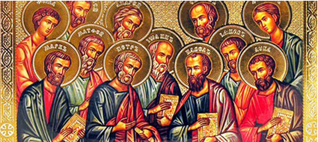

Slide 4
The Apostles’ Creed (ca AD 150-750)
The Apostles' Creed is the oldest. Already by 150 A.D. this creed was in use at Christian centers all along the Mediterranean Sea, such as Jerusalem, Alexandria (North Africa), Rome, and even Spain. The Apostles' Creed developed in conjunction with Baptism. As the water was applied, the question would be asked: "Do you believe in God the Father? God the Son? etc." Very quickly the answer developed into what we now call the Apostles' Creed. It is often called the baptismal creed. In addition to its primary use at all baptisms, it is also very appropriate for use in daily devotions. Also known as the Baptismal Creed or the Roman Symbol. Its central doctrines are those of the Trinity and God the Creator. It has been called the Creed of Creeds because already by AD 150 it was employed at Christian centers all along the Mediterranean Sea, such as Jerusalem, Alexandria (North Africa), Rome, and even Spain. It is also used in daily devotions.

Slide 7
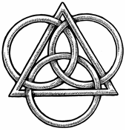
The Apostles’ Creed
I believe in God, the Father, Almighty,
Maker of heaven and earth.
I believe in Jesus Christ, his only Son, our Lord,
who was conceived by the Holy Spirit,
born of the virgin Mary,
suffered under Pontius Pilate,
was crucified, died and was buried;
He descended to hell.
The third day he rose again from the dead.
He ascended to heaven
and sits at the right hand of God the Father Almighty.
From thence He will come to judge the living and the dead.
I believe in the Holy Spirit,
the holy Christian (catholic) Church,
the communions of saints,
the forgiveness of sins,
the resurrection of the body,
and the life + everlasting. Amen.

Slide 8
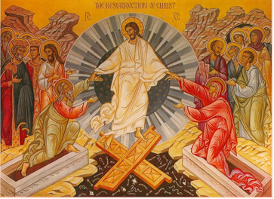

Slide 9
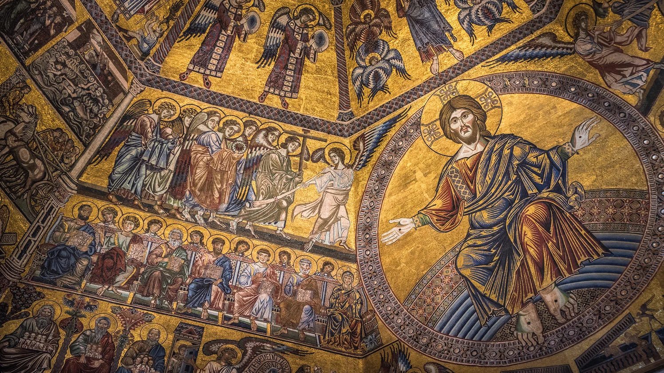

Slide 10
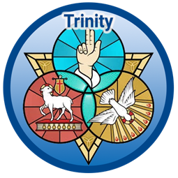

Slide 11
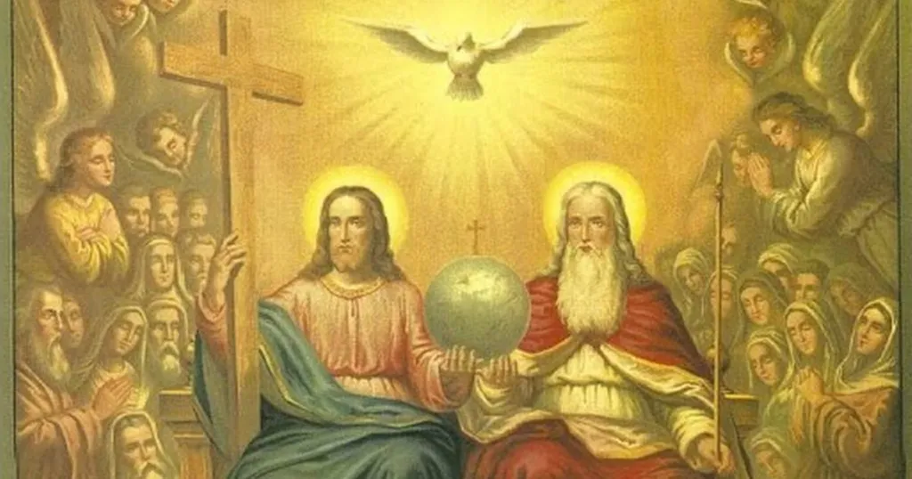

Slide 12
XI. The resurrection of the body.
1. Read Luke 16:19-31 in which Jesus explains some details of life after death.
2. Read Philippians 1:21-24 to know how Paul felt about life and death.
3. Read Revelation 20:11-15 about the Last Day
4. Read 1 John 3:1-3 to help you grasp the great difference between Christian and non-Christian thought.
5. Read I Corinthians ch. 2:6-9 and chapter 15 to help you understand what is in store for the Christian.

Slide 13
LIFE APPLICATION –
Apology of the Augsburg Confession
ARTICLE XVII Christ’s Return for Judgment Note: During the Reformation, radical groups made numerous predictions about the end of the world. Such foolishness still plagues the Church today. The vast majority of Christians agree on the basics of this important article of faith. These are also beautifully summarized in the Apostles’ Creed. (See AC XVII.)
[66] The adversaries accept Article XVII without qualification. In it we confess that Christ will appear at the consummation of the world. He will raise up all the dead and will give eternal life and eternal joys to the godly [2 Timothy 4: 8], but He will condemn the ungodly to endless punishment with the devil [Matthew 25: 46].

Slide 14
The Athanasian Creed
For as the rational soul and flesh is one man, so God and man is one Christ, who suffered for our salvation, descended into hell, rose again on the third day from the dead, ascended into heaven, and is seated at the right hand of the Father, from whence He will come to judge the living and the dead.
At His coming all people will rise again with their bodies and give an account concerning their own deeds. And those who have done good will enter into eternal life, and those who have done evil into eternal fire. This is the catholic faith; whoever does not believe it faithfully and firmly cannot be saved.

Slide 15
John W. Kleinig, Wonderfully Made: A Protestant Theology of the Body (pp. 127-129). Lexham Press.
THE LIVING BODY “Thus, the most precious treasure and the strongest consolation we Christians have is this: that the Word, the true and natural Son of God, became man, with flesh and blood like that of any human; that he became incarnate for our sakes in order that we might enter into glory, that our flesh and blood, skin and hair, hands and feet, stomach stomach and back might reside in heaven as God does, and in order that we might defy the devil and whatever else assails us. We are convinced that all our members belong in heaven as heirs of heaven’s realm.” —Martin Luther
All human life on earth shares the same common condition: it is lived in the body. We were conceived with embryonic bodies in the body of our mother. We were born with bodies, grow up in them, and have them for as long as we live. We identify ourselves with our bodies. We use our bodies to associate with others and interact with our environment. We enjoy life and health with our bodies and suffer sickness and pain with them. Our bodies locate us geographically and socially here on earth.
Like us, they cannot exist by themselves because they depend on the world and the people around them for their nourishment and growth, survival and safety. We mature and age and die with our bodies. So human life on earth is, always and only, life in the body. Our spiritual life on earth is also life in the body. It is the life that we live with the triune God, Father, Son, and Holy Spirit. More correctly, it is the life of Jesus in us, our life of faith in him, his eternal life that he shares with us, as we live for a short while in our bodies here on earth.

Slide 16
Like our physical life, our spiritual life comes from the living God. He made us in his image so that we would not just resemble the animals and other human beings with their bodies; he made us to resemble him in body, soul, and spirit. He wanted us to receive his love and share it bodily with each other. So, even when we humans turn away from him in suicidal disregard, he does not turn away from us.
He continues to protect us and provides for us in our bodily journey from the womb to the tomb. Even if we do not believe in him as our God, we still live and move and have our bodily being in him. He is not far from any of us, even if we are far from him. Through what we experience with our fragile bodies, he shows us how dependent we are on others for our livelihood and on him for our existence. Yet God is not satisfied with keeping us physically alive for the enjoyment of a transitory life with each other and his creatures.
He wants us to become fully alive with a spiritual life as well. God the Father therefore sent his one and only Son to live a full human life in human flesh and die a human death, in order to rescue us from eternal death and share his own divine life with us. He raised his Son from the dead in order to raise us up with our bodies for eternal life with him. His incarnate Son now interacts with us physically by speaking to us, regenerating us by water and the Holy Spirit, and giving us his life-giving body and blood for our spiritual nourishment.
Through these physical means he also now sanctifies our bodies so that they are living temples for him, holy shrines for his life-giving Holy Spirit. And the goal of all that is eternal life that begins already now by faith here on earth and is fulfilled in God’s new creation. So we Christians always have life in the body, from its inauguration to its consummation.

