Slide 1
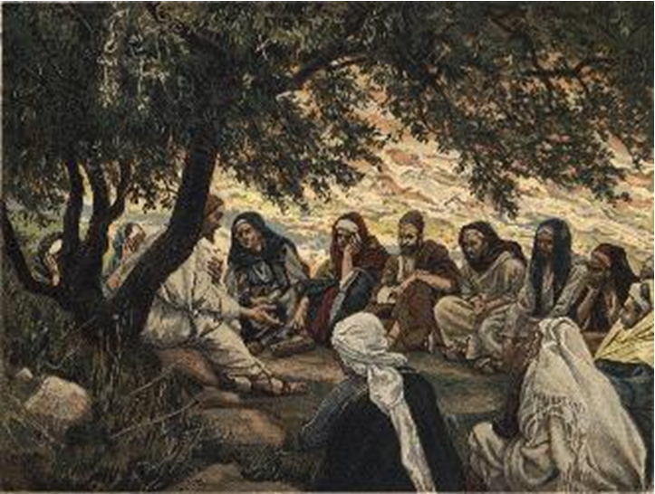
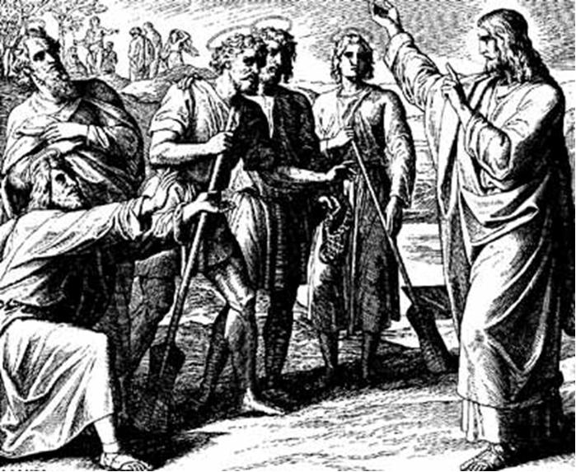
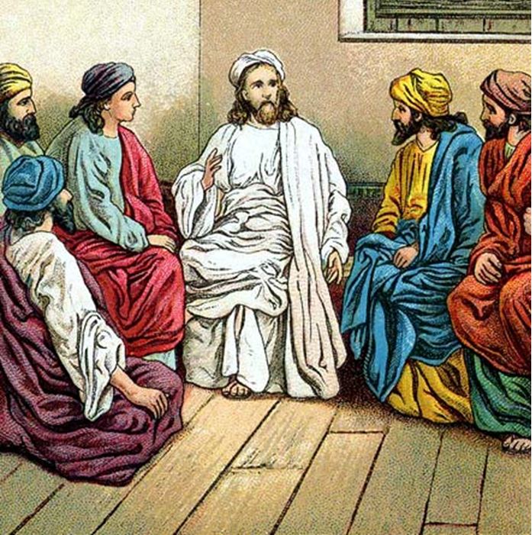
“The Apostles, Nicene and Athanasian Creeds
The Truth about the Trinity”
-The Ecumenical Creeds as Summaries
About Who God Is,
Versus False Religions and Cults-
Part 1 - A Bible Study of the Apostles’ Creed
Trinity Lutheran Church LCMS Norman, OK. Pastor David Nehrenz
Lesson 8 – May 18, 2025

Slide 2
  The Three Ecumenical Creeds
  Lutheran Church - Missouri Synod adheres to the three Ecumenical Creeds. These creeds are succinct yet accurate statements of the true Christian faith.
  Among the major doctrines confessed in the creeds are:
  • the eternal and triune natures of God,
  • the dual nature of Christ Jesus (being both fully God and fully man),
  • the working of faith in believers by the Holy Spirit,
  • the resurrection of the dead on the last day,
  • the return of Christ Jesus in judgement, and
  • everlasting life in heaven for those redeemed by the Grace of God through the working of the Holy Spirit and the innocent suffering and death & true resurrection of our Lord Jesus Christ on the third day.
  1. The Apostle's Creed
  The Nicene Creed
  The Athanasian Creed

Slide 3
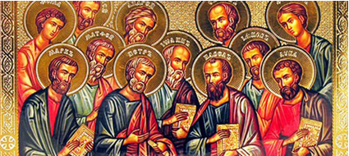

Slide 4
The Apostles’ Creed (ca AD 150-750)
The Apostles' Creed is the oldest. Already by 150 A.D. this creed was in use at Christian centers all along the Mediterranean Sea, such as Jerusalem, Alexandria (North Africa), Rome, and even Spain. The Apostles' Creed developed in conjunction with Baptism. As the water was applied, the question would be asked: "Do you believe in God the Father? God the Son? etc." Very quickly the answer developed into what we now call the Apostles' Creed. It is often called the baptismal creed. In addition to its primary use at all baptisms, it is also very appropriate for use in daily devotions. Also known as the Baptismal Creed or the Roman Symbol. Its central doctrines are those of the Trinity and God the Creator. It has been called the Creed of Creeds because already by AD 150 it was employed at Christian centers all along the Mediterranean Sea, such as Jerusalem, Alexandria (North Africa), Rome, and even Spain. It is also used in daily devotions.

Slide 7
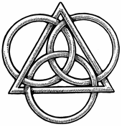
The Apostles’ Creed
I believe in God, the Father, Almighty,
Maker of heaven and earth.
I believe in Jesus Christ, his only Son, our Lord,
who was conceived by the Holy Spirit,
born of the virgin Mary,
suffered under Pontius Pilate,
was crucified, died and was buried;
He descended to hell.
The third day he rose again from the dead.
He ascended to heaven
and sits at the right hand of God the Father Almighty.
From thence He will come to judge the living and the dead.
I believe in the Holy Spirit,
the holy Christian (catholic) Church,
the communions of saints,
the forgiveness of sins,
the resurrection of the body,
and the life + everlasting. Amen.

Slide 8
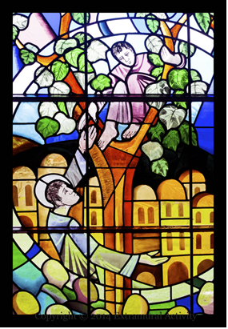

Slide 9
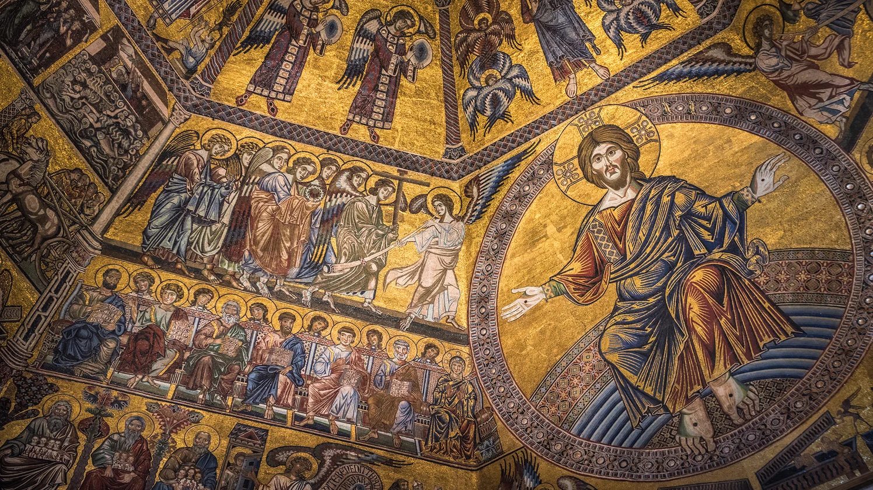

Slide 10
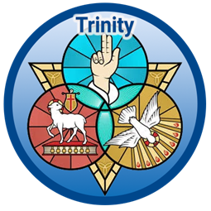

Slide 11
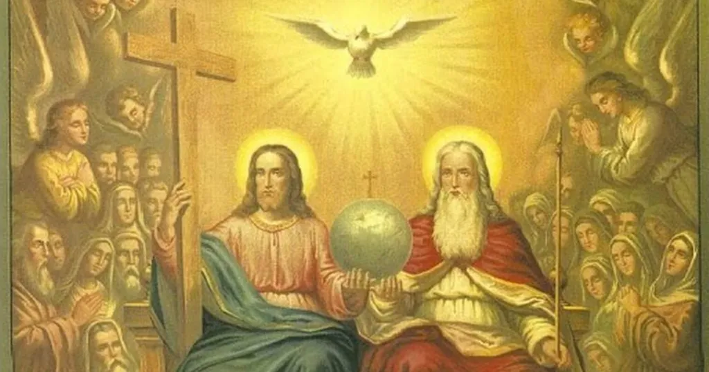

Slide 12
X. The forgiveness of sins.
1. Read I John 1:7 and I John 2:1-2 to know what happens when a Christian falls into sin.
2. Read Romans 7:21-25 to see that a baptized Christian must fight against the sinful human nature / the old adam.
3. Read Romans 3:21-28, Galatians 2:15-16 and Hebrews 11 where we learn that we are justified through faith by God's grace and not by our works.
4. Read Micah 7:18-19 to understand how our forgiveness was planned hundreds of years before the birth of Christ.

Slide 13
XI. The resurrection of the body.
1. Read Luke 16:19-31 in which Jesus explains some details of life after death.
2. Read Philippians 1:21-24 to know how Paul felt about life and death.
3. Read Revelation 20:11-15 about the Last Day
4. Read I John 3:1-3 to help you grasp the great difference between Christian and non-Christian thought.
5. Read I Corinthians ch. 2:6-9 and chapter 15 to help you understand what is in store for the Christian.

Slide 14
XII. And the Life everlasting. Amen.
1. Read II Corinthians 5:1-6 to better understand our heavenly home.
2. Read Revelation 22 and try to picture with your finite mind what is in store for us.
3. Read Matthew 6:9-13 where Jesus instructs His disciples how to pray.
4. Read II Corinthians 1:8-20 and Revelation 22:21-22 to see how the word "Amen" is used.

Slide 15
LIFE APPLICATION – The Large Catechism – The Third Article
[54] We further believe that in this Christian Church we have forgiveness of sin, which is wrought through the holy Sacraments and Absolution [Matthew 26: 28; Mark 1: 4; John 20: 23] and through all kinds of comforting promises from the entire Gospel. Therefore, whatever ought to be preached about the Sacraments belongs here. In short, the whole Gospel and all the offices of Christianity belong here, which also must be preached and taught without ceasing. God’s grace is secured through Christ [John 1: 17], and sanctification is wrought by the Holy Spirit through God’s Word in the unity of the Christian Church. Yet because of our flesh, which we bear about with us, we are never without sin [Romans 7: 23– 24].
[55] Everything, therefore, in the Christian Church is ordered toward this goal: we shall daily receive in the Church nothing but the forgiveness of sin through the Word and signs, to comfort and encourage our consciences as long as we live here. So even though we have sins, the ‹grace of the› Holy Spirit does not allow them to harm us. For we are in the Christian Church, where there is nothing but ‹continuous, uninterrupted› forgiveness of sin. This is because God forgives us and because we forgive, bear with, and help one another [Galatians 6: 1– 2].
[56] But outside of this Christian Church, where the Gospel is not found, there is no forgiveness, as also there can be no holiness. Therefore, all who seek and wish to earn holiness not through the Gospel and forgiveness of sin, but by their works, have expelled and severed themselves ‹from this Church› [Galatians 5: 4].

Slide 16
[57] However, while sanctification has begun and is growing daily [2 Thessalonians 1: 3], we expect that our flesh will be destroyed and buried with all its uncleanness [Romans 6: 4– 11]. Then we will come forth gloriously and arise in a new, eternal life of entire and perfect holiness.
[58] For now we are only half pure and holy. So the Holy Spirit always has some reason to continue His work in us through the Word. He must daily administer forgiveness until we reach the life to come. At that time there will be no more forgiveness, but only perfectly pure and holy people [1 Corinthians 13: 10]. We will be full of godliness and righteousness, removed and free from sin, death, and all evil, in a new, immortal, and glorified body [1 Corinthians 15: 43, 53].
[59] You see, all this is the Holy Spirit’s office and work. He begins and daily increases holiness upon earth through these two things: the Christian Church and the forgiveness of sin. But in our death He will accomplish it altogether in an instant [1 Corinthians 15: 52] and will forever preserve us therein by the last two parts [of the Creed].

