Slide 1
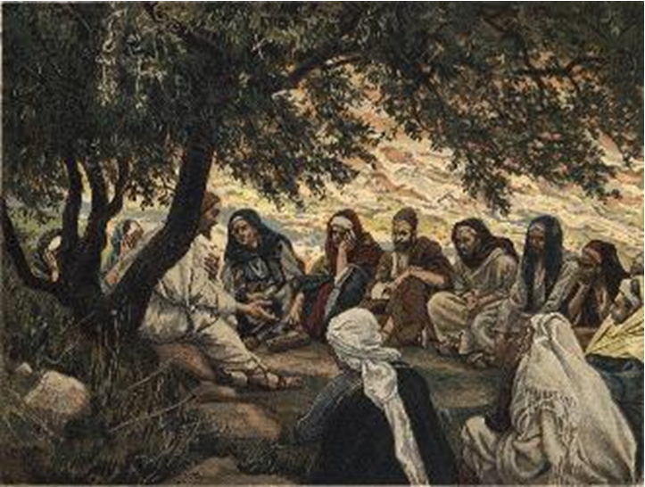
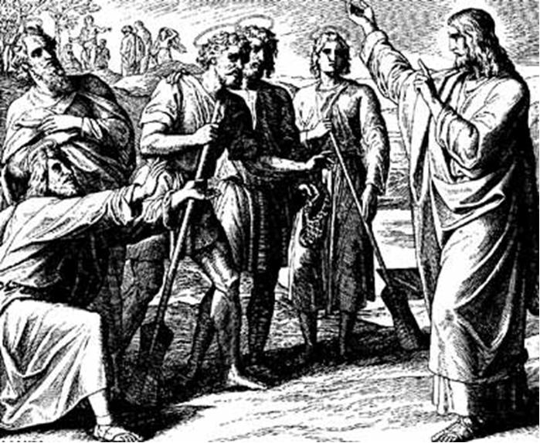
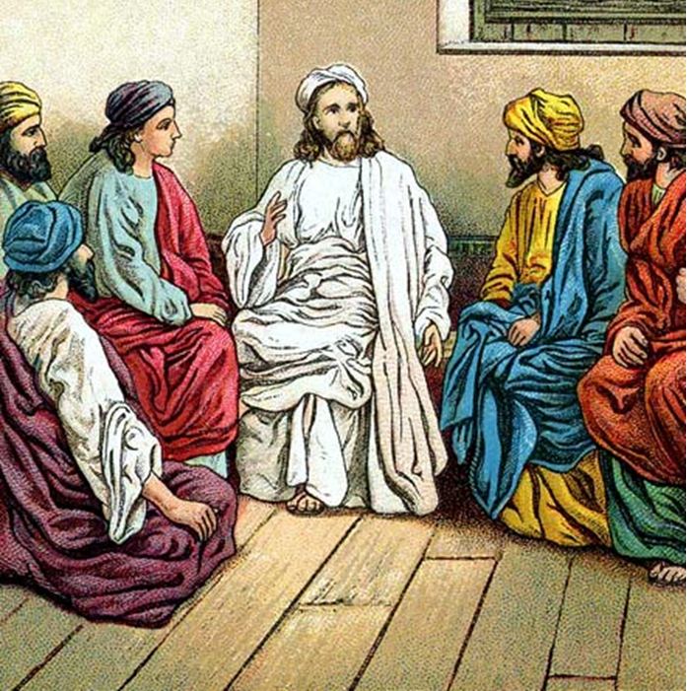
“The Apostles, Nicene and Athanasian Creeds
The Truth about the Trinity”
-The Ecumenical Creeds as Summaries
About Who God Is,
Versus False Religions and Cults-
Part 1 - A Bible Study of the Apostles’ Creed
Trinity Lutheran Church LCMS Norman, OK. Pastor David Nehrenz
Lesson 7 – May 11, 2025

Slide 2
  The Three Ecumenical Creeds
  Lutheran Church - Missouri Synod adheres to the three Ecumenical Creeds. These creeds are succinct yet accurate statements of the true Christian faith.
  Among the major doctrines confessed in the creeds are:
  • the eternal and triune natures of God,
  • the dual nature of Christ Jesus (being both fully God and fully man),
  • the working of faith in believers by the Holy Spirit,
  • the resurrection of the dead on the last day,
  • the return of Christ Jesus in judgement, and
  • everlasting life in heaven for those redeemed by the Grace of God through the working of the Holy Spirit and the innocent suffering and death & true resurrection of our Lord Jesus Christ on the third day.
  1. The Apostle's Creed
  The Nicene Creed
  The Athanasian Creed

Slide 3
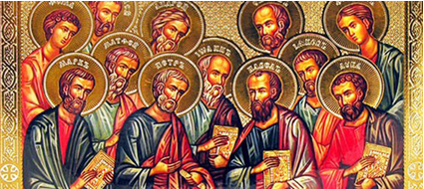

Slide 4
The Apostles’ Creed (ca AD 150-750)
The Apostles' Creed is the oldest. Already by 150 A.D. this creed was in use at Christian centers all along the Mediterranean Sea, such as Jerusalem, Alexandria (North Africa), Rome, and even Spain. The Apostles' Creed developed in conjunction with Baptism. As the water was applied, the question would be asked: "Do you believe in God the Father? God the Son? etc." Very quickly the answer developed into what we now call the Apostles' Creed. It is often called the baptismal creed. In addition to its primary use at all baptisms, it is also very appropriate for use in daily devotions. Also known as the Baptismal Creed or the Roman Symbol. Its central doctrines are those of the Trinity and God the Creator. It has been called the Creed of Creeds because already by AD 150 it was employed at Christian centers all along the Mediterranean Sea, such as Jerusalem, Alexandria (North Africa), Rome, and even Spain. It is also used in daily devotions.

Slide 7
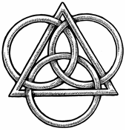
The Apostles’ Creed
I believe in God, the Father, Almighty,
Maker of heaven and earth.
I believe in Jesus Christ, his only Son, our Lord,
who was conceived by the Holy Spirit,
born of the virgin Mary,
suffered under Pontius Pilate,
was crucified, died and was buried;
He descended to hell.
The third day he rose again from the dead.
He ascended to heaven
and sits at the right hand of God the Father Almighty.
From thence He will come to judge the living and the dead.
I believe in the Holy Spirit,
the holy Christian (catholic) Church,
the communions of saints,
the forgiveness of sins,
the resurrection of the body,
and the life + everlasting. Amen.

Slide 8
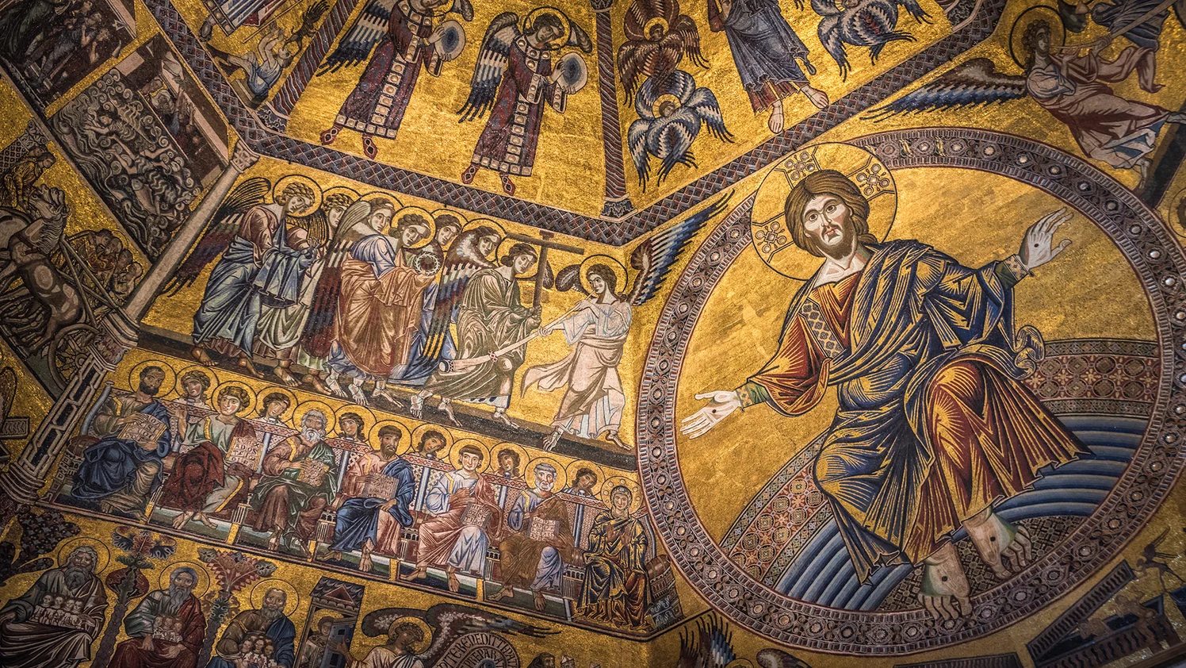

Slide 9
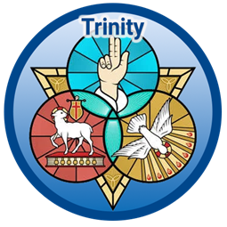

Slide 10
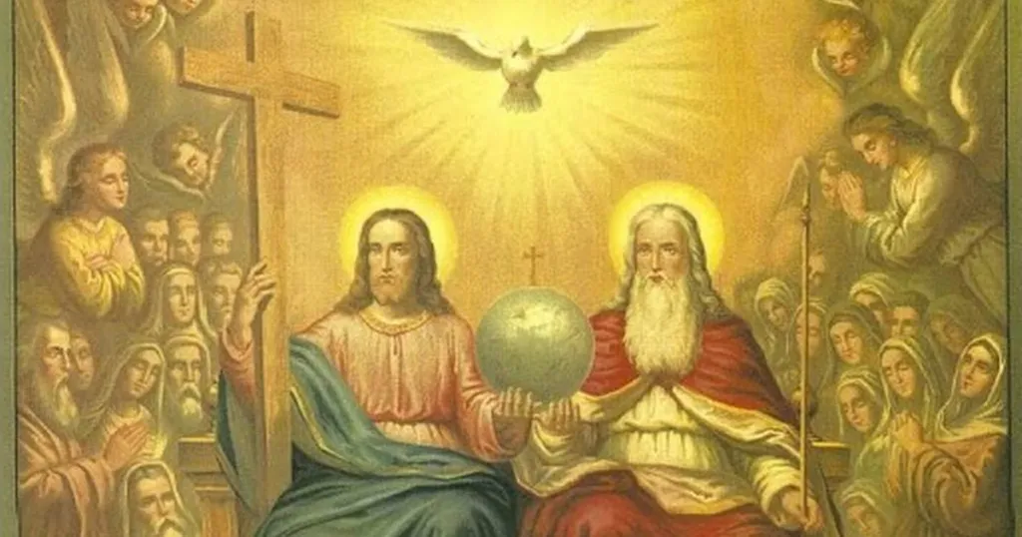

Slide 11
IX. I believe in the holy Christian (catholic) Church the communion of saints.
1. Read Genesis 12:1-5; 26:1-5 to see when the catholic, or universal, church was first prophesied
2. Read Matthew 28:16-20 and Acts 10 where we learn that Jesus Christ is Lord of all and non-Jews can also become part of the Kingdom of God.
3. Read I Corinthians 12 to understand that the church of Jesus Christ is one body but has many parts.
4. Read Ephesians 2:19-21; 4:1-16 and learn how the body of Christ grows and builds itself up in love.
5. Read Revelation 7:9-17 the church is made up of people of all nations and peoples.

Slide 12
LIFE APPLICATION – The Large Catechism – The Third Article
[47] The Creed calls the “holy Christian Church” a “communion of saints.” Both expressions, taken together, are identical. But in the past the expression “communion of saints” was not there. This phrase has been poorly and unwisely translated into the German as a communion of saints. If it is to be rendered plainly, it must be expressed quite differently in a German way. In the same way, the word ecclesia properly means in German “a gathering.”
[48] But we are used to seeing it translated as the word Church, by which the simple do not understand a gathered multitude but the consecrated house or building. This is true even though the house ought not to be called a Church, just because the multitude gathers there. For we who gather there make and choose for ourselves a particular place and give a name to the house according to the gathering. So the word Church really means nothing other than a common gathering, and is not really German, but Greek (as is also the word ecclesia). For in their own language the Greeks call it kyria, as in Latin it is called curia. Therefore, in real German, in our mother tongue, it ought to be called “a Christian congregation or gathering” or, best of all and most clearly, “holy Christendom.”
[49] So also the word communio, which is added, ought not to be translated “communion,” but “congregation.” It is nothing else than an interpretation or explanation by which someone meant to show what the Christian Church is..“a congregation of saints”; that is, a congregation made up purely of saints, or, to speak yet more plainly, “a holy congregation.”

Slide 13
[51] But this is the meaning and substance of this addition: I believe that there is upon earth a little holy group and congregation of pure saints, under one head, even Christ [Ephesians 1: 22]. This group is called together by the Holy Spirit in one faith, one mind, and understanding, with many different gifts, yet agreeing in love, without sects or schisms [Ephesians 4: 5– 8, 11].
[52] I am also a part and member of this same group, a sharer and joint owner of all the goods it possesses [Romans 8: 17]. I am brought to it and incorporated into it by the Holy Spirit through having heard and continuing to hear God’s Word [Galatians 3: 1– 2], which is the beginning of entering it. In the past, before we had attained to this, we were altogether of the devil, knowing nothing about God and about Christ [Romans 3: 10– 12].
[53] So, until the Last Day, the Holy Spirit abides with the holy congregation or Christendom [John 14: 17]. Through this congregation He brings us to Christ and He teaches and preaches to us the Word [John 14: 26]. By the Word He works and promotes sanctification, causing this congregation daily to grow and to become strong in the faith and its fruit, which He produces [Galatians 5].

Slide 14
[54] We further believe that in this Christian Church we have forgiveness of sin, which is wrought through the holy Sacraments and Absolution [Matthew 26: 28; Mark 1: 4; John 20: 23] and through all kinds of comforting promises from the entire Gospel. Therefore, whatever ought to be preached about the Sacraments belongs here. In short, the whole Gospel and all the offices of Christianity belong here, which also must be preached and taught without ceasing. God’s grace is secured through Christ [John 1: 17], and sanctification is wrought by the Holy Spirit through God’s Word in the unity of the Christian Church. Yet because of our flesh, which we bear about with us, we are never without sin [Romans 7: 23– 24].
[55] Everything, therefore, in the Christian Church is ordered toward this goal: we shall daily receive in the Church nothing but the forgiveness of sin through the Word and signs, to comfort and encourage our consciences as long as we live here. So even though we have sins, the ‹grace of the› Holy Spirit does not allow them to harm us. For we are in the Christian Church, where there is nothing but ‹continuous, uninterrupted› forgiveness of sin. This is because God forgives us and because we forgive, bear with, and help one another [Galatians 6: 1– 2].

