Slide 1
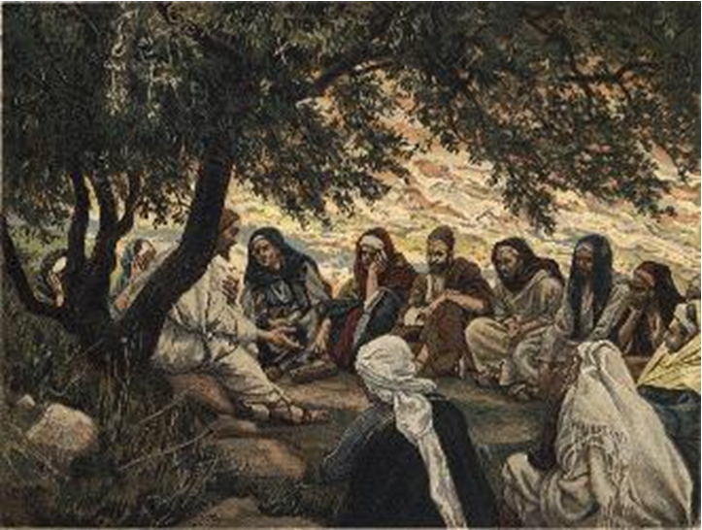
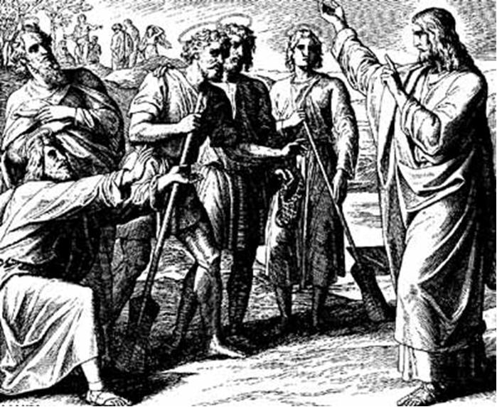
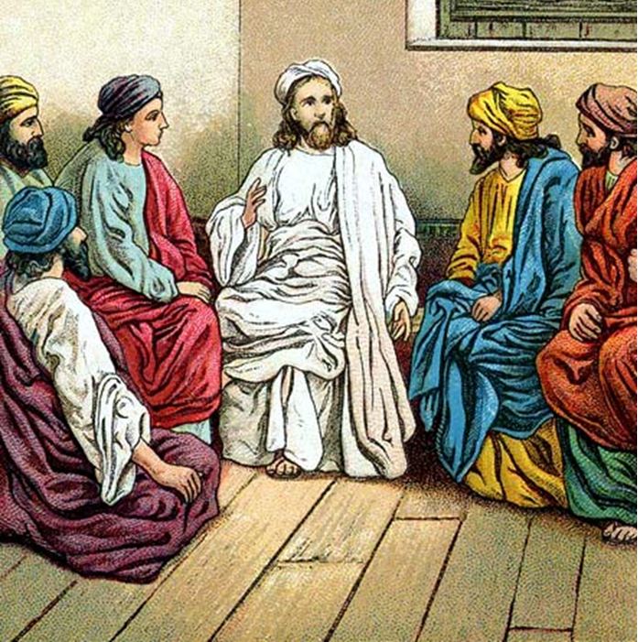
“The Apostles, Nicene and Athanasian Creeds
The Truth about the Trinity”
-The Ecumenical Creeds as Summaries
About Who God Is,
Versus False Religions and Cults-
Part 1 - A Bible Study of the Apostles’ Creed
Trinity Lutheran Church LCMS Norman, OK. Pastor David Nehrenz
Lesson 6 – May 4, 2025

Slide 2
  The Three Ecumenical Creeds
  Lutheran Church - Missouri Synod adheres to the three Ecumenical Creeds. These creeds are succinct yet accurate statements of the true Christian faith.
  Among the major doctrines confessed in the creeds are:
  • the eternal and triune natures of God,
  • the dual nature of Christ Jesus (being both fully God and fully man),
  • the working of faith in believers by the Holy Spirit,
  • the resurrection of the dead on the last day,
  • the return of Christ Jesus in judgement, and
  • everlasting life in heaven for those redeemed by the Grace of God through the working of the Holy Spirit and the innocent suffering and death & true resurrection of our Lord Jesus Christ on the third day.
  1. The Apostle's Creed
  The Nicene Creed
  The Athanasian Creed

Slide 3
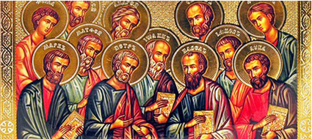

Slide 4
The Apostles’ Creed (ca AD 150-750)
The Apostles' Creed is the oldest. Already by 150 A.D. this creed was in use at Christian centers all along the Mediterranean Sea, such as Jerusalem, Alexandria (North Africa), Rome, and even Spain. The Apostles' Creed developed in conjunction with Baptism. As the water was applied, the question would be asked: "Do you believe in God the Father? God the Son? etc." Very quickly the answer developed into what we now call the Apostles' Creed. It is often called the baptismal creed. In addition to its primary use at all baptisms, it is also very appropriate for use in daily devotions. Also known as the Baptismal Creed or the Roman Symbol. Its central doctrines are those of the Trinity and God the Creator. It has been called the Creed of Creeds because already by AD 150 it was employed at Christian centers all along the Mediterranean Sea, such as Jerusalem, Alexandria (North Africa), Rome, and even Spain. It is also used in daily devotions.

Slide 7
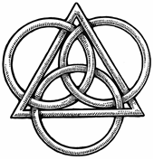
The Apostles’ Creed
I believe in God, the Father, Almighty,
Maker of heaven and earth.
I believe in Jesus Christ, his only Son, our Lord,
who was conceived by the Holy Spirit,
born of the virgin Mary,
suffered under Pontius Pilate,
was crucified, died and was buried;
He descended to hell.
The third day he rose again from the dead.
He ascended to heaven
and sits at the right hand of God the Father Almighty.
From thence He will come to judge the living and the dead.
I believe in the Holy Spirit,
the holy Christian (catholic) Church,
the communions of saints,
the forgiveness of sins,
the resurrection of the body,
and the life + everlasting. Amen.

Slide 8
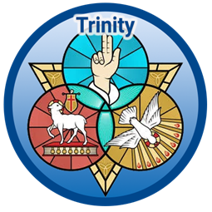

Slide 9
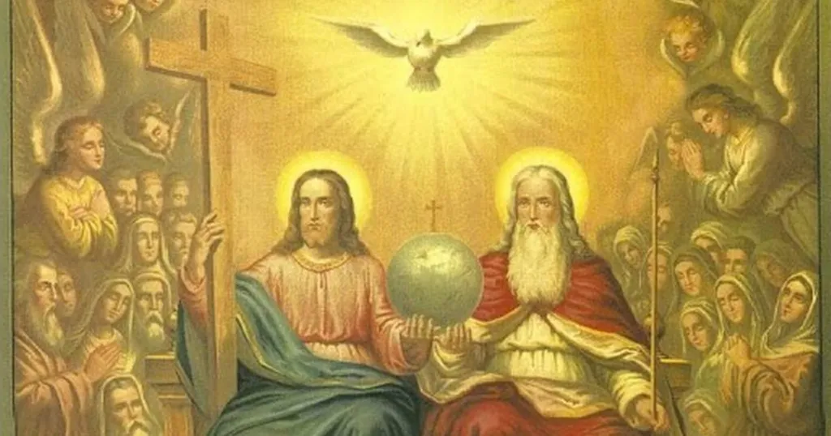

Slide 10
STUDY GUIDES
VIII. I believe in the Holy Spirit. (Pentecost – Acts chapter 2)
1. Read Galatians 4:4-7 again to see how the Spirit has changed slaves of sin into children of
God.
2. Read II Corinthians 1:20-22 which shows what methods God uses to help His children stand firm in their faith.
3. Read Ephesians 1:13-14 to see how God fulfills our call to faith through the operation of the
Holy Spirit.
4. Read I Peter 1:1-2 to see how God chooses His own.

Slide 11
IX. I believe in the holy Christian (catholic) Church the communion of saints.
Read Genesis 26:1-6 to see when the catholic, or universal, church was first prophesied?
2. Read Acts 10 where we learn that Jesus Christ is Lord of all and non-Jews can also become
part of the Kingdom of God.
3. Read I Corinthians 12 to understand that the church of Jesus Christ is one body but has many parts.
4. Read Ephesians 4:1-16 and learn how the body of Christ grows and builds itself up in love.

Slide 12
LIFE APPLICATION – The Large Catechism – The Third Article
The salvation Christ won on the cross has truly come to pass (objective reality). But unless the Holy Spirit applies that salvation to us personally and individually (subjectively), it will remain hidden from us. Sanctification is often understood to refer to our good works. Here Luther uses it, as the Bible often does, to describe the entire work of the Holy Spirit bringing us salvation, including justification. Luther drives home the point that “Church” is, first and foremost, the people the Holy Spirit is gathering together through the preaching of the Gospel. It is not primarily a building or an institution. Luther suggests it is best to understand the “communion of saints” as a “community of saints” or a “holy community.” It is not holy because of their works, but because of the Holy Spirit’s work in their midst. Within the Church the Holy Spirit, through preaching and through “signs” (that is, the Sacraments), forgives us and keeps us in the faith. Therefore, in this sense, it is right to say that outside the Church there is no salvation. This is not because of an infallible papacy, but because of what is going on by the Spirit’s power. He works the forgiveness of sins and continues that work to the very end of time. (See AC VII/ VIII; SA III XII.)

Slide 13
[34] I believe in the Holy Spirit, the holy Christian Church, the communion of saints, the forgiveness of sins, the resurrection of the body, and the life everlasting. Amen.
[35] I cannot connect this article (as I have said) to anything better than Sanctification. Through this article the Holy Spirit, with His office, is declared and shown: He makes people holy [1 Corinthians 6: 11]. Therefore, we must take our stand upon the term Holy Spirit, because it is so precise and complete that we cannot find another.
[36] For there are many kinds of spirits mentioned in the Holy Scriptures, such as the spirit of man [1 Corinthians 2: 11], heavenly spirits [Hebrews 12: 23], and evil spirits [Luke 7: 21]. But God’s Spirit alone is called the Holy Spirit, that is, He who has sanctified and still sanctifies us. For just as the Father is called “Creator” and the Son is called “Redeemer,” so the Holy Spirit, from His work, must be called “Sanctifier,” or “One who makes holy.”
[37] “But how is such sanctifying done?” Answer, “The Son receives dominion, by which He wins us, through His birth, death, resurrection, and so on. In a similar way, the Holy Spirit causes our sanctification by the following: the communion of saints or the Christian Church, the forgiveness of sins, the resurrection of the body, and the life everlasting. That means He leads us first into His holy congregation and places us in the bosom of the Church. Through the Church He preaches to us and brings us to Christ.”
[38] Neither you nor I could ever know anything about Christ, or believe on Him, and have Him for our Lord, unless it were offered to us and granted to our hearts by the Holy Spirit through the preaching of the Gospel [1 Corinthians 12: 3; Galatians 4: 6]. The work of redemption is done and accomplished [John 19: 30]. Christ has acquired and gained the treasure for us by His suffering, death, resurrection, and so on [Colossians 2: 3]. But if the work remained concealed so that no one knew about it, then it would be useless and lost. So that this treasure might not stay buried, but be received and enjoyed, God has caused the Word to go forth and be proclaimed. In the Word He has the Holy Spirit bring this treasure home and make it our own. .

Slide 14
[47] The Creed calls the “holy Christian Church” a “communion of saints.” Both expressions, taken together, are identical. But in the past the expression “communion of saints” was not there. This phrase has been poorly and unwisely translated into the German as a communion of saints. If it is to be rendered plainly, it must be expressed quite differently in a German way. In the same way, the word ecclesia properly means in German “a gathering.”
[48] But we are used to seeing it translated as the word Church, by which the simple do not understand a gathered multitude but the consecrated house or building. This is true even though the house ought not to be called a Church, just because the multitude gathers there. For we who gather there make and choose for ourselves a particular place and give a name to the house according to the gathering. So the word Church really means nothing other than a common gathering, and is not really German, but Greek (as is also the word ecclesia). For in their own language the Greeks call it kyria, as in Latin it is called curia. Therefore, in real German, in our mother tongue, it ought to be called “a Christian congregation or gathering” or, best of all and most clearly, “holy Christendom.”
[49] So also the word communio, which is added, ought not to be translated “communion,” but “congregation.” It is nothing else than an interpretation or explanation by which someone meant to show what the Christian Church is..“a congregation of saints”; that is, a congregation made up purely of saints, or, to speak yet more plainly, “a holy congregation.”
[51] But this is the meaning and substance of this addition: I believe that there is upon earth a little holy group and congregation of pure saints, under one head, even Christ [Ephesians 1: 22]. This group is called together by the Holy Spirit in one faith, one mind, and understanding, with many different gifts, yet agreeing in love, without sects or schisms [Ephesians 4: 5– 8, 11]. [52] I am also a part and member of this same group, a sharer and joint owner of all the goods it possesses [Romans 8: 17].

