Slide 1
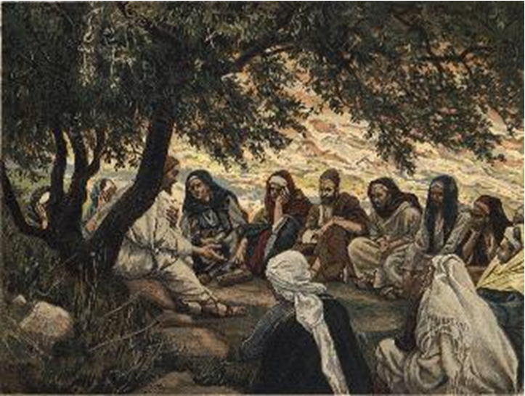
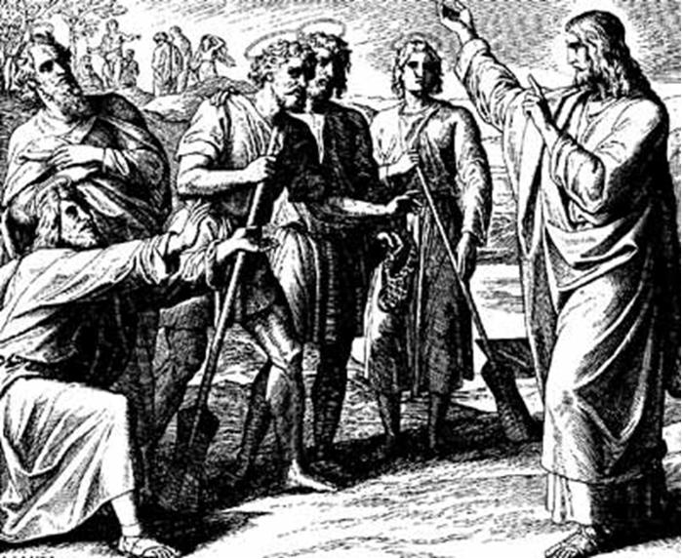
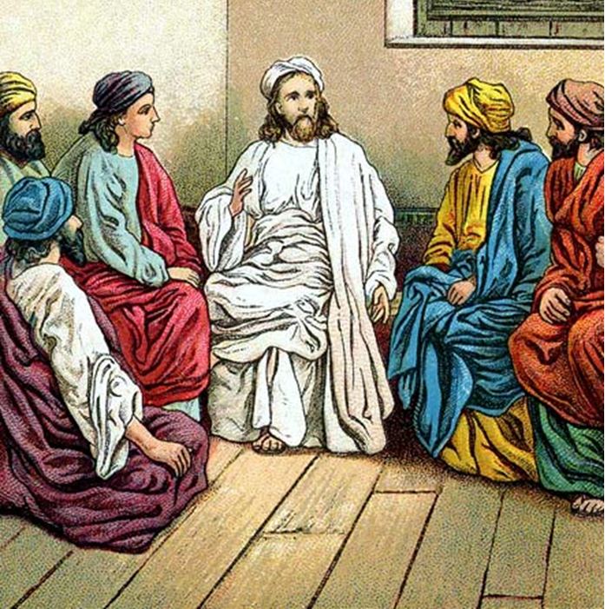
“The Apostles, Nicene and Athanasian Creeds
The Truth about the Trinity”
-The Ecumenical Creeds as Summaries
About Who God Is,
Versus False Religions and Cults-
Part 1 - A Bible Study of the Apostles’ Creed
Trinity Lutheran Church LCMS Norman, OK. Pastor David Nehrenz
Lesson 5 – April 13, 2025

Slide 2
  The Three Ecumenical Creeds
  Lutheran Church - Missouri Synod adheres to the three Ecumenical Creeds. These creeds are succinct yet accurate statements of the true Christian faith.
  Among the major doctrines confessed in the creeds are:
  • the eternal and triune natures of God,
  • the dual nature of Christ Jesus (being both fully God and fully man),
  • the working of faith in believers by the Holy Spirit,
  • the resurrection of the dead on the last day,
  • the return of Christ Jesus in judgement, and
  • everlasting life in heaven for those redeemed by the Grace of God through the working of the Holy Spirit and the innocent suffering and death & true resurrection of our Lord Jesus Christ on the third day.
  1. The Apostle's Creed
  The Nicene Creed
  The Athanasian Creed

Slide 3
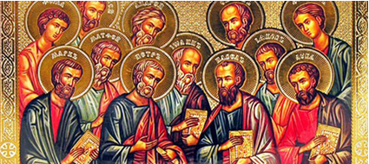

Slide 4
The Apostles’ Creed (ca AD 150-750)
The Apostles' Creed is the oldest. Already by 150 A.D. this creed was in use at Christian centers all along the Mediterranean Sea, such as Jerusalem, Alexandria (North Africa), Rome, and even Spain. The Apostles' Creed developed in conjunction with Baptism. As the water was applied, the question would be asked: "Do you believe in God the Father? God the Son? etc." Very quickly the answer developed into what we now call the Apostles' Creed. It is often called the baptismal creed. In addition to its primary use at all baptisms, it is also very appropriate for use in daily devotions. Also known as the Baptismal Creed or the Roman Symbol. Its central doctrines are those of the Trinity and God the Creator. It has been called the Creed of Creeds because already by AD 150 it was employed at Christian centers all along the Mediterranean Sea, such as Jerusalem, Alexandria (North Africa), Rome, and even Spain. It is also used in daily devotions.

Slide 7
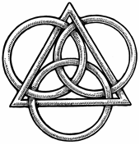
The Apostles’ Creed
I believe in God, the Father, Almighty,
Maker of heaven and earth.
I believe in Jesus Christ, his only Son, our Lord,
who was conceived by the Holy Spirit,
born of the virgin Mary,
suffered under Pontius Pilate,
was crucified, died and was buried;
He descended to hell.
The third day he rose again from the dead.
He ascended to heaven
and sits at the right hand of God the Father Almighty.
From thence He will come to judge the living and the dead.
I believe in the Holy Spirit,
the holy Christian (catholic) Church,
the communions of saints,
the forgiveness of sins,
the resurrection of the body,
and the life + everlasting. Amen.

Slide 8
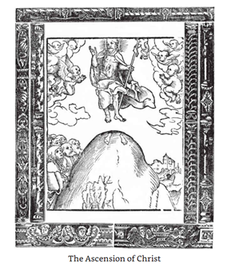

Slide 9
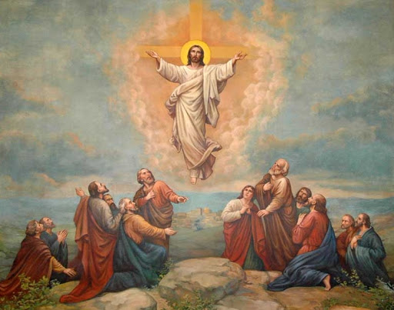

Slide 10
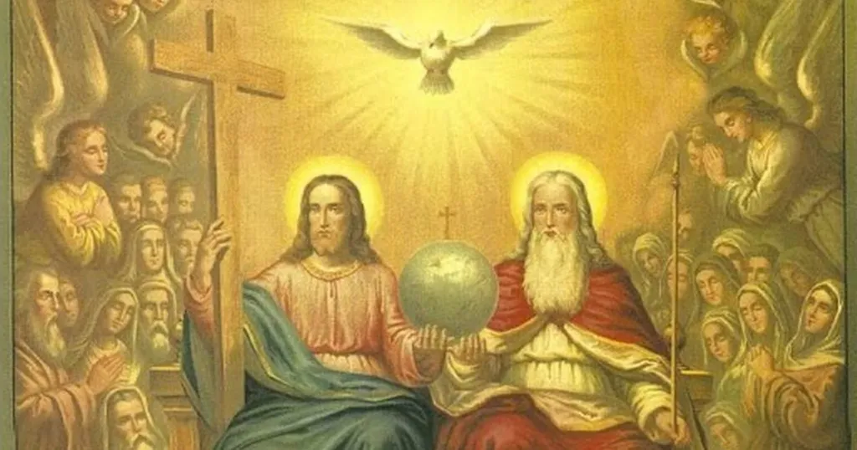

Slide 11
STUDY GUIDES
VI. He ascended into heaven,
and sits at the right hand of God the Father Almighty.
1. Read the ascension story as it is related in Luke 24:50-53; Acts 1:1-11.
2. Read that Christ is in heaven for our interest and benefit in Hebrews 9:24-28.
3. Read Hebrews 4:14-16 to find out why we should have a confident attitude and live a grateful life.
4. Read I John 2:1 to understand what Jesus is doing in heaven.
5. Read Ephesians 2:1-9 to see how our eternal life with Christ is a gift of grace and cannot be earned.

Slide 12
VII. From thence He shall come to judge the living and the dead.
1. Read Philippians 3 to see what the goal of every Christian should be.
2. Read Titus 2 to see how the Christian should live while we are waiting for Jesus Christ to return.
3. Read I Thessalonians 4:13-18 to see what the Scripture says about Jesus' return.
4. Read the parables that Jesus relates in Matthew 25.
5. Read II Thessalonians 1:3-10 to learn about God's justice.

Slide 13
LIFE APPLICATION The Formula of Concord VIII. The Person of Christ
[12] We also believe, teach, and confess that the received human nature in Christ has and retains its natural, essential properties. But over and above these, through the personal union with the Deity, and afterward through glorification, Christ’s human nature has been exalted to the right hand of majesty, power, and might, over everything that can be named, not only in this world, but also in that which is to come [Ephesians 1: 21].
[13] Consider this majesty, to which Christ has been exalted according to His humanity. He did not first receive it when He rose from the dead and ascended into heaven. He received it when He was conceived in His mother’s womb and became man, and the divine and human natures were personally united with each other.
[14] However, this personal union is not to be understood (as some incorrectly explain it) as though the two natures, the divine and the human, were united with each other, like two boards are glued together. Some say that (in deed and truth) they have no communion whatsoever with each other.
[15] This was the error and heresy of Nestorius and Samosatenus. As Suidas and Theodore, presbyter of Raithu, testify, they taught and held that the two natures have no communion whatsoever with each other. In this way, the natures are separated from each other, and the two Christs are constituted. So Christ is one, and God the Word (who dwells in Christ) is another…

Slide 14
[26] The human nature, after the resurrection from the dead, is exalted above all creatures in heaven and on earth. This is nothing other than that He entirely laid aside the form of a servant [Philippians 2: 7– 11]. He did not lay aside His human nature, but retains it to eternity. He has the full possession and use of the divine majesty according to His received human nature. However, He had this majesty immediately at His conception, even in His mother’s womb. As the apostle testifies [Philippians 2: 7], He laid it aside. As Dr. Luther explains, He kept it concealed in the state of His humiliation and did not always use it, but only when He wanted to use it [LW 15: 291].
[27] Now He has ascended to heaven, not merely as any other saint, but as the apostle testifies [Ephesians 4: 10], above all heavens. He also truly fills all things, being present everywhere, not only as God, but also as man. He rules from sea to sea and to the ends of the earth, as the prophets predict [Psalm 8: 1, 6; 93: 1– 4; Zechariah 9: 10] and the apostles testify [Mark 16: 20]. He did this everywhere with them and confirmed their word with signs.
[28] This did not happen in an earthly way. As Dr. Luther explains, this happened according to the way things are done at God’s right hand [LW 37: 55– 58; 37: 228]. “God’s right hand” is no set place in heaven, as the Sacramentarians assert without any ground in the Holy Scriptures. It is nothing other than God’s almighty power, which fills heaven and earth. Christ is installed according to His humanity (in deed and truth), without confusing or equalizing the two natures in their essence and essential properties.
[29] By this communicated ‹divine› power, according to the words of His testament, He can be and is truly present with His body and blood in the Holy Supper. He has pointed this out for us by His Word.

