Slide 1
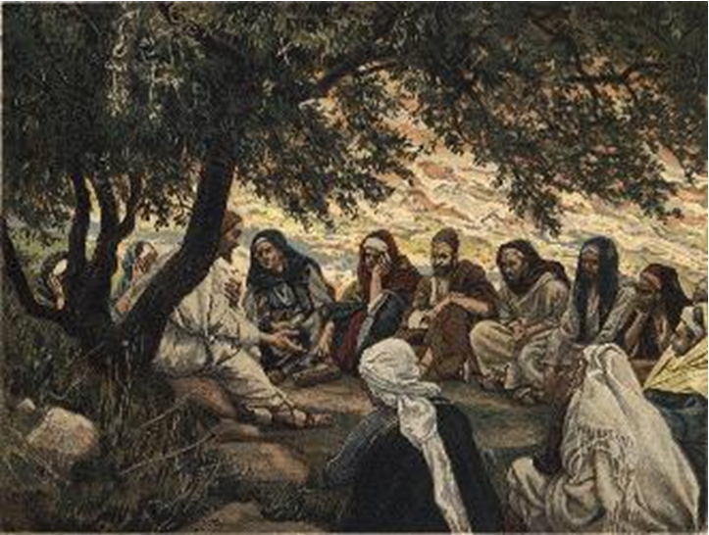
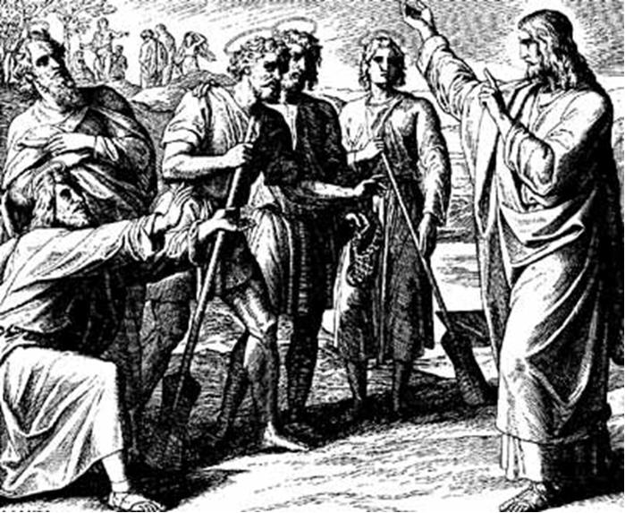
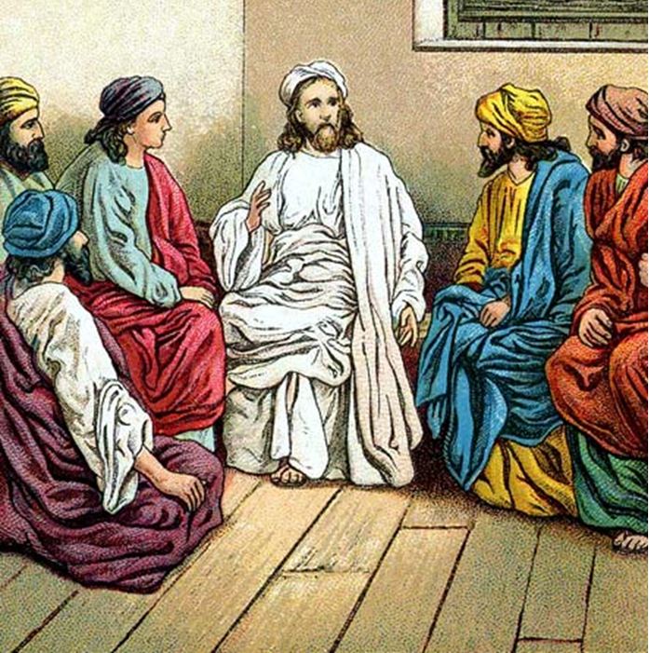
“The Apostles, Nicene and Athanasian Creeds
The Truth about the Trinity”
-The Ecumenical Creeds as Summaries
About Who God Is,
Versus False Religions and Cults-
Part 1 - A Bible Study of the Apostles’ Creed
Trinity Lutheran Church LCMS Norman, OK. Pastor David Nehrenz
Lesson 4 – April 6, 2025

Slide 2
  The Three Ecumenical Creeds
  Lutheran Church - Missouri Synod adheres to the three Ecumenical Creeds. These creeds are succinct yet accurate statements of the true Christian faith.
  Among the major doctrines confessed in the creeds are:
  • the eternal and triune natures of God,
  • the dual nature of Christ Jesus (being both fully God and fully man),
  • the working of faith in believers by the Holy Spirit,
  • the resurrection of the dead on the last day,
  • the return of Christ Jesus in judgement, and
  • everlasting life in heaven for those redeemed by the Grace of God through the working of the Holy Spirit and the innocent suffering and death & true resurrection of our Lord Jesus Christ on the third day.
  1. The Apostle's Creed
  The Nicene Creed
  The Athanasian Creed

Slide 3
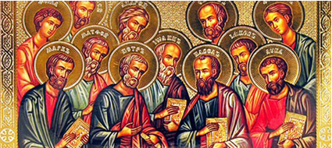

Slide 4
The Apostles’ Creed (ca AD 150-750)
The Apostles' Creed is the oldest. Already by 150 A.D. this creed was in use at Christian centers all along the Mediterranean Sea, such as Jerusalem, Alexandria (North Africa), Rome, and even Spain. The Apostles' Creed developed in conjunction with Baptism. As the water was applied, the question would be asked: "Do you believe in God the Father? God the Son? etc." Very quickly the answer developed into what we now call the Apostles' Creed. It is often called the baptismal creed. In addition to its primary use at all baptisms, it is also very appropriate for use in daily devotions. Also known as the Baptismal Creed or the Roman Symbol. Its central doctrines are those of the Trinity and God the Creator. It has been called the Creed of Creeds because already by AD 150 it was employed at Christian centers all along the Mediterranean Sea, such as Jerusalem, Alexandria (North Africa), Rome, and even Spain. It is also used in daily devotions.

Slide 7
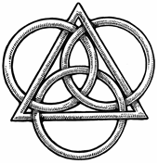
The Apostles’ Creed
I believe in God, the Father, Almighty,
Maker of heaven and earth.
I believe in Jesus Christ, his only Son, our Lord,
who was conceived by the Holy Spirit,
born of the virgin Mary,
suffered under Pontius Pilate,
was crucified, died and was buried;
He descended to hell.
The third day he rose again from the dead.
He ascended to heaven
and sits at the right hand of God the Father Almighty.
From thence He will come to judge the living and the dead.
I believe in the Holy Spirit,
the holy Christian (catholic) Church,
the communions of saints,
the forgiveness of sins,
the resurrection of the body,
and the life + everlasting. Amen.

Slide 8
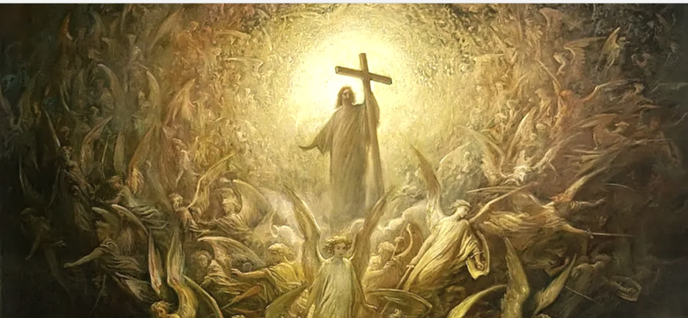

Slide 9
STUDY GUIDES
V. He descended into hell, The third day He rose again from the dead.
1. His descent into hell to proclaim victory over sin, death and
hell Rom 10:6-8; Eph. 4:7-10; 1 Peter 3:18-21
2. Read the story of Jesus' resurrection in John 20.
3. Read how the Apostle Paul explains the resurrection in
I Corinthians 15.
4. Read how the Christians will be made alive in Christ in
Ephesians 2:1-7.
5. Read what your life truly is, when you are resurrected in
Christ, now and forever in
Colossians 3:1-4.

Slide 10
EPITOME OF THE FORMULA OF CONCORD
IX. THE DESCENT OF CHRIST INTO HELL
Note: This article attests that Christ descended into hell to proclaim and announce His victory over sin, death, and the devil; not as part of His atonement for the sins of the world. It put an end to the squabbling that had arisen among Lutherans over the meaning of Christ’s descent to hell, and it based its conclusions on one of Luther’s sermons discussing this issue.(See also Apostles’ Creed; Nicene Creed; Athanasian Creed;SA I; SC II; LC II;
[1] This article has also been disputed among some theologians who have subscribed to the Augsburg Confession: When and in what manner did the Lord Christ, according to our simple Christian faith, descend to hell? Was this done before or after His death? Did this happen only to His soul, only to the divinity, or with body and soul, spiritually or bodily? Does this article belong to Christ’s passion or to His glorious victory and triumph?
[2] This article, like the preceding article, cannot be grasped by the senses or by our reason. It must be grasped through faith alone. Therefore, it is our unanimous opinion that there should be no dispute over it. It should be believed and taught only in the simplest way.
[3] Teach it like Dr. Luther, of blessed memory, in his sermon at Torgau in the year 1533 [WA 37: 62– 67]. He has explained this article in a completely Christian way. He separated all useless, unnecessary questions from it, and encouraged all godly Christians to believe with Christian simplicity.
[4] It is enough if we know that Christ descended into hell, destroyed hell for all believers, and delivered them from the power of death and of the devil, from eternal condemnation and the jaws of hell. We will save our questions ‹and not curiously investigate› about how this happened until the other world. Then not only this ‹mystery›, but others also will be revealed that we simply believe here and cannot grasp with our blind reason.

Slide 11
SOLID DECLARTION OF THE FORMULA OF CONCORD
IX. THE DESCENT OF CHRIST INTO HELL
[1] Even in the Ancient Christian teachers of the Church, as well as among some of our teachers, different explanations of the article about Christ’s descent to hell are found. Therefore, we abide in the simplicity of our Christian faith. Dr. Luther has pointed us to this in a sermon about Christ’s descent to hell, which he delivered in the castle at Torgau in the year 1533. In the Creed we confess, “I believe ... in Jesus Christ, His only Son, our Lord, who . . . was crucified, died and was buried. He descended into hell.” In this Confession Christ’s burial and descent to hell are distinguished as different articles.
[2] We simply believe that the entire person (God and man) descended into hell after the burial, conquered the devil, destroyed hell’s power, and took from the devil all his might.
[3] We should not, however, trouble ourselves with high and difficult thoughts about how this happened. With our reason and our five senses this article can be understood as little as the preceding one about how Christ is placed at the right hand of God’s almighty power and majesty. We are simply to believe it and cling to the Word. So we hold to the substance and consolation that neither hell nor the devil can take captive or injure us and all who believe in Christ.

Slide 12
LARGE CATECHISM – SECOND ARTICLE – WORK OF JESUS CHRIST – His Resurrection
… It explains that He became man [John 1: 14], was conceived and born without sin [Hebrews 4: 15], from the Holy Spirit and from the virgin Mary [Luke 1: 35], so that He might overcome sin. Further, it explains that He suffered, died, and was buried so that He might make satisfaction for me and pay what I owe [1 Corinthians 15: 3– 4], not with silver or gold, but with His own precious blood [1 Peter 1: 18– 19]. And He did all this in order to become my Lord. He did none of these things for Himself, nor did He have any need for redemption. After that He rose again from the dead, swallowed up and devoured death [1 Corinthians 15: 54], and finally ascended into heaven and assumed the government at the Father’s right hand [1 Peter 3: 22].
He did these things so that the devil and all powers must be subject to Him and lie at His feet [Hebrews 10: 12– 13] until finally, at the Last Day, He will completely divide and separate us from the wicked world, the devil, death, sin, and such [Matthew 25: 31– 46; 13: 24– 30, 47– 50].

Slide 13
LIFE APPLICATION
Explain the significance for you that
-Christ descended into hell
-Christ rose from the dead

