Slide 1
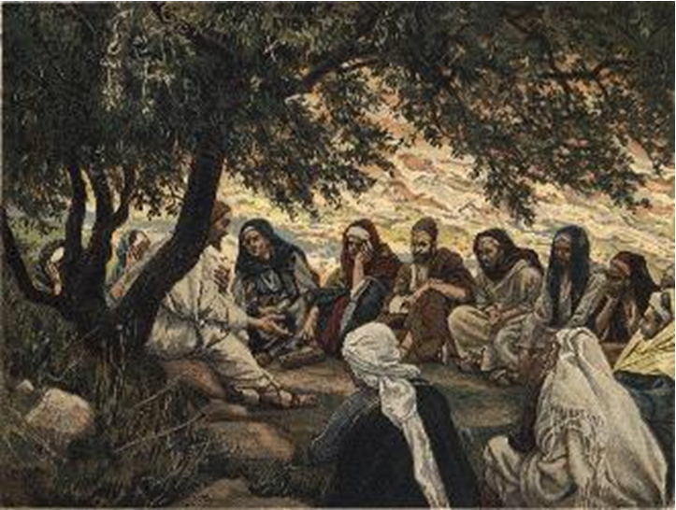
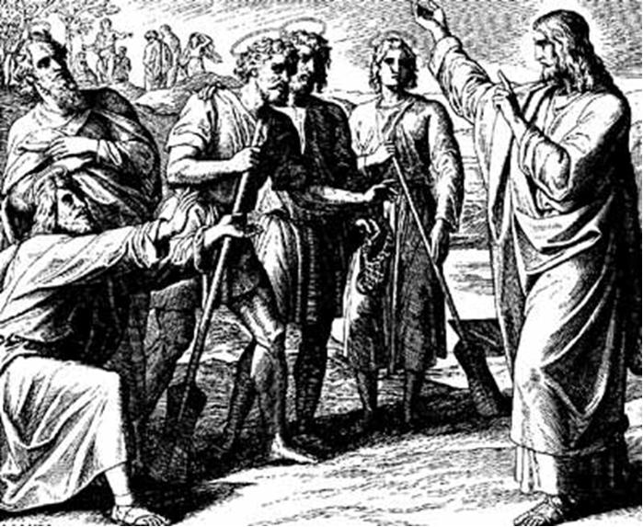
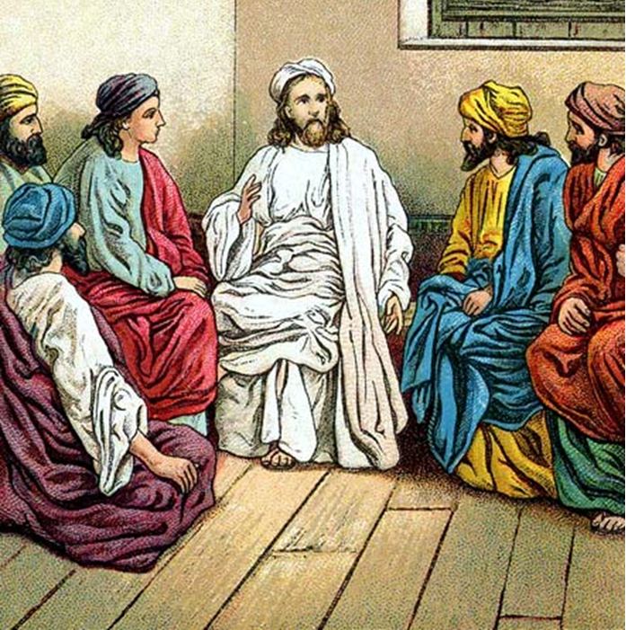
“The Apostles, Nicene and Athanasian Creeds
The Truth about the Trinity”
-The Ecumenical Creeds as Summaries
About Who God Is,
Versus False Religions and Cults-
Part 1 - A Bible Study of the Apostles’ Creed
Trinity Lutheran Church LCMS Norman, OK. Pastor David Nehrenz
Lesson 2 - March 23, 2025

Slide 2
  The Three Ecumenical Creeds
  March 16, 2025
  Lutheran Church - Missouri Synod adheres to the three Ecumenical Creeds. These creeds are succinct yet accurate statements of the true Christian faith.
  Among the major doctrines confessed in the creeds are:
  • the eternal and triune natures of God,
  • the dual nature of Christ Jesus (being both fully God and fully man),
  • the working of faith in believers by the Holy Spirit,
  • the resurrection of the dead on the last day,
  • the return of Christ Jesus in judgement, and
  • everlasting life in heaven for those redeemed by the Grace of God through the working of the Holy Spirit and the innocent suffering and death & true resurrection of our Lord Jesus Christ on the third day.
  1. The Apostle's Creed
  The Nicene Creed
  The Athanasian Creed

Slide 3
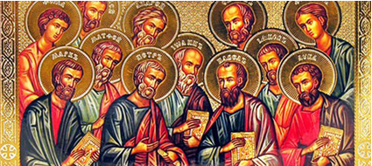

Slide 4
The Apostles’ Creed (ca AD 150-750)
The Apostles' Creed is the oldest. Already by 150 A.D. this creed was in use at Christian centers all along the Mediterranean Sea, such as Jerusalem, Alexandria (North Africa), Rome, and even Spain. The Apostles' Creed developed in conjunction with Baptism. As the water was applied, the question would be asked: "Do you believe in God the Father? God the Son? etc." Very quickly the answer developed into what we now call the Apostles' Creed. It is often called the baptismal creed. In addition to its primary use at all baptisms, it is also very appropriate for use in daily devotions. Also known as the Baptismal Creed or the Roman Symbol. Its central doctrines are those of the Trinity and God the Creator. It has been called the Creed of Creeds because already by AD 150 it was employed at Christian centers all along the Mediterranean Sea, such as Jerusalem, Alexandria (North Africa), Rome, and even Spain. It is also used in daily devotions.

Slide 7
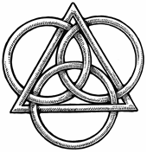
The Apostles’ Creed
I believe in God, the Father, Almighty,
Maker of heaven and earth.
I believe in Jesus Christ, his only Son, our Lord,
who was conceived by the Holy Spirit,
born of the virgin Mary,
suffered under Pontius Pilate,
was crucified, died and was buried;
He descended to hell.
The third day he rose again from the dead.
He ascended to heaven
and sits at the right hand of God the Father Almighty.
From thence He will come to judge the living and the dead.
I believe in the Holy Spirit,
the holy Christian (catholic) Church,
the communions of saints,
the forgiveness of sins,
the resurrection of the body,
and the life + everlasting. Amen.

Slide 8
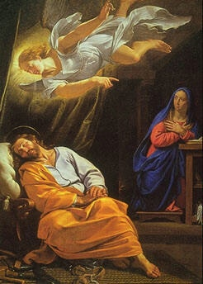

Slide 9
II. And in Jesus Christ, His only begotten Son, our Lord.
1. Read how Jesus' birth was foretold in Luke 1:26-38 and then the actual incarnation in Luke 2:1-20.
2. Read how Jesus explains His oneness with God the Father in John 20:17, 28-29.
3. Read Romans 8:1-4 to see the relationship between God the Father and His Son, Jesus Christ.
4. Read John 1:1-5 to see the divine and eternal attributes of Jesus.

Slide 10
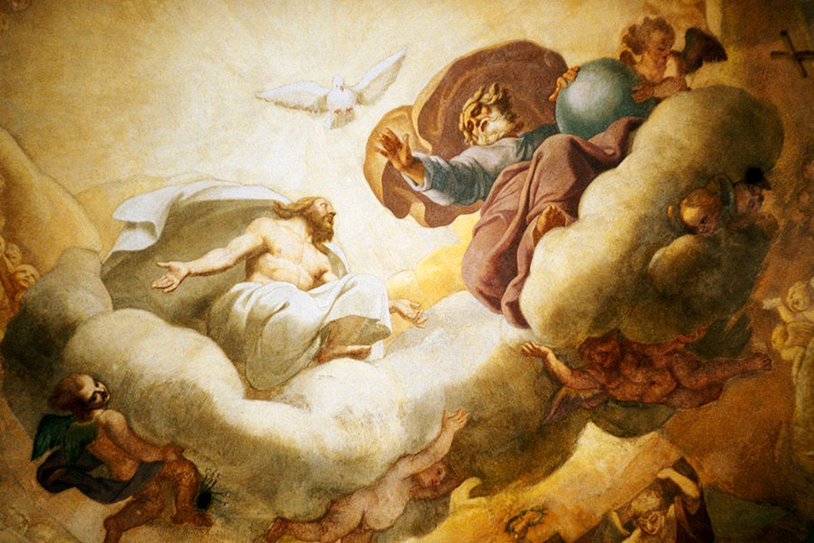

Slide 11
III. Who was conceived by the Holy Spirit, born of the virgin Mary.
1. Read what the gospel of Matthew adds to Luke's story of the conception of Jesus in Matthew 1:18-25.
2. Read in Hebrews 4:14-15 and Luke 2:41-52 how Jesus still had His divine nature even as He lived on earth.
3. Read Isaiah 9:6-7 and Isaiah 7:13-14 and compare the Old Testament prophecy of Christ's birth with the New Testament revelation in Luke 1:26-38
4. Read Jude verses 17-23 to see what influence the Holy Spirit has in the Christians' lives.

Slide 12
STUDY GUIDES - The Formula of Concord - The Epitome Summary, Content and Norm Part VIII The Person of Christ
AFFIRMATIVE STATEMENTS: The Pure Teaching of the Christian Church about the Person of Christ
[4] To explain this controversy and settle it according to the guidance ‹analogy› of our Christian faith, our doctrine, faith, and confession is as follows: [5] 1. The divine and human natures in Christ are personally united. So there are not two Christs, one the Son of God and the other the Son of Man. But one and the same person is the Son of God and Son of Man (Luke 1: 35; Romans 9: 5).
[6] 2. We believe, teach, and confess that the divine and human natures are not mingled into one substance, nor is one changed into the other. Each keeps its own essential properties, which can never become the properties of the other nature. [7] 3. The properties of the divine nature are these: to be almighty, eternal, infinite, and to be everywhere present (according to the property of its nature and its natural essence, of itself), to know everything, and so on. These never become properties of the human nature.
[8] 4. The properties of the human nature are to be a bodily creature, to be flesh and blood, to be finite and physically limited, to suffer, to die, to ascend and descend, to move from one place to another, to suffer hunger, thirst, cold, heat, and the like. These never become properties of the divine nature.

Slide 13
[9] 5. The two natures are united personally (i.e., in one person). Therefore, we believe, teach, and confess that this union is not the kind of joining together and connection that prevents either nature from having anything in common with the other personally (i.e., because of the personal union). It is not like when two boards are glued together, where neither gives anything to the other or takes anything from the other.
But here is described the highest communion that God truly has with the man. From this personal union, the highest and indescribable communion results. There flows everything human that is said and believed about God, and everything divine that is said and believed about the man Christ. The ancient teachers of the Church explained this union and communion of the natures by the illustration of iron glowing with fire, and also by the union of body and soul in man.
[10] 6. We believe, teach, and confess that God is man and man is God. This could not be true if the divine and human natures had (in deed and truth) absolutely no communion with each other. [11] For how could the man, the Son of Mary, in truth be called or be God, or the Son of God the Most High, if His humanity were not personally united with the Son of God? How could He have no real communion (that is, in deed and truth) with the Most High, but only share God’s name? [12] 7. So we believe, teach, and confess that Mary conceived and bore not merely a man and no more, but God’s true Son. Therefore, she also is rightly called and truly is “the mother of God.”

Slide 14
LIFE APPLICATION
Since Jesus is both true God and true Man,
how does this assure us that he has all power in heaven and earth,
yet he also understands our everyday needs and daily struggles?

