Slide 1
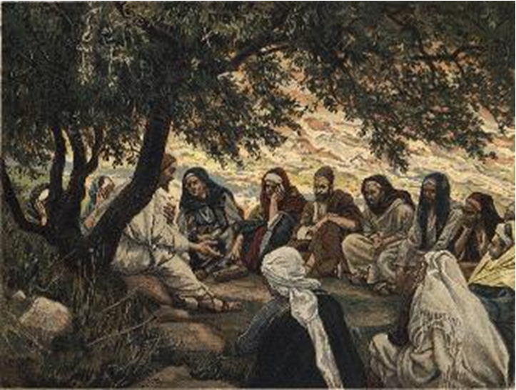
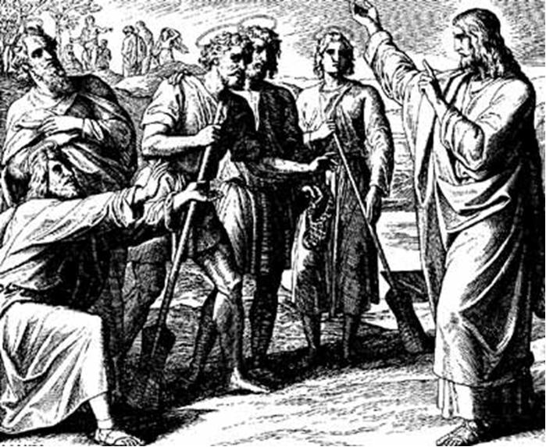
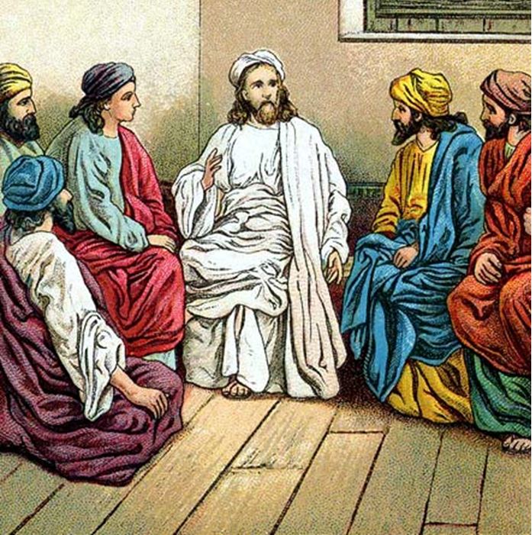
“The Apostles, Nicene and Athanasian Creeds
The Truth about the Trinity”
-The Ecumenical Creeds as Summaries
About Who God Is,
Versus False Religions and Cults-
Part 1 - A Bible Study of the Apostles’ Creed
Trinity Lutheran Church LCMS Norman, OK. Pastor David Nehrenz
Lesson 10 – June 8, 2025

Slide 2
  The Three Ecumenical Creeds
  Lutheran Church - Missouri Synod adheres to the three Ecumenical Creeds. These creeds are succinct yet accurate statements of the true Christian faith.
  Among the major doctrines confessed in the creeds are:
  • the eternal and triune natures of God,
  • the dual nature of Christ Jesus (being both fully God and fully man),
  • the working of faith in believers by the Holy Spirit,
  • the resurrection of the dead on the last day,
  • the return of Christ Jesus in judgement, and
  • everlasting life in heaven for those redeemed by the Grace of God through the working of the Holy Spirit and the innocent suffering and death & true resurrection of our Lord Jesus Christ on the third day.
  1. The Apostle's Creed
  The Nicene Creed
  The Athanasian Creed

Slide 3
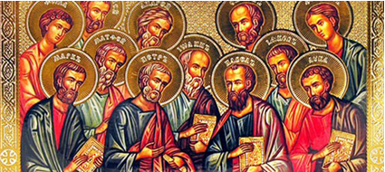

Slide 4
The Apostles’ Creed (ca AD 150-750)
The Apostles' Creed is the oldest. Already by 150 A.D. this creed was in use at Christian centers all along the Mediterranean Sea, such as Jerusalem, Alexandria (North Africa), Rome, and even Spain. The Apostles' Creed developed in conjunction with Baptism. As the water was applied, the question would be asked: "Do you believe in God the Father? God the Son? etc." Very quickly the answer developed into what we now call the Apostles' Creed. It is often called the baptismal creed. In addition to its primary use at all baptisms, it is also very appropriate for use in daily devotions. Also known as the Baptismal Creed or the Roman Symbol. Its central doctrines are those of the Trinity and God the Creator. It has been called the Creed of Creeds because already by AD 150 it was employed at Christian centers all along the Mediterranean Sea, such as Jerusalem, Alexandria (North Africa), Rome, and even Spain. It is also used in daily devotions.

Slide 7
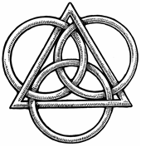
The Apostles’ Creed
I believe in God, the Father, Almighty,
Maker of heaven and earth.
I believe in Jesus Christ, his only Son, our Lord,
who was conceived by the Holy Spirit,
born of the virgin Mary,
suffered under Pontius Pilate,
was crucified, died and was buried;
He descended to hell.
The third day he rose again from the dead.
He ascended to heaven
and sits at the right hand of God the Father Almighty.
From thence He will come to judge the living and the dead.
I believe in the Holy Spirit,
the holy Christian (catholic) Church,
the communions of saints,
the forgiveness of sins,
the resurrection of the body,
and the life + everlasting. Amen.

Slide 8
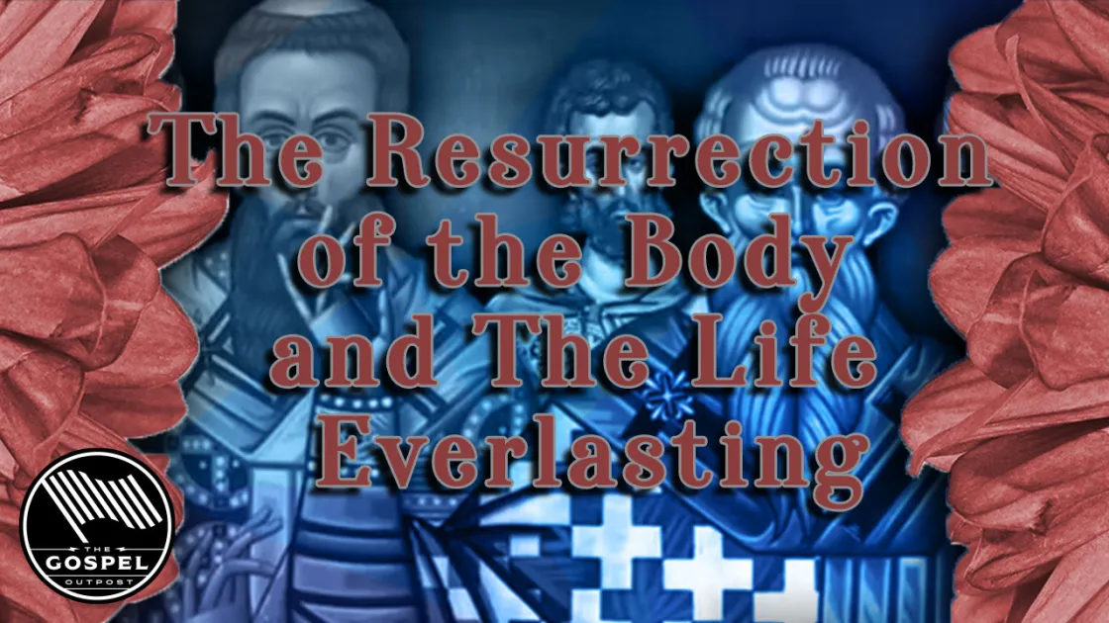

Slide 9
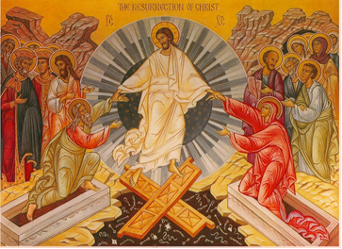

Slide 10
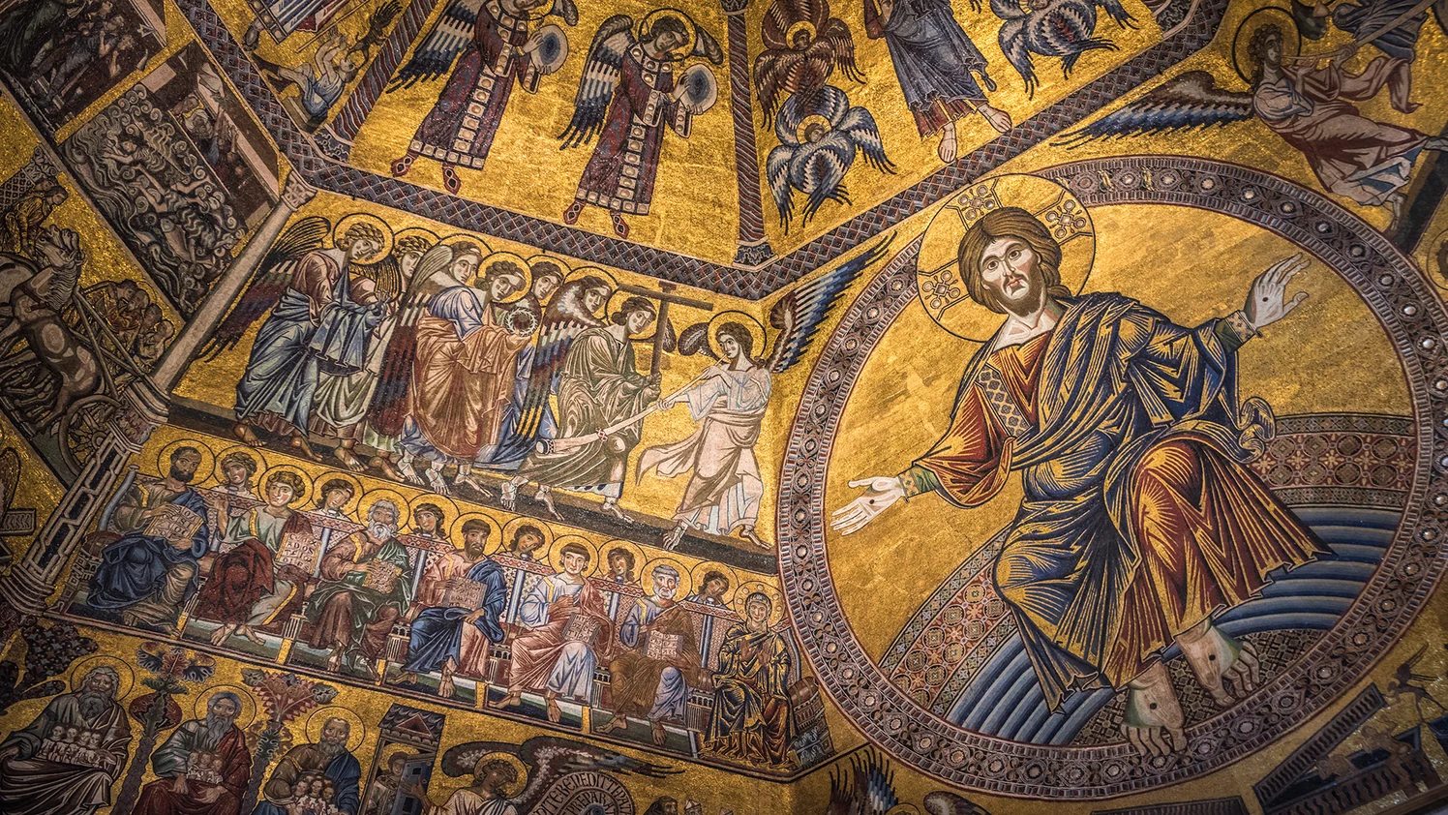

Slide 11
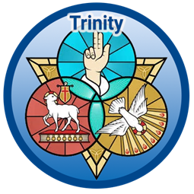

Slide 12
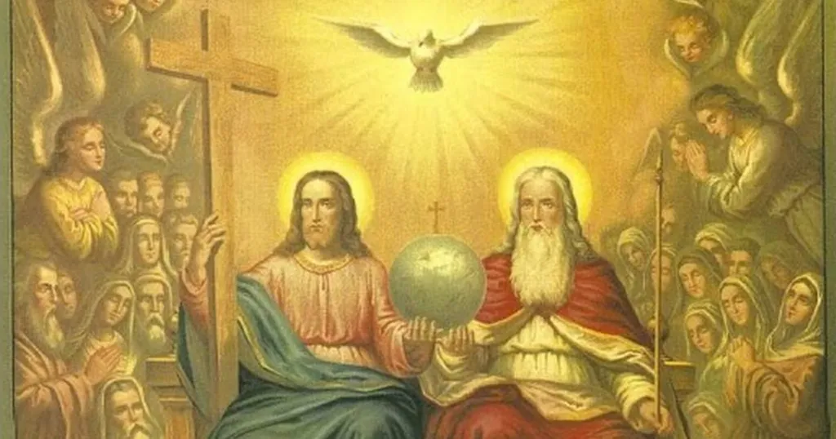

Slide 13
XII. And the life everlasting. Amen.
1. Read Matt 25:46; John 3:15,16; 4:14; 5:24,39; 6:47,54; 10:28; 17:2,3; Acts13:48; Rom 2:7; 6:22,23; Gal 6:8; 1 Tim 6:12; Titus 3:7; 2 Corinthians 5:1-6; 1 Jn 2:25; 5:11-13; Jude 1:21 to better understand our heavenly home.
2. Read Daniel 12:1-3; Revelation 22 and try to picture with your finite mind what is in store for us.
3. Read Matthew 6:9-13 where Jesus instructs His disciples how to pray.
4. Read 2 Corinthians 1:8-20 and Revelation 22:21-22 to see how the word "Amen" is used.

Slide 14
LIFE APPLICATION – THE FORMULA OF CONCORD –
XI. GOD’S ETERNAL FOREKNOWLEDGE AND ELECTION
The human race is truly redeemed and reconciled with God through Christ. By His faultless obedience, suffering, and death, Christ merited for us the righteousness that helps us before God and also merits eternal life.
[16] 2. Such merit and benefits of Christ are presented, offered, and distributed to us through His Word and Sacraments.
[17] 3. By His Holy Spirit, through the Word, when it is preached, heard, and pondered, Christ will be effective and active in us, will convert hearts to true repentance and preserve them in the true faith.
[18] 4. The Spirit will justify all those who in true repentance receive Christ by a true faith. He will receive them into grace, the adoption of sons, and the inheritance of eternal life [Galatians 3: 19].
[19] 5. He will also sanctify in love those who are justified, as St. Paul says (Ephesians 1: 4).
[20]6. He also will protect them in their great weakness against the devil, the world, and the flesh. He will rule and lead them in His ways [Deuteronomy 8: 6], raise them again when they stumble [Proverbs 4: 11– 12], comfort them under the cross and in temptation [2 Corinthians 1: 3– 5], and preserve them for life eternal [John 12: 25].

Slide 15
[21] 7. He will also strengthen, increase, and support to the end the good work that He has begun in them [Philippians 1: 6], if they cling to God’s Word, pray diligently, abide in God’s goodness, and faithfully use the gifts they received [Matthew 25: 14– 30].
[22] 8. Finally, He will eternally save and glorify in life eternal those whom He has elected, called, and justified.
[23] God has prepared salvation not only in general in this counsel, purpose, and ordination. In grace He has considered and chosen to salvation each and every one of the elect who are to be saved through Christ. He has also ordained that in the way just mentioned He will, by His grace, gifts, and efficacy, bring them to salvation. He will aid, promote, strengthen, and preserve them.
[24] All this, according to the Scriptures, is included in the teaching about God’s eternal election to adoption and eternal salvation, and is to be understood by it. It must never be excluded or omitted when we speak about God’s purpose, predestination, election, and ordination to salvation. When our thoughts about this article are formed according to the Scriptures in this way, we can simply adapt ourselves to it by God’s grace.

Slide 16
[25] The following issue also belongs to the further explanation and saving use of the teaching about God’s foreknowledge to salvation: Only the elect, whose names are written in the book of life [Revelation 21: 27], are saved. Therefore, how can we know, or why and how can we perceive who the elect are and who can and should receive this teaching for comfort?
[26] In this matter we should not judge according to our reason, or according to the Law or from any outward appearance. Neither should we attempt to investigate the secret, concealed depth of divine predestination. Instead, we should listen to God’s revealed will. For He has made “known to us the mystery of His will” (Ephesians 1: 9) and made it clear through Christ so that it might be preached (2 Timothy 1: 9).

