Slide 1
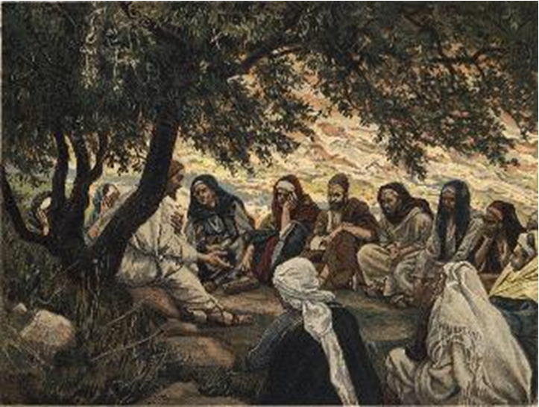
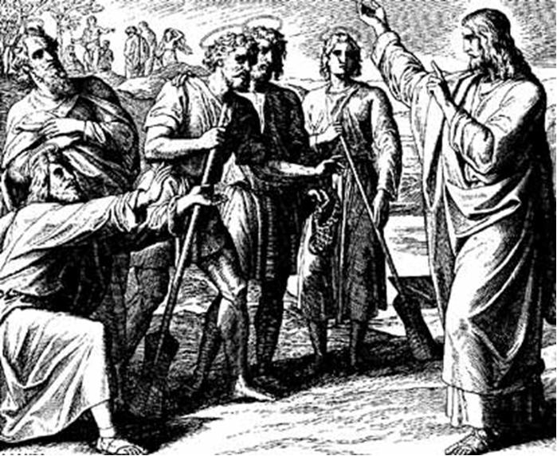
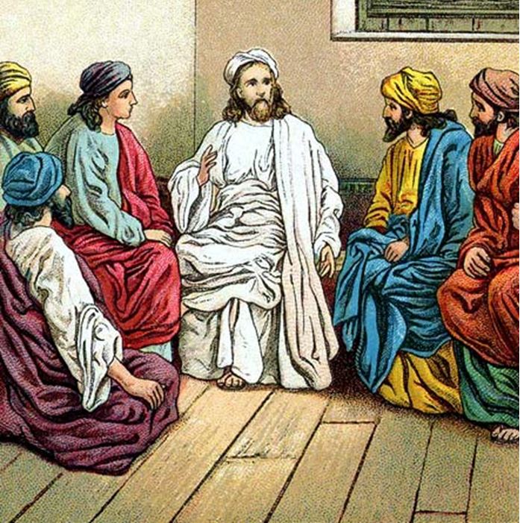
“The Apostles, Nicene and Athanasian Creeds
The Truth about the Trinity”
-The Ecumenical Creeds as Summaries
About Who God Is,
Versus False Religions and Cults-
Part 1 - A Bible Study of the Apostles’ Creed
Trinity Lutheran Church LCMS Norman, OK. Pastor David Nehrenz
Lesson 1 - March 16, 2025

Slide 2
  The Three Ecumenical Creeds
  March 16, 2025
  Lutheran Church - Missouri Synod adheres to the three Ecumenical Creeds. These creeds are succinct yet accurate statements of the true Christian faith.
  Among the major doctrines confessed in the creeds are:
  • the eternal and triune natures of God,
  • the dual nature of Christ Jesus (being both fully God and fully man),
  • the working of faith in believers by the Holy Spirit,
  • the resurrection of the dead on the last day,
  • the return of Christ Jesus in judgement, and
  • everlasting life in heaven for those redeemed by the Grace of God through the working of the Holy Spirit and the innocent suffering and death & true resurrection of our Lord Jesus Christ on the third day.
  1. The Apostle's Creed
  The Nicene Creed
  The Athanasian Creed

Slide 3
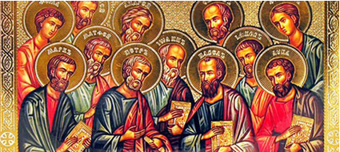

Slide 4
The Apostles’ Creed (ca AD 150-750)
The Apostles' Creed is the oldest. Already by 150 A.D. this creed was in use at Christian centers all along the Mediterranean Sea, such as Jerusalem, Alexandria (North Africa), Rome, and even Spain. The Apostles' Creed developed in conjunction with Baptism. As the water was applied, the question would be asked: "Do you believe in God the Father? God the Son? etc." Very quickly the answer developed into what we now call the Apostles' Creed. It is often called the baptismal creed. In addition to its primary use at all baptisms, it is also very appropriate for use in daily devotions. Also known as the Baptismal Creed or the Roman Symbol. Its central doctrines are those of the Trinity and God the Creator. It has been called the Creed of Creeds because already by AD 150 it was employed at Christian centers all along the Mediterranean Sea, such as Jerusalem, Alexandria (North Africa), Rome, and even Spain. It is also used in daily devotions.

Slide 7
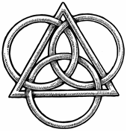
The Apostles’ Creed
I believe in God, the Father, Almighty,
Maker of heaven and earth.
I believe in Jesus Christ, his only Son, our Lord,
who was conceived by the Holy Spirit,
born of the virgin Mary,
suffered under Pontius Pilate,
was crucified, died and was buried;
He descended to hell.
The third day he rose again from the dead.
He ascended to heaven
and sits at the right hand of God the Father Almighty.
From thence He will come to judge the living and the dead.
I believe in the Holy Spirit,
the holy Christian (catholic) Church,
the communions of saints,
the forgiveness of sins,
the resurrection of the body,
and the life + everlasting. Amen.

Slide 8
I. I believe in God the Father Almighty, Maker of heaven and earth.
1. Read the story of creation as it is recorded in Genesis 1 and 2.
2. Read what God says to the Israelites in Isaiah 40:6-31.
3. Read how God answers the doubts of a child of God in Job 38-41.
4. Read how God considers those who do not worship Him as Creator in Romans 1:18-25.

Slide 9
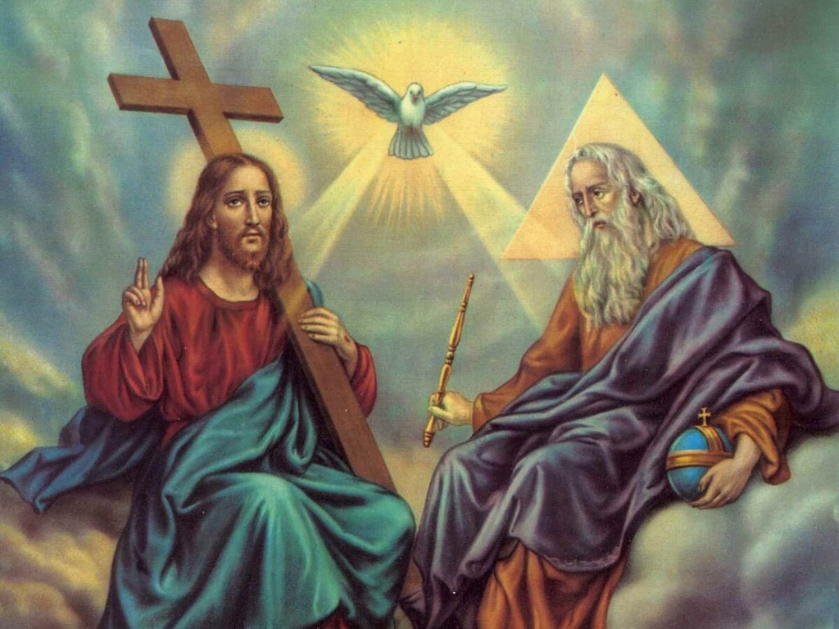

Slide 10
II. And in Jesus Christ, His only begotten Son, our Lord.
1. Read how Jesus' birth was foretold in Luke 1:26-38 and then the actual incarnation in Luke 2:1-20.
2. Read how Jesus explains His oneness with God the Father in John 20:17, 28-29.
3. Read Romans 8:1-4 to see the relationship between God the Father and His Son, Jesus Christ.
4. Read John 1:1-5 to see the divine and eternal attributes of Jesus.

Slide 11
