Slide 1
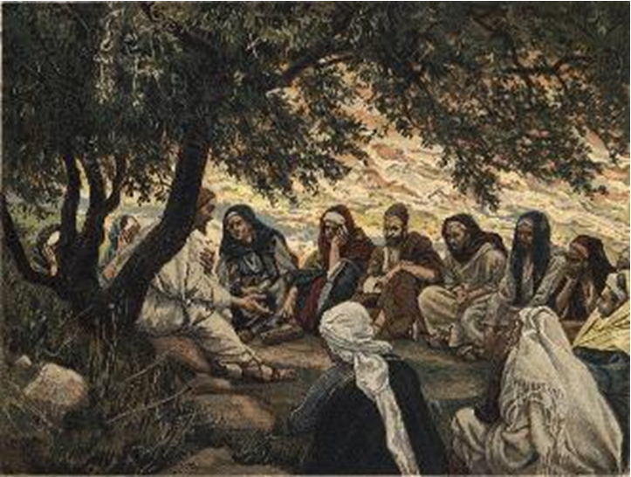
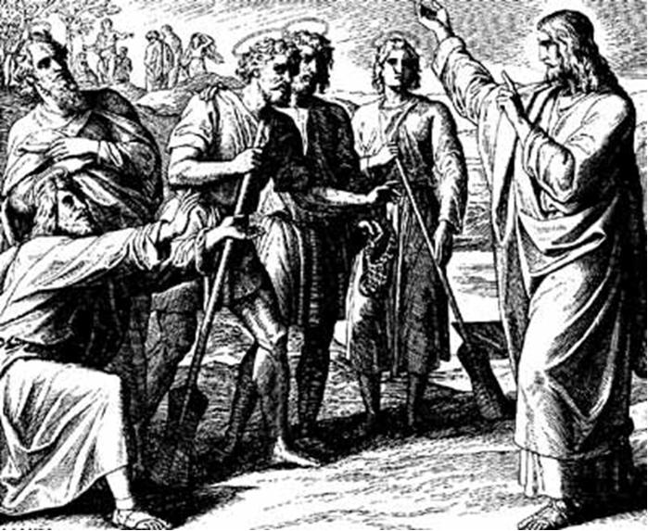
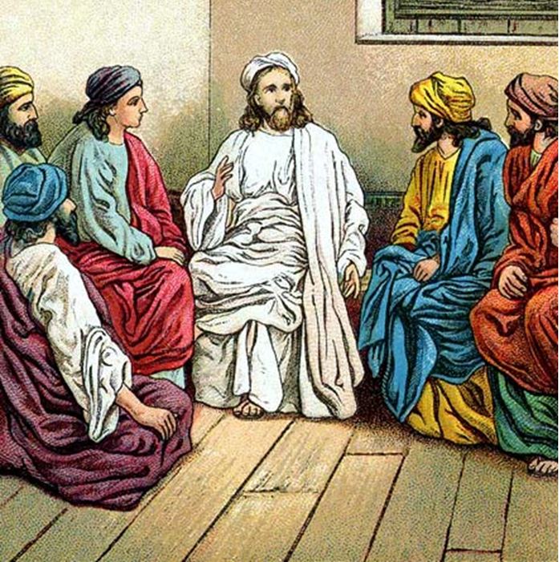
“The Apostles, Nicene and Athanasian Creeds
The Truth about the Trinity”
-The Ecumenical Creeds as Summaries
About Who God Is,
Versus False Religions and Cults-
Part 2 - A Bible Study of the Nicene Creed
Trinity Lutheran Church LCMS Norman, OK. Pastor David Nehrenz
Lesson 9 – August 31, 2025

Slide 2
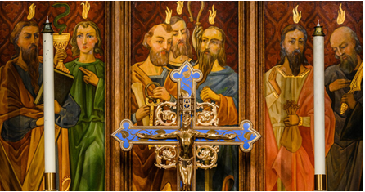

Slide 3
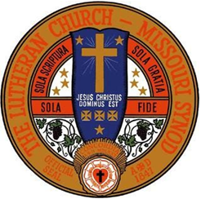

Slide 4
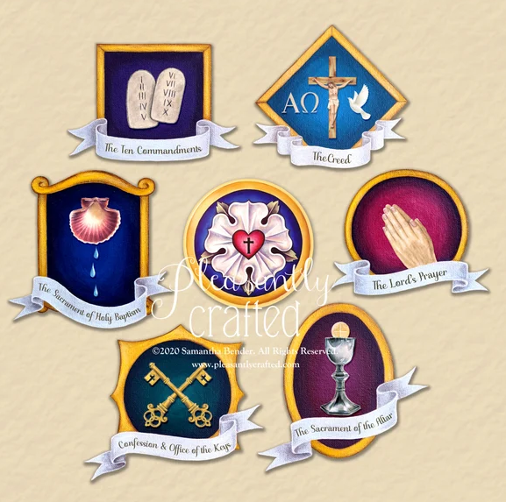

Slide 5
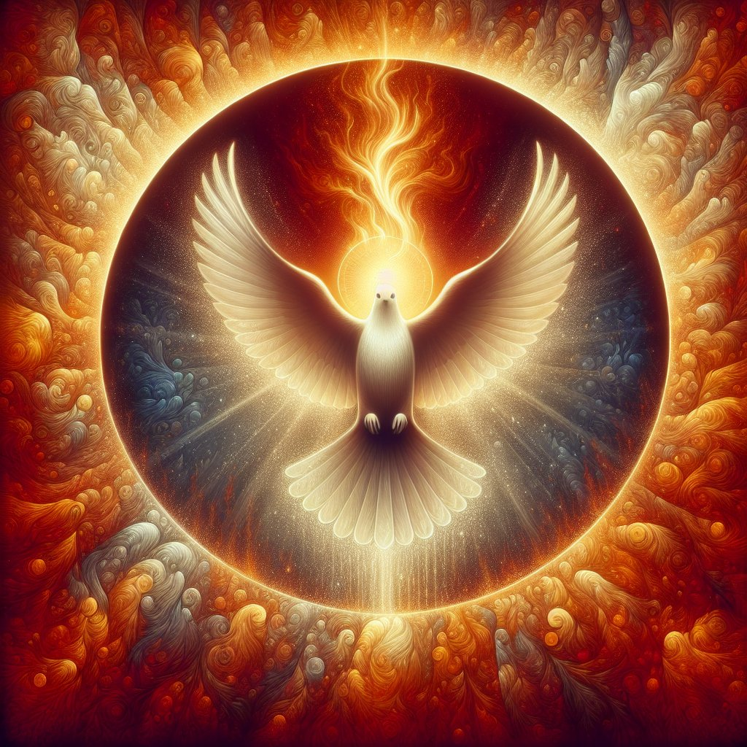
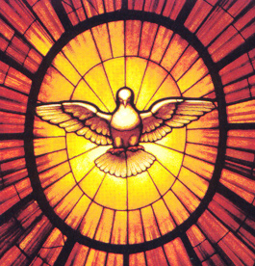

Slide 6
  The Three Ecumenical Creeds
  Lutheran Church - Missouri Synod adheres to the three Ecumenical Creeds. These creeds are succinct yet accurate statements of the true Christian faith.
  Among the major doctrines confessed in the creeds are:
  • the eternal and triune natures of God,
  • the dual nature of Christ Jesus (being both fully God and fully man),
  • the working of faith in believers by the Holy Spirit,
  • the resurrection of the dead on the last day,
  • the return of Christ Jesus in judgement, and
  • everlasting life in heaven for those redeemed by the Grace of God through the working of the Holy Spirit and the innocent suffering and death & true resurrection of our Lord Jesus Christ on the third day.
  1. The Apostle's Creed
  The Nicene Creed
  The Athanasian Creed

Slide 7
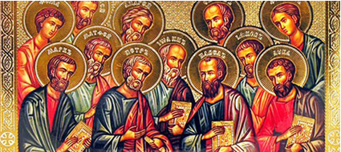

Slide 8
The Apostles’ Creed (ca AD 150-750)
The Apostles' Creed is the oldest. Already by 150 A.D. this creed was in use at Christian centers all along the Mediterranean Sea, such as Jerusalem, Alexandria (North Africa), Rome, and even Spain. The Apostles' Creed developed in conjunction with Baptism. As the water was applied, the question would be asked: "Do you believe in God the Father? God the Son? etc." Very quickly the answer developed into what we now call the Apostles' Creed. It is often called the baptismal creed. In addition to its primary use at all baptisms, it is also very appropriate for use in daily devotions. Also known as the Baptismal Creed or the Roman Symbol. Its central doctrines are those of the Trinity and God the Creator. It has been called the Creed of Creeds because already by AD 150 it was employed at Christian centers all along the Mediterranean Sea, such as Jerusalem, Alexandria (North Africa), Rome, and even Spain. It is also used in daily devotions.

Slide 12
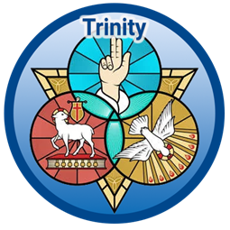

Slide 13
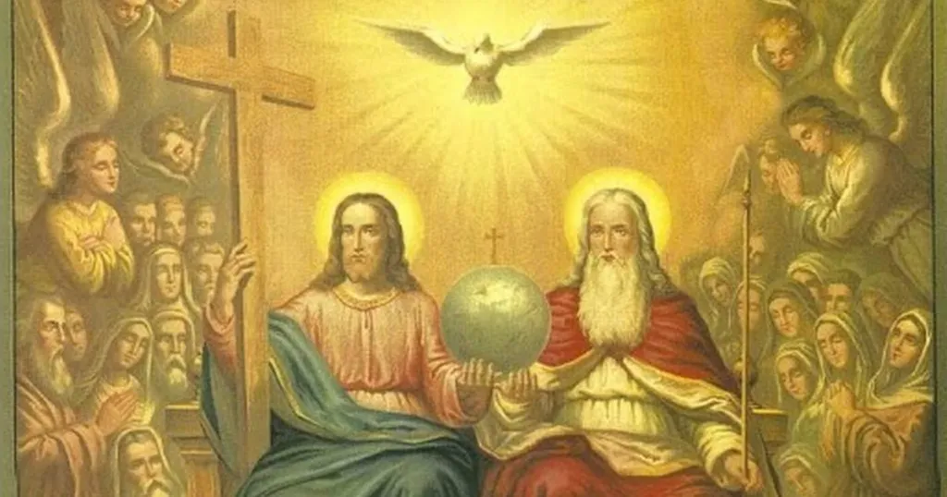

Slide 14
II. The Nicene Creed
I believe in one God
the Father Almighty,
maker of heaven and earth
and of all things visible and invisible.
And in one Lord Jesus Christ,
the only-begotten Son of God,
begotten of His Father before all worlds,
God of God, Light of Light,
very God of very God,
begotten, not made,
being of one substance with the Father;
by whom all things were made;
who for us men and for our salvation
came down from heaven,
and was incarnate by the Holy Spirit of the virgin Mary
and was made man;
and was crucified also for us under Pontius Pilate.
He suffered and was buried.
And the third day He rose again
according to the Scriptures
and ascended into heaven
and sits at the right hand of the Father.
And He will come again with glory to judge
both the living and the dead,
whose kingdom will have no end.
And I believe in the Holy Spirit,
the Lord and giver of life,
who proceeds from the Father and the Son,
who with the Father and the Son together
is worshiped and glorified,
who spoke by the prophets.
And I believe in one holy Christian (catholic) and apostolic Church.
I acknowledge one Baptism for the remission of sins,
and I look for the resurrection of the dead
and the life of the world to come. Amen.

Slide 15
III. Early Christian Creedal Statements
A brief survey of fragments of creeds and confessions of faith found in the New Testament, suggesting that the early Christians found it necessary to summarize their distinctive beliefs. The basic pattern of these early statements is concerned with two things: (1) the naming of Jesus, who lived and died and rose again in history, and (2) the ascription of a title or titles to him, marking his divinity.
Here are some of the fragments that the early church used:
“Jesus is the Christ, the Son of the living God” (Mk. 8:29; 14:61; 15:2)
“Jesus is the Son of God” (John 1:34; 1 John 4:15; Acts 9:20; Heb. 4:14)
“Jesus is Lord” (1 Cor. 12:3; Rom. 10:9; Phil. 2:11)

Slide 16
These confessions in time were enlarged to include the resurrection, as well as the divine nature of Jesus, the Christ, who was with the Father in the beginning and became the mediator between God and people.
The most extensive one is found in 1 Corinthians 15:3b-7, the summary of the Gospel, the essence of the Christian faith:
“That Christ died for our sins according to the Scriptures, and that He was buried, and that He was raised on the third day according to the Scriptures, and that He appeared to Cephas, then to the twelve, then to more than five hundred brethren at one time . . . then He appeared to James, then to all the apostles” etc.
Other condensed versions of creeds may be found in Romans 1:3-5a, 8:34, and 1 Timothy 3:16. In fact, some of the creeds were preserved in the early hymns of the Church, such as in John 1:1-18, Colossians 1:15-20, and Philippians 2:6-11.
1 Timothy 3:16 will serve as a good example:
“And by a common confession, great is the mystery of godliness;
God was revealed in the flesh, was vindicated in the Spirit,
was seen of angels, proclaimed in the world, taken up to glory.”

Slide 17
Begin here:
These confessions of faith by the early Church served several purposes:
(1) they became the center of the teaching of the Church,
the essential doctrine;
(2) they formed the basis of the Gospel, the proclamation to be made to the world;
(3) they provided new converts with the proper things to say at the time of baptism; and
(4) they provided worshipers with a nucleus of expressions for their liturgy.
But the important point that comes out of a study of the Old and New Testament about creeds is that they were formed out of necessity. The new community of worshipers of Christ found it necessary to formulate what they believed in common when they were confronted by old religions, false teachings, and established heresies. The early Church was confronted and attacked on every point, but held onto the belief in the person and work of Jesus the Christ by these fixed formulas.

Slide 18
IV. SCRIPTURE STUDY There are 12 articles included in the Nicene Creed which define the most important doctrines (dogmas) of our faith in the following order:
Article 1 - God the Father.
Articles 2, 3, 4, 5, 6, 7 - The Son of God, our Lord Jesus Christ
Article 8 – The Church
Article 10 – Holy Baptism
Article 11 – The Resurrection of the dead.
Article 12 – The Second Coming, or Judgment Day.

Slide 19
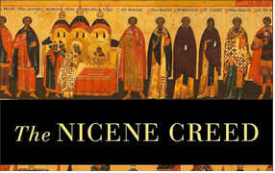
References from Holy Scripture in the Nicene-Creed:
I believe in (Romans 10: 8-10; 1 John 4: 15)
One God (Deuteronomy 6: 4, Ephesians 4: 6)
Father (Matthew 6: 9)
Almighty, (Exodus 6: 3)
Maker of heaven and earth, (Genesis 1:1)
and of all things visible and invisible; (Colossians 1:15-16)
and in one Lord, Jesus Christ, (Acts 11:17)
Son of God (Matthew 14:33; 16:16)
begotten (John 1: 18; 3:16)
begotten of the Father before all ages; (John 1: 2)
Light of Light (Psalm 27:1; John 8:12; Matthew 17:2,5)
true God of true God, (John 17:1-5)
of one substance with the Father, (John 10:30)

Slide 20
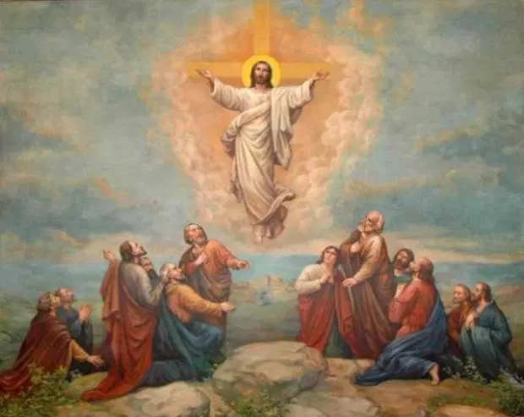
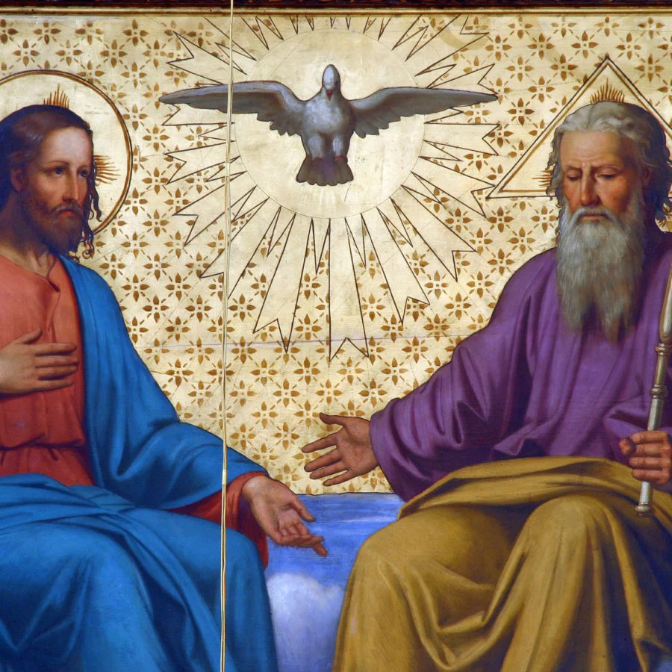
And ascended into heaven, (Luke 24:51; Acts 1:10)
He is seated at the right hand of the Father; (Mark 16:19; Acts 7:55)
And will come again in glory (Matthew 24:27)
to judge the living and dead, (Acts 10:42; 2 Timothy 4:1)
His kingdom shall have no end; (2 Peter 1:11)

Slide 21
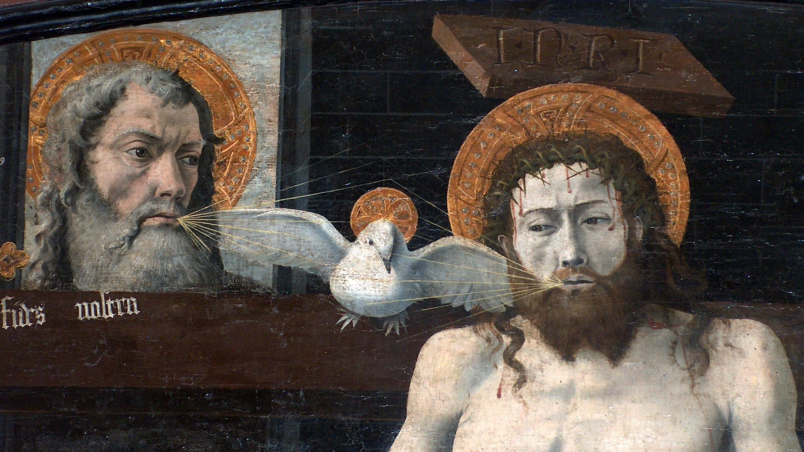

Slide 22
And in the Holy Spirit,
(John 1:32,33; 3:1-8; 14:16,17, 26; 15:26;
16:13-15; 20:22; Acts chap 2)
Lord (Acts 5:3-4)
the Giver of life, (Genesis 1:2)
Who proceeds from the Father,
(John 15:26)
Who together with the Father and the Son is worshipped and glorified,
(Matthew 3:16-17)
Who spoke through the prophets;
(I Samuel 19: 20; Ezekiel 11:5,13)

Slide 23
In one, (Ephesians 4:1-4)
holy, (Acts 9:31; Eph 5:25-27; 1 Peter 2:5-9)
catholic/universal/Christian (1 Cor 1:2; 4:17; 11:28; 12:28)
and apostolic Church; (Acts 2:42; 20:28; Ephesians 1:22; 2:19-22; 3:21)
I acknowledge one baptism for the remission of sins; (Ephesians 4:5; Col 2:9-15)
I look for the resurrection of the dead; (John 11:24; 1 Cor. 15:12-49)
And the life of the world to come. (Mark 10:29-30; Rev. 7:9-17)
Amen. (Psalm 106:48; Revelation 1:6,7; 3:14; 7:12; 22:20,21)

Slide 24
What is the Office of the Keys?*
The Office of the Keys is that special authority which Christ has given to His church on earth to forgive the sins of repentant sinners, but to withhold forgiveness from the unrepentant as long as they do not repent.
Where is this written?*
This is what St. John the Evangelist writes in chapter twenty: The Lord Jesus breathed on His disciples and said, 'Receive the Holy Spirit. If you forgive anyone his sins, they are forgiven; if you do not forgive them, they are not forgiven' (John 20:22-23).
What do you believe according to these words?*
I believe that when the called ministers of Christ deal with us by His divine command, in particular when they exclude openly unrepentant sinners from the Christian congregation and absolve those who repent of their sins and want to do better, this is just as valid and certain, even in heaven, as if Christ our dear Lord dealt with us Himself.

Slide 25
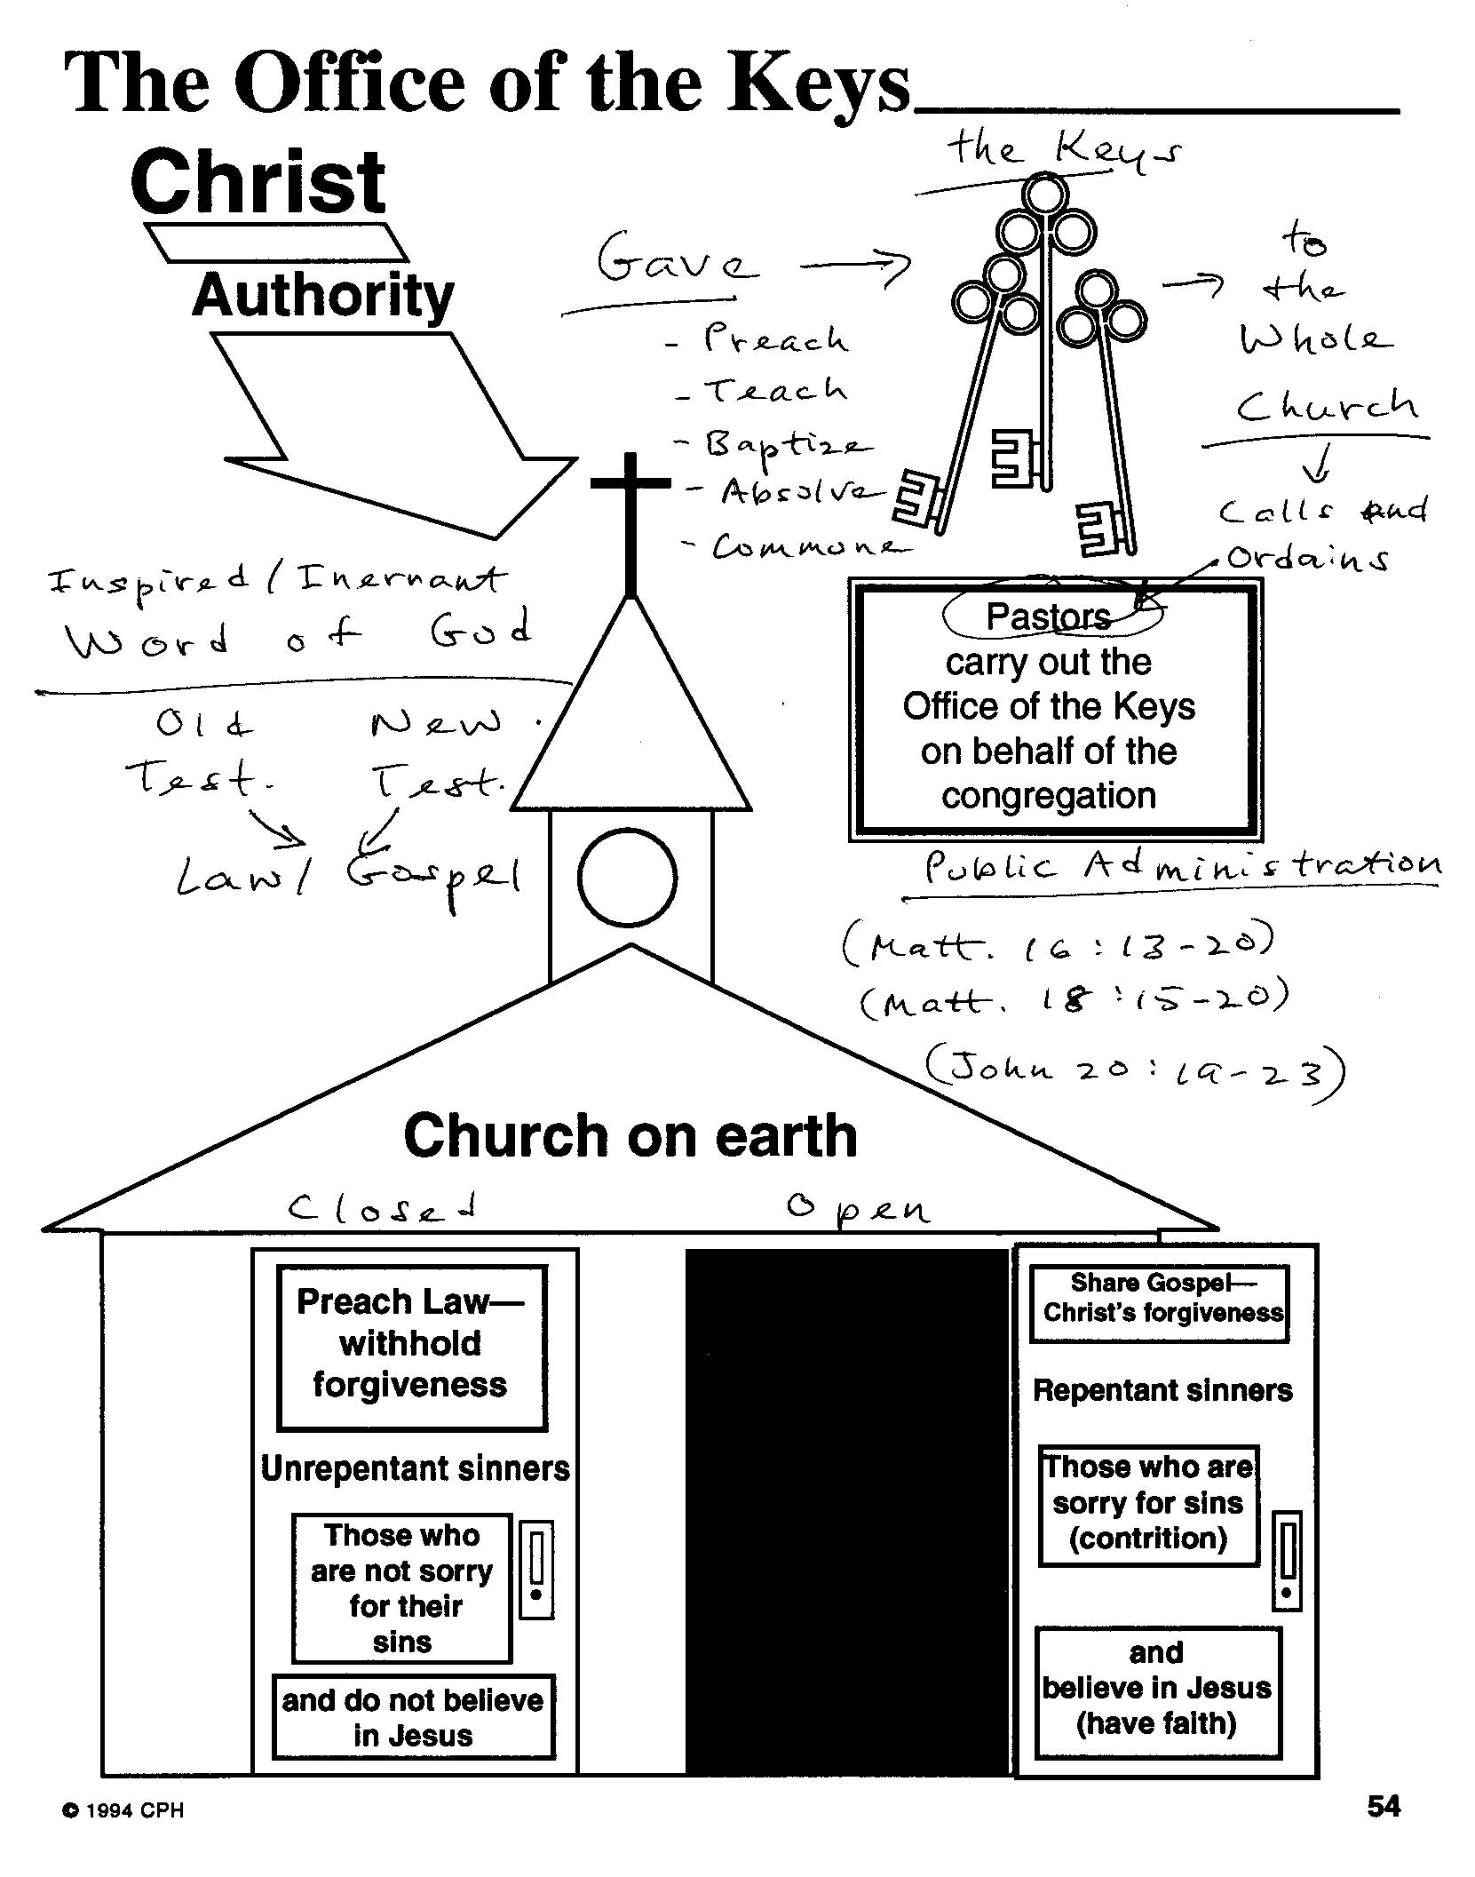

Slide 26
Next Sunday September 7
Vicar leads combined Bible class on
“Ephesians chapter 3”
(Pastor is at the Council of Presidents Meeting at the International Center
the “IC” in St. Louis)
Sunday September 14
Pastor continues our classes on the creeds
“A Study of the Athanasian Creed”

