Slide 1
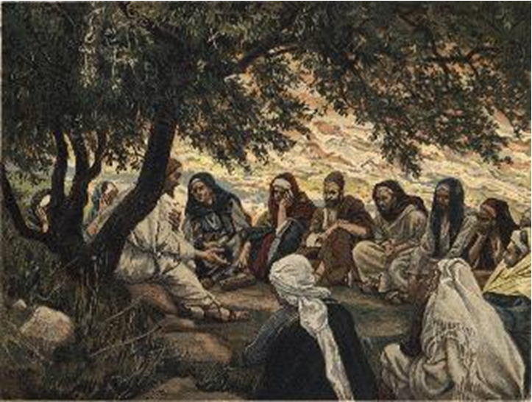
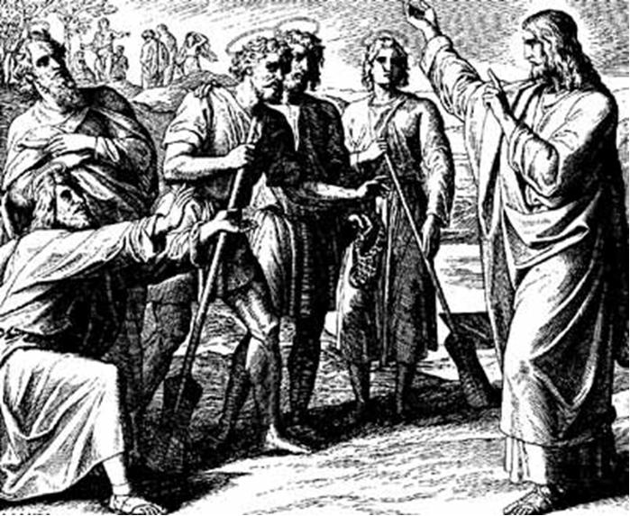
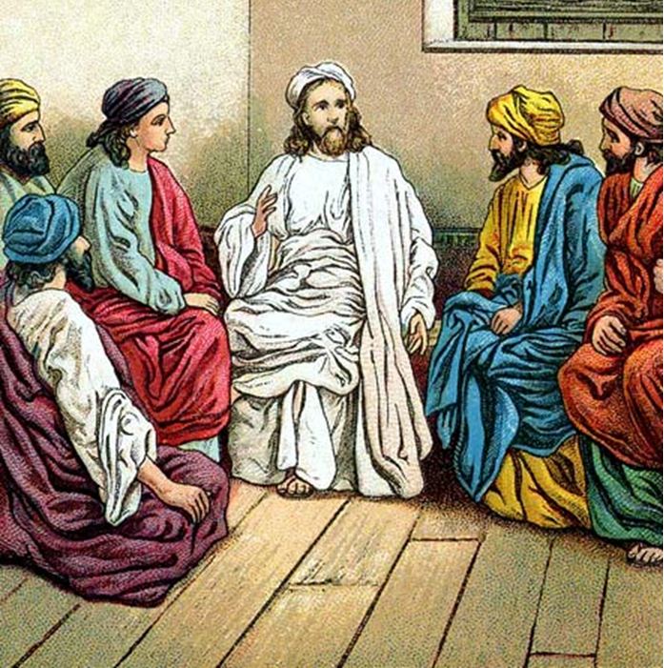
“The Apostles, Nicene and Athanasian Creeds
The Truth about the Trinity”
-The Ecumenical Creeds as Summaries
About Who God Is,
Versus False Religions and Cults-
Part 3 - A Bible Study of the Athanasian Creed
Trinity Lutheran Church LCMS Norman, OK. Pastor David Nehrenz
Lesson 15 – December 28, 2025

Slide 2
The Three Ecumenical Creeds
Lutheran Church - Missouri Synod adheres to the three Ecumenical Creeds. These creeds are succinct yet accurate statements of the true Christian faith.
Among the major doctrines confessed in the creeds are:
• the eternal and triune natures of God,
• the dual nature of Christ Jesus (being both fully God and fully man),
• the working of faith in believers by the Holy Spirit,
• the resurrection of the dead on the last day,
• the return of Christ Jesus in judgement, and
• everlasting life in heaven for those redeemed by the Grace of God through the working of the Holy Spirit and the innocent suffering and death & true resurrection of our Lord Jesus Christ on the third day.
1. The Apostle's Creed
The Nicene Creed
The Athanasian Creed

Slide 3
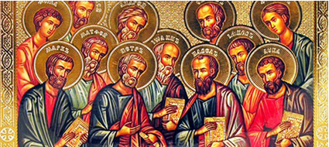

Slide 4
The Apostles’ Creed (ca AD 150-750)
The Apostles' Creed is the oldest. Already by 150 A.D. this creed was in use at Christian centers all along the Mediterranean Sea, such as Jerusalem, Alexandria (North Africa), Rome, and even Spain. The Apostles' Creed developed in conjunction with Baptism. As the water was applied, the question would be asked: "Do you believe in God the Father? God the Son? etc." Very quickly the answer developed into what we now call the Apostles' Creed. It is often called the baptismal creed. In addition to its primary use at all baptisms, it is also very appropriate for use in daily devotions. Also known as the Baptismal Creed or the Roman Symbol. Its central doctrines are those of the Trinity and God the Creator. It has been called the Creed of Creeds because already by AD 150 it was employed at Christian centers all along the Mediterranean Sea, such as Jerusalem, Alexandria (North Africa), Rome, and even Spain. It is also used in daily devotions.

Slide 7
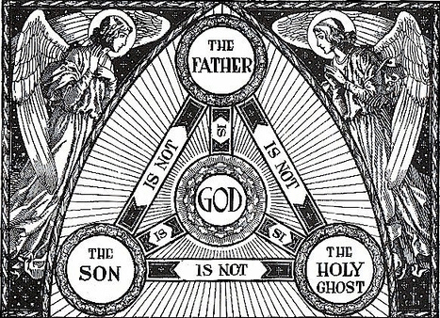

Slide 8
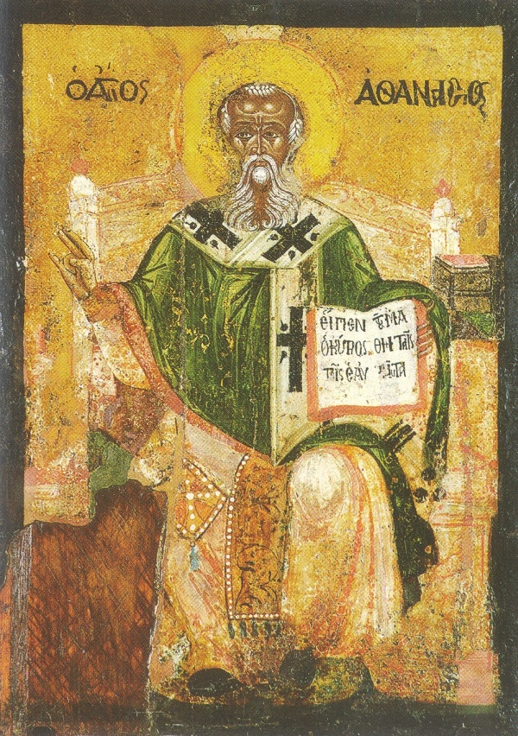

Slide 9
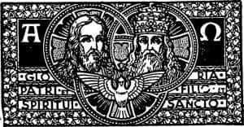

Slide 10
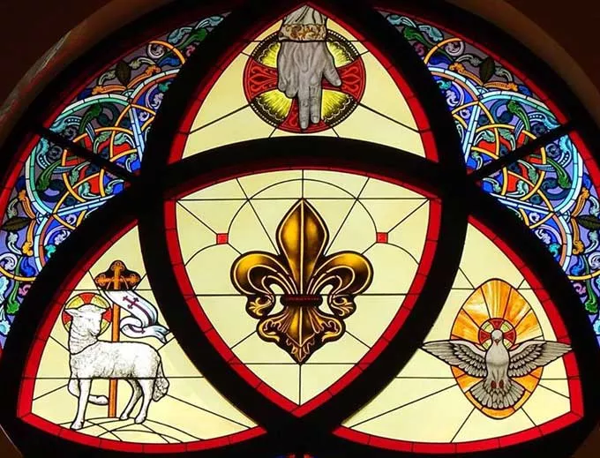

Slide 11
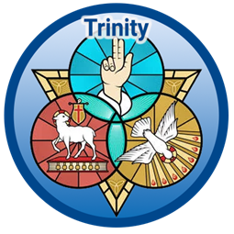

Slide 12
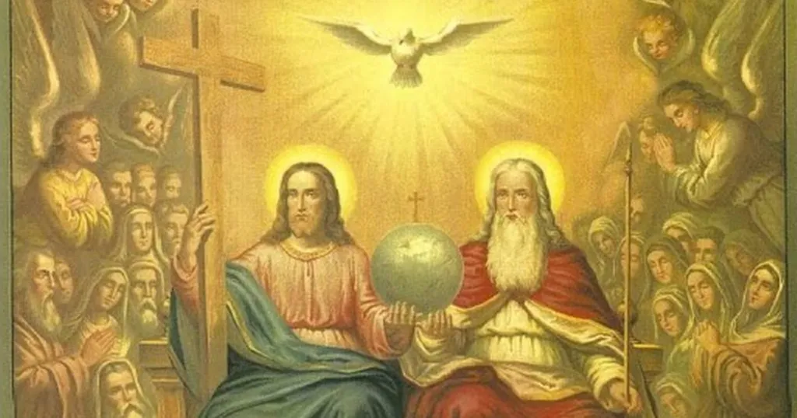

Slide 13
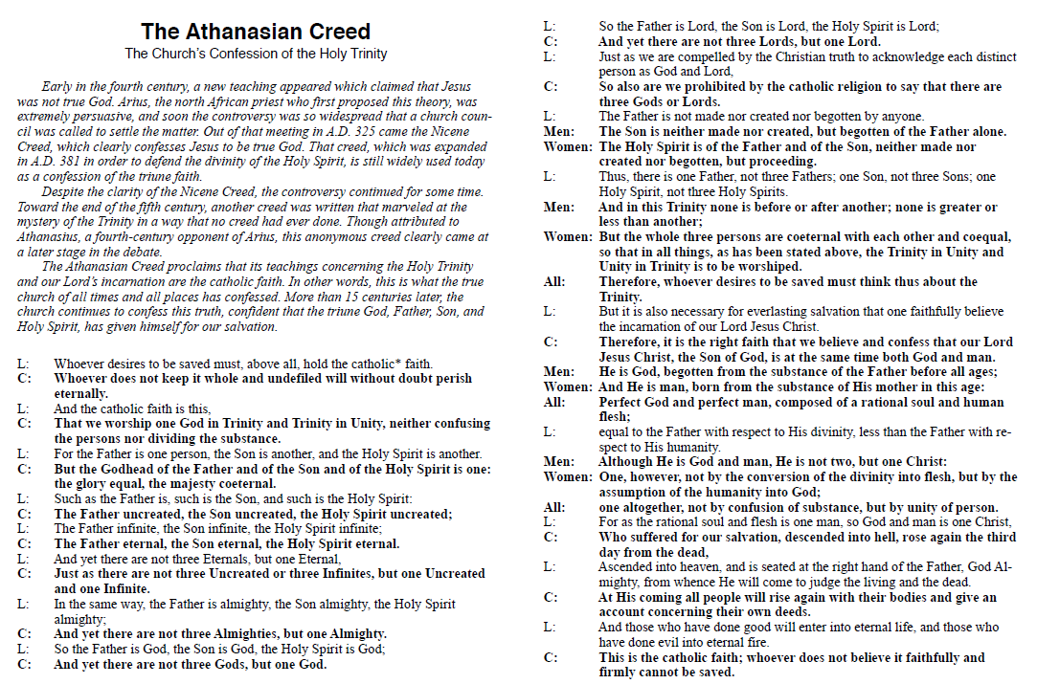

Slide 14
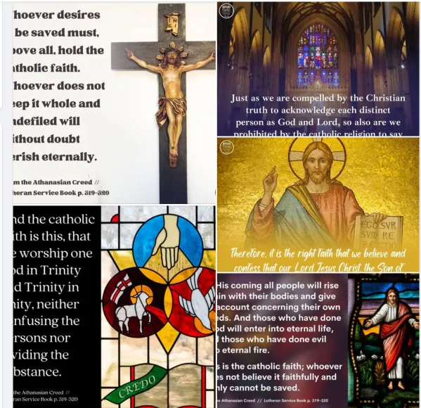

Slide 15
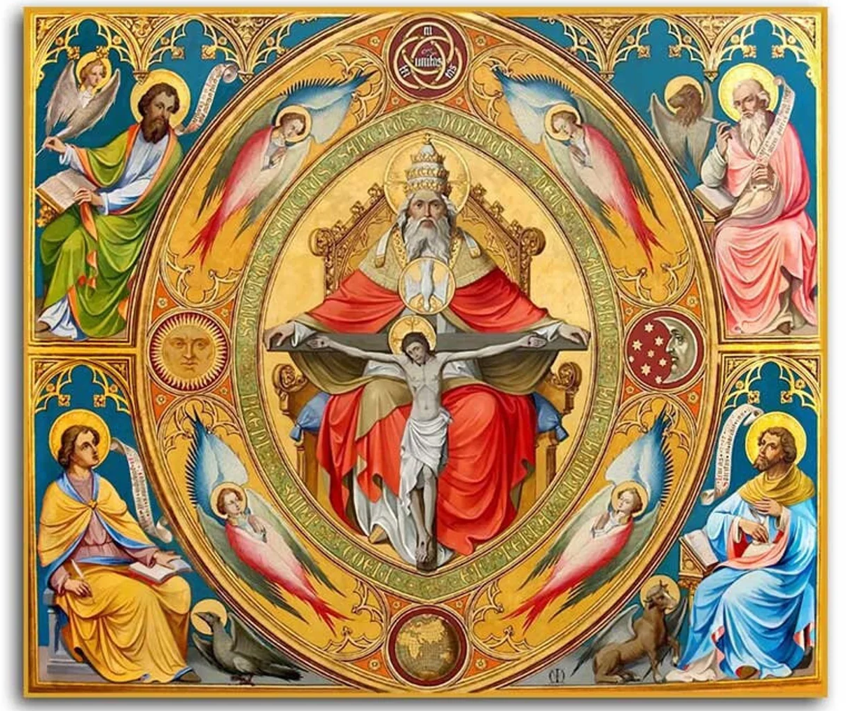

Slide 16
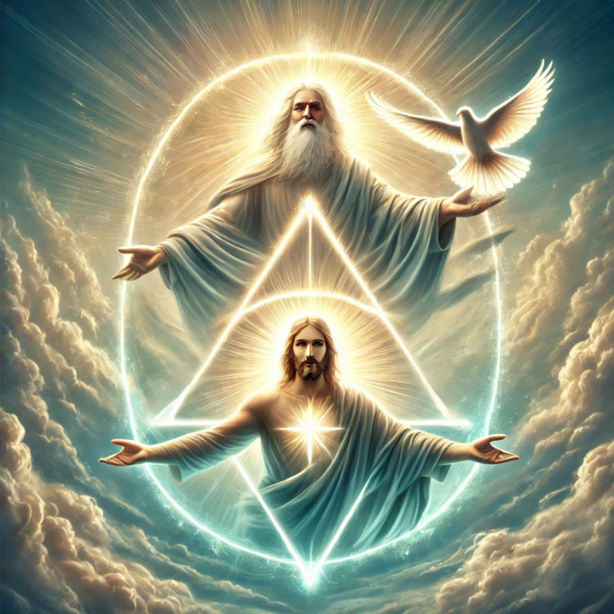

Slide 17
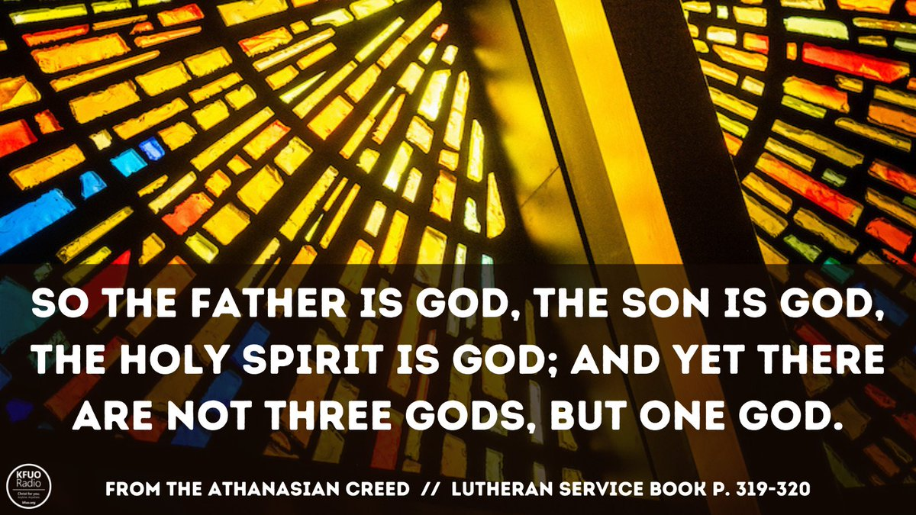

Slide 18
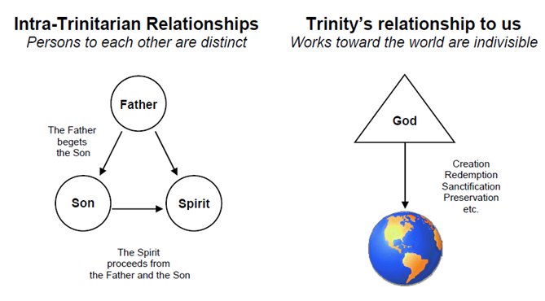

Slide 19
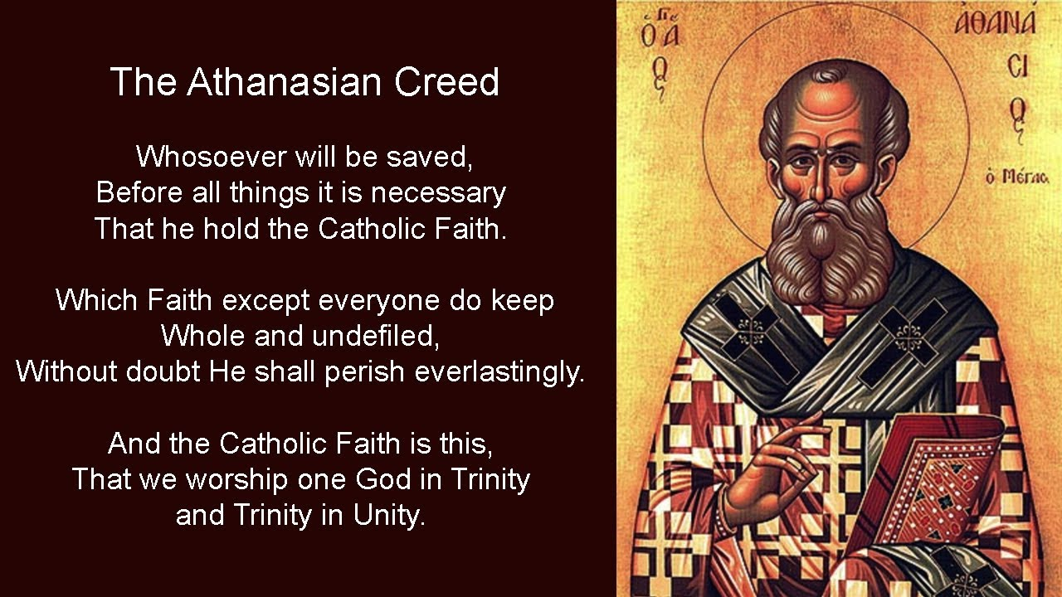

Slide 20
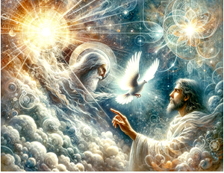

Slide 21


Slide 22
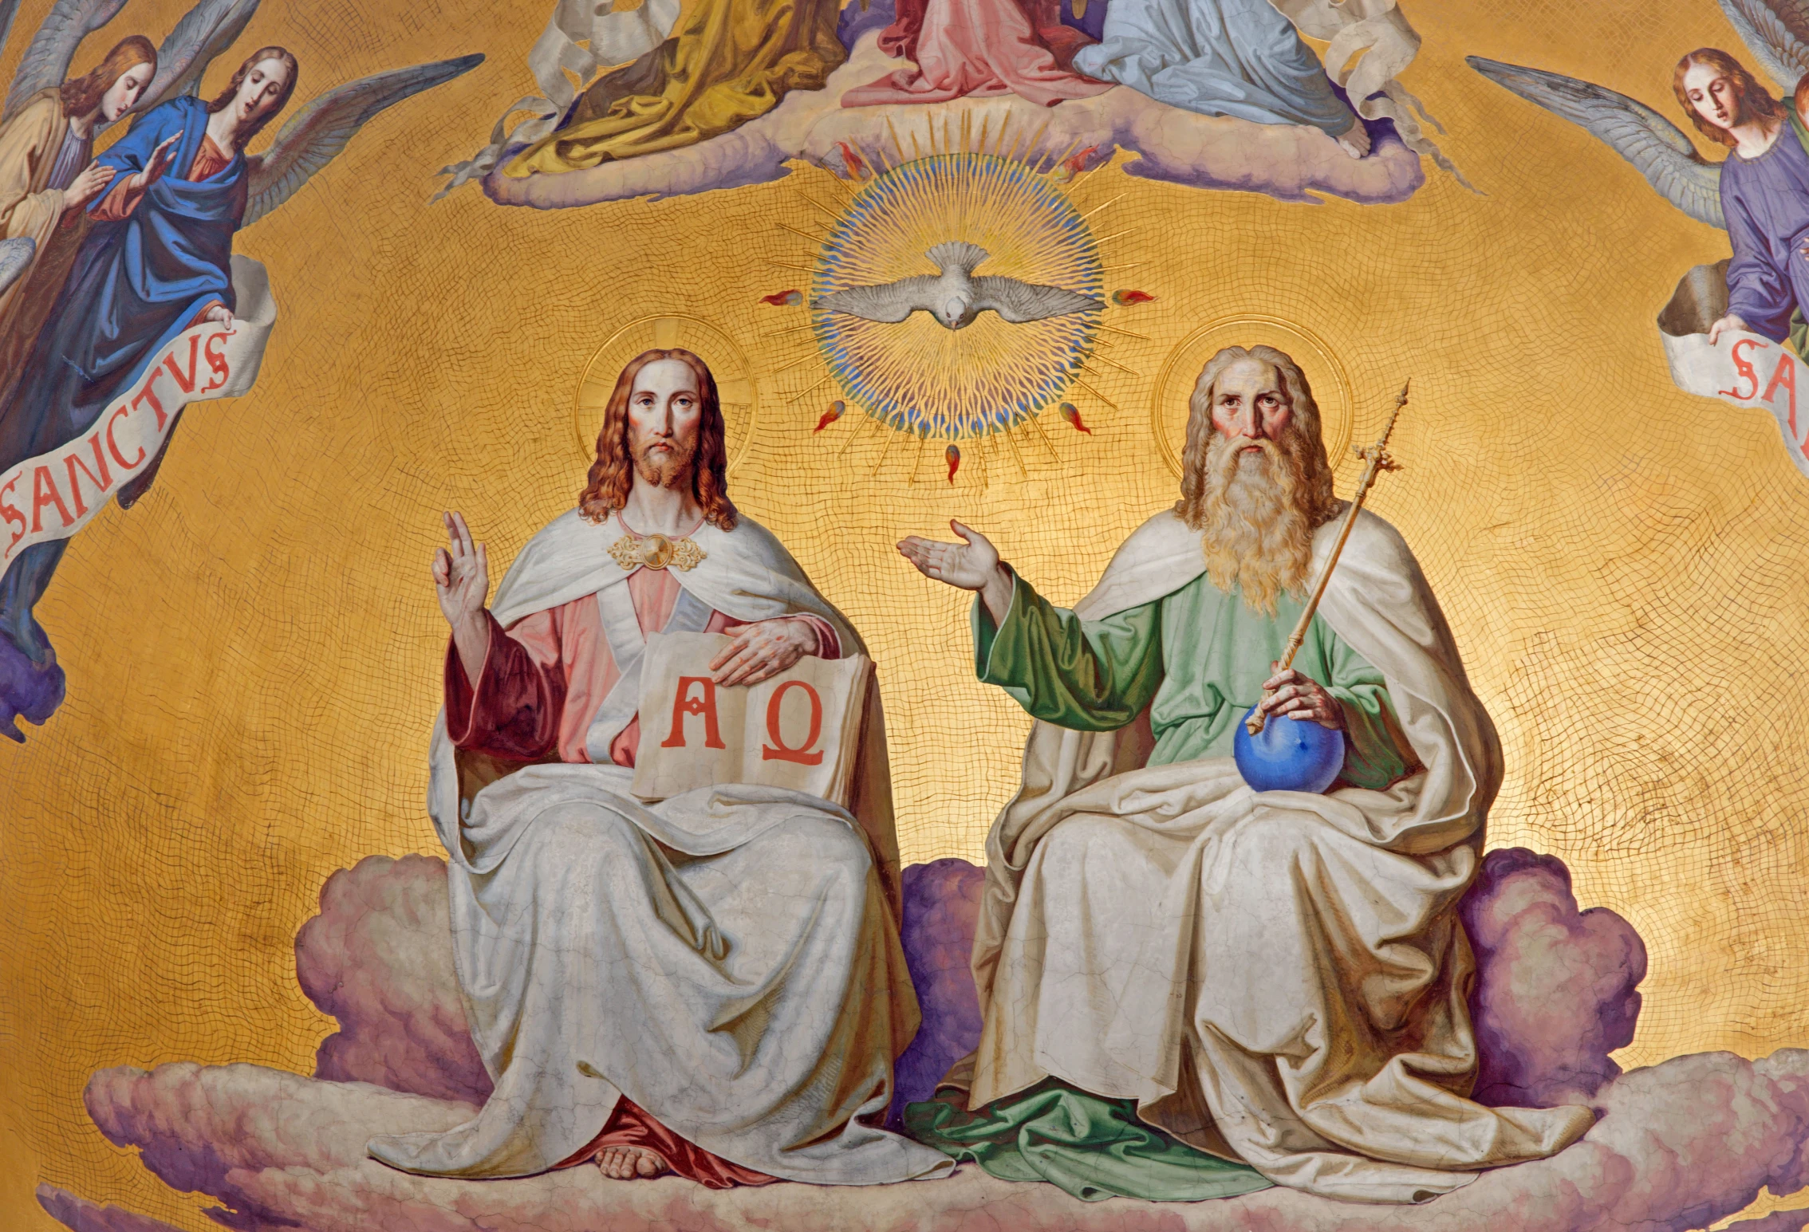

Slide 23
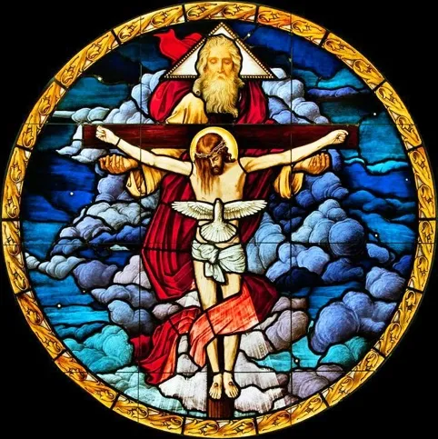

Slide 24
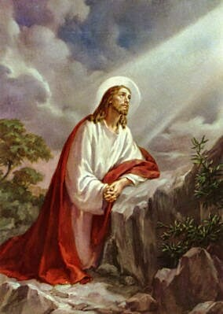
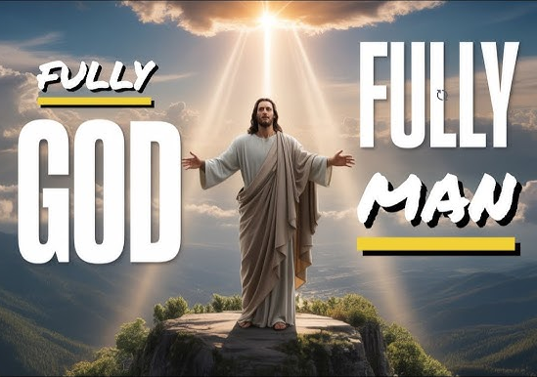

Slide 25
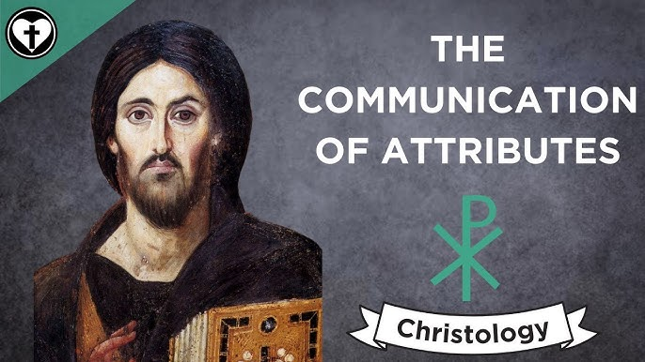

Slide 26
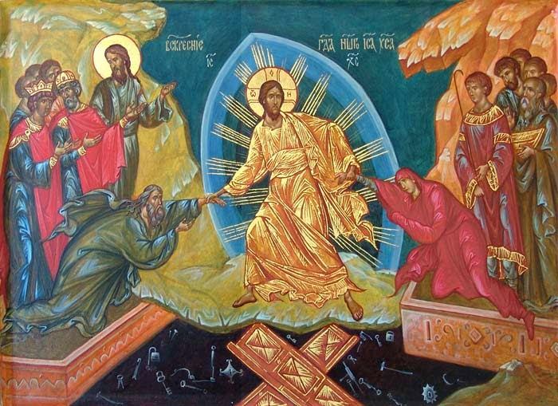

Slide 27


Slide 28
28) At his coming all people shall rise bodily to give an account of their own deeds.
This speaks of the physical resurrection that will take place as each person will give an account to God for all that they have done.
(Job 19:26; John 5:28–29; Romans 14:12; Revelation 20:12)

Slide 29
29) Those who have done good will enter eternal life; those who have done evil will enter eternal fire.
This is indeed the final judgment. For those who are in Christ it will be glorious and for those who are left wanting it will be utter torment.
(Matthew 16:27; 25:31–46; John 5:28-29; 2 Corinthians 5:10; Revelation 20:12)

Slide 30
30) This is the catholic faith:
One cannot be saved without believing this firmly and faithfully.
(John 3:18; Galatians 1:8; 2 Thessalonians 2:15; Jude 3)
To Him be Glory forever and ever! Amen.

Slide 31
BIBLE STUDIES
Starting Sunday January 4th, 2026
-led by the ordained LCMS
Pulpit supply Pastors each Sunday
“TODAY’S LESSONS –
A Deeper Dive”
(a study of the three
Sunday Divine Services
Scripture Lessons from the PERICOPE:
Old Testament
Epistle
Gospel)
Here in the Fellowship Hall
9:15 to 10:15 a.m.

