Slide 1
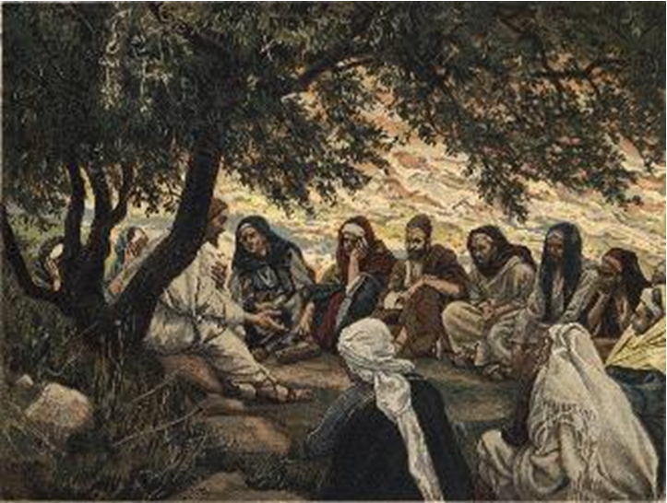
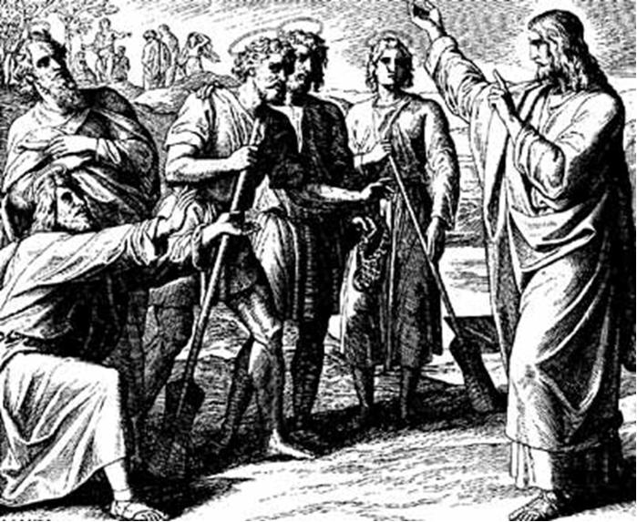
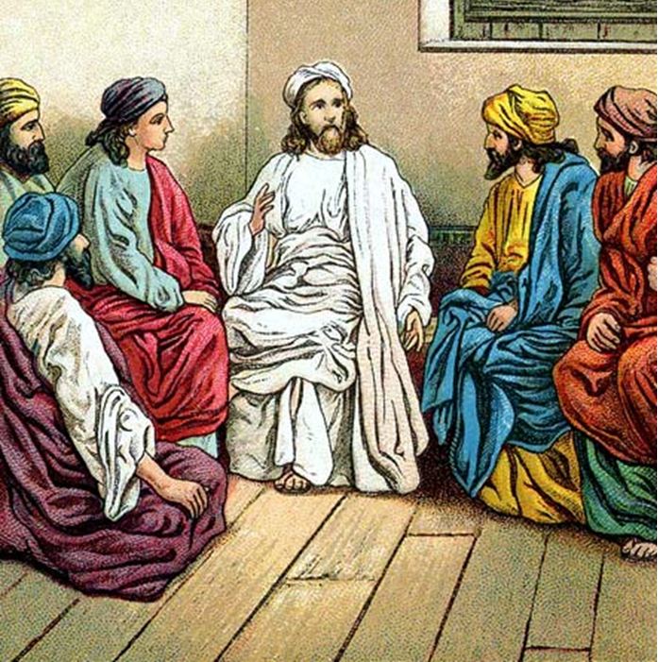
“The Apostles, Nicene and Athanasian Creeds
The Truth about the Trinity”
-The Ecumenical Creeds as Summaries
About Who God Is,
Versus False Religions and Cults-
Part 3 - A Bible Study of the Athanasian Creed
Trinity Lutheran Church LCMS Norman, OK. Pastor David Nehrenz
Lesson 14 – December 21, 2025

Slide 2
The Three Ecumenical Creeds
Lutheran Church - Missouri Synod adheres to the three Ecumenical Creeds. These creeds are succinct yet accurate statements of the true Christian faith.
Among the major doctrines confessed in the creeds are:
• the eternal and triune natures of God,
• the dual nature of Christ Jesus (being both fully God and fully man),
• the working of faith in believers by the Holy Spirit,
• the resurrection of the dead on the last day,
• the return of Christ Jesus in judgement, and
• everlasting life in heaven for those redeemed by the Grace of God through the working of the Holy Spirit and the innocent suffering and death & true resurrection of our Lord Jesus Christ on the third day.
1. The Apostle's Creed
The Nicene Creed
The Athanasian Creed

Slide 3
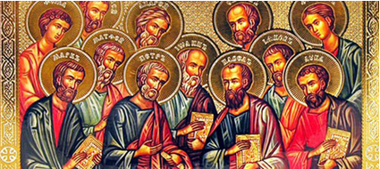

Slide 4
The Apostles’ Creed (ca AD 150-750)
The Apostles' Creed is the oldest. Already by 150 A.D. this creed was in use at Christian centers all along the Mediterranean Sea, such as Jerusalem, Alexandria (North Africa), Rome, and even Spain. The Apostles' Creed developed in conjunction with Baptism. As the water was applied, the question would be asked: "Do you believe in God the Father? God the Son? etc." Very quickly the answer developed into what we now call the Apostles' Creed. It is often called the baptismal creed. In addition to its primary use at all baptisms, it is also very appropriate for use in daily devotions. Also known as the Baptismal Creed or the Roman Symbol. Its central doctrines are those of the Trinity and God the Creator. It has been called the Creed of Creeds because already by AD 150 it was employed at Christian centers all along the Mediterranean Sea, such as Jerusalem, Alexandria (North Africa), Rome, and even Spain. It is also used in daily devotions.

Slide 7
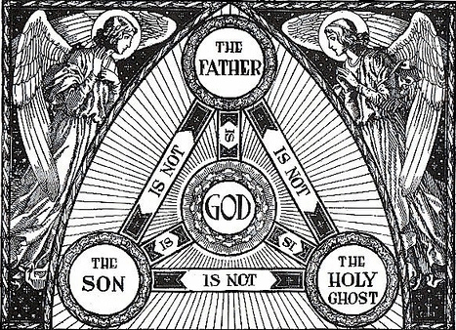

Slide 8
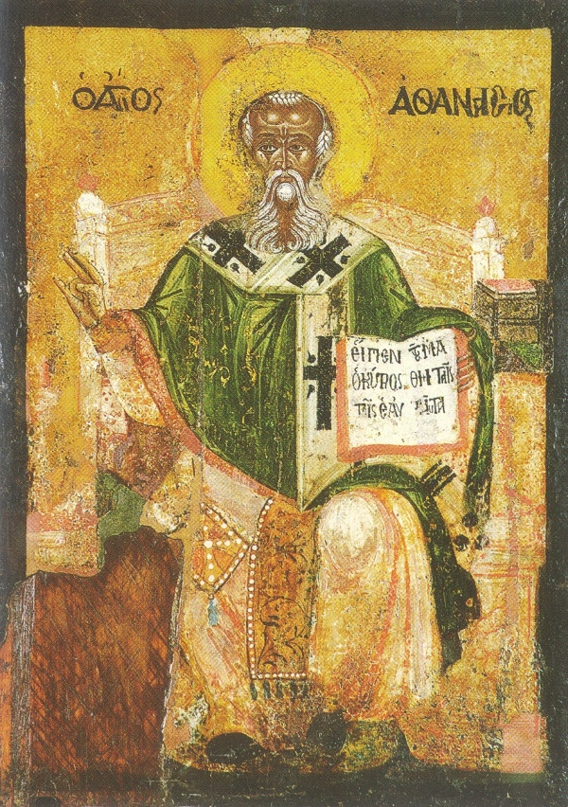

Slide 9
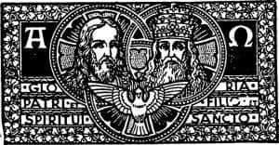

Slide 10
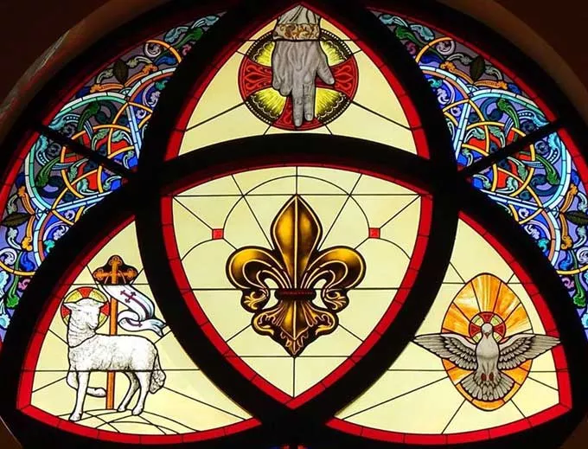

Slide 11
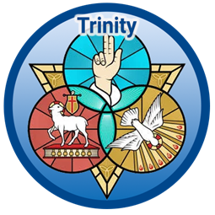

Slide 12
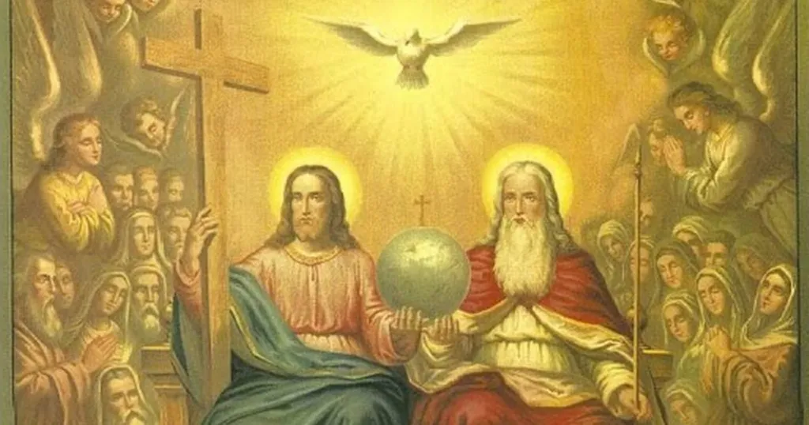

Slide 13
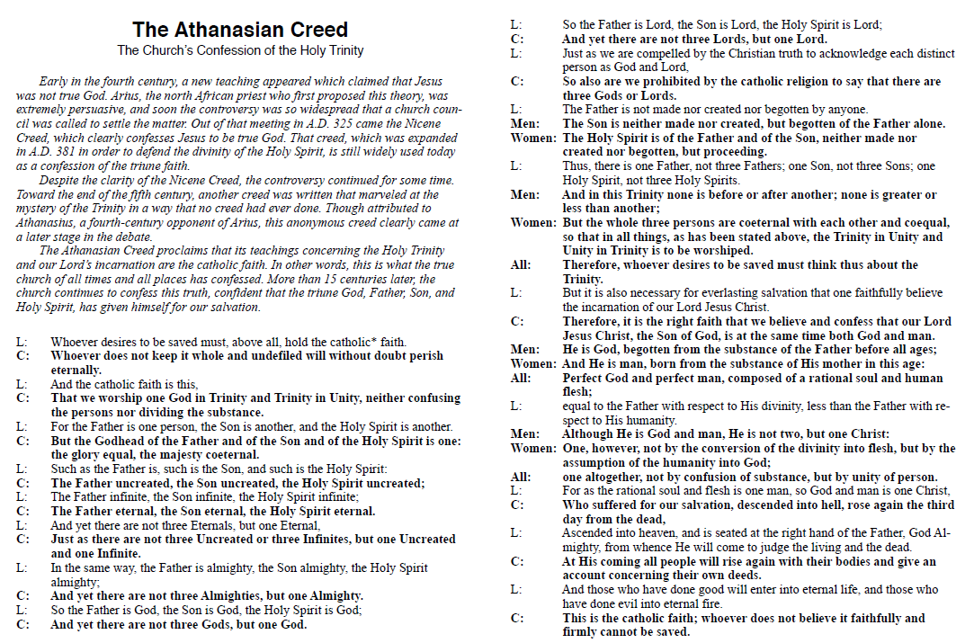

Slide 14
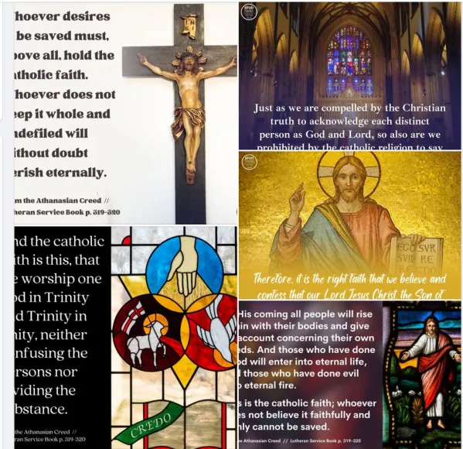

Slide 15
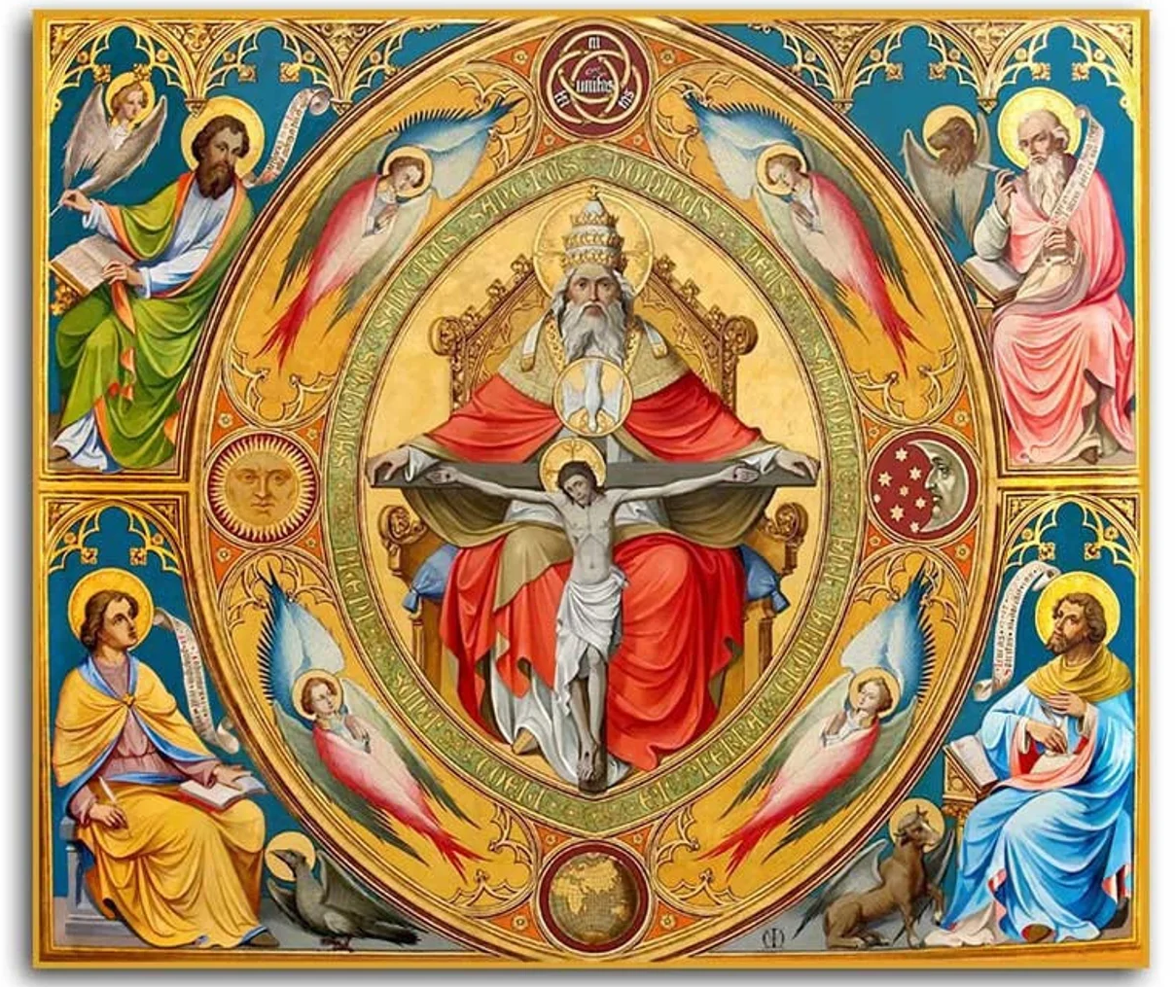

Slide 16
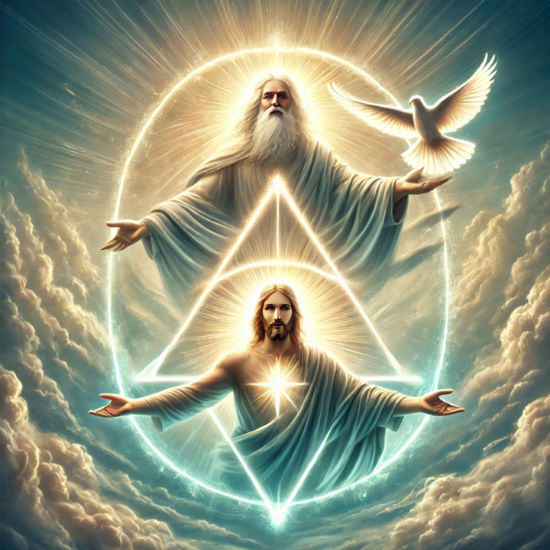

Slide 17
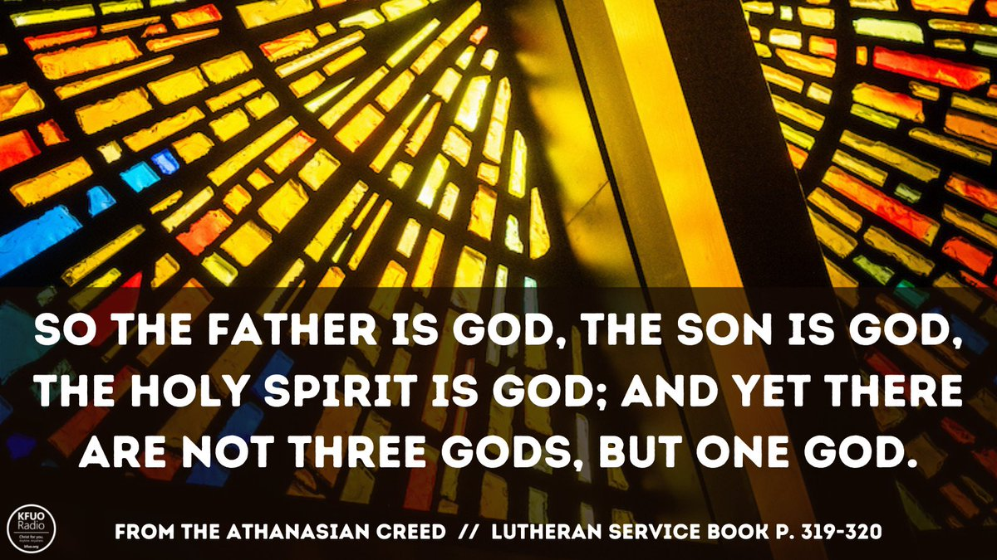

Slide 18
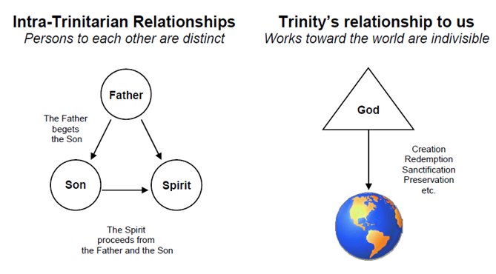

Slide 19
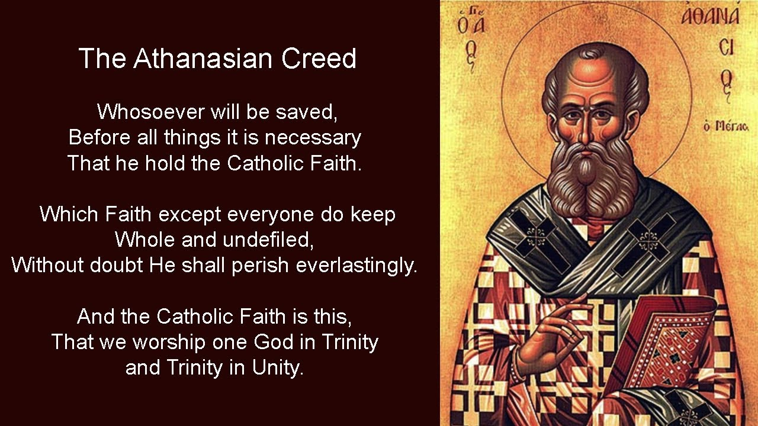

Slide 20
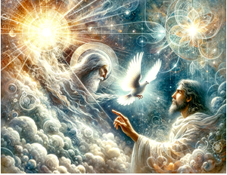

Slide 21


Slide 22
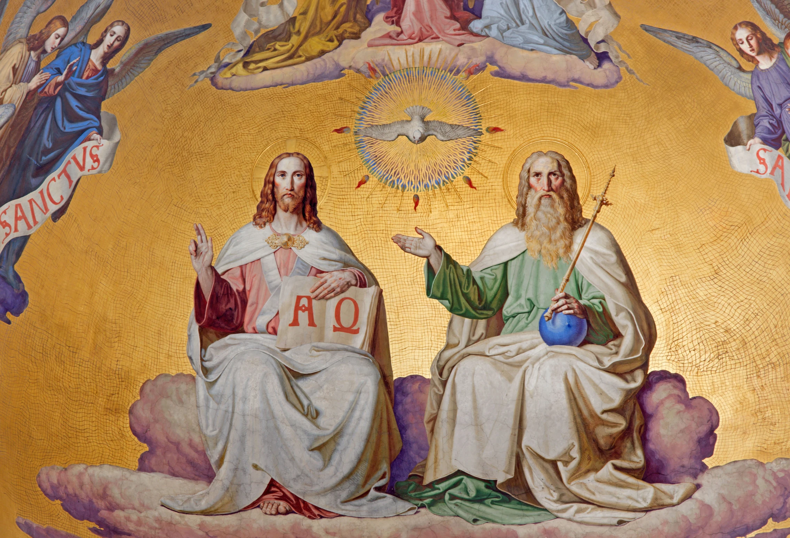

Slide 23
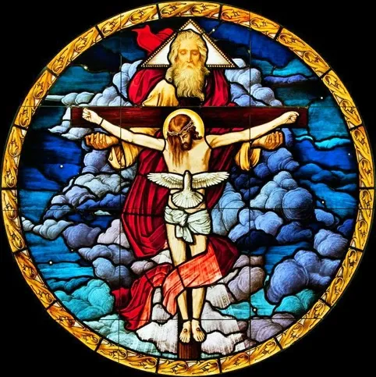

Slide 24
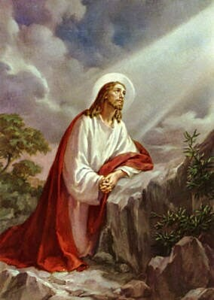
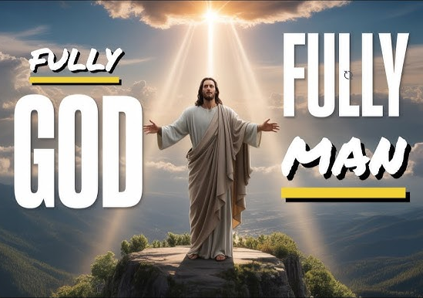

Slide 25
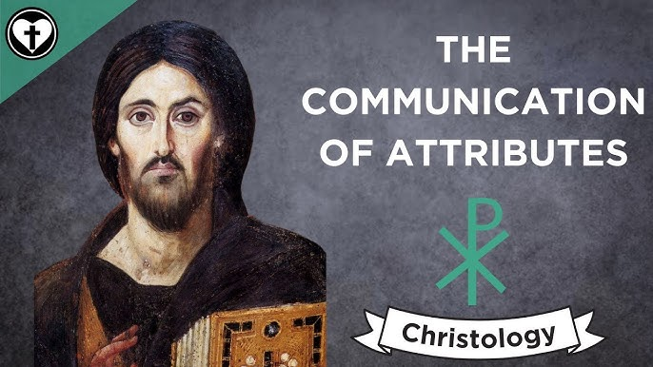

Slide 26
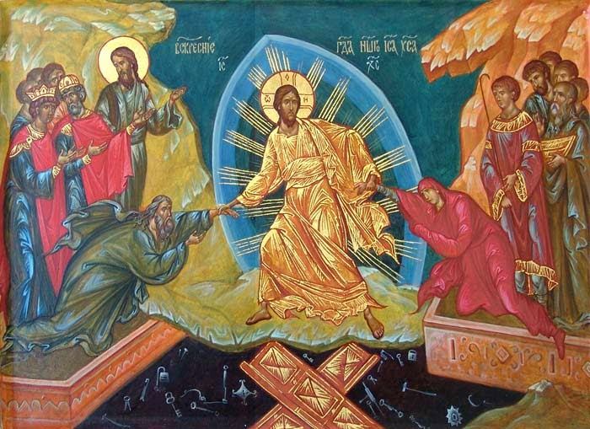

Slide 27
25) He suffered death for our salvation. He descended into hell and rose again from the dead.
Not only was Christ’s perfect life necessary but His atoning death was necessary for the salvation of His people as well. He lived in the perfect manner that we could not and He died in the cursed manner that we deserve. After His death and burial He rose from the grave proving that He had power and victory over sin, death, and hell.
(Isaiah 53; Romans 3:25; 4:25; 6:4; 8:11; 1 Corinthians 6:14;
Galatians 1:4; Ephesians 1:7; Colossians 1:20; 1 Thessalonians 4:14; 5:10;
Hebrews 2:17; 1 Peter 1:3; 2:24; 3:18–19; 1 John 2:2)

Slide 28
26) He ascended into heaven and is seated at the right hand of the Father.
Because Jesus perfectly completed His mission He was then rightfully exalted at the right hand of the Father in glory.
(Psalm 110:1; Luke 24:51; Acts 1:9; 7:56; Romans 8:34; Colossians 3:1)

Slide 29
27) He will come again to judge the living and the dead.
There will be a day in which all will rise and be justly judged by Him who is the only just judge.
(John 5:22; Acts 1:11; 10:42; 17:31; 2 Corinthians 5:10)

Slide 30
EARLY CHURCH FATHERS
Clement I
“Let us consider, beloved, how the Master is continually proving to us that there will be a future resurrection, of which he has made the Lord Jesus Christ the firstling, by raising him from the dead. Let us look, beloved, at the resurrection which is taking place seasonally. Day and night make known the resurrection to us. The night sleeps, the day arises. Consider the plants that grow. How and in what manner does the sowing take place? The sower went forth and cast each of the seeds onto the ground; and they fall to the ground, parched and bare, where they decay. Then from their decay the greatness of the master’s providence raises them up, and from the one grain more grow and bring forth fruit” (Letter to the Corinthians 24:1–6 [A.D. 80]).
Aristides
“[Christians] have the commandments of the Lord Jesus Christ himself impressed upon their hearts, and they observe them, awaiting the resurrection of the dead and the life of the world to come” (Apology 15 [A.D. 140]).
.

Slide 31
Justin Martyr
“The prophets have proclaimed his [Christ’s] two comings. One, indeed, which has already taken place, was that of a dishonored and suffering man. The second will take place when, in accord with prophecy, he shall come from the heavens in glory with his angelic host, when he shall raise the bodies of all the men who ever lived. Then he will clothe the worthy in immortality, but the wicked, clothed in eternal sensibility, he will commit to the eternal fire along with the evil demons” (First Apology 52 [A.D. 151]).
“Indeed, God calls even the body to resurrection and promises it everlasting life. When he promises to save the man, he thereby makes his promise to the flesh. What is man but a rational living being composed of soul and body? Is the soul by itself a man? No, it is but the soul of a man. Can the body be called a man? No, it can but be called the body of a man. If, then, neither of these is by itself a man, but that which is composed of the two together is called a man, and if God has called man to life and resurrection, he has called not a part, but the whole, which is the soul and the body” (The Resurrection 8 [A.D. 153]).

Slide 32
Irenaeus
“For the Church, although dispersed throughout the whole world even to the ends of the earth, has received from the apostles and from their disciples the faith in . . . the raising up again of all flesh of all humanity” (Against Heresies 1:10:1–4 [A.D. 189]).
Cyril of Jerusalem
“This body shall be raised, not remaining weak as it is now, but this same body shall be raised. By putting on incorruption, it shall be altered, as iron blending with fire becomes fire—or rather, in a manner the Lord who raises us knows. However it will be, this body shall be raised, but it shall not remain such as it is. Rather, it shall abide as an eternal body. It shall no longer require for its life such nourishment as now, nor shall it require a ladder for its ascent; for it shall be made a spiritual body, a marvelous thing, such as we have not the ability to describe” (Catechetical Lectures 18:18 [A.D. 350]).
.
.

Slide 33
BIBLE STUDIES
Starting Sunday January 4th, 2026
-led by the ordained LCMS
Pulpit supply Pastors each Sunday
“TODAY’S LESSONS –
A Deeper Dive”
(a study of the three
Sunday Divine Services
Scripture Lessons from the PERICOPE:
Old Testament
Epistle
Gospel)
Here in the Fellowship Hall
9:15 to 10:15 a.m.

