Slide 1
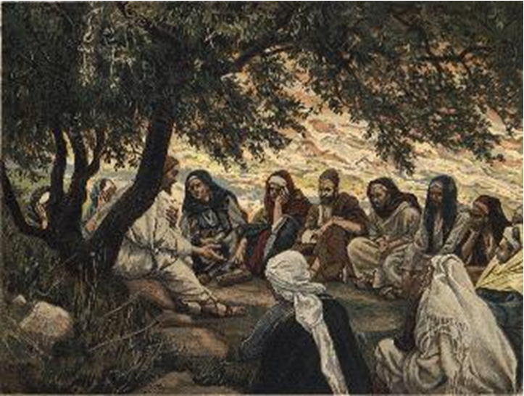
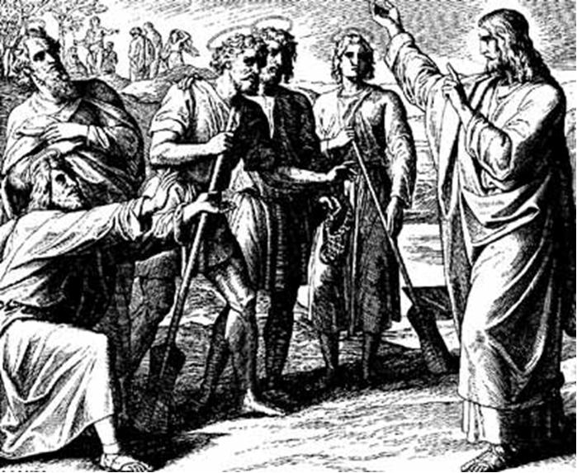
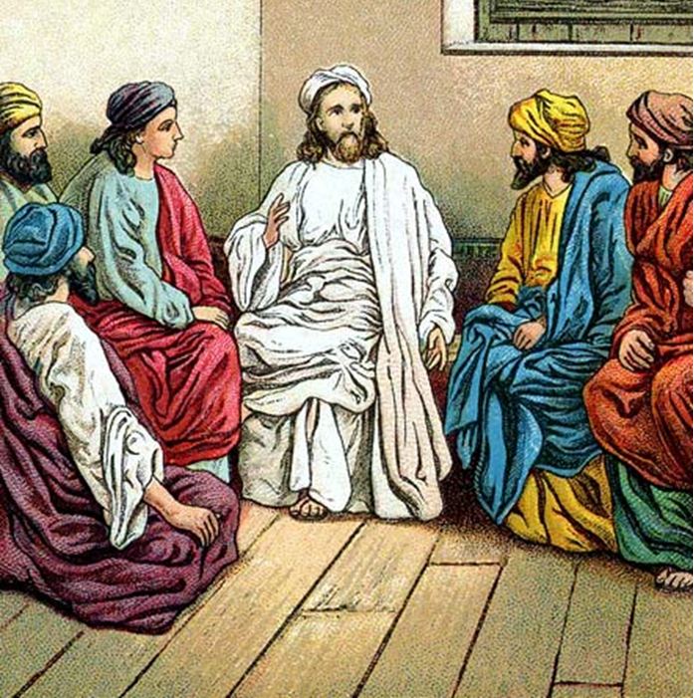
“The Apostles, Nicene and Athanasian Creeds
The Truth about the Trinity”
-The Ecumenical Creeds as Summaries
About Who God Is,
Versus False Religions and Cults-
Part 3 - A Bible Study of the Athanasian Creed
Trinity Lutheran Church LCMS Norman, OK. Pastor David Nehrenz
Lesson 13 – December 14, 2025

Slide 2
The Three Ecumenical Creeds
Lutheran Church - Missouri Synod adheres to the three Ecumenical Creeds. These creeds are succinct yet accurate statements of the true Christian faith.
Among the major doctrines confessed in the creeds are:
• the eternal and triune natures of God,
• the dual nature of Christ Jesus (being both fully God and fully man),
• the working of faith in believers by the Holy Spirit,
• the resurrection of the dead on the last day,
• the return of Christ Jesus in judgement, and
• everlasting life in heaven for those redeemed by the Grace of God through the working of the Holy Spirit and the innocent suffering and death & true resurrection of our Lord Jesus Christ on the third day.
1. The Apostle's Creed
The Nicene Creed
The Athanasian Creed

Slide 3
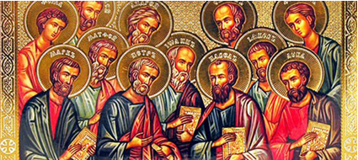

Slide 4
The Apostles’ Creed (ca AD 150-750)
The Apostles' Creed is the oldest. Already by 150 A.D. this creed was in use at Christian centers all along the Mediterranean Sea, such as Jerusalem, Alexandria (North Africa), Rome, and even Spain. The Apostles' Creed developed in conjunction with Baptism. As the water was applied, the question would be asked: "Do you believe in God the Father? God the Son? etc." Very quickly the answer developed into what we now call the Apostles' Creed. It is often called the baptismal creed. In addition to its primary use at all baptisms, it is also very appropriate for use in daily devotions. Also known as the Baptismal Creed or the Roman Symbol. Its central doctrines are those of the Trinity and God the Creator. It has been called the Creed of Creeds because already by AD 150 it was employed at Christian centers all along the Mediterranean Sea, such as Jerusalem, Alexandria (North Africa), Rome, and even Spain. It is also used in daily devotions.

Slide 7
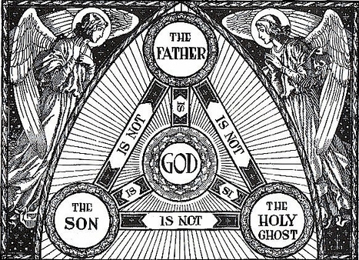

Slide 8
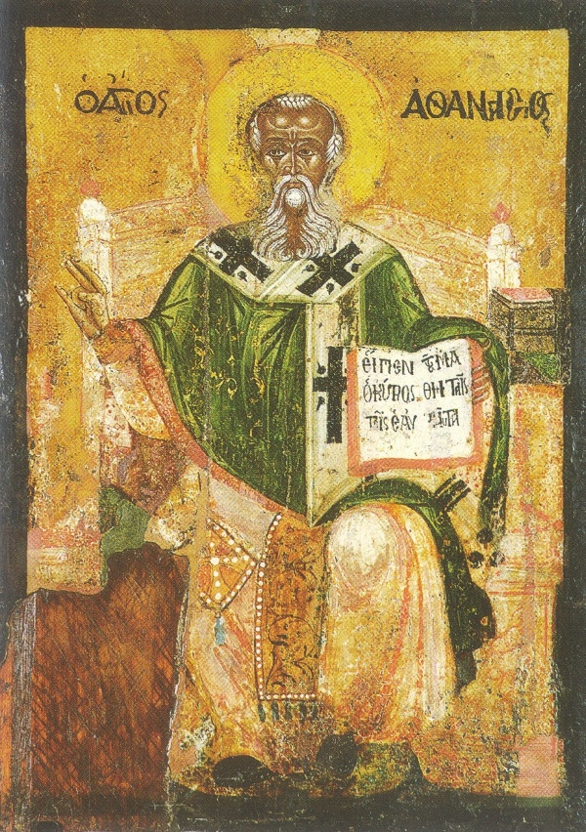

Slide 9
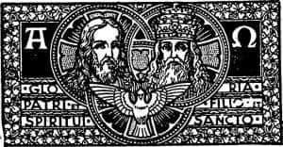

Slide 10
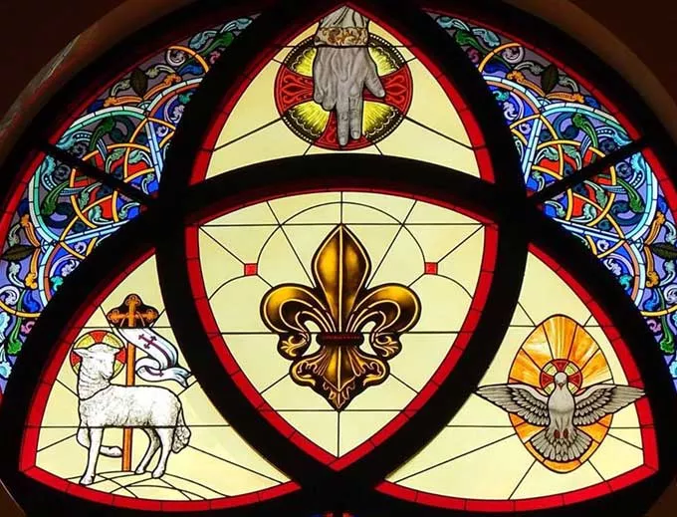

Slide 11
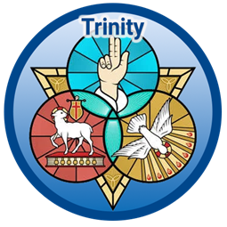

Slide 12
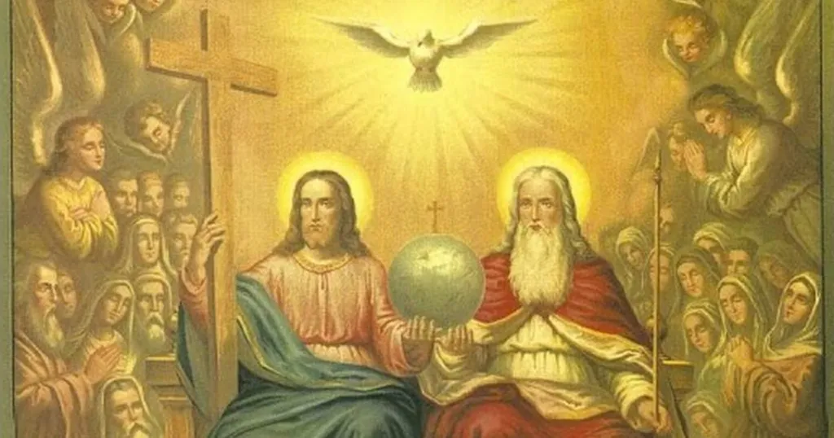

Slide 13
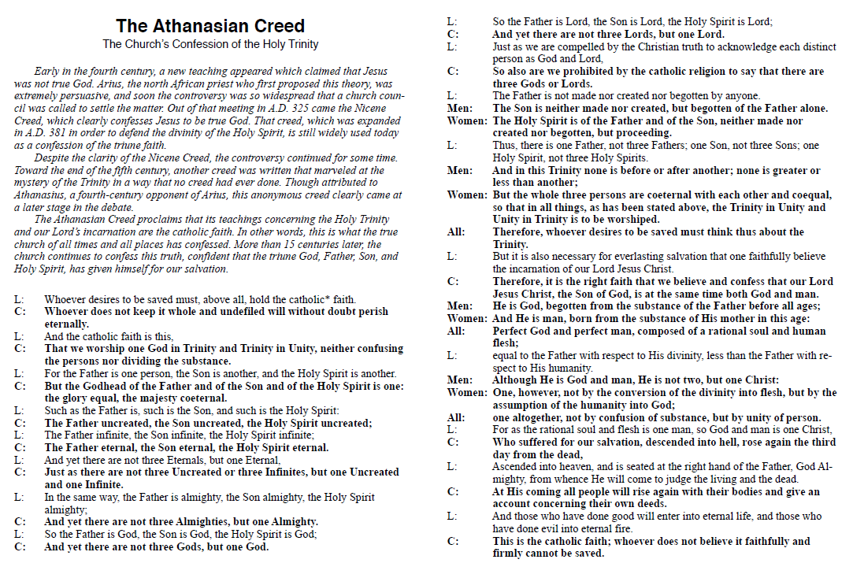

Slide 14
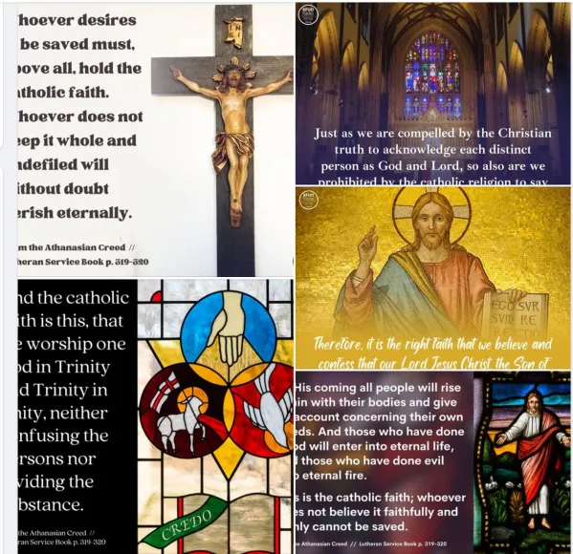

Slide 15
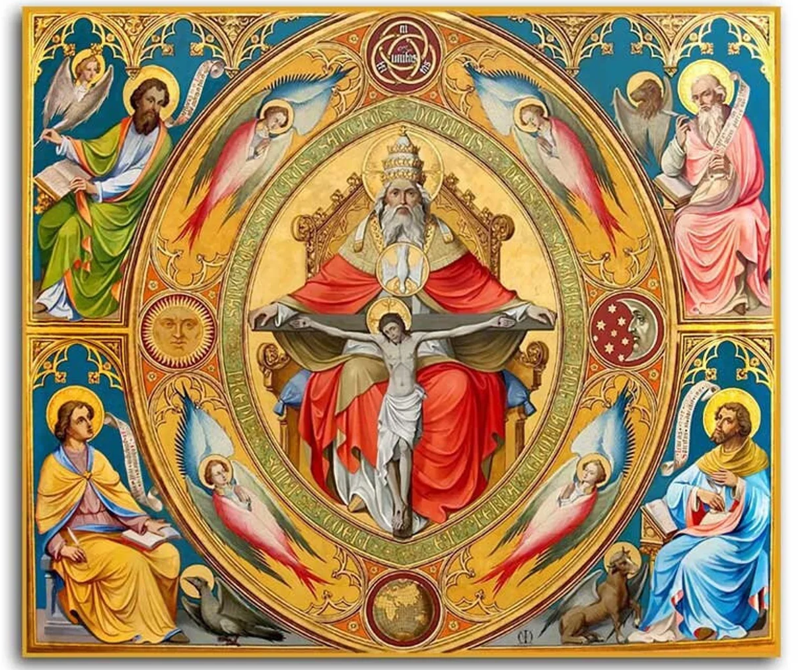

Slide 16
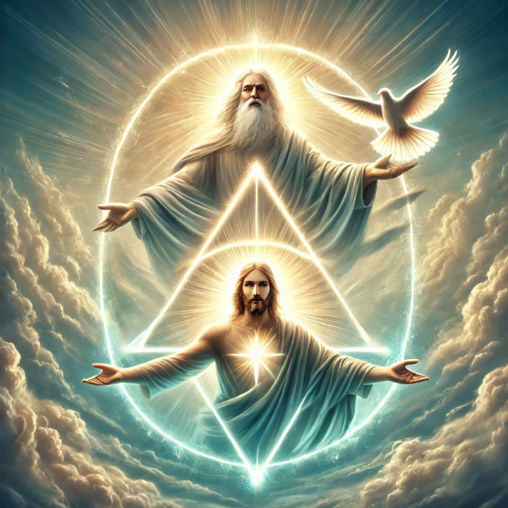

Slide 17
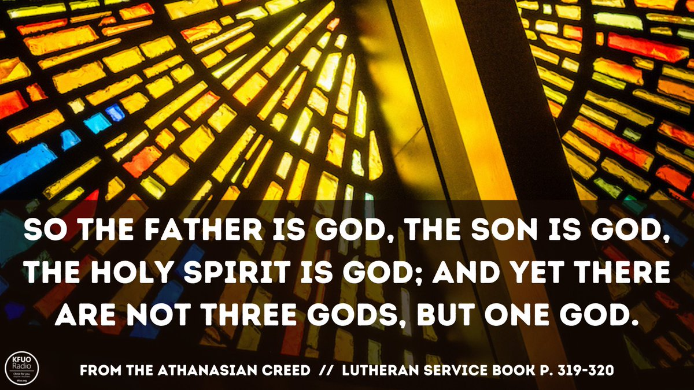

Slide 18
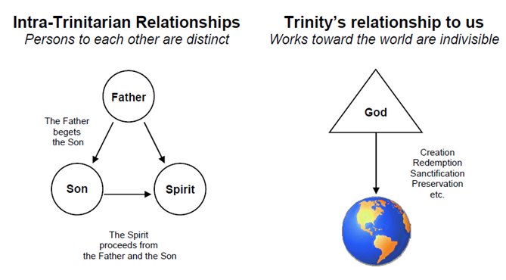

Slide 19
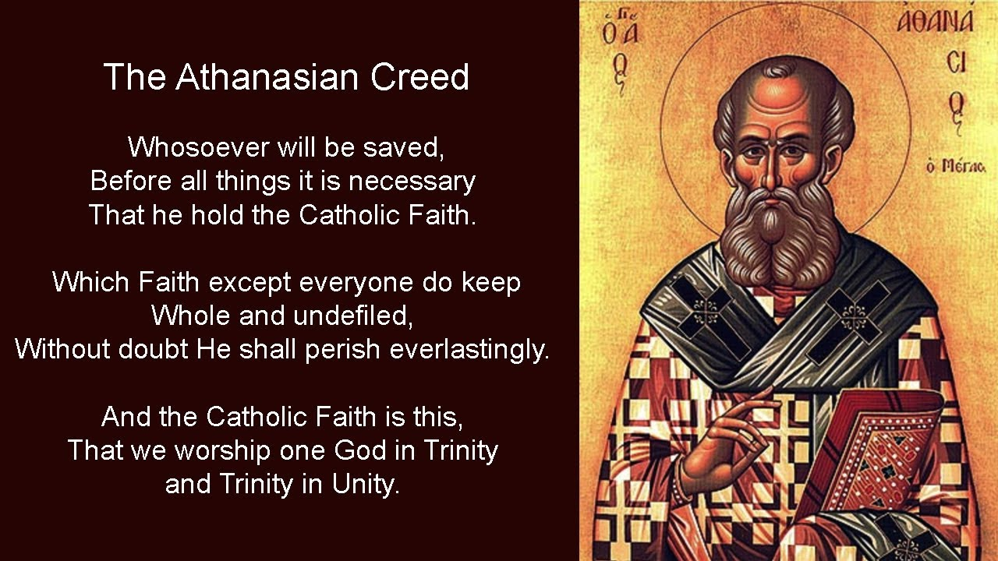

Slide 20
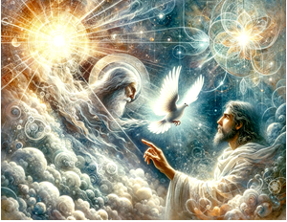

Slide 21
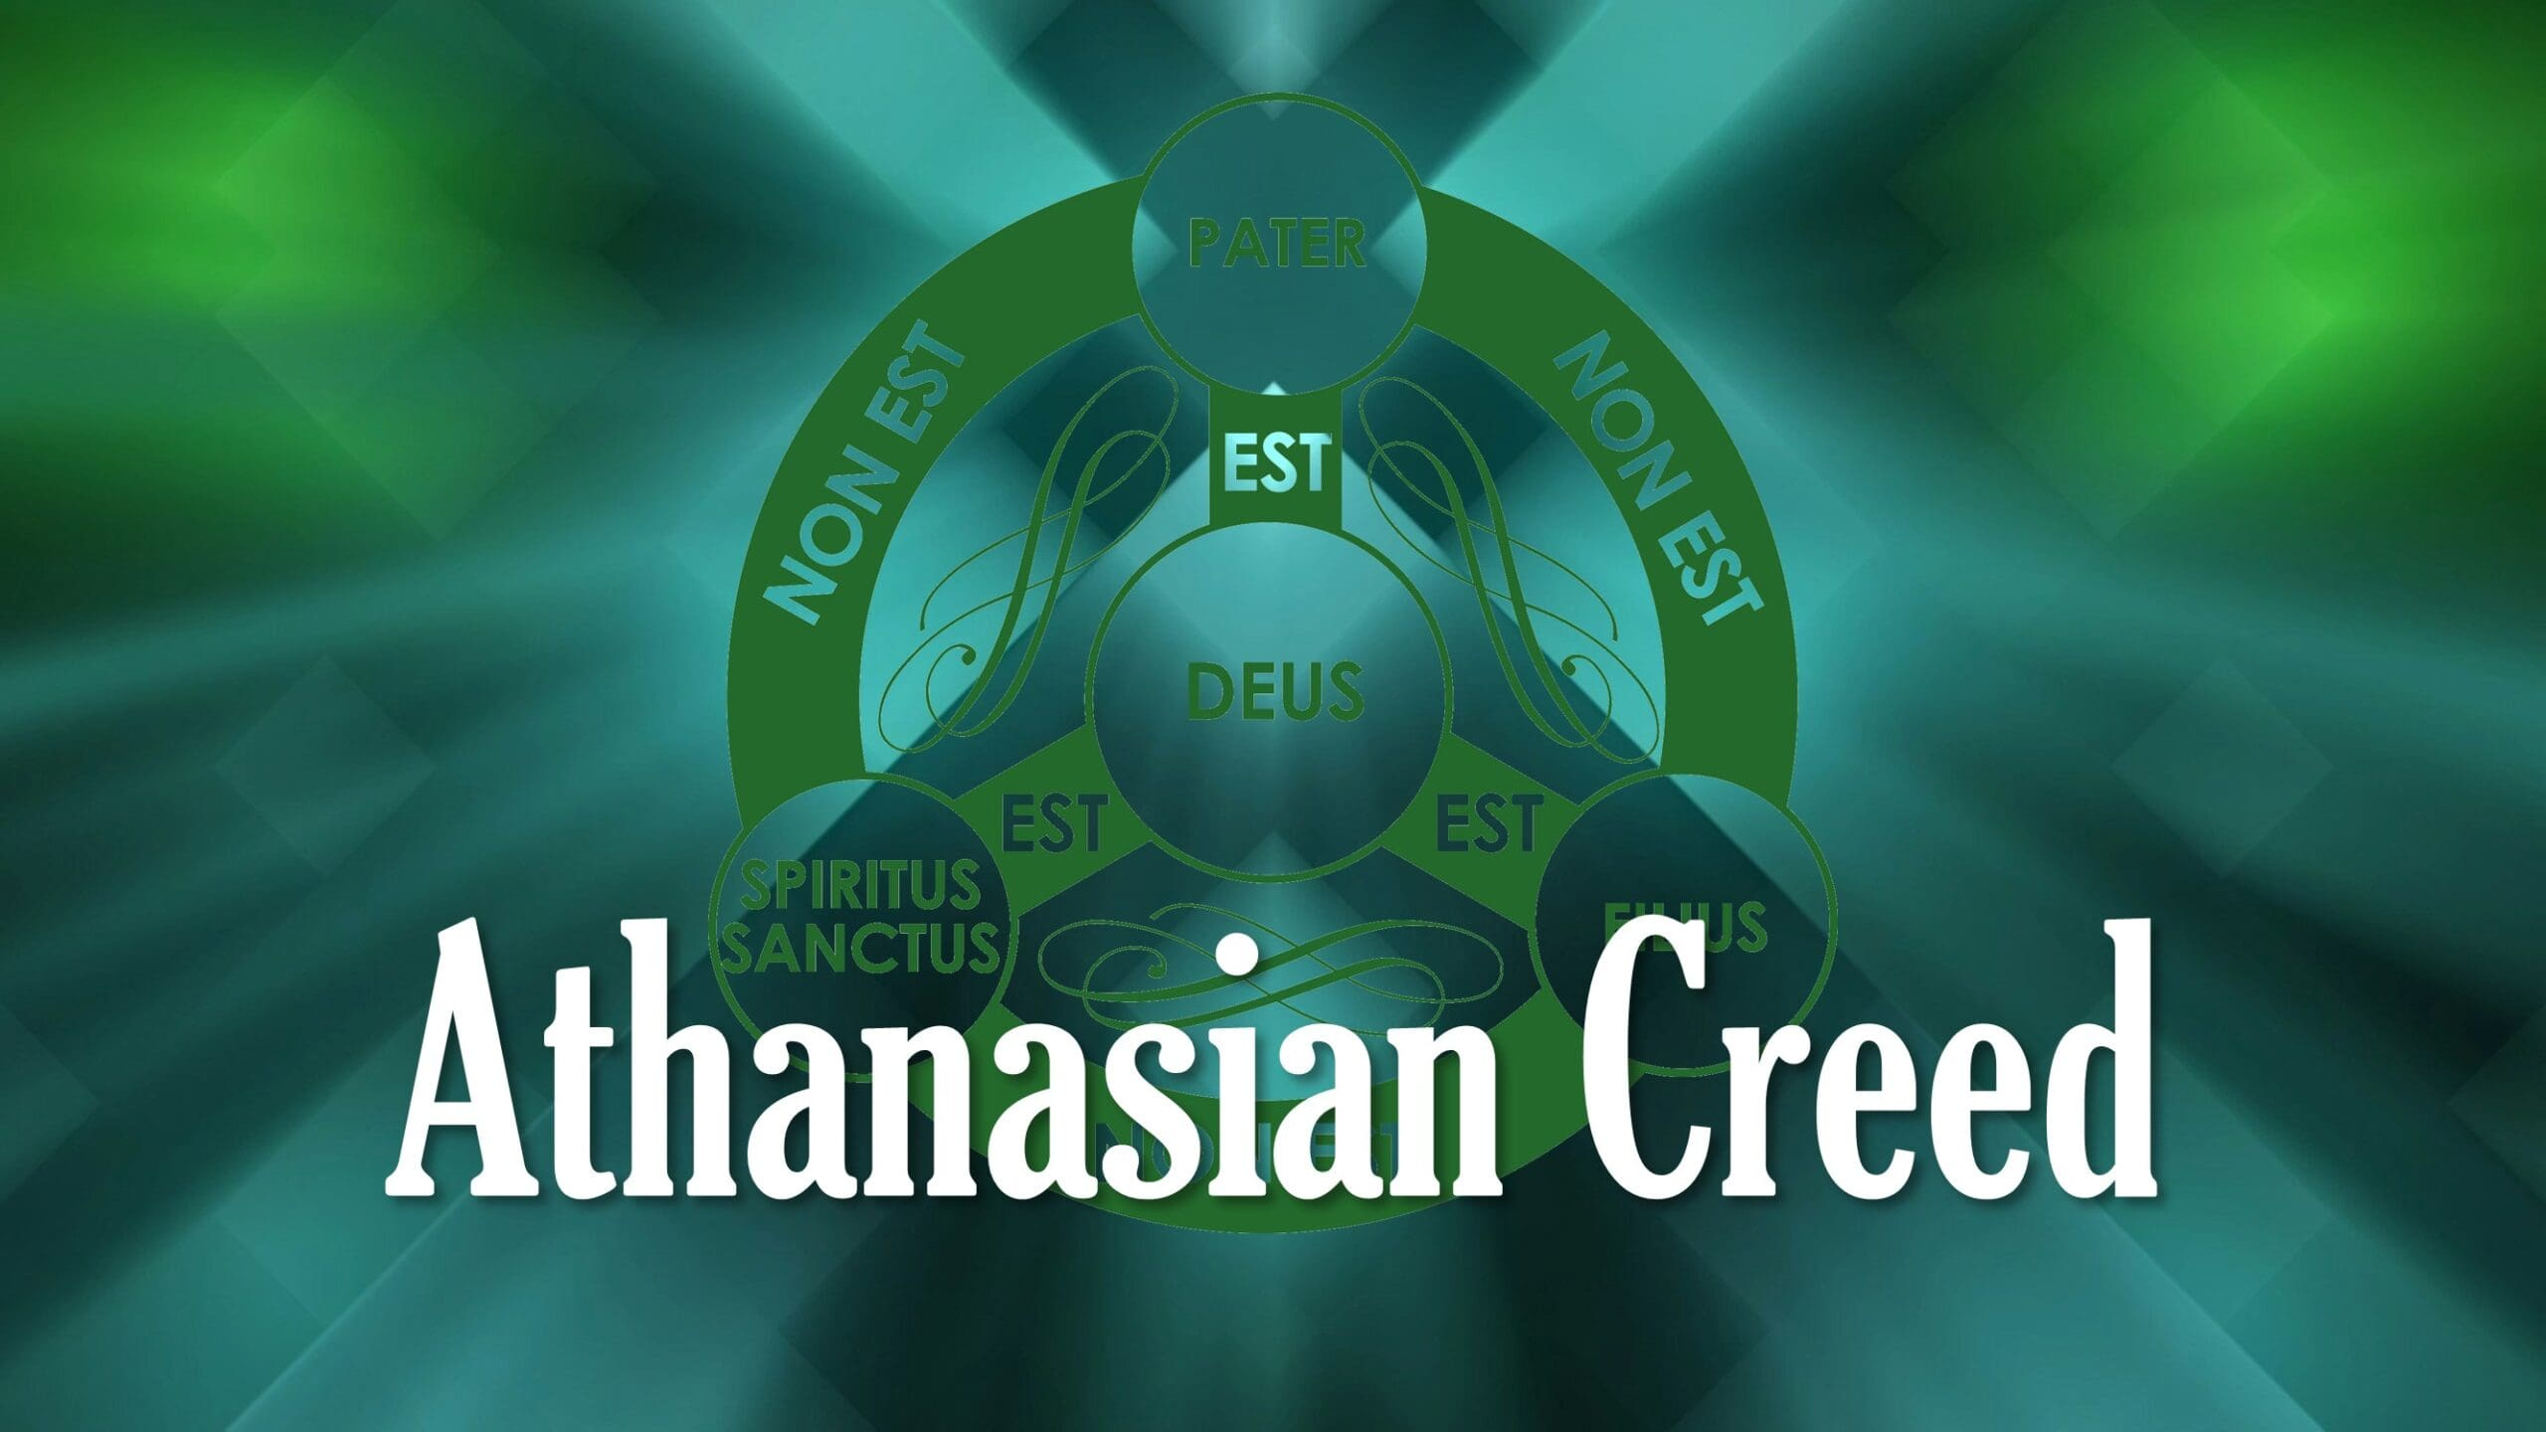

Slide 22
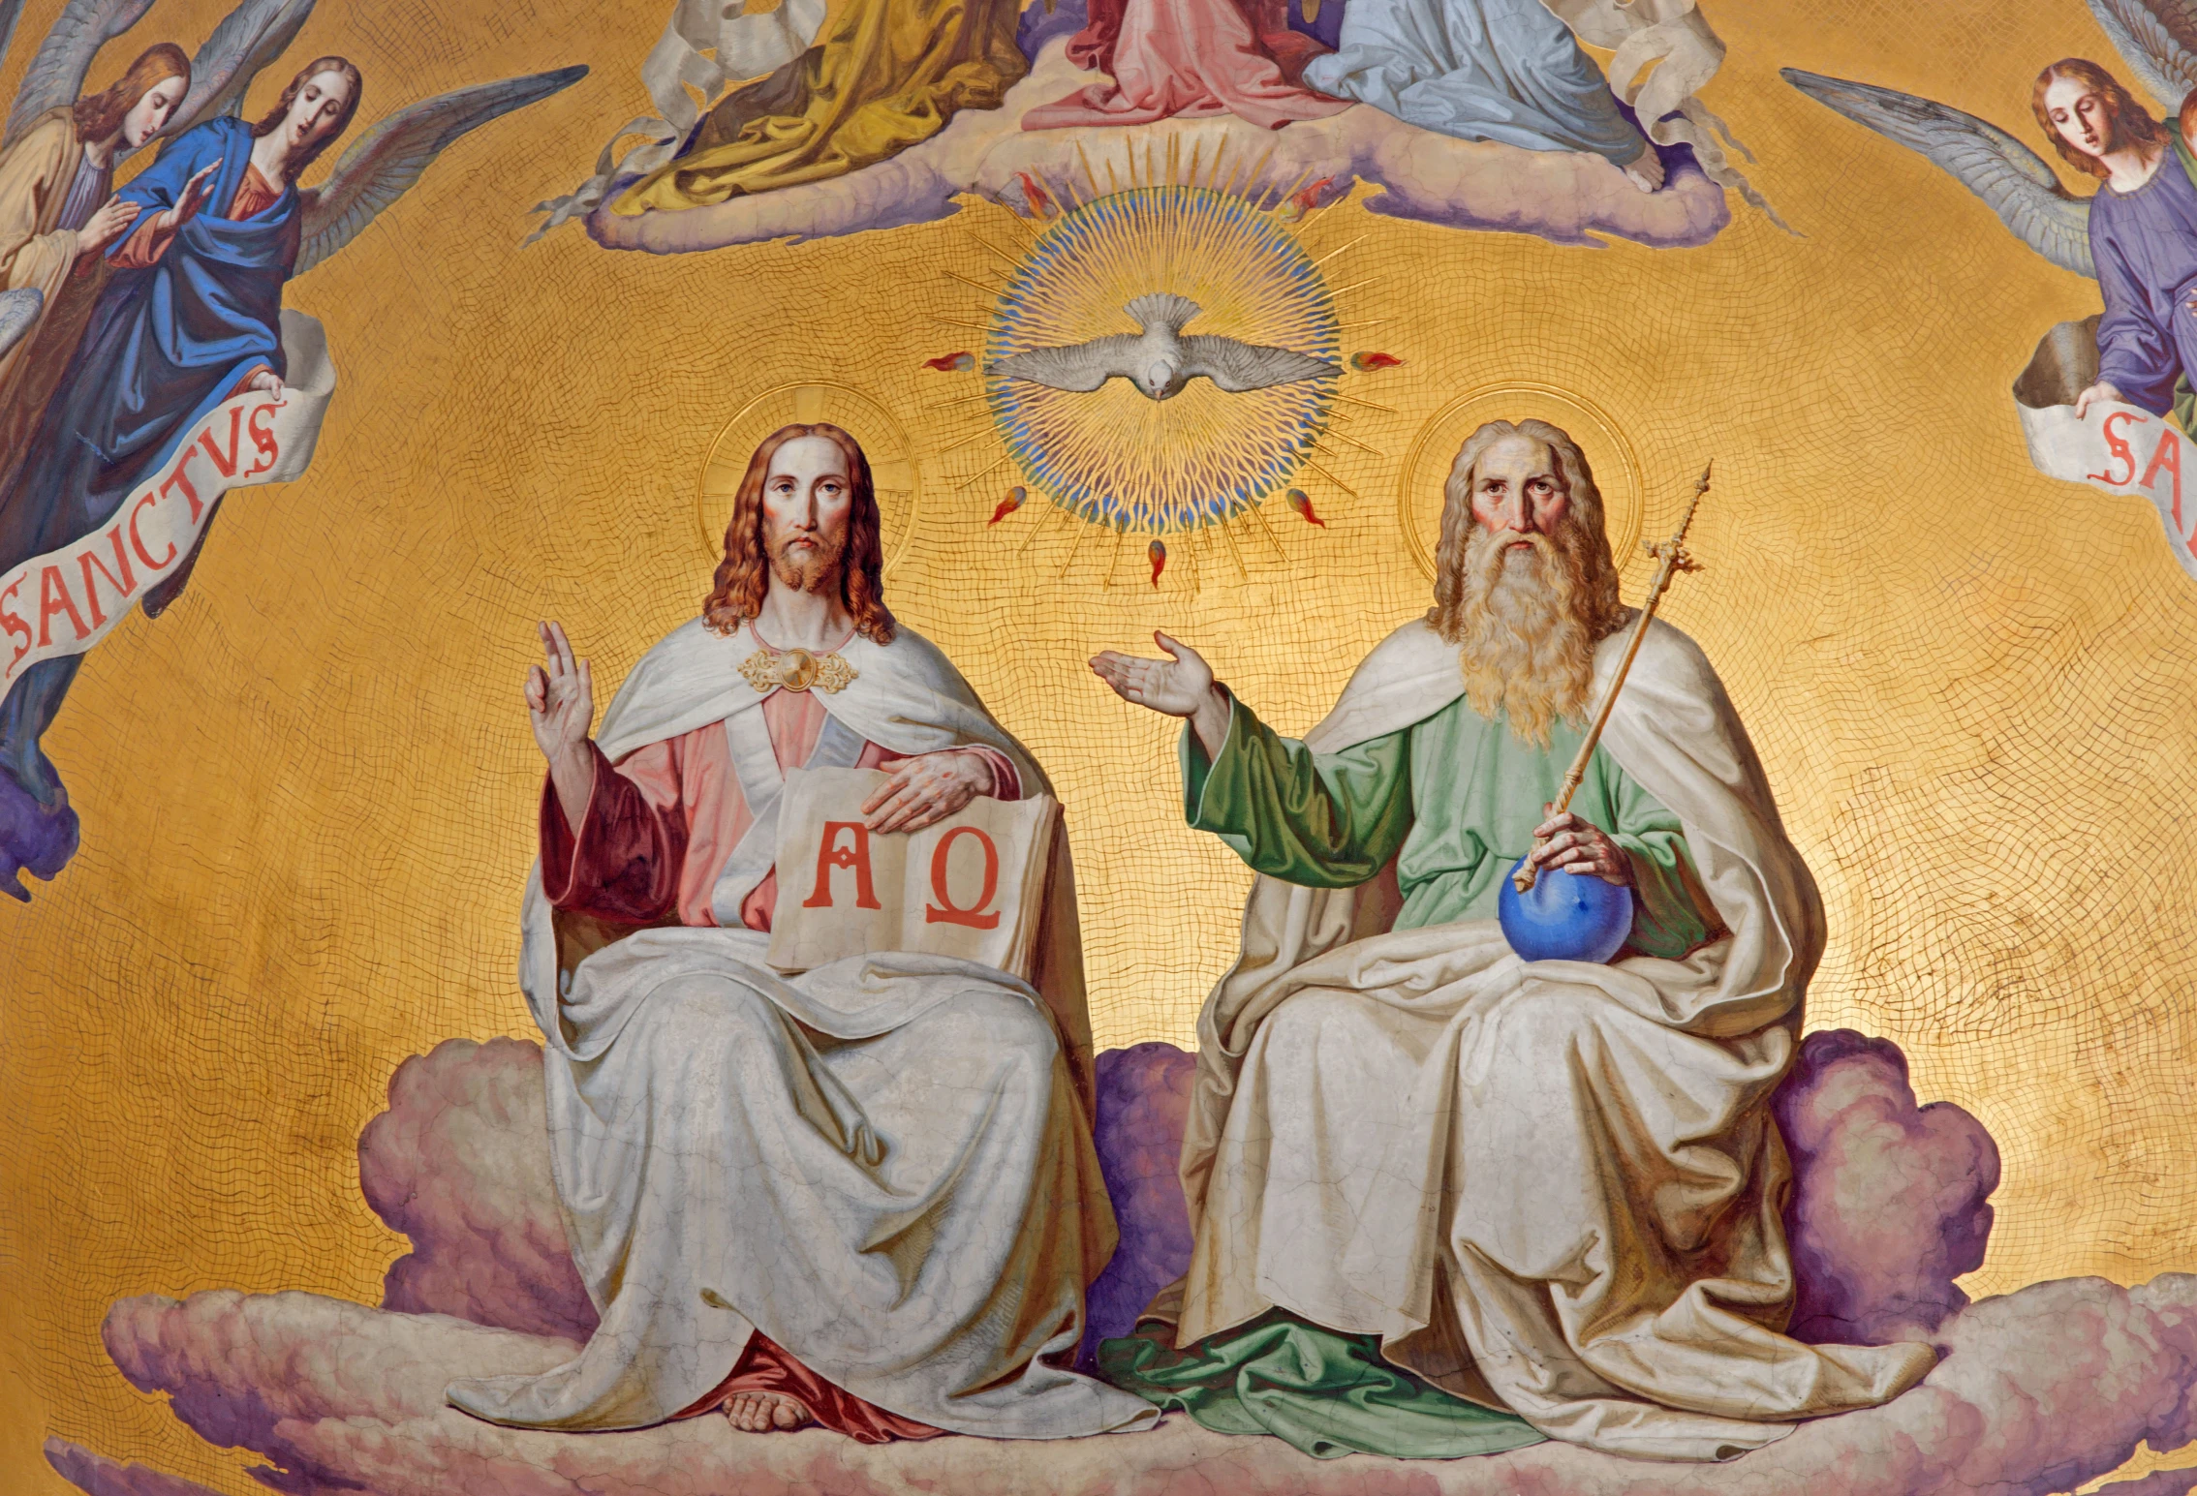

Slide 23
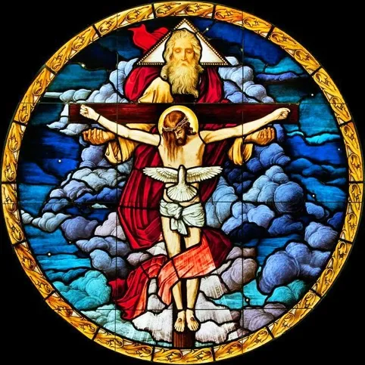

Slide 24
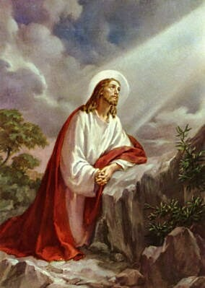


Slide 25
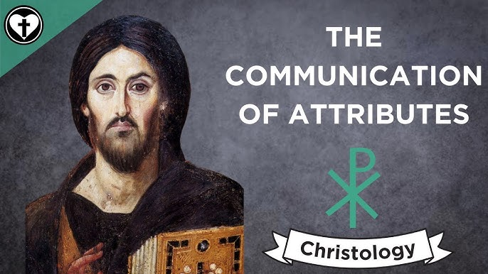

Slide 26
21) Although he is God and man, he is not divided, but is one Christ.
(Romans 5:15-19; 1 Corinthians 8:4-6; Ephesians 4:4-10; 1 John 2:20-25)

Slide 27
22) He is united because God has taken humanity into himself;
he does not transform deity into humanity.
23) He is completely one in the unity of his person,
without confusing his natures.
24) For as the rational soul and body are one person,
so the one Christ is God and man.
(Matthew 1:18-25; Philippians 2:5–11; Colossians 1:11-20; 2:6-15; Hebrews 2:14–18)

Slide 28
The Communication of Attributes in Christ Jesus
We see that the divine attributes of Christ were communicated to His human nature so that it was enriched. This happened at the incarnation. Jesus is not simply a man who was endowed with super abilities from time to time. According to Colosssians 2:9,
“In Him dwells all the fullness of the Godhead bodily.”
Formula of Concord, Solid Declaration, VIII:
12] We believe, teach, and confess also that the assumed human nature in Christ not only has and retains its natural, essential properties, but that over and above these, through the personal union with the Deity, and afterwards through glorification, it has been exalted to the right hand of majesty, power, and might, over everything that can be named, not only in this world, but also in that which is to come [Eph. 1, 21].

Slide 29
26] Hence also the human nature, after the resurrection from the dead, has its exaltation above all creatures in heaven and on earth; which is nothing else than that He entirely laid aside the form of a servant, and yet did not lay aside His human nature, but retains it to eternity, and is put in the full possession and use of the divine majesty according to His assumed human nature.
However, this majesty He had immediately at His conception, even in His mother’s womb, but, as the apostle testifies [Phil. 2, 7], laid it aside; and, as Dr. Luther explains, He kept it concealed in the state of His humiliation, and did not employ it always, but only when He wished.
.

Slide 30
We see the distinction between Christ and believers. At Christ’s incarnation, His human nature received the fullness of divine attributes. Believers, prophets and apostles and saints also receive gifts due to their union with Christ and according to His graciousness, but those gifts are limited and require reliance upon the Triune God.
Formula of Concord, Solid Declaration, VIII:
72] But we believe, teach, and confess that God the Father has so given His Spirit to Christ, His beloved Son, according to the assumed humanity (on account of which He is called also Messias, i.e., the Anointed), that He has not received His gifts by measure as other saints. For upon Christ the Lord, according to His assumed human nature (because, according to His divinity, He is of one essence with the Holy Ghost), rests the Spirit of wisdom and understanding, the Spirit of counsel and might, the Spirit of knowledge [and of the fear of the Lord, Col. 2, 3; Is. 11, 2; 61, 1],

Slide 31
73] not in such a way that on this account, as a man, He knew and could do only some things, as other saints know and can do by the Spirit of God, who works in them only created gifts, but since Christ, according to His divinity, is the second person in the Holy Trinity, and from Him, as also from the Father, the Holy Ghost proceeds, and thus is and remains His and the Father’s own Spirit to all eternity, not separated from the Son of God, therefore (as the Fathers say) the entire fullness of the Spirit has been communicated by the personal union to Christ according to the flesh, which is personally united with the Son of God.
74] This voluntarily manifests and shows itself, with all its power therein, therewith and thereby [in, with, and through the human nature of Christ], so that He [Christ, according to His human nature] not only knows some things and is ignorant of others, can do some things and is unable to do others, but [according to the assumed human nature] knows and can do all things. For upon Him the Father poured without measure the Spirit of wisdom and power, so that, as man, He has received through this personal union all knowledge and all power in deed and truth. And thus all the treasures of wisdom are hidden in Him, thus all power is given to Him, and He is seated at the right hand of the majesty and power of God.
.

