Slide 1
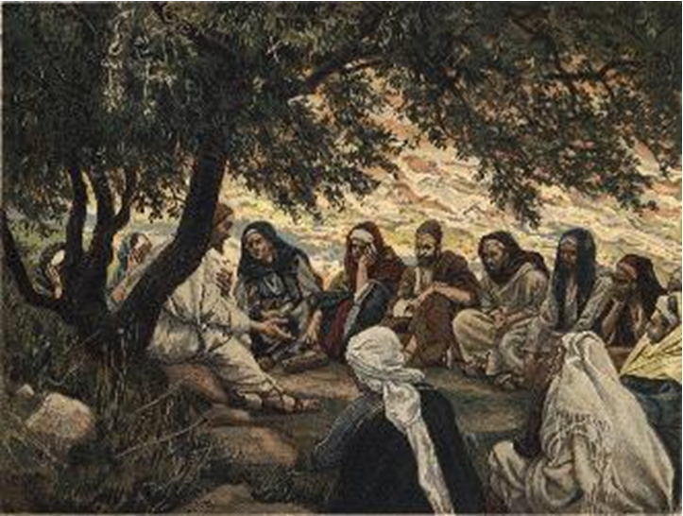
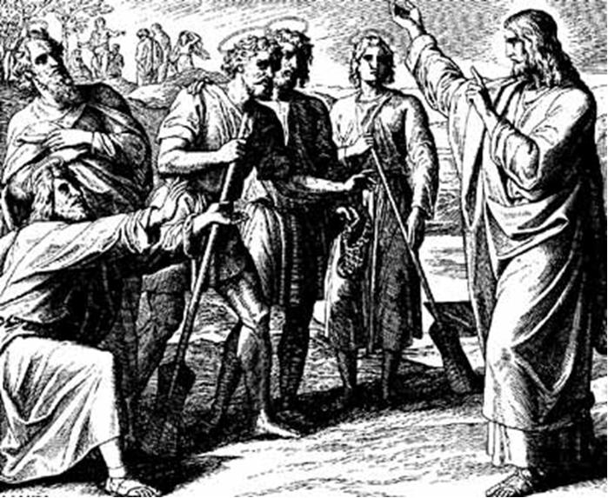
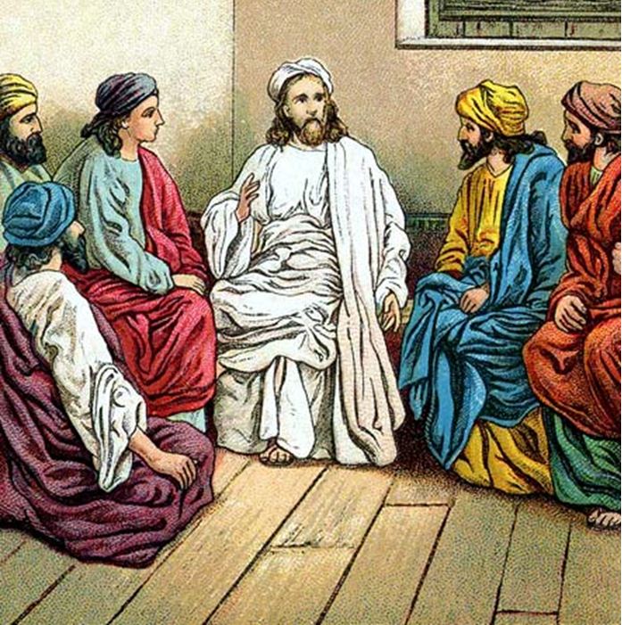
“The Apostles, Nicene and Athanasian Creeds
The Truth about the Trinity”
-The Ecumenical Creeds as Summaries
About Who God Is,
Versus False Religions and Cults-
Part 3 - A Bible Study of the Athanasian Creed
Trinity Lutheran Church LCMS Norman, OK. Pastor David Nehrenz
Lesson 12 – December 7, 2025

Slide 2
The Three Ecumenical Creeds
Lutheran Church - Missouri Synod adheres to the three Ecumenical Creeds. These creeds are succinct yet accurate statements of the true Christian faith.
Among the major doctrines confessed in the creeds are:
• the eternal and triune natures of God,
• the dual nature of Christ Jesus (being both fully God and fully man),
• the working of faith in believers by the Holy Spirit,
• the resurrection of the dead on the last day,
• the return of Christ Jesus in judgement, and
• everlasting life in heaven for those redeemed by the Grace of God through the working of the Holy Spirit and the innocent suffering and death & true resurrection of our Lord Jesus Christ on the third day.
1. The Apostle's Creed
The Nicene Creed
The Athanasian Creed

Slide 3
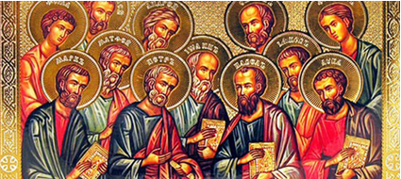

Slide 4
The Apostles’ Creed (ca AD 150-750)
The Apostles' Creed is the oldest. Already by 150 A.D. this creed was in use at Christian centers all along the Mediterranean Sea, such as Jerusalem, Alexandria (North Africa), Rome, and even Spain. The Apostles' Creed developed in conjunction with Baptism. As the water was applied, the question would be asked: "Do you believe in God the Father? God the Son? etc." Very quickly the answer developed into what we now call the Apostles' Creed. It is often called the baptismal creed. In addition to its primary use at all baptisms, it is also very appropriate for use in daily devotions. Also known as the Baptismal Creed or the Roman Symbol. Its central doctrines are those of the Trinity and God the Creator. It has been called the Creed of Creeds because already by AD 150 it was employed at Christian centers all along the Mediterranean Sea, such as Jerusalem, Alexandria (North Africa), Rome, and even Spain. It is also used in daily devotions.

Slide 7
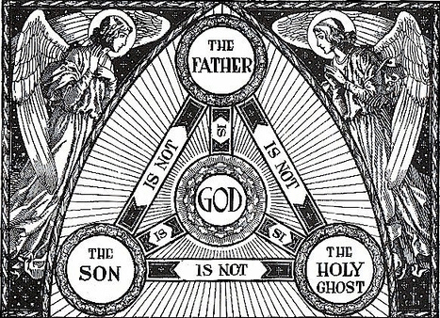

Slide 8
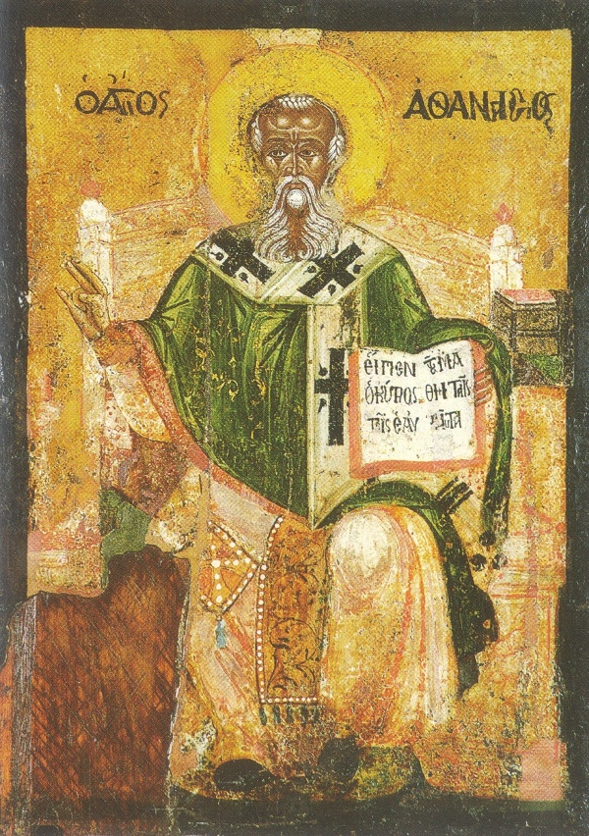

Slide 9
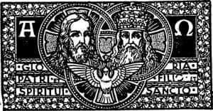

Slide 10
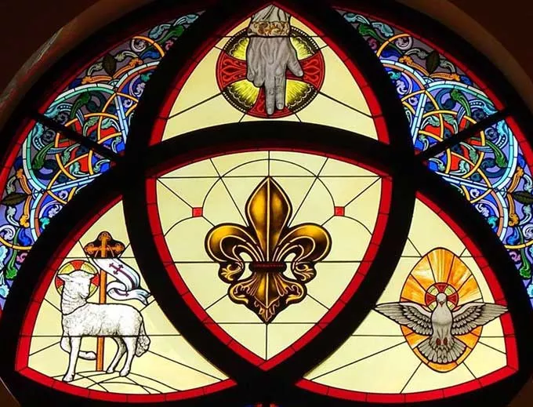

Slide 11
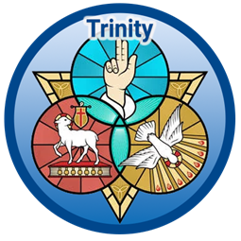

Slide 12
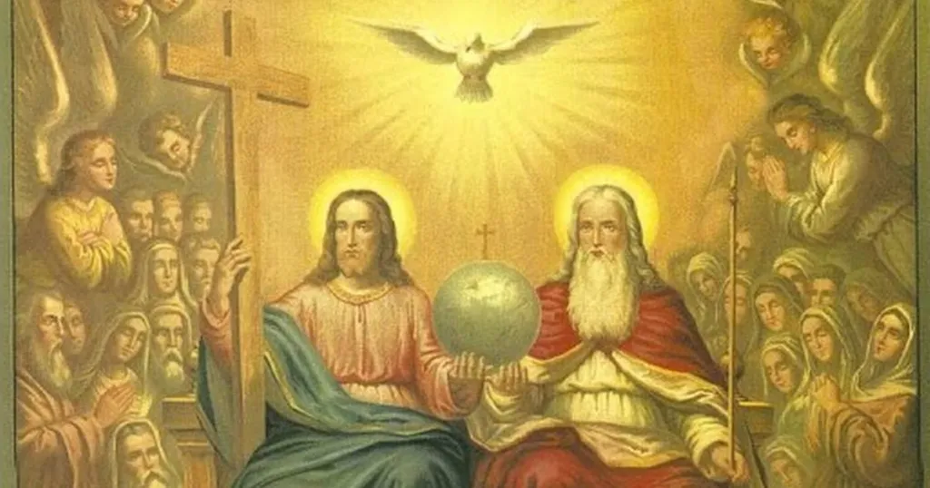

Slide 13
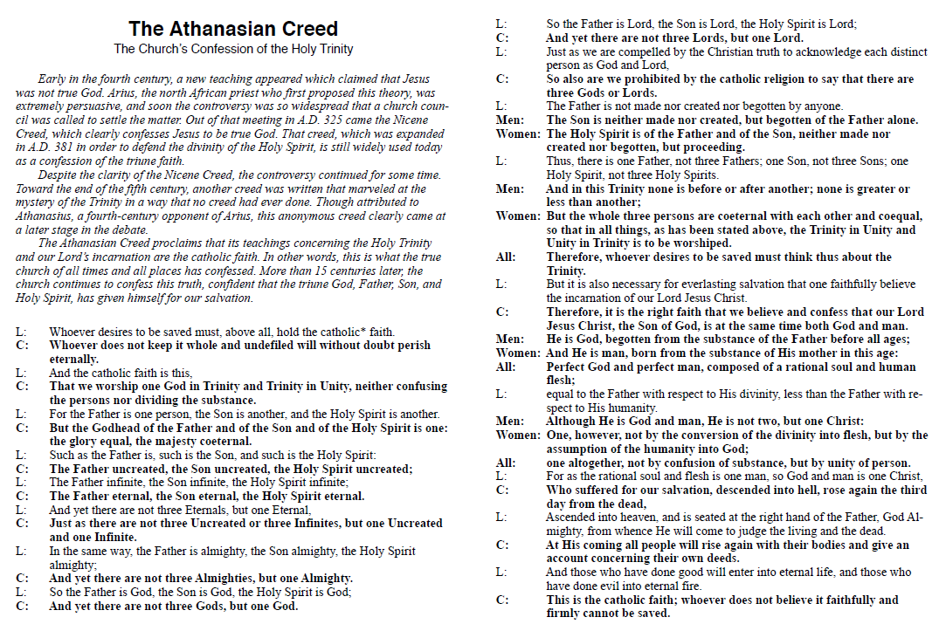

Slide 14
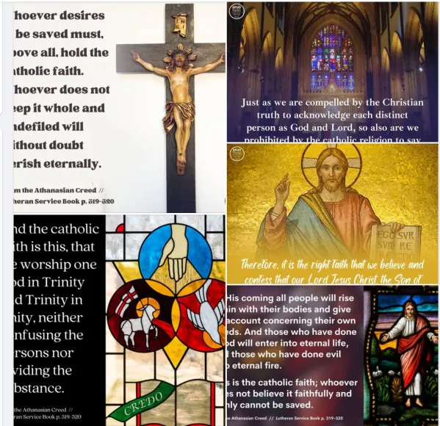

Slide 15
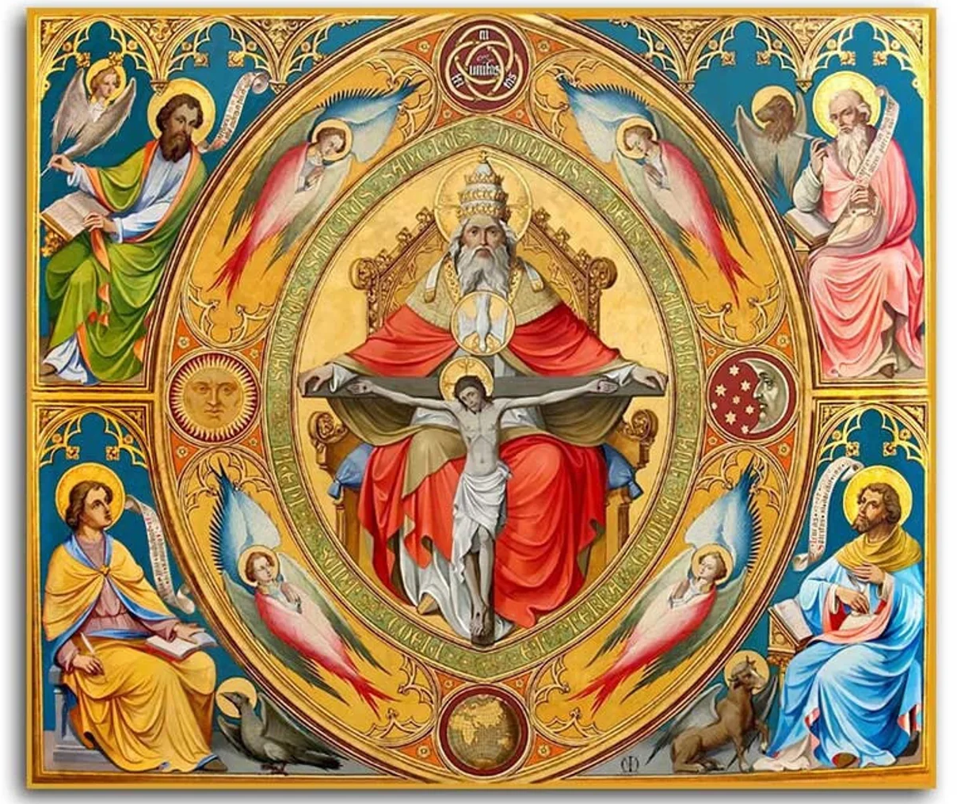

Slide 16
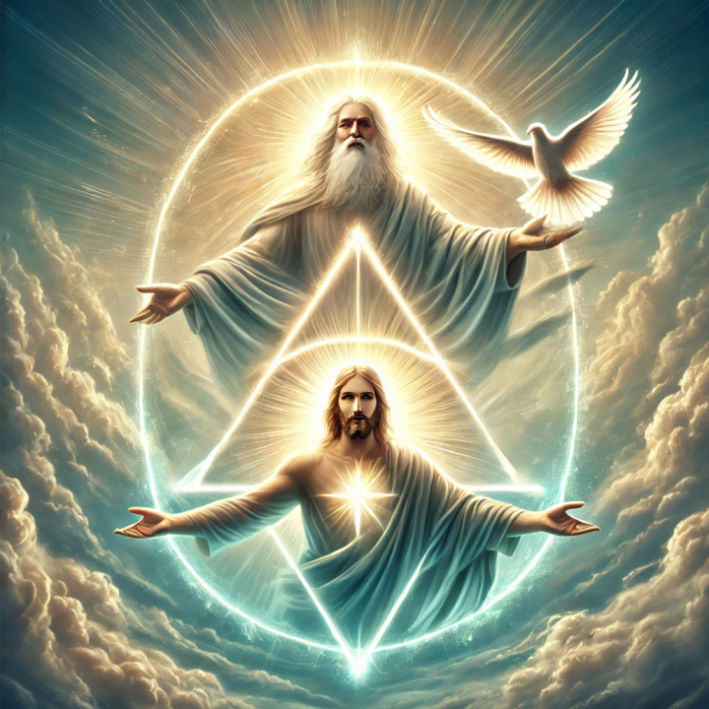

Slide 17
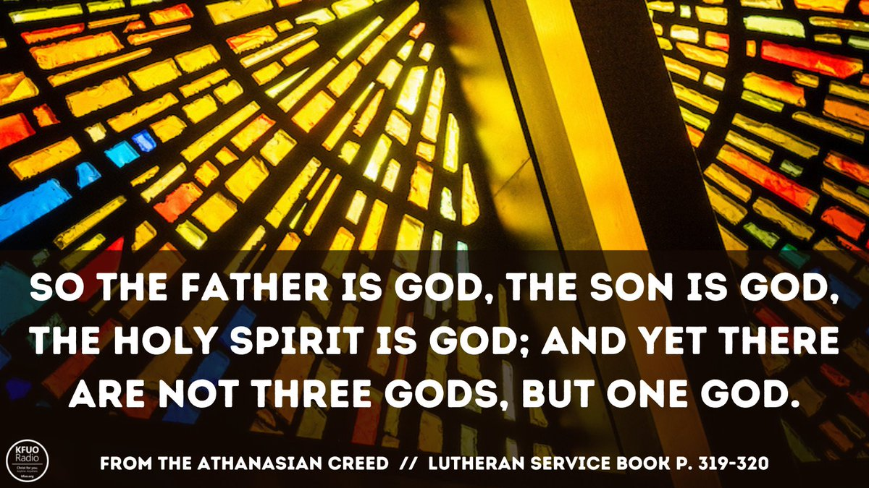

Slide 18
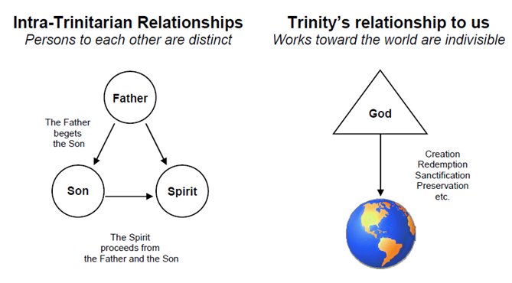

Slide 19
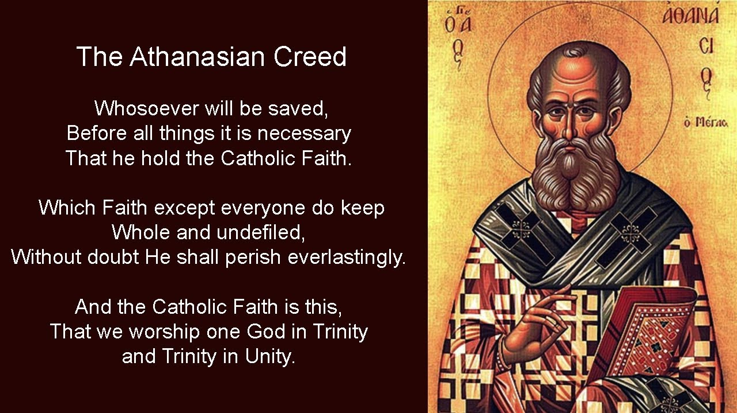

Slide 20
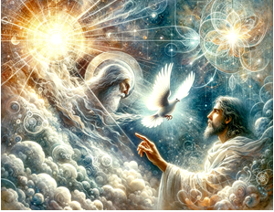

Slide 21
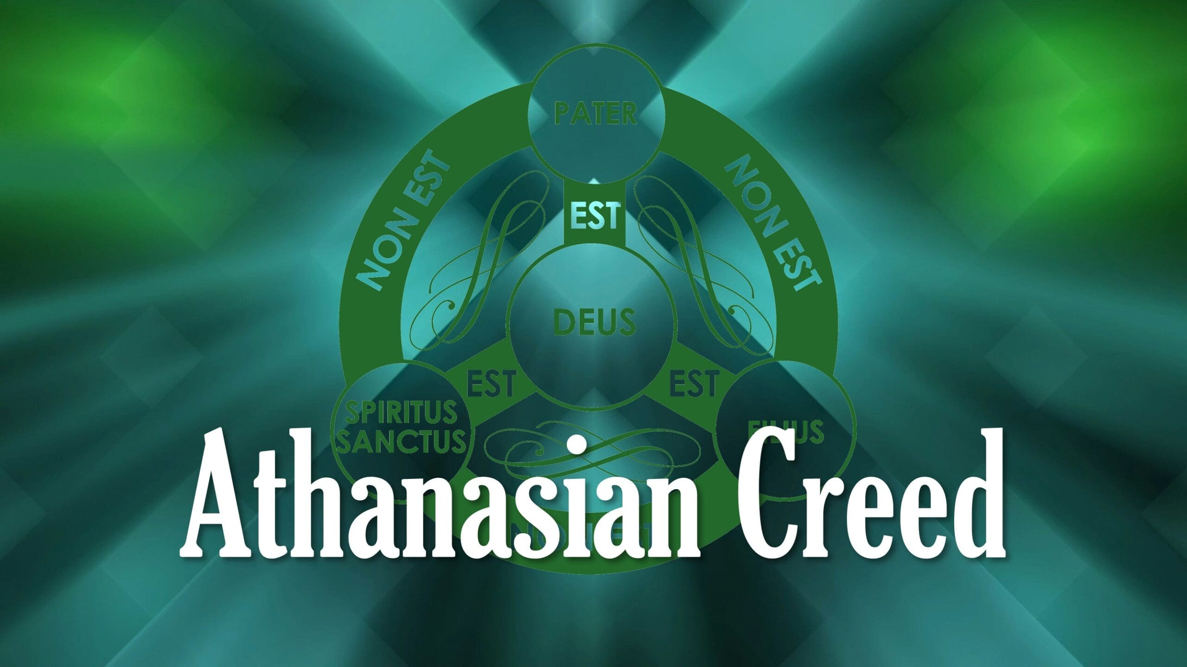

Slide 22
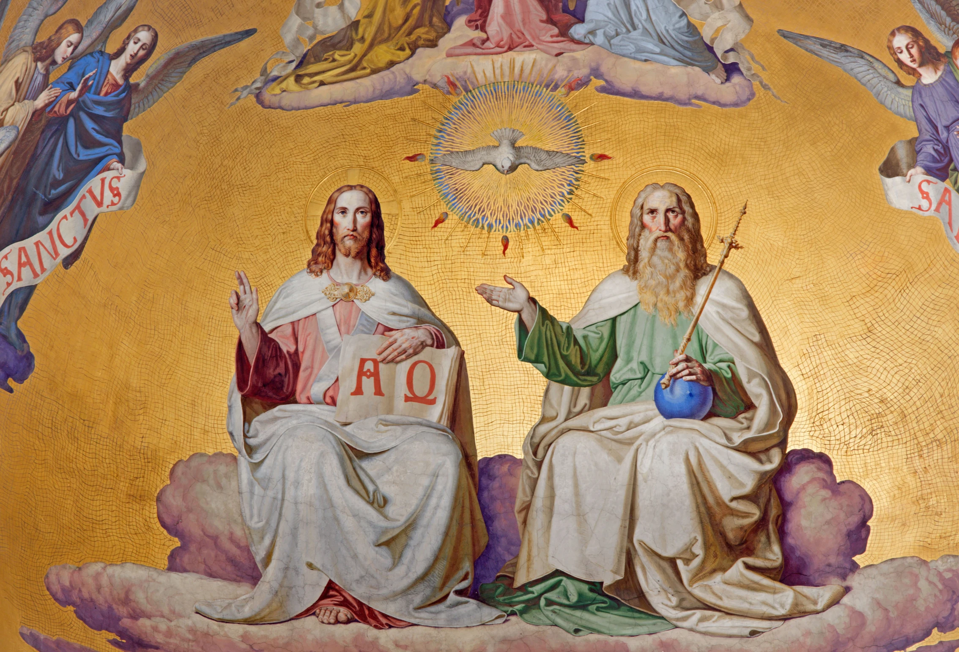

Slide 23
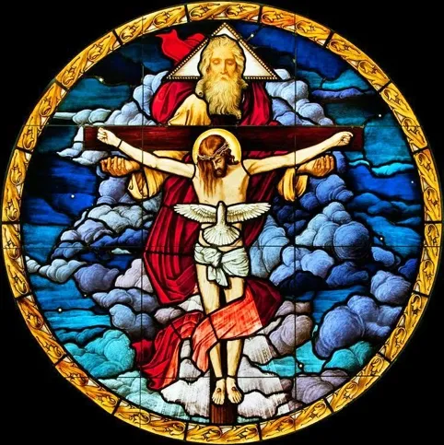

Slide 24
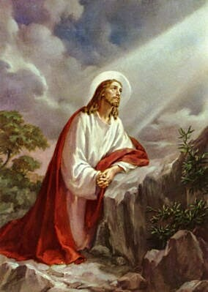
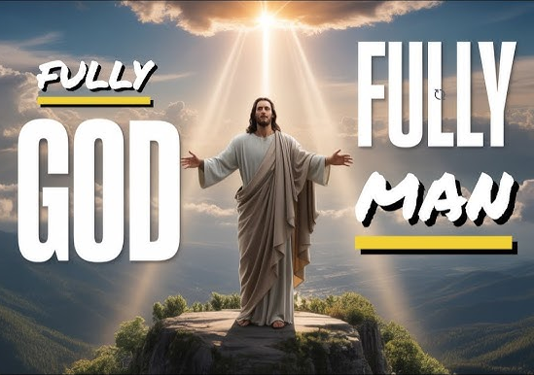

Slide 25
18) It is necessary for eternal salvation that one also faithfully believes that our Lord Jesus Christ became flesh.
Shifting from the Trinity the creed now addresses the humanity of the second person of the Godhead. It was indeed necessary that Christ would become like us that we might become like Him. In other words, because of sin and God’s eternal decree, Christ had to become a man to live the perfect life that was required by God in order to atone for the sin and lack of perfection in mankind.
(Matthew 1:23; John 1:14; 3:18; 6:40;
Acts 13:38; Galatians 4:4; Philippians 2:6–8;
1 Timothy 2:5–6; 3:16)

Slide 26
19) For this is the true faith that we believe and confess: That our Lord Jesus Christ, God's Son, is both God and man.
Just as Scripture states, Jesus is Immanuel… God with us. This begins the portion of the creed addressing the remarkable truth that is the hypostatic union, which will extend through sentence 24.
(Matthew 1:23; 3:17; 10:32–33; 17:5; Luke 2:11;
John 1:14; 3:18; 6:40; 8:58;
Acts 13:38; Romans 10:9; Galatians 4:4; Philippians 2:5–11; Colossians 3:17;
1 Timothy 2:5–6; 3:16;
Hebrews 5:5; 1 Peter 3:15; 2 Peter 1:17)

Slide 27
20) He is God, begotten before all worlds from the being of the Father, and he is man, born in the world from the being of his mother -- existing fully as God, and fully as man with a rational soul and a human body; equal to the Father in divinity, subordinate to the Father in humanity.
This sentence states the biblical truth that Christ both displays his divinity and humanity in the single person of Jesus.
(Luke 2:52; 24:39;
John 1:1–3, 14; 5:23; 7:29; 10:30;
11:35; 16:15; 17:24; 19:33–34;
Romans 1:3; Galatians 4:4; Colossians 1:16)

Slide 28
THE LARGE CATECHISM: ARTICLE II –
Note: God withholds nothing from us, but gives all that we need for our life on earth. Even more, He gives us all that we need for eternal life with Him in heaven. Luther focuses on the one phrase he believes is the very essence of this article: “in Jesus Christ, . . . our Lord.” Providing a sweeping description of creation and the fall, Luther notes that the word “we” includes every single person in the horrible drama of the Garden of Eden. In that sin we all fell away from God and were doomed to everlasting damnation. Yet Christ, our Lord, came and snatched us from the jaws of hell. This description of Christ’s victory over Satan would have been very familiar to the people who first read the Large Catechism. Many paintings from that era depict hell with horrifying detail, showing men and women being led into the gaping mouth of a dragonlike creature. Luther uses the biblical motif of Christ as Victor to describe His work of salvation for us. Jesus offered His own precious blood as satisfaction for our sins. This article of the Creed is essential for proper understanding and confession of the Gospel.

Slide 29
[25] And in Jesus Christ, His only Son, our LORD, who was conceived by the Holy Spirit, born of the virgin Mary, suffered under Pontius Pilate, was crucified, died and was buried. He descended into hell. The third day He rose again from the dead. He ascended into heaven and sits at the right hand of God the Father Almighty. From thence He will come to judge the living and the dead.
[26] Here we learn to know the Second Person of the Godhead. We see what we have from God over and above the temporal goods mentioned before. We see how He has completely poured forth Himself [Matthew 26: 28] and withheld nothing from us [2 Corinthians 8: 9]. Now, this article is very rich and broad. But in order to explain it briefly also and in a childlike way, we shall take up one phrase and sum up the entire article. As we have said, we may learn from this article how we have been redeemed. We shall base this on these words, “In Jesus Christ, our Lord.”
[27] Now, if you are asked, “What do you believe in the Second Article about Jesus Christ?” answer briefly, “I believe that Jesus Christ, God’s true Son, has become my Lord.” “But what does it mean to become Lord?” “It is this. He has redeemed me from sin, from the devil, from death, and from all evil. For before I did not have a Lord or King, but was captive under the devil’s power, condemned to death, stuck in sin and blindness” [see Ephesians 2: 1– 3].

Slide 30
[28] For when we had been created by God the Father and had received from Him all kinds of good, the devil came and led us into disobedience, sin, death, and all evil [Genesis 3]. So we fell under God’s wrath and displeasure and were doomed to eternal damnation, just as we had merited and deserved.
[29] There was no counsel, help, or comfort until this only and eternal Son of God— in His immeasurable goodness— had compassion upon our misery and wretchedness. He came from heaven to help us [John 1: 9].
[30] So those tyrants and jailers are all expelled now. In their place has come Jesus Christ, Lord of life, righteousness, every blessing, and salvation. He has delivered us poor, lost people from hell’s jaws, has won us, has made us free [Romans 8: 1– 2], and has brought us again into the Father’s favor and grace. He has taken us as His own property under His shelter and protection [Psalm 61: 3– 4] so that He may govern us by His righteousness, wisdom, power, life, and blessedness.

Slide 31
[31] Let this, then, be the sum of this article: the little word Lord means simply the same as redeemer. It means the One who has brought us from Satan to God, from death to life, from sin to righteousness, and who preserves us in the same. But all the points that follow in this article serve no other purpose than to explain and express this redemption. They explain how and by whom it was accomplished. They explain how much it cost Him and what He spent and risked so that He might win us and bring us under His dominion. It explains that He became man [John 1: 14], was conceived and born without sin [Hebrews 4: 15], from the Holy Spirit and from the virgin Mary [Luke 1: 35], so that He might overcome sin. Further, it explains that He suffered, died, and was buried so that He might make satisfaction for me and pay what I owe [1 Corinthians 15: 3– 4], not with silver or gold, but with His own precious blood [1 Peter 1: 18– 19]. And He did all this in order to become my Lord. He did none of these things for Himself, nor did He have any need for redemption. After that He rose again from the dead, swallowed up and devoured death [1 Corinthians 15: 54], and finally ascended into heaven and assumed the government at the Father’s right hand [1 Peter 3: 22]. He did these things so that the devil and all powers must be subject to Him and lie at His feet [Hebrews 10: 12– 13] until finally, at the Last Day, He will completely divide and separate us from the wicked world, the devil, death, sin, and such [Matthew 25: 31– 46; 13: 24– 30, 47– 50].
[32] To explain all these individual points does not belong to brief sermons for children. That belongs to fuller sermons that extend throughout the entire year, especially at those times that are appointed for the purpose of treating each article at length— for Christ’s birth, sufferings, resurrection, ascension, and so on. [33] Yes, the entire Gospel that we preach is based on this point, that we properly understand this article as that upon which our salvation and all our happiness rests. It is so rich and complete that we can never learn it fully.

