Slide 1
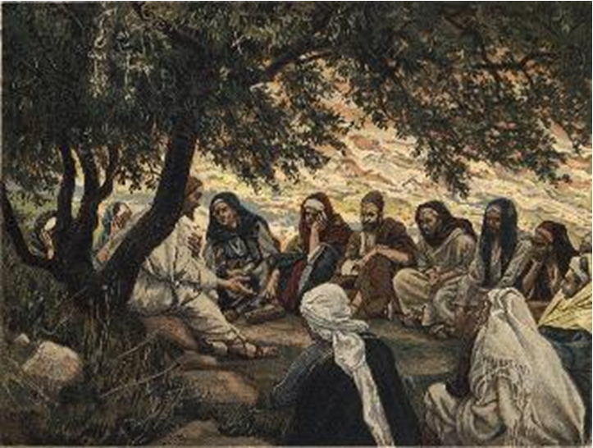
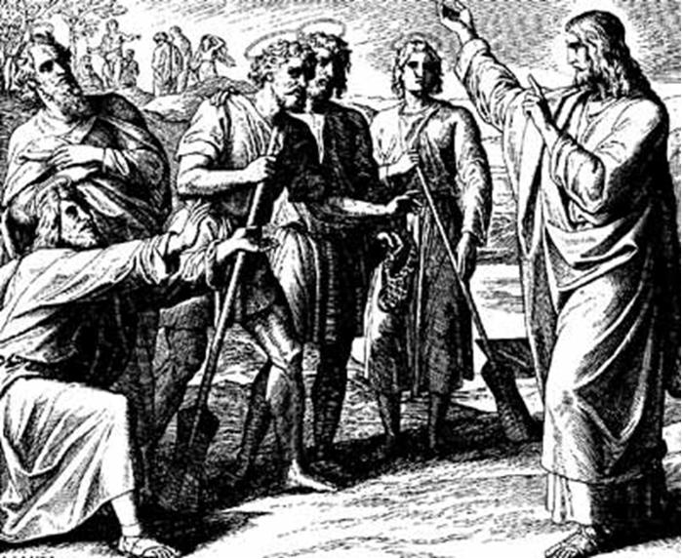
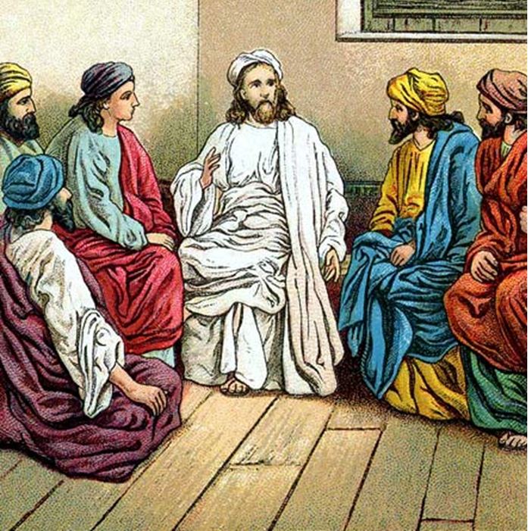
“The Apostles, Nicene and Athanasian Creeds
The Truth about the Trinity”
-The Ecumenical Creeds as Summaries
About Who God Is,
Versus False Religions and Cults-
Part 3 - A Bible Study of the Athanasian Creed
Trinity Lutheran Church LCMS Norman, OK. Pastor David Nehrenz
Lesson 11 – November 30, 2025

Slide 2
The Three Ecumenical Creeds
Lutheran Church - Missouri Synod adheres to the three Ecumenical Creeds. These creeds are succinct yet accurate statements of the true Christian faith.
Among the major doctrines confessed in the creeds are:
• the eternal and triune natures of God,
• the dual nature of Christ Jesus (being both fully God and fully man),
• the working of faith in believers by the Holy Spirit,
• the resurrection of the dead on the last day,
• the return of Christ Jesus in judgement, and
• everlasting life in heaven for those redeemed by the Grace of God through the working of the Holy Spirit and the innocent suffering and death & true resurrection of our Lord Jesus Christ on the third day.
1. The Apostle's Creed
The Nicene Creed
The Athanasian Creed

Slide 3
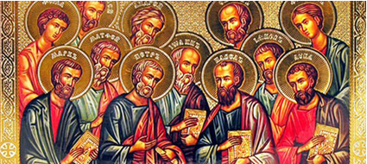

Slide 4
The Apostles’ Creed (ca AD 150-750)
The Apostles' Creed is the oldest. Already by 150 A.D. this creed was in use at Christian centers all along the Mediterranean Sea, such as Jerusalem, Alexandria (North Africa), Rome, and even Spain. The Apostles' Creed developed in conjunction with Baptism. As the water was applied, the question would be asked: "Do you believe in God the Father? God the Son? etc." Very quickly the answer developed into what we now call the Apostles' Creed. It is often called the baptismal creed. In addition to its primary use at all baptisms, it is also very appropriate for use in daily devotions. Also known as the Baptismal Creed or the Roman Symbol. Its central doctrines are those of the Trinity and God the Creator. It has been called the Creed of Creeds because already by AD 150 it was employed at Christian centers all along the Mediterranean Sea, such as Jerusalem, Alexandria (North Africa), Rome, and even Spain. It is also used in daily devotions.

Slide 7
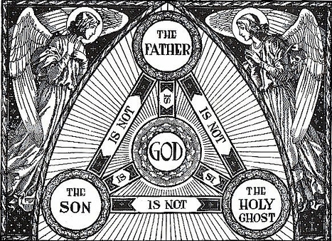

Slide 8
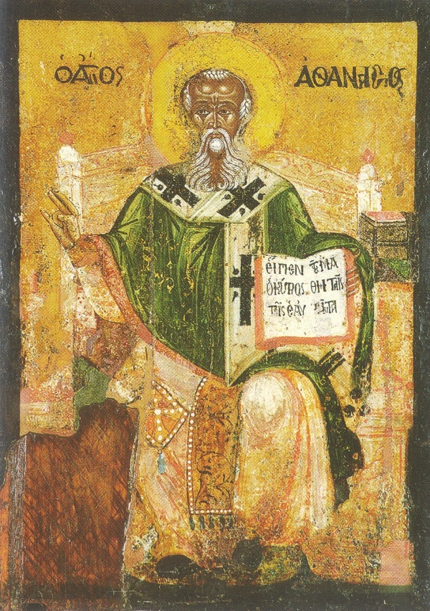

Slide 9
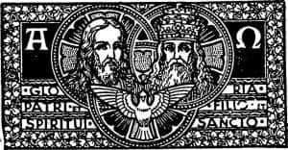

Slide 10
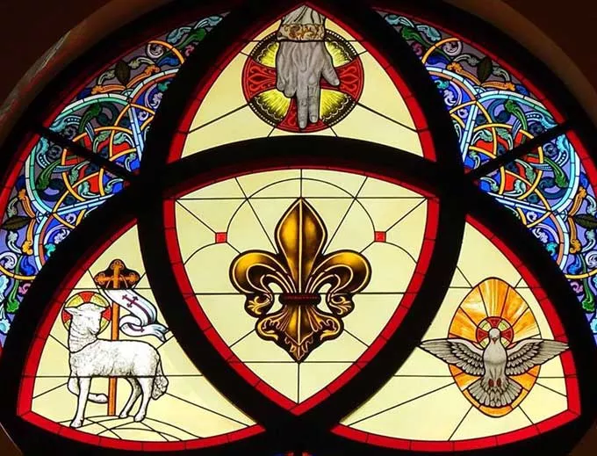

Slide 11
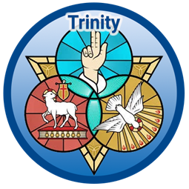

Slide 12
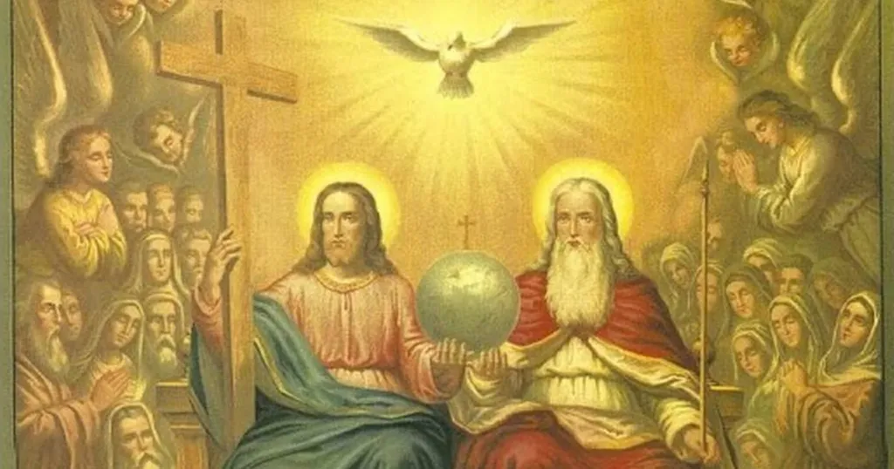

Slide 13
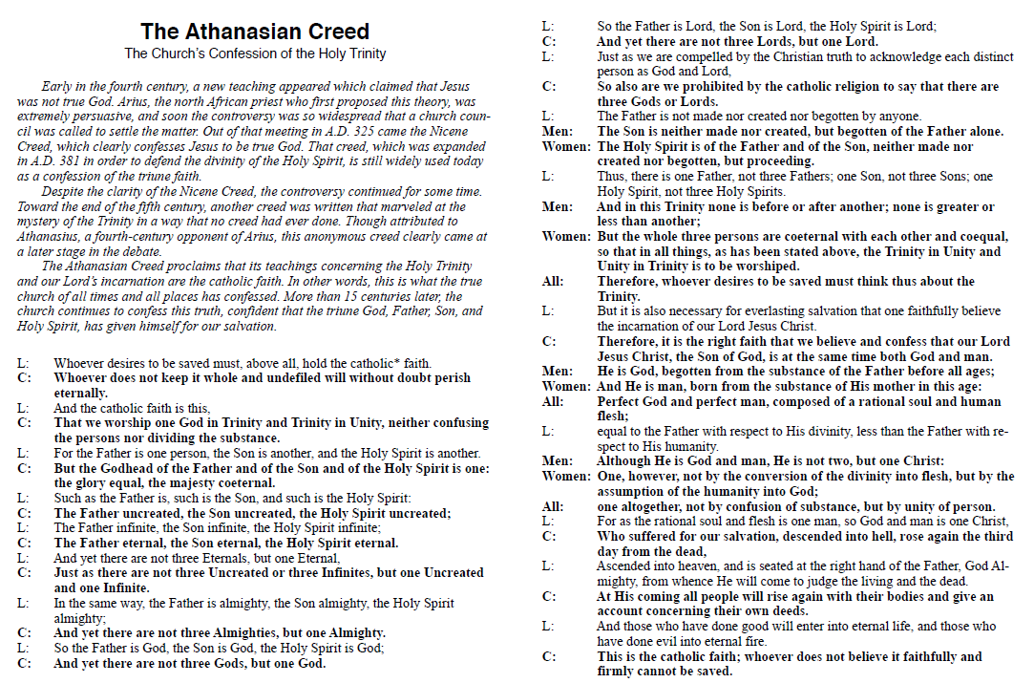

Slide 14
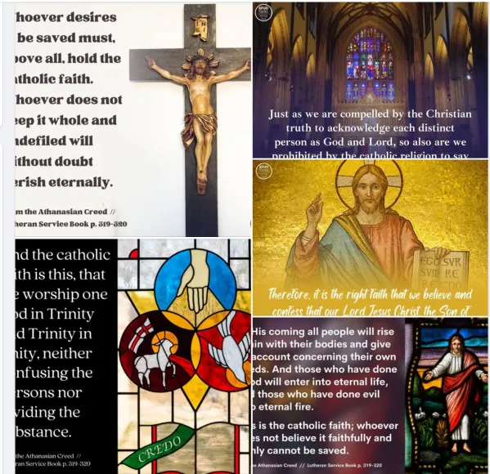

Slide 15
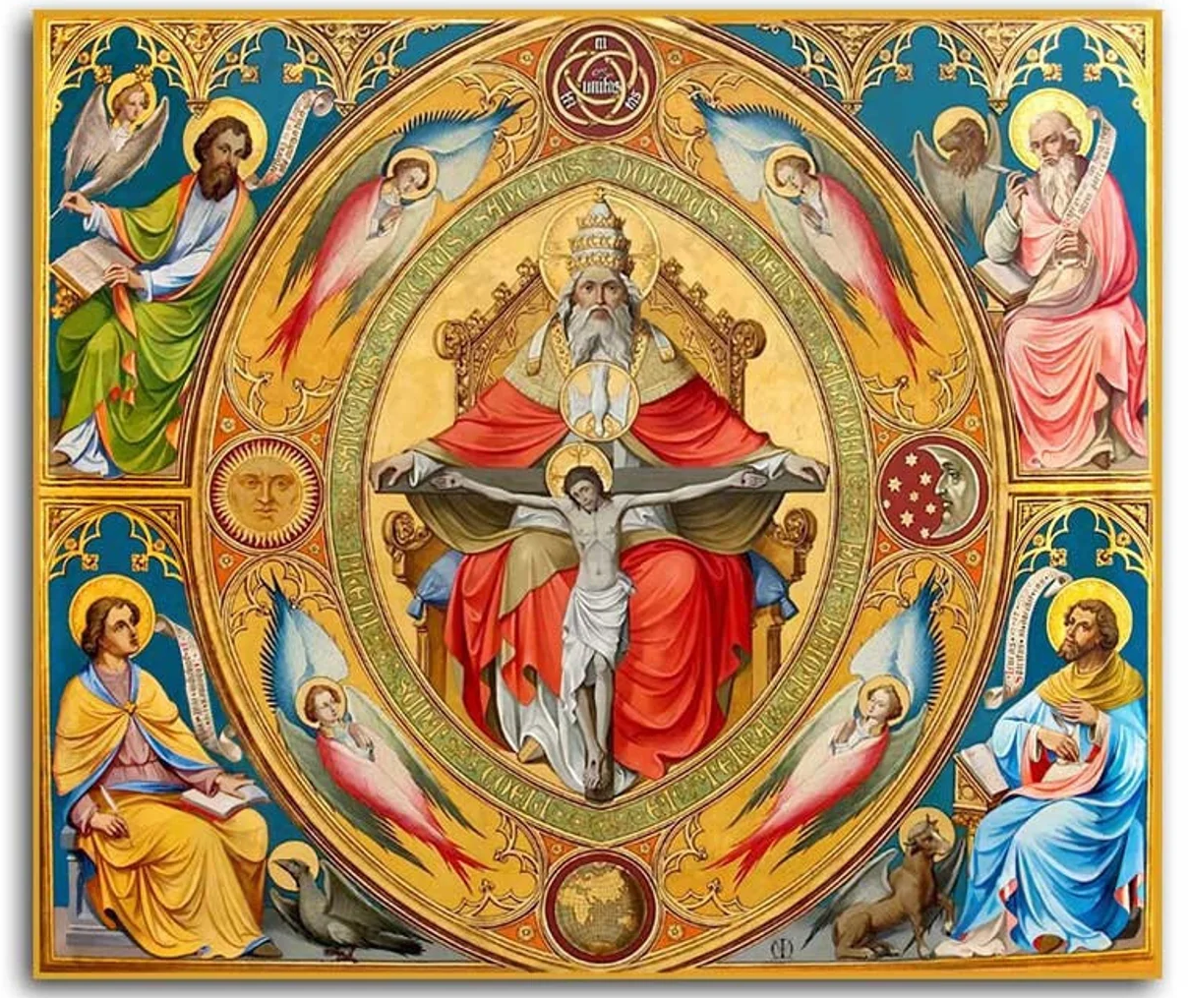

Slide 16
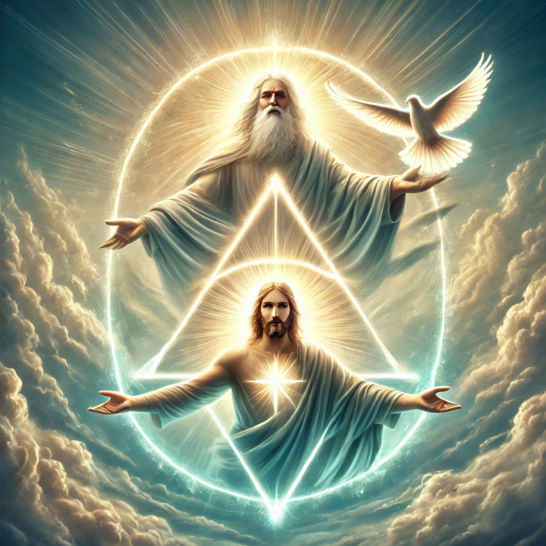

Slide 17
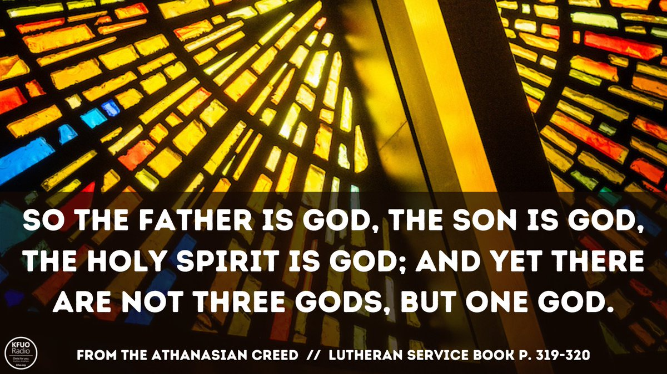

Slide 18
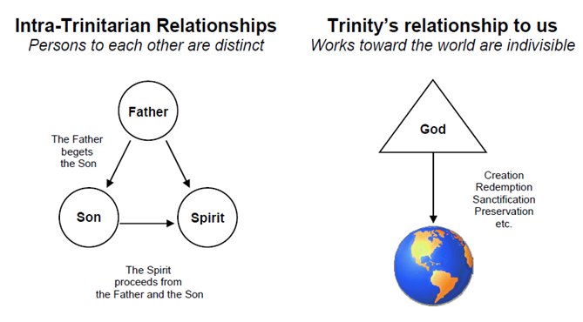

Slide 19
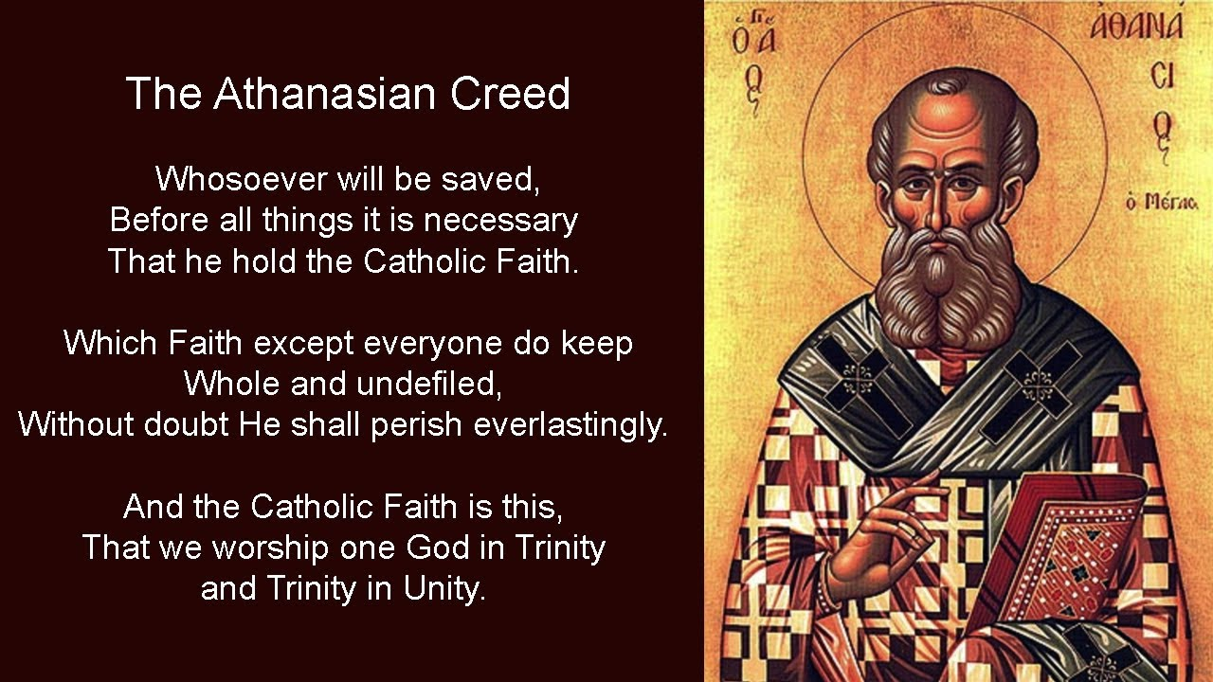

Slide 20
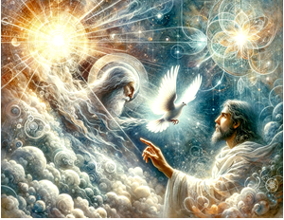

Slide 21


Slide 22
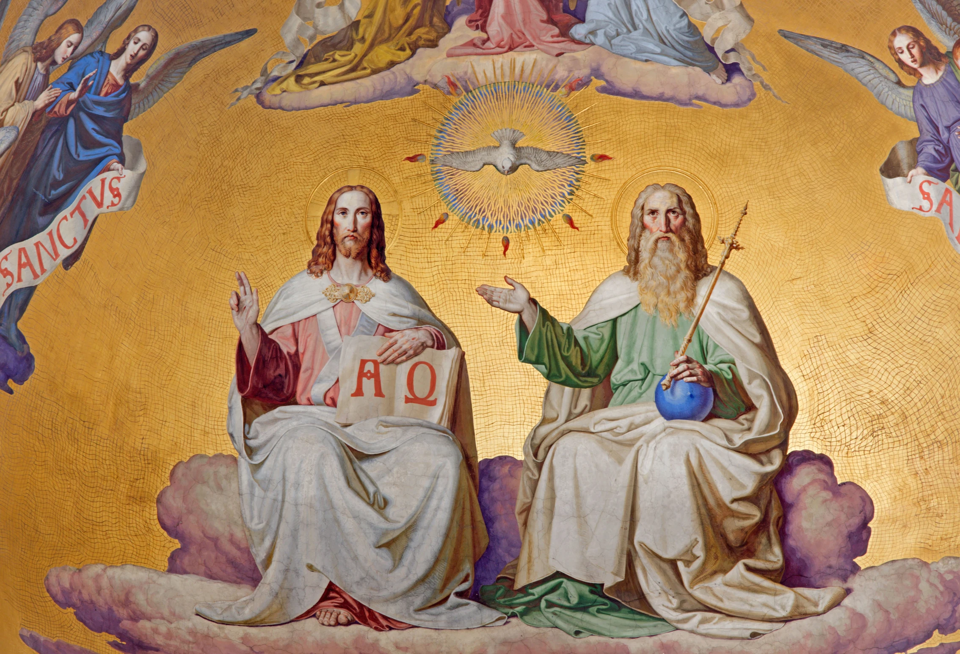

Slide 23
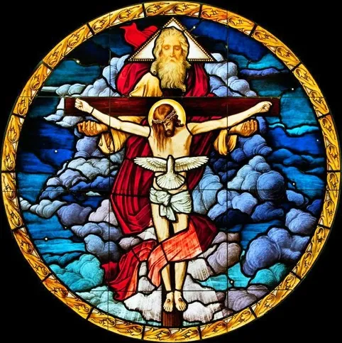

Slide 24
15) Thus there is one Father, not three fathers; one Son, not three sons; one Holy Spirit, not three spirits.
Each person of the Trinity is distinctly unique in his personhood, but each person wholly, fully, and entirely has the divine essence.
(Matthew 23:9; 1 Corinthians 12:13; Ephesians 4:4–6)

Slide 25
16) And in this Trinity, no one is before or after, greater or less than the other; but all three persons are in themselves, coeternal and coequal; and so we must worship the Trinity in unity and the one God in three persons.
Although distinct in their personhood and unique in their role and function as God, each person of the Godhead is equally one God and fully deserving of worship.
(John 1:1–2; 10:30; 16:14–15; 17:5, 10;
Acts 5:3–4; 1 Corinthians 12:11; Ephesians 4:4–6;
Hebrews 9:14)

Slide 26
17) Whoever wants to be saved should think thus about the Trinity.
Right beliefs in the profound truths of the glorious Gospel of the Triune God
are necessary for salvation.
(Matthew 28:19–20; John 3:18, 36; 8:34; Romans 3:28)

Slide 27
Of God – LCMS Brief Statement
On the basis of the Holy Scriptures we teach the sublime article of the Holy Trinity; that is, we teach that the one true God, Deut. 6:4; 1 Cor. 8:4, is the Father and the Son and the Holy Ghost, three distinct persons, but of one and the same divine essence, equal in power, equal in eternity, equal in majesty, because each person possesses the one divine essence entire, Col. 2:9, Matt. 28:19. We hold that all teachers and communions that deny the doctrine of the Holy Trinity are outside the pale of the Christian Church. The Triune God is the God who is gracious to man, John 3:16-18, 1 Cor. 12:3. Since the Fall, no man can believe in the "fatherhood" of God except he believe in the eternal Son of God, who became man and reconciled us to God by His vicarious satisfaction, 1 John 2:23; John 14:6. Hence we warn against Unitarianism, which in our country has to a great extent impenetrated the sects and is being spread particularly also through the influence of the lodges.
https://www.lcms.org/about/beliefs/doctrine/brief-statement-of-lcms-doctrinal-position#god

Slide 28
Rev. Paul A. Rydecki Emmanuel Lutheran Church Las Cruces, NM
But the true God—God the Father—gave His Son to the world, to mankind, to be lifted up on the cross, to bear the sins of mankind, to suffer the condemnation we should have suffered, to be righteous where we were unrighteous, to be our Substitute before the throne of divine justice that we might approach the Throne of Grace with confidence, that we should repent of our sins and believe in the Son of Man, Jesus Christ, in order not to perish for our sins, but to live eternally with this Holy Trinity.
But even faith itself is beyond our power. So how does God bring us to God? How does God bring us to faith and give us entrance into His heavenly kingdom? Through the work of His Holy Spirit. Unless one is born of water and the Spirit, he cannot enter the kingdom of God. That which is born of the flesh is flesh, and that which is born of the Spirit is spirit. So this Person of the Trinity, the Holy Spirit, is the one responsible for giving new birth to spiritually dead sinners. And He uses water to do it, of all things! The water included in God’s command and connected to God’s word, the water of Holy Baptism, which is the washing of regeneration and renewing of the Holy Spirit, as Paul wrote in Titus chapter 3.
The Holy Spirit proceeds from the Father and the Son. He is responsible for the inspiration of the Holy Scriptures. He is powerfully working in the Christian Church through the preaching of the Word and the administration of the Sacraments to break through stony hearts, to raise the spiritually dead to life, to convert the lost from unbelief to faith in Christ, to comfort Christians, to strengthen and to guide us, and to preserve us in the true faith until the end.

Slide 29
That’s who our God is. That’s what we’re “compelled by the Christian verity” to acknowledge and moved by the Holy Spirit to believe. To believe in the Father, who loved the world and sent His Son. To believe in the Son, who was sent from the Father and came down from heaven that He might be lifted up on the cross as our Savior. To believe in the Spirit, who proceeds from Father and Son, who works through Word and Sacrament to give faith and new birth. To believe in Father, Son and Spirit as three distinct Persons, and yet not as three gods, but as one God who is zealous for the salvation of the human race that He created.
In fact, we are so bold as to confess in the Athanasian Creed that “whoever wants to be saved, before all things it is necessary that he hold” this catholic faith, that is, this faith that is common to all who are rightfully called Christians. Because unless you know these basic truths about who God is, you don’t know God, and if you don’t know Him, you can’t trust in Him.
We’ve attempted to simply the doctrine of the Holy Trinity this morning, so that all can see that all the things you need to know and understand and believe for your salvation have been placed within your reach by the Holy Spirit.
It’s a gift to be able to know God in His simplicity and to study the things He’s revealed to us about Himself and to study what His beloved Church has confessed about Him through the ages. But in the end, whether it’s His triune nature or His unfathomable ways, we’re still left with our jaws dropped in awe and wonder, amazed at all the things we don’t understand about God and just as amazed at the things we do. And all that’s left is to say with the Apostle Paul: Oh, the depth of the riches both of the wisdom and knowledge of God! … For of Him and through Him and to Him are all things, to whom be glory forever. Amen.
https://www.godwithuslc.org/the-doctrine-of-the-holy-trinity-simplified/

