Slide 1
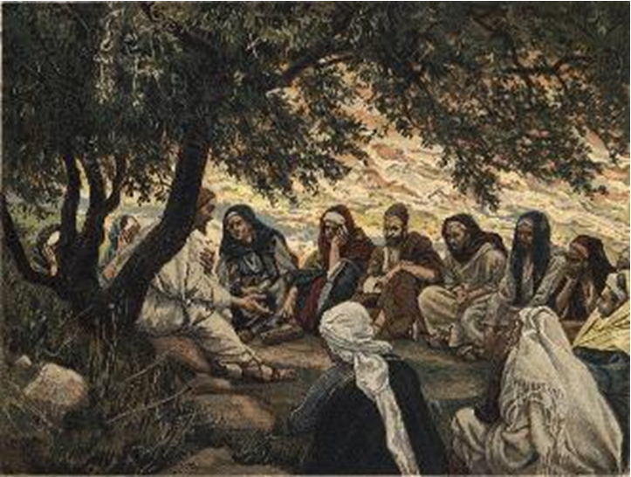
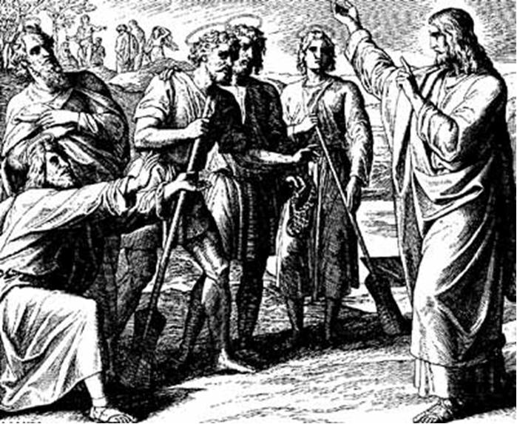
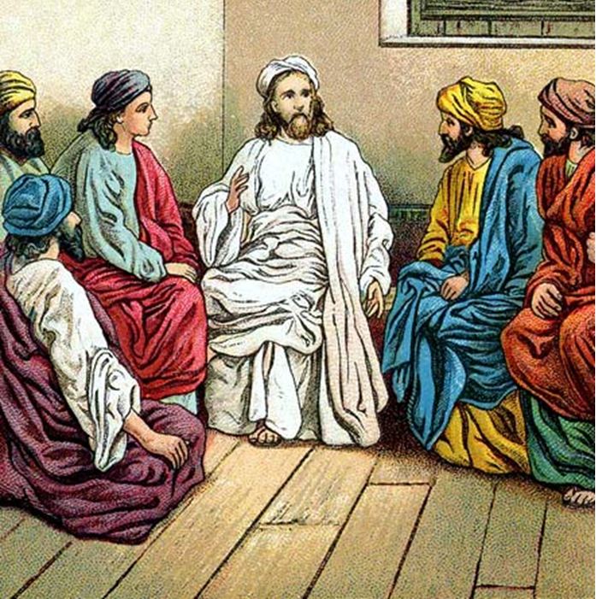
“The Apostles, Nicene and Athanasian Creeds
The Truth about the Trinity”
-The Ecumenical Creeds as Summaries
About Who God Is,
Versus False Religions and Cults-
Part 3 - A Bible Study of the Athanasian Creed
Trinity Lutheran Church LCMS Norman, OK. Pastor David Nehrenz
Lesson 10 – November 23, 2025

Slide 2
  The Three Ecumenical Creeds
  Lutheran Church - Missouri Synod adheres to the three Ecumenical Creeds. These creeds are succinct yet accurate statements of the true Christian faith.
  Among the major doctrines confessed in the creeds are:
  • the eternal and triune natures of God,
  • the dual nature of Christ Jesus (being both fully God and fully man),
  • the working of faith in believers by the Holy Spirit,
  • the resurrection of the dead on the last day,
  • the return of Christ Jesus in judgement, and
  • everlasting life in heaven for those redeemed by the Grace of God through the working of the Holy Spirit and the innocent suffering and death & true resurrection of our Lord Jesus Christ on the third day.
  1. The Apostle's Creed
  The Nicene Creed
  The Athanasian Creed

Slide 3
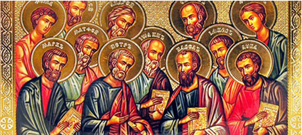

Slide 4
The Apostles’ Creed (ca AD 150-750)
The Apostles' Creed is the oldest. Already by 150 A.D. this creed was in use at Christian centers all along the Mediterranean Sea, such as Jerusalem, Alexandria (North Africa), Rome, and even Spain. The Apostles' Creed developed in conjunction with Baptism. As the water was applied, the question would be asked: "Do you believe in God the Father? God the Son? etc." Very quickly the answer developed into what we now call the Apostles' Creed. It is often called the baptismal creed. In addition to its primary use at all baptisms, it is also very appropriate for use in daily devotions. Also known as the Baptismal Creed or the Roman Symbol. Its central doctrines are those of the Trinity and God the Creator. It has been called the Creed of Creeds because already by AD 150 it was employed at Christian centers all along the Mediterranean Sea, such as Jerusalem, Alexandria (North Africa), Rome, and even Spain. It is also used in daily devotions.

Slide 7
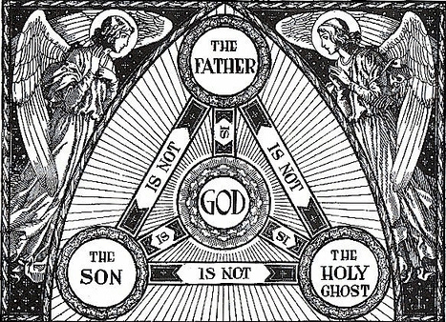

Slide 8
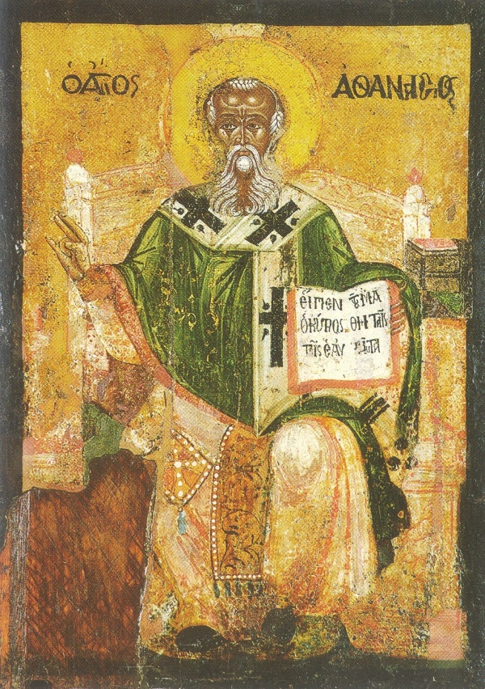

Slide 9
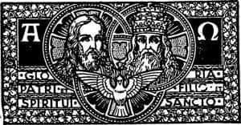

Slide 10
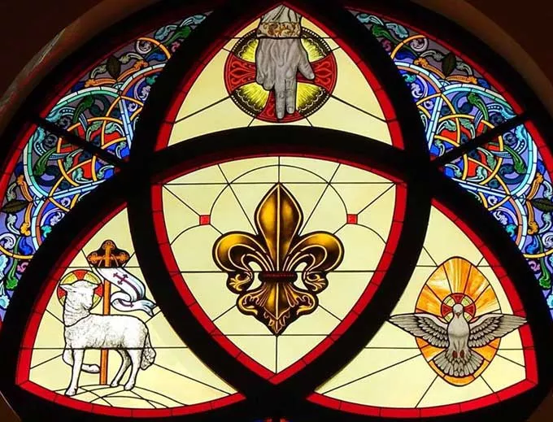

Slide 11
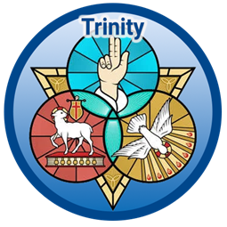

Slide 12
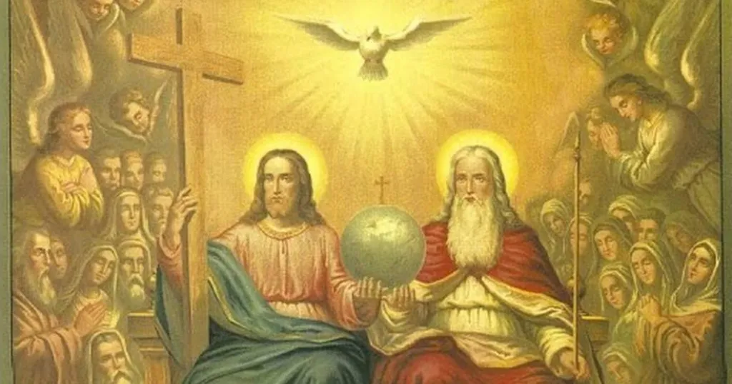

Slide 13
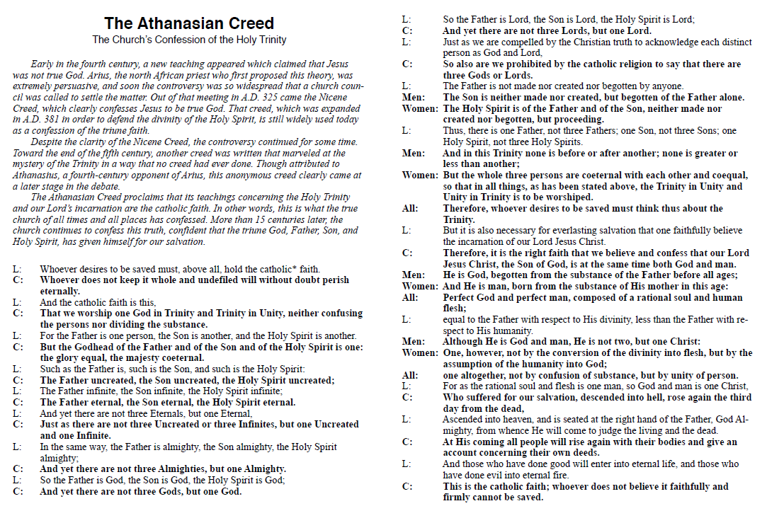

Slide 14
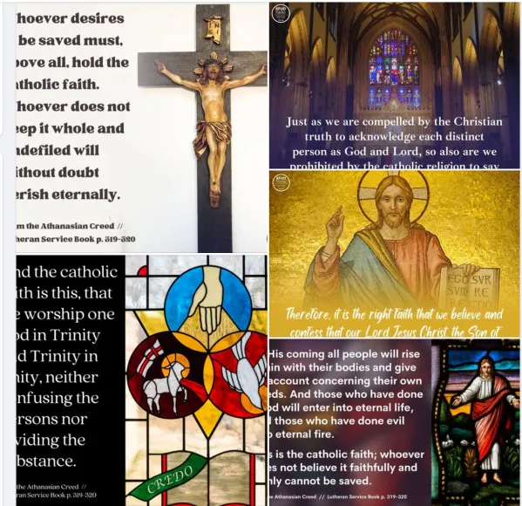

Slide 15
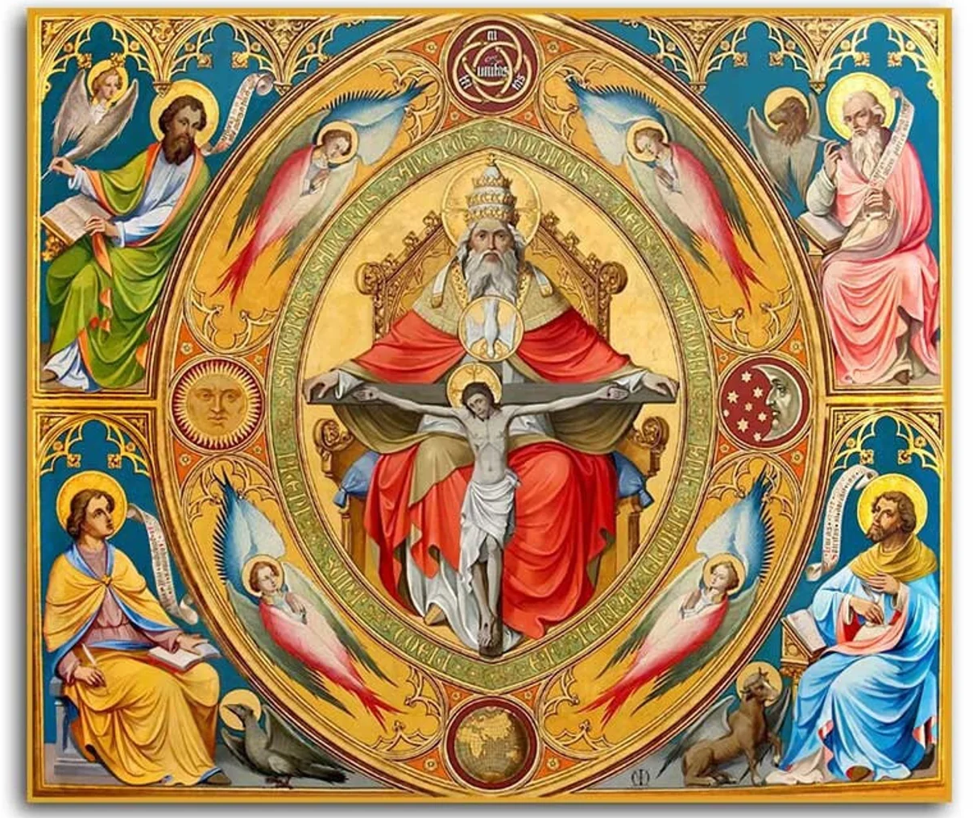

Slide 16
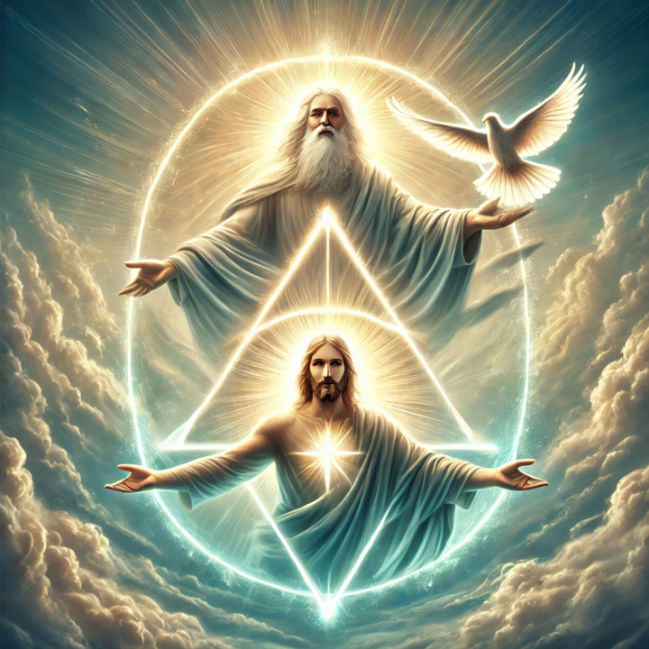

Slide 17
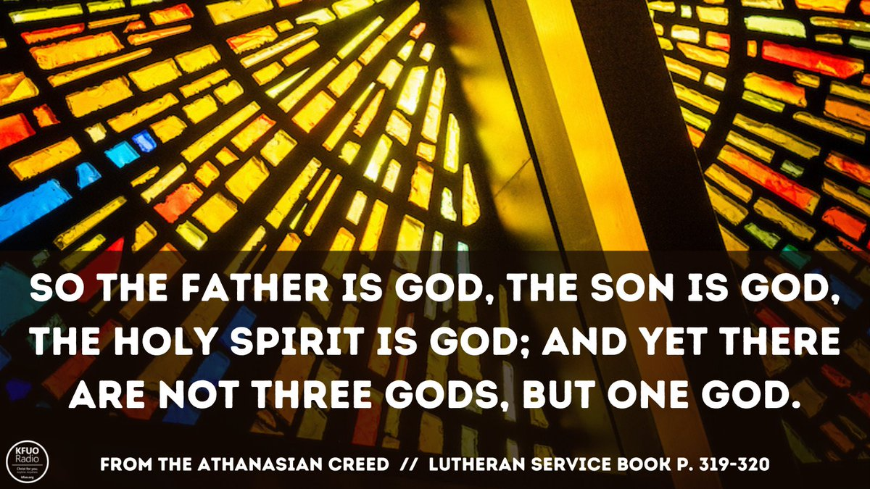

Slide 18
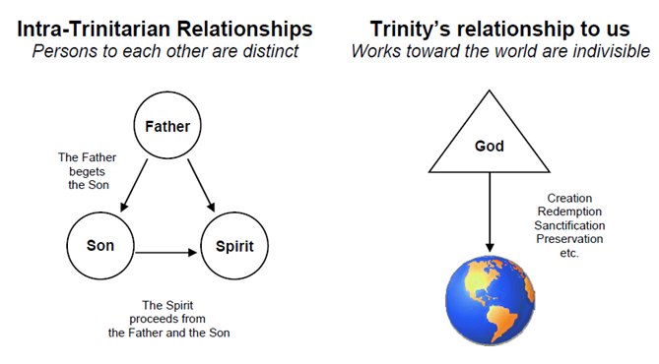

Slide 19
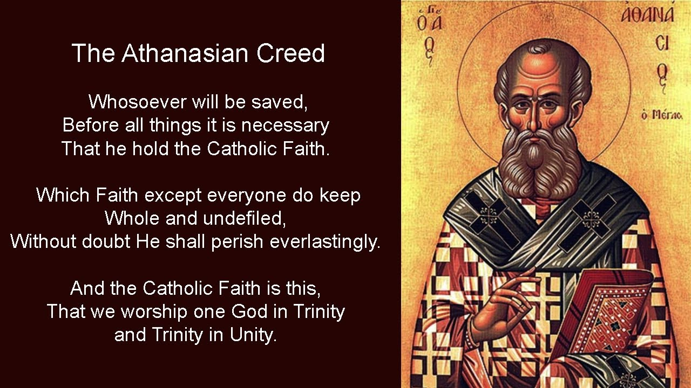

Slide 20
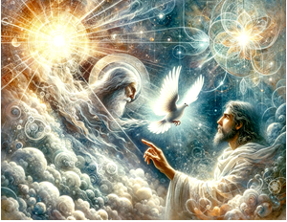

Slide 21


Slide 22
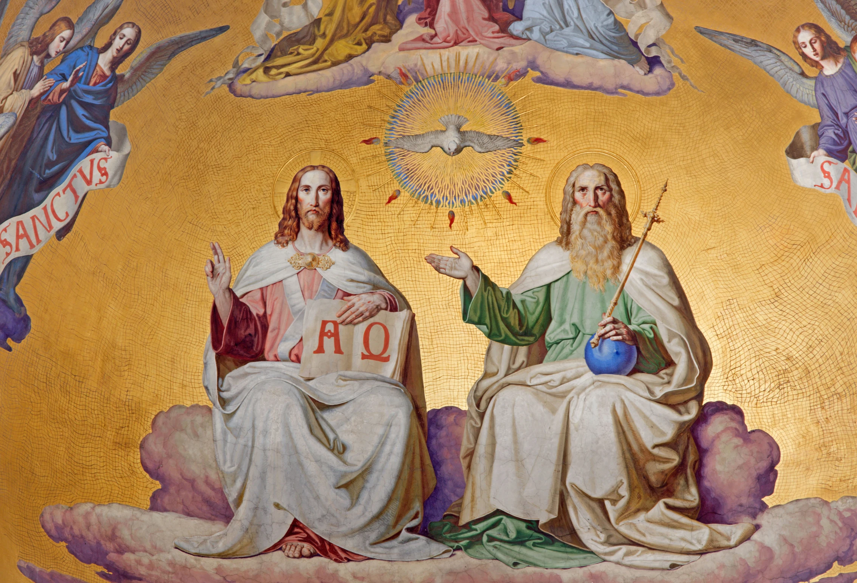

Slide 23
13) As Christian truth compels us to acknowledge each distinct person as God and Lord, so catholic religion forbids us to say that there are three gods or lords.
As mentioned before, the use of the word “catholic” refers to the “whole” or “universal” Christian religion. The bible clearly present the doctrine of the Trinity, therefore those faithful to the Word of God must accept this doctrine that states there is one God
and three distinct persons exists as one God.

Slide 24
14) The Father was neither made nor created nor begotten; the Son was neither made nor created, but was alone begotten of the Father; the Spirit was neither made nor created, but is proceeding from the Father and the Son.
The Triune-God is the Creator of all things therefore He cannot be created. The persons of the Godhead are therefore uncreated yet each maintains a certain distinctiveness of their eternality. This sentence addresses the relational order of the Godhead
while still affirming the ontological or essential unity.
(Genesis 1:1; Deuteronomy 33:27; Job 38:4; Isaiah 9:6;
John 1:14,18; 3:16,18; 5:26; 14:26; 15:26; 16:7;
1 Corinthians 8:6; Ephesians 3:9; Colossians 1:16–17; 1 John 5:20; Revelation 4:11)

Slide 25
THE SPIRIT PROCEEDS FROM THE FATHER AND THE SON in Latin = “filioque”
The filioque is the teaching that the Holy Spirit proceeds from the Father and the Son together. That is to say, from all eternity the Holy Spirit has His origin from both the Father and the Son, and not from the Father alone. In John 15:26, Jesus calls the Holy Spirit “the Spirit of truth, who proceeds from the Father.” The word “proceeds” here doesn’t just mean that the Spirit comes from the Father into the world. It actually means that the Spirit originates in the Father. Another way that theologians will speak about this is to say that the Spirit is “breathed” by the Father (one meaning of the word “spirit” is “breath”). As human breath originates in the man who breathes, so the Holy Spirit originates in the Father who breathes Him forth. But the Father who breathes forth the Spirit is one God with His Son. This means that it is the Father and the Son together who as one God breathe forth the Spirit, eternally bringing Him into being.
It is important to keep this in mind when we think about the filioque. When all we say is that the Spirit “proceeds from the Father and the Son,” as we confess in the Nicene Creed, it’s easy to get the idea that the Father and the Son are to be seen as two different sources, as if each breathes on His own and their breath meets in a confluence that is the Holy Spirit. This, however, is not the teaching of the Lutheran Church. Rather, it is because “I and the Father are one” (John 10:30) that the Spirit proceeds from the Son as from the Father. He proceeds from them, not as from two distinct sources, but as from one God.

Slide 26
This is why the Scriptures can call the Holy Spirit the “Spirit of the Father” (Matt. 10:20), the “Spirit of His Son” (Gal. 4:6), and also the “Spirit of God” (Rom. 8:14). The Holy Spirit is the Spirit of both the Father and the Son because He is the Spirit of God. These, by the way, are only representative verses. There are many more that could be referenced in each category! It is also why the Scriptures speak of the Father sending the Son (John 20:21), and of the Father and the Son both sending the Spirit (John 14:26; John 15:26), but never of the Spirit sending the Son, and never of anyone sending the Father. What gives one divine person the authority to send another divine person? How can one person within the Godhead have authority over another? It’s not that the Father is greater in honor than the Son and the Spirit, or that the Father and the Son are greater in honor than the Spirit. No, they are all of equal honor and majesty, being all one God. What gives the Father authority to send the Son, and what gives the Father and the Son authority to send the Spirit, is their manner of origin, the ways in which they eternally come into being. The Father originates from no one, so He is under the authority of no one. The Son originates from the Father alone, so He is under the authority of the Father alone. The Spirit originates from the Father and the Son, so He is under the authority of the Father and the Son.
Finally, this relationship of origin and authority is why Jesus names the persons of the Trinity the way He does, commanding His Apostles to baptize “in the name of the Father and of the Son and of the Holy Spirit” (Matt. 28:19). Why did He not say, “In the name of the Son and of the Spirit and of the Father,” or some other order? Because there is a specific order within the Trinity, an order that is not due to honor or majesty or power or might, and can only therefore be due to origin. The Father originates from no one, so He is first; the Son originates from the Father alone, so He comes second; the Spirit originates from the Father and the Son, so He comes third. And yet together they are one God, sharing the one divine name.

Slide 27
It may be tempting to ask why any of this matters. What does it have to do with us? Well, the early Lutherans thought it mattered, and they were unwilling to compromise with the Greek Orthodox Church on this teaching. They thought it mattered because without distinguishing the persons of the Trinity in terms of origin, we would be forced to distinguish them in some other way, which would threaten their perfect equality within the Godhead. They thought it mattered because to deny that the Father shares with the Son the breathing forth of the Spirit is to suggest that the Father can do things without the Son, which threatens Jesus’ teaching that “I and the Father are one.” They thought it mattered simply because they found it to be taught in Holy Scripture, and whatever the Scriptures teach is important for us to learn. And they thought it mattered because it concerns the nature of God.
This last point is worthy of our special consideration. What could possibly be more important to us than our God? What could possibly matter more to us than the God who created, redeemed, and sanctified us? Contemplation of divine mysteries such as this may be difficult, but there is great blessing in recognizing that such contemplation soars far above the things of this world. Paradoxically, by having absolutely nothing to do with the frivolities of this earthly life, contemplation of the Holy Trinity is the most relevant thing imaginable to every one of us.
Never tire of studying God as He has revealed Himself to you in His Word. Never weary of contemplating His divine essence, nor of adoring the three Persons who desire above all else your salvation from sin and death and your eternal communion with God. After all, once we enter into the blessed life to come, the contemplation of God will still be an inexhaustible font of joy and gladness. Reflecting on the mystery of the Holy Trinity is to taste of heaven.
https://www.holycrossdav.org/may_2016
Holy Cross Evangelical Lutheran Church (LCMS) 1705 E. Locust St, Davenport, IA 52803
Pastor Neuendorf

