Slide 1
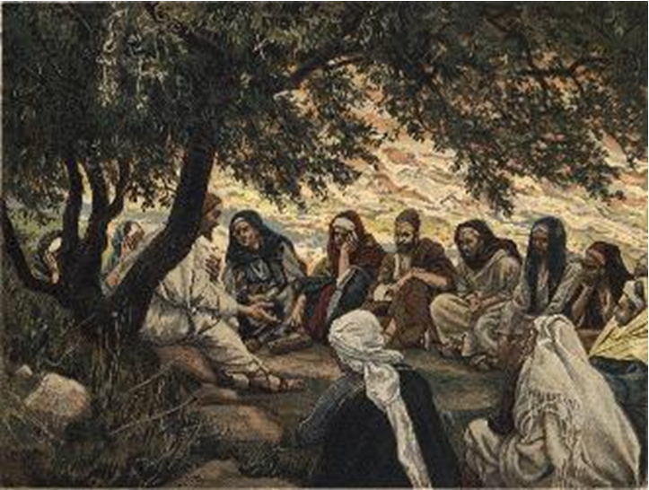
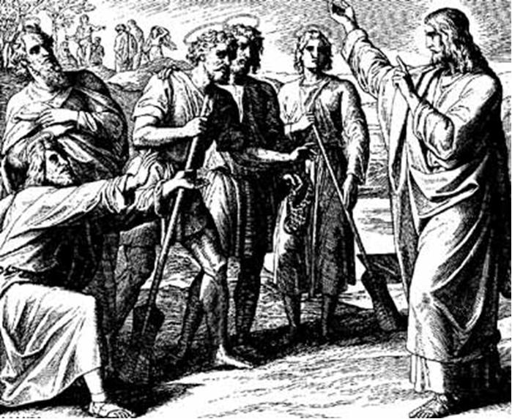
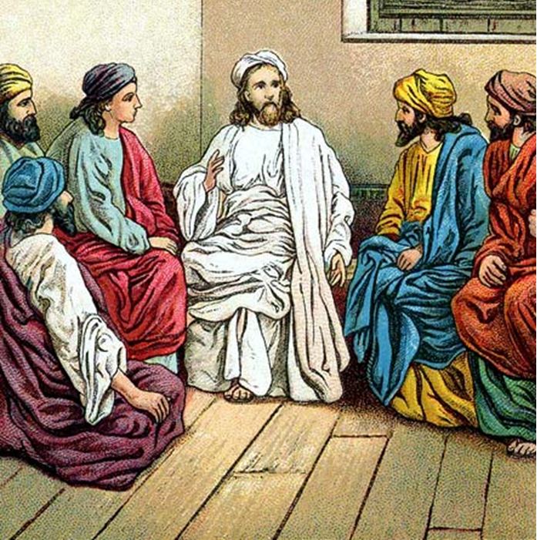
“The Apostles, Nicene and Athanasian Creeds
The Truth about the Trinity”
-The Ecumenical Creeds as Summaries
About Who God Is,
Versus False Religions and Cults-
Part 3 - A Bible Study of the Athanasian Creed
Trinity Lutheran Church LCMS Norman, OK. Pastor David Nehrenz
Lesson 9 – November 16, 2025

Slide 2
The Three Ecumenical Creeds
Lutheran Church - Missouri Synod adheres to the three Ecumenical Creeds. These creeds are succinct yet accurate statements of the true Christian faith.
Among the major doctrines confessed in the creeds are:
• the eternal and triune natures of God,
• the dual nature of Christ Jesus (being both fully God and fully man),
• the working of faith in believers by the Holy Spirit,
• the resurrection of the dead on the last day,
• the return of Christ Jesus in judgement, and
• everlasting life in heaven for those redeemed by the Grace of God through the working of the Holy Spirit and the innocent suffering and death & true resurrection of our Lord Jesus Christ on the third day.
1. The Apostle's Creed
The Nicene Creed
The Athanasian Creed

Slide 3
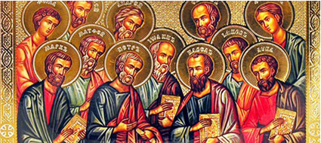

Slide 4
The Apostles’ Creed (ca AD 150-750)
The Apostles' Creed is the oldest. Already by 150 A.D. this creed was in use at Christian centers all along the Mediterranean Sea, such as Jerusalem, Alexandria (North Africa), Rome, and even Spain. The Apostles' Creed developed in conjunction with Baptism. As the water was applied, the question would be asked: "Do you believe in God the Father? God the Son? etc." Very quickly the answer developed into what we now call the Apostles' Creed. It is often called the baptismal creed. In addition to its primary use at all baptisms, it is also very appropriate for use in daily devotions. Also known as the Baptismal Creed or the Roman Symbol. Its central doctrines are those of the Trinity and God the Creator. It has been called the Creed of Creeds because already by AD 150 it was employed at Christian centers all along the Mediterranean Sea, such as Jerusalem, Alexandria (North Africa), Rome, and even Spain. It is also used in daily devotions.

Slide 7
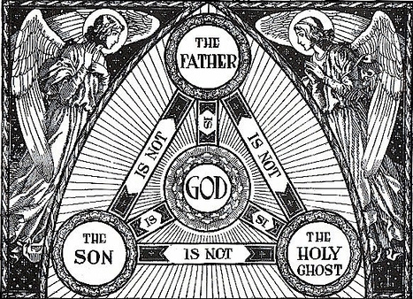

Slide 8
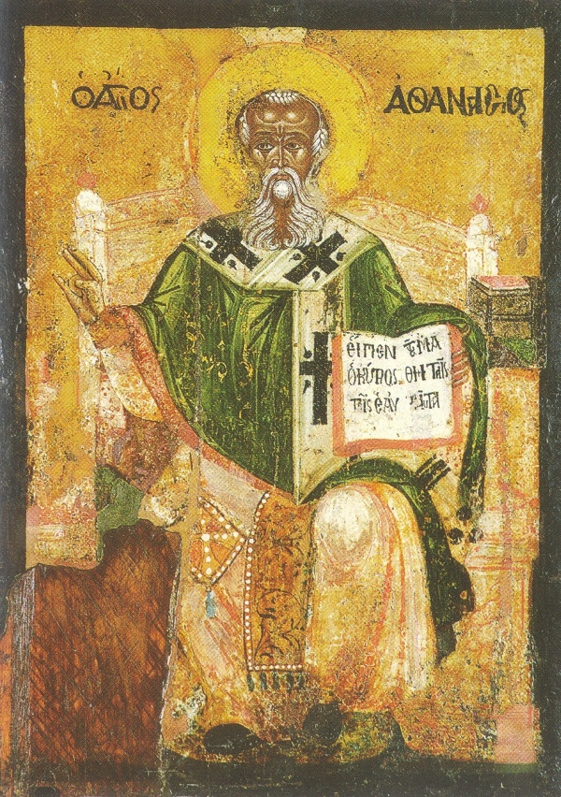

Slide 9
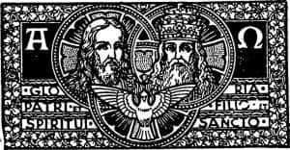

Slide 10
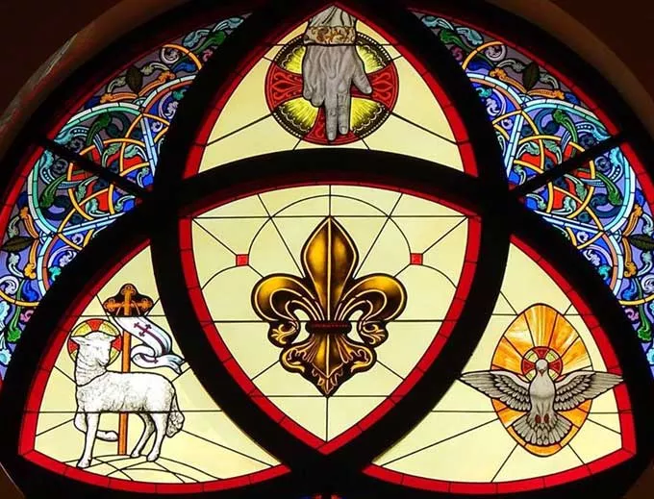

Slide 11
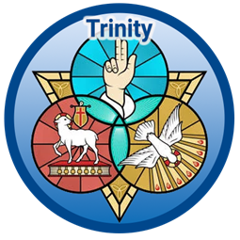

Slide 12
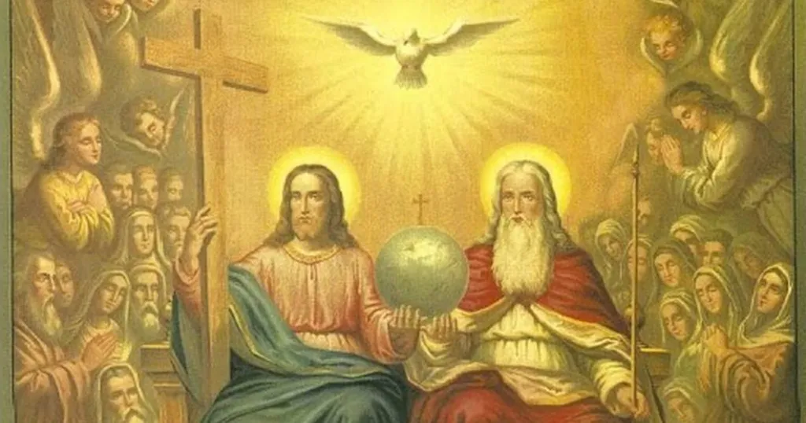

Slide 13
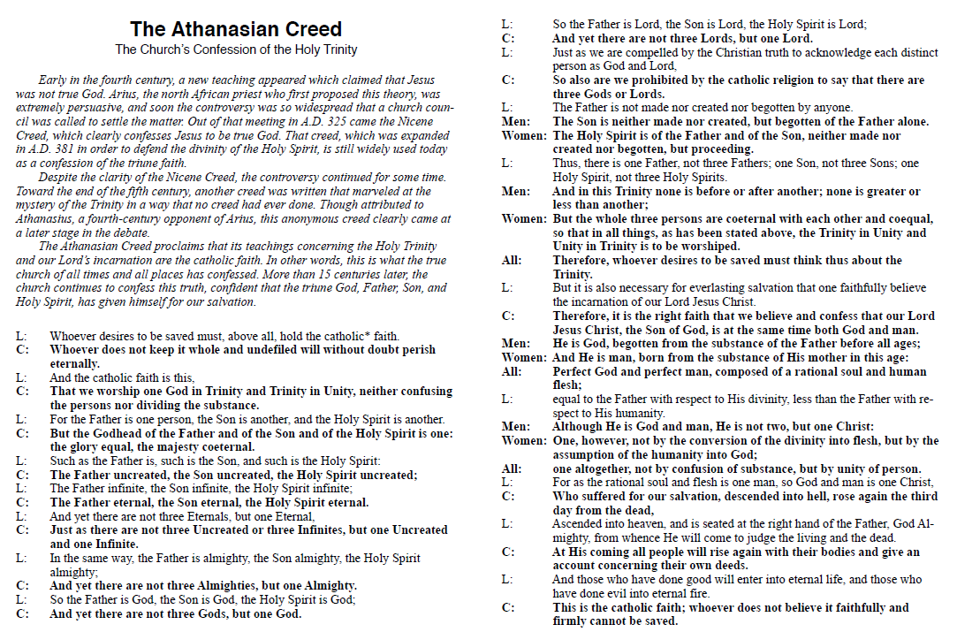

Slide 14
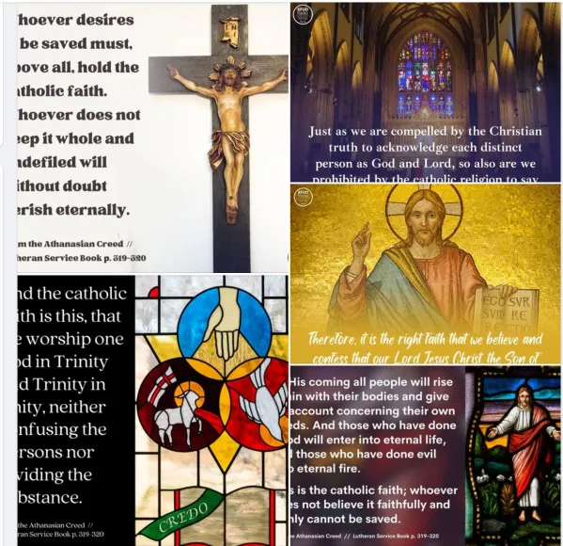

Slide 15
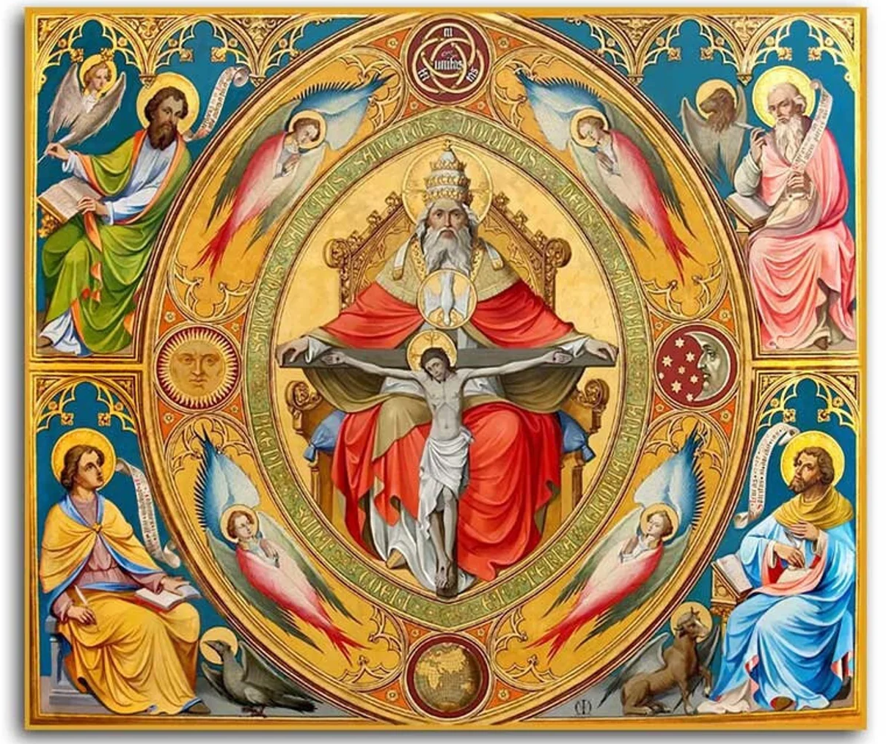

Slide 16
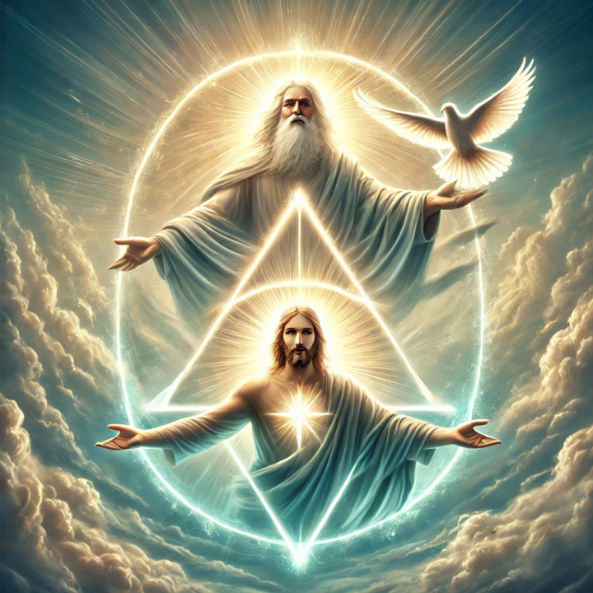

Slide 17
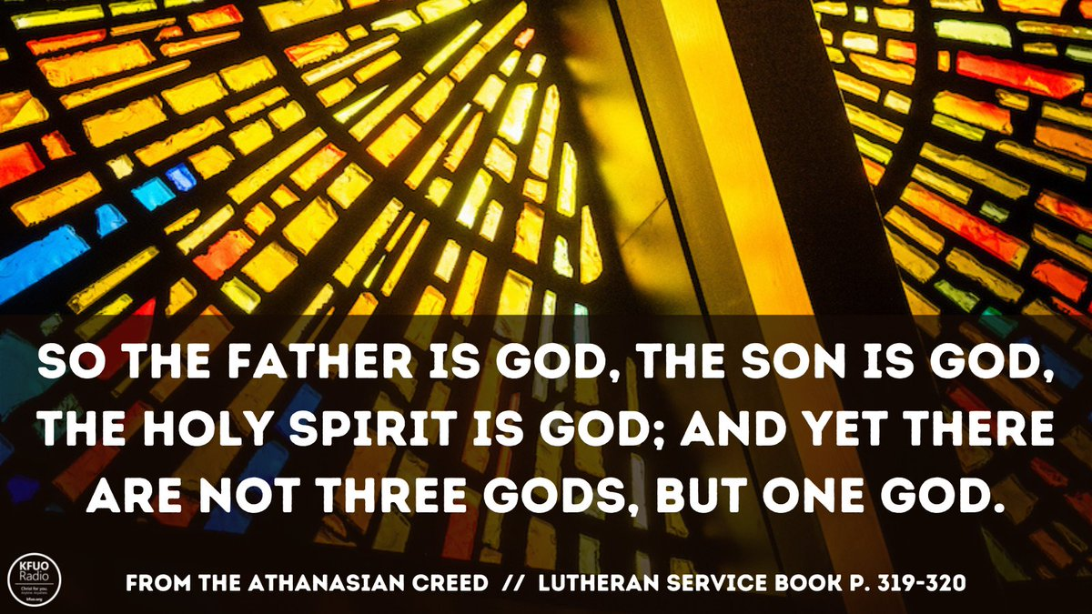

Slide 18
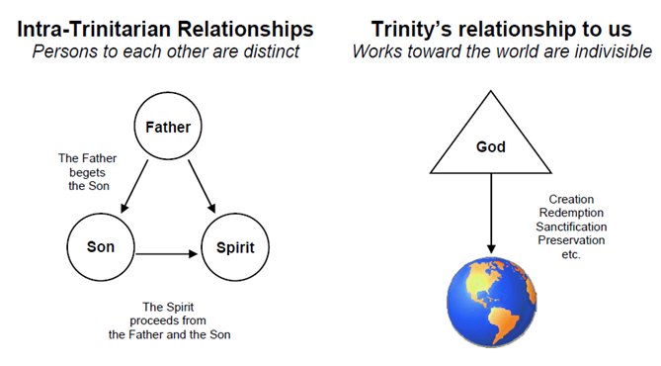

Slide 19
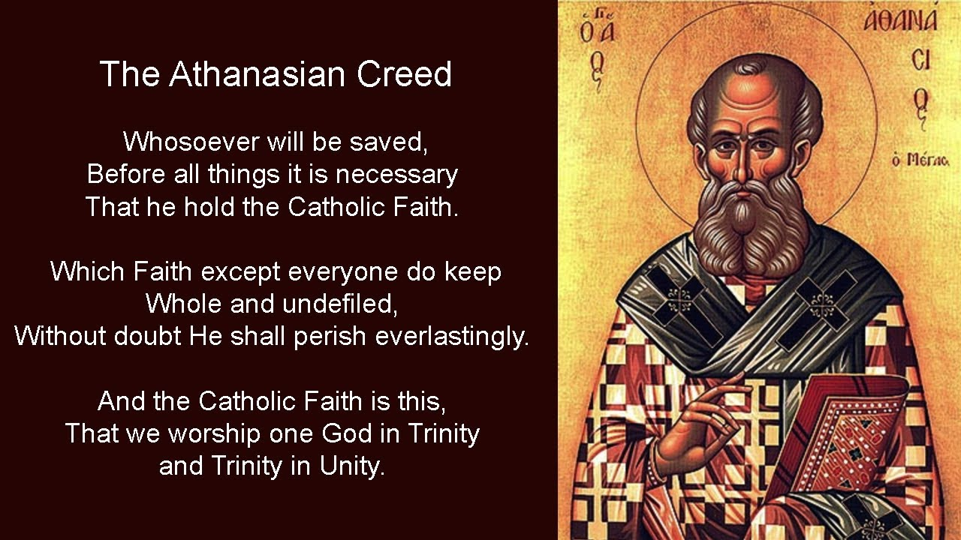

Slide 20
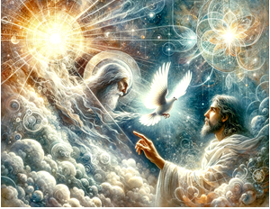

Slide 21
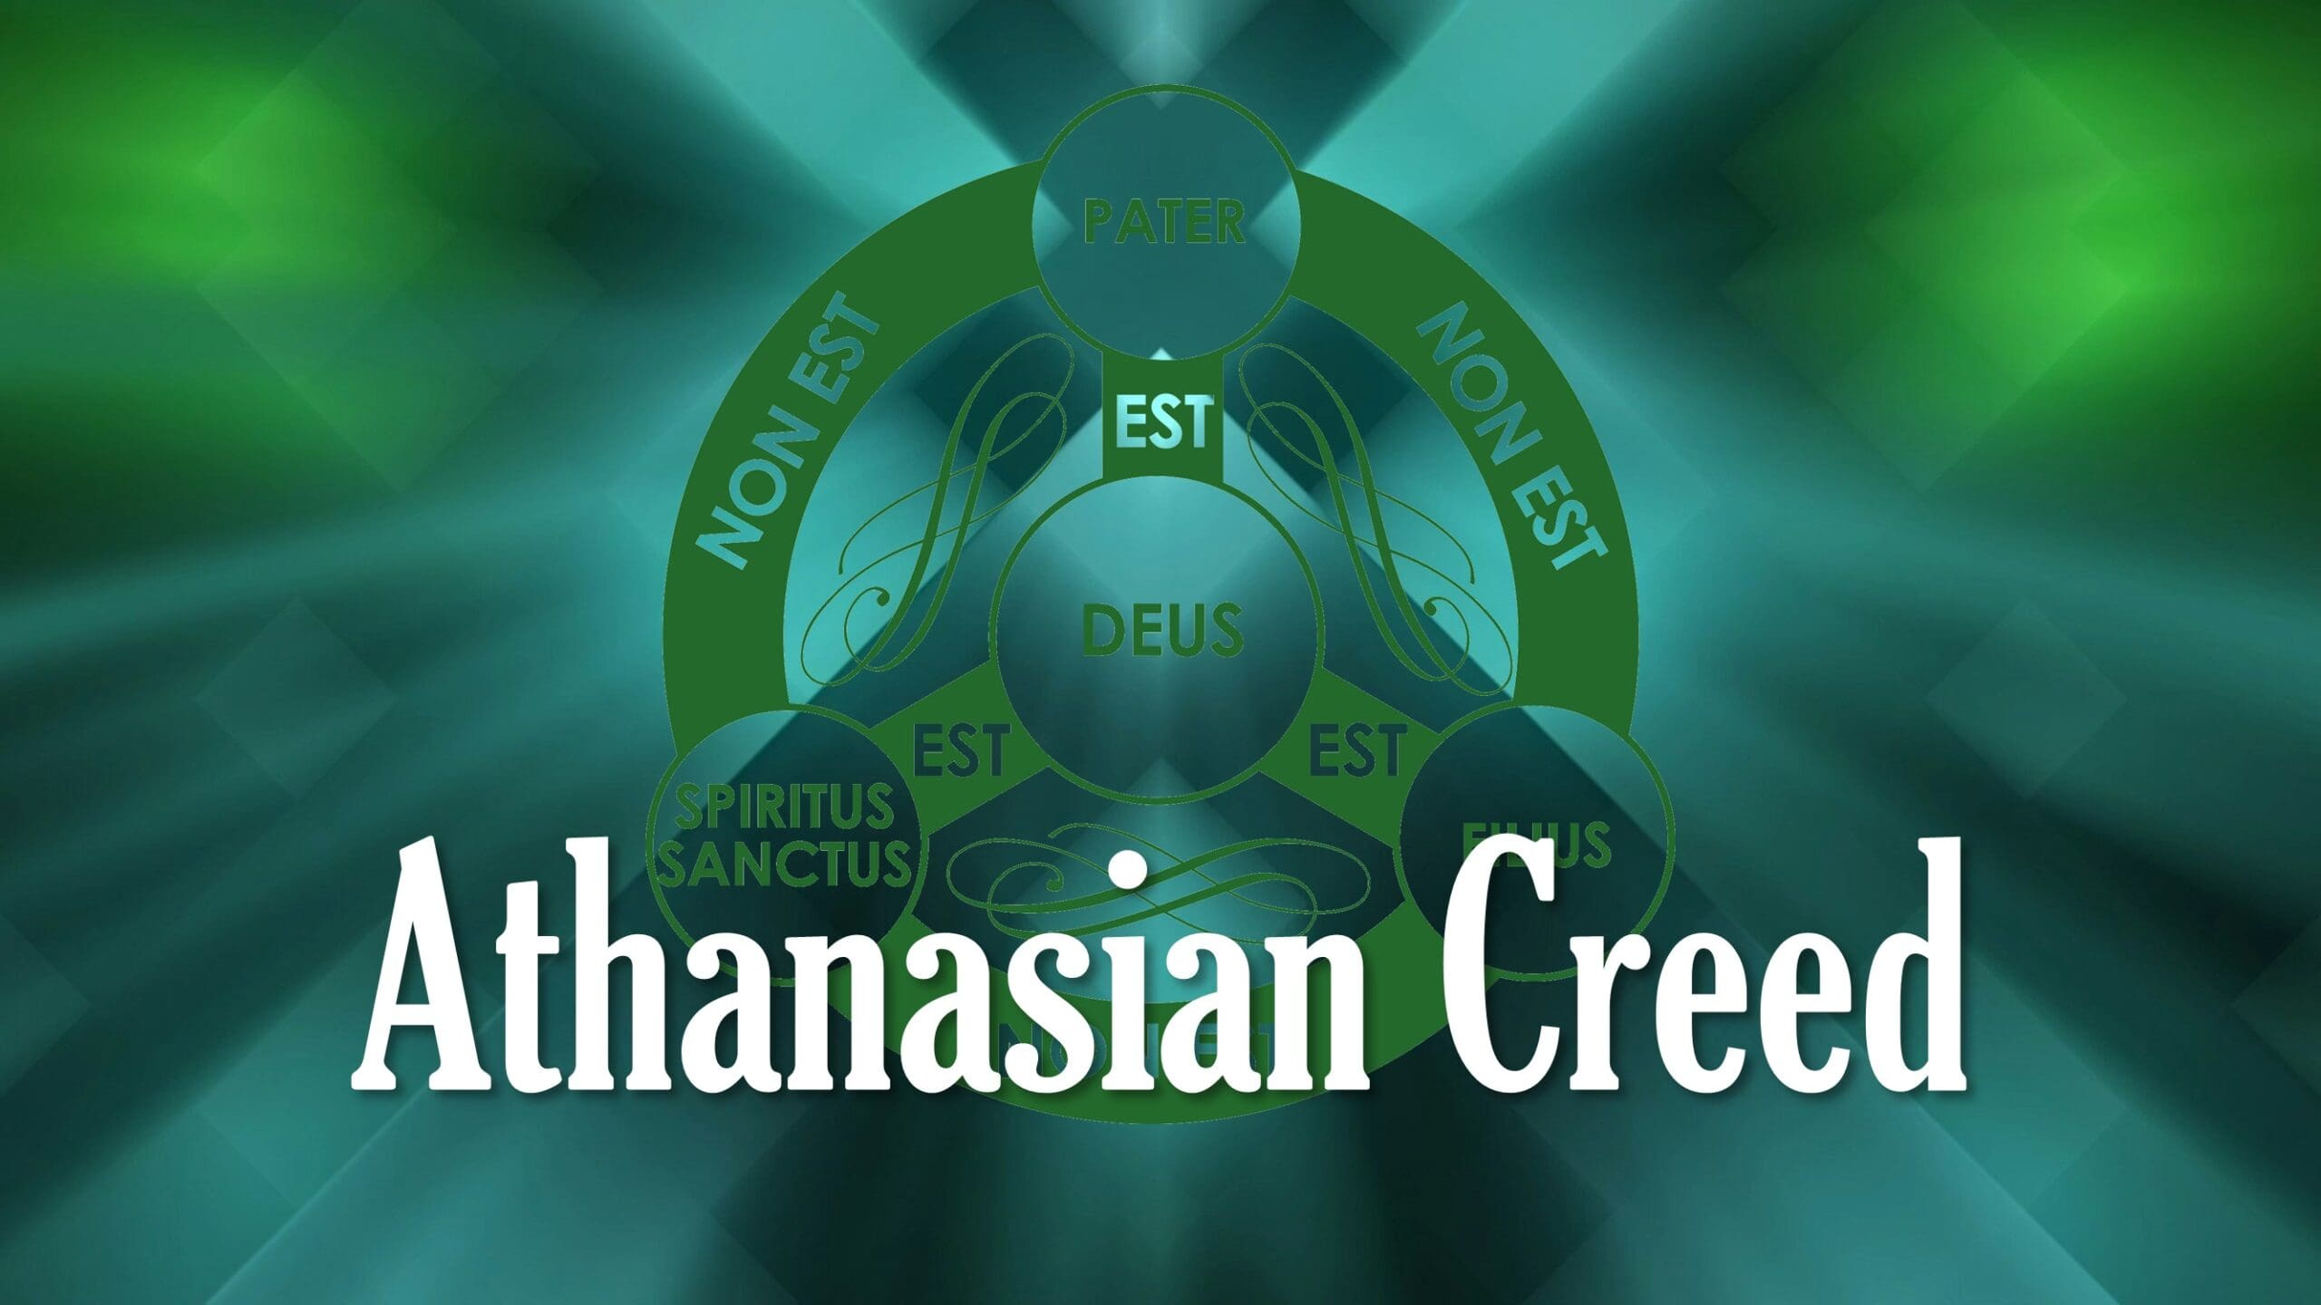

Slide 22
11) Thus the Father is God; the Son is God; the Holy Spirit is God:
And yet there are not three gods, but one God.
(1 Corinthians 2:10-11; 3:16; 6:19; 8:4;
2 Corinthians 1:21-22; 3:17;
Colossians 1:15-17; 2:9;
Titus 2:10)

Slide 23
12) Thus the Father is Lord; the Son is Lord; the Holy Spirit is Lord: And yet there are not three lords, but one Lord.
The creed now promotes the lordship of each member of the Trinity.
(Deuteronomy 6:4;
Matthew 11:25; Luke 2:11; Acts 10:36;
1 Corinthians 6:14; Revelation 17:14)

Slide 24
13) As Christian truth compels us to acknowledge each distinct person as God and Lord, so catholic religion forbids us to say that there are three gods or lords.
As mentioned before, the use of the word “catholic” refers to the “whole” or “universal” Christian religion. The bible clearly present the doctrine of the Trinity, therefore those faithful to the Word of God must accept this doctrine that states there is one God
and three distinct persons exists as one God.

Slide 25
14) The Father was neither made nor created nor begotten; the Son was neither made nor created, but was alone begotten of the Father; the Spirit was neither made nor created, but is proceeding from the Father and the Son.
The Triune-God is the Creator of all things therefore He cannot be created. The persons of the Godhead are therefore uncreated yet each maintains a certain distinctiveness of their eternality. This sentence addresses the relational order of the Godhead
while still affirming the ontological or essential unity.
(Genesis 1:1; Deuteronomy 33:27; Job 38:4; Isaiah 9:6;
John 1:14,18; 3:16,18; 5:26; 14:26; 15:26; 16:7;
1 Corinthians 8:6; Ephesians 3:9; Colossians 1:16–17; 1 John 5:20; Revelation 4:11)

Slide 26
The Large Catechism
PART 1 THE FIRST COMMANDMENT Note: Luther spends more time on the First Commandment than on any other portion of the catechism, explaining how essential it is to know, trust, and believe in the true God and to let nothing take His place. Luther was convinced that where this commandment was being kept, all other commandments would follow. A right relationship with God produces right relationships with fellow human beings. You shall have no other gods.
[1] What this means: You shall have Me alone as your God. What is the meaning of this, and how is it to be understood? What does it mean to have a god? Or, what is God?
[2] Answer: A god means that from which we are to expect all good and in which we are to take refuge in all distress. So, to have a God is nothing other than trusting and believing Him with the heart. I have often said that the confidence and faith of the heart alone make both God and an idol.
[3] If your faith and trust is right, then your god is also true. On the other hand, if your trust is false and wrong, then you do not have the true God. For these two belong together, faith and God [Hebrews 11: 6]. Now, I say that whatever you set your heart on and put your trust in is truly your god.

Slide 27
[4] The purpose of this commandment is to require true faith and trust of the heart, which settles upon the only true God and clings to Him alone. It is like saying, “See to it that you let Me alone be your God, and never seek another.” In other words, “Whatever you lack of good things, expect it from Me. Look to Me for it. And whenever you suffer misfortune and distress, crawl and cling to Me. I, yes, I, will give you enough and help you out of every need. Only do not let your heart cleave to or rest on any other.”
[5] This point I must unfold more clearly. It may be understood and seen through ordinary, counterexamples. Many a person thinks that he has God and everything in abundance when he has money and possessions. He trusts in them and boasts about them with such firmness and assurance as to care for no one.
[6] Such a person has a god by the name of “Mammon” (i.e., money and possessions; [Matthew 6: 24]), on which he sets all his heart.
[7] This is the most common idol on earth. He who has money and possessions feels secure [Luke 12: 16– 21] and is joyful and undismayed as though he were sitting in the midst of Paradise.
[8] On the other hand, he who has no money doubts and is despondent, as though he knew of no God.
[9] For very few people can be found who are of good cheer and who neither mourn nor complain if they lack Mammon. This care and desire for money sticks and clings to our nature, right up to the grave.
[10] So, too, whoever trusts and boasts that he has great skill, prudence, power, favor, friendship, and honor also has a god. But it is not the true and only God. This truth reappears when you notice how arrogant, secure, and proud people are because of such possessions, and how despondent they are when the possessions no longer exist or are withdrawn. Therefore, I repeat that the chief explanation of this point is that to “have a god” is to have something in which the heart entirely trusts.

