Slide 1
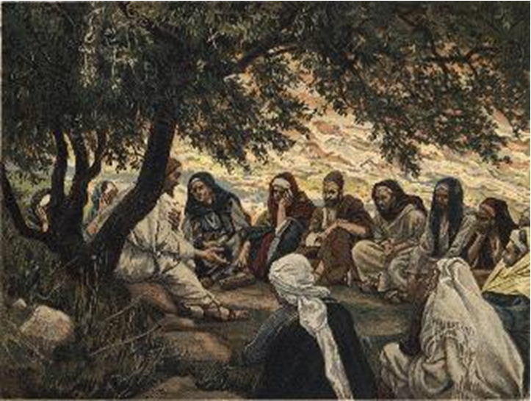
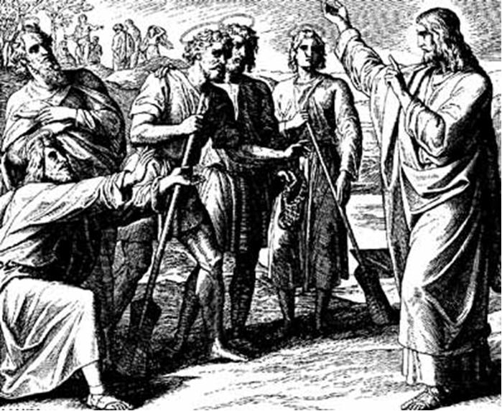
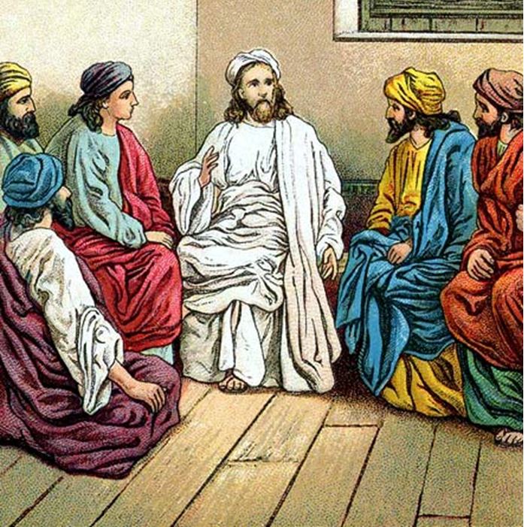
“The Apostles, Nicene and Athanasian Creeds
The Truth about the Trinity”
-The Ecumenical Creeds as Summaries
About Who God Is,
Versus False Religions and Cults-
Part 3 - A Bible Study of the Athanasian Creed
Trinity Lutheran Church LCMS Norman, OK. Pastor David Nehrenz
Lesson 6 – October 26, 2025

Slide 2
The Three Ecumenical Creeds
Lutheran Church - Missouri Synod adheres to the three Ecumenical Creeds. These creeds are succinct yet accurate statements of the true Christian faith.
Among the major doctrines confessed in the creeds are:
• the eternal and triune natures of God,
• the dual nature of Christ Jesus (being both fully God and fully man),
• the working of faith in believers by the Holy Spirit,
• the resurrection of the dead on the last day,
• the return of Christ Jesus in judgement, and
• everlasting life in heaven for those redeemed by the Grace of God through the working of the Holy Spirit and the innocent suffering and death & true resurrection of our Lord Jesus Christ on the third day.
1. The Apostle's Creed
The Nicene Creed
The Athanasian Creed

Slide 3
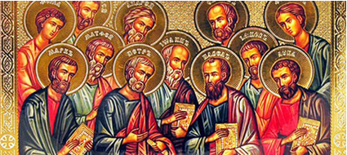

Slide 4
The Apostles’ Creed (ca AD 150-750)
The Apostles' Creed is the oldest. Already by 150 A.D. this creed was in use at Christian centers all along the Mediterranean Sea, such as Jerusalem, Alexandria (North Africa), Rome, and even Spain. The Apostles' Creed developed in conjunction with Baptism. As the water was applied, the question would be asked: "Do you believe in God the Father? God the Son? etc." Very quickly the answer developed into what we now call the Apostles' Creed. It is often called the baptismal creed. In addition to its primary use at all baptisms, it is also very appropriate for use in daily devotions. Also known as the Baptismal Creed or the Roman Symbol. Its central doctrines are those of the Trinity and God the Creator. It has been called the Creed of Creeds because already by AD 150 it was employed at Christian centers all along the Mediterranean Sea, such as Jerusalem, Alexandria (North Africa), Rome, and even Spain. It is also used in daily devotions.

Slide 7
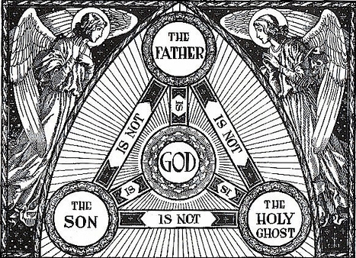

Slide 8
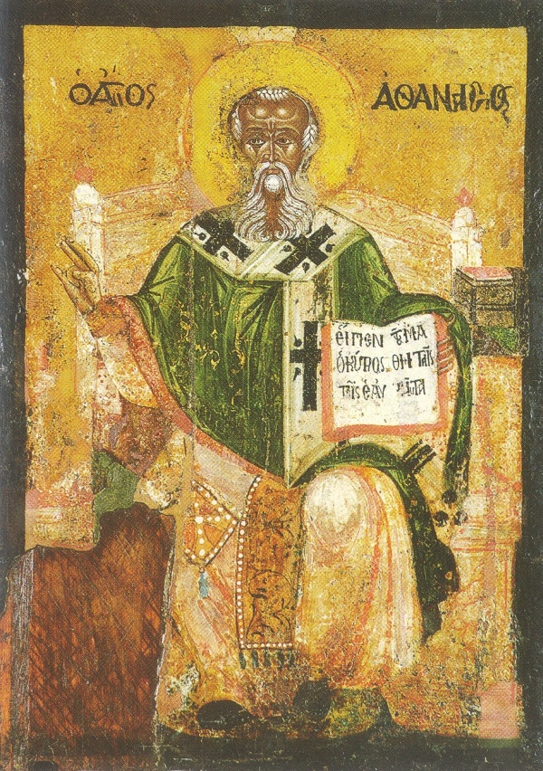

Slide 9
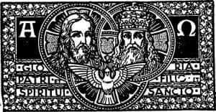

Slide 10
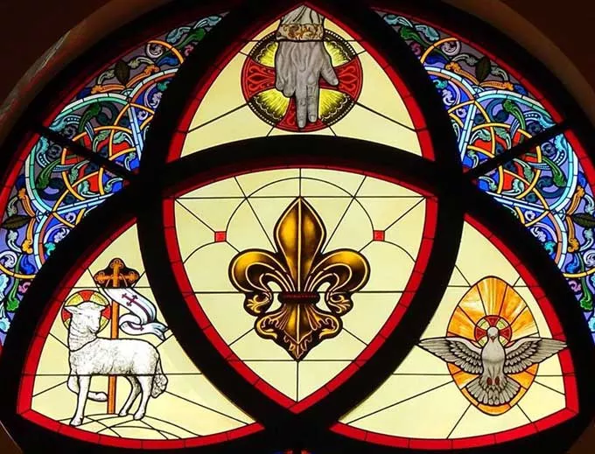

Slide 11
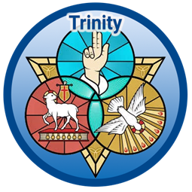

Slide 12
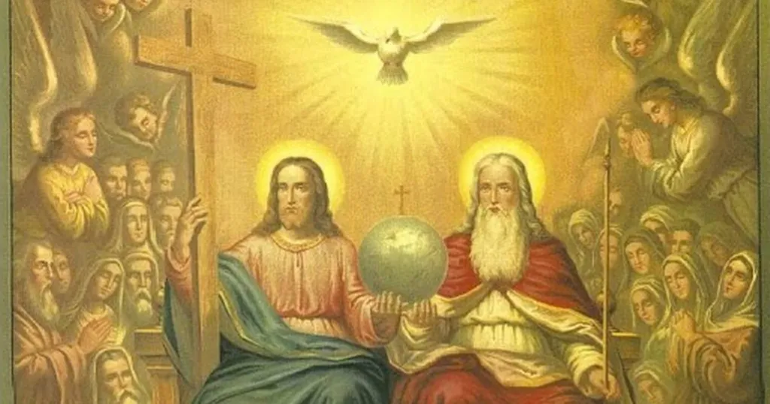

Slide 13
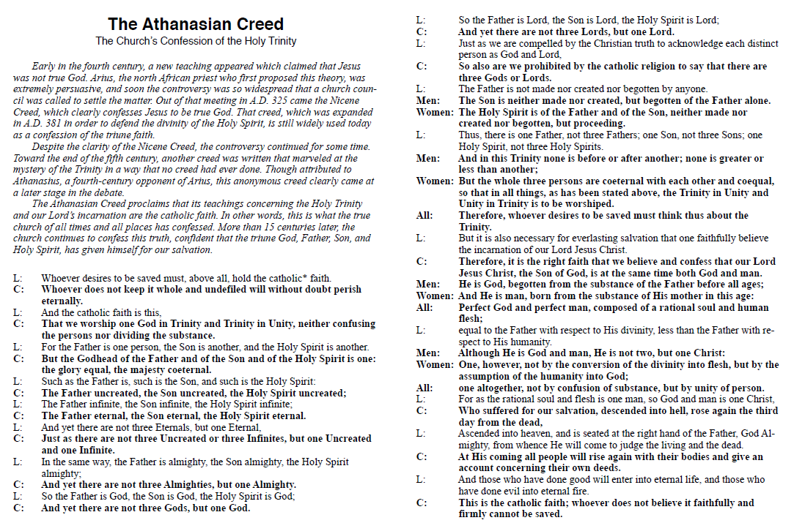

Slide 14
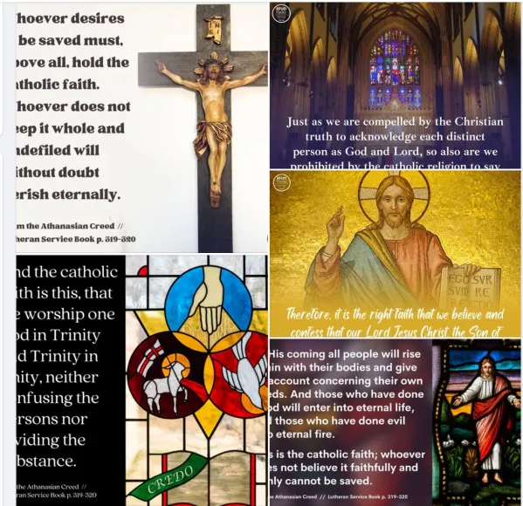

Slide 15
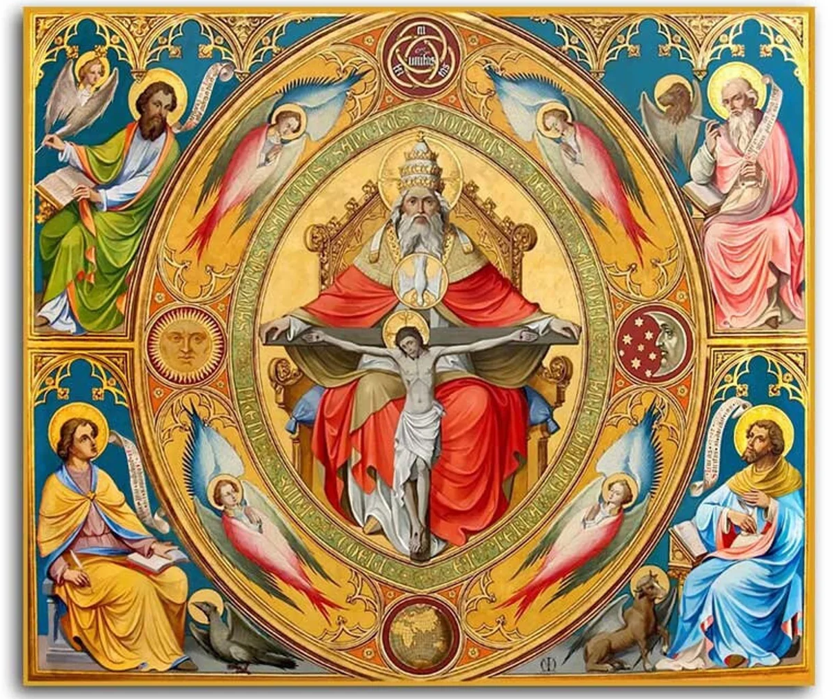

Slide 16
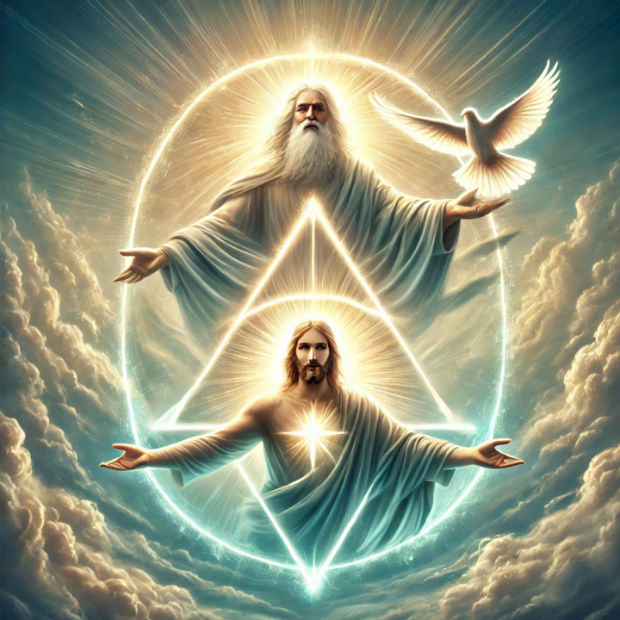

Slide 17
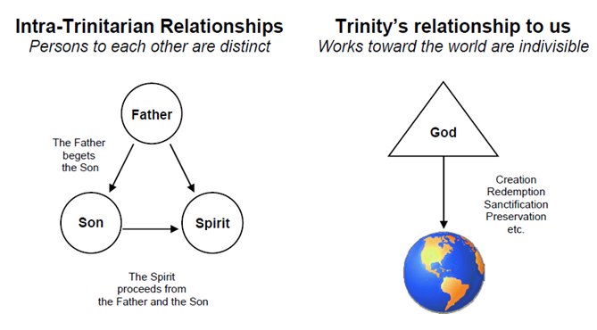

Slide 18
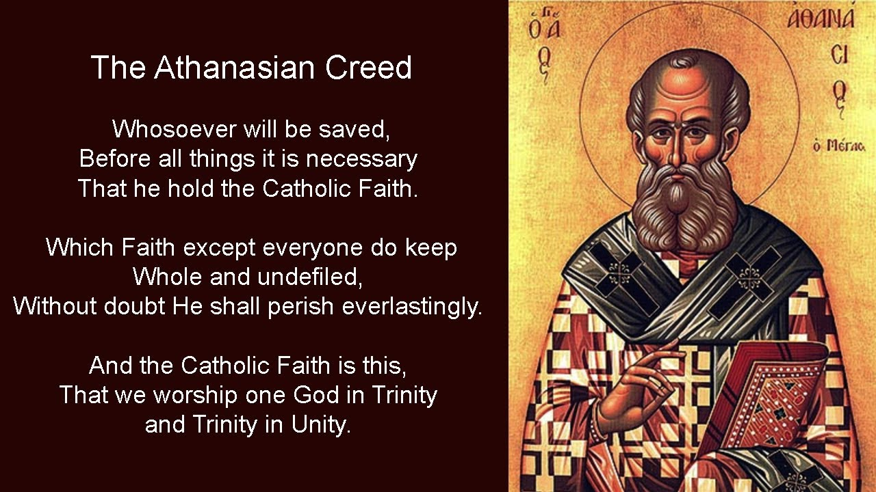

Slide 19
9) Eternal is the Father; eternal is the Son; eternal is the Spirit: And yet there are not three eternal beings, but one who is eternal; as there are not three uncreated and unlimited beings, but one who is uncreated and unlimited.
Closely related to sentences 7 and 8, this demonstrates the oneness of the persons of the Trinity and the fact that one did not create the others but the 3 persons have eternally coexisted as one God.
(Isaiah 9:6; 48:12;
Matthew 3:11; John 1:1, 3; Romans 1:4;
1 Corinthians 8:4; 17:5; Colossians 1:17;
Hebrews 9:14; Titus 3:5–6;
Revelation 1:8; 22:13)

Slide 20
10) Almighty is the Father; almighty is the Son; almighty is the Spirit:
And yet there are not three almighty beings, but one who is almighty.
While restating the three persons in one God yet again, we now see an emphasis on the almightiness of God. God is omnipotent; that is, God is all-powerful.
(Genesis 17:1; 18:14; Psalm 62:11;
Matthew 19:26; Mark 14:36; Luke 1:35; John 5:21;
1 Corinthians 8:4; 12:4, 11; Ephesians 1:20–21; 3:20-21;
Philippians 3:20-21; Colossians 2:9-10;
Hebrews 1:3; 1 Peter 3:22;
Revelation 1:8; 4:8; 11:17; 15:3; 16:7,14; 19:6)
.

Slide 21
11) Thus the Father is God; the Son is God; the Holy Spirit is God:
And yet there are not three gods, but one God.
(Genesis 1:26; Isaiah 9:6;
Matthew 1:18, 23; 28:19; John 1:1,14; 6:27; 10:30; 20:28;
Acts 5:3-4; 20:28; Romans 9:5;
1 Corinthians 2:10-11; 3:16; 6:19; 8:4;
2 Corinthians 1:21-22; 3:17;
Colossians 1:15-17; 2:9;
Titus 2:10)

Slide 22
The Holy Trinity and Life Together
June 8, 2011 / The Magazine / By The LCMS by Rev. Christopher Hall
The Athanasian Creed confesses the Church’s belief in the Trinity. What is the relationship between the three Persons of the Trinity, and what does that mean for our Life Together?
Created to be together
God made human beings to have relationships with one another…
In fact, our existence is established with others. God created the womb to be the perfect environment for growing a new life. But life beginning inside the mother also reveals something profound: We are created to be together, to live together, to have life together, so much so that God forms us and gives us life inside of another human being. The couple—the husband and wife—were not created to be alone but to bear children when God allows it. Once the child is born, he or she remains in a community, broadened to parents and siblings and extended family.
Relationships with others continue in every way throughout our lives, and it is within those relationships that our faith expresses itself, where it is put to the test. It is only with others that our love can be expressed and used, that we can be forgiven and strengthened. Love demands another to love.
God creates a community because He is a community. He creates us with others because He is with others. He is not alone. He is One but also Three: the Father, Son and the Holy Spirit

Slide 23
The relationship of the Trinity
In all three creeds we recite—the Apostles’, the Nicene and the Athanasian—we confess that the Son of God is begotten of the Father. This does not mean that the Father reproduced Himself to form the Son in a biological way, like a father begets a son in our lives, but the First Person of the Trinity’s relationship with the Second is like that of Father and Son. And it always has been that way, because the Son is eternally present…
God is love
Scripture testifies to this “inner relationship” of the Trinity. We can see this relationship that is at the heart of the Godhead when St. John writes, “God is love” (1 John 4:8). This is more than a warm and wooly feeling, more than a vague and emotional statement. It is at the heart of who God is. In order to love, there must be someone to love. St. Paul refers to this in the famous passage from 1 Corinthians, “Love is patient and kind; love does not envy or boast; it is not arrogant or rude. It does not insist on its own way; it is not irritable or resentful” (1 Cor. 13:4–5).
In other words, love is always directed at another person. It is always a denial of oneself in favor of the other, their interests and their life and being. In this sense, self-love is an oxymoron, like saying “married bachelor.” We cannot love ourselves if we truly understand what love is. Love is always about the other.

Slide 24
If God is love itself, then God must have another to love. It is not enough to say that He loves His creation. He does, but if that is the only “other” that He loved, then before creation, God would not have been love. No, if God is love in its perfect and biblical definition, then love also describes His relationship with Himself. The Father loves the Son and the Spirit. The Son loves the Father and the Spirit. The Spirit loves the Father and the Son. In other words, God is One, but since God is love, He loves within Himself, in the way of the Holy Trinity.
When we confess the Athanasian Creed, we also see that God is never alone. God Himself is a community, a relationship. He is One but also Three and always One in Three and Three in One. This love of God passes to us who have been created in His own image, who were also created in a community with Him and given a community with one another. We, too, are created to express our love not by ourselves, not by looking in a mirror, but in community with spouse and children, friends and neighbors.

Slide 25
Uncreated, infinite, eternal
Even when the Son of God became a man, He reflects and teaches this inner life of God—this community of God, the relationship He has with the Father—and relates it to us. He says that He is One with the Father, that we may be One with Him (John 17:22). He says the Word He speaks is not His own but was given by His Father (John 14:10). Jesus’ ministry was centered on glorifying His Father in allowing Himself to do what the Father sent Him for. But it is double-sided: All that Jesus said and did was for us and our salvation.
Jesus does the Father’s will and speaks the Father’s Word completely and faithfully and obediently and lovingly. And what He speaks is life-giving and eternal. What the Father has, the Son gives, and it is eternal life. You could even say He gives Himself. He is life and love, and He gives Himself to those who hear, to those He calls, to those who listen to His Word.
—
About the Author: Rev. Christopher Hall is pastor of Grace Lutheran Church, Tulsa, Okla. and 1st Vice-President of the OK District

