Slide 1
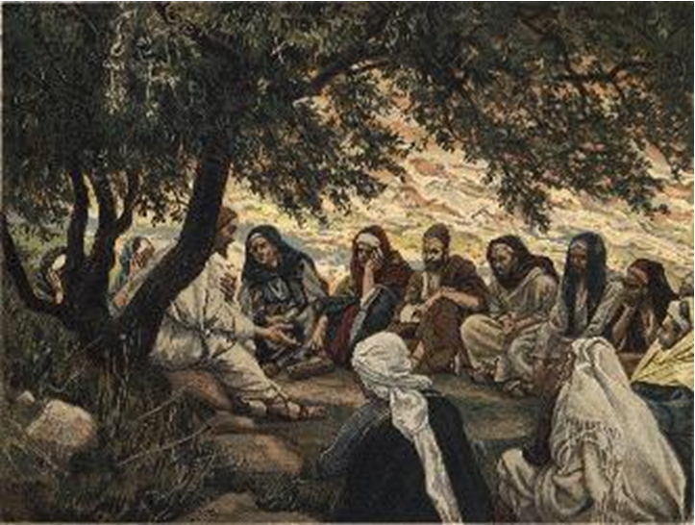
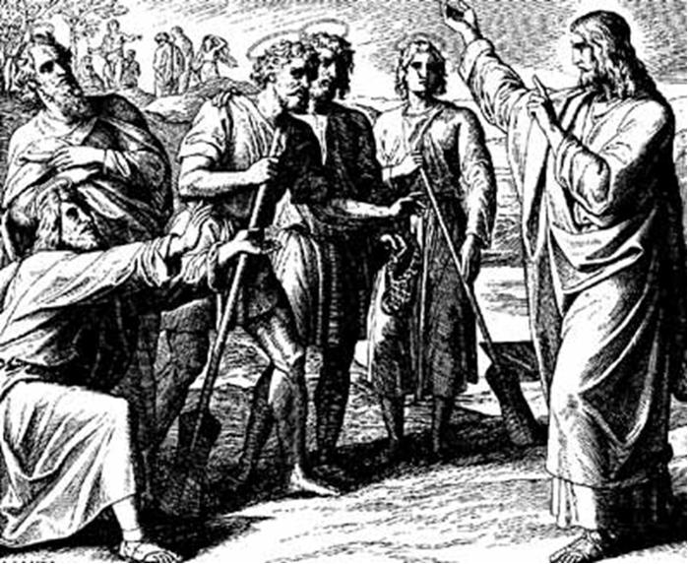
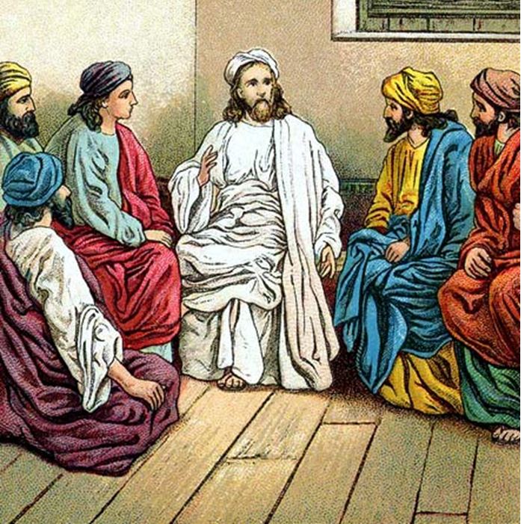
“The Apostles, Nicene and Athanasian Creeds
The Truth about the Trinity”
-The Ecumenical Creeds as Summaries
About Who God Is,
Versus False Religions and Cults-
Part 3 - A Bible Study of the Athanasian Creed
Trinity Lutheran Church LCMS Norman, OK. Pastor David Nehrenz
Lesson 5 – October 19, 2025

Slide 2
The Three Ecumenical Creeds
Lutheran Church - Missouri Synod adheres to the three Ecumenical Creeds. These creeds are succinct yet accurate statements of the true Christian faith.
Among the major doctrines confessed in the creeds are:
• the eternal and triune natures of God,
• the dual nature of Christ Jesus (being both fully God and fully man),
• the working of faith in believers by the Holy Spirit,
• the resurrection of the dead on the last day,
• the return of Christ Jesus in judgement, and
• everlasting life in heaven for those redeemed by the Grace of God through the working of the Holy Spirit and the innocent suffering and death & true resurrection of our Lord Jesus Christ on the third day.
1. The Apostle's Creed
The Nicene Creed
The Athanasian Creed

Slide 3
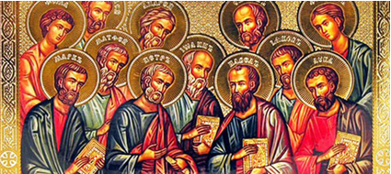

Slide 4
The Apostles’ Creed (ca AD 150-750)
The Apostles' Creed is the oldest. Already by 150 A.D. this creed was in use at Christian centers all along the Mediterranean Sea, such as Jerusalem, Alexandria (North Africa), Rome, and even Spain. The Apostles' Creed developed in conjunction with Baptism. As the water was applied, the question would be asked: "Do you believe in God the Father? God the Son? etc." Very quickly the answer developed into what we now call the Apostles' Creed. It is often called the baptismal creed. In addition to its primary use at all baptisms, it is also very appropriate for use in daily devotions. Also known as the Baptismal Creed or the Roman Symbol. Its central doctrines are those of the Trinity and God the Creator. It has been called the Creed of Creeds because already by AD 150 it was employed at Christian centers all along the Mediterranean Sea, such as Jerusalem, Alexandria (North Africa), Rome, and even Spain. It is also used in daily devotions.

Slide 7
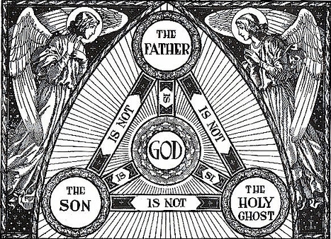

Slide 8
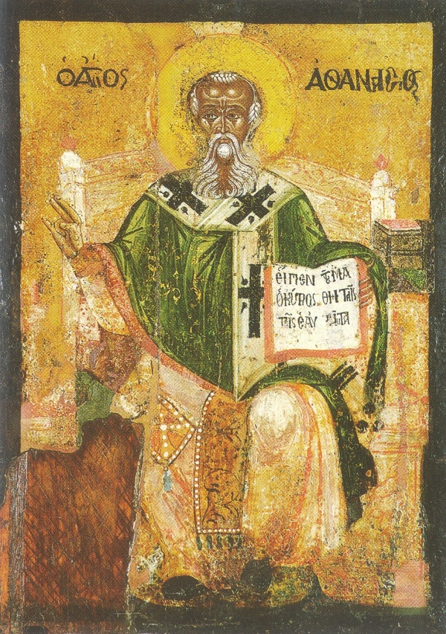

Slide 9
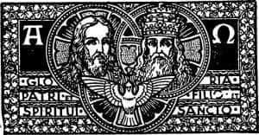

Slide 10
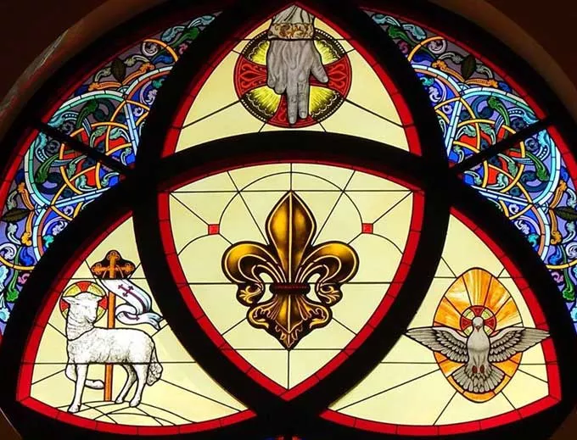

Slide 11
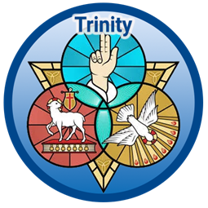

Slide 12
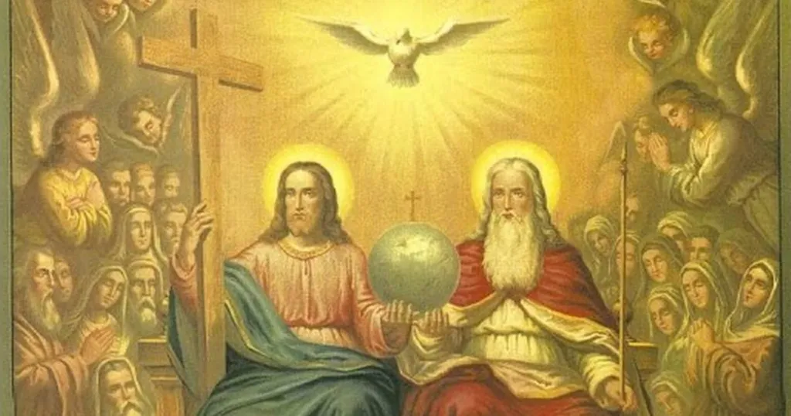

Slide 13
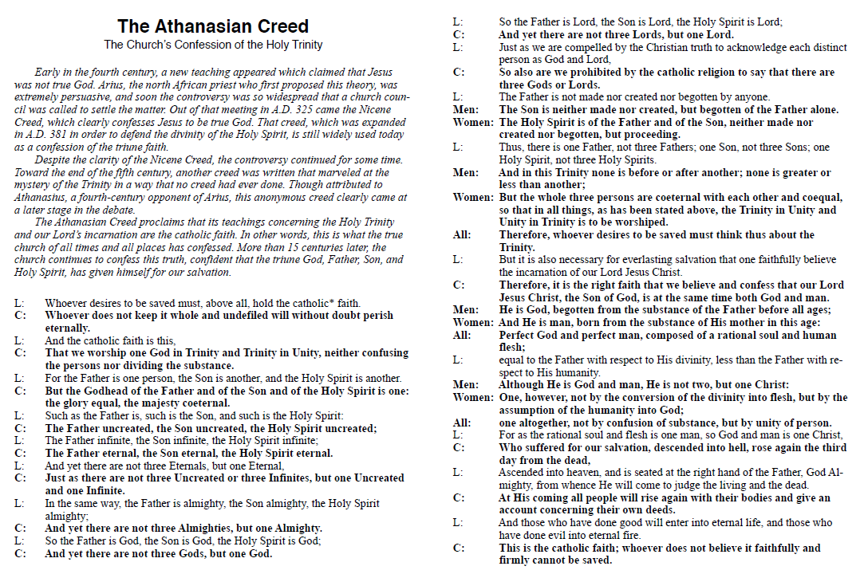

Slide 14
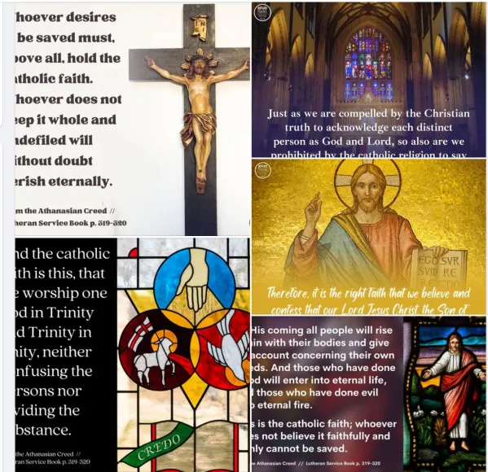

Slide 15
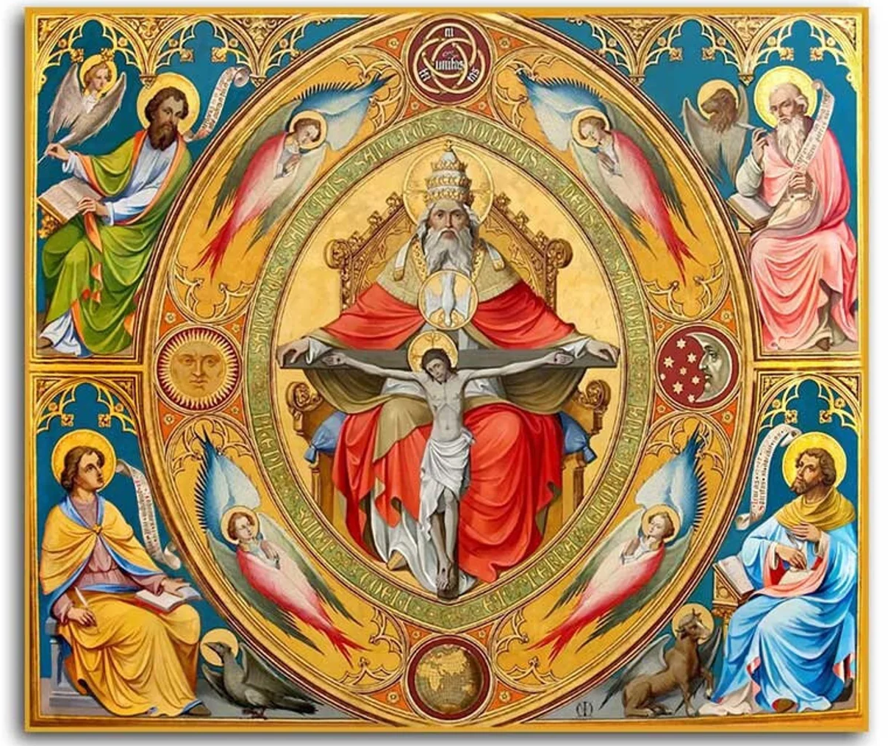

Slide 16
6) What the Father is, the Son is, and so is the Holy Spirit.
This sentence strongly emphasizes what the sentence preceding it has already stated and what following sentences will state. The Father, Son, and Spirit are not the same in function, but they are the same in essence or nature; that is, they are all equally God. (See Scripture references from preceding sentence 5 and following sentences 7-16.)
7) Uncreated is the Father; uncreated is the Son; uncreated is the Spirit.
This points to the fact that the Trinity is eternal. The Trinity has no beginning and has no end, God simply is. This creed continually restates truths from various aspects so that no nuances or subtle differences would be introduced to distort the true Trinitarian doctrine.
(Genesis 1:1; Deuteronomy 33:27; Psalm 90:2; Isaiah 40:28;
John 1:1; Ephesians 3:10-11;
Colossian 1:17; Hebrews 9:14; 1 Timothy 1:17; Revelation 1:8)

Slide 17
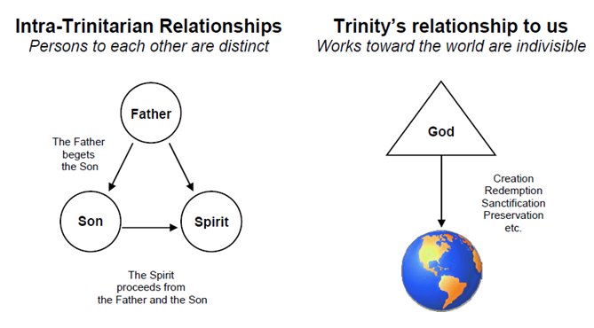

Slide 18
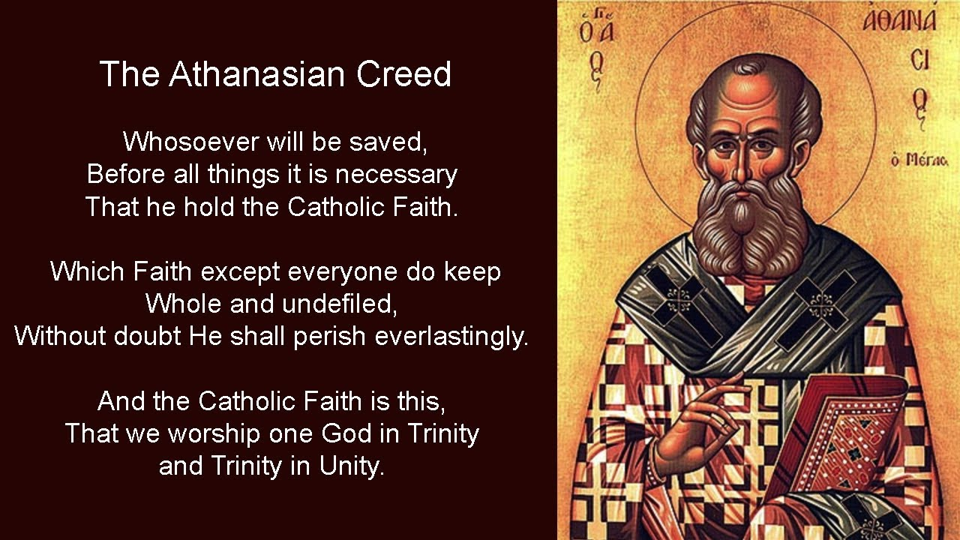

Slide 19
8) The Father is infinite; the Son is infinite; the Holy Spirit is infinite.
In other words, the Godhead is boundless, limitless, imponderable, incomprehensible, and never-ending.
(Genesis 1:1; 1 Kings 8:27; Psalm 113:4–6; 145:3; 147:5;
Isaiah 40:28; Jeremiah 23:24;
Romans 11:33; Ephesians 3:8; Revelation 4:8)
9) Eternal is the Father; eternal is the Son; eternal is the Spirit: And yet there are not three eternal beings, but one who is eternal; as there are not three uncreated and unlimited beings, but one who is uncreated and unlimited.
Closely related to sentences 7 and 8, this demonstrates the oneness of the persons of the Trinity and the fact that one did not create the others but the 3 persons have eternally coexisted as one God.
(Isaiah 9:6; 48:12;
Matthew 3:11; John 1:1, 3; Romans 1:4;
1 Corinthians 8:4; 17:5; Colossians 1:17; Hebrews 9:14; Titus 3:5–6;
Revelation 1:8; 22:13)

Slide 20
https://lutheranmissions.org/b-a-s-i-c-277/
Martin Luther once said of the Athanasian Creed: ‘I doubt whether the New Testament church has a more important document since the Apostolic Age.’ However, in our day, the Athanasian Creed is not nearly as well known as it was in Luther’s day.
The Athanasian Creed is like the Apostles’ in that its author is unknown. It was written later than the Nicene Creed, appearing in its complete form near the end of the eighth century. It has kept that title because of Athanasius’ defense of the deity of Christ and the Trinity – the two main subjects of this creed.
The Athanasian Creed is an excellent summary of the decisions of the first four ecumenical councils (Nicea – 325, Constantinople – 381, Ephesus – 431, and Chalcedon – 451) against various and many false teachings concerning the fundamental teachings of Scripture.
In the years 400-800 A.D. false teachers arose who began to deny the doctrine of the Trinity and the person and work of Jesus Christ. For this reason, the ‘Athanasian Creed’ deals with the most fundamental Christian truths of the Trinity, the Deity of Christ, and His redeeming work. Our ultimate salvation is at stake because without knowledge of these truths saving faith is impossible.

Slide 21
This confession consists of two distinct parts: The first sets forth in great detail the teaching of the Trinity. It goes beyond the Apostles’ and Nicene Creeds which do not state the doctrine of the Trinity explicitly, but by implication. The second part contains a short and clear statement concerning the doctrine of the person of Christ, teaching the proper relation between the divine and human nature of Christ.
So that there is no confusion, we should take note of a few things:
The expression ‘catholic faith’ does not refer to membership in the Roman Catholic Church, but of those who are united in the ‘universal Christian faith’ and members of the Holy Christian Church. ‘Catholic’ is the Latin word for ‘universal.’
The term ‘uncreate’ reminds us that all three persons of the Holy Trinity (Father, Son and Holy Spirit) are equal and without beginning or end. The Son was not ‘created’ by the Father, nor was the Holy Spirit ‘created’ by the Father and the Son. All three persons have existed from eternity as one united equal God.

Slide 22
The creed also goes into detail (‘perfect God and perfect man’; ‘one altogether; not by confusion of substance but by unity of Person.’) to show that Jesus Christ was at once fully God and fully man. Jesus was not half God and half man, but as incomprehensible as it seems both immortal and mortal at the same time.
Whenever works are spoken of in connection with the judgment it is good to remember –
Good Works are those things done by believers in the true fear and love of God – for Jesus’ sake. The writer to the Hebrews writes: ‘Without faith it is impossible to please Him’ (Hebrews 11:6).
These will stand as evidence of true faith in Christ, which alone saves. James declares: ‘Thus also faith by itself, if it does not have works, is dead’ (James 2:17).
In contrast to the peaceful tone of the Apostles’ and Nicene Creeds, the Athanasian Creed begins and ends with the strong condemnation: ‘This is the catholic faith; which except a man believe faithfully and firmly, he cannot be saved.’ While many have opposed this harsh wording, the same is taught in Scripture: Jesus said, ‘Therefore I said to you that you will die in your sins; for if you do not believe that I am He, you will die in your sins’ (John 8:24; cf. Acts 4:12, Mark 16:15-16).
Let us continue to proclaim both the Law and Gospel of Scripture to today’s world!

