Slide 1
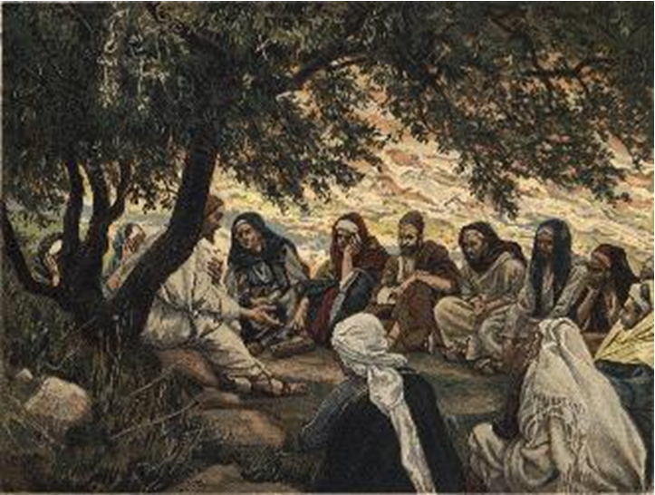
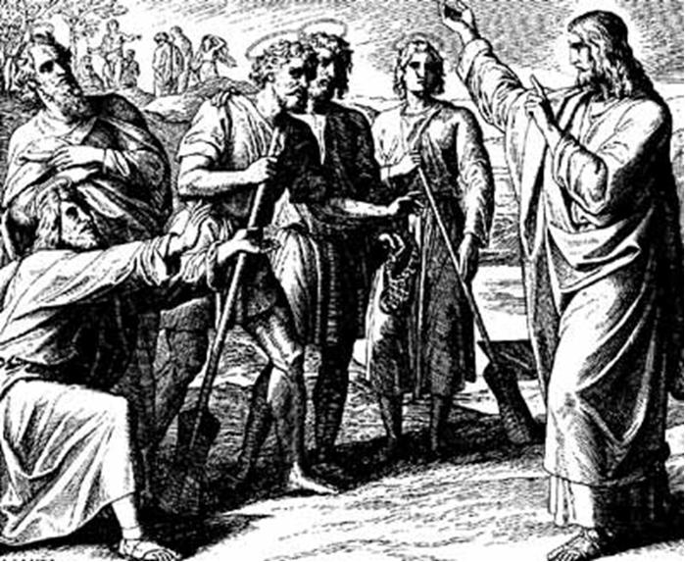
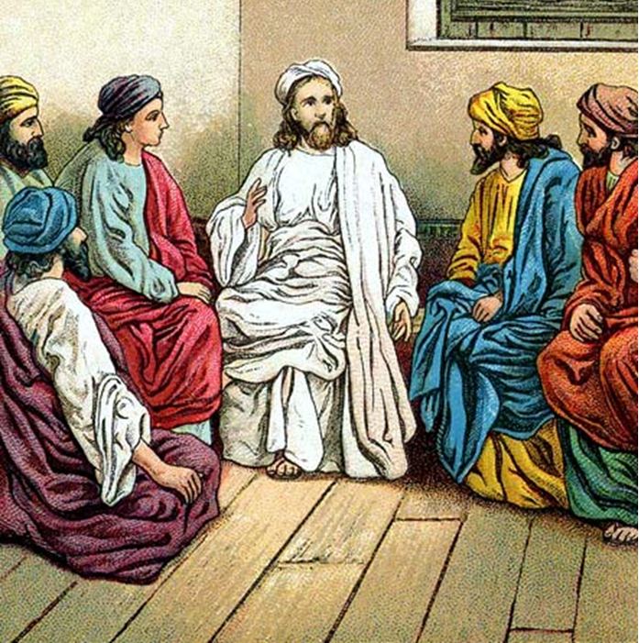
“The Apostles, Nicene and Athanasian Creeds
The Truth about the Trinity”
-The Ecumenical Creeds as Summaries
About Who God Is,
Versus False Religions and Cults-
Part 3 - A Bible Study of the Athanasian Creed
Trinity Lutheran Church LCMS Norman, OK. Pastor David Nehrenz
Lesson 2 – September 21, 2025

Slide 2
The Three Ecumenical Creeds
Lutheran Church - Missouri Synod adheres to the three Ecumenical Creeds. These creeds are succinct yet accurate statements of the true Christian faith.
Among the major doctrines confessed in the creeds are:
• the eternal and triune natures of God,
• the dual nature of Christ Jesus (being both fully God and fully man),
• the working of faith in believers by the Holy Spirit,
• the resurrection of the dead on the last day,
• the return of Christ Jesus in judgement, and
• everlasting life in heaven for those redeemed by the Grace of God through the working of the Holy Spirit and the innocent suffering and death & true resurrection of our Lord Jesus Christ on the third day.
1. The Apostle's Creed
The Nicene Creed
The Athanasian Creed

Slide 3
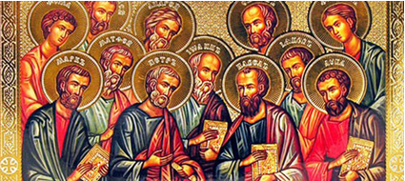

Slide 4
The Apostles’ Creed (ca AD 150-750)
The Apostles' Creed is the oldest. Already by 150 A.D. this creed was in use at Christian centers all along the Mediterranean Sea, such as Jerusalem, Alexandria (North Africa), Rome, and even Spain. The Apostles' Creed developed in conjunction with Baptism. As the water was applied, the question would be asked: "Do you believe in God the Father? God the Son? etc." Very quickly the answer developed into what we now call the Apostles' Creed. It is often called the baptismal creed. In addition to its primary use at all baptisms, it is also very appropriate for use in daily devotions. Also known as the Baptismal Creed or the Roman Symbol. Its central doctrines are those of the Trinity and God the Creator. It has been called the Creed of Creeds because already by AD 150 it was employed at Christian centers all along the Mediterranean Sea, such as Jerusalem, Alexandria (North Africa), Rome, and even Spain. It is also used in daily devotions.

Slide 7
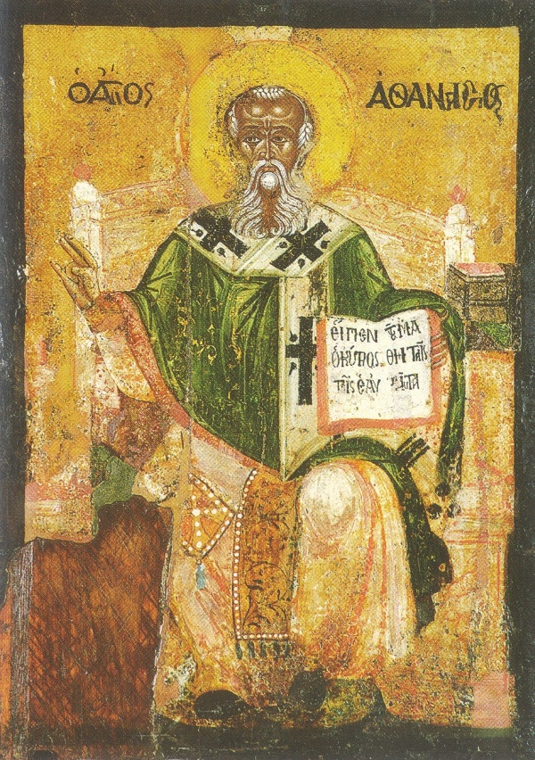

Slide 8
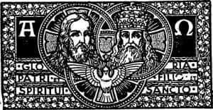

Slide 9
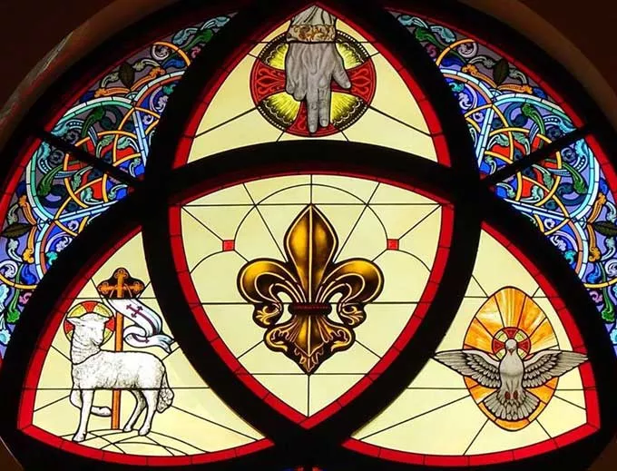

Slide 10
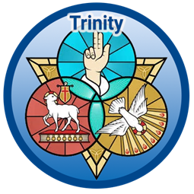

Slide 11
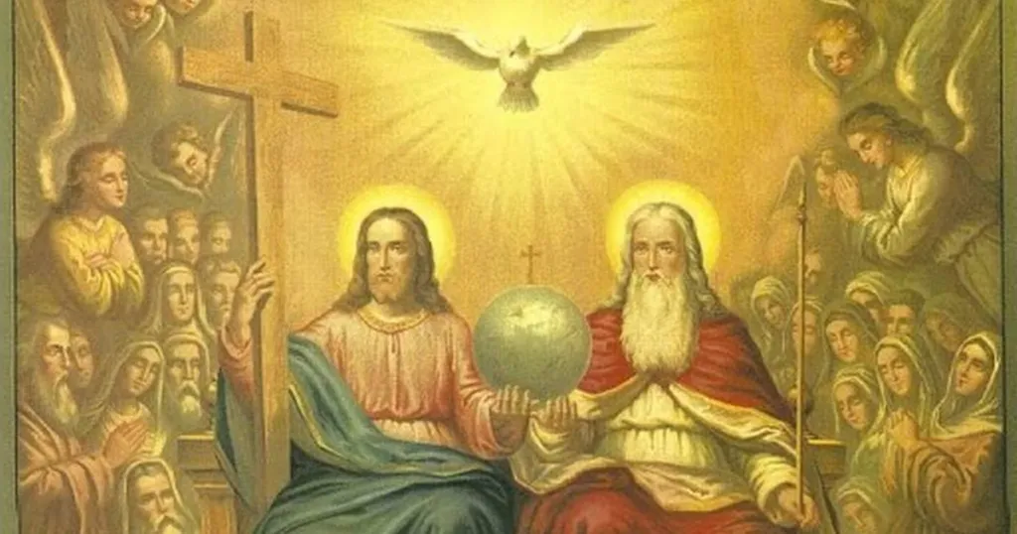

Slide 12
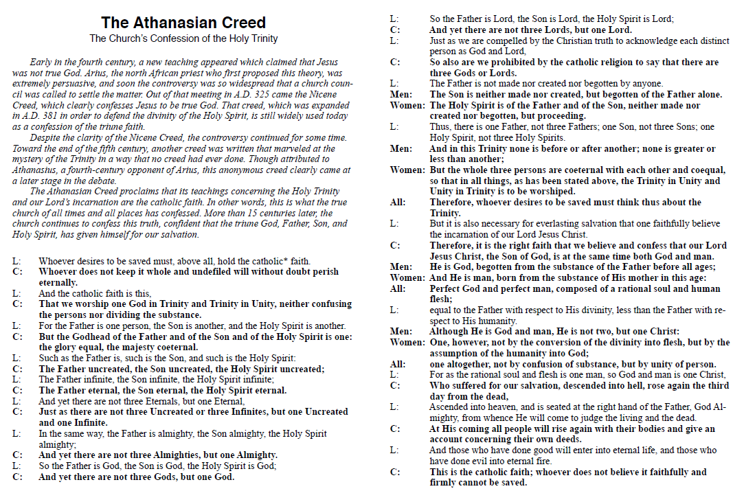

Slide 13
A Bible Study
Trinity Lutheran Church Norman, OK.
www.tlcnorman.org
Explanation of The Athanasian Creed and the Holy Trinity
Source: Rev. Dr. Jayson S. Galler -Pilgrim Lutheran Church, Kilgore, Texas
• Athanasian Creed, also known as Symbolum Quincunque (vult salvus esse), and other titles.
Used almost daily in Medieval morning devotions, now generally used only on Trinity Sunday.
Luther called it “the most important and glorious composition since the days of the apostles.”
One of the so-called “ecumenical” creeds.Included in The Book of Concord (the Lutheran Confessions) and therefore binding and normative.
• Since the ninth century the Athanasian Creed was thought to be the work of Athanasius, the Greek
Bishop of Alexandria (d.372/373), known for anti-Arianism (Arius d.336, author of heresy that denied
full Divinity of Jesus Christ, created Logos before ages, etc.) at Council of Nicea. Legend says
Athanasius composed the creed during exile in Rome, but it was not known until later (e.g., not in
Athanasius’s own writings) and known first in Latin. Presupposes controversies that came later.
• One theory is that the Creed originated in Southern Gaul (France) around the 5th century.
The full form was known at the close of the 8th century or the beginning of the 9th. Some speculate the Creed was originally two distinct and separately composed parts later put together. Origin doesn’t really matter.

Slide 14
• Clear and precise summary of ecumenical councils. Brief sentences artistically arranged and rhythmically expressed. Two major parts (paragraph numbers correspond to LSB pp.319-320).
First ([1]3-26) gives orthodox doctrine of the Holy Trinity, said to be in strict Augustinian form.
Explicitly rules out the subordination of the Persons, where Nicene and Apostolic don’t.
Persons are more than a form or manifestation but less than an independent separate being.
(Avoids Sabellianism [a.k.a. the Modalist form of Monarchianism, named for Sabellius, who tried to safeguard monotheism and unity of the Godhead but did not do justice to the independent subsistence of the Son, related to Patripassians, who said the Father suffered as the Son] and Tritheism [which denies the unity of the substance, Monophysites who said one nature in Christ, common nature an abstraction and persons actually separate substances or natures].)
Second (27-39[40]) gives a succinct statement on Christ, as settled at Ephesus in 431 and
Chalcedon in 451. Proper relation between divine and human nature, excluding Nestorian (two separate persons, one Divine and one Human, in Christ) and Eutychian or Monophysite heresies
• Some things in the Creed may need clarifying:
1, 3, 19, 40: “catholic” or “universal” faith, held always, everywhere, by everyone who believes.Nicene Creed’s “catholic” translated into German before Luther as “Christian”.

Slide 15
The “damnatory clauses” (2, 19, 40) make this faith “indispensable condition of salvation”.
Not just a warning, but an exclusion from heaven of those who reject the truth confessed.
Hard for some to hear, because we want to think other religions are going to the same place.
Clearly Jews, Muslims, JWs, Mormons, etc. are excluded. Saving faith is impossible without
knowledge of the Trinity, the Divinity of Christ, and His work of redemption
(Acts 4:12; John 8:21; 14:6). The “intolerance” is Biblical.
3-4: Faith = worship (seeking and receiving forgiveness), emphasized again midway (25)
4: One substance (Godhead) not to be divided.
Three persons (Father, Son, Holy Ghost) not to be confounded
6 ff.: Godhead one, glory co-equal, majesty co-eternal. All uncreate(d), incomprehensible (“That cannot beThe Athanasian Creed, written c.a. A.D. 500-600, combatted false doctrine that was rampant in the first few centuries of the church such as Gnosticism, Sabellianism, Apollonarianism, and Arianism, to name a few. This creed continues to combat false doctrine that remains rampant even in the twenty-first century, such as Modalism, Jehovah’s Witness doctrine, Mormonism, Islam, and the New Age movement. The following analysis will examine the biblical roots of each sentence of The Athanasian Creed.

Slide 16
2. Whoever does not guard it whole and inviolable will doubtless perish eternally.
Whoever does not hold, keep, or believe this one true faith will inherit the wrath of God, which is rightfully due to everyone because of God’s holiness and man’s sin.
(Matthew 25:46; Mark 9:43; Romans 2:6–8; 6:23; 1 Corinthians 1:18; 2 Thessalonians 1:9; Revelation 21:8)
3. Now this is the catholic faith: We worship one God in trinity and the Trinity in unity, neither confusing the persons nor dividing the divine being.
The creed now begins to share what the universal faith is. The one true God is the one Triune God who alone is worthy of worship, praise and adoration. Three persons exist in this Godhead, yet they exist as one God. Each person is distinct from the other two, yet at the same time each person is fully God.
(Genesis 1:26; Deuteronomy 6:4; Isaiah 43:10; Matthew 3:16-17; 28:19; Mark 12:29, 32; John 10:30; 2 Corinthians 13:14; Ephesians 4:5; James 2:19)

Slide 17
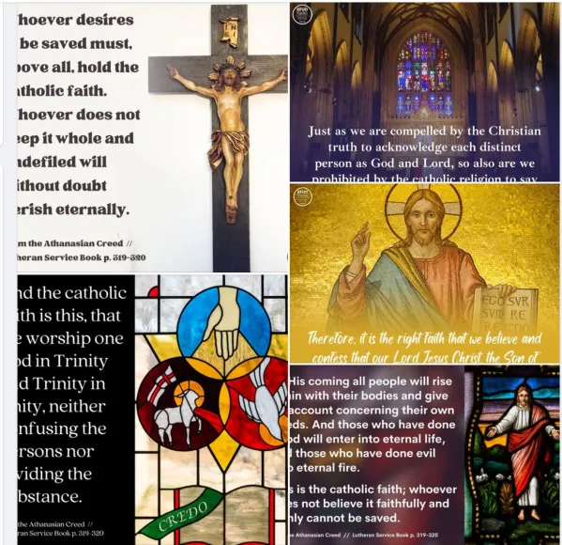

Slide 18
4. For the Father is one person, the Son is another, and the Spirit is still another.
This emphasizes the distinctiveness of each person of the Godhead. Contrary to what Modalism professes, in Scripture we see all three persons of the Trinity operating at the same time, which proves that the Father, the Son, and the Spirit are indeed distinct and simultaneously existent.
(Matthew 3:16–17; Mark 1:9–11; Luke 3:21–22; John 1:18; 6:44; 10:15; 14:16–17, 26–27; 15:26; 16:7, 13–15; Acts 8:29; 10:19; 13:2–4; Romans 8:27; 1 Corinthians 8:6; Ephesians 4:4–6)
5. But the deity of the Father, Son, and Holy Spirit is one, equal in glory, coeternal in majesty.
Although the persons of the Trinity are clearly distinct, Scripture is very clear that they are all equally and eternally God.
(Genesis 1:2, 26; Exodus 3:14–15; Isaiah 44:6; John 8:58; 16:15; Acts 5:3–4; Romans 8:9; 1 Corinthians 12:4–6; Colossians 2:9; Hebrews 9:14; 10:29; 1 Peter 1:2; Revelation 5:13; 21:22–23)

Slide 19
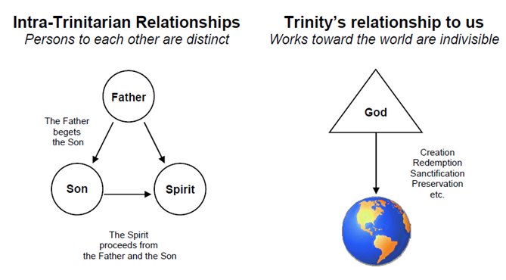

Slide 20
The Shield of the Trinity, a visual representation of the doctrine of the Trinity, derived from the Athanasian Creed. The Latin reads: "The Father is God, The Son is God, The Holy Spirit is God; God is the Father, God is the Son, God is the Holy Spirit; The Father is not the Son, The Son is not the Father, The Father is not the Holy Spirit, The Holy Spirit is not the Father, The Son is not the Holy Spirit, The Holy Spirit is not the Son."
Finally, The Athanasian Creed was popular among monks of the Middle Ages who considered it well adapted to meditation and memorizing. In the time of Charlemagne it came to be used as a canticle at Prime. Luther called this Confession the grandest production of the Church since the times of the Apostles.

