Slide 1
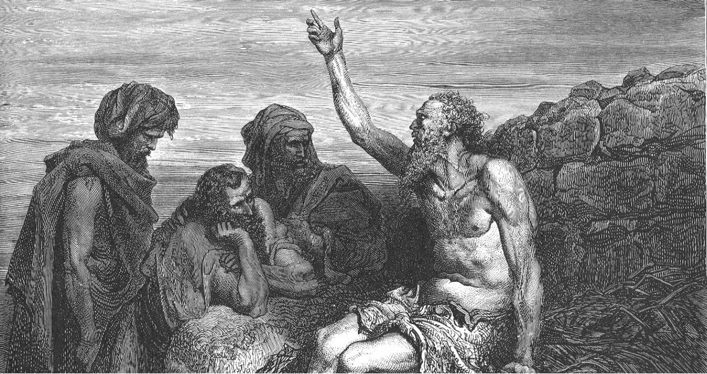
Begins July 16

Slide 2
THE BOOK OF JOB –
“The Suffering and Consolation of the Christian”
Date: 12-3-17 Lesson: 4
Text: Chapters 6,7
Theme: “The words of the Holy One,
The fear of the Almighty”

Slide 3
(Job 6:1-30) To Eliphaz: Then Job answered and said: (2) "Oh that my vexation were weighed, and all my calamity laid in the balances! (3) For then it would be heavier than the sand of the sea; therefore my words have been rash. (4) For the arrows of the Almighty are in me; my spirit drinks their poison; the terrors of God are arrayed against me. (5) Does the wild donkey bray when he has grass, or the ox low over his fodder? (6) Can that which is tasteless be eaten without salt, or is there any taste in the juice of the mallow? (7) My appetite refuses to touch them; they are as food that is loathsome to me.
(8) "Oh that I might have my request, and that God would fulfill my hope, (9) that it would please God to crush me, that he would let loose his hand and cut me off! (10) This would be my comfort; I would even exult in pain unsparing, for I have not denied the words of the Holy One. (11) What is my strength, that I should wait? And what is my end, that I should be patient? (12) Is my strength the strength of stones, or is my flesh bronze? (13) Have I any help in me, when resource is driven from me? (14) "He who withholds kindness from a friend forsakes the fear of the Almighty.

Slide 4
(15) My brothers are treacherous as a torrent-bed, as torrential streams that pass away, (16) which are dark with ice, and where the snow hides itself. (17) When they melt, they disappear; when it is hot, they vanish from their place. (18) The caravans turn aside from their course; they go up into the waste and perish. (19) The caravans of Tema look, the travelers of Sheba hope. (20) They are ashamed because they were confident; they come there and are disappointed.
(21) For you have now become nothing; you see my calamity and are afraid. (22) Have I said, 'Make me a gift'? Or, 'From your wealth offer a bribe for me'? (23) Or, 'Deliver me from the adversary's hand'? Or, 'Redeem me from the hand of the ruthless'? (24) "Teach me, and I will be silent; make me understand how I have gone astray. (25) How forceful are upright words! But what does reproof from you reprove? (26) Do you think that you can reprove words, when the speech of a despairing man is wind? (27) You would even cast lots over the fatherless, and bargain over your friend. (28) "But now, be pleased to look at me, for I will not lie to your face. (29) Please turn; let no injustice be done. Turn now; my vindication is at stake. (30) Is there any injustice on my tongue? Cannot my palate discern the cause of calamity?

Slide 5
(Job 7:1-21) To God: "Has not man a hard service on earth, and are not his days like the days of a hired hand? (2) Like a slave who longs for the shadow, and like a hired hand who looks for his wages, (3) so I am allotted months of emptiness, and nights of misery are apportioned to me. (4) When I lie down I say, 'When shall I arise?' But the night is long, and I am full of tossing till the dawn. (5) My flesh is clothed with worms and dirt; my skin hardens, then breaks out afresh. (6) My days are swifter than a weaver's shuttle and come to their end without hope.
(7) "Remember that my life is a breath; my eye will never again see good. (8) The eye of him who sees me will behold me no more; while your eyes are on me, I shall be gone. (9) As the cloud fades and vanishes, so he who goes down to Sheol does not come up; (10) he returns no more to his house, nor does his place know him anymore. (11) "Therefore I will not restrain my mouth; I will speak in the anguish of my spirit; I will complain in the bitterness of my soul. (12) Am I the sea, or a sea monster, that you set a guard over me?

Slide 6
.
(13) When I say, 'My bed will comfort me, my couch will ease my complaint,' (14) then you scare me with dreams and terrify me with visions, (15) so that I would choose strangling and death rather than my bones. (16) I loathe my life; I would not live forever. Leave me alone, for my days are a breath. (17) What is man, that you make so much of him, and that you set your heart on him, (18) visit him every morning and test him every moment? (19) How long will you not look away from me, nor leave me alone till I swallow my spit? (20) If I sin, what do I do to you, you watcher of mankind? Why have you made me your mark? Why have I become a burden to you? (21) Why do you not pardon my transgression and take away my iniquity? For now I shall lie in the earth; you will seek me, but I shall not be."

Slide 7
STUDY NOTES:
1. The arrows of the Almighty are aimed at him, is how he feels about it (Lam 3:12; Dt 32:23; Ps 7:13; 38:2)
2. Vv. 14-15 see (Gal 6:1-5) His undependable friends are not giving him true spiritual help.
3. My life is but a breath – my eye will never see good again – hopelessness
(Gen 27:46; Ps 39:4,5,11; 62:9; 78:39; 89:47; 144:3,4; Eccl 7:15; Jas 4:14)
4. The sea monster of the deep was a symbol of chaos and ruin
(Ps 74:13,14; Is 27:1; 51:9)

Slide 8
5. “What is man, that you make so much of him, and that you set your heart on him…”
This is a common thought in the Old Testament and among all mankind (Ps 8:4-8; Heb 2:6)
and though we are small, compared to the vast universe, we are made in God’s image
(Gen 1:27,28) and Jesus shares our “small” flesh and blood (Heb 4:14-16).
6. Sheol in 7:9. Sheol varies in meaning according to the context. Here it means “grave and death” and
in other contexts it means “hell.” The idea here is that man goes to his grave, and is on the other side of
eternity – he will never return again to us on earth, but has disappeared like a cloud that vanishes in the sky.
(Gen 37:35; Ps 16:10; 31:17; 89:48; Is 38:10)

Slide 9
7. “The words of the Holy One, The fear of the Almighty”
(Holy One - Mk 1:24; Jn 6:69; Acts 2:27; 1 Jn 2:20; Rev 3:7; 16:5)
(Almighty – 2 Cor 6:18; Rev 1:8; 4:8; 11:17; 15:3; 16:7; 19:6; 21:22)

Slide 10
Luther’s Works Vol. 6 p. 95
“This consignment into Satan’s hands which is held up to your eyes and heart is a temptation for an hour and a moment of time, not for your perdition but to try you, for your salvation and endless gain. It is as Christ says in John 12:24: “Unless a grain of wheat falls into the earth and dies, it remains alone; but if it dies, it bears much fruit.” For so Christ was also delivered into the hands of robbers, but only for an hour and for salvation. Accordingly, if you feel that you are being vexed and tempted by the devil, pray and give thanks that you have not been consumed but only tried and proved, according to the statement in Lam. 3:22: “It is of the Lord’s mercies that we are not consumed, because His compassions fail not.” Likewise we read in 2 Cor. 4:9: “We are persecuted, but not forsaken; struck down, but not destroyed, etc.”
Job’s example teaches the same thing. The devil at first takes all his property from him with his children and leaves him a peevish, irksome, and abusive wife. He also afflicts his health with a terrible ulcer. Nevertheless, the devil says to God: “Have You put a hedge about him?” (Job 1:10) Here he complains that the godly, and the ungodly too, are surrounded by a wall. With silent indignation he threatens destruction to body and property, as though he meant to say: “If Job were in my hands, I would show what I could do and how he should sound forth Your praises. I would bring it to pass that he would curse You to Your face.” But the Lord permits him to torture Job’s body and to take away his goods but not to take his life.
Accordingly, examples of this kind teach us that all the malice and vexation of the devil is only instruction and chastisement, by which we are aroused so that we do not snore and become listless and are thus overthrown among those who are half asleep. At the same time, however, this doctrine is confirmed and remains sure and certain, that the angels are God’s armies regardless of the fact that many evils occur in this life because of the evil angels.”

Slide 11
LIFE APPLICATION:
How do
the words of the Holy One,
and
the fear of the Almighty,
console us in the midst of our afflictions?”

Slide 12
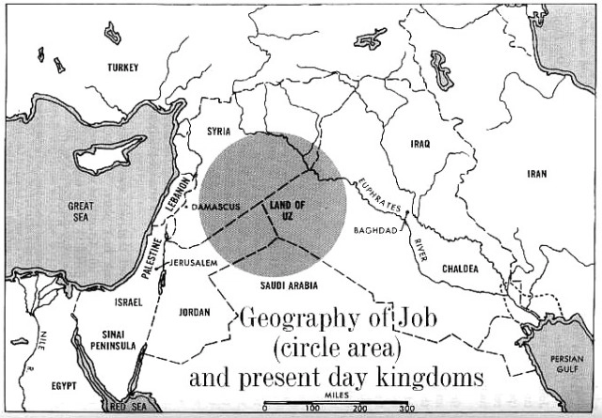

Slide 13
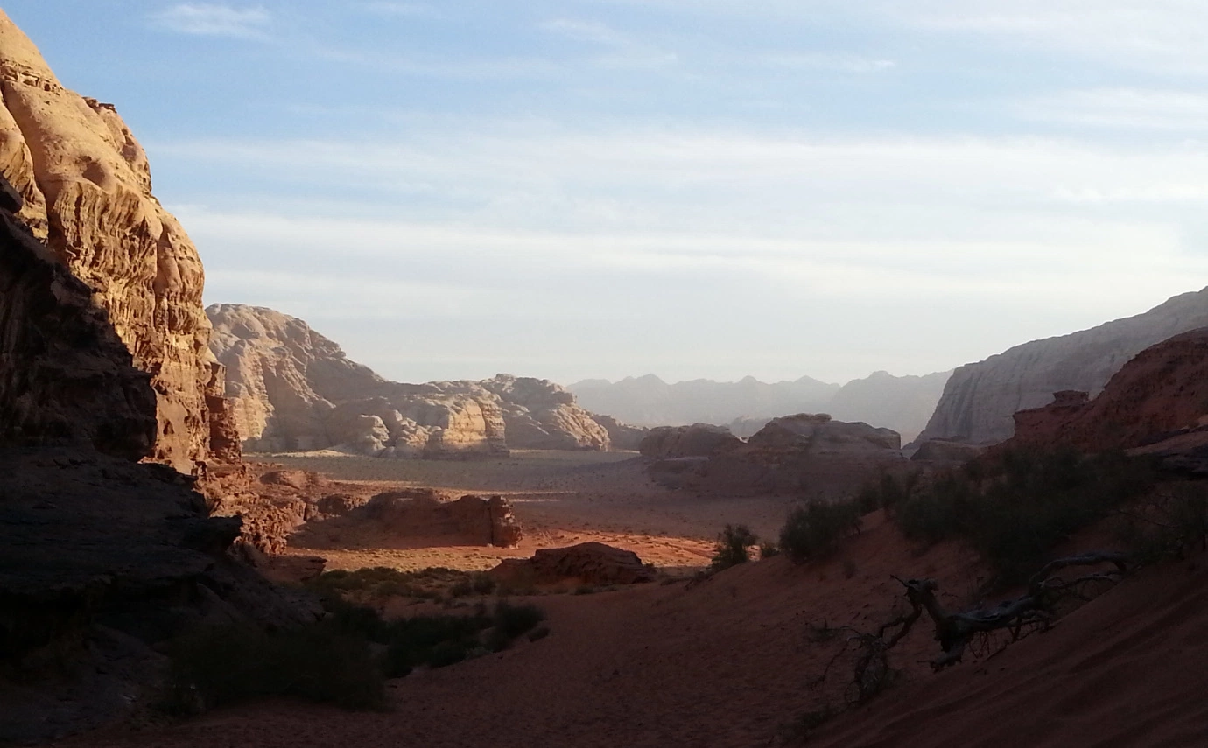

Slide 14
