Slide 1
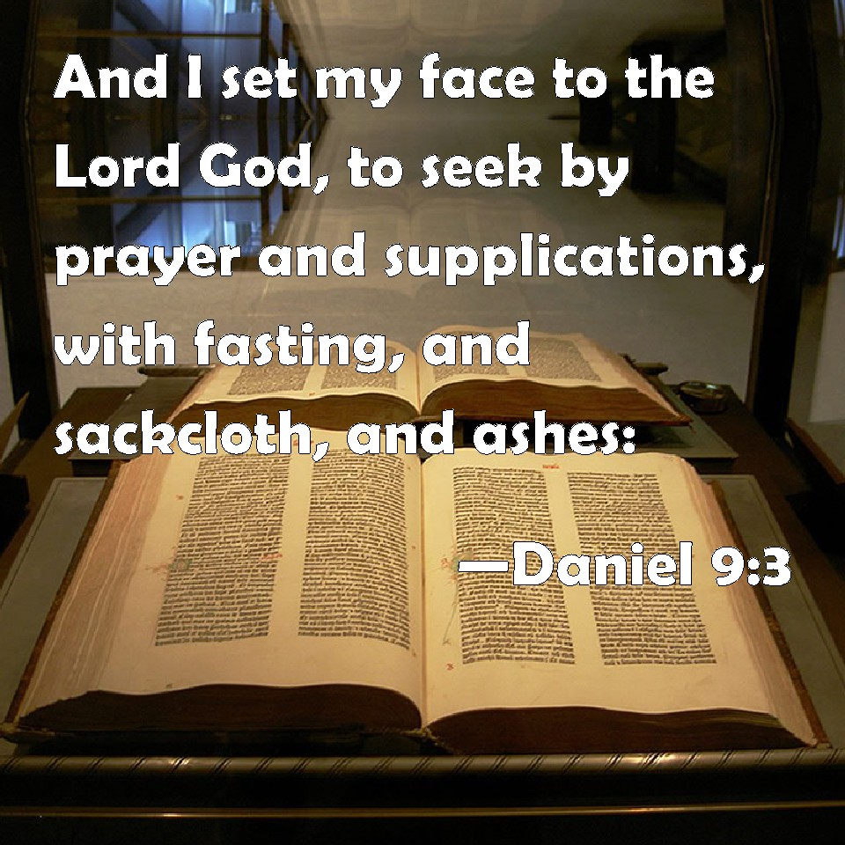
Begins July 16

Slide 2
“THE POWER OF GOD
IN PRAYER”
Five Week Bible Class:
1. God’s Power
2. Adoration – 3. Confession
4. Thanksgiving – 5. Supplication
Date: 6-17-18
Lesson 5 -Supplication
(To Ask and Make Requests)

Slide 3
In the Scriptures, the Triune God speaks to us in His Word
and we speak to him in Prayer. A two-way conversation.
BY WORD
God the Father
↓
gave his words to
↓
God the Son
who gave his words to
↓
The Holy Spirit
who gave his words to
↓
The Prophets / Apostles
(Old and New Testament)
who wrote down the words in the
↓
Bible
which words are read and heard and believed by
↓
YOU
BY PRAYER
God the Father
↑
who brings your requests to
↑
God the Son
through the Mediator
↑
The Holy Spirit
you speak your words in
↑
The Prophets / Apostles
(Old and New Testament)
written down words in the
↑
the Bible
your words which you read and heard in
pray
↑
YOU

Slide 4
(Job 6:8) "Oh that I might have my request, and that God would fulfill my hope,
(Psalm 21:1-6) O Lord, in your strength the king rejoices, and in your salvation how greatly he exults! (2) You have given him his heart's desire and have not withheld the request of his lips. Selah (3) For you meet him with rich blessings; you set a crown of fine gold upon his head. (4) He asked life of you; you gave it to him, length of days forever and ever. (5) His glory is great through your salvation; splendor and majesty you bestow on him. (6) For you make him most blessed forever; you make him glad with the joy of your presence.
(Jeremiah 42:4-6) Jeremiah the prophet said to them, "I have heard you. Behold, I will pray to the Lord your God according to your request, and whatever the Lord answers you I will tell you. I will keep nothing back from you." (5) Then they said to Jeremiah, "May the Lord be a true and faithful witness against us if we do not act according to all the word with which the Lord your God sends you to us. (6) Whether it is good or bad, we will obey the voice of the Lord our God to whom we are sending you, that it may be well with us when we obey the voice of the Lord our God."

Slide 5
(Matthew 7:7-8) "Ask, and it will be given to you; seek, and you will find; knock, and it will be opened to you. (8) For everyone who asks receives, and the one who seeks finds, and to the one who knocks it will be opened.
(Matthew 18:19-20) Again I say to you, if two of you agree on earth about anything they ask, it will be done for them by my Father in heaven. (20) For where two or three are gathered in my name, there am I among them."
(Mark 11:24-25) (24) Therefore I tell you, whatever you ask in prayer, believe that you have received it, and it will be yours. (25) And whenever you stand praying, forgive, if you have anything against anyone, so that your Father also who is in heaven may forgive you your trespasses."
(Luke 11:9-13) And I tell you, ask, and it will be given to you; seek, and you will find; knock, and it will be opened to you. (10) For everyone who asks receives, and the one who seeks finds, and to the one who knocks it will be opened. (11) What father among you, if his son asks for a fish, will instead of a fish give him a serpent; (12) or if he asks for an egg, will give him a scorpion? (13) If you then, who are evil, know how to give good gifts to your children, how much more will the heavenly Father give the Holy Spirit to those who ask him!"

Slide 6
(John 14:13-17) Whatever you ask in my name, this I will do, that the Father may be glorified in the Son. (14) If you ask me anything in my name, I will do it. (15) "If you love me, you will keep my commandments. (16) And I will ask the Father, and he will give you another Helper, to be with you forever, (17) even the Spirit of truth, whom the world cannot receive, because it neither sees him nor knows him. You know him, for he dwells with you and will be in you.

Slide 7
.
(1 Timothy 2:1-6) First of all, then, I urge that supplications, prayers, intercessions, and thanksgivings be made for all people, (2) for kings and all who are in high positions, that we may lead a peaceful and quiet life, godly and dignified in every way. (3) This is good, and it is pleasing in the sight of God our Savior, (4) who desires all people to be saved and to come to the knowledge of the truth. (5) For there is one God, and there is one mediator between God and men, the man Christ Jesus, (6) who gave himself as a ransom for all, which is the testimony given at the proper time.
(1 Timothy 5:1-8) Do not rebuke an older man but encourage him as you would a father. Treat younger men like brothers, (2) older women like mothers, younger women like sisters, in all purity. (3) Honor widows who are truly widows. (4) But if a widow has children or grandchildren, let them first learn to show godliness to their own household and to make some return to their parents, for this is pleasing in the sight of God. (5) She who is truly a widow, left all alone, has set her hope on God and continues in supplications and prayers night and day, (6) but she who is self-indulgent is dead even while she lives. (7) Command these things as well, so that they may be without reproach. (8) But if anyone does not provide for his relatives, and especially for members of his household, he has denied the faith and is worse than an unbeliever.

Slide 8
(Hebrews 5:1-10) For every high priest chosen from among men is appointed to act on behalf of men in relation to God, to offer gifts and sacrifices for sins. (2) He can deal gently with the ignorant and wayward, since he himself is beset with weakness. (3) Because of this he is obligated to offer sacrifice for his own sins just as he does for those of the people. (4) And no one takes this honor for himself, but only when called by God, just as Aaron was. (5) So also Christ did not exalt himself to be made a high priest, but was appointed by him who said to him, "You are my Son, today I have begotten you"; (6) as he says also in another place, "You are a priest forever, after the order of Melchizedek." (7) In the days of his flesh, Jesus offered up prayers and supplications, with loud cries and tears, to him who was able to save him from death, and he was heard because of his reverence. (8) Although he was a son, he learned obedience through what he suffered. (9) And being made perfect, he became the source of eternal salvation to all who obey him, (10) being designated by God a high priest after the order of Melchizedek.

Slide 9
(Philippians 4:1-9) Therefore, my brothers, whom I love and long for, my joy and crown, stand firm thus in the Lord, my beloved. (2) I entreat Euodia and I entreat Syntyche to agree in the Lord. (3) Yes, I ask you also, true companion, help these women, who have labored side by side with me in the gospel together with Clement and the rest of my fellow workers, whose names are in the book of life. (4) Rejoice in the Lord always; again I will say, Rejoice. (5) Let your reasonableness be known to everyone. The Lord is at hand; (6) do not be anxious about anything, but in everything by prayer and supplication with thanksgiving let your requests be made known to God. (7) And the peace of God, which surpasses all understanding, will guard your hearts and your minds in Christ Jesus. (8) Finally, brothers, whatever is true, whatever is honorable, whatever is just, whatever is pure, whatever is lovely, whatever is commendable, if there is any excellence, if there is anything worthy of praise, think about these things. (9) What you have learned and received and heard and seen in me--practice these things, and the God of peace will be with you.

Slide 10
(Ephesians 3:19-21) and to know the love of Christ that surpasses knowledge, that you may be filled with all the fullness of God. (20) Now to him who is able to do far more abundantly than all that we ask or think, according to the power at work within us, (21) to him be glory in the church and in Christ Jesus throughout all generations, forever and ever. Amen.
(Ephesians 6:13-20) Therefore take up the whole armor of God, that you may be able to withstand in the evil day, and having done all, to stand firm. (14) Stand therefore, having fastened on the belt of truth, and having put on the breastplate of righteousness, (15) and, as shoes for your feet, having put on the readiness given by the gospel of peace. (16) In all circumstances take up the shield of faith, with which you can extinguish all the flaming darts of the evil one; (17) and take the helmet of salvation, and the sword of the Spirit, which is the word of God, (18) praying at all times in the Spirit, with all prayer and supplication. To that end keep alert with all perseverance, making supplication for all the saints, (19) and also for me, that words may be given to me in opening my mouth boldly to proclaim the mystery of the gospel, (20) for which I am an ambassador in chains, that I may declare it boldly, as I ought to speak.

Slide 11
(James 1:5-6) If any of you lacks wisdom, let him ask God, who gives generously to all without reproach, and it will be given him. (6) But let him ask in faith, with no doubting, for the one who doubts is like a wave of the sea that is driven and tossed by the wind.
(1 John 5:10-15) Whoever believes in the Son of God has the testimony in himself. Whoever does not believe God has made him a liar, because he has not believed in the testimony that God has borne concerning his Son. (11) And this is the testimony, that God gave us eternal life, and this life is in his Son. (12) Whoever has the Son has life; whoever does not have the Son of God does not have life. (13) I write these things to you who believe in the name of the Son of God that you may know that you have eternal life. (14) And this is the confidence that we have toward him, that if we ask anything according to his will he hears us. (15) And if we know that he hears us in whatever we ask, we know that we have the requests that we have asked of him.

Slide 12
STUDY NOTES:
1. ἱκετηρία = hiketéria = An olive branch, held in the hand of a suppliant, showed heartfelt "supplication, entreaty" in ancient times was frequently used of a suppliant carrying an olive branch as a token for "seeking peace."
2. αἰτέω = aiteó = ask,beg, called, making a request

Slide 13
HYMNS for LIFE APPLICATION:
Lord of our life
and God of our salvation, Star of our night and
hope of ev’ry nation: Hear and receive
Your Church’s supplication, Lord God Almighty.
Kyrie! O Christ, our king, Salvation for all You came to bring. O Lord Jesus, God’s own Son, Our mediator at the heav’nly throne: Hear our cry and grant our supplication. Eleison! Eleison!
Hail! Hosanna, David’s Son! Jesus, hear our supplication! Let Thy kingdom, scepter, crown, Bring us blessing and salvation, That forever we may sing: Hail! Hosanna to our King.

Slide 14
